Slide 1
Learning Objective
We will evaluate₁ functions and graph functions.
Declare the Objective
Read the learning objective to your partner.
Activate Prior Knowledge
Evaluate the expressions using substitution.
Make the Connection
1.
2$x$+5 at $x$=4
Students, you already know how to substitute numbers for variables. This is called evaluating an expression. Now, we will use evaluation in function notation.
2(4)+5
For the input 4, we obtained the output 13.
8+5
Remember the Concept
13
A function is a rule that assigns an input to exactly one output.
An input replaces the 𝑥’s and the expression gives the corresponding output.
Evaluating a function means substituting a number for the input to figure out the output.
2.
2$x$+5 at $x$=6
2(6)+5
$f$(input)=output
For the input 6, we obtained the output 17.
Make the Connection
12+5
$$x$$
$f$($x$)
Students, you already know how to substitute numbers for variables. This is called evaluating an expression. Now, we will evaluate functions.
17
Definitions
¹ find the value of
95

Slide 2
Concept Development 2
Functions can be represented as graphs by plotting the input-output pairs.
Evaluate the function using an input to figure out the output.
Checking for Understanding
Which ordered pair is on the graph of $g(x$)=3$x$+1 at $x$=1? How do you know?
A (1, 4)
B (1, 6)
Use functions to make graphs.
f(x)
Input$x$ | Output$f(x)$
1 | 7
0 | 5
-1 | 3
-2 | 1
8
(1, 7)
(input,output)
7
(0, 5)
6
x
f(x)
$f$(1)=7
5
(-1, 3)
4
3
A
2
$f$(0)=5
1
x
-8
-7
-6
-5
-4
-3
-2
-1
1
2
3
4
5
6
7
8
-1
$f$(-1)=3
-2
-3
-4
-5
$f$(-2 )= 1
f
-6
-7
-8
Since (-2, 1) is a point on the graph of the function, $f$(-2)=1.
Remember the Concept
A function is a rule that assigns an input to exactly one output.
An input replaces the 𝑥’s and the expression gives the corresponding output.
Evaluating a function means substituting a number for the input to figure out the output.
98

Slide 3
Skill Development & Guided Practice 2
Evaluate and graph functions.
Checking for Understanding
1 Read the function.
2 Substitute input values into the function.
3 Use order of operations to evaluate and obtain the outputs. (write in table)
4 Use the table to create ordered pairs (input, output) and graph these points.
5 Connect the points.
2 How did I/you substitute the input value into the function?
$f$($x$)=($x$+1)² – 3
$$x$$ | $f(x$)
-3
-2
-1
0
1
1
$x$=-3
$f$(-3)=(-3+1)² – 3
$f$(-3)=(-2)² – 3
$f$(-3)= 4 – 3
$f$(-3)= 1
$x$=-2
$f$(-2)=(-2+1)² – 3
$f$(-2)=(-1)² – 3
$f$(-2)=1 – 3
$f$(-2)= -2
f(x)
-2
8
-3
7
6
f
-2
5
4
1
3
(-3, 1)
2
(1, 1)
1
x
-8
-7
-6
-5
-4
-3
-2
-1
1
2
3
4
5
6
7
8
$x$=-1
$f$(-1)=(-1+1)² – 3
$f$(-1)=(0)² – 3
$f$(-1)=0 – 3
$f$(-1)= -3
$x$=0
$f$(0)=(0+1)² – 3
$f$(0)=(1)² – 3
$f$(0)=1 – 3
$f$(0)= -2
$x$=1
$f$(1)=(1+1)² – 3
$f$(1)=(2)² – 3
$f$(1)=4 – 3
$f$(1)= 1
(-2, -2)
-1
(0, -2)
-2
-3
(-1, -3)
-4
-5
-6
-7
-8
Extended Thinking Describe the shape of the graph.
99

Slide 4
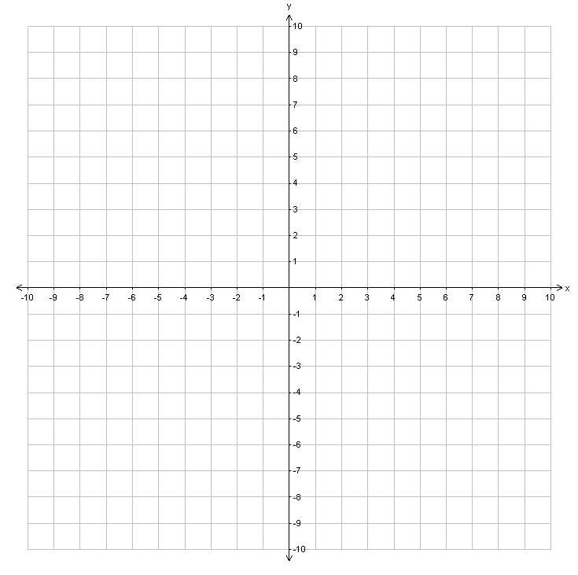
Skill Development & Guided Practice 2
Evaluate and graph functions.
Checking for Understanding
Declare the Objective
1 Read the function.
2 Substitute input values into the function.
3 Use order of operations to evaluate and obtain the outputs. (write in table)
4 Use the table to create ordered pairs (input, output) and graph these points.
5 Connect the points.
2 How did I/you substitute the input value into the function?
Read the learning objective to your partner.
$g$(x)
$g$($x$)=$x$³+2
(2, 10)
$$x$$ | $$g(x)$$
-2
-1
0
1
2
$x$=-2
$g$(-2)=(-2)³+2
$g$(-2)=-8+2
$g$(-2)= -6
$x$=-1
$g$(-1)=(-1)³+2
$g$(-1)=-1+2
$g$(-1)= 1
-6
1
2
(1, 3)
(0, 2)
3
$x$=0
$g$(0)=(0)³+2
$g$(0)=0+2
$g$(0)= 2
$x$=1
$g$(1)=(1)³+2
$g$(1)=1+2
$g$(1)= 3
(-1, 1)
10
$x$=2
$g$(2)=(2)³+2
$g$(2)=8+2
$g$(2)= 10
(-2, -6)
$$g$$
99

Slide 5
Skill Development & Guided Practice 2
Evaluate and graph functions.
1 Read the function.
2 Substitute input values into the function.
3 Use order of operations to evaluate and obtain the outputs. (write in table)
4 Use the table to create ordered pairs (input, output) and graph these points.
5 Connect the points.
h(x)
Notice that no matter what the input is, the output stays the same.
$h$($x$)=-5
8
7
$x$=-2
$h$(-2)=-5
$$x$$ | $$h(x)$$
-2
-1
0
1
2
6
5
4
-5
3
$x$=-1
$h$(-1)=-5
2
-5
1
x
-8
-7
-6
-5
-4
-3
-2
-1
1
2
3
4
5
6
7
8
$x$=0
$h$(0)=-5
-1
-5
-2
-3
(-1, -5)
(1, -5)
h
-4
$x$=1
$h$(1)=-5
-5
-5
(-2, -5)
-6
(2, -5)
(0, -5)
-5
-7
$x$=2
$h$(2)=-5
-8
This is called a constant function.
100

Slide 6
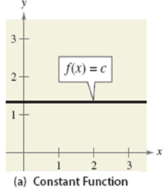
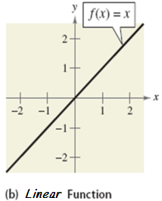
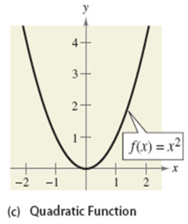
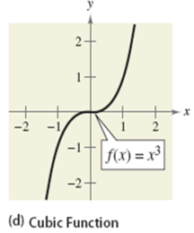
Skill Development & Guided Practice 2
Graphs of functions.
$$y=x^{3}$$
$$y=5$$
(Horizontal line)
Slope
Y-intercept
Positive
Opens Up
Positive
Opens Up
$$x=5$$
(Vertical line)
100

Slide 7
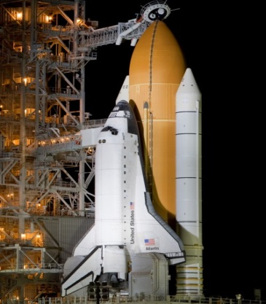
Relevance
1
Evaluating functions will help NASA track space shuttles.
H($x$)=$x$² +.97$x$+.35 represents the height of a rocket in kilometers after x seconds. How high will the rocket be after 2 seconds?
H(2)=2² +.97(2)+.35=6.29 km
The rocket is 6.29 kilometers high.
2
Evaluating functions will help you do well on tests.
Sample Test Question
2. Drag a number into each box to correctly fill in the function table.
x | f(x)=2x-3
2 | 1
3
4
5 | 7
6
Checking for Understanding
3
Which reason is most relevant to you?
5
9
101

Slide 8
Closure
Skill Closure Make an input-output table for $f\left(x\right)=4x−3$ using 4 inputs.
x | f(x)
-1
0
1
2
$x$=-1
$f$(-1) = 4(-1) – 3
$f$(-1) = -4 – 3
$f$(-1) = -7
$x$=0
$f$(0) = 4(0) – 3
$f$(0) = 0 – 3
$f$(0) = -3
$x$=1
$f$(1) = 4(1) – 3
$f$(1) = 4 – 3
$f$(1) = 1
$x$=2
$f$(2) = 4(2) – 3
$f$(2) = 8 – 3
$f$(2) = 5
-7
-3
1
5
Extended Thinking Jessica tries to evaluate functions, but she keeps getting the wrong answers. What mistake(s) is she making? What should she do instead?
$f$($x$) = 10$x$ – 5
$g$($x$) = -2$x$ + 6
$h$($x$) = 8$x$+3
$f$(3) = 10(3) – 5
$g$(1) = -2(1)+6
$h$(4) = 8(4)+3
$f$(3) = 10(-2)
$g$(1) = -2(7)
$h$(4) = 8(7)
$f$(3) = -20
$g$(1) = -14
$h$(4) = 56
Jessica is not following the order of operations. She needs to multiply first before adding or subtracting to get the right answers.
Remember the Concept
A function is a rule that assigns an input to exactly one output.
An input replaces the 𝑥’s and the expression gives the corresponding output.
Evaluating a function means substituting a number for the input to figure out the output.
Summary Closure What did you learn today about evaluating functions?
Word Bank
input output table
ordered pair function
102

