Slide 2
Learning Objective
We will identify₁ function types.
Declare the Objective
Read the learning objective to your partner.
Activate Prior Knowledge
Evaluate the functions.
Make the Connection
Students, you already know function notation and how to evaluate functions. Now, we will identify common types of functions.
1.
$f$(6) when $f$($x$)=2$x$+5
2.
$g$(2) when $g$($x$)=$x$² +3
$f$(6)=2(6)+5
$g$(2)=(2)²+3
$f$(6)=12+5
$g$(2)=4+3
$f$(6)=17
$g$(2)=7
Definitions
¹ find
112

Slide 3
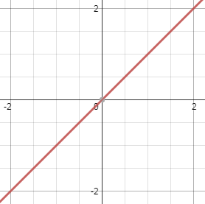
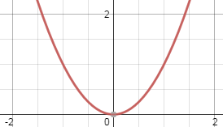
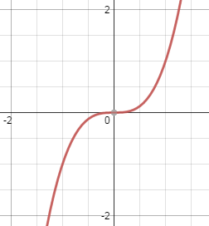
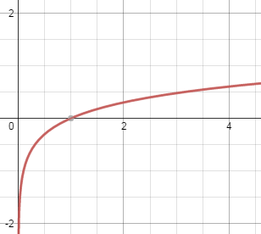
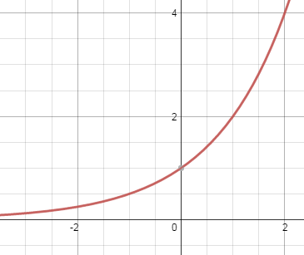
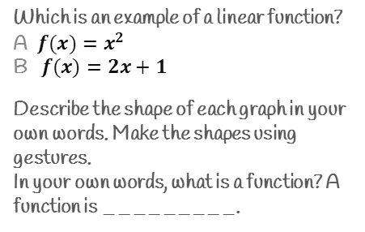
Concept Development
A function is a rule that assigns an input to exactly one output.
When function rules are defined by the same type of expression, we can group them into function types.
Checking for Understanding
Which is an example of a linear function?
A $f(x)=x^{2}$
B $f(x)=2x+1$
Describe the shape of each graph in your own words. Make the shapes using gestures.
In your own words, what is a function? A function is _________.
Common Types of Functions
 | Linear | Quadratic | Cubic | Logarithmic | Exponential
Equation: | $f$($x$)=a$x$+b | $f$($x$)=a$x$²+b$x$+c | $f$($x$)=a$x$³+b$x$²+c | $f$($x$)=log_{b}$x$ | $f$($x$)=a$x$
Graph: | Straight line | Both ends same direction | One end up, one end down | Sideways L-shape | L-shape rising steeply
Look at the degree of the expression
a, b, and c are numbers
b is a positive number not equal to 1
a is a positive number not equal to 1
Degree: In a single-variable expression, the degree is the value of the largest exponent in the expression.
Definitions
² how things are connected
112

Slide 4
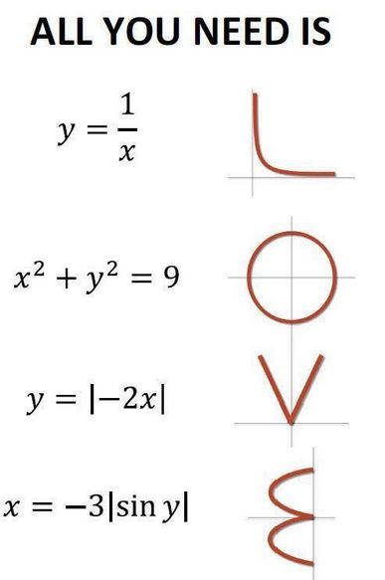

Slide 5
Skill Development & Guided Practice
Identify function types.
Checking for Understanding
1 Identify the function type using the expression.
a If the expression has numerical exponents, use the degree.
1$→$linear, 2 $→$quadratic, 3 $→$cubic
b If the expression has a variable exponent, it is exponential. If it says log, it is logarithmic.
1 How did I/you identify the function type?
Label each function as linear, quadratic, cubic, exponential, or logarithmic.
1. $f\left(x\right)=7x^{2}−4x+1$
quadratic
Checking for Understanding
What is the degree of a quadratic function?
A 2
B 3
2.$f\left(x\right)=5^{x}$
exponential
Remember the Concept
3. $f\left(x\right)=\log_{3}{x+6}$
logarithmic
A function is a rule that assigns an input to exactly one output.
When function rules are defined by the same type of expression, we can group them into function types.
4. $f\left(x\right)$ = -2$x$ + 10
linear
5. $f\left(x\right)=11x^{3}+9x^{2}−8$
cubic
113

Slide 6
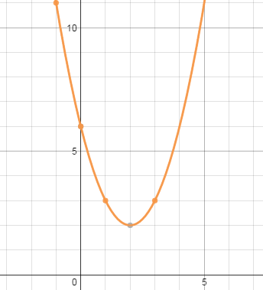
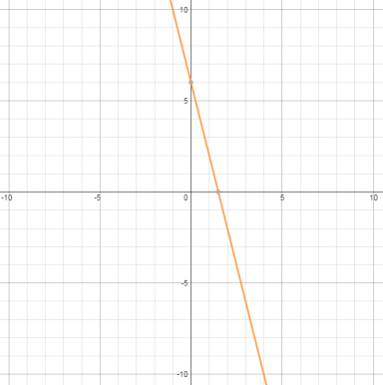
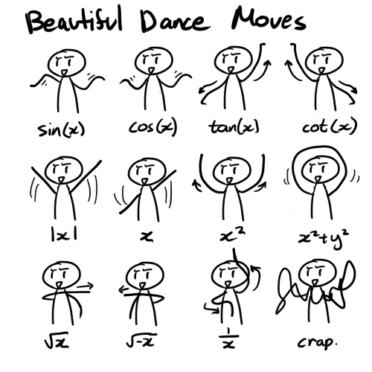
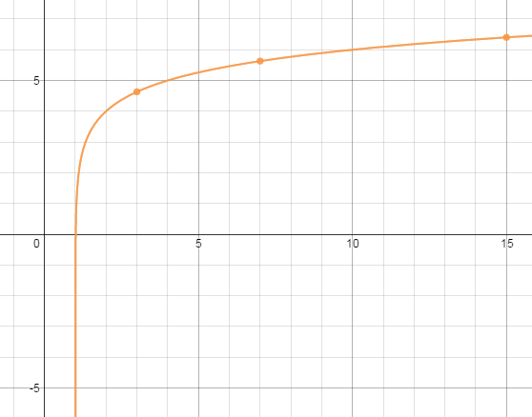
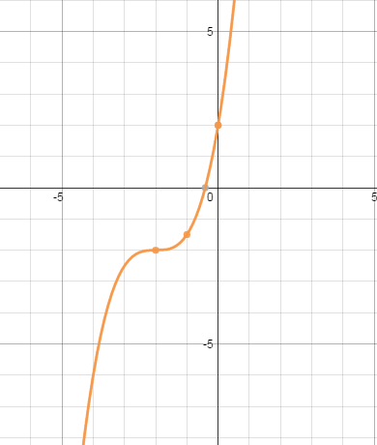
Skill Development & Guided Practice
Identify function types from graphs.
Checking for Understanding
Declare the Objective
1 Look at the graph carefully.
2 Identify the shape of the graph and the direction of the ends.
straight line $→$linear
both ends same direction $→$quadratic
one end up and one down $→$cubic
L-shaped curve & rising steeply $→$exponential
sideways L $→$ logarithmic
2 How did I/you identify the shape of the graph?
Read the learning objective to your partner.
Checking for Understanding
What is the shape of the graph of a linear function?
A L-shaped curve
B straight line
Label the graph of each function as linear, quadratic, cubic, logarithmic, or exponential.
1.
2.
Remember the Concept
A function is a rule that assigns an input to exactly one output.
When function rules are defined by the same type of expression, we can group them into function types.
quadratic
linear
3.
4.
logarithmic
cubic
113

Slide 7
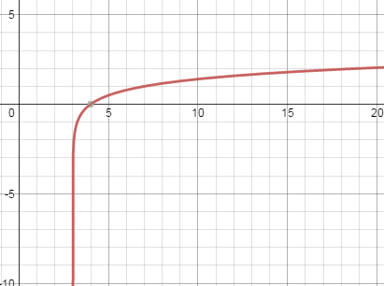
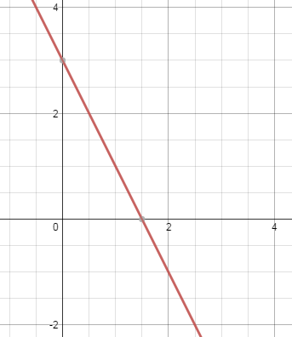
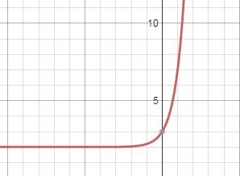
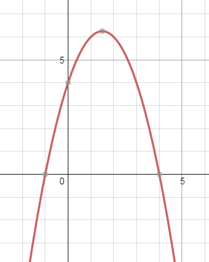
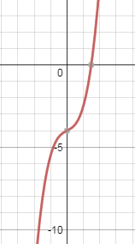
Skill Development & Guided Practice
Identify function types from graphs.
Remember the Concept
1 Identify the function type using the expression.
2 Identify the type of graph.
Linear
Expression: 1st degree
Graph: Straight Line
Quadratic
Expression: 2nd degree
Graph: both ends
same direction
Cubic
Expression: 3rd degree
Graph: one end up, other one down
Exponential
Expression: variable exponent
Graph: L-Shaped
Rising steeply
Logarithmic
Expression: has “log”
Graph: Sideways L
Match each function to its graph.
E
A.
B.
1. $f$($x$)=$x$³+$x$ – 4
A
2. $f$($x$)=log₄($x$ – 3)
D
3. $f$($x$)=-$x$² +3$x$+4
B
C.
D.
4. $f$($x$)=-2$x$+3
C
5. $f$($x$)=5$x$+2
E.
114

Slide 8
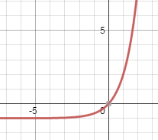
Relevance
1
Identifying function types will help you manage your finances.
By looking at a graph of a stock’s prices over time, investors can choose the one whose function increases most steeply.
Checking for Understanding
Which reason is most relevant to you?
2
Identifying function types will help you do well on tests.
Sample Test Question
9. Choose the function that
matches the graph.
A $f(x)=x^{2}+4x – 7$
B $f(x)=3^{x} – 1$
C $f(x)=8x+2$
f(x)
3
Identifying function types will help you do well in this StepUP Academy.
8
7
6
f
$$x$$ | $$f(x)$$
5
4
In later lessons, we will graph the different function types.
3
-3
1
(-3, 1)
2
(1, 1)
1
x
-2
-2
-8
-7
-6
-5
-4
-3
-2
-1
1
2
3
4
5
6
7
8
(-2, -2)
-1
(0, -2)
Graph $f$($x$)=($x$+1)² – 3 and
state the type of function.
-2
-1
-3
-3
(-1, -3)
-4
0
-2
-5
-6
This is a quadratic function.
1
1
-7
-8
115

Slide 9
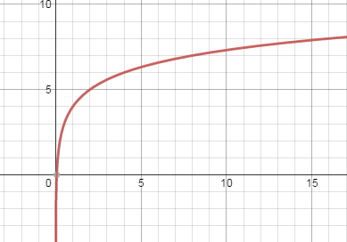
Closure
Skill Closure Identify function types from functions and graphs.
Label the graph or function as linear, quadratic, cubic, logarithmic, or exponential.
1. $f$($x$)=7$x$³ – 8
2.
Cubic
Logarithmic
Remember the Concept
Extended Thinking
Write an example of a linear function and draw a sketch of a linear function graph.
A function is a rule that assigns an input to exactly one output.
When function rules are defined by the same type of expression, we can group them into function types.
f(x)
8
7
6
5
4
3
$f$($x$)=2$x$+1
2
1
x
-8
-7
-6
-5
-4
-3
-2
-1
1
2
3
4
5
6
7
8
-1
-2
-3
-4
-5
-6
-7
-8
116

Slide 10
Closure (continued)
Summary Closure What did you learn today about identifying function types? (Pair-Share)
Word Bank
quadratic cubic linear exponential logarithmic function graph
116

