Slide 1
Objectives
Student will learn how to determine if two triangles are similar using the triangle proofs and solve for missing variables of similar triangles

Slide 2

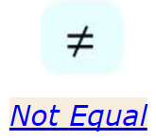
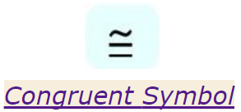
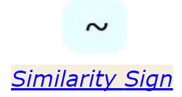
Math Symbols:
Not Equal To (inequality).
If the two objects have exactly the same shape, and exactly the same size, they are congruent.
If two geometric objects have exactly the same shape (although not necessarily the same size), they are similar.

Slide 3
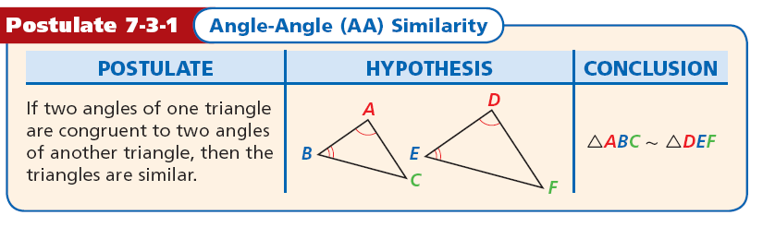

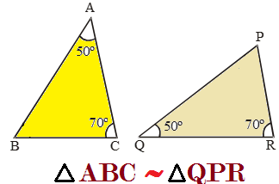
Concept

Slide 4
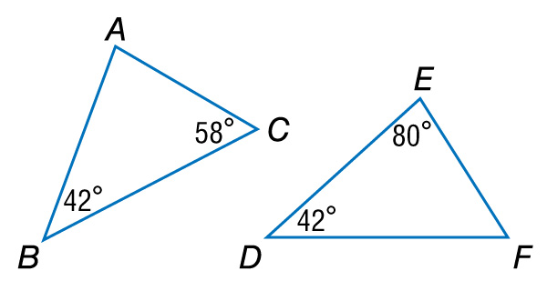

Example 1
Use the AA Similarity Postulate
A. Determine whether the triangles are similar. If so, write a similarity statement. Explain your reasoning.
Use the AA Similarity Postulate
Since m∠B = m∠D, ∠B ∠D.
By the Triangle Sum Theorem, 42 + 58 + m∠A = 180,
so m∠A = 80.
Since m∠E = 80, ∠A ∠E.
Answer: So, ΔABC ~ ΔEDF by the AA Similarity.

Slide 5



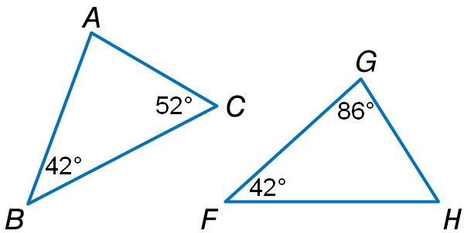
Example 1
A. Determine whether the triangles are similar. If so, write
a similarity statement.

Slide 6
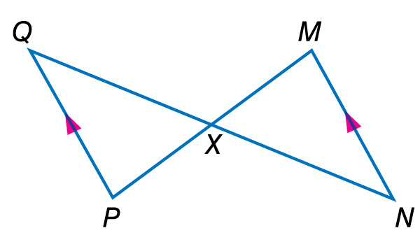
Example 1
Use the AA Similarity Postulate
B. Determine whether the triangles are similar. If so, write a similarity statement. Explain your reasoning.
Use the AA Similarity Postulate
∠QXP ∠NXM //Vertical Angles
Since QP || MN, ∠Q ∠N.
Answer: So, ΔQXP ~ ΔNXM by AA Similarity.
Example 1

Slide 7
Using the AA Similarity Postulate
Explain why the triangles are similar and write a similarity statement.
∠BCA ≅ ∠ECD by the Vertical Angles Theorem. Also, ∠A ≅ ∠D by the Right Angle Congruence Theorem. Therefore ∆ABC ~ ∆DEC by AA~.

Slide 8
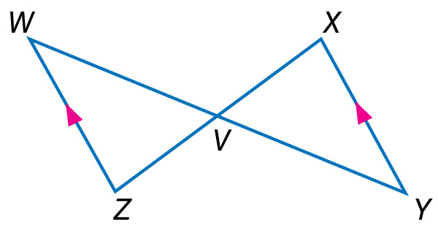
Example 1
B. Determine whether the triangles are similar. If so, write a similarity statement.

Slide 9
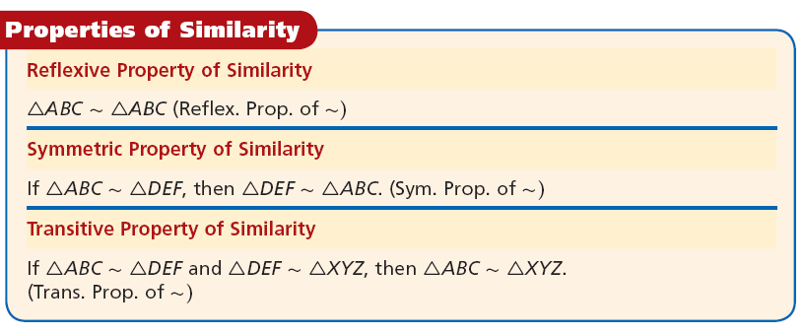
A ~ A
A ~ B, then B ~ A
A ~ B and B ~ C, then A ~ C

Slide 10
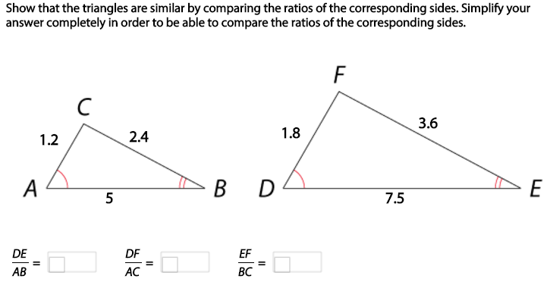




Slide 11
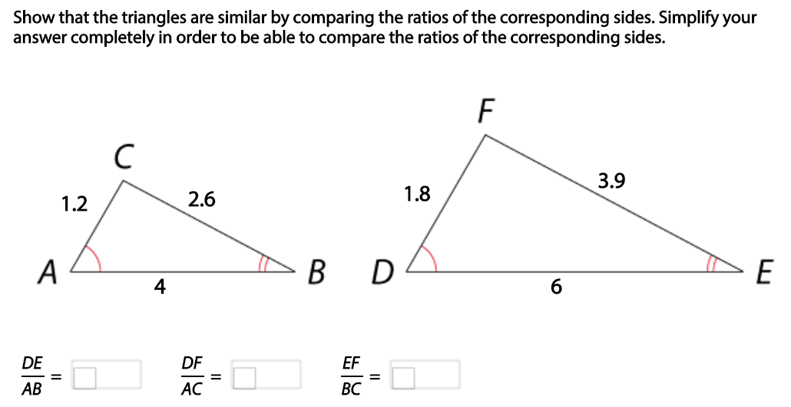




Slide 12
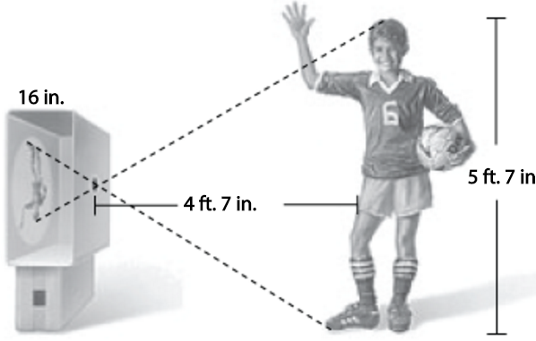
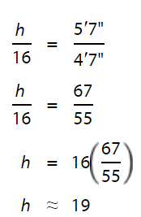

Slide 13
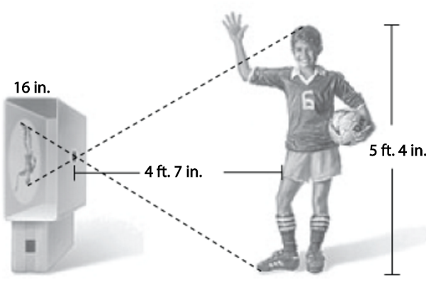
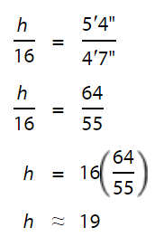

Slide 14
