Slide 1
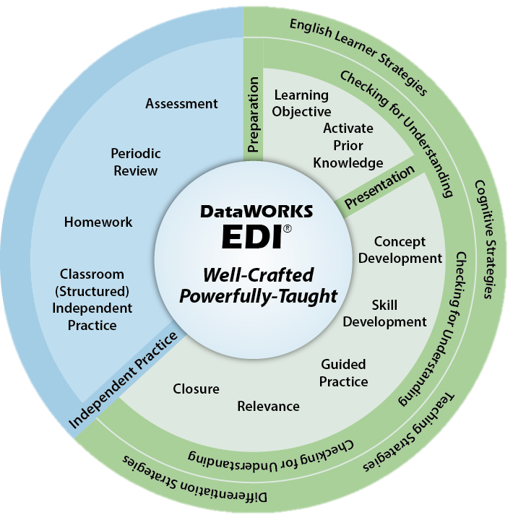
®
explicit direct instruction
Great
Initial
First
Teaching

