Slide 1
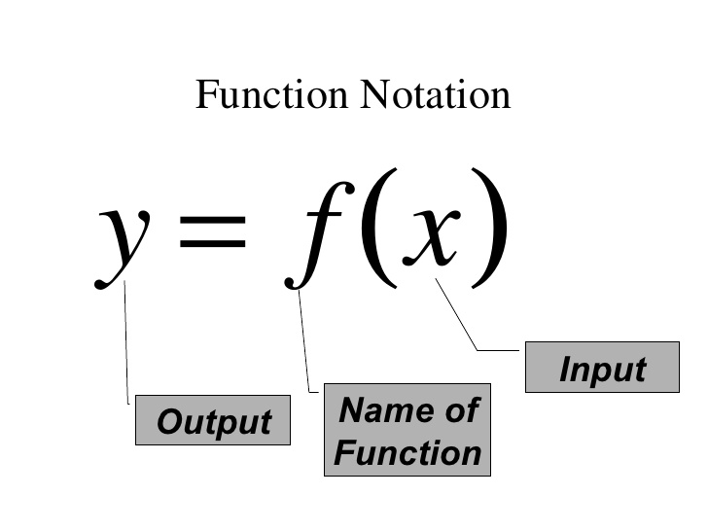
Inverse Functions Objectives
Find the inverse of a function
Use the horizontal line test to determine if the function has an inverse function

Slide 2
What does an inverse function look like?
f(x) = 2x + 1
f (x) = (x-1)/2
-1
x | y
-1 | -1
0 | 1
1 | 3
2 | 5
x | y
-1 | -1
1 | 0
3 | 1
5 | 2
What’s the difference in the two tables?
We simply interchanged the x and y coordinates.

Slide 3
The x and y coordinates traded places to form the inverse function’s table of values.
To put it in mathematical jargon, the input values (x) in the original function became the output values (y) in the inverse function.
Both functions become inverse functions of each other.

Slide 4
Inverses of Functions
If the inverse of a function f is also a function, it is named f ⁻¹ and read “f-inverse.”
The negative 1 in f ⁻¹ is not an exponent. This does not mean the reciprocal of f.
Note: f ⁻¹(x) = “f-inverse.”
f ⁻¹(x) is not equal to

Slide 5
Steps for Finding the Inverse of a One-to-One Function
Replace y with f ⁻¹(x)
Solve for y
Trade places with x and y
Replace f(x) with y

Slide 6
Find the inverse function of $f\left(x\right)=2x+1$
Replace $f\left(x\right)$ with y.
$$y=2x+1$$
Change the "y" to "x" and change the "x" to “y”
$$x=2y+1$$
$$y=\frac{1}{2}x−\frac{1}{2}$$
Solve for y
$$f^{−1}\left(x\right)=\frac{1}{2}x−\frac{1}{2}$$
Replace y with $f^{−1}\left(x\right)$

Slide 7
Finding the Inverse of a Function
Find the inverse of f(x) = 7x - 5
$$y=7x−5$$
$$x=7y−5$$
$$7y=x+5$$
$$y=\frac{1}{7}x+\frac{5}{7}$$
$$f^{−1}\left(x\right)=\frac{1}{7}x+\frac{5}{7}$$

Slide 8
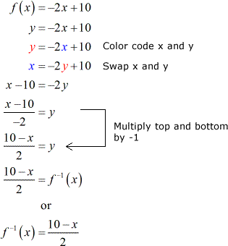
Finding the Inverse of a Function

Slide 9
Find the inverse of
y = f ⁻¹(x)
or
Solve for y
Interchange x and y
Replace f(x) with y

Slide 10
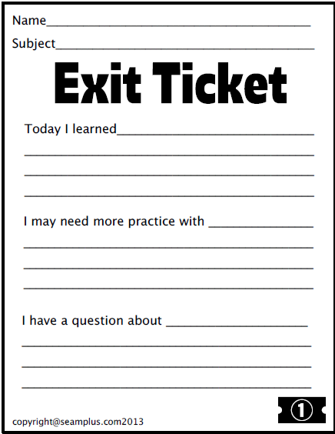

Slide 11
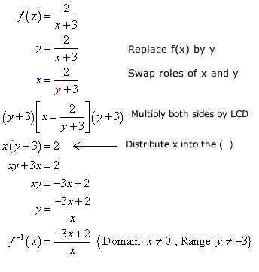
Find the inverse of

Slide 12
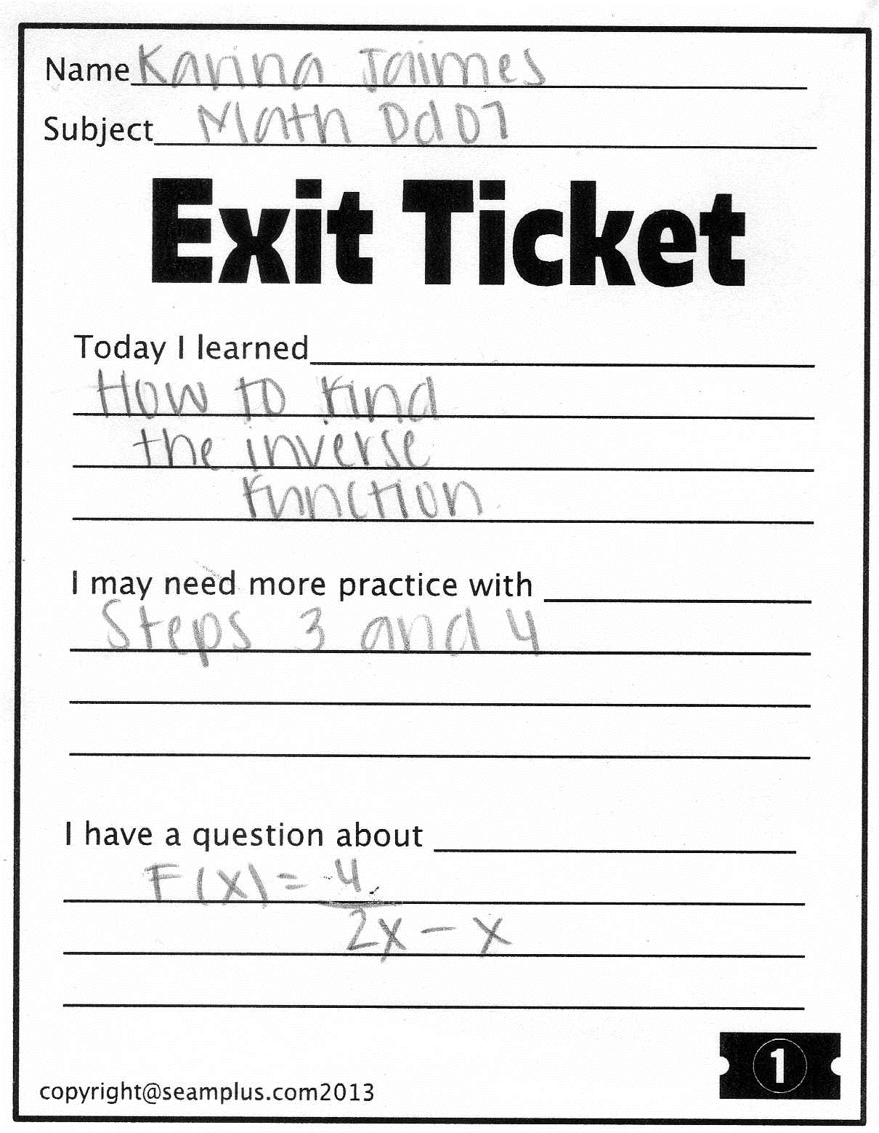
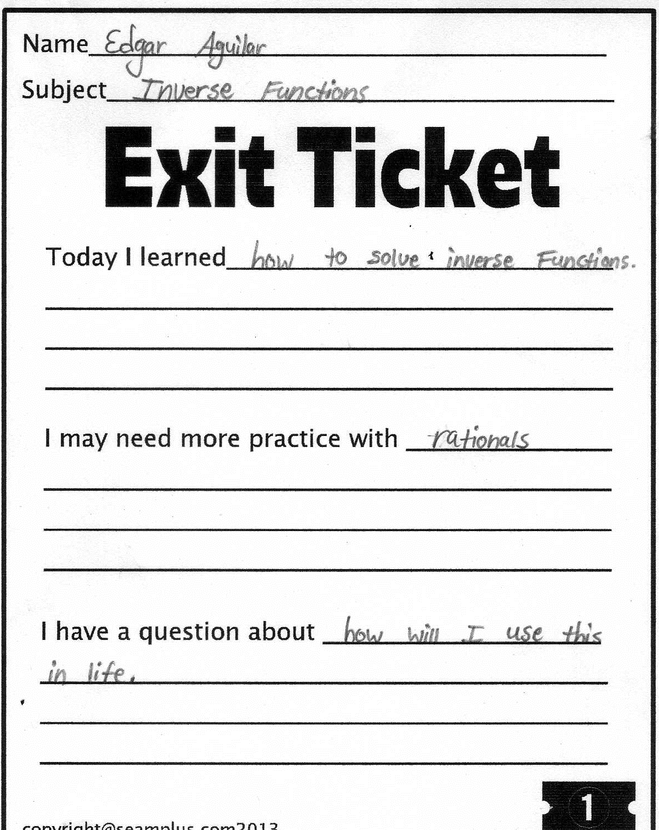
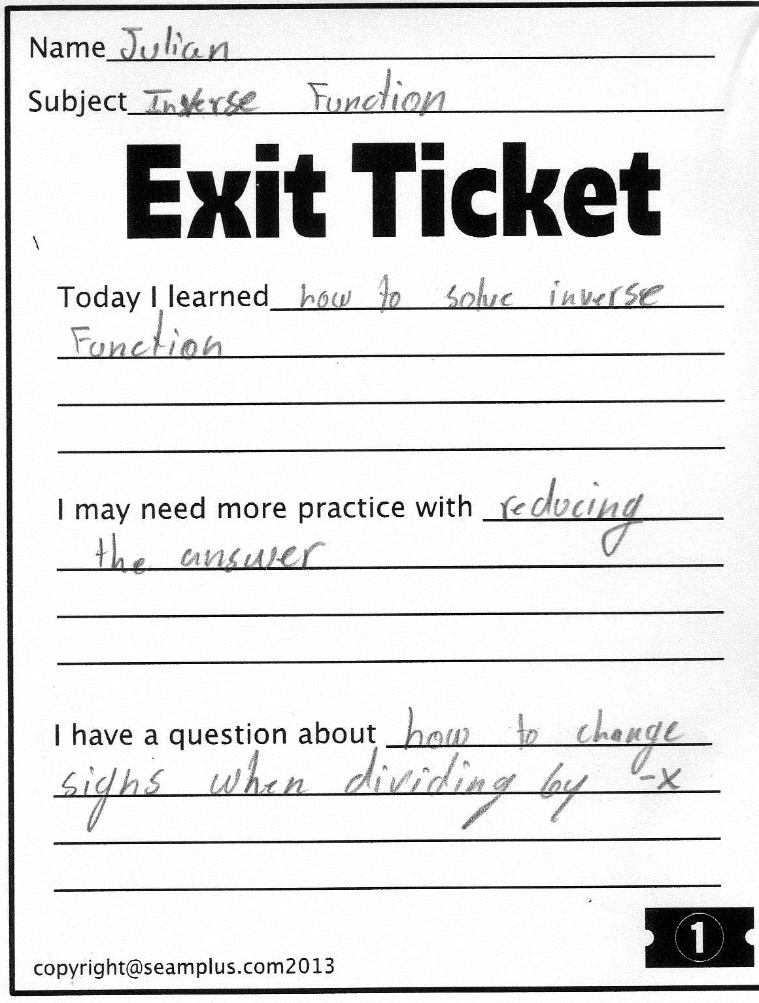
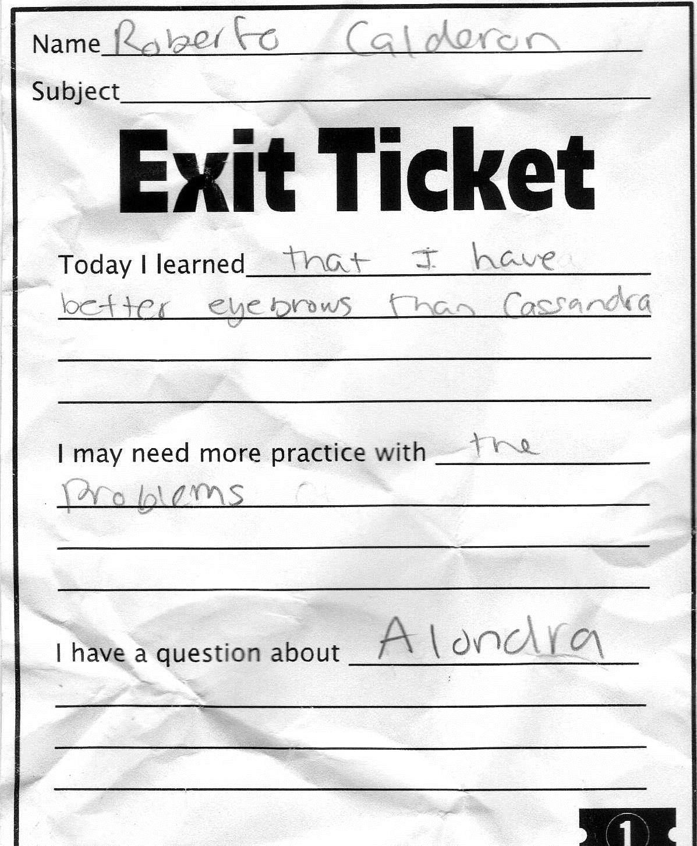
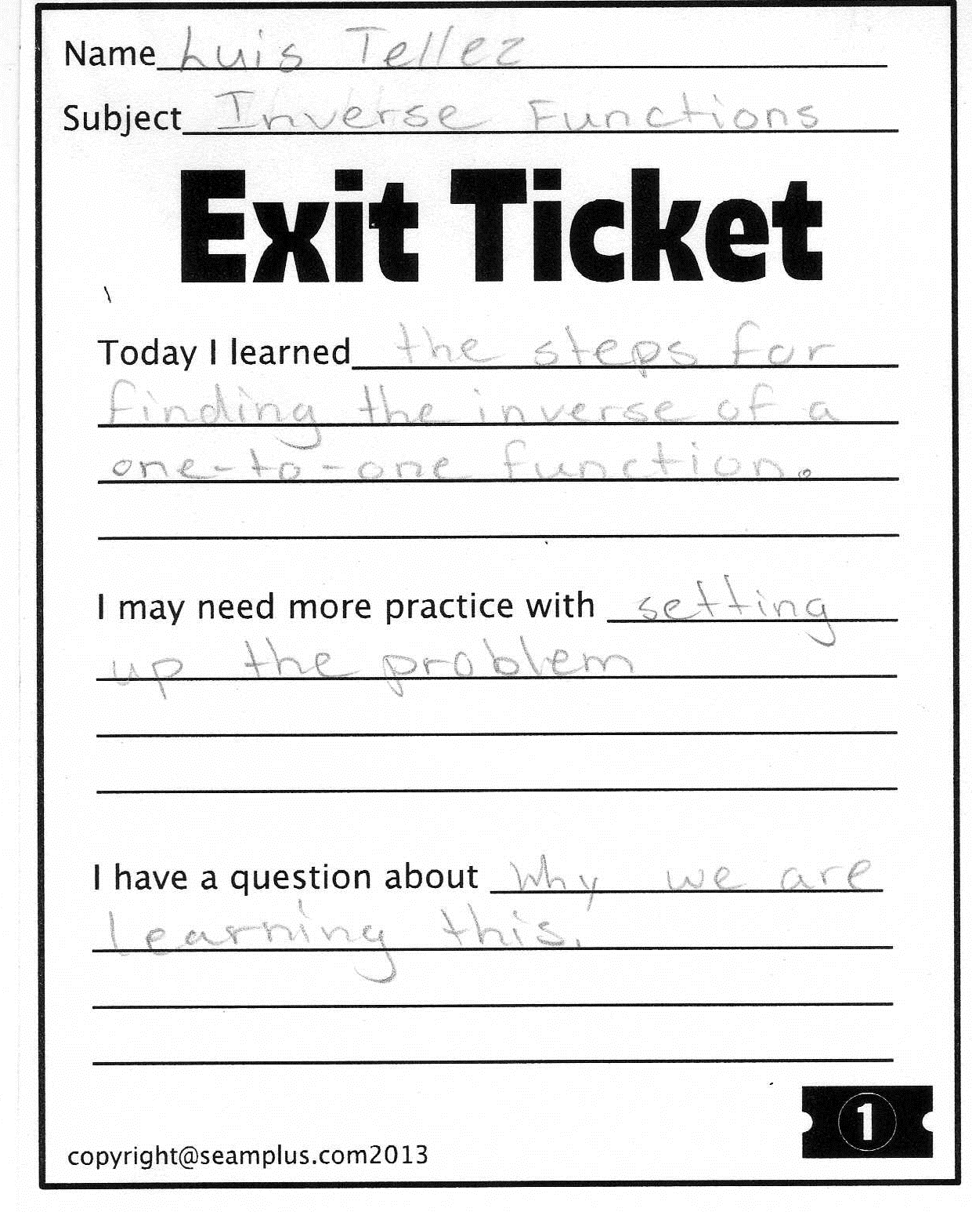
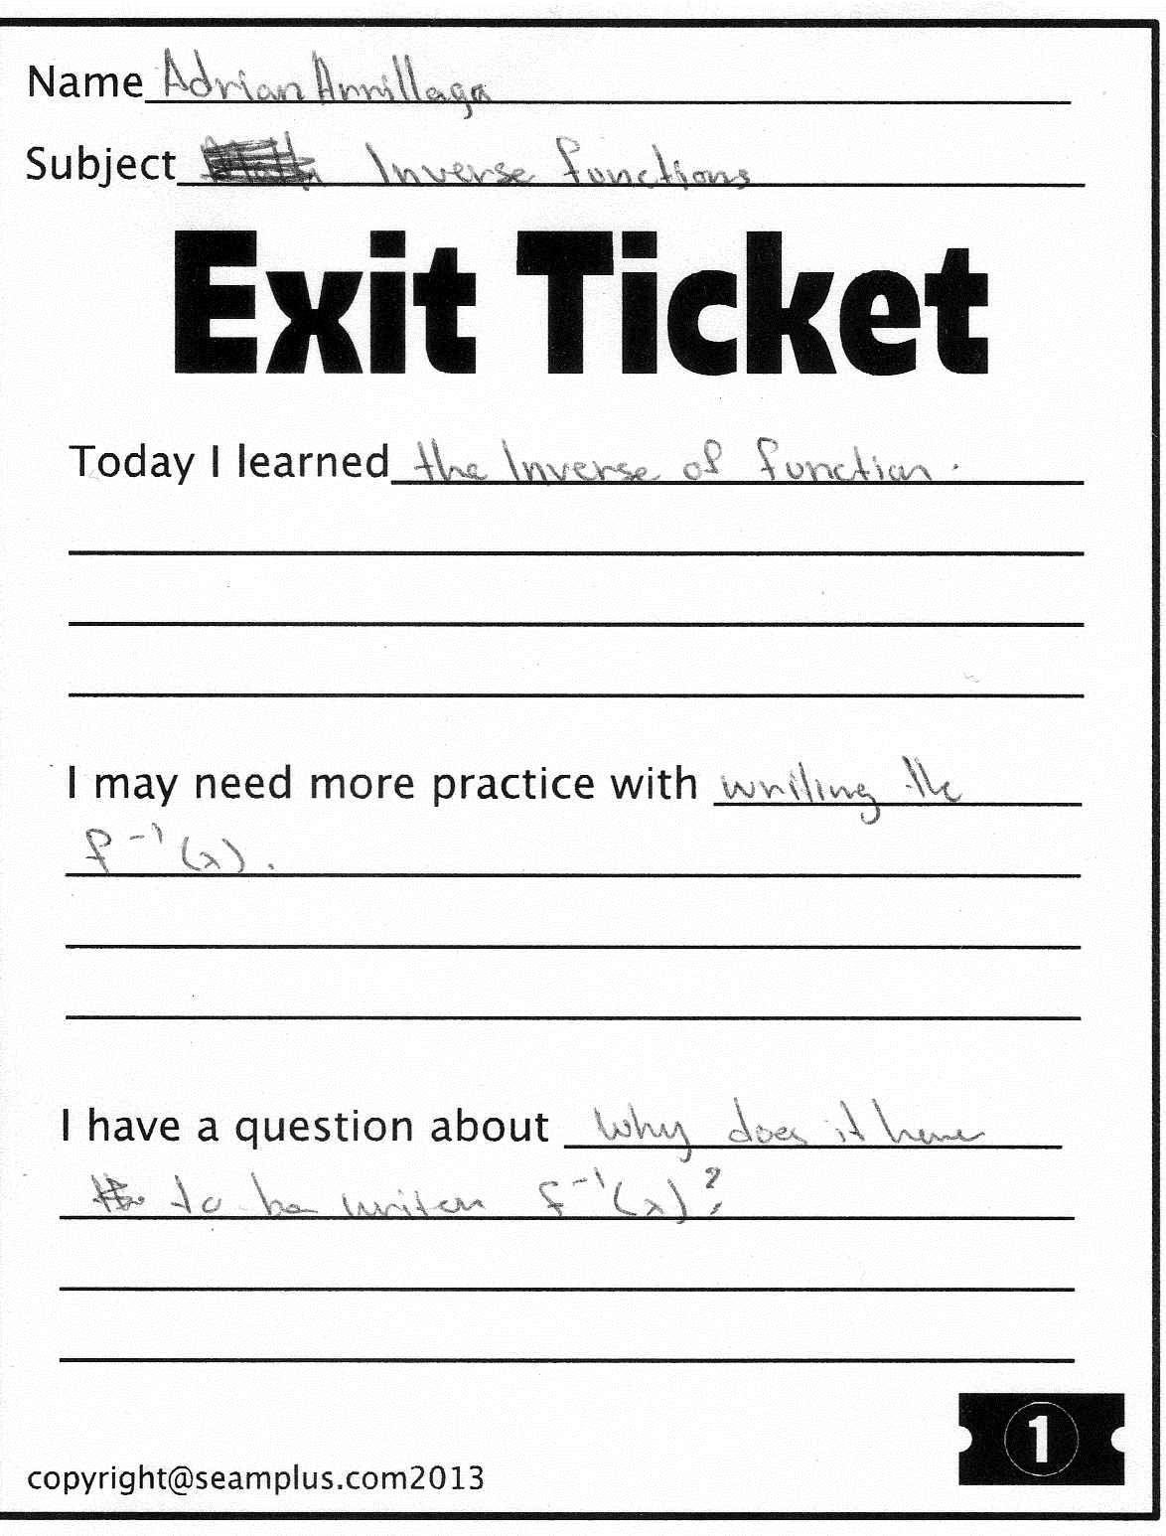

Slide 13
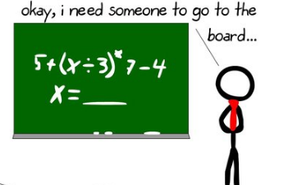

Slide 14
Study of Inverses Functions will lead into study of calculus, specifically integration. The concept of a function is also central to computer programming, Engineering, Medicine, science, etc..
Big Idea: math occur in the context of other math, science, or engineering, rather than in the ordinary activities of life, so it's not realistic to pretend everyone will be using advanced math whenever they go shopping or something, or that anything outside their experience is unimportant.

Slide 15
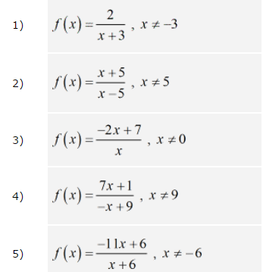

Slide 16
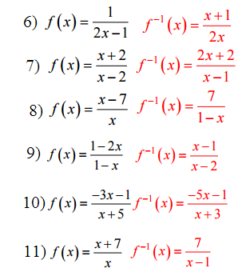

Slide 17
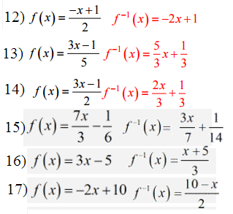

Slide 18
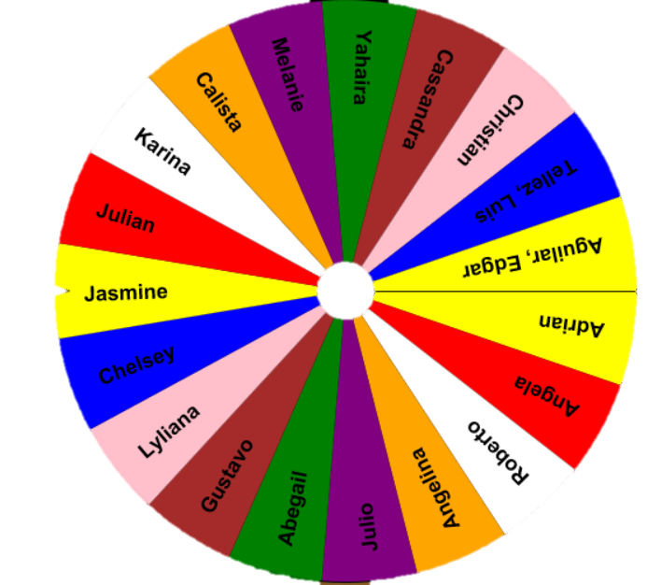

Slide 19
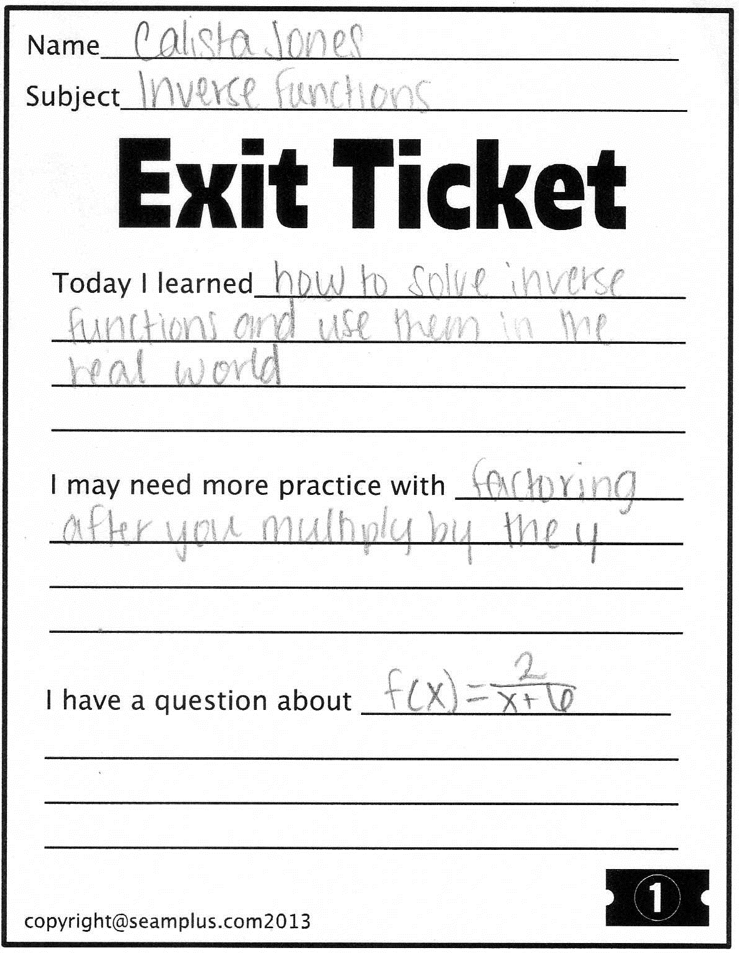
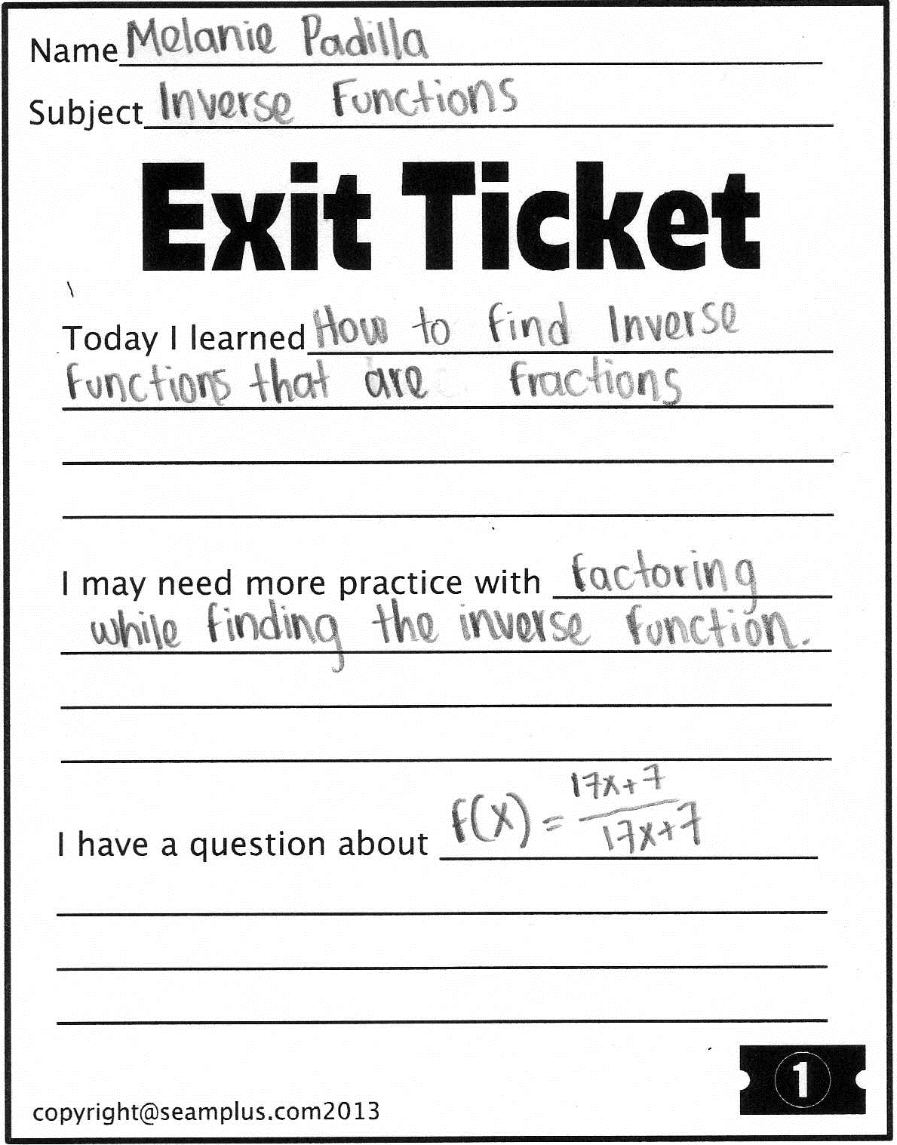
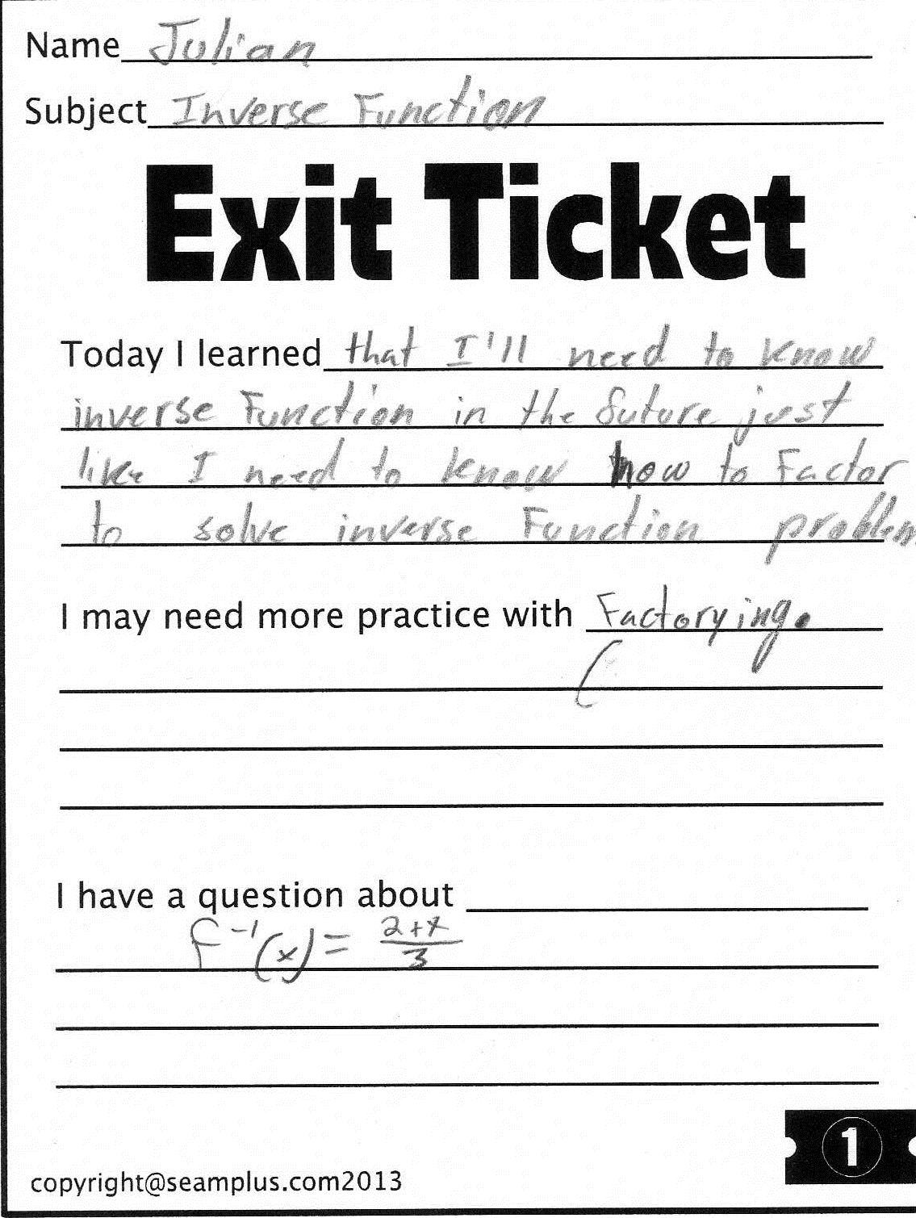
Homework!!
Take good notes!!

Slide 20
Son & Father Example
One-to-One Functions
Son (Domain)
Father (Range)
Son (Domain)
Father (Range)

Slide 21
One-to-One Functions
A function f has an inverse function if and only if the function is one-to-one.
Find the inverse function of $f\left(x\right)=x^{2}$
Step 1 Replace $f(x)$ with y: $y=x^{2}$
Step 2 Interchange $x$ and $y$: $x=y^{2}$
Step 3 Solve for $y:$ $y=±\sqrt{x}$
A one-to-one function is a function in which no two different ordered pairs have the same y-coordinate. This function has two y-coordinates for every x-coordinate. Only one-to-one functions have inverse functions.

Slide 23
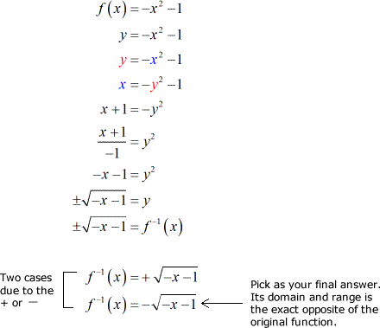

Slide 25
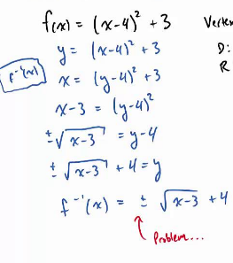

Slide 26
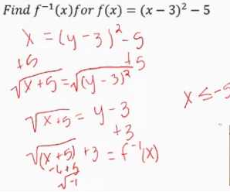

Slide 28
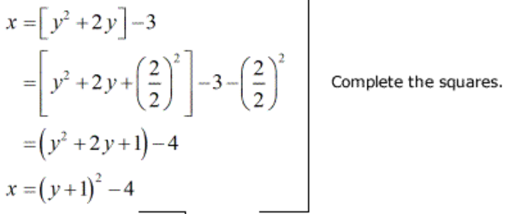

Slide 29
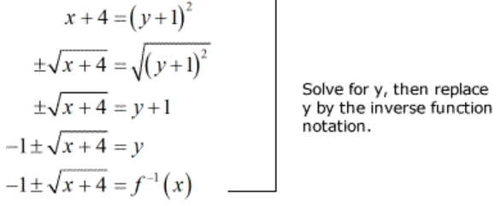

Slide 30
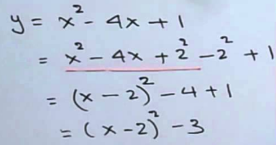

Slide 31
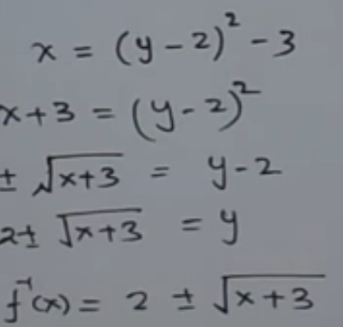

Slide 32
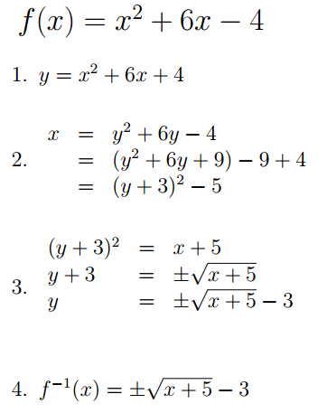
Finding the Inverse of:
+

Slide 33
Finding the Inverse of a Function
Find the inverse of $f\left(x\right)=x^{3}+3$
$$y=x^{3}+3$$
$$x=y^{3}+3$$
$$y^{3}=x−3$$
$$y=\sqrt[3]{x−3}$$
$$f^{−1}\left(x\right)= \sqrt[3]{x−3}$$

Slide 34
Finding the Inverse of a Function
Find the inverse of $f\left(x\right)=x^{3}−4$

Slide 35
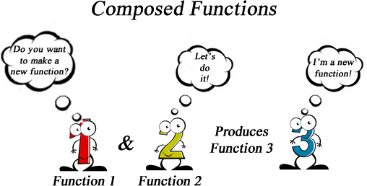

Slide 36
Horizontal Line Test
A function f has an inverse function if and only if the function is one-to-one. A function $y=f(x)$ is one-to-one if and only if no horizontal line intersects the graph of $y=f(x)$ in more than one point.
y
One-to-one means that for every x-coordinate, the y-coordinates cannot repeat.
(0, 7)
(4, 7)
y = 7
Example: The function y = x² – 4x + 7 is not one-to-one on the real numbers because the line y = 7 intersects the graph at both (0, 7) and (4, 7).
2
x
2

Slide 37
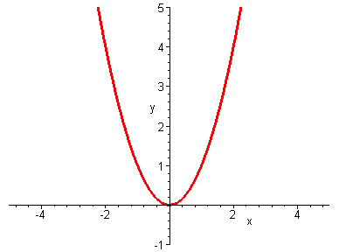
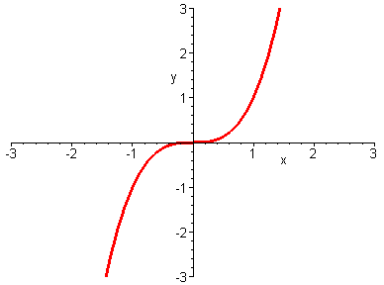
To be a one-to-one function, each y value could only be paired with one x. Let’s look at a couple of graphs.
Look at a y value (for example y = 3) and see if there is only one x value on the graph for it.
For any y value, a horizontal line will only intersect the graph once so we have only have one x value
This is a many-to-one function
This then IS a one-to-one function

Slide 38
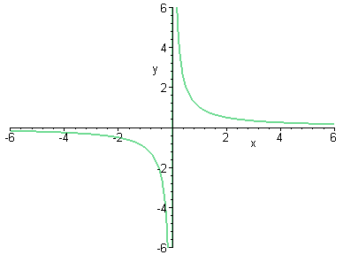
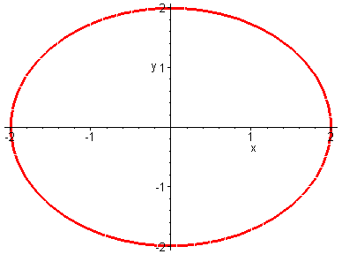
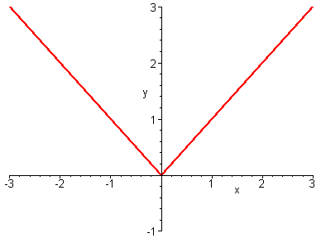
If a horizontal line intersects the graph of an equation more than one time, the equation graphed is NOT a one-to-one function and will NOT have an inverse function.
This is NOT a one-to-one function
This is a one-to-one function
This is NOT a one-to-one function

Slide 39
Example: Apply the horizontal line test to the graphs below to determine if the functions are one-to-one.
a) y = x³
b) y = x³ + 3x² – x – 1
y
y
8
8
4
4
-4
4
-4
4
x
x
one-to-one
not one-to-one

Slide 40
Why are one-to-one functions important?
One-to-One Functions
have
Inverse functions

Slide 41
Existence of an Inverse Function
A function, f, has an inverse function, g, if and only if the function f is a one-to-one (1-1) function.

Slide 42
The graphs of a relation and its inverse are reflections in the line y = x.
Example: Find the graph of the inverse relation geometrically from the graph of f (x) =
The ordered pairs of f are given by the equation .
y
y = x
2
The ordered pairs of the inverse are given by .
x
-2
2
-2

Slide 43
Notice that the x and y values traded places for the function and its inverse.
These functions are reflections of each other about the line y = x
Let’s consider the function and compute some values and graph them.
This means “inverse function”
x f (x)
(2,8)
-2 -8 -1 -1 0 0 1 1 2 8
(8,2)
x f ⁻¹(x)
-8 -2 -1 -1 0 0 1 1 8 2
Let’s take the values we got out of the function and put them into the inverse function and plot them
(-8,-2)
(-2,-8)
Is this a one-to-one function?
Yes, so it will have an inverse function
What will “undo” a cube?
A cube root

Slide 44
Determine Inverse Function
Example: From the graph of the function y = f (x), determine if the inverse relation is a function and, if it is, sketch its graph.
y
y = f ⁻¹(x)
y = x
y = f(x)
The graph of f passes the horizontal line test.
x
The inverse relation is a function.
Reflect the graph of f in the line y = x to produce the graph of f ⁻¹.

Slide 45
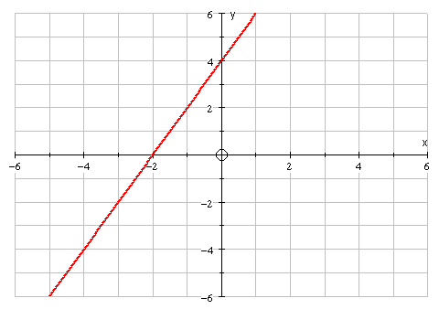
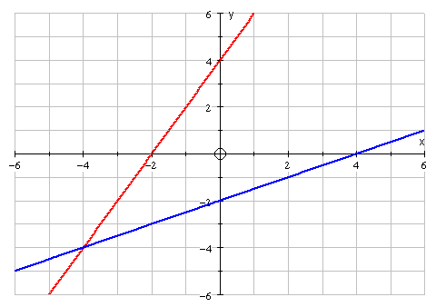
Example:
Consider the graph of the function
The inverse function is

Slide 46
Consider the graph of the function
x
x
x
x
The inverse function is
An inverse function is just a rearrangement with x and y swapped. So the graphs just swap x and y

Slide 47
What else do you notice about the graphs?
x
x
x
x
x
is a reflection of in the line y = x
The function and its inverse must meet on y = x

