Slide 1
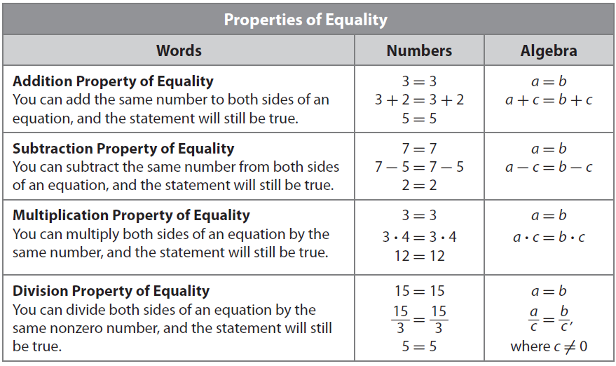
Lesson 1: 1.1 Solving One-Variable Two-Step Equations
Name:_______________________
Period:____
Activate Prior Knowledge
There are many ways to solve an equation. One way is by using a method called . A guess- and-check method involves guessing a value for the variable in an equation and checking to see if it is the solution by ____________ . the value in the equation. If the resulting equation is a ____________ , then the value you guessed is the ${\text{____________}}_{1}$ of the equation. If the equation is not a true statement, then you adjust the value of your guess and try again, continuing until you find the solution.
Use the guess-and-check method to find the solution of the equation x - 6 = 4.
Make Connection
Is 11 the solution of x - 6 = 4? Explain.
Is 10 the solution of x - 6 = 4? Explain.
Students, you already know how to use guess-and-check method to solve equations. Now, we will learn how to solve an equation by working backward.
Vocabulary
11 _____the solution of x - 6 = 4 because it _____ make the equation true.
10 _____ the solution of x - 6 = 4 because it _____ the equation true.
¹ makes the equation true
Concept Development
Another way to solve an equation is by _____________________. In this method, you begin at the end and work backward toward the beginning. Using a guess-and-check method could take _____________________ to find the solution. Working backward seems more _____________________ because it uses reasoning about the values.
A _______________ of an equation is a value for the variable that makes the equation __________.
To determine the solution of an equation, you will use the Properties of Equality.

Slide 2
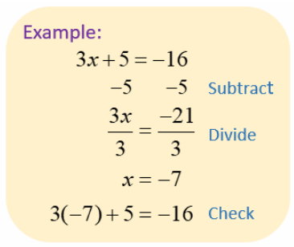
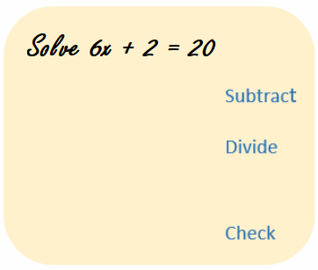
A two-step equation contains₂ two operations.
Inverse Operations
multiplication
subtraction
+ and –
2x + 3 = 7
x
4
- 5 = 1
addition
• and ÷
Solving Two-Step Equations
division
A two-step equation requires₃ two inverse operations to solve for the variable.
To keep an equation balanced, inverse operations must be done on both sides of the equation.
2x + 3 = 7
Inverse Operation
Balance
Inverse Operation
Balance
Solution
Checking a Solution
The solution is the value of the variable that makes the equation true.
x = 2
x = 4
2x + 3 = 7
2x + 3 = 7
2( ) + 3 = 7
2( ) + 3 = 7
= 7
= 7
= 7
= 7
False!
Skill Development/Guided Practice
What you do to one side of an equation, you MUST do the same to the other side of the "=" sign.
Solving =
Isolate the variable
Solution =
Makes the Equation True
How did I/you identify the Inverse of Addition/Subtraction?
How did I/you identify the Inverse of Multiplication/Division?
How did I/you “Check the Solution”?
Solving Two Step Equations
CFU
1
Using Inverse Operations: Add or Subtract Numeric value (Circle).
Using Inverse Operations: Multiple or Divide Numeric value (Circle).
Check your solution.
1
2
2
3
3

Slide 3
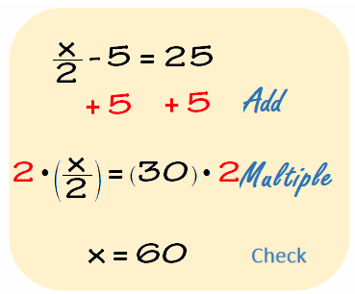
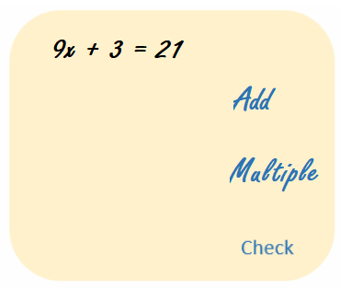
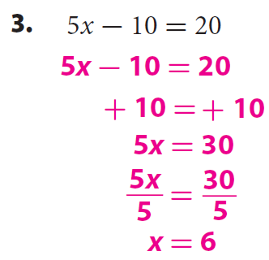
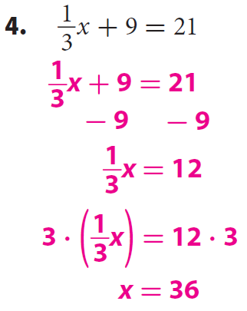
Skill Development/Guided Practice (continued)
Solving =
Isolate the variable
What you do to one side of an equation, you MUST do the same to the other side of the "=" sign.
Solution =
Makes the Equation True
How did I/you identify the Inverse of Addition/Subtraction?
How did I/you identify the Inverse of Multiplication/Division?
How did I/you “Check the Solution”?
Solving Two Step Equations
CFU
1
Using Inverse Operations: Add or Subtract Numeric value (Circle).
Using Inverse Operations: Multiple or Divide Numeric value (Circle).
Check your solution.
1
2
2
3
3
Independent Practice (Homework)
5.

Slide 4
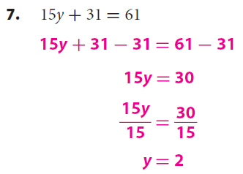
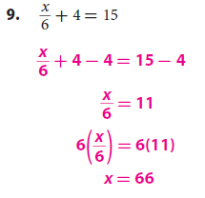
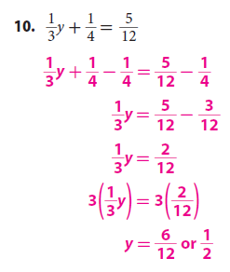
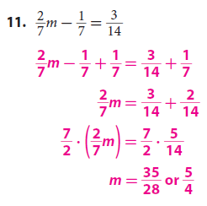
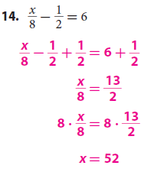
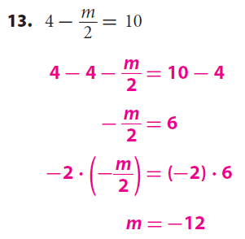
Independent Practice (Homework)
Solving =
Isolate the variable
What you do to one side of an equation, you MUST do the same to the other side of the "=" sign.
Solution =
Makes the Equation True
How did I/you identify the Inverse of Addition/Subtraction?
How did I/you identify the Inverse of Multiplication/Division?
How did I/you “Check the Solution”?
Solving Two Step Equations
CFU
1
Using Inverse Operations: Add or Subtract Numeric value (Circle).
Using Inverse Operations: Multiple or Divide Numeric value (Circle).
Check your solution.
1
2
2
3
3

Slide 5
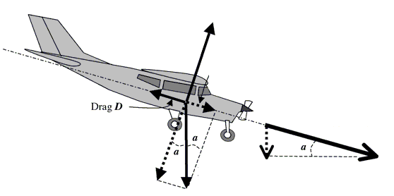
Relevance
The words ___________, ___________, ___________, and __________all share the same root (______) and they all have to do with being __________ (=), or the same.
Solving =
Isolate the variable
Solution =
Makes the Equation True
1
Equations help us find solution to complex and real world problems in short time.
An airplane descends in altitude from 20,000 feet to 10,000 feet. A gauge at Radar Traffic Control reads that the airplane’s altitude drops 1.8939 miles. How many feet a mile is the plan dropping?
2
Knowing how to solve equations will help you do well on tests.
Sample Test Question:
Remember the Concept
A two-step equation contains two operations. A two-step equation requires two inverse operations to solve. To keep an equation balanced, inverse operations must be done on both sides of the equation. The solution is the value of the variable that makes the equation true.
Essential Question: How do you solve an equation in one variable?
Summary of Closure
Solving =
Isolate the variable
What you do to one side of an equation, you MUST do the same to the other side of the "=" sign.
Solution =
Makes the Equation True
Solving Two Step Equations:
1
Using Inverse Operations: Add or Subtract Numeric value (Circle).
Using Inverse Operations: Multiple or Divide Numeric value (Circle).
Check your solution.
2
Word Bank
3
Equations
Solution
Operation
Isolate
Inverse
Properties of Equality.
To solve Two-Step equations, you __________________________ ____________________________________________________________
____________________________________________________________.
SUMMARY CLOSURE

