Slide 1





ACT RESPONSIBLY & SUPPORT the COMMUNITY.
Be on Time
Wear ID
Chromebook Ready
SEE SOMETHING, SAY SOMETHING

Slide 2


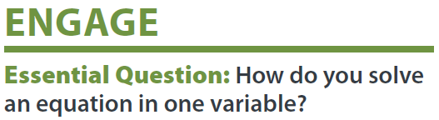
We will determine₁ how to Solve Two-Step Equations in One-Variable.
Learning Objective
LEARNING OBJECTIVE
CFU
What are we going to learn today?
What is Determine means?_______.
Definition
¹ figure out

Slide 3
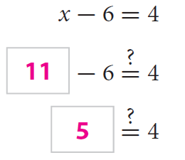
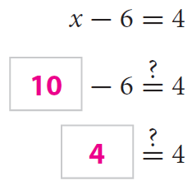
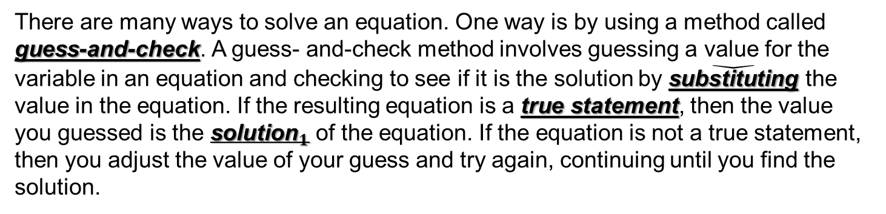
Objective & Prior Knowledge
Activate Prior Knowledge
There are many ways to solve an equation. One way is by using a method called guess-and-check. A guess- and-check method involves guessing a value for the variable in an equation and checking to see if it is the solution by $\check{\text{substituting}}$ the value in the equation. If the resulting equation is a true statement, then the value you guessed is the ${\text{solution}}_{1}$ of the equation. If the equation is not a true statement, then you adjust the value of your guess and try again, continuing until you find the solution.
Use the guess-and-check method to find the solution of the equation x - 6 = 4.
Is 11 the solution
of x - 6 = 4? Explain.
Is 10 the solution
of x - 6 = 4? Explain.
Students, you already know how to use guess-and-check method to solve equations. Now, we will learn how to solve an equation by working backward.
Make Connection
11 _____the solution of x - 6 = 4 because it _____ make the equation true.
10 _____ the solution of x - 6 = 4 because it _____ the equation true.
¹ makes the equation true
Vocabulary

Slide 4
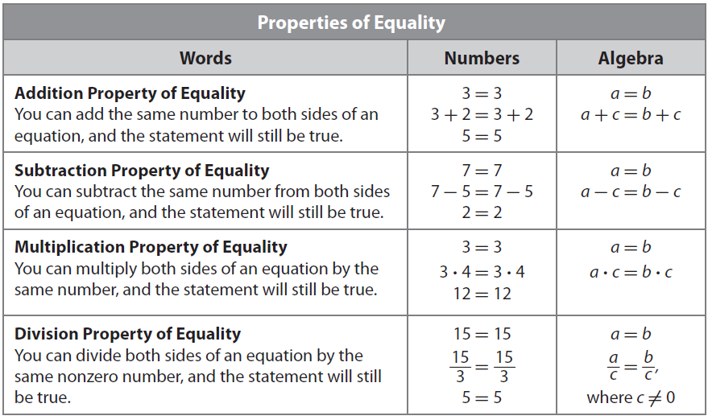


Concept Development
Concept Development
Another way to solve an equation is by working backward. In this method, you begin at the end and work backward toward the beginning. Using a guess-and-check method could take many guesses to find the solution. Working backward seems more efficient because it uses reasoning about the values.
A solution of an equation is a value for the variable that makes the equation true.
To determine the solution of an equation, you will use the Properties of Equality.
CFU: Pair Share
What determines whether you use the Addition or Subtraction Property of Equality to solve an equation?

Slide 5

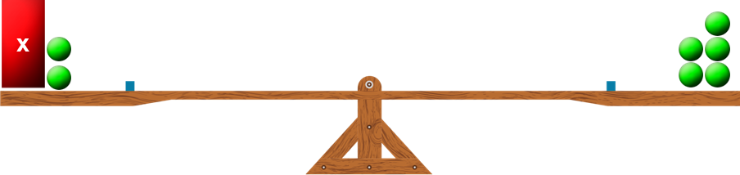


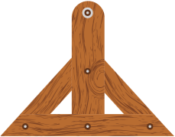
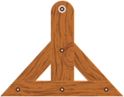

Concept Development (Clarification and CFU)
A one-step equation requires one inverse operation to solve for the variable.
• To keep an equation balanced, inverse operations must be done on both sides of the equation.
Inverse Operations
+ and –
The solution is the value of the variable that makes the equation true.
• and ÷
x + 2 = 5
− 2
− 2
x = 3
3 + 2
=
5
x
x
x
x
Why is 2 subtracted on both sides of the equation?
Why is 3 the solution to the equation x + 2 = 5?
CFU
Go to
Skill Dev 1

Slide 6
Inverse Operations
A two-step equation contains₂ two operations.
+ and –
multiplication
subtraction
• and ÷
2x + 3 = 7
x
4
- 5 = 1
addition
division
Check for Understanding
Which two inverse operations would be used to solve the two-step equation 5x - 4 = 6? How do you know?
What is the difference between the solution (x = 2) and non-solution (x = 4)?
Solving Two-Step Equations
Check for Understanding
Which of the following is an example of a two-step equation? How do you know? A 5x = 6 B 5x - 4 = 6 C x - 4 = 6
A two-step equation requires₃ two inverse operations to solve for the variable.
To keep an equation balanced, inverse operations must be done on both sides of the equation.
2x + 3 = 7
Inverse Operation
- 3
- 3
Balance
CONCEPT DEVELOPMENT
2x = 4
Inverse Operation
2
2
Balance
x = 2
Checking a Solution
Solution
The solution is the value of the variable that makes the equation true.
x = 2
x = 4
2x + 3 = 7
2x + 3 = 7
2(2) + 3 = 7
2(4) + 3 = 7
Definition
² has ³ needs (synonym)
4 + 3 = 7
8 + 3 = 7
7 = 7
True!
11 = 7
False!

Slide 7

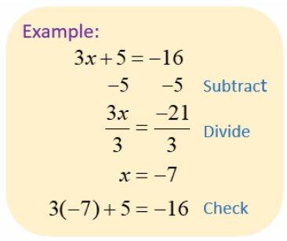
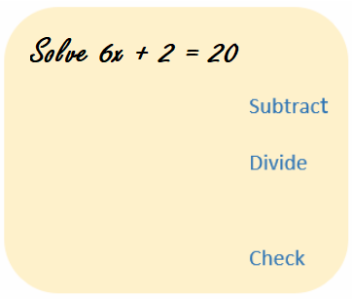
Skill Development
Skill Development/Guided Practice
What you do to one side of an equation, you MUST do the same to the other side of the "=" sign.
Solving =
Isolate the variable
Solution =
Makes the Equation True
How did I/you identify the Inverse of Addition/Subtraction?
How did I/you identify the Inverse of Multiplication/Division?
How did I/you “Check the Solution”?
Solving Two Step Equations
CFU
1
Using Inverse Operations: Add or Subtract Numeric value (Circle).
Using Inverse Operations: Multiple or Divide Numeric value (Circle).
Check your solution.
1
2
2
3
3

Slide 8
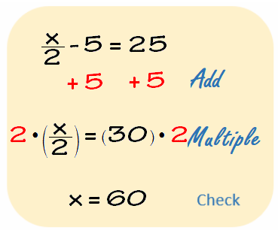
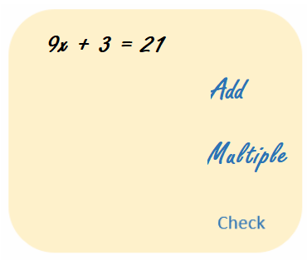
Skill Development cont.
Skill Development/Guided Practice (continued)
What you do to one side of an equation, you MUST do the same to the other side of the "=" sign.
Solving =
Isolate the variable
Solution =
Makes the Equation True
How did I/you identify the Inverse of Addition/Subtraction?
How did I/you identify the Inverse of Multiplication/Division?
How did I/you “Check the Solution”?
CFU
Solving Two Step Equations
Using Inverse Operations: Add or Subtract Numeric value (Circle).
Using Inverse Operations: Multiple or Divide Numeric value (Circle).
Check your solution.
1
1
2
2
3
3
CFU
Do you usually add/subtract first or multiply/divide first when isolating a variable? Explain why this might be helpful.

Slide 9
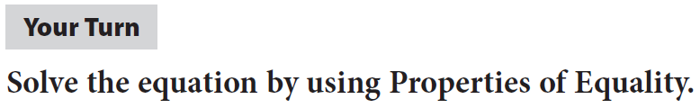
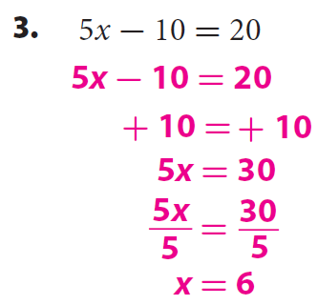
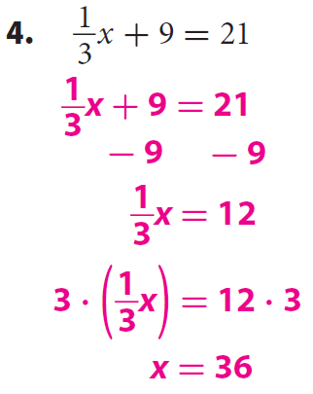


Skill Development cont.
Skill Development/Guided Practice (continued)
What you do to one side of an equation, you MUST do the same to the other side of the "=" sign.
Solving =
Isolate the variable
Solution =
Makes the Equation True
How did I/you identify the Inverse of Addition/Subtraction?
How did I/you identify the Inverse of Multiplication/Division?
How did I/you “Check the Solution”?
CFU
Solving Two Step Equations
Using Inverse Operations: Add or Subtract Numeric value (Circle).
Using Inverse Operations: Multiple or Divide Numeric value (Circle).
Check your solution.
1
1
2
2
3
3
5.

Slide 10
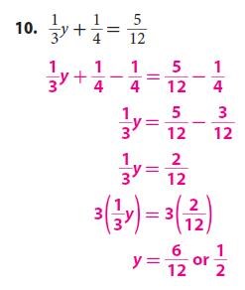
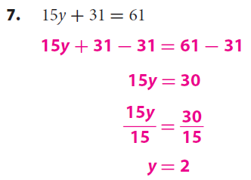
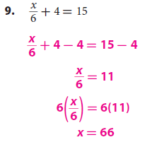
Skill Development cont.
Skill Development/Guided Practice (continued)
What you do to one side of an equation, you MUST do the same to the other side of the "=" sign.
Solving =
Isolate the variable
Solution =
Makes the Equation True
How did I/you identify the Inverse of Addition/Subtraction?
How did I/you identify the Inverse of Multiplication/Division?
How did I/you “Check the Solution”?
CFU
Solving Two Step Equations
Using Inverse Operations: Add or Subtract Numeric value (Circle).
Using Inverse Operations: Multiple or Divide Numeric value (Circle).
Check your solution.
1
1
2
2
3
3

Slide 11
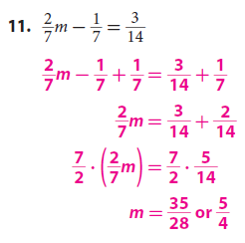
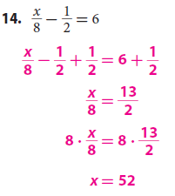
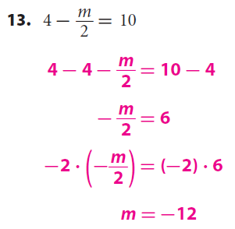
Skill Development cont.
Skill Development/Guided Practice (continued)
What you do to one side of an equation, you MUST do the same to the other side of the "=" sign.
Solving =
Isolate the variable
Solution =
Makes the Equation True
How did I/you identify the Inverse of Addition/Subtraction?
How did I/you identify the Inverse of Multiplication/Division?
How did I/you “Check the Solution”?
CFU
Solving Two Step Equations
Using Inverse Operations: Add or Subtract Numeric value (Circle).
Using Inverse Operations: Multiple or Divide Numeric value (Circle).
Check your solution.
1
1
2
2
3
3

Slide 12
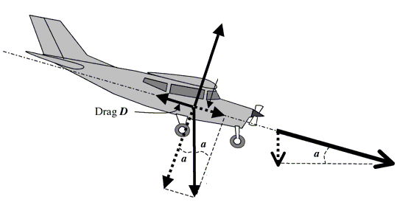


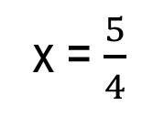
Lesson Relevance
Relevance
The words equation, equal, equality, and equivalent
all share the same root (equ) and they all have to do
with being equal (=), or the same.
Solving =
Isolate the variable
Solution =
Makes the Equation True
1
Equations help us find solution to complex and real world problems in short time.
An airplane descends in altitude from 20,000 feet to 10,000 feet. A gauge at Radar Traffic Control reads that the airplane’s altitude drops 1.8939 miles. How many feet a mile is the plan dropping?
2
Knowing how to solve equations will help you do well on tests.
Sample Test Question:
Remember the Concept
A two-step equation contains two operations. A two-step equation requires two inverse operations to solve. To keep an equation balanced, inverse operations must be done on both sides of the equation. The solution is the value of the variable that makes the equation true.
Multiply by LCD
+2 +2
x = $\frac{5}{4}$
4x = 5
4

Slide 13
Exit Activity & Closure
Summary of Closur
Essential Question: How do you solve an equation in one variable?
What you do to one side of an equation, you MUST do the same to the other side of the "=" sign.
Solution =
Solving =
Isolate the variable
Makes the Equation True
How did I/you identify the Inverse of Addition/Subtraction?
How did I/you identify the Inverse of Multiplication/Division?
How did I/you “Check the Solution”?
Solving Two Step Equations:
CFU
1
Using Inverse Operations: Add or Subtract Numeric value (Circle).
Using Inverse Operations: Multiple or Divide Numeric value (Circle).
Check your solution.
1
2
2
3
3
Word Bank
Equations
Solution
Operation
Isolate
Inverse
Properties of
Equality.
To solve Two-Step equations, you______
_________________________________________________________________________________
________________________________________.
SUMMARY CLOSURE

