Slide 1
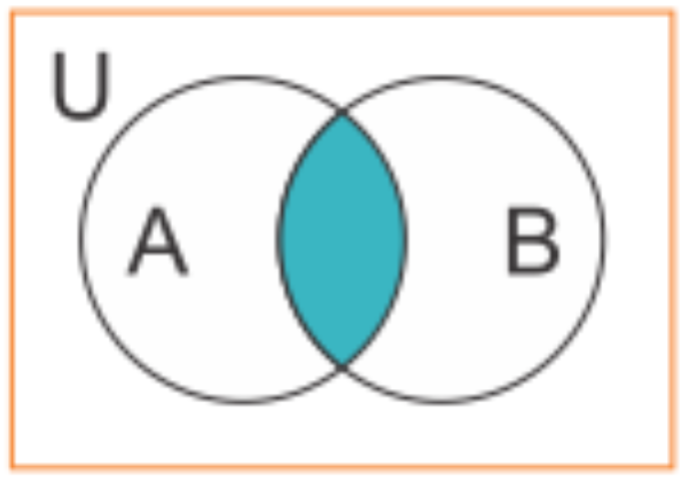
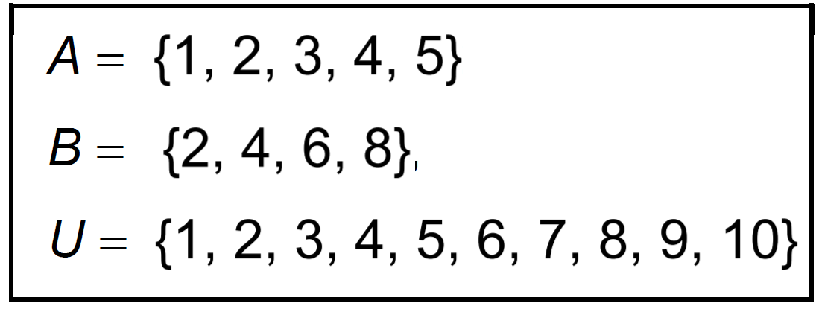
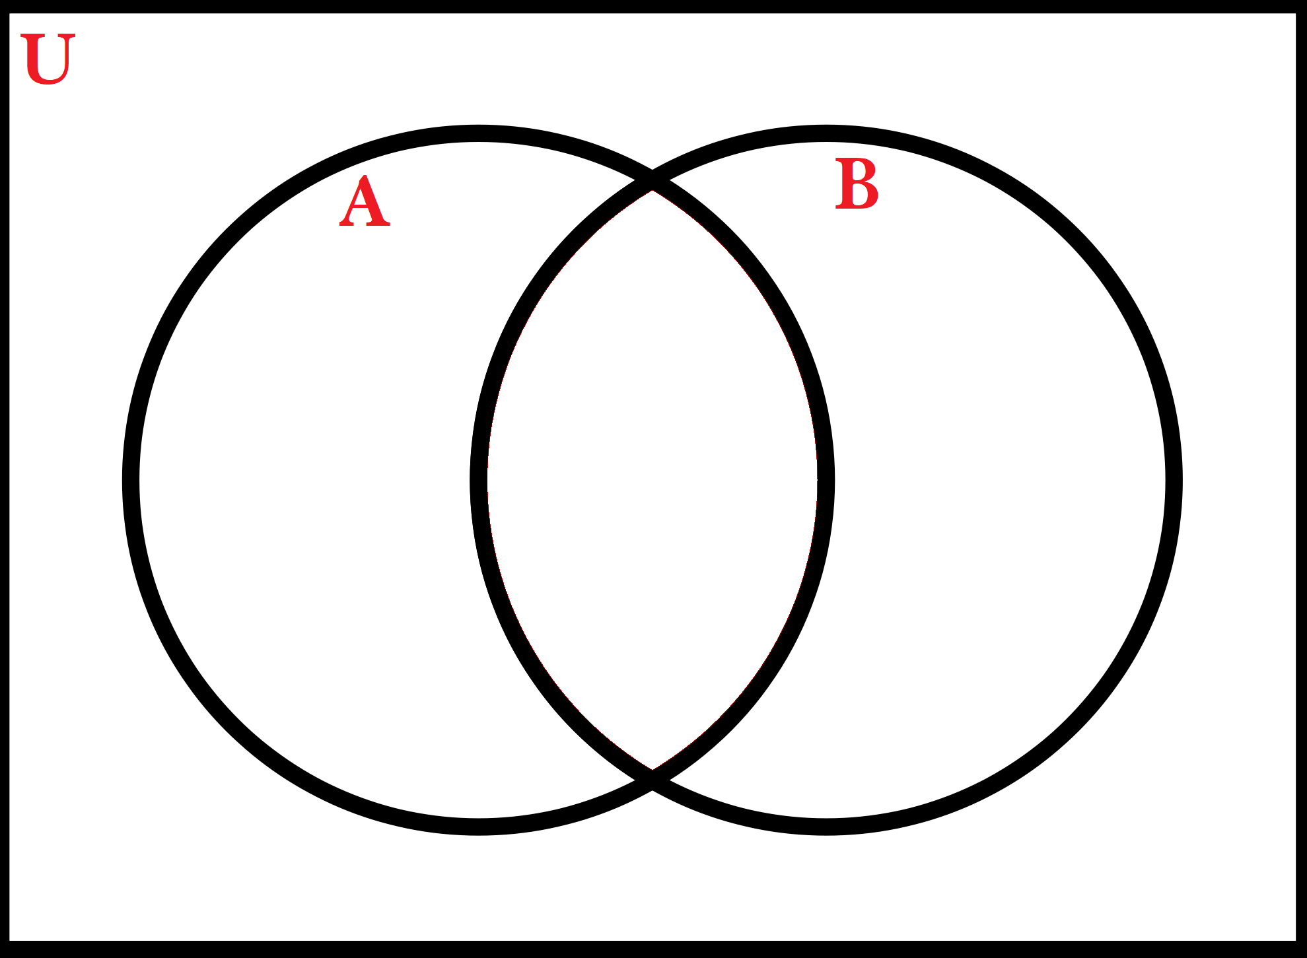
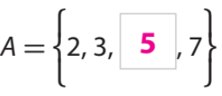
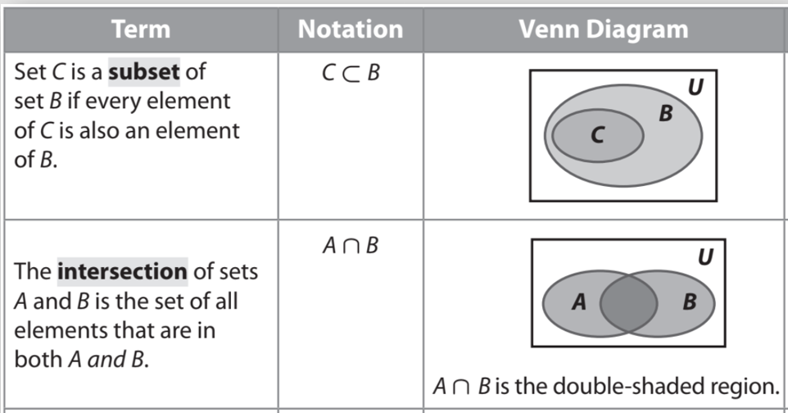
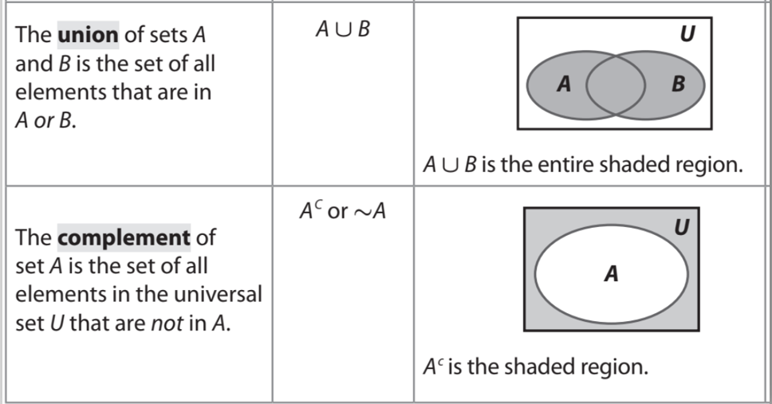
Lesson_1
22.1 Probability and Set Theory
Name:___________________________
Period:________
1. Write each statement in set notation. Use the descriptions of the sets to the right to complete each statement.
Draw a Venn Diagram to Organize the Sets
A ⋂ B = { }
A ∪ B = { }
2. Write each statement in set notation. Use the descriptions of the sets to the right to complete each statement.
Draw a Venn Diagram to Organize the Sets
A ⋂ B = { }
A ∪ B = { }
Remember the Concept
Venn Diagrams: Shows logical relations between a collection of sets. Intersection: A ∩ B Each element is in both set A and set B. Find where the sets overlap. Union: A ∪ B All elements in set A or set B. Join together all of the elements in both sets.
ACTIVATE PRIOR KNOWLEDGE
Make the Connection
Students you already know what is a set and subset. Now we are going to use that information to find probabilities.
Note: Venn diagram can make it easier to identify the sets.
A set is a collection of distinct objects. Each object in a set is called an element of the set.
A set is often denoted by writing the elements in braces.
The set with no elements is the empty set, denoted by ⌀ or { }.
The set of all elements under is the universal set, denoted by U.
Identifying the number of elements in a set is important for calculating probabilities.

Slide 2
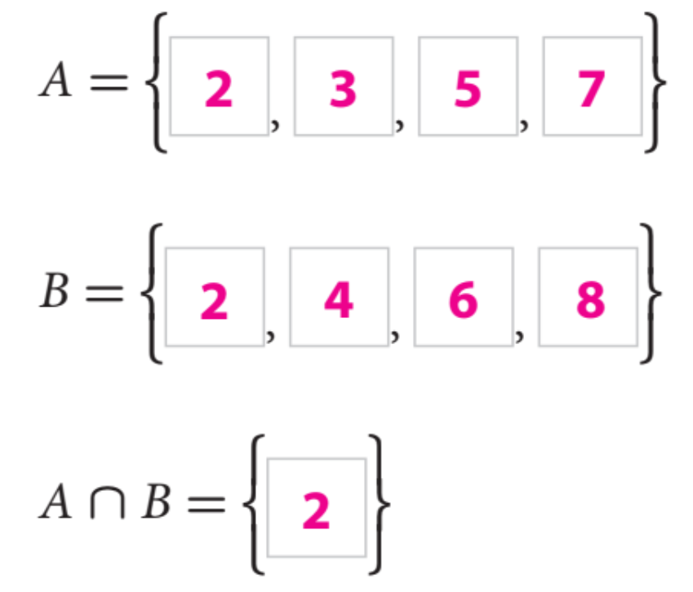
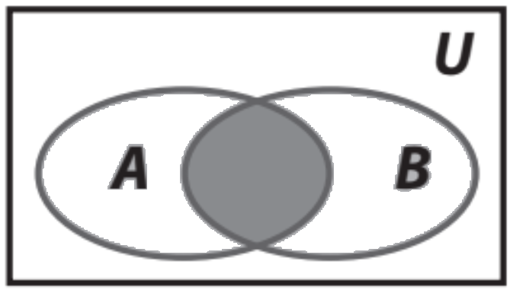
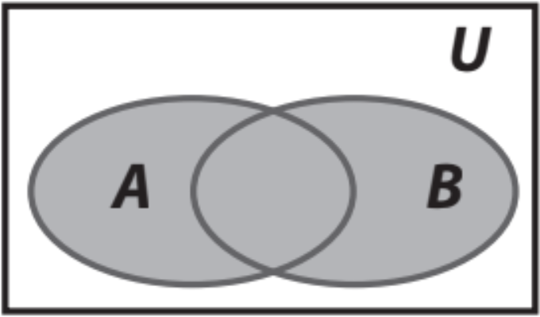
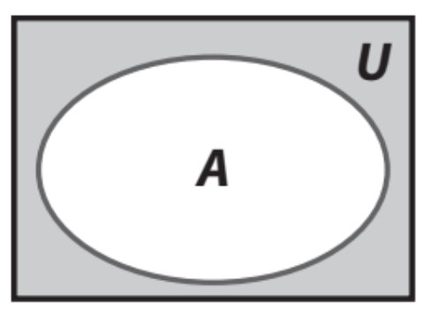
Name the type of set and find the element(s)?
CFU: Whiteboard
Remember the Concept
Intersection: A ∩ B Each element is in both set A and set B. Find where the sets overlap. Union: A ∪ B All elements in set A or set B. Join together all of the elements in both sets.
Working with Sets:
U = {1, 2, 3, 4, 5, 6, 7, 8, 9, 10, 11, 12}
A = {1, 2, 3, 4, 6, 12} B = {2, 4, 6, 8, 10, 12}
C = {1, 3, 5, 7, 9, 11} D = {2, 4, 6}
Answer each question (WB).
What is A ⋂ B ?
What is A ⋃ B ?
What is A ⋃ C ?
What is A ⋂ D ?
What is B ⋂ C ?
Steps to find sets
1 Identify the definition of the notation.
CFU How did I/you identify the definition of the notation?
2 Apply the definition by drawing a Venn Diagram.
CFU How did I/you apply the definitions by drawing a Venn Diagram?
3 Find the elements, write it on set notation.
CFU How did I/you find the elements in set notation?
SKILL DEVELOPMENT
The complement (A’ or ) of a set of A refers to elements not in A.
(Opposite)

Slide 3
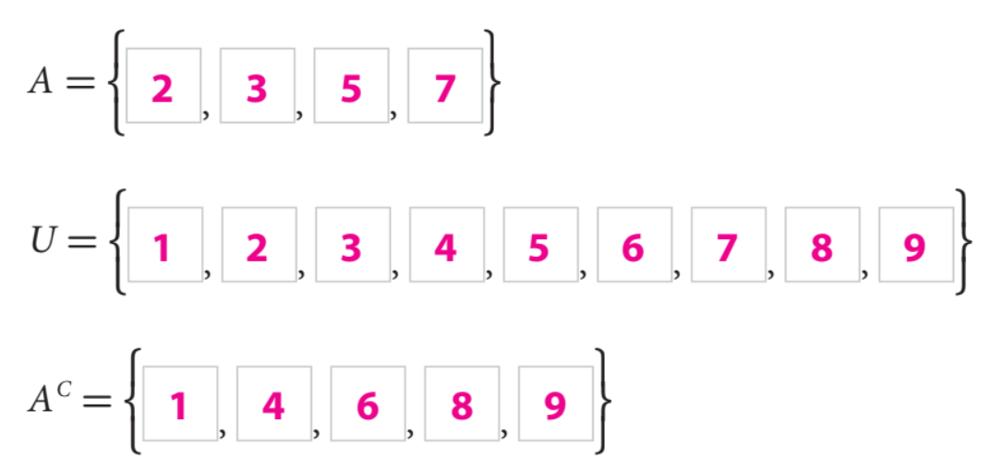
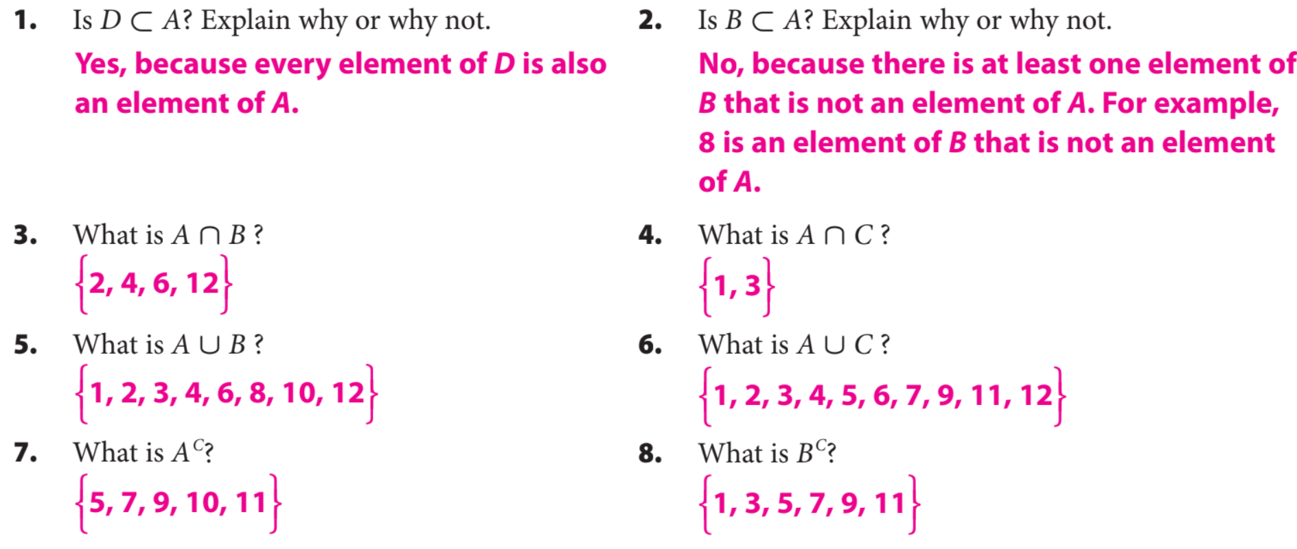
Find the complement of A:
To determine the complement of set A, first identify the elements of set A and universal
set U separately, then identify all the elements in the universal set that are not in set A.
CFU: Whiteboard
SKILL DEVELOPMENT
Homework and Practice
GUIDED PRACTICE

Slide 4
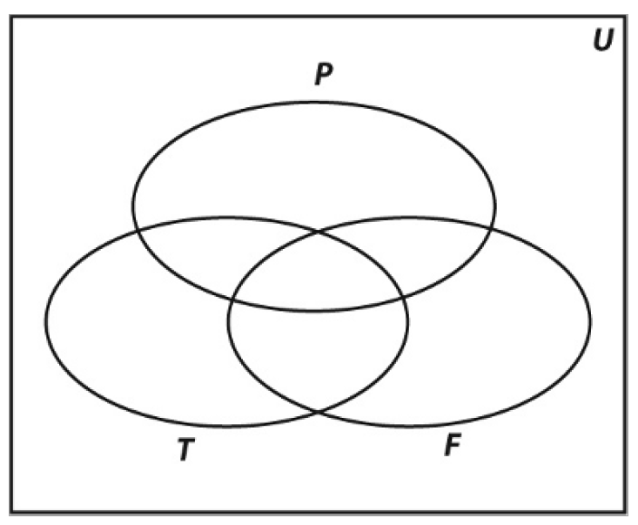
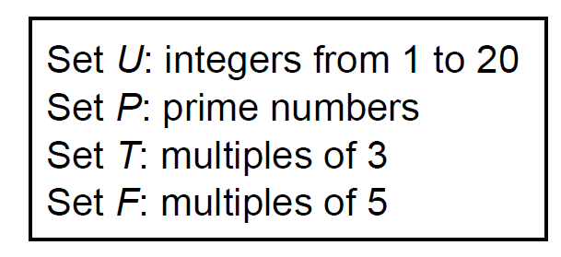
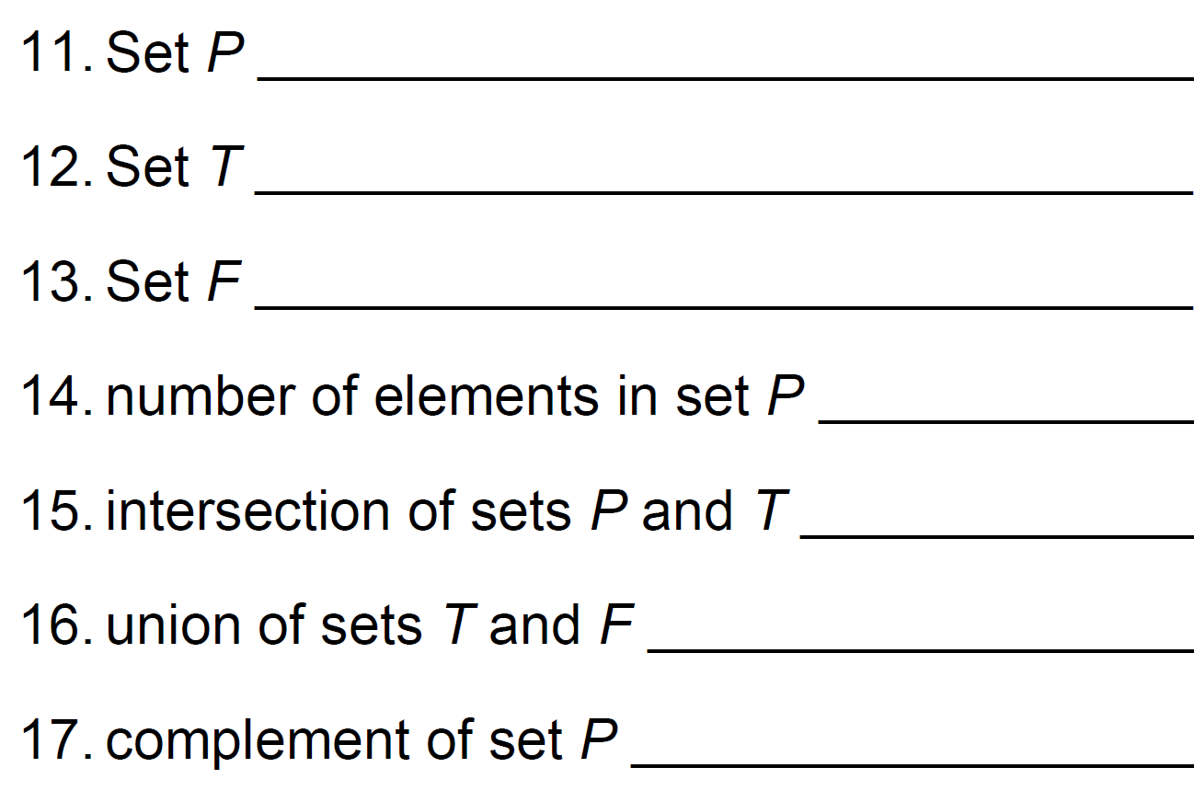
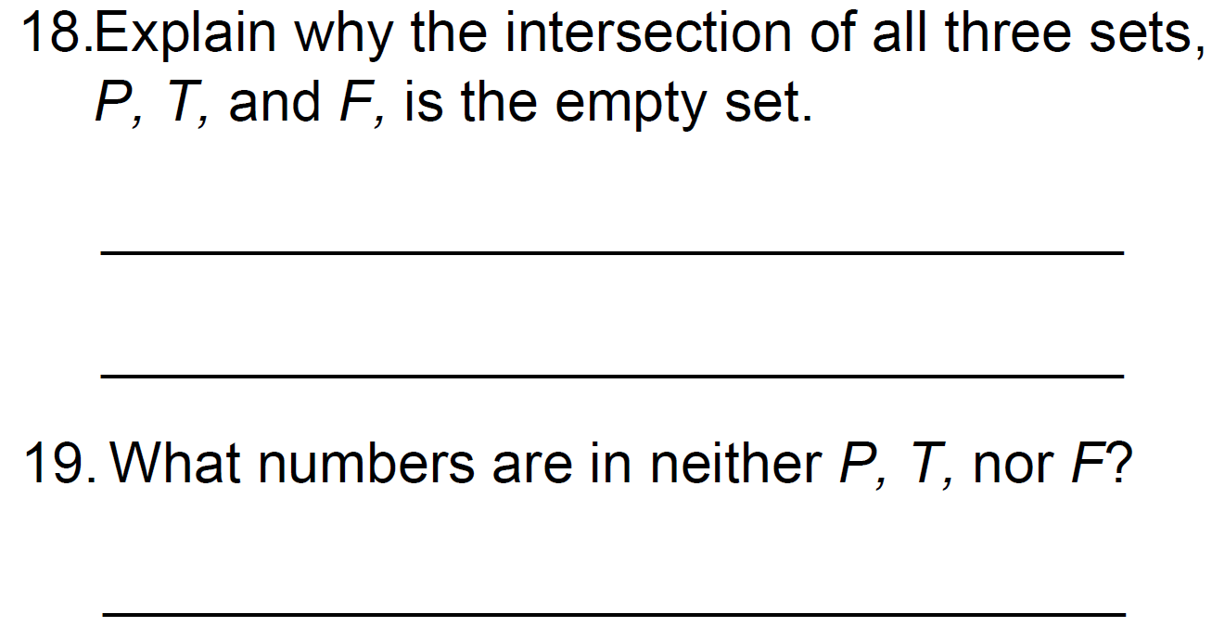
Homework and Practice
10. Use the sets below to create Venn Diagram to the right:
GUIDED PRACTICE
Remember the Concept
Venn Diagrams: Shows logical relations between a collection of sets. Intersection: A ∩ B Each element is in both set A and set B. Find where the sets overlap. Union: A ∪ B All elements in set A or set B. Join together all of the elements in both sets.

Slide 5
What did you learn about how to describe subsets, unions, intersections, and complements of probability?
Word Bank
Element
Universal Set
Complement
Subset
Intersection
Union
Theoretical Probability
SUMMARY CLOSURE
Today, I learned how to _________________________________________________________________________________.

