Slide 1
ACT RESPONSIBLY & SUPPORT the COMMUNITY.
Be on Time
Wear ID
Chromebook Ready
SEE SOMETHING, SAY SOMETHING

Slide 2
We will determine how to describe subsets, unions, intersections, and complements of probability₁.
LEARNING OBJECTIVE
Declare the Objective
Read the objective to your partner.
Definition
¹ the extent to which an event is likely to occur,

Slide 3
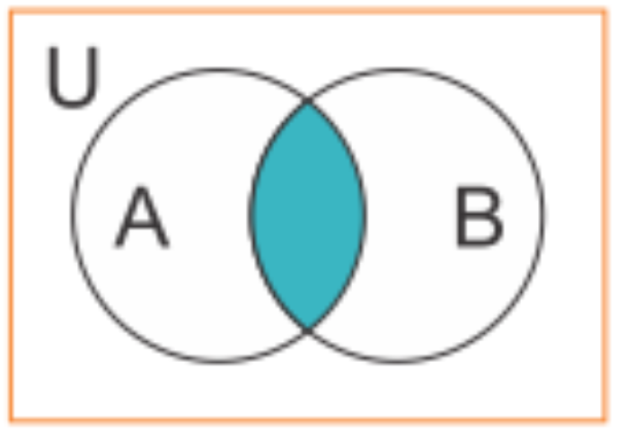
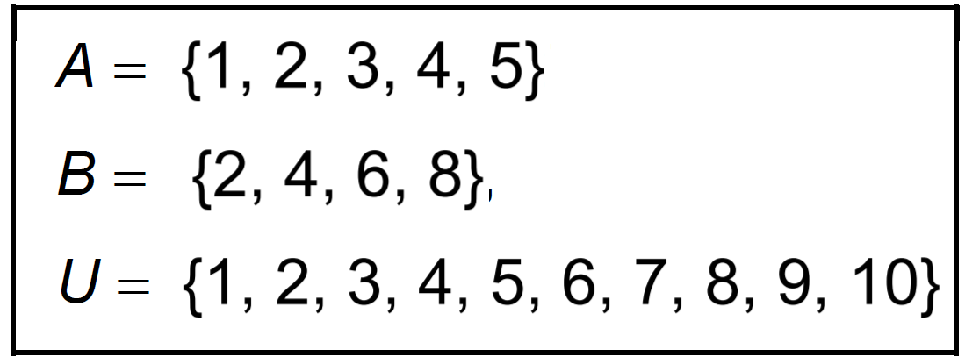
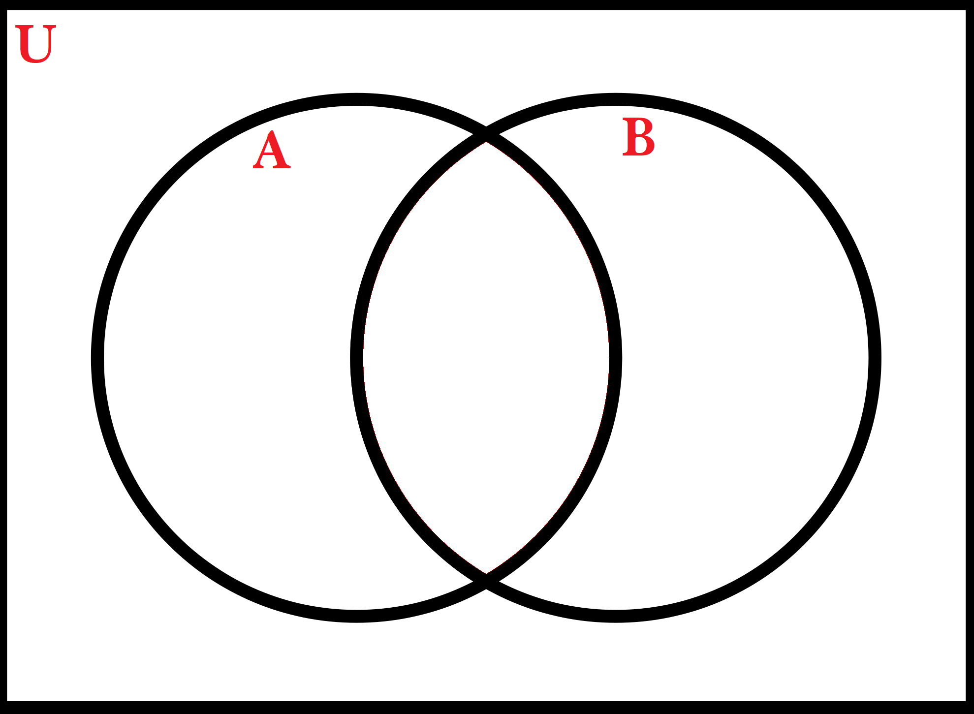
1. Write each statement in set notation. Use the descriptions of the sets to the right to complete each statement.
Draw a Venn Diagram to Organize the Sets
A ⋂ B = { }
A ∪ B = { }
2. Write each statement in set notation. Use the descriptions of the sets to the right to complete each statement.
Draw a Venn Diagram to Organize the Sets
A ⋂ B = { }
A ∪ B = { }
Remember the Concept
Venn Diagrams: Shows logical relations between a collection of sets. Intersection: A ∩ B Each element is in both set A and set B. Find where the sets overlap. Union: A ∪ B All elements in set A or set B. Join together all of the elements in both sets.
ACTIVATE PRIOR KNOWLEDGE
7, 9, 10
1, 3, 5
2,
4
6, 8
Make the Connection
Students you already know what is a set and subset. Now we are going to use that information to find probabilities.
2, 4
1, 2, 3, 4, 5, 6, 8
Note: Venn diagram can make it easier to identify the sets.

Slide 4
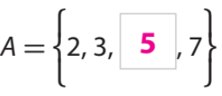
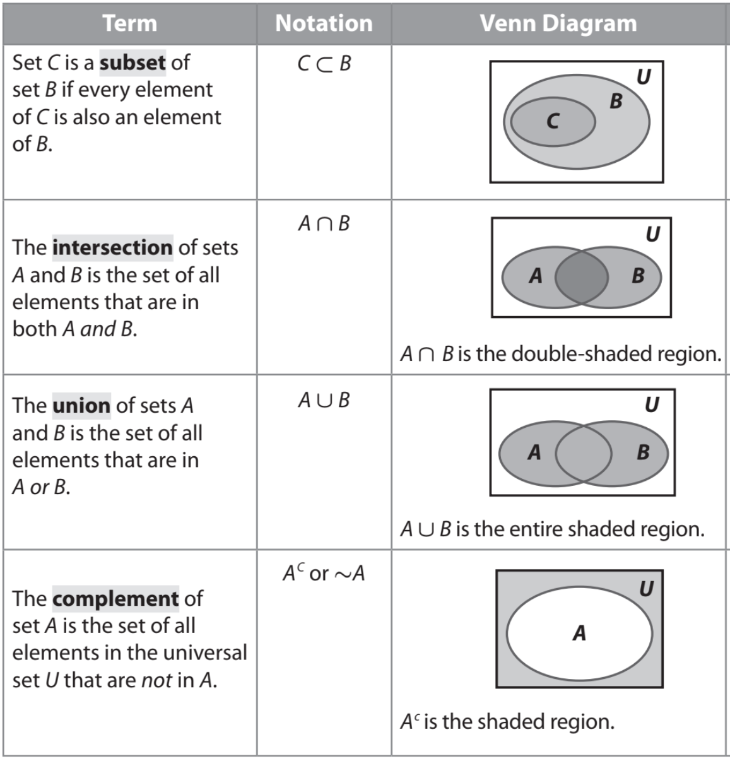
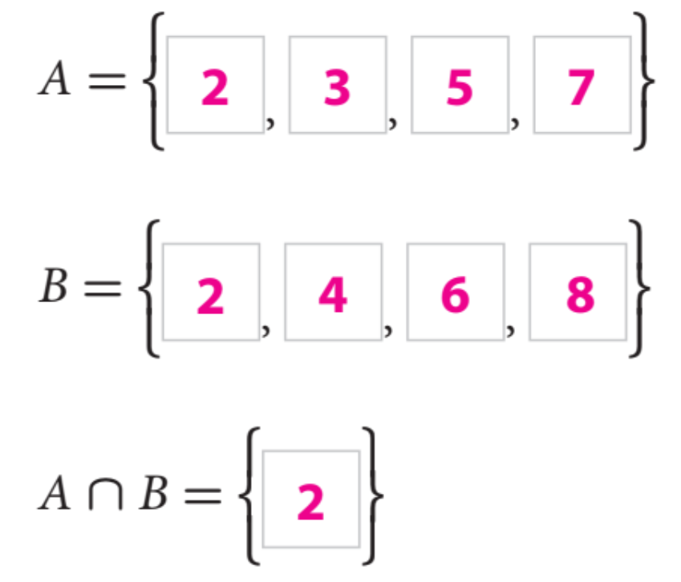
A set is a collection of distinct objects. Each object in a set is called an element of the set.
A set is often denoted by writing the elements in braces.
The set with no elements is the empty set, denoted by ⌀ or { }.
The set of all elements under is the universal set, denoted by U.
Identifying the number of elements in a set is important for calculating probabilities.
Partner-A: Explain what is a set, element, and empty set?
Partner-B: Explain what is universal set and why identify element in a set?
CFU: Pair-Share
Partner-A: Explain what is a subset and intersection?
Partner-B: Explain what is union and complement?
CFU: Pair-Share
Name the type of set and find the element(s)?
CFU: Whiteboard

Slide 5
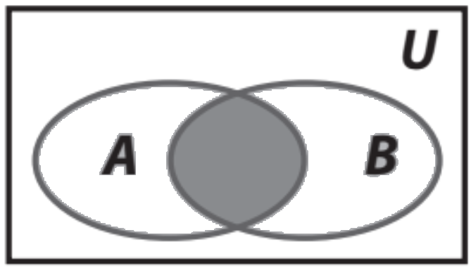
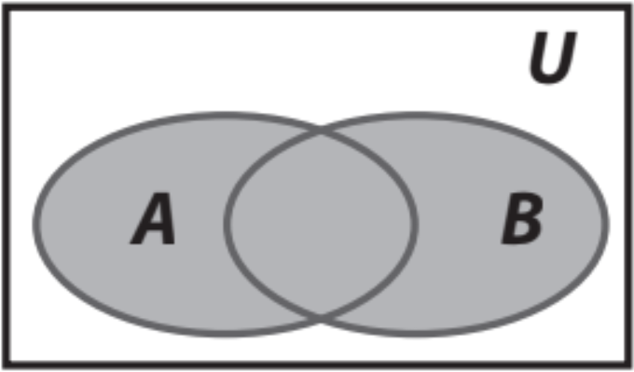
Working with Sets:
U = {1, 2, 3, 4, 5, 6, 7, 8, 9, 10, 11, 12}
A = {1, 2, 3, 4, 6, 12} B = {2, 4, 6, 8, 10, 12}
C = {1, 3, 5, 7, 9, 11} D = {2, 4, 6}
Steps to find sets
1 Identify the definition of the notation.
CFU How did I/you identify the definition of the notation?
2 Apply the definition by drawing a Venn Diagram.
CFU How did I/you apply the definitions by drawing a Venn Diagram?
3 Find the elements, write it on set notation.
CFU How did I/you find the elements in set notation?
Answer each question (WB).
What is A ⋂ B ?
What is A ⋃ B ?
What is A ⋃ C ?
What is A ⋂ D ?
What is B ⋂ C ?
SKILL DEVELOPMENT
Remember the Concept
Intersection: A ∩ B Each element is in both set A and set B. Find where the sets overlap. Union: A ∪ B All elements in set A or set B. Join together all of the elements in both sets.

Slide 6
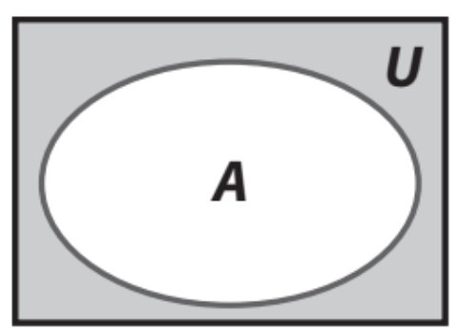
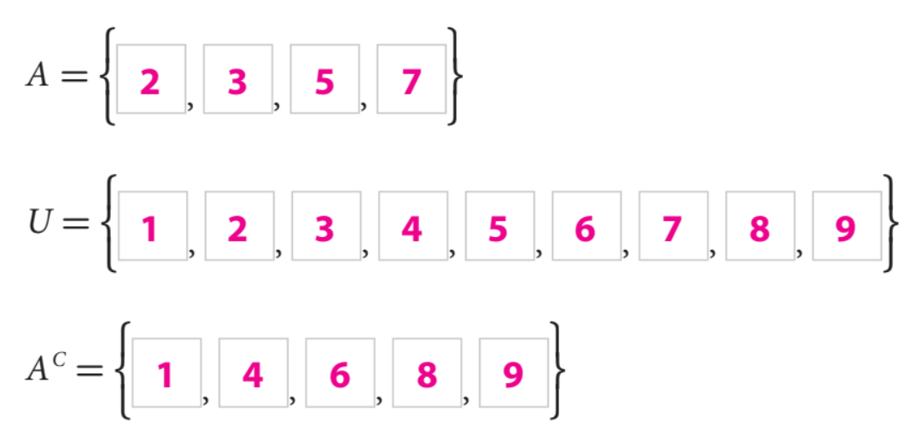
The complement (A’ or ) of a set of A refers to elements not in A.
(Opposite)
SKILL DEVELOPMENT
Find the complement of A:
CFU: Whiteboard
To determine the complement of set A, first identify the elements of set A and universal
set U separately, then identify all the elements in the universal set that are not in set A.

Slide 7
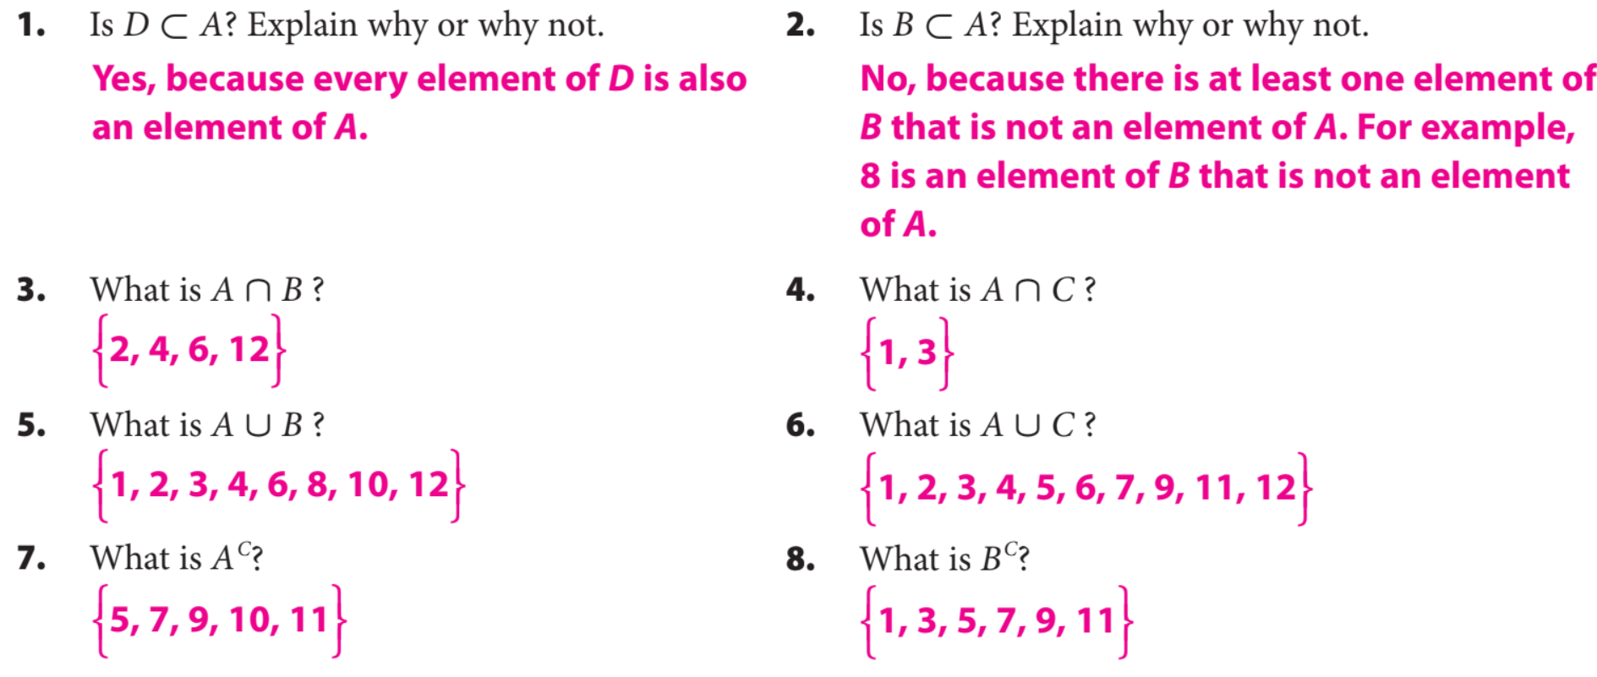
Homework and Practice
GUIDED PRACTICE

Slide 8
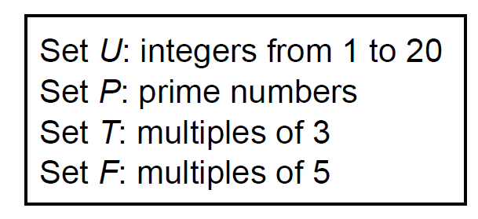
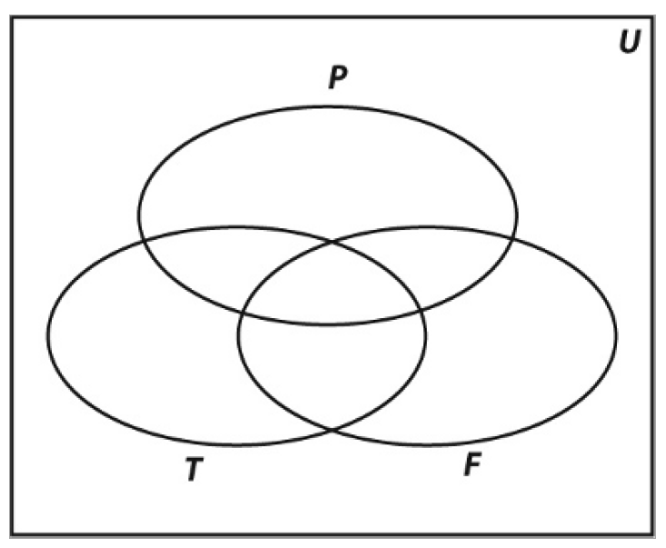
Homework and Practice
10. Use the sets below to create Venn Diagram to the right:
GUIDED PRACTICE

Slide 9
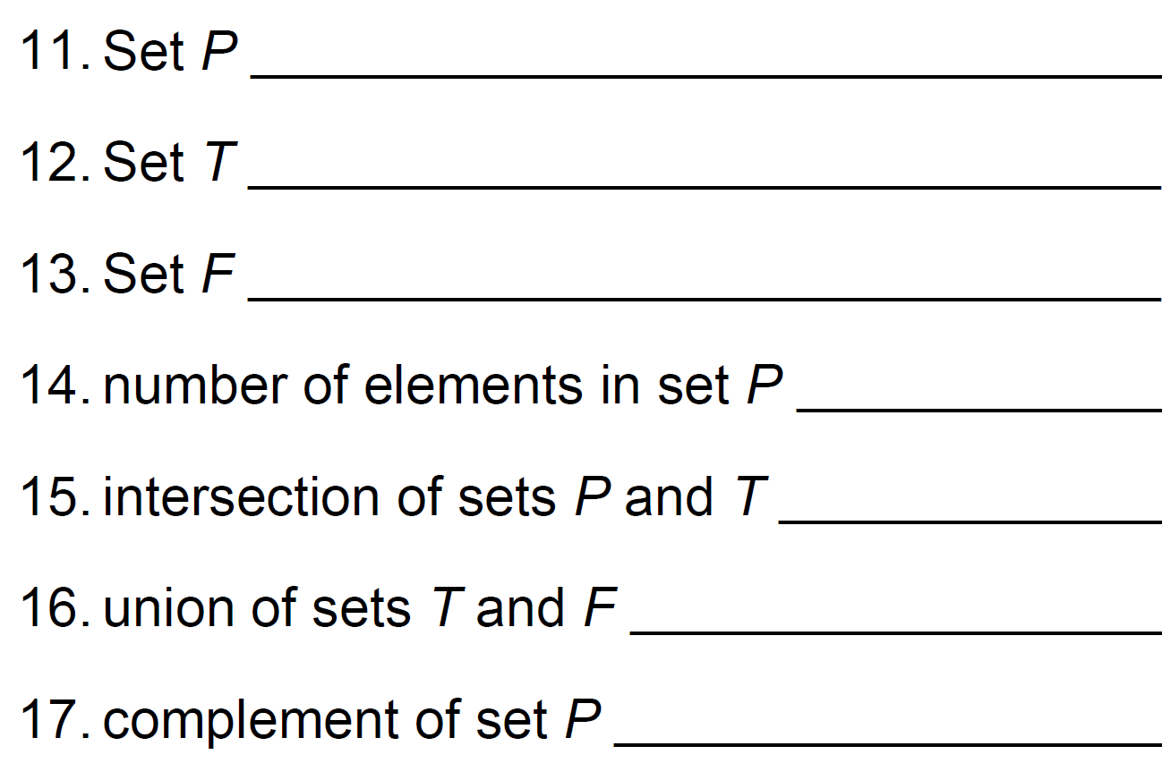
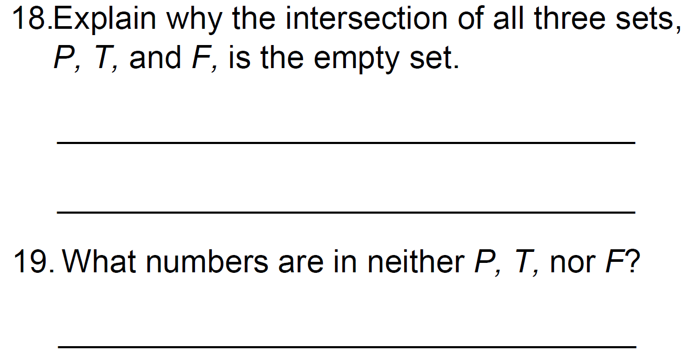
Remember the Concept
Venn Diagrams: Shows logical relations between a collection of sets. Intersection: A ∩ B Each element is in both set A and set B. Find where the sets overlap. Union: A ∪ B All elements in set A or set B. Join together all of the elements in both sets.

Slide 10
Word Bank
What did you learn about how to describe subsets, unions, intersections, and complements of probability?
Element
Universal Set
Complement
Subset
Intersection
Union
Theoretical Probability
SUMMARY CLOSURE
Today, I learned how to _________________________________________________________________________________.

