Slide 1
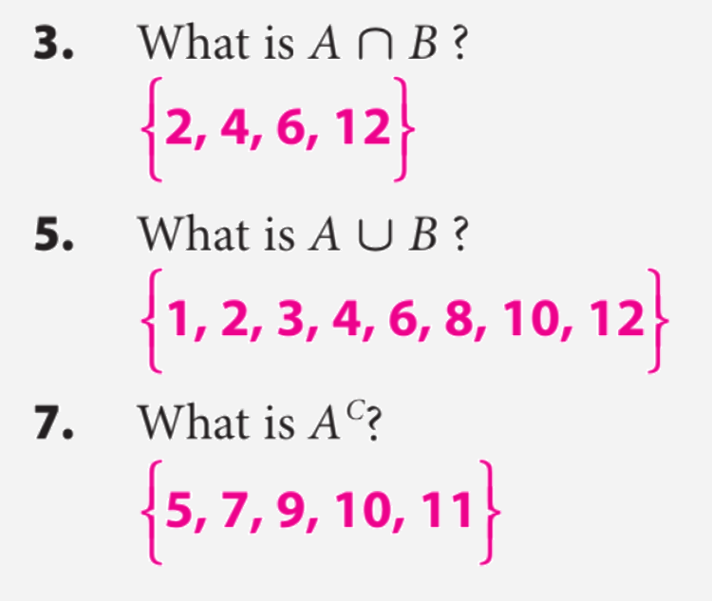
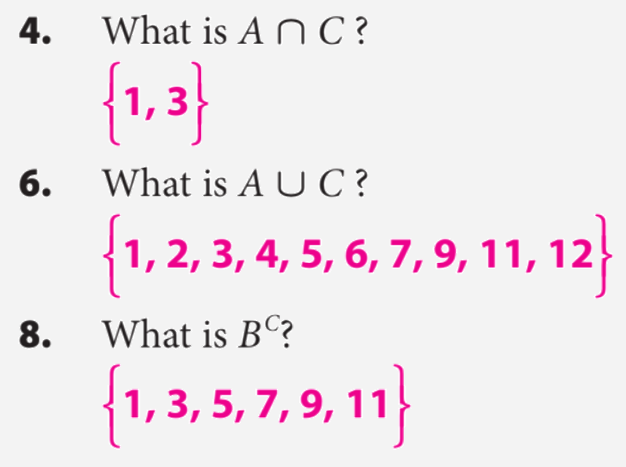
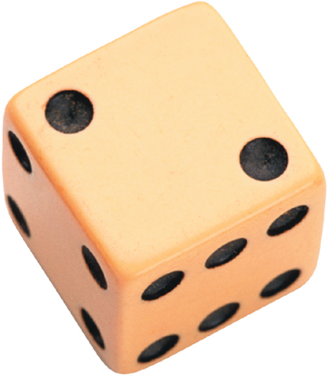
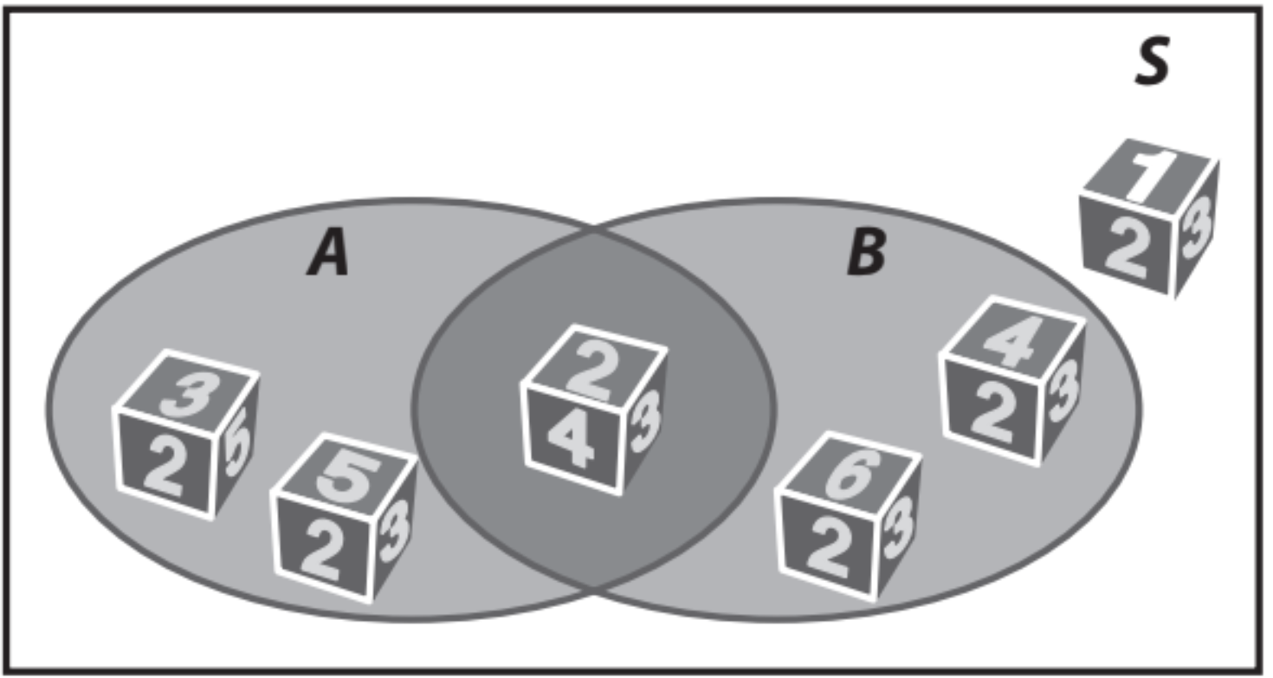
Lesson-1: 22.1 Theoretical Probability.
Name:_______________________
Period:____
Remember the Concept
Intersection: A ∩ B Each element is in both set A and set B. Find where the sets overlap. Union: A ∪ B All elements in set A or set B. Join together all of the elements in both sets.
ACTIVATE PRIOR KNOWLEDGE
Make the Connection
Students you already know how to find unions, intersections, and complements of probability. Today we are going to use that information to find probabilities.
A ______________________ is an activity involving chance. Each repetition of the experiment is called a ________ and each possible result of the experiment is termed an __________. A set of outcomes is known as an __________, and the set of all possible outcomes is called the _____________.
Experiment Sample Space
Toss coin {head, tail}
Roll a die {1, 2, 3, 4, 5, 6}
“Possible outcomes
or Events”
“probability”
When all the outcomes of a probability experiment are equally likely, the theoretical probability of an event A in the sample space S is given by
CONCEPT DEVELOPMENT
Calculating theoretical probability
P(A):
P(A ⋃ B):
P(A ⋂ B):
P($A^{C}$):
Probability of getting an element in space _____.
Probability of getting an element in space _________.
Probability of getting an element in space __________.
Probability of getting an element ________ in space A .

Slide 2
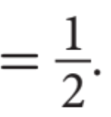
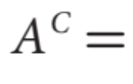
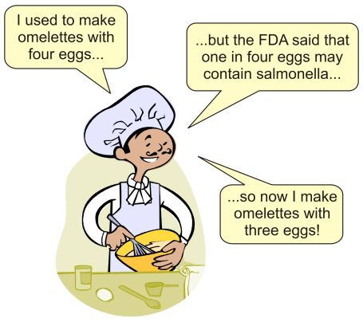
You roll a number cube.
Event A is rolling a prime number.
Event B is rolling an even number.

Slide 3
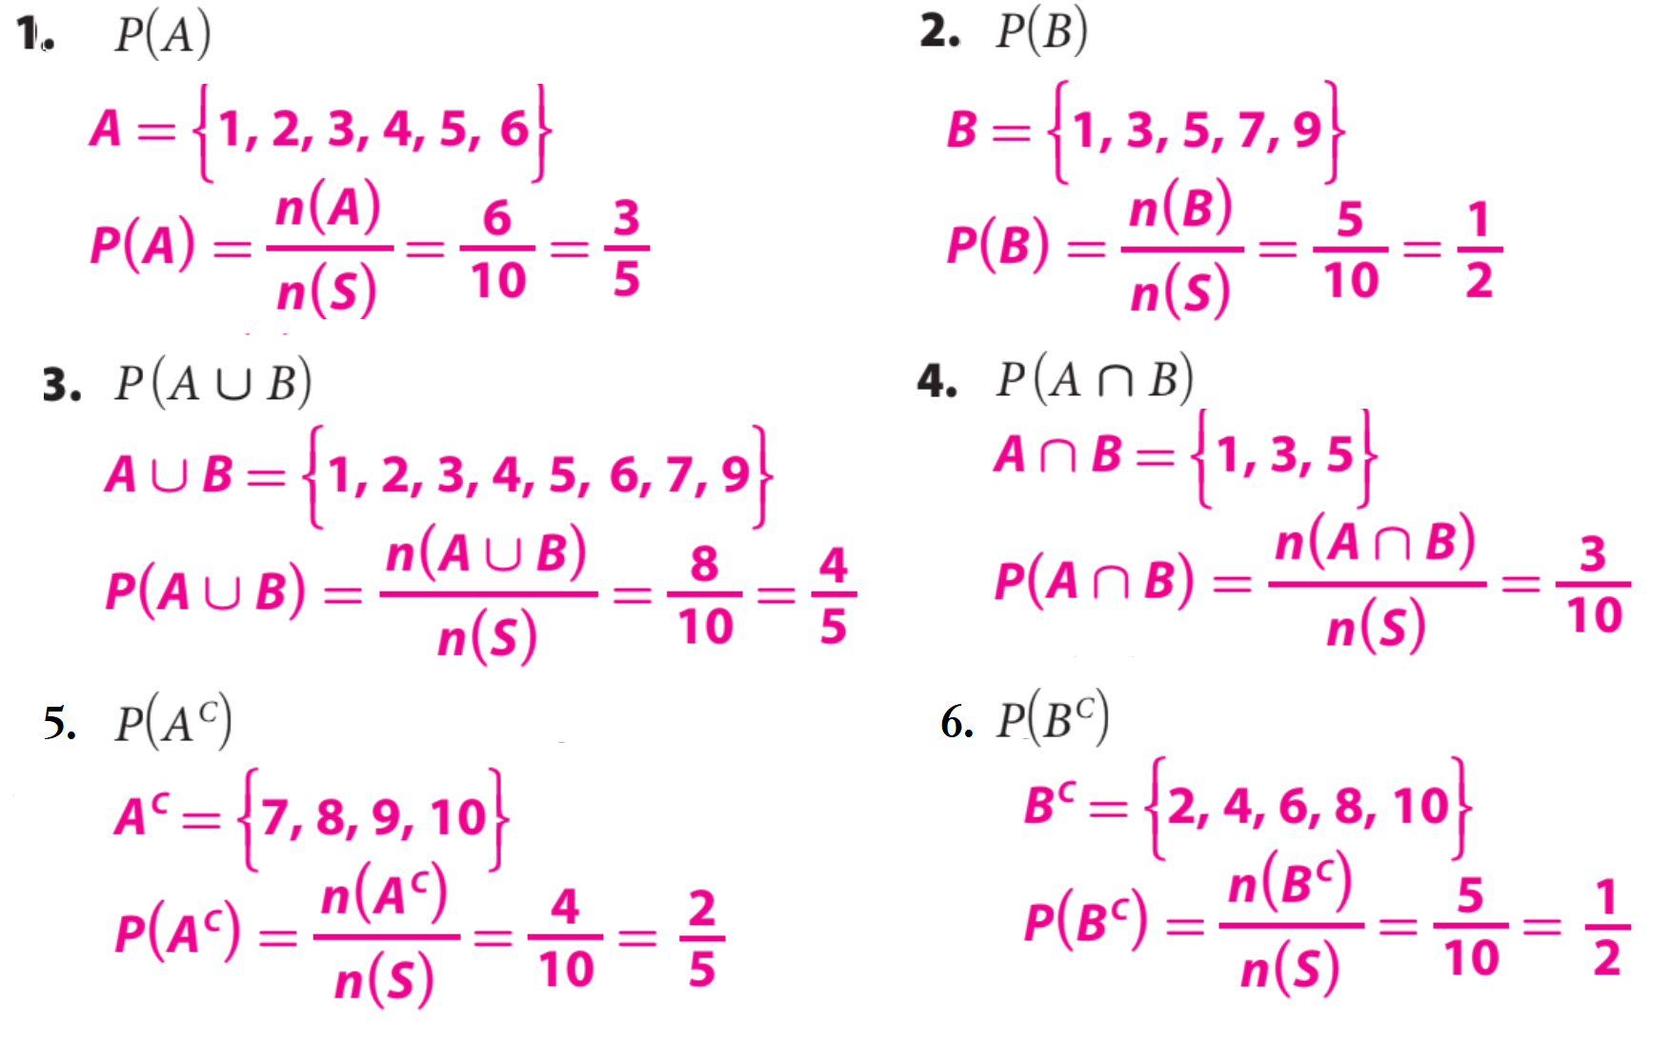
Steps | How to find the probability:
1 | List the Sample Space.
CFU | How did I/you determine List the Sample Space?
2 | Count the number of favorable outcomes.
CFU | How did I/you determine number of favorable outcomes?
3 | Count the total number of elements.
CFU | How did I/you determine the total number of elements?
4 | Divide the possible outcome by total elements.
CFU | How did I/you determine probability?
HW Practice
You have a set of 10 cards numbered 1 to 10. You choose a card at random.
Event A is choosing a number less than 7.
Event B is choosing an odd number. Calculate the probability:

Slide 4
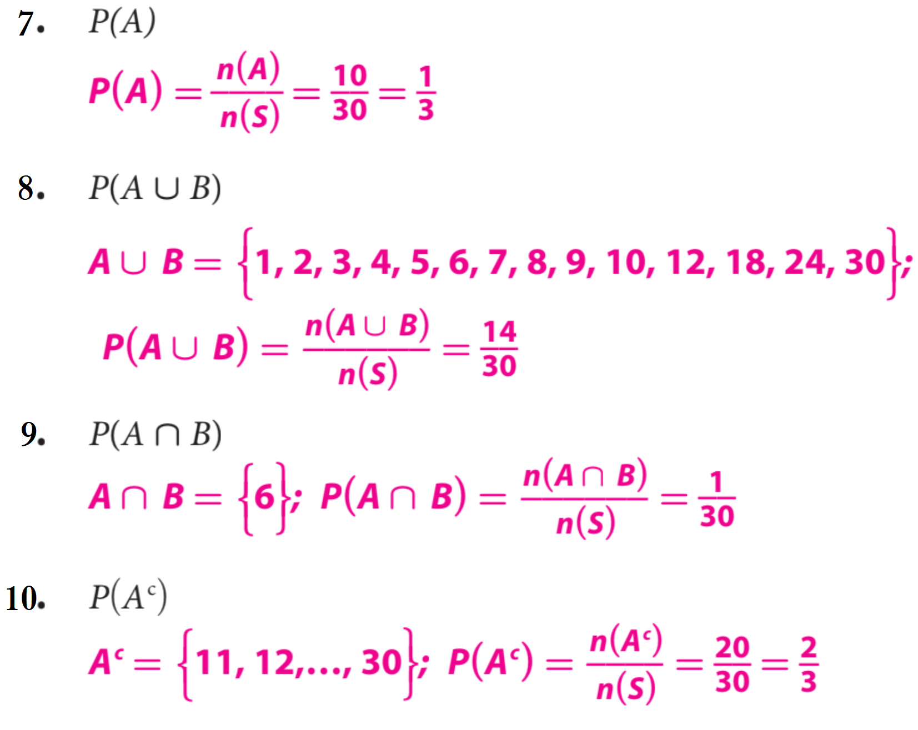
The numbers 1 through 30 are written on slips of paper that are then placed in a hat.
Students draw a slip to determine the order in which they will give an oral report.
Event A is being one of the first 10 students to give their report.
Event B is picking a multiple of 6. Calculate each of the indicated probabilities:
Word Bank
What did you learn about how to calculate the Theoretical Probability.
Element
Universal Set
Complement
Subset
Intersection
Union
Theoretical Probability
SUMMARY CLOSURE
Today, I learned how to _________________________________________________________________________________________________________________.

