Slide 1
ACT RESPONSIBLY & SUPPORT the COMMUNITY.
Be on Time
Wear ID
Chromebook Ready
SEE SOMETHING, SAY SOMETHING

Slide 2
We will determine how to calculate the Theoretical Probability₁.
LEARNING OBJECTIVE
Declare the Objective
Read the objective to your partner.
Definition
¹ The extent to which an event is likely to occur.

Slide 3
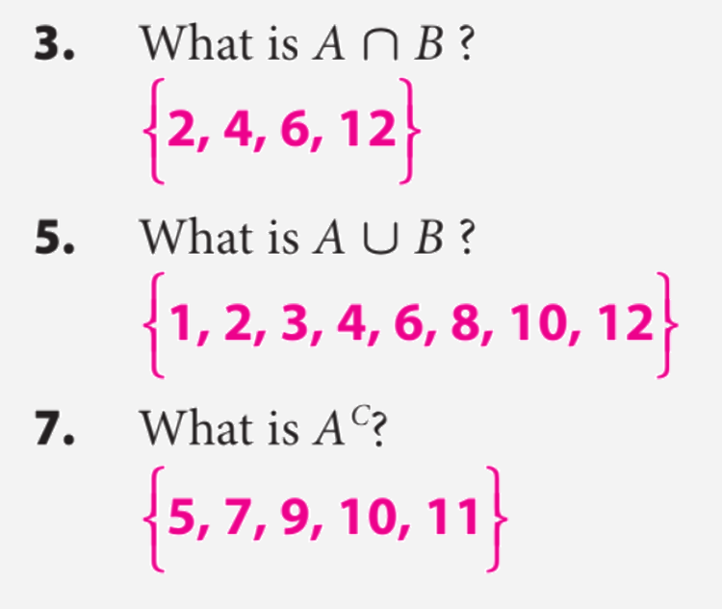
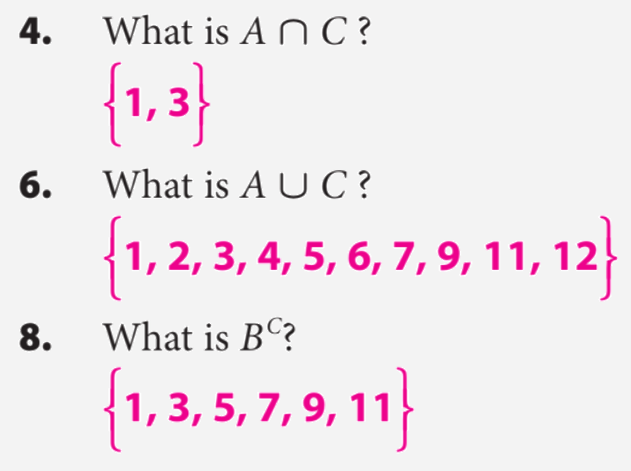
Remember the Concept
Intersection: A ∩ B Each element is in both set A and set B. Find where the sets overlap. Union: A ∪ B All elements in set A or set B. Join together all of the elements in both sets. Complement: $A^{C}$of a set A refers to all elements in the given universal set U that are not in A.
ACTIVATE PRIOR KNOWLEDGE
Make the Connection
Students you already know how to find unions, intersections, and complements of probability. Today we are going to use that information to find probabilities.

Slide 4
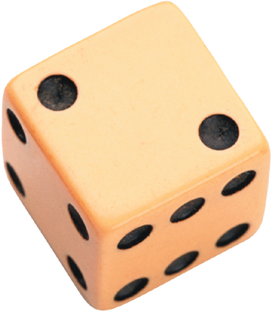
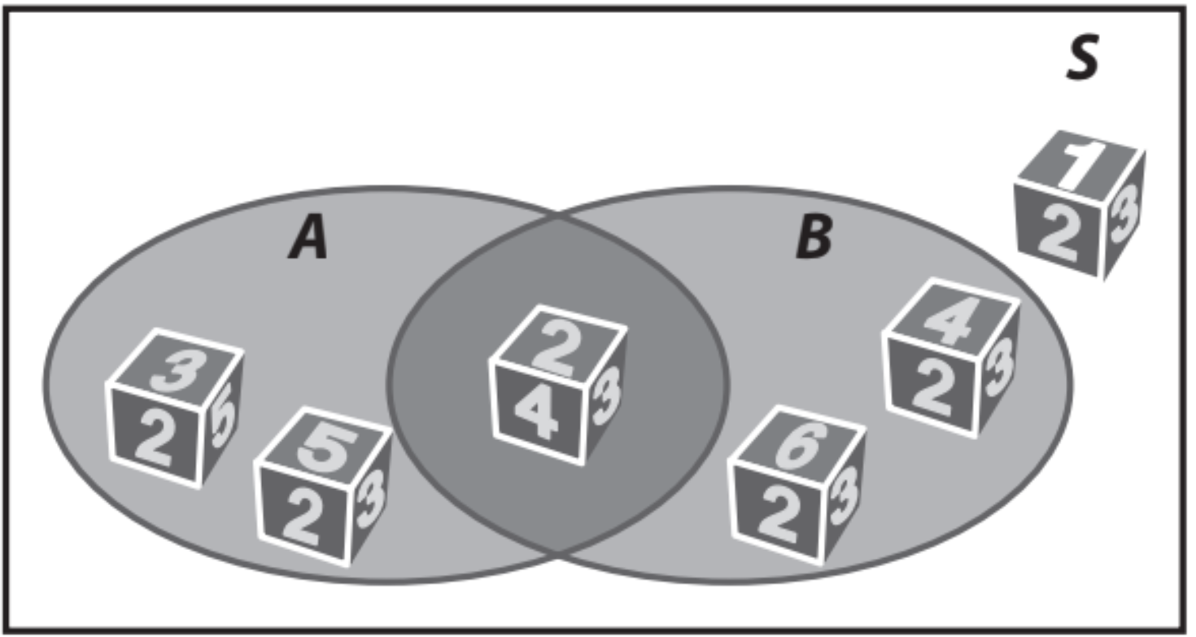
A probability experiment is an activity involving chance. Each repetition of the experiment
is called a trial and each possible result of the experiment is termed an outcome. A set of
outcomes is known as an event, and the set of all possible outcomes is called the sample space.
Experiment Sample Space
Toss coin {head, tail}
Roll a die {1, 2, 3, 4, 5, 6}
“Possible outcomes
or Events”
“probability”
When all the outcomes of a probability experiment are equally likely, the theoretical probability of an event A in the sample space S is given by
CONCEPT DEVELOPMENT
CONCEPT DEVELOPMENT
Partner-A: Explain what is a Experiment and Sample Space?
Partner-B: Explain what is Outcome and Theoretical Probability?
CFU: Pair-Share
Calculating theoretical probability
P(A):
P(A ⋃ B):
P(A ⋂ B):
P($A^{C}$):
Probability of getting an element in space A.
Probability of getting an element in space A or B.
Probability of getting an element in space A and B.
Probability of getting an element not in space A .

Slide 5
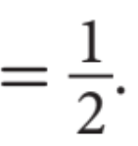
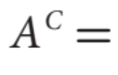
You roll a number cube.
Event A is rolling a prime number.
Event B is rolling an even number.
Partner-A: Explain how to calculate P(A) and P(A ⋃ B)?
Partner-B: Explain how to calculate P(A ⋂ B) and P($A^{C}$)?
CFU: Pair-Share
Steps | How to find the probability:
1 | List the Sample Space.
CFU | How did I/you determine List the Sample Space?
2 | Count the number of favorable outcomes.
CFU | How did I/you determine number of favorable outcomes?
3 | Count the total number of elements.
CFU | How did I/you determine the total number of elements?
4 | Divide the possible outcome by total elements.
CFU | How did I/you determine probability?

Slide 6
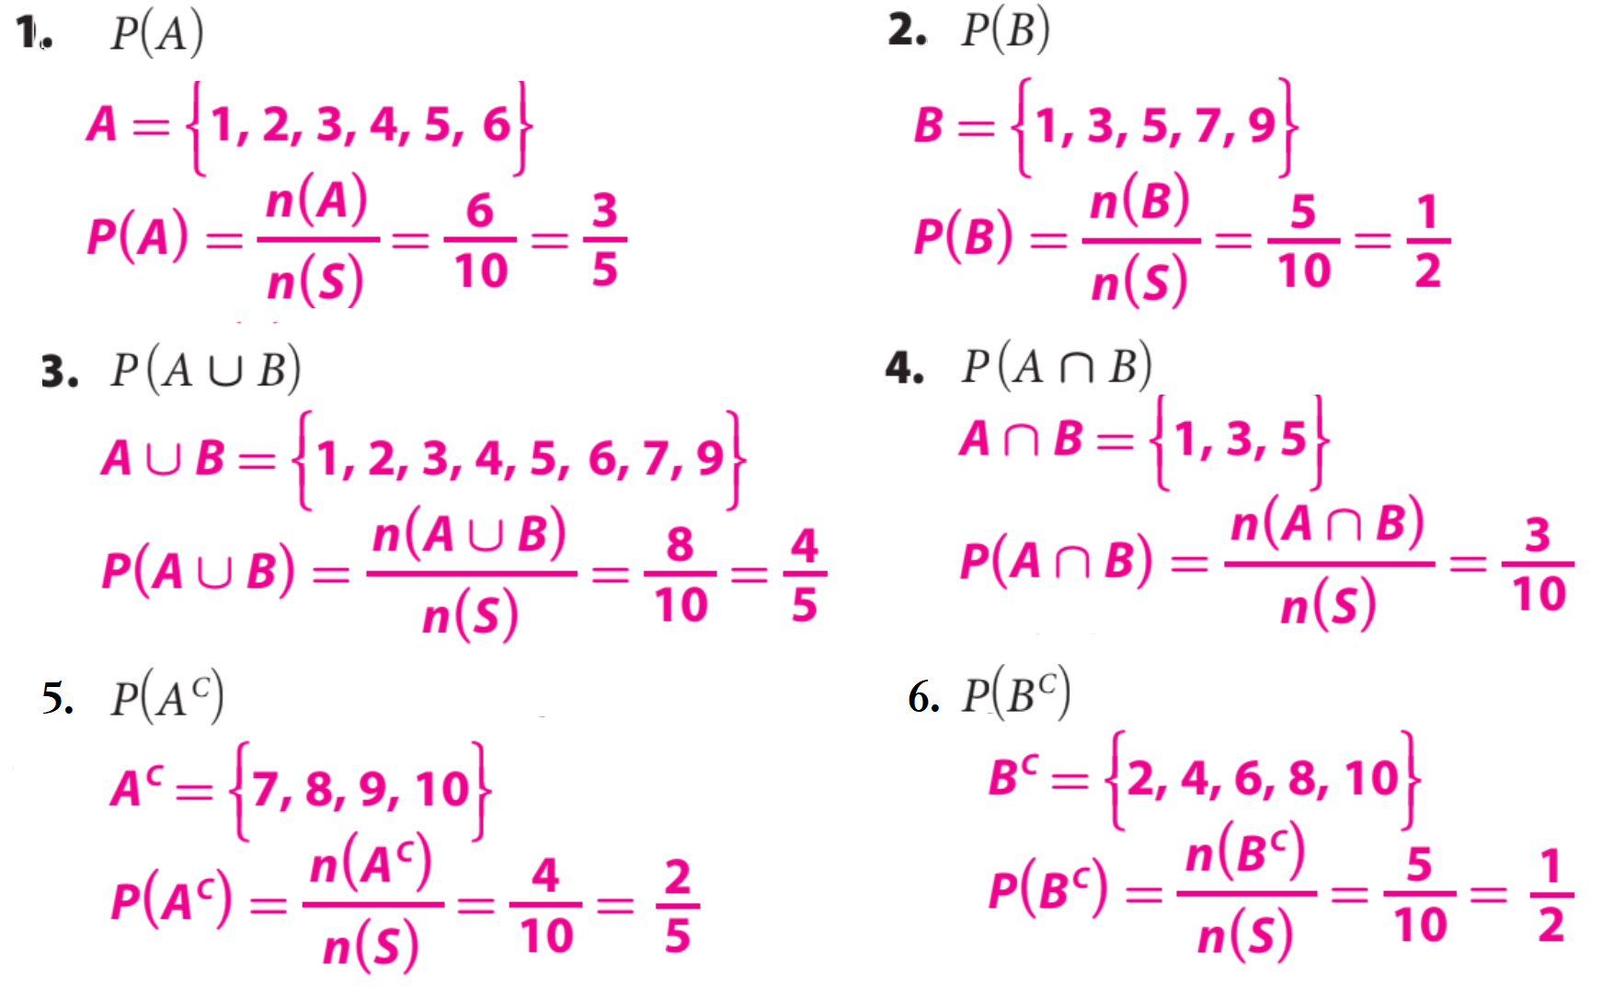
You have a set of 10 cards numbered 1 to 10. You choose a card at random.
Event A is choosing a number less than 7.
Event B is choosing an odd number. Calculate the probability:
HW Practice

Slide 7
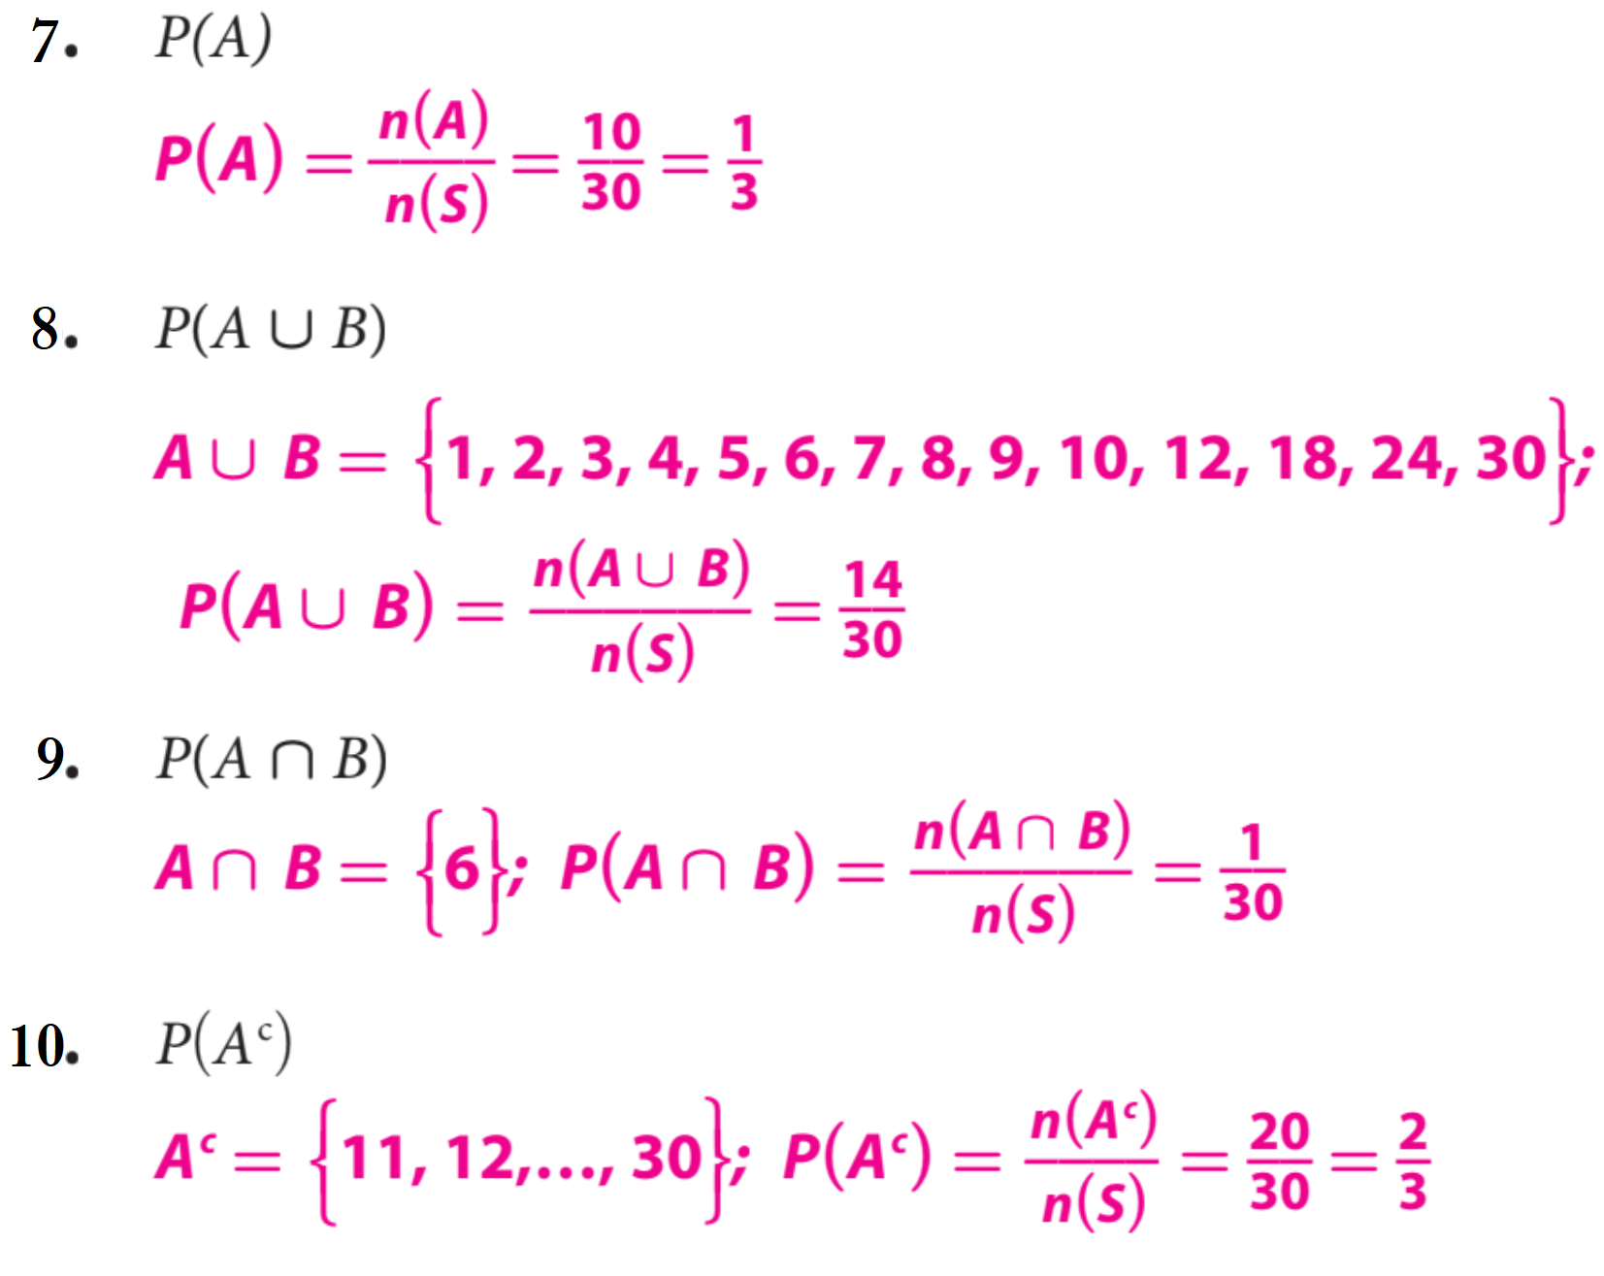
The numbers 1 through 30 are written on slips of paper that are then placed in a hat.
Students draw a slip to determine the order in which they will give an oral report.
Event A is being one of the first 10 students to give their report.
Event B is picking a multiple of 6. Calculate each of the indicated probabilities:
HW Practice

Slide 8
Word Bank
Element
Universal Set
Complement
Subset
Intersection
Union
Theoretical Probability
What did you learn about how to calculate the Theoretical Probability.
SUMMARY CLOSURE
Today, I learned how to _________________________________________________________________________________.

