Slide 1
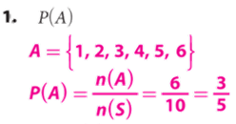
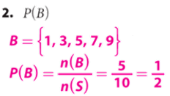
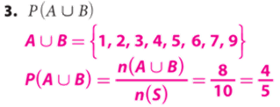
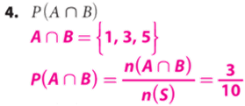
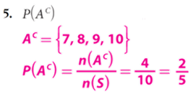
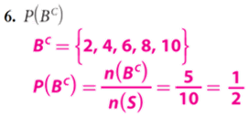
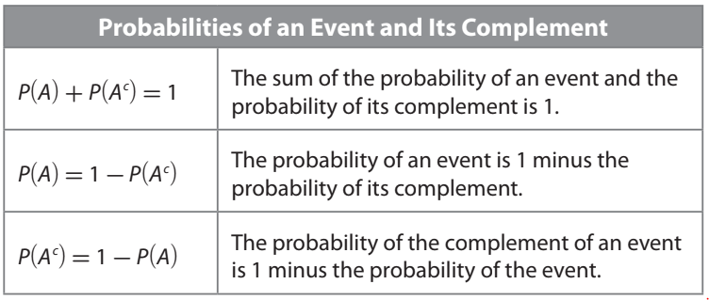
Lesson-1: 22.1 Using the Complement of an Event.
Name:_______________________
Period:____
You have a set of 10 cards numbered 1 to 10. You choose a card at random.
Event A is choosing a number less than 7.
Event B is choosing an odd number. Calculate the probability:
Remember the Concept
P(A) refers to the probability that event A will occur. Intersection (AND): A ∩ B Each element is in both set A and set B. Find where the sets overlap. Union (OR): A ∪ B All elements in set A or set B. Join together all of the elements in both sets. Complement(NOT): $A^{C}$of a set A refers to all elements in the given universal set U that are not in A.
ACTIVATE PRIOR KNOWLEDGE
Make the Connection
Students you already know how to find unions, intersections, and complements of probability. Today, we are going to use the complement of an event to calculate the Theoretical Probability.
The probability of an event and the probability of the event __-_______ (i.e., the probability of the complement of the event) have a __________This relationship can be useful when it is more convenient to calculate the probability of the complement of an event than it is to calculate the probability of the event.
“probability”

Slide 2
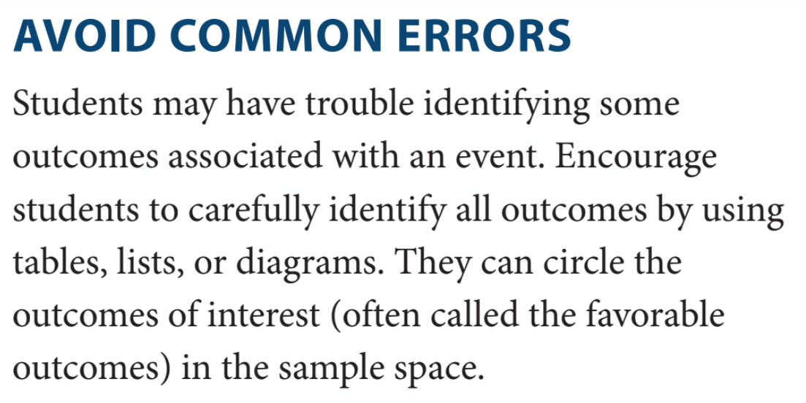
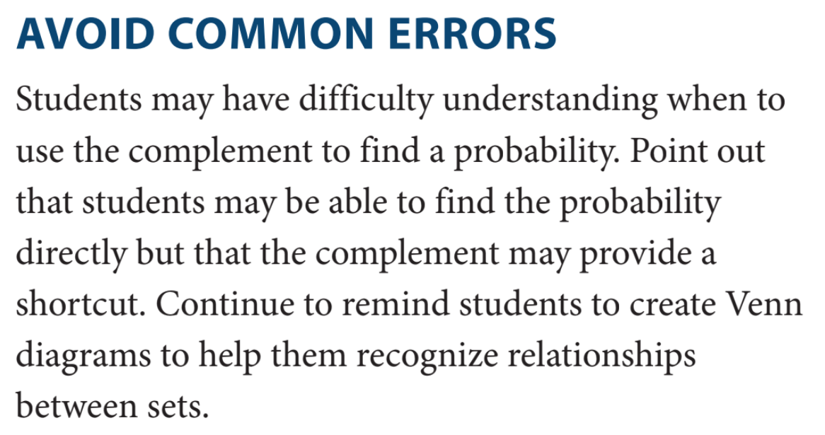
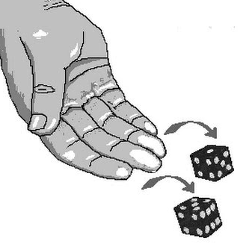
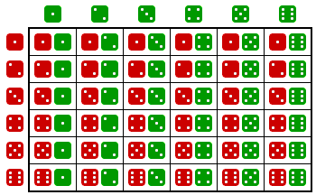
Remember: To calculate the probability of an event, you need to know the number of _____ in the set of outcomes for that event, as well as the number of items in the set of _____ possible outcomes. The theoretical probability of the event is the ratio of the two numbers.
You roll a green number cube and a red number cube at the same time. What is the probability that you do not roll doubles?
Step 1. Define the events. Let A: be that you ____ roll doubles and
${ A}^{C}:$ that you do _____ roll doubles.
Step 2. Make a diagram. A two-way table is one helpful way to identify _____ the possible outcomes in the sample space.
CONCEPT DEVELOPMENT
CONCEPT DEVELOPMENT
Green number cube (Possibility)
Red number cube (Possibility)
Step 3. Determine P(A).
Step 4. Determine P($A^{C}$ ). Use the relationship between the probability of an event and its complement to determine P(A).

Slide 3
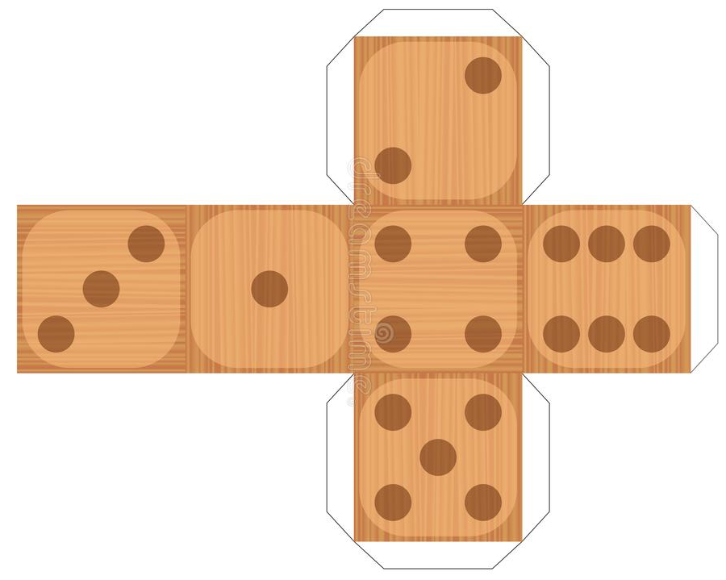
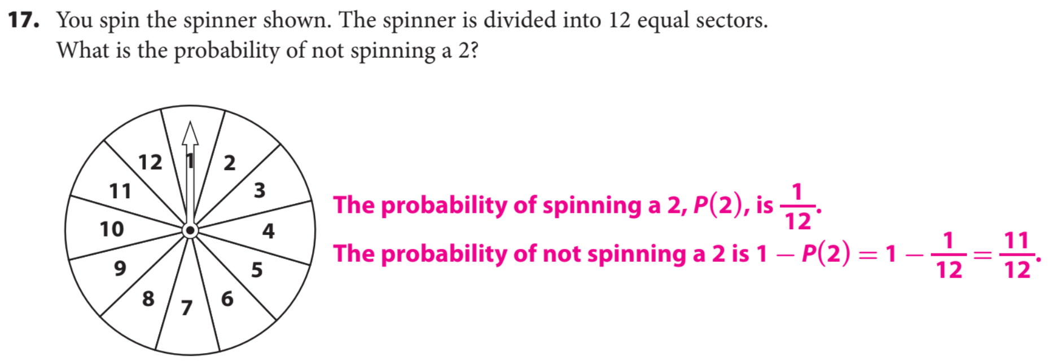
Steps | How to find the probability:
1 | List the Sample Space.
CFU | How did I/you determine List the Sample Space?
2 | Count the number of favorable outcomes.
CFU | How did I/you determine number of favorable outcomes?
3 | Count the total number of elements.
CFU | How did I/you determine the total number of elements?
4 | Divide the possible outcome by total elements.
CFU | How did I/you determine probability?
HW Practice
Guided/Independent practice

Slide 4
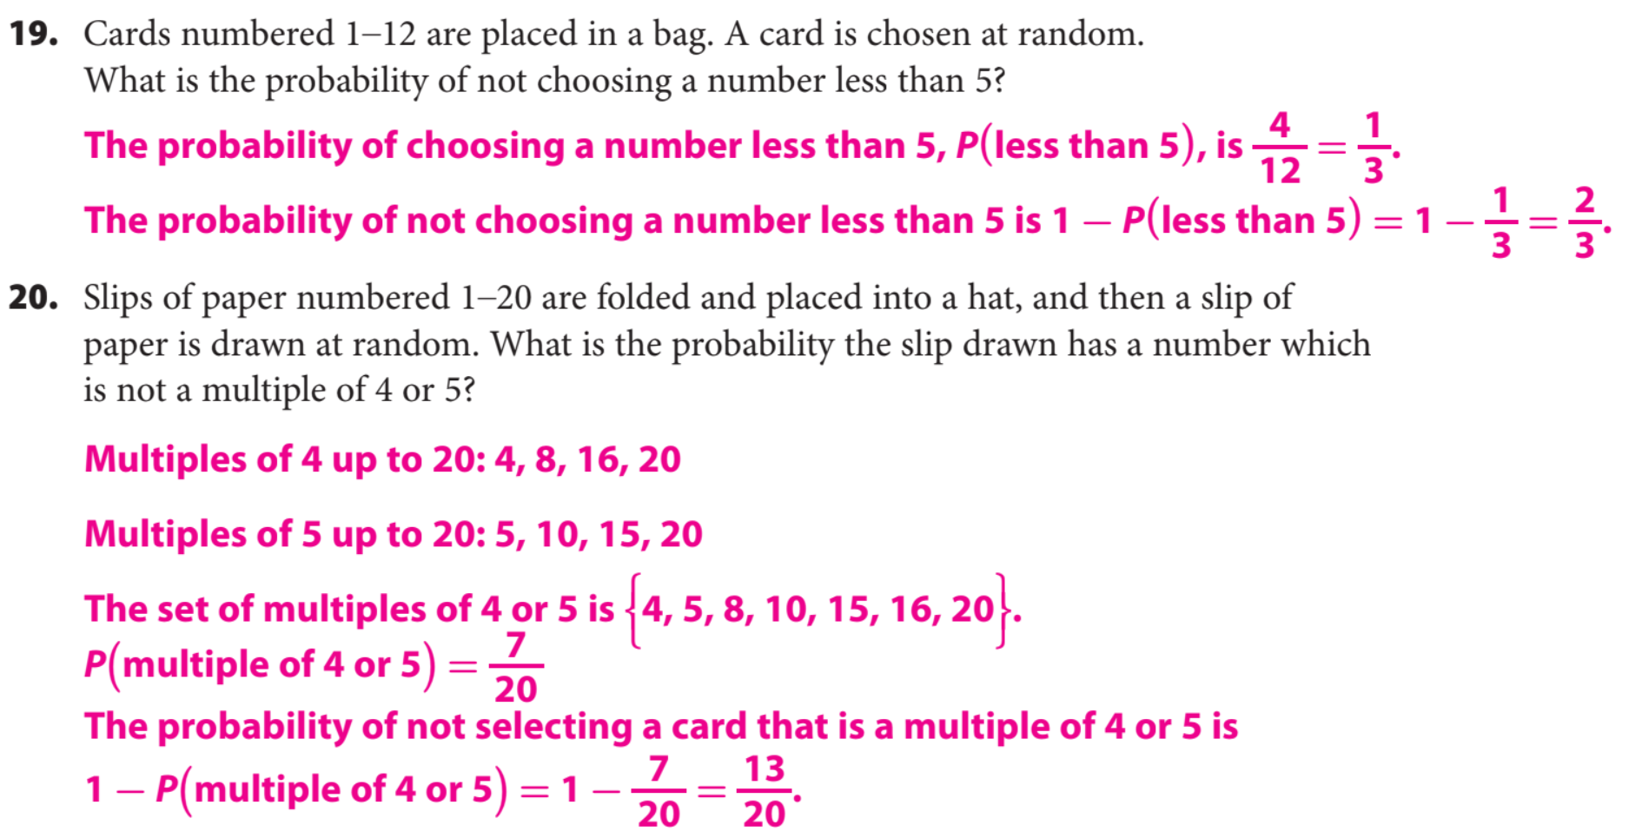
HW Practice
Guided/Independent practice
Word Bank
What did you learn about how to use the complement of an event to calculate the Theoretical Probability₁.
Element
Universal Set
Complement
Subset
Intersection
Union
Theoretical Probability
SUMMARY CLOSURE
Today, I learned how to _____________________________________________________________________________________________________________________.

