Slide 1
ACT RESPONSIBLY & SUPPORT the COMMUNITY.
Be on Time
Wear ID
Chromebook Ready
SEE SOMETHING, SAY SOMETHING

Slide 2
We will determine how to use the complement of an event to calculate the Theoretical Probability₁.
LEARNING OBJECTIVE
Declare the Objective
Read the objective to your partner.
Definition
¹ The extent to which an event is likely to occur.

Slide 3
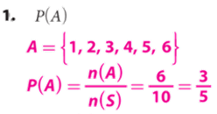
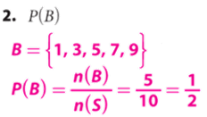
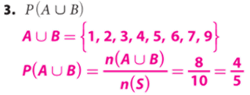
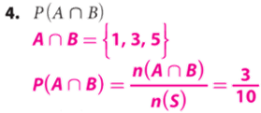
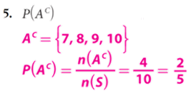
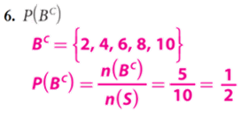
You have a set of 10 cards numbered 1 to 10. You choose a card at random.
Event A is choosing a number less than 7.
Event B is choosing an odd number. Calculate the probability:
Remember the Concept
P(A) refers to the probability that event A will occur. Intersection (AND): A ∩ B Each element is in both set A and set B. Find where the sets overlap. Union (OR): A ∪ B All elements in set A or set B. Join together all of the elements in both sets. Complement(NOT): $A^{C}$of a set A refers to all elements in the given universal set U that are not in A.
ACTIVATE PRIOR KNOWLEDGE
Make the Connection
Students you already know how to find unions, intersections, and complements of probability. Today, we are going to use the complement of an event to calculate the Theoretical Probability.

Slide 4
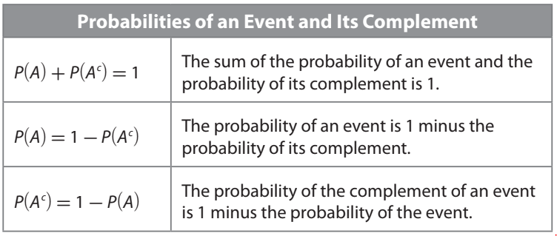
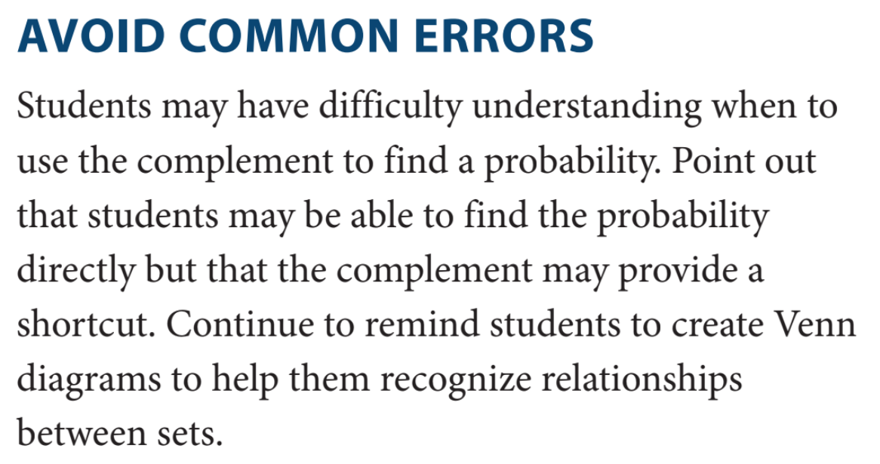
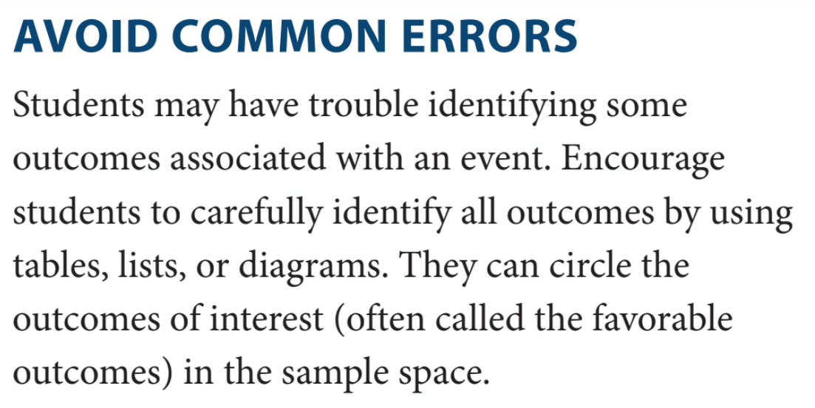
The probability of an event occurring and the probability of the event not occurring (i.e., the probability of the complement of the event) have a sum of 1. This relationship can be useful when it is more convenient to calculate the probability of the complement of an event than it is to calculate the probability of the event.
Partner-A: Explain what is Probabilities of an Event and Its Complement?
Partner-B: Why are there different equations that relate the probability of an event and its complement??
CFU: Pair-Share
“probability”
CONCEPT DEVELOPMENT
CONCEPT DEVELOPMENT
Remember: To calculate the probability of an event, you need to know the number of items in the set of outcomes for that event, as well as the number of items in the set of all possible outcomes. The theoretical probability of the event is the ratio of the two numbers.

Slide 5
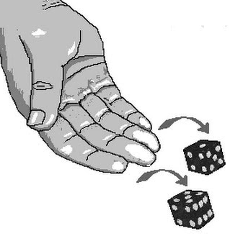
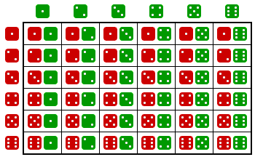
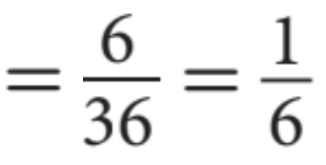
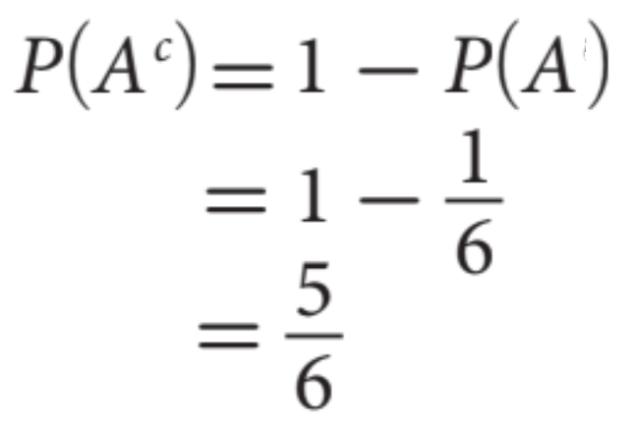
You roll a green number cube and a red number cube at the same time. What is the probability that you do not roll doubles?
Partner-A: Explain Steps 1 & 2?
Partner-B: Explain Steps 3 & 4?
CFU: Pair-Share
Step 1. Define the events. Let A be that you do roll doubles and $A^{C}$ that you do NOT roll doubles.
Step 2. Make a diagram. A two-way table is one helpful way to identify all the possible outcomes in the sample space.
Step 3. Determine P(A).
Green number cube (Possibility)
roll doubles
1
Steps | How to find the probability:
1 | List the Sample Space.
CFU | How did I/you determine List the Sample Space?
2 | Count the number of favorable outcomes.
CFU | How did I/you determine number of favorable outcomes?
3 | Count the total number of elements.
CFU | How did I/you determine the total number of elements?
4 | Divide the possible outcome by total elements.
CFU | How did I/you determine probability?
Step 4. Determine P($A^{C}$ ). Use the relationship between the probability of an event and its complement to determine P(A).
2
3
Red number cube (Possibility)
4
5
6

Slide 6
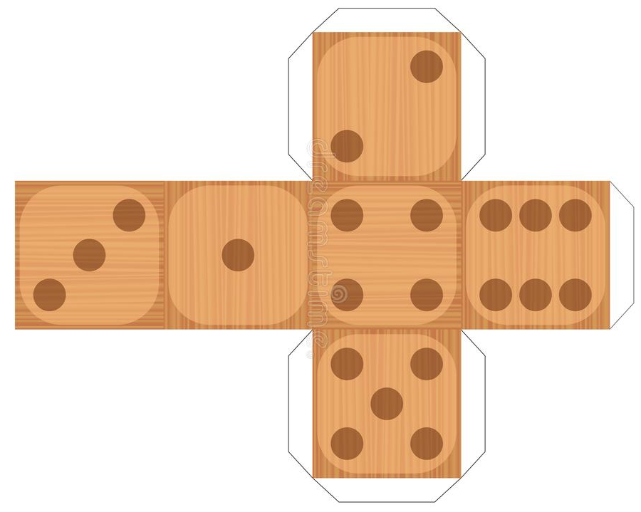
HW Practice

Slide 7
HW Practice

Slide 8
Word Bank
What did you learn about how to use the complement of an event to calculate the Theoretical Probability₁.
Element
Universal Set
Complement
Subset
Intersection
Union
Theoretical Probability
SUMMARY CLOSURE
Today, I learned how to _________________________________________________________________________________.

