Slide 1
Lesson_1_6.1_Find Solutions of equations in two variables
Name:__________________________
Period:______
A system of linear equations is a set₁ of linear equations with the same variables.
Check for Understanding
Select one or more below that are systems of linear equations. Explain. “…are systems of linear equations because…”
Not a system of linear equations
System of Linear Equations
y = 2q + 4
y = 3x + 2
A
2x $−$ 3y = -2
4x + y = 24
y = 2x + 4
y = 3x + 2
2z $−$ 4m = 2
z = -m +4
2y $−$ 4m = 2
x = -m +4
B
p + 2q = -1
2p + 5y = 0
A system of linear equations is a set of linear equations with the same variables.
A solution to a system of linear equations is an ordered pair (x, y) that satisfies₂ both equations.
C
m = 3a
a + 2m = 4
One Solution | Infinite Solutions | No Solution
The graphs intersect The solution (ordered-pair - x, y) satisfies both equations Different slopes and y-intercepts | The graphs are the same line All the solutions (ordered-pairs - x, y) satisfy both equations Same slope and y-intercept | The graphs are parallel lines No solution (ordered-pairs - x, y) satisfies both equations Same slope but different y-intercepts
Check for Understanding
Select one or more below that are NOT systems of linear equations. Explain. “…are NOT systems of linear equations because…”
A
2p $−$ 3q = -2
4p + q = 24
5
5
5
y = -3x - 5
4
4
4
p + 2q = -1
2p + 5q = 0
y = 2x
3
3
3
B
2
6x - 4y = 8
1
2
2
-5
-4
-3
-2
-1
1
2
3
4
5
-5
-4
-3
-2
-1
1
1
2
3
4
5
-5
-4
-3
-2
-1
1
1
2
3
4
5
(-1, -2)
-1
-1
(0, -2)
-1
-2
-2
2x + y = -3
2x + y = 1
y + x = 3a
y + 2x = 4
-3
3x - 2y = 4
-2
C
-4
-3
-3
-5
-4
-4
-5
-5
Check for Understanding
In your own words, what is a system of linear equations? “A system of linear equations is_____________________________________________________ ___________________________________________________________________________________.
Check for Understanding
In your own words, what are the three types of solutions to system of equations? “A solution to a system of linear equations can be _________________________________ _________________________________________________________________________________.
Definition
¹ collection ² makes true
Notes:
https://www.desmos.com/calculator

Slide 2
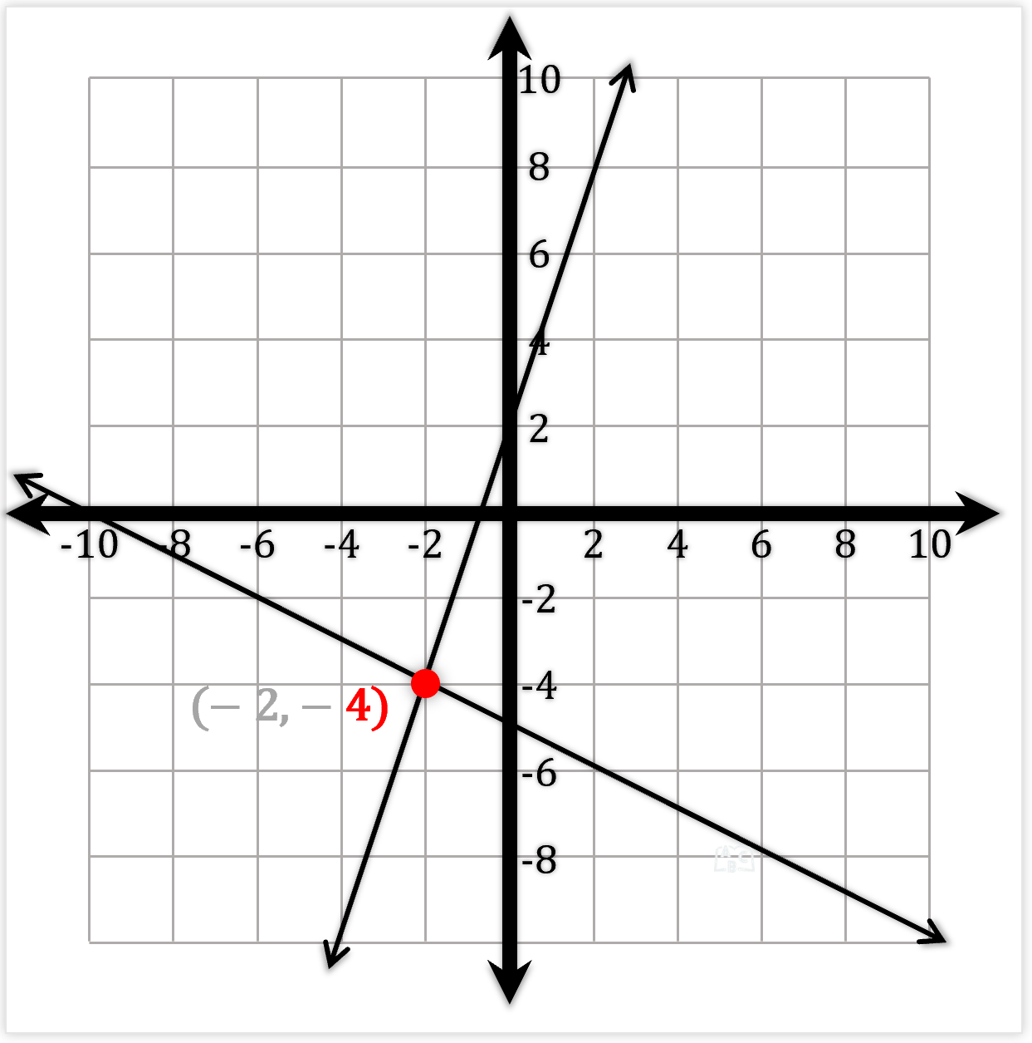
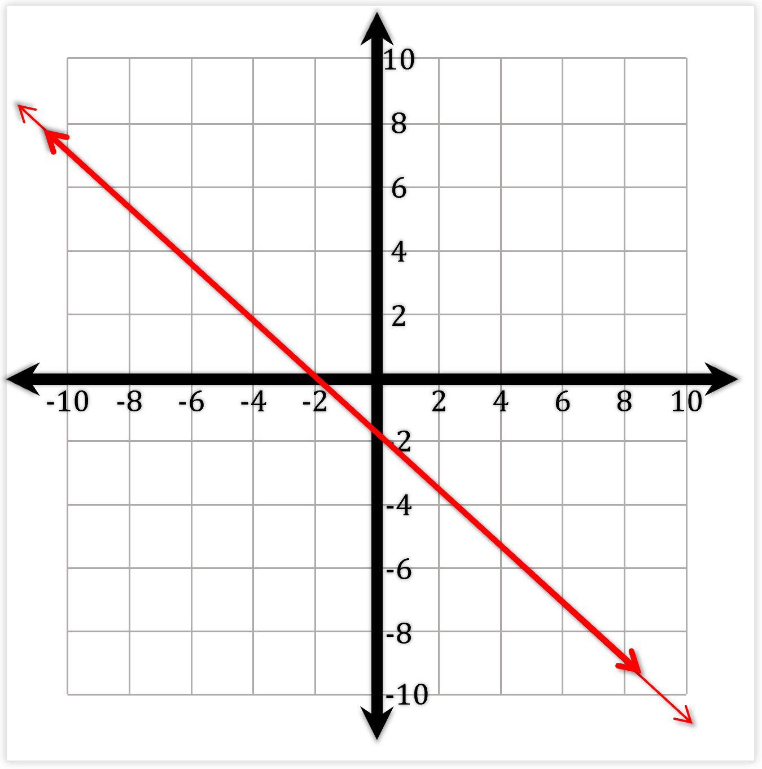
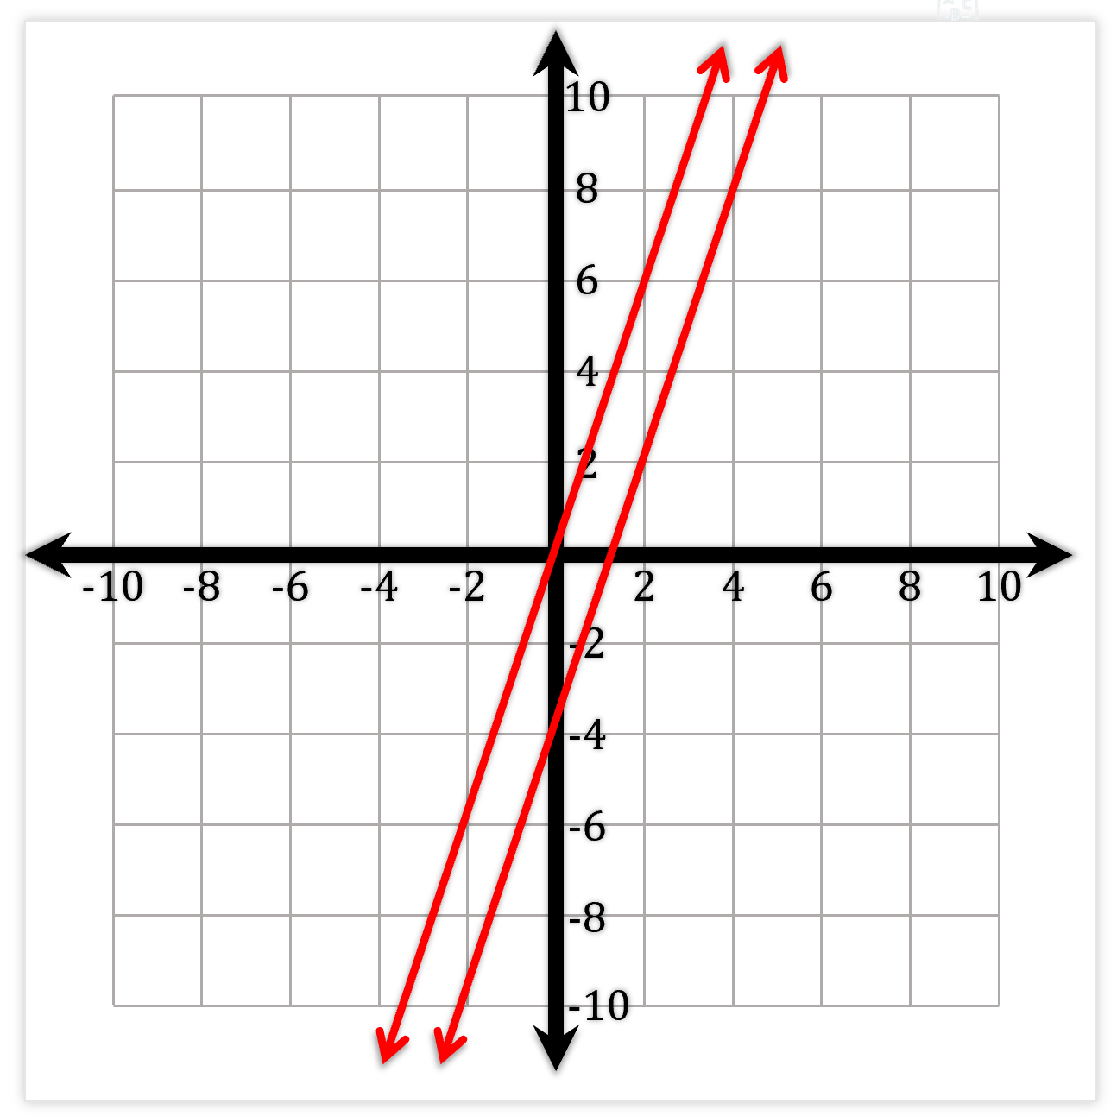
A system of linear equations is a set of linear equations with the same variables.
A solution to a system of linear equations is an ordered pair (x, y) that satisfies₁ both equations.
Check for Understanding
How many solutions are there for this system of linear equations? Explain. The system of linear equation has ________________ because…”
The graphs intersect
The solution (ordered pair - x, y) satisfies both equations
Different slopes and y-intercepts
Check for Understanding
How many solutions are there for this system of linear equations? Explain. The system of linear equation has ________________ because…”
3x + 4y = -8
8y = -6x − 16
The graphs are the same line
All the solutions (ordered pair - x, y) satisfy both equations
Same slope and y-intercepts
Check for Understanding
How many solutions are there for this system of linear equations? Explain. The system of linear equation has ___________________because…”
6x − 2y = -2
3x − y = 3
The graphs are parallel lines
No solution (ordered pair - x, y) satisfies both equations
Same slopes but different y-intercepts
Definition
¹ makes true

Slide 3
t | We will identify systems of linear equations. | Skill Development/Guided Practice
A system of linear equations is a set of linear equations with the same variables.
1. Circle yes if this is a system of linear equations; circle no if it is not.
$y$= $2x+4$
$y$= 3$x+2$
Yes
No
2. Circle yes if this is a system of linear equations; circle no if it is not.
$y$= $2p+2$
$y$= 3q$+1$
Yes
No
3. Circle yes if this is a system of linear equations; circle no if it is not.
$y$= $2u+2$
$y$= 5u$+9$
Yes
No
4. Circle yes if this is a system of linear equations; circle no if it is not.
$y$= 5$x −1$
$y$= 3w$+1$
Yes
No
5. Circle yes if this is a system of linear equations; circle no if it is not.
$y$= 9$x −18$
$y$= x $+ 16$
Yes
No
6. Circle yes if this is a system of linear equations; circle no if it is not.
$y$= 3a$+6$
$y$= 4b $+ 6$
Yes
No
7. Circle yes if this is a system of linear equations; circle no if it is not.
$y$= 8k$+4$
$y$= 4h $− 4$
Yes
No
8. Circle yes if this is a system of linear equations; circle no if it is not.
$y$= 5m$+2$
$y$= 7p $− 4$
Yes
No
9. Circle yes if this is a system of linear equations; circle no if it is not.
$y$= 5p$+5y$
$y$= 7p $− 3y$
Yes
No

Slide 4
t | We will identify systems of linear equations. | Skill Development/Guided Practice
A system of linear equations is a set of linear equations with the same variables.
10. Circle yes if this is a system of linear equations; circle no if it is not.
$2x+4$ = y
$y$= 8$x+2$
Yes
No
11. Circle yes if this is a system of linear equations; circle no if it is not.
9$p+2=y$
$y$= 3p$+10$
Yes
No
12. Circle yes if this is a system of linear equations; circle no if it is not.
7$u−8=y$
$y$= 5k$+4$
Yes
No
13. Circle yes if this is a system of linear equations; circle no if it is not.
6$x −1=y$
$y$= 3t$+1$
Yes
No
14. Circle yes if this is a system of linear equations; circle no if it is not.
$y$= 9$x −18$
x $+ 16=y$
Yes
No
15. Circle yes if this is a system of linear equations; circle no if it is not.
$y$= 4a$+6$
7b $+2=y$
Yes
No
16. Circle yes if this is a system of linear equations; circle no if it is not.
$y$= 8k$+12$
4k $− 4=y$
Yes
No
17. Circle yes if this is a system of linear equations; circle no if it is not.
$y$= 2m$+2$
5p $− 7=y$
Yes
No
18. Circle yes if this is a system of linear equations; circle no if it is not.
$y$= 9p$+5y$
8p $− 3y=y$
Yes
No

Slide 5
t | We will identify systems of linear equations. | Skill Development/Guided Practice
A system of linear equations is a set of linear equations with the same variables.
1. Circle yes if this is a system of linear equations; circle no if it is not. | 2. Circle yes if this is a system of linear equations; circle no if it is not.
3. Circle yes if this is a system of linear equations; circle no if it is not. | 4. Circle yes if this is a system of linear equations; circle no if it is not.
5. Circle yes if this is a system of linear equations; circle no if it is not. | 6. Circle yes if this is a system of linear equations; circle no if it is not.
7. Circle yes if this is a system of linear equations; circle no if it is not. | 8. Circle yes if this is a system of linear equations; circle no if it is not.
$y$= $2x+4$
$y$= 3$x+2$
$y$= $2p+2$
$y$= 3q$+1$
Yes
No
Yes
No
$y$= $2u+2$
$y$= 5u$+9$
$y$= 5$x −1$
$y$= 3w$+1$
Yes
No
Yes
No
$y$= 9$x −18$
$y$= x $+ 16$
$y$= 3a$+6$
$y$= 4b $+ 6$
Yes
No
Yes
No
$y$= 8k$+4$
$y$= 4h $− 4$
$y$= 5m$+2$
$y$= 7p $− 4$
Yes
No
Yes
No

Slide 6
t | We will identify systems of linear equations. | Skill Development/Guided Practice
9. Circle yes if this is a system of linear equations; circle no if it is not. | 10.Circle yes if this is a system of linear equations; circle no if it is not.
11. Circle yes if this is a system of linear equations; circle no if it is not. | 12. Circle yes if this is a system of linear equations; circle no if it is not.
13. Circle yes if this is a system of linear equations; circle no if it is not. | 14. Circle yes if this is a system of linear equations; circle no if it is not.
15. Circle yes if this is a system of linear equations; circle no if it is not. | 16. Circle yes if this is a system of linear equations; circle no if it is not.
17. Circle yes if this is a system of linear equations; circle no if it is not. | 18. Circle yes if this is a system of linear equations; circle no if it is not.
$y$= 5p$+5y$
$y$= 7p $− 3y$
$2x+4$ = y
$y$= 8$x+2$
Yes
No
Yes
No
9$p+2=y$
$y$= 3p$+10$
7$u−8=y$
$y$= 5k$+4$
Yes
No
Yes
No
6$x −1=y$
$y$= 3t$+1$
$y$= 9$x −18$
x $+ 16=y$
Yes
No
Yes
No
$y$= 4a$+6$
7b $+2=y$
$y$= 8k$+12$
4k $− 4=y$
Yes
No
Yes
No
$y$= 2m$+2$
5p $− 7=y$
$y$= 9p$+5y$
8p $− 3y=y$
Yes
No
Yes
No

Slide 7
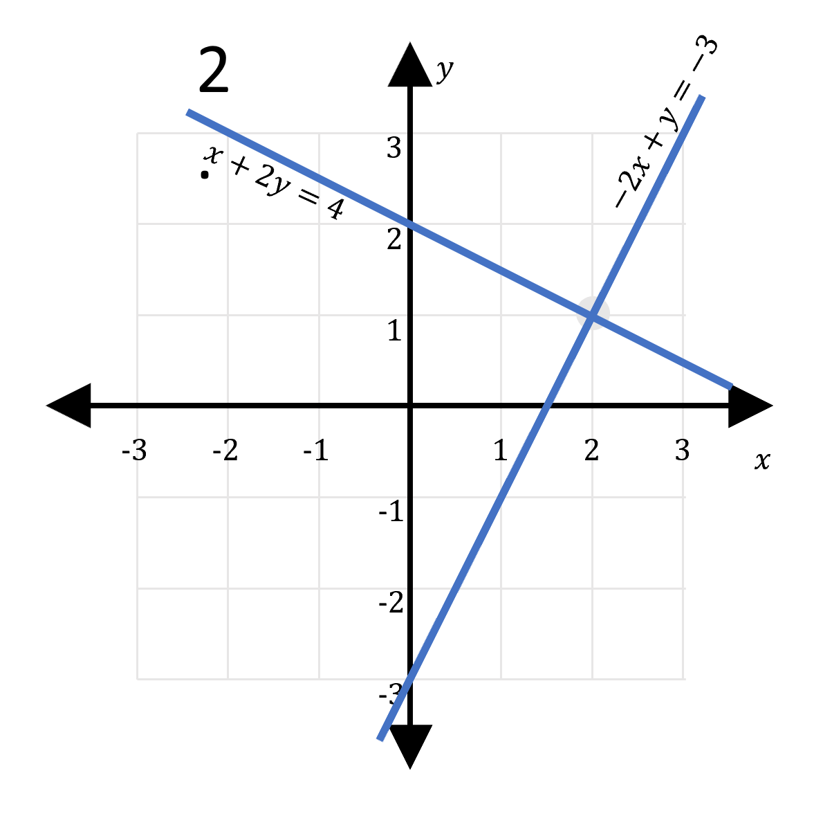
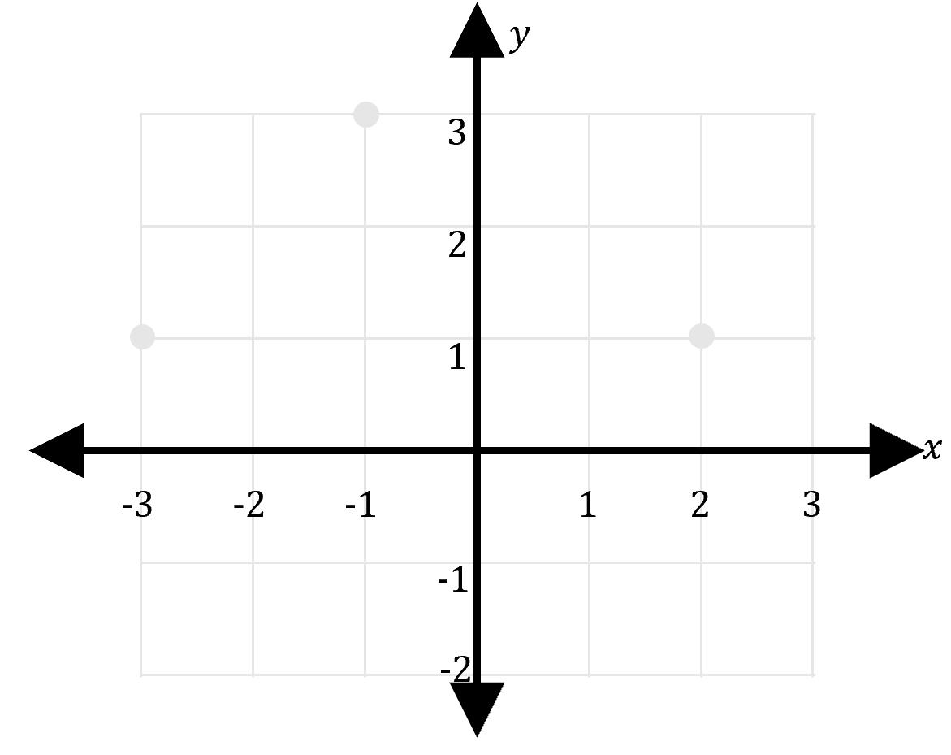
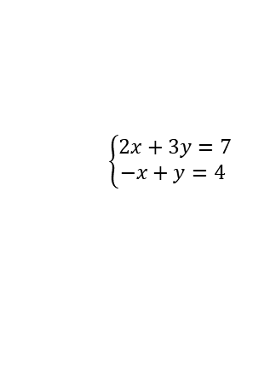
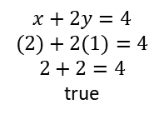
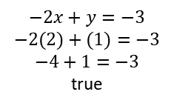
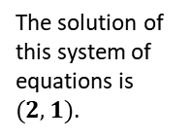
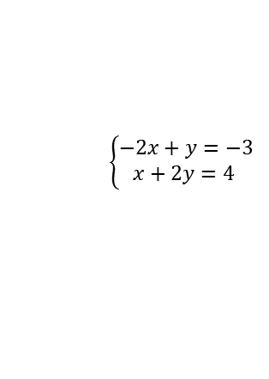
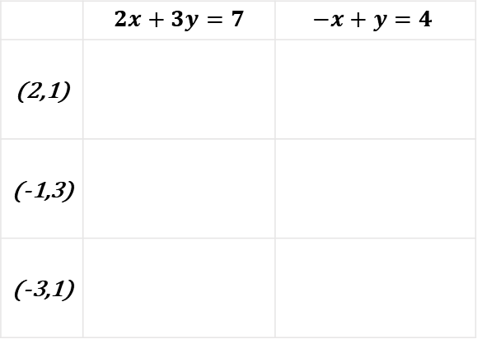
A system of linear equations is a ____, or ___________, of linear equation that are to be analyzed _________________, or simultaneously.
To analyze a system of equations means to answer questions about it’s solution(s).
A solution to a system of linear equations is an $(x,y)$ ordered pair that:
Can be substituted into BOTH equations and BOTH evaluate as true.
Represent the location where the lines cross.
1.
$$−2x+y=−3$$
$$−2(2)+(1)=−3$$
$$−4+1=−3$$
true
$$\left\{\begin{aligned}−2x+y=−3 \\ x+2y=4 \end{aligned}\right.$$
The solution of this system of equations is $(2,1)$.
$$x+2y=4$$
$$(2)+2(1)=4$$
$$2+2=4$$
true
Substitute the ordered pairs in the table to find the solution to the system of linear equations .
$$\left\{\begin{aligned}2x+3y=7 \\ −x+y=4 \end{aligned}\right.$$
 | $$2x+3y=7$$ | $$−x+y=4$$
(2,1)
(-1,3)
(-3,1)
Use the three points to sketch both lines.

Slide 8
t | We will interpret solutions of a system of linear equations. | Skill Development/Guided Practice
A system of linear equations is a set of linear equations with the same variables.
A solution to a system of linear equations is an
ordered pair (x, y) that satisfies₁ both equations.
x + 4y = 8
x + 2y = 6
10
How many solutions are there for this system of linear equations? One Infinite None
Explain:
8
6
4
(4, 1)
Graphs | intersect same line parallel lines
Slope | Same Different
Y-Intercepts | Same Different
2
-10
-8
-6
-4
-2
2
4
6
8
10
-2
-4
-6
-8
-10
10
8
3x + 9y = 18
x + 3y = -6
2. How many solutions are there for this system of linear equations? One Infinite None
Explain:
6
4
2
Graphs | intersect same line parallel lines
Slope | Same Different
Y-Intercepts | Same Different
-10
-8
-6
-4
-2
2
4
6
8
10
-2
-4
-6
-8
-10
10
x + 4y = 8
x + 2y = 6
8
3. How many solutions are there for this system of linear equations? One Infinite None
Explain:
6
4
(4, 1)
2
Graphs | intersect same line parallel lines
Slope | Same Different
Y-Intercepts | Same Different
-10
-8
-6
-4
-2
2
4
6
8
10
-2
-4
-6
-8
-10
10
8
x = -y + 2
8x + 8y = 16
4. How many solutions are there for this system of linear equations? One Infinite None
Explain:
6
4
2
Graphs | intersect same line parallel lines
Slope | Same Different
Y-Intercepts | Same Different
-10
-8
-6
-4
-2
2
4
6
8
10
-2
-4
-6
-8
-10

Slide 9
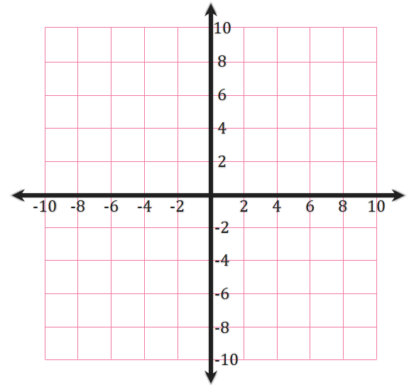
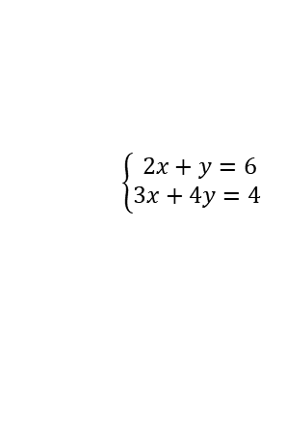

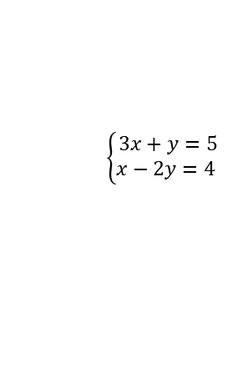
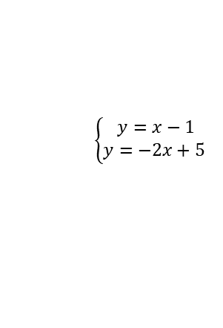
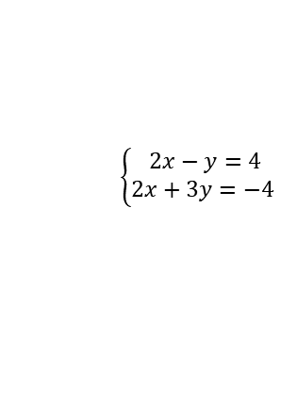
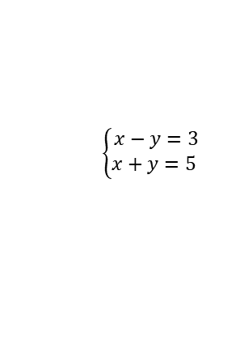
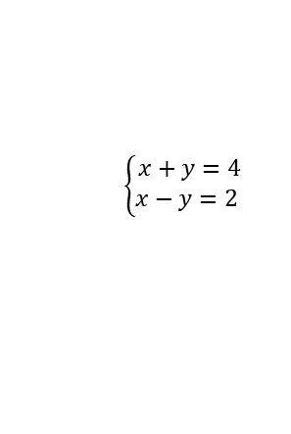
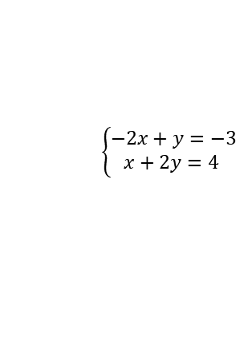
1. Graph the system of linear equations.
2. Then find and label the their intersection (solution to the system).
$$\left\{\begin{aligned}y=x−1 \\ y=−2x+5 \end{aligned}\right.$$
$$\left\{\begin{aligned}y=x+1 \\ y=\frac{2}{3}x \end{aligned}\right.$$
$$\left\{\begin{aligned}x+y=4 \\ x−y=\text{2} \end{aligned}\right.$$
$$\left\{\begin{aligned}x−y=3 \\ x+y=5 \end{aligned}\right.$$
$$\left\{\begin{aligned}2x−y=4 \\ 2x+3y=−4 \end{aligned}\right.$$
$$\left\{\begin{aligned}3x+y=5 \\ x−2y=4 \end{aligned}\right.$$
$$\left\{\begin{aligned}2x+y=6 \\ 3x+4y=4 \end{aligned}\right.$$
$$\left\{\begin{aligned}−2x+y=−3 \\ x+2y=4 \end{aligned}\right.$$

Slide 10
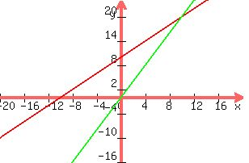
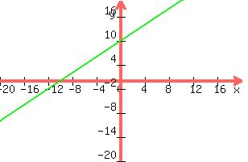
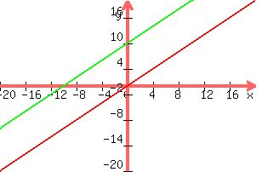
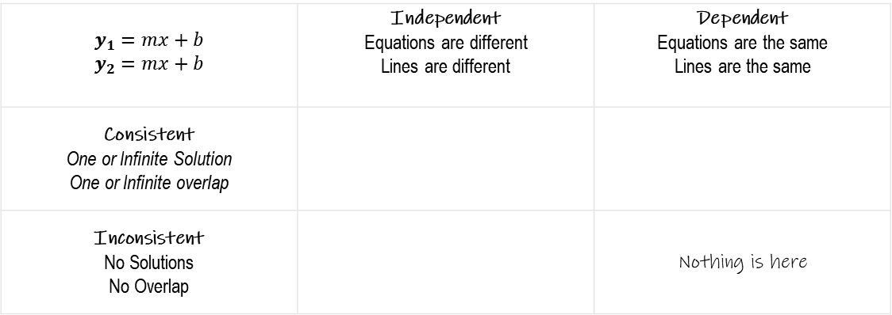
$$y_{1}=mx+b$$ $$y_{2}=mx+b$$ | Independent Equations are different Lines are different | Dependent Equations are the same Lines are the same
Consistent One or Infinite Solution One or Infinite overlap
Inconsistent No Solutions No Overlap |  | Nothing is here

Slide 11
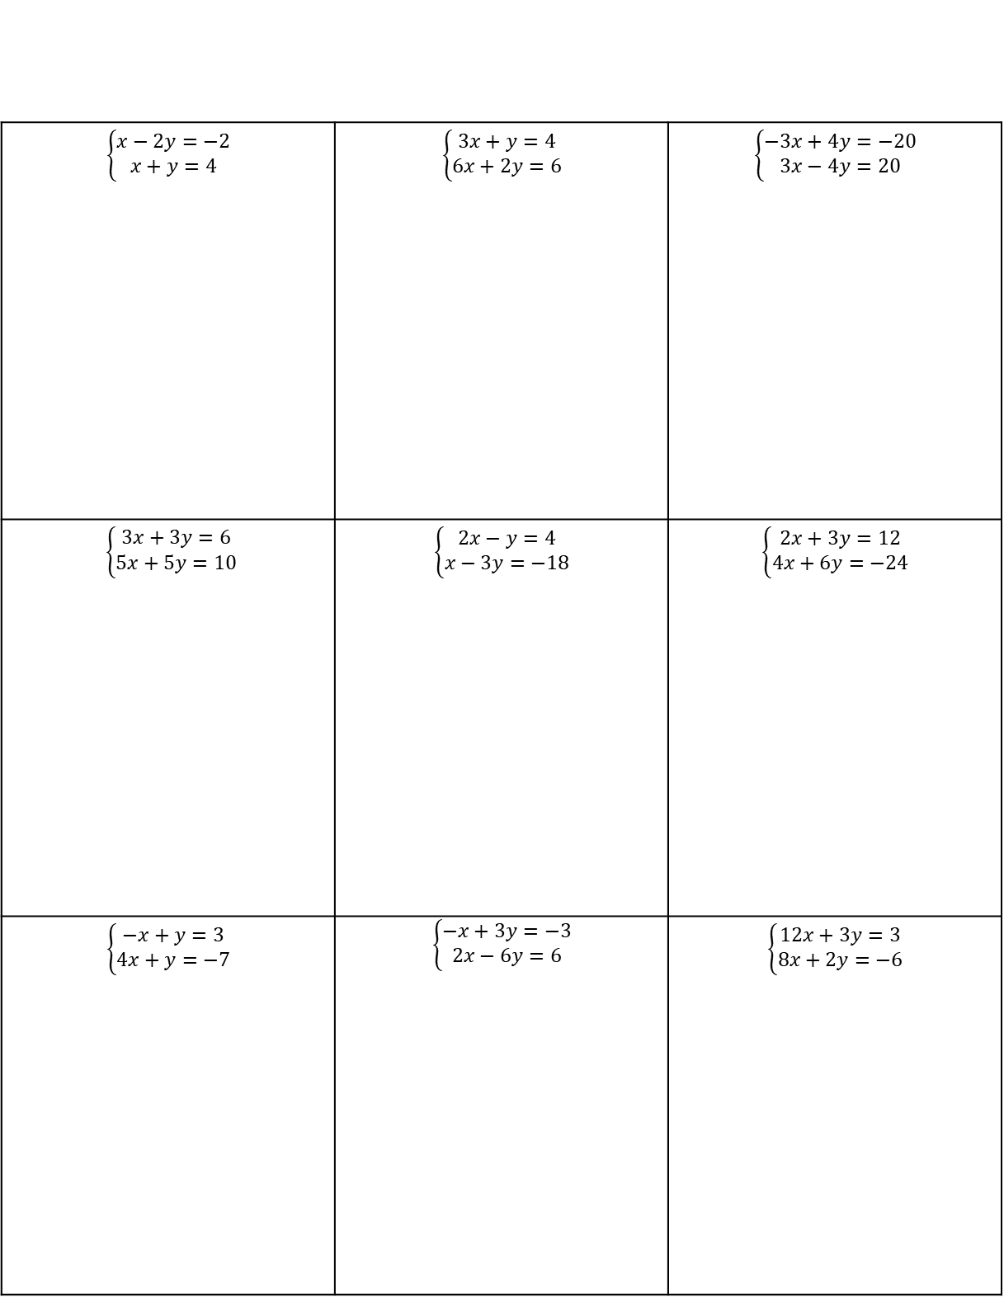
1. Find the slope and y-intercept for each equation.
2. Use the slope and y-intercept to classify each system. (CI, II, or CD)
3. IF Consistent & Independent, then find the solution ordered pair.
$$\left\{\begin{matrix}x−2y=−2 \\ x+y=4\end{matrix}\right.$$ | $$\left\{\begin{matrix}3x+y=4 \\ 6x+2y=6\end{matrix}\right.$$ | $$\left\{\begin{matrix}−3x+4y=−20 \\ 3x−4y=20\end{matrix}\right.$$
$\left\{\begin{matrix}3x+3y=6 \\ 5x+5y=10\end{matrix}\right.$ | $$\left\{\begin{matrix}2x−y=4 \\ x−3y=−18\end{matrix}\right.$$ | $$\left\{\begin{matrix}2x+3y=12 \\ 4x+6y=−24\end{matrix}\right.$$
$$\left\{\begin{matrix}−x+y=3 \\ 4x+y=−7\end{matrix}\right.$$ | $$\left\{\begin{matrix}−x+3y=−3 \\ 2x−6y=6\end{matrix}\right.$$ | $$\left\{\begin{matrix}12x+3y=3 \\ 8x+2y=−6\end{matrix}\right.$$

