Slide 1
We will learn how to identify and find the solutions to the $system of {equations}_{1}$.
LEARNING OBJECTIVE
What is our Learning Objective?
What does “Equation” mean? Quadratic means _________.
CFU
Definition
¹ two or more equations involving the same set of variables.

Slide 2


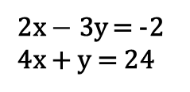
Systems of Linear Equations
A system of linear equations is a set₁ of linear equations with the same variables.
Check for Understanding
Select one or more below that are systems of linear equations. Explain. “…are systems of linear equations because…”
System of Linear Equations
A
2x $−$ 3y = -2
4x + y = 24
y = 2x + 4
y = 3x + 2
2z $−$ 4m = 2
z = -m +4
B
p + 2q = -1
2p + 5y = 0
C
m = 3a
a + 2m = 4
Not a system of linear equations
y = 2q + 4
y = 3x + 2
2y $−$ 4m = 2
x = -m +4
Definition
¹ collection
Notes:
https://www.desmos.com/calculator

Slide 3
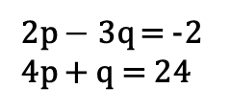
Systems of Linear Equations
A system of linear equations is a set₁ of linear equations with the same variables.
Check for Understanding
Select one or more below that are NOT systems of linear equations. Explain. “…are NOT systems of linear equations because…”
System of Linear Equations
Check for Understanding
Which is NOT a system of linear equations? Explain.
A
2p $−$ 3q = -2
4p + q = 24
y = 2x + 4
y = 3x + 2
2z $−$ 4m = 2
z = -m +4
B
p + 2q = -1
2p + 5q = 0
C
y + x = 3a
y + 2x = 4
Not a system of linear equations
y = 2q + 4
y = 3x + 2
2y $−$ 4m = 2
x = -m +4
Definition
¹ collection
Notes:
https://www.desmos.com/calculator

Slide 4
Systems of Linear Equations
A system of linear equations is a set₁ of linear equations with the same variables.
System of Linear Equations
Check for Understanding
In your own words, what is a system of linear equations? “A system of linear equations is…”
y = 2x + 4
y = 3x + 2
2z $−$ 4m = 2
z = -m +4
Not a system of linear equations
y = 2q + 4
y = 3x + 2
2y $−$ 4m = 2
x = -m +4
Definition
¹ collection
Notes:
https://www.desmos.com/calculator

Slide 5
A system of linear equations is a set of linear equations with the same variables.
A solution to a system of linear equations is an ordered pair (x, y) that satisfies₁ both equations.
One Solution | Infinite Solutions | No Solution
The graphs intersect The solution (ordered-pair - x, y) satisfies both equations Different slopes and y-intercepts | The graphs are the same line All the solutions (ordered-pairs - x, y) satisfy both equations Same slope and y-intercept | The graphs are parallel lines No solution (ordered-pairs - x, y) satisfies both equations Same slope but different y-intercepts
Check for Understanding
In your own words, what are the three types of solutions to system of equations? “A solution to a system of linear equations can be…”
5
5
5
y = -3x - 5
4
4
4
y = 2x
3
3
3
2
6x - 4y = 8
1
2
2
1
1
-5
-4
-3
-2
-1
1
2
3
4
5
-5
-4
-3
-2
-1
1
2
3
4
5
-5
-4
-3
-2
-1
1
2
3
4
5
(-1, -2)
-1
-1
(0, -2)
-1
-2
-2
2x + y = -3
2x + y = 1
-3
3x - 2y = 4
-2
-4
-3
-3
-5
-4
-4
-5
-5
Definition
¹ makes true
Homework Page 3, 4 , 5 & 6

Slide 6
t | We will identify systems of linear equations. | Skill Development/Guided Practice
A system of linear equations is a set of linear equations with the same variables.
1. Circle yes if this is a system of linear equations; circle no if it is not.
$y$= $2x+4$
$y$= 3$x+2$
Yes
No
2. Circle yes if this is a system of linear equations; circle no if it is not.
$y$= $2p+2$
$y$= 3q$+1$
Yes
No
3. Circle yes if this is a system of linear equations; circle no if it is not.
$y$= $2u+2$
$y$= 5u$+9$
Yes
No
4. Circle yes if this is a system of linear equations; circle no if it is not.
$y$= 5$x −1$
$y$= 3w$+1$
Yes
No
5. Circle yes if this is a system of linear equations; circle no if it is not.
$y$= 9$x −18$
$y$= x $+ 16$
Yes
No
6. Circle yes if this is a system of linear equations; circle no if it is not.
$y$= 3a$+6$
$y$= 4b $+ 6$
Yes
No
7. Circle yes if this is a system of linear equations; circle no if it is not.
$y$= 8k$+4$
$y$= 4h $− 4$
Yes
No
8. Circle yes if this is a system of linear equations; circle no if it is not.
$y$= 5m$+2$
$y$= 7p $− 4$
Yes
No
9. Circle yes if this is a system of linear equations; circle no if it is not.
$y$= 5p$+5y$
$y$= 7p $− 3y$
Yes
No

Slide 7
t | We will identify systems of linear equations. | Skill Development/Guided Practice
A system of linear equations is a set of linear equations with the same variables.
10. Circle yes if this is a system of linear equations; circle no if it is not.
$2x+4$ = y
$y$= 8$x+2$
Yes
No
11. Circle yes if this is a system of linear equations; circle no if it is not.
9$p+2=y$
$y$= 3p$+10$
Yes
No
12. Circle yes if this is a system of linear equations; circle no if it is not.
7$u−8=y$
$y$= 5k$+4$
Yes
No
13. Circle yes if this is a system of linear equations; circle no if it is not.
6$x −1=y$
$y$= 3t$+1$
Yes
No
14. Circle yes if this is a system of linear equations; circle no if it is not.
$y$= 9$x −18$
x $+ 16=y$
Yes
No
15. Circle yes if this is a system of linear equations; circle no if it is not.
$y$= 4a$+6$
7b $+2=y$
Yes
No
16. Circle yes if this is a system of linear equations; circle no if it is not.
$y$= 8k$+12$
4k $− 4=y$
Yes
No
17. Circle yes if this is a system of linear equations; circle no if it is not.
$y$= 2m$+2$
5p $− 7=y$
Yes
No
18. Circle yes if this is a system of linear equations; circle no if it is not.
$y$= 9p$+5y$
8p $− 3y=y$
Yes
No

Slide 8
t | We will identify systems of linear equations. | Skill Development/Guided Practice
A system of linear equations is a set of linear equations with the same variables.
1. Circle yes if this is a system of linear equations; circle no if it is not. | 2. Circle yes if this is a system of linear equations; circle no if it is not.
3. Circle yes if this is a system of linear equations; circle no if it is not. | 4. Circle yes if this is a system of linear equations; circle no if it is not.
5. Circle yes if this is a system of linear equations; circle no if it is not. | 6. Circle yes if this is a system of linear equations; circle no if it is not.
7. Circle yes if this is a system of linear equations; circle no if it is not. | 8. Circle yes if this is a system of linear equations; circle no if it is not.
$y$= $2x+4$
$y$= 3$x+2$
$y$= $2p+2$
$y$= 3q$+1$
Yes
No
Yes
No
$y$= $2u+2$
$y$= 5u$+9$
$y$= 5$x −1$
$y$= 3w$+1$
Yes
No
Yes
No
$y$= 9$x −18$
$y$= x $+ 16$
$y$= 3a$+6$
$y$= 4b $+ 6$
Yes
No
Yes
No
$y$= 8k$+4$
$y$= 4h $− 4$
$y$= 5m$+2$
$y$= 7p $− 4$
Yes
No
Yes
No

Slide 9
t | We will identify systems of linear equations. | Skill Development/Guided Practice
9. Circle yes if this is a system of linear equations; circle no if it is not. | 10.Circle yes if this is a system of linear equations; circle no if it is not.
11. Circle yes if this is a system of linear equations; circle no if it is not. | 12. Circle yes if this is a system of linear equations; circle no if it is not.
13. Circle yes if this is a system of linear equations; circle no if it is not. | 14. Circle yes if this is a system of linear equations; circle no if it is not.
15. Circle yes if this is a system of linear equations; circle no if it is not. | 16. Circle yes if this is a system of linear equations; circle no if it is not.
17. Circle yes if this is a system of linear equations; circle no if it is not. | 18. Circle yes if this is a system of linear equations; circle no if it is not.
$y$= 5p$+5y$
$y$= 7p $− 3y$
$2x+4$ = y
$y$= 8$x+2$
Yes
No
Yes
No
9$p+2=y$
$y$= 3p$+10$
7$u−8=y$
$y$= 5k$+4$
Yes
No
Yes
No
6$x −1=y$
$y$= 3t$+1$
$y$= 9$x −18$
x $+ 16=y$
Yes
No
Yes
No
$y$= 4a$+6$
7b $+2=y$
$y$= 8k$+12$
4k $− 4=y$
Yes
No
Yes
No
$y$= 2m$+2$
5p $− 7=y$
$y$= 9p$+5y$
8p $− 3y=y$
Yes
No
Yes
No

Slide 10
A system of linear equations is a set of linear equations with the same variables.
A solution to a system of linear equations is an ordered pair (x, y) that satisfies₁ both equations.
Definition
¹ makes true
10
Check for Understanding
How many solutions are there for this system of linear equations? Explain. The system of linear equation has ________________ because…”
8
6
4
one solution
2
The graphs intersect
The solution (ordered pair - x, y) satisfies both equations
Different slopes and y-intercepts
-10
-8
-6
-4
-2
2
4
6
8
10
-2
(− 2, − 4)
-4
-6
-8
-10

Slide 11
A system of linear equations is a set of linear equations with the same variables.
A solution to a system of linear equations is an ordered pair (x, y) that satisfies₁ both equations.
Definition
¹ makes true
10
Check for Understanding
How many solutions are there for this system of linear equations? Explain. The system of linear equation has _________________because…”
8
6
3x + 4y = -8
8y = -6x − 16
4
2
-10
-8
-6
-4
-2
2
4
6
8
10
infinite solutions
-2
The graphs are the same line
All the solutions (ordered pair - x, y) satisfy both equations
Same slope and y-intercepts
-4
-6
-8
-10

Slide 12
A system of linear equations is a set of linear equations with the same variables.
A solution to a system of linear equations is an ordered pair (x, y) that satisfies₁ both equations.
Definition
¹ makes true
10
Check for Understanding
How many solutions are there for this system of linear equations? Explain. The system of linear equation has ___________________ because…”
8
6
6x − 2y = -2
3x − y = 3
4
2
-10
-8
-6
-4
-2
2
4
6
8
10
no solution
-2
-4
The graphs are parallel lines
No solution (ordered pair - x, y) satisfies both equations
Same slopes but different y-intercepts
-6
-8
-10

Slide 13

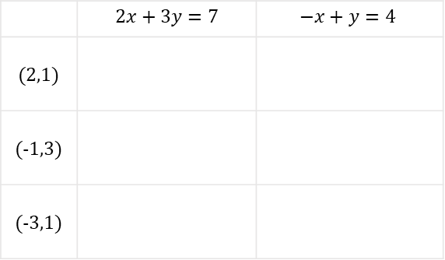
Substitute the ordered pairs in the table to find the solution to the system of linear equations .
$$\left\{\begin{aligned}2x+3y=7 \\ −x+y=4 \end{aligned}\right.$$
 | $$2x+3y=7$$ | $$−x+y=4$$
(2,1)
(-1,3)
(-3,1)
Use the three points to sketch both lines.
$$y$$
3
2
1
-3
-2
-1
1
2
3
$$x$$
-1
-2

Slide 14
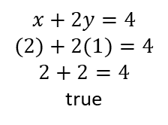
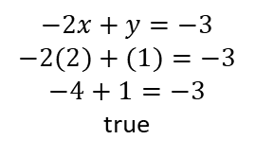

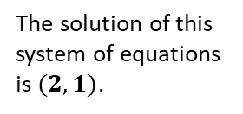
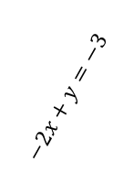
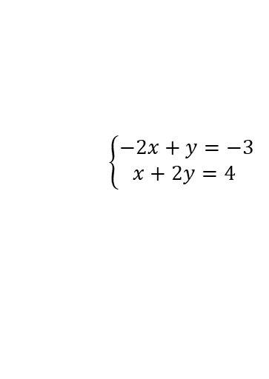
set
collection
A system of linear equations is a _______, or ___________, of linear equation that are to be analyzed _________________, or simultaneously.
at the same time
To analyze a system of equations means to answer questions about it’s solution(s).
A solution to a system of linear equations is an $(x,y)$ ordered pair that:
Can be substituted into BOTH equations and BOTH evaluate as true.
Represent the location where the lines cross.
$$\left\{\begin{aligned}−2x+y=−3 \\ x+2y=4 \end{aligned}\right.$$
1.
2.
$$−2x+y=−3$$
$$−2(2)+(1)=−3$$
$$−4+1=−3$$
true
$$y$$
3
$$−2x+y=−3$$
$$x+2y=4$$
2
The solution of this system of equations is $(2,1)$.
$$x+2y=4$$
$$(2)+2(1)=4$$
$$2+2=4$$
true
1
-3
-2
-1
1
2
3
$$x$$
-1
-2
-3

Slide 15
t | We will interpret solutions of a system of linear equations. | Skill Development/Guided Practice
A system of linear equations is a set of linear equations with the same variables.
A solution to a system of linear equations is an
ordered pair (x, y) that satisfies₁ both equations.
10
x + 4y = 8
x + 2y = 6
How many solutions are there for this system of linear equations? One Infinite None
Explain:
8
6
4
(4, 1)
Graphs | intersect same line parallel lines
Slope | Same Different
Y-Intercepts | Same Different
-10
-8
-6
-4
-2
2
10
2
4
6
8
-2
-4
-6
-8
-10
10
8
3x + 9y = 18
x + 3y = -6
2. How many solutions are there for this system of linear equations? One Infinite None
Explain:
6
4
-10
-8
-6
-4
-2
2
10
2
4
6
8
Graphs | intersect same line parallel lines
Slope | Same Different
Y-Intercepts | Same Different
-2
-4
-6
-8
-10
10
x + 4y = 8
x + 2y = 6
8
3. How many solutions are there for this system of linear equations? One Infinite None
Explain:
6
4
(4, 1)
-10
-8
-6
-4
-2
2
10
2
4
6
8
Graphs | intersect same line parallel lines
Slope | Same Different
Y-Intercepts | Same Different
-2
-4
-6
-8
-10
10
8
x = -y + 2
8x + 8y = 16
4. How many solutions are there for this system of linear equations? One Infinite None
Explain:
6
4
-10
-8
-6
-4
-2
2
10
2
4
6
8
Graphs | intersect same line parallel lines
Slope | Same Different
Y-Intercepts | Same Different
-2
-4
-6
-8
-10

Slide 16
We will learn how to solve $system of linear {equations}_{1}$ by graphing.
LEARNING OBJECTIVE
What is our Learning Objective?
What does “Equation” mean? Quadratic means _________.
CFU
Definition
¹ two or more equations involving the same set of variables.

Slide 17
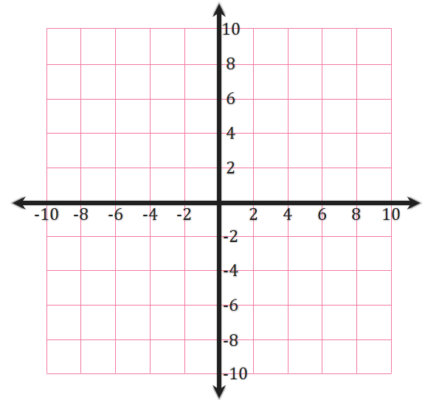
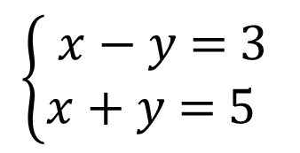
We will learn how to solve the $system of linear {equations}_{1}$ by graphing.
Step 1 | Isolate (SOLVE for) the 'y' term. “ I added/subtracted ‘x’ term from both sides.”
Step 2 | Divide all terms by the coefficient of y. “I divided both side by______”
Step 3 | Simplify: “The slope-intercept is y = ______.”
$$\left\{\begin{matrix}\text{x}\text{ − }\text{y}\text{ = 3} \\ \text{x}\text{ + }\text{y}\text{ = 5 } \end{matrix}\right.$$
Step 4 | Graph the Equation . Start with the y-intercept (b) on the graph. From this point, use the slope to find a second point and plot it. Draw the line that connects the two points.
$$\text{x}\text{ − }\text{y}\text{ = 3}$$
$$\text{x}\text{ + }\text{y}\text{ = 5}$$

Slide 18
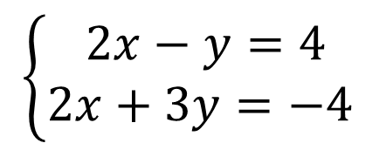
We will learn how to solve the $system of linear {equations}_{1}$ by graphing.
Step 1 | Isolate (SOLVE for) the 'y' term. “ I added/subtracted ‘x’ term from both sides.”
Step 2 | Divide all terms by the coefficient of y. “I divided both side by______”
Step 3 | Simplify: “The slope-intercept is y = ______.”
$$\left\{\begin{aligned}2x−y=4 \\ 2x+3y=−4 \end{aligned}\right.$$
Step 4 | Graph the Equation . Start with the y-intercept (b) on the graph. From this point, use the slope to find a second point and plot it. Draw the line that connects the two points.
$$2x−y=4$$
$$2x+3y=−4$$

Slide 19
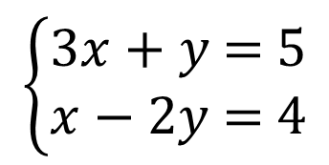
We will learn how to solve the $system of linear {equations}_{1}$ by graphing.
Step 1 | Isolate (SOLVE for) the 'y' term. “ I added/subtracted ‘x’ term from both sides.”
Step 2 | Divide all terms by the coefficient of y. “I divided both side by______”
Step 3 | Simplify: “The slope-intercept is y = ______.”
$$\left\{\begin{matrix}\text{3}\text{x}\text{ + }\text{y}\text{ = 5} \\ \text{x}\text{ − 2}\text{y}\text{ = 4}\end{matrix}\right.$$
Step 4 | Graph the Equation . Start with the y-intercept (b) on the graph. From this point, use the slope to find a second point and plot it. Draw the line that connects the two points.
$$\text{3}\text{x}\text{ + }\text{y}\text{ = 5}$$
$$\text{x}\text{ − 2}\text{y}\text{ = 4}$$

Slide 20
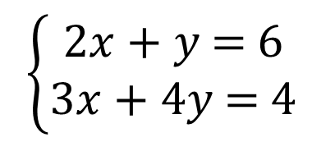
We will learn how to solve the $system of linear {equations}_{1}$ by graphing.
Step 1 | Isolate (SOLVE for) the 'y' term. “ I added/subtracted ‘x’ term from both sides.”
Step 2 | Divide all terms by the coefficient of y. “I divided both side by______”
Step 3 | Simplify: “The slope-intercept is y = ______.”
$\left\{\begin{matrix}\text{2}\text{x}\text{ + }\text{y}\text{ = 6} \\ \text{3}\text{x}\text{ + 4}\text{y}\text{ = 4}\end{matrix}\right.$
Step 4 | Graph the Equation . Start with the y-intercept (b) on the graph. From this point, use the slope to find a second point and plot it. Draw the line that connects the two points.
$$\text{2}\text{x}\text{ + }\text{y}\text{ = 6}$$
$$\text{3}\text{x}\text{ + 4}\text{y}\text{ = 4}$$

Slide 21
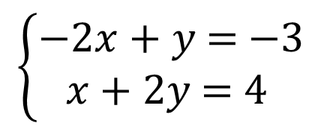
We will learn how to solve the $system of linear {equations}_{1}$ by graphing.
Step 1 | Isolate (SOLVE for) the 'y' term. “ I added/subtracted ‘x’ term from both sides.”
Step 2 | Divide all terms by the coefficient of y. “I divided both side by______”
Step 3 | Simplify: “The slope-intercept is y = ______.”
$$\left\{\begin{matrix}\text{−2}\text{x}\text{ + }\text{y}\text{ = −3} \\ \text{x}\text{ + 2}\text{y}\text{ = 4} \end{matrix}\right.$$
Step 4 | Graph the Equation . Start with the y-intercept (b) on the graph. From this point, use the slope to find a second point and plot it. Draw the line that connects the two points.
$$\text{−2}\text{x}\text{ + }\text{y}\text{ = −3}$$
$$\text{x}\text{ + 2}\text{y}\text{ = 4}$$

Slide 22
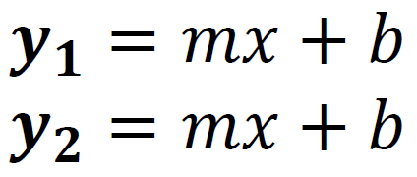
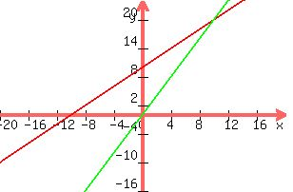
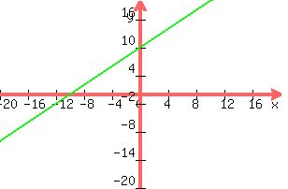
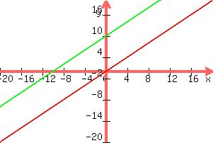
Identify the type of solution to the System of Equations.
 | Independent Equations are different Lines are different | Dependent Equations are the same Lines are the same
Consistent One or Infinite Solution One or Infinite overlap
Inconsistent No Solutions No Overlap
Independent
Consistent (IC)
Dependent
Consistent (DC)
Different slopes and y-intercepts
One Solution
Same slopes and y-intercepts
Infinite Solution i
Independent
Inconsistent (II)
Nothing is here
Same slopes but Different y-intercepts
No Solution

Slide 23
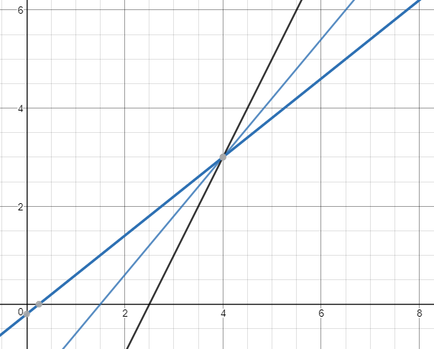
Check if the given order pairs is the solution to the system of equations.
(4, 3, -1)

Slide 24
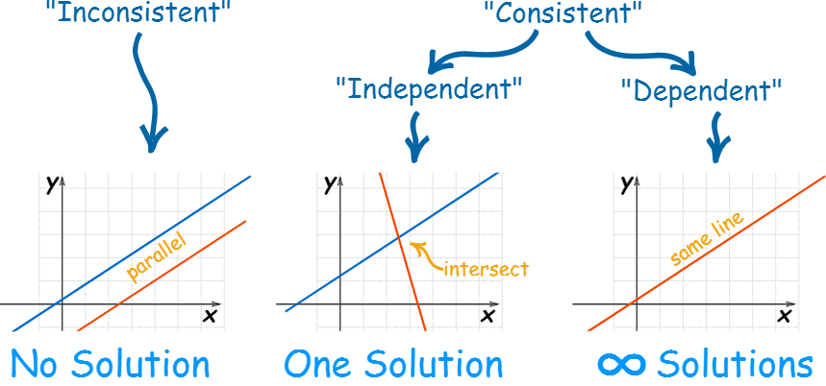
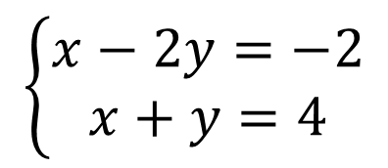
We will learn how to identify the equation types and find the solution, if it exist.
1. Find the slope and y-intercept for each equation.
2. Use the slope and y-intercept to classify each system. (CI, II, or CD)
3. IF Consistent & Independent, then find the solution ordered pair.
Step 1 | Isolate (SOLVE for) the 'y' term. “ I added/subtracted ‘x’ term from both sides.”
Step 2 | Divide all terms by the coefficient of y. “I divided both side by______”
Step 3 | Simplify: “The slope-intercept is y = ___.”
$$\left\{\begin{matrix}x−2y=−2 \\ x+y=4\end{matrix}\right.$$
Same slopes but
Different y-intercepts
Different slopes
and y-intercepts
Same slopes
y-intercept

Slide 25
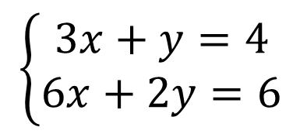
We will learn how to identify the equation types and find the solution, if it exist.
1. Find the slope and y-intercept for each equation.
2. Use the slope and y-intercept to classify each system. (CI, II, or CD)
3. IF Consistent & Independent, then find the solution ordered pair.
Step 1 | Isolate (SOLVE for) the 'y' term. “ I added/subtracted ‘x’ term from both sides.”
Step 2 | Divide all terms by the coefficient of y. “I divided both side by______”
Step 3 | Simplify: “The slope-intercept is y = ___.”
$$\left\{\begin{matrix}3x+y=4 \\ 6x+2y=6\end{matrix}\right.$$
Same slopes but
Different y-intercepts
Different slopes
and y-intercepts
Same slopes
y-intercept

Slide 26
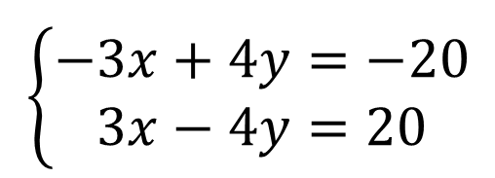
We will learn how to identify the equation types and find the solution, if it exist.
1. Find the slope and y-intercept for each equation.
2. Use the slope and y-intercept to classify each system. (CI, II, or CD)
3. IF Consistent & Independent, then find the solution ordered pair.
Step 1 | Isolate (SOLVE for) the 'y' term. “ I added/subtracted ‘x’ term from both sides.”
Step 2 | Divide all terms by the coefficient of y. “I divided both side by______”
Step 3 | Simplify: “The slope-intercept is y = ___.”
$$\left\{\begin{matrix}−3x+4y=−20 \\ 3x−4y=20\end{matrix}\right.$$
Same slopes but
Different y-intercepts
Different slopes
and y-intercepts
Same slopes
y-intercept

Slide 27
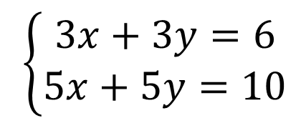
We will learn how to identify the equation types and find the solution, if it exist.
1. Find the slope and y-intercept for each equation.
2. Use the slope and y-intercept to classify each system. (CI, II, or CD)
3. IF Consistent & Independent, then find the solution ordered pair.
Step 1 | Isolate (SOLVE for) the 'y' term. “ I added/subtracted ‘x’ term from both sides.”
Step 2 | Divide all terms by the coefficient of y. “I divided both side by______”
Step 3 | Simplify: “The slope-intercept is y = ___.”
$\left\{\begin{matrix}3x+3y=6 \\ 5x+5y=10\end{matrix}\right.$
Same slopes but
Different y-intercepts
Different slopes
and y-intercepts
Same slopes
y-intercept

Slide 28
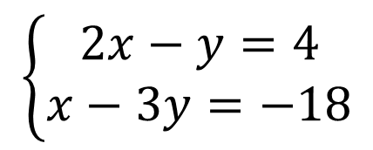
We will learn how to identify the equation types and find the solution, if it exist.
1. Find the slope and y-intercept for each equation.
2. Use the slope and y-intercept to classify each system. (CI, II, or CD)
3. IF Consistent & Independent, then find the solution ordered pair.
Step 1 | Isolate (SOLVE for) the 'y' term. “ I added/subtracted ‘x’ term from both sides.”
Step 2 | Divide all terms by the coefficient of y. “I divided both side by______”
Step 3 | Simplify: “The slope-intercept is y = ___.”
$$\left\{\begin{matrix}2x−y=4 \\ x−3y=−18\end{matrix}\right.$$
Same slopes but
Different y-intercepts
Different slopes
and y-intercepts
Same slopes
y-intercept

Slide 29
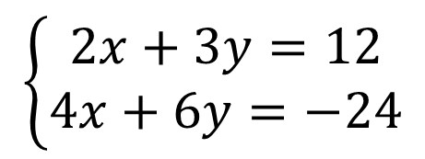
We will learn how to identify the equation types and find the solution, if it exist.
1. Find the slope and y-intercept for each equation.
2. Use the slope and y-intercept to classify each system. (CI, II, or CD)
3. IF Consistent & Independent, then find the solution ordered pair.
Step 1 | Isolate (SOLVE for) the 'y' term. “ I added/subtracted ‘x’ term from both sides.”
Step 2 | Divide all terms by the coefficient of y. “I divided both side by______”
Step 3 | Simplify: “The slope-intercept is y = ___.”
Same slopes but
Different y-intercepts
Different slopes
and y-intercepts
Same slopes
y-intercept
$$\left\{\begin{matrix}2x+3y=12 \\ 4x+6y=−24\end{matrix}\right.$$

Slide 30
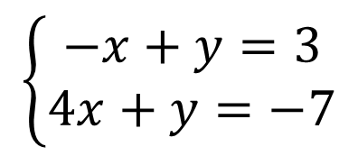
We will learn how to identify the equation types and find the solution, if it exist.
1. Find the slope and y-intercept for each equation.
2. Use the slope and y-intercept to classify each system. (CI, II, or CD)
3. IF Consistent & Independent, then find the solution ordered pair.
Step 1 | Isolate (SOLVE for) the 'y' term. “ I added/subtracted ‘x’ term from both sides.”
Step 2 | Divide all terms by the coefficient of y. “I divided both side by______”
Step 3 | Simplify: “The slope-intercept is y = ___.”
$$\left\{\begin{matrix}−x+y=3 \\ 4x+y=−7\end{matrix}\right.$$
Same slopes but
Different y-intercepts
Different slopes
and y-intercepts
Same slopes
y-intercept

Slide 31
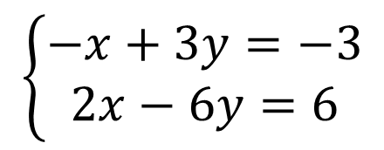
We will learn how to identify the equation types and find the solution, if it exist.
1. Find the slope and y-intercept for each equation.
2. Use the slope and y-intercept to classify each system. (CI, II, or CD)
3. IF Consistent & Independent, then find the solution ordered pair.
Step 1 | Isolate (SOLVE for) the 'y' term. “ I added/subtracted ‘x’ term from both sides.”
Step 2 | Divide all terms by the coefficient of y. “I divided both side by______”
Step 3 | Simplify: “The slope-intercept is y = ___.”
$$\left\{\begin{matrix}−x+3y=−3 \\ 2x−6y=6\end{matrix}\right.$$
Same slopes but
Different y-intercepts
Different slopes
and y-intercepts
Same slopes
y-intercept

Slide 32
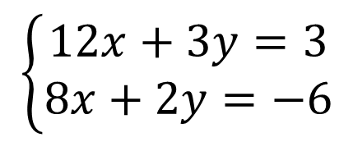
We will learn how to identify the equation types and find the solution, if it exist.
1. Find the slope and y-intercept for each equation.
2. Use the slope and y-intercept to classify each system. (CI, II, or CD)
3. IF Consistent & Independent, then find the solution ordered pair.
Step 1 | Isolate (SOLVE for) the 'y' term. “ I added/subtracted ‘x’ term from both sides.”
Step 2 | Divide all terms by the coefficient of y. “I divided both side by______”
Step 3 | Simplify: “The slope-intercept is y = ___.”
Same slopes but
Different y-intercepts
Different slopes
and y-intercepts
Same slopes
y-intercept
$$\left\{\begin{matrix}12x+3y=3 \\ 8x+2y=−6\end{matrix}\right.$$

