Slide 1
ACT RESPONSIBLY & SUPPORT the COMMUNITY.
Be on Time
Wear ID
Chromebook Ready
SEE SOMETHING, SAY SOMETHING

Slide 2
Learning Objective
We will derive₁ the equation of a line.
What are we going to do?
What does derive mean?
Derive means __________.
CFU
Activate Prior Knowledge
The slope of a line (m) is the ratio of the change in y (rise) to the change in x (run) between two points on a line.
Slope
m =
change in y
change in x
Determine the slope of the line. Hint: Use any two points.
1.
2.
5
5
4
4
-3
3
3
2
2
+1
1
1
Students, you already know how to determine the slope of a line. Now, we will use the slope of a line to derive the equation of a line.
-5
-4
-3
-2
-1
1
2
3
4
5
-5
-4
-3
-2
-1
1
2
3
4
5
Make Connection
-1
+3
-1
-2
+2
-2
-3
-3
-4
-4
-5
-5
¹ develop (synonym)
Vocabulary
-3
1
= -3
2
3
m = _____
m = _____

Slide 3
Concept Development
A line can be described by the equation y = mx + b.
The slope of a line (m) is the ratio of the change in y to the change in x.
The y-intercept (b) is the point at which the line passes through the y-axis.
y-intercept
y = mx + b
Equation
2
3
y = x − 1
slope
y
5
CFU
4
In the equation y = 3x − 5, which is the slope?
How do you know?
Which is the y-intercept?
How do you know?
A x
B y
C 3
D -5
Explain the difference between the slope and y-intercept.
m =
2
3
3
2
+ 3
+ 2
1
x
-5
-4
-3
-2
-1
1
2
3
4
5
-1
(0, -1)
slope
2
3
y = x − 1
y-intercept
-2
-3
b = -1
-4
-5

Slide 4
Skill Development/Guided Practice
The slope of a line (m) is the ratio of the change in y to the change in x.
The y-intercept (b) is the point at which the line passes through the y-axis.
Derive the equation of a line.
How did I/you determine the slope of the line?
How did I/you determine the y-intercept?
How did I/you derive the equation of the line?
CFU
1
Determine₂ the slope of the line. (write)
Determine the y-intercept. (write)
Derive the equation of the line. (write)
Interpret₃ the equation.
“The equation of the line with a slope of ___ and a y-intercept of ___ is ________.”
1
2
2
3
4
3
1. Slope: ______________ y-intercept: __________ Equation: ___________ | 2. Slope: ______________ y-intercept: __________ Equation: ___________
y-intercept
5
5
y = mx + b
4
4
1
3
3
3
slope
y = x + 1
2
+3
2
1
1
+1
(0, 1)
-5
-4
-3
-2
-1
+1
1
2
3
4
5
-5
-4
-3
-2
-1
1
2
3
4
5
-1
-1
+1
y = x − 3
(0, -3)
-2
-2
-3
-3
-4
-4
-5
-5
m =
1
1
= 1
m =
1
3
b = -3
b = 1
² figure out
³ explain (synonym)
1
3
Vocabulary
y = x − 3
y = x + 1

Slide 5
Skill Development/Guided Practice (continued)
The slope of a line (m) is the ratio of the change in y to the change in x.
The y-intercept (b) is the point at which the line passes through the y-axis.
Derive the equation of a line.
How did I/you determine the slope of the line?
How did I/you determine the y-intercept?
How did I/you derive the equation of the line?
CFU
1
Determine the slope of the line. (write)
Determine the y-intercept. (write)
Derive the equation of the line. (write)
Interpret the equation.
“The equation of the line with a slope of ___ and a y-intercept of ___ is ________.”
1
2
2
3
4
3
3. Slope: ______________ y-intercept: __________ Equation: ___________ | 4. Slope: ______________ y-intercept: __________ Equation: ___________
y-intercept
5
5
y = mx + b
4
4
3
y = -2x
slope
2
3
3
y = ⁻ x
2
2
1
1
(0, 0)
(0, 0)
-5
-4
-3
-2
-1
1
2
3
4
5
-5
-4
-3
-2
-1
1
2
3
4
5
-2
-1
-2
-1
-2
-2
+3
+1
-3
-3
-4
-4
-5
-5
2
3
-2
1
m = -
m =
= -2
b = 0
b = 0
2
3
y = - x
y = -2x

Slide 6
Skill Development/Guided Practice (continued)
The slope of a line (m) is the ratio of the change in y to the change in x.
The y-intercept (b) is the point at which the line passes through the y-axis.
Derive the equation of a line.
How did I/you determine the slope of the line?
How did I/you determine the y-intercept?
How did I/you derive the equation of the line?
CFU
1
Determine the slope of the line. (write)
Determine the y-intercept. (write)
Derive the equation of the line. (write)
Interpret the equation.
“The equation of the line with a slope of ___ and a y-intercept of ___ is ________.”
1
2
2
3
4
3
5. Write the equation of a line with a slope of -2 and y-intercept of (0, 5). | 6. Write the equation of a line with a slope of 4 and y-intercept of (0, -3).
7. Write the equation of the line represented by the table below. | 8. Write the equation of the line represented by the table below.
y-intercept
y = mx + b
slope
m = -2
y = -2x + 5
m = 4
y = 4x − 3
b = 5
b = -3
x | y
2 | 1
0 | 4
-2 | 7
3
-2
x | y
4 | -2
0 | -3
-4 | -4
-1
-4
1
4
m =
m =
=
− 2
+ 3
b = 4
− 4
− 1
b = -3
3
2
1
4
y = - x + 4
y = x − 3

Slide 7
Skill Development/Guided Practice (continued)
The slope of a line (m) is the ratio of the change in y to the change in x.
The y-intercept (b) is the point at which the line passes through the y-axis.
Derive the equation of a line.
How did I/you determine the slope of the line?
How did I/you determine the y-intercept?
How did I/you derive the equation of the line?
CFU
1
Determine the slope of the line. (write)
Determine the y-intercept. (write)
Derive the equation of the line. (write)
Interpret the equation.
“The equation of the line with a slope of ___ and a y-intercept of ___ is ________.”
1
2
2
3
4
3
Write the equation of the line passing through (-2, -1) and (2, 5). | 10. Write the equation of the line passing through (6, 2) and (-3, -4).
y-intercept
y = mx + b
-1 − 5
-2 − 2
-6
-4
3
2
2 − (-4)
6 − (-3)
6
9
2
3
slope
m =
=
=
m =
=
=
3
2
2
3
y = x + b
y = x + b
3
2
2
3
-1 = (-2) + b
-4 = (-3) + b
-1 = -3 + b
-4 = -2 + b
+3
+3
+2
+2
2 = b
-2 = b
3
2
2
3
y = x + 2
y = x − 2

Slide 8
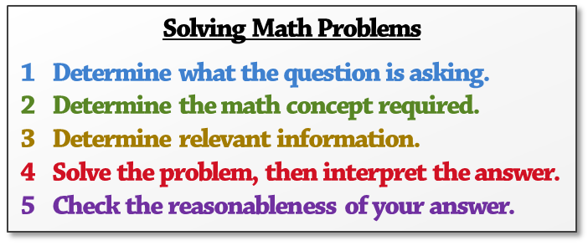
Skill Development/Guided Practice (continued)
How did I/you determine what the question is asking?
How did I/you determine the math concept required?
How did I/you determine the relevant information?
How did I/you solve and interpret the problem?
How did I/you check the reasonableness of the answer?
y-intercept
CFU
y = mx + b
1
2
slope
3
4
5
11. Henrietta is saving money while working a summer job. At the beginning of summer, she has $40 in her bank account. She saves $30 more every 4 weeks. Write an equation to show the relationship between money saved (d) and weeks worked (w). Slope: ______________ y-intercept: __________ Equation: ___________ | 12. Wayne is driving and notices traffic ahead is coming to a stop. He is going 70 miles per hour and slows 50 miles per hour every 6 seconds. Write an equation to show the relationship between his speed (s) to the number of seconds (t) that pass. Slope: ______________ y-intercept: __________ Equation: ___________
$80
+4
80
(0, 70)
$70
70
+30
30
4
$60
d = w + 40
60
50
50
6
$50
-50
y = ⁻ x + 70
(0, 40)
Speed (s)
Money Saved (d)
40
$40
$30
30
$20
20
+6
$10
10
0
1
2
3
4
5
6
7
8
0
1
2
3
4
5
6
7
8
Weeks Works (w)
Seconds (t)
m =
30
4
m =
-50
6
b = 40
30
4
b = 70
d = w + 40
50
6
s = ⁻ t + 70

Slide 9
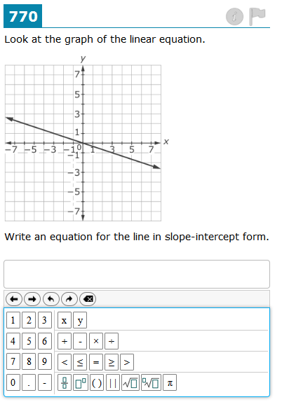
Relevance
The slope of a line (m) is the ratio of the change in y to the change in x.
The y-intercept (b) is the point at which the line passes through the y-axis.
1
Deriving the equation of a line will help you solve real-world problems.
Effects of Air Temperature
on Speed of Sound
From the graph, we can write the equation s = t + 331.3 to accurately predict the speed of sound at any air temperature.
350
10
3
5
6
Speed (m/s)
340
330
10
20
30
40
Temperature (°C)
2
Deriving the equation of a line will help you do well on tests.
Sample Test Question:
Does anyone else have another reason why it is relevant to derive the equation of a line? (Pair-Share) Why is it relevant to derive the equation of a line? You may give one of my reasons or one of your own. Which reason is more relevant to you? Why?
CFU

Slide 10
The slope of a line (m) is the ratio of the change in y to the change in x.
The y-intercept (b) is the point at which the line passes through the y-axis.
y-intercept
y = mx + b
Skill Closure
slope
Derive the equation of a line.
1
Determine the slope of the line. (write)
Determine the y-intercept. (write)
Derive the equation of the line. (write)
Interpret the equation.
“The equation of the line with a slope of ___ and a y-intercept of ___ is ________.”
2
3
4
1. | Slope: ______________ y-intercept: __________ Equation: ___________
5
4
3
3
2
+2
y = x − 2
2
+3
1
-5
-4
-3
-2
-1
1
2
3
4
5
3
2
-1
m =
-2
(0, -2)
b = -2
-3
3
2
-4
y = x − 2
-5
Access Common Core
Word Bank
Explain what information is needed to derive the equation of a line.
derive
equation
line
slope
y-intercept
To derive the equation of a line, the slope and y-intercept are needed.
Summary Closure
What did you learn today about deriving the equation of a line? (Pair-Share)
Use words from the word bank.

