Slide 1
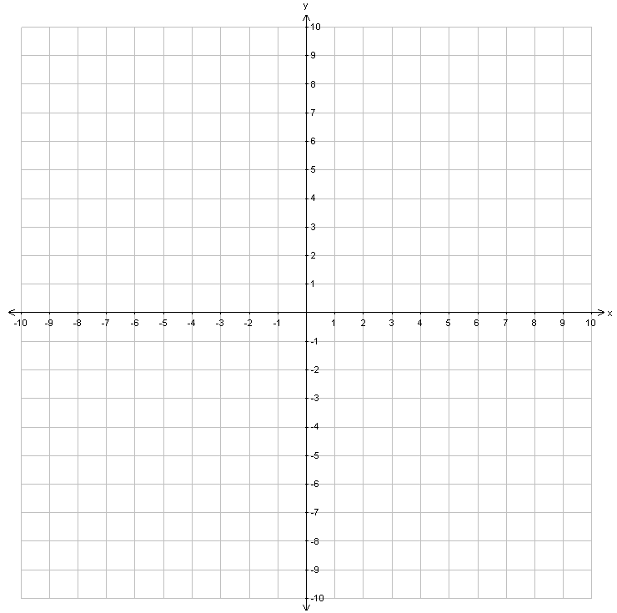
Learning Objective
We will identify₁ quadratic function graphs.
What are we going to do?
What does identify mean? Identify means _________.
CFU
Activate Prior Knowledge
A coefficient is a number that is multiplied to a variable.
The y-intercept is the point where a line crosses the y-axis.
Identify the coefficient of the following terms.
1.
2.
Identify the y-intercept of the following graphs.
Students, you already know how to identify coefficients and y-intercepts. Now, we will use coefficients and y-intercepts to identify the graphs of quadratic functions.
3.
4.
Make Connection
y
y
(0, 2)
(0, 1)
x
x
¹ find and name
Vocabulary

Slide 2

Concept Development
Quadratic Functions
A quadratic function graphs as a parabola.
• A quadratic function can be written in the form y = ax² + bx + c, where a ≠ 0.
The coefficient of x² declares₂ the direction and width of the parabola.
The constant declares the y-intercept of the parabola.
y = x² + 5x + 7
y = 3x² − 7
y = 4x²
CFU
Parabolas
Which words best describe the direction of the parabola for the quadratic function y = -4x² + 5? How do you know?
A Opens Upward
B Opens Downward
Which word best describes the width of the parabola for the quadratic function y = 3x² − 2? How do you know?
A Wide
B Narrow
How do you know the point
(0, 1) is the y-intercept for the quadratic function ?
If a is positive then the parabola opens upward.
4
If |a| < 1 then the parabola will be wide.
3
2
-4
1
If a is negative then the parabola opens downward.
-3
-2
-1
1
2
3
4
(0, 0)
If |a| > 1 then the parabola will be narrow.
-1
-2
-3
-4
4
4
4
3
3
3
2
2
2
(0, 1)
-4
1
1
1
-3
-2
-1
1
2
3
4
-4
-3
-2
-1
1
2
3
4
-4
-3
-2
-1
1
2
3
4
(0, 0)
² tells
-1
-1
-1
Vocabulary
-2
(0, -2)
-2
-2
-3
-3
-3
-4
-4
-4

Slide 3
Concept Development (Clarification and CFU)
10
y
10
9
9
8
8
7
7
6
6
5
5
Parabola _______________
4
opens downwards
shifted down to
y-intercept (0,-3)
became narrower
Parabola _______________
opens upwards
became wider
shifted up to
y-intercept (0, 2)
4
3
3
2
2
1
1
x
x
-10
-9
-8
-7
-6
-5
-4
-3
-2
-1
1
2
3
4
5
6
7
8
9
10
-10
-9
-8
-7
-6
-5
-4
-3
-2
-1
-1
1
2
3
4
5
6
7
8
9
10
-1
-2
-2
-3
-3
Fill in the blanks with the following terms.
-4
-4
y-intercept width direction
-5
-5
direction
-6
-6
-7
-7
y-intercept
-8
-8
width
-9
-9
-10
y
-10

Slide 4

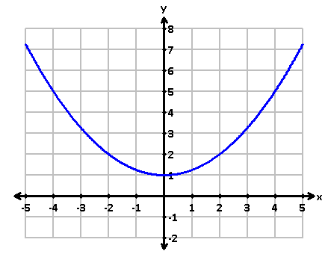
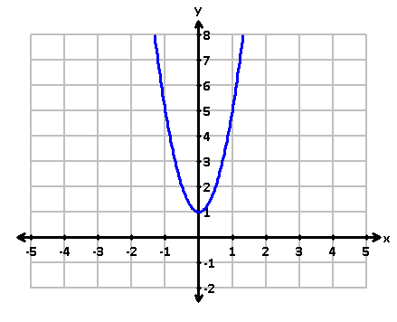
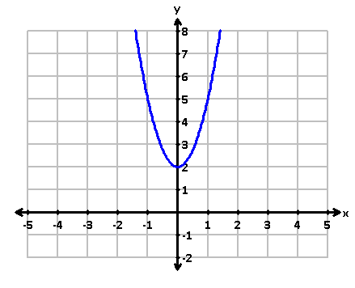
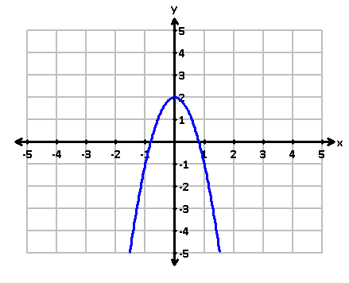
Skill Development/Guided Practice
direction
A quadratic function graphs as a parabola.
The coefficient of x² declares the direction and width of the parabola.
The constant declares the y-intercept of the parabola.
y-intercept
width
Identify quadratic function graphs.
How did I/you determine the direction and width of the parabola?
How did I/you determine the y-intercept of the parabola?
How did I/you identify the graph of the quadratic function?
CFU
1
Identify the coefficient (a) and constant (c) of the quadratic function. (label)
Determine₃ the direction and width of the parabola.
Determine the y-intercept of the parabola.
Identify the graph of the quadratic function.
2
2
3
3
4
a
c
a
c
4
upward
narrow
upward
narrow
Direction: _________ Width: _________
y-intercept: ______
The graph of the quadratic function is ___________.
Direction: _________ Width: _________
y-intercept: ______
The graph of the quadratic function is ___________.
(0, 2)
(0, 1)
Parabola C
Parabola B
A
B
C
D
³ figure out
Vocabulary

Slide 5
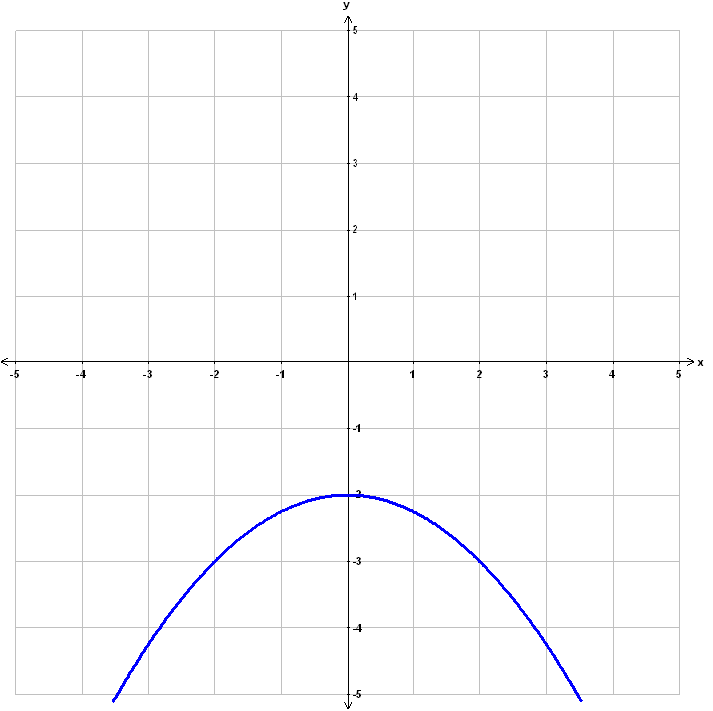
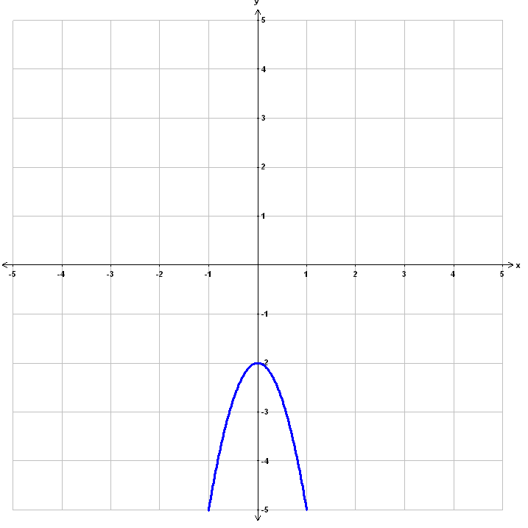
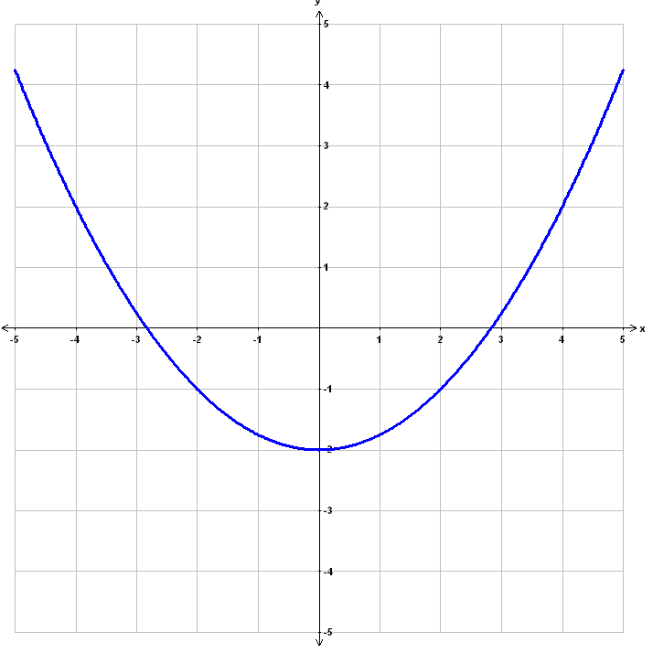
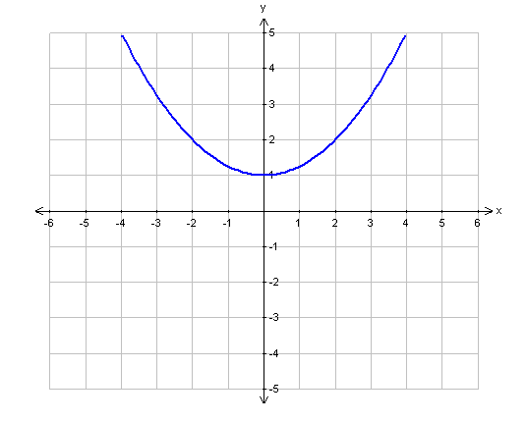
Skill Development/Guided Practice (continued)
direction
A quadratic function graphs as a parabola.
The coefficient of x² declares the direction and width of the parabola.
The constant declares the y-intercept of the parabola.
y-intercept
width
Identify quadratic function graphs.
How did I/you determine the direction and width of the parabola?
How did I/you determine the y-intercept of the parabola?
How did I/you identify the graph of the quadratic function?
CFU
1
Identify the coefficient (a) and constant (c) of the quadratic function. (label)
Determine the direction and width of the parabola.
Determine the y-intercept of the parabola.
Identify the graph of the quadratic function.
2
2
3
3
4
a
c
a
c
4
upward
wide
upward
wide
Direction: _________ Width: _________
y-intercept: ______
The graph of the quadratic function is ___________.
Direction: _________ Width: _________
y-intercept: ______
The graph of the quadratic function is ___________.
(0, -2)
(0, 1)
Parabola C
Parabola D
A
B
C
D

Slide 6
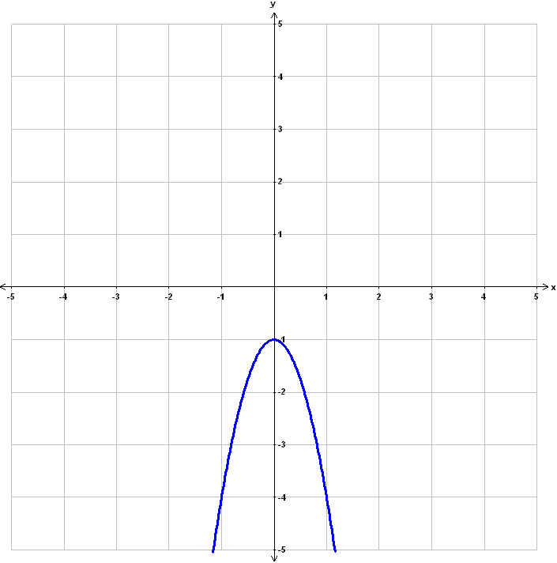
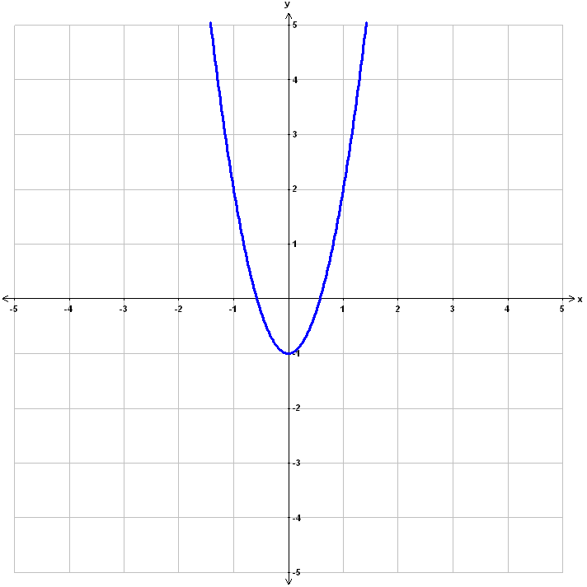
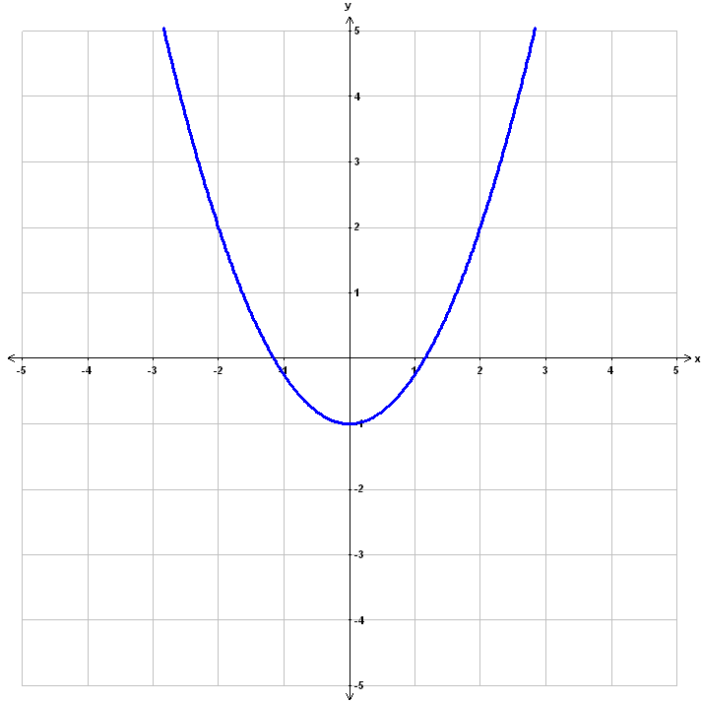
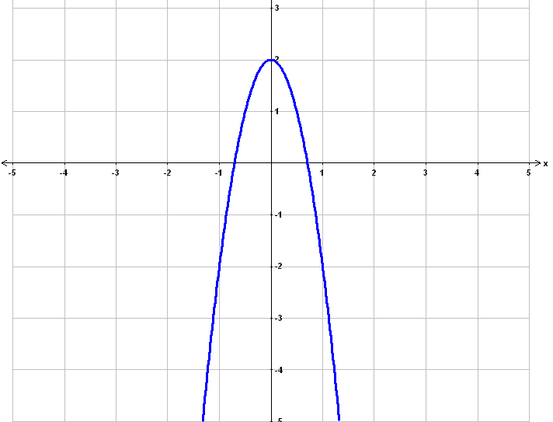
Skill Development/Guided Practice (continued)
direction
A quadratic function graphs as a parabola.
The coefficient of x² declares the direction and width of the parabola.
The constant declares the y-intercept of the parabola.
y-intercept
width
Identify quadratic function graphs.
How did I/you determine the direction and width of the parabola?
How did I/you determine the y-intercept of the parabola?
How did I/you identify the graph of the quadratic function?
CFU
1
Identify the coefficient (a) and constant (c) of the quadratic function. (label)
Determine the direction and width of the parabola.
Determine the y-intercept of the parabola.
Identify the graph of the quadratic function.
2
2
3
3
4
a
c
a
c
4
downward
narrow
downward
narrow
Direction: _________ Width: _________
y-intercept: ______
The graph of the quadratic function is ___________.
Direction: _________ Width: _________
y-intercept: ______
The graph of the quadratic function is ___________.
(0, -1)
(0, 2)
Parabola A
Parabola D
A
B
C
D

Slide 7
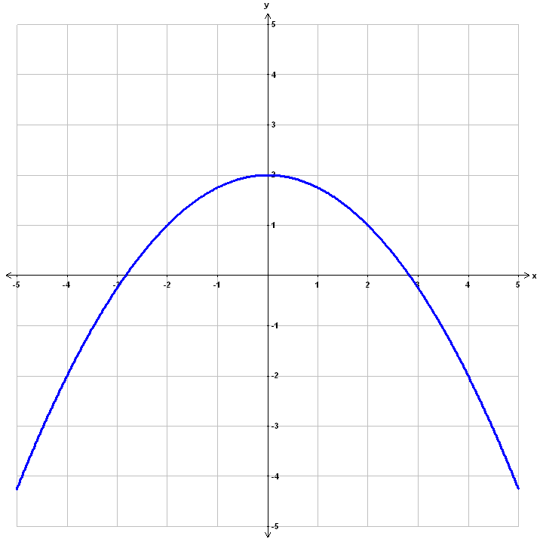
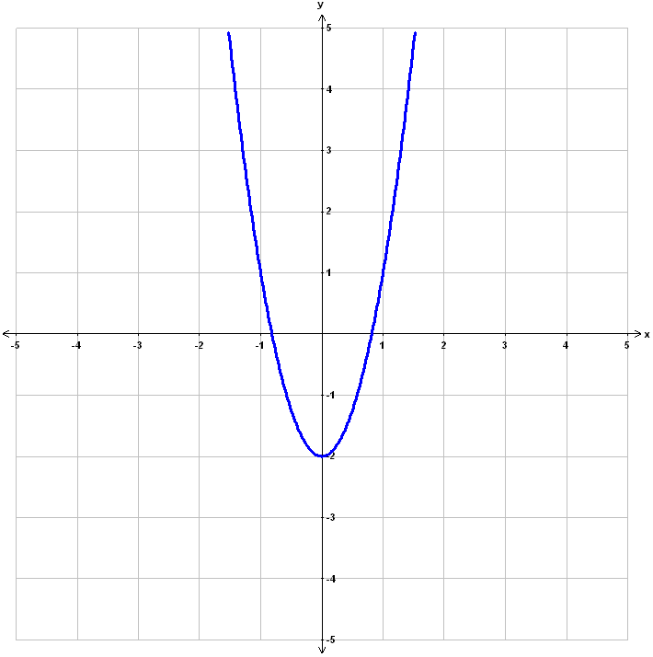
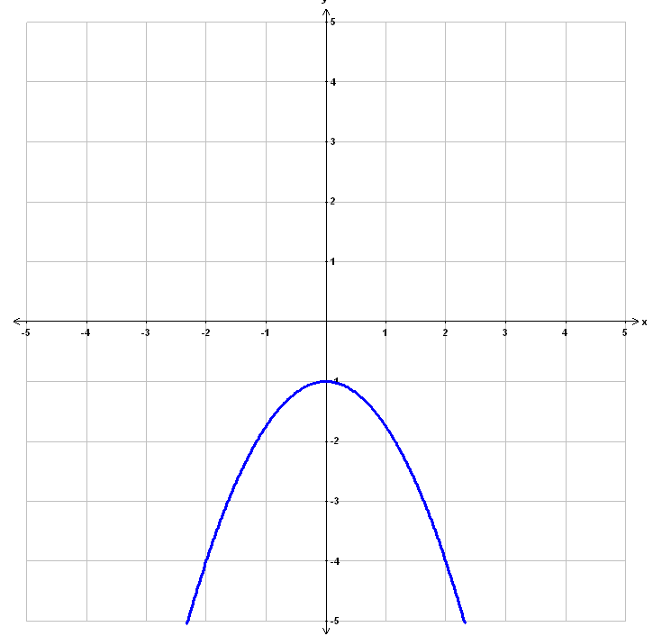
Skill Development/Guided Practice (continued)
direction
A quadratic function graphs as a parabola.
The coefficient of x² declares the direction and width of the parabola.
The constant declares the y-intercept of the parabola.
y-intercept
width
Identify quadratic function graphs.
How did I/you determine the direction and width of the parabola?
How did I/you determine the y-intercept of the parabola?
How did I/you identify the graph of the quadratic function?
CFU
1
Identify the coefficient (a) and constant (c) of the quadratic function. (label)
Determine the direction and width of the parabola.
Determine the y-intercept of the parabola.
Identify the graph of the quadratic function.
2
2
3
3
4
a
c
a
c
4
downward
wide
downward
wide
Direction: _________ Width: _________
y-intercept: ______
The graph of the quadratic function is ___________.
Direction: _________ Width: _________
y-intercept: ______
The graph of the quadratic function is ___________.
(0, -1)
(0, 2)
Parabola D
Parabola A
A
B
C
D

Slide 8





ACT RESPONSIBLY & SUPPORT the COMMUNITY.
Be on Time
Wear ID
Chromebook Ready
SEE SOMETHING, SAY SOMETHING

Slide 9
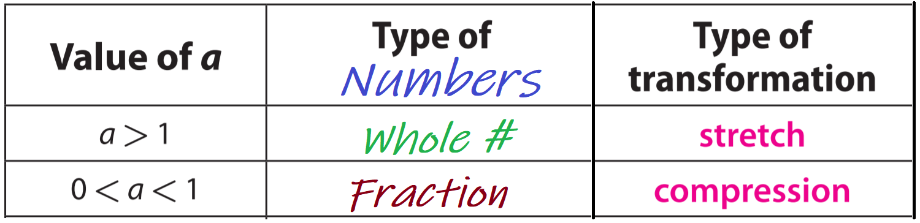
LO (continued)
We will identify quadratic function graphs.
Fill in the blanks with the following terms.
y-intercept width direction
direction
y-intercept
width
Identify quadratic function graphs.
1
Identify the coefficient (a) and constant (c) of the quadratic function. (label)
Determine the direction and width of the parabola.
Determine the y-intercept of the parabola.
Identify the graph of the quadratic function.
2
3
4

Slide 10
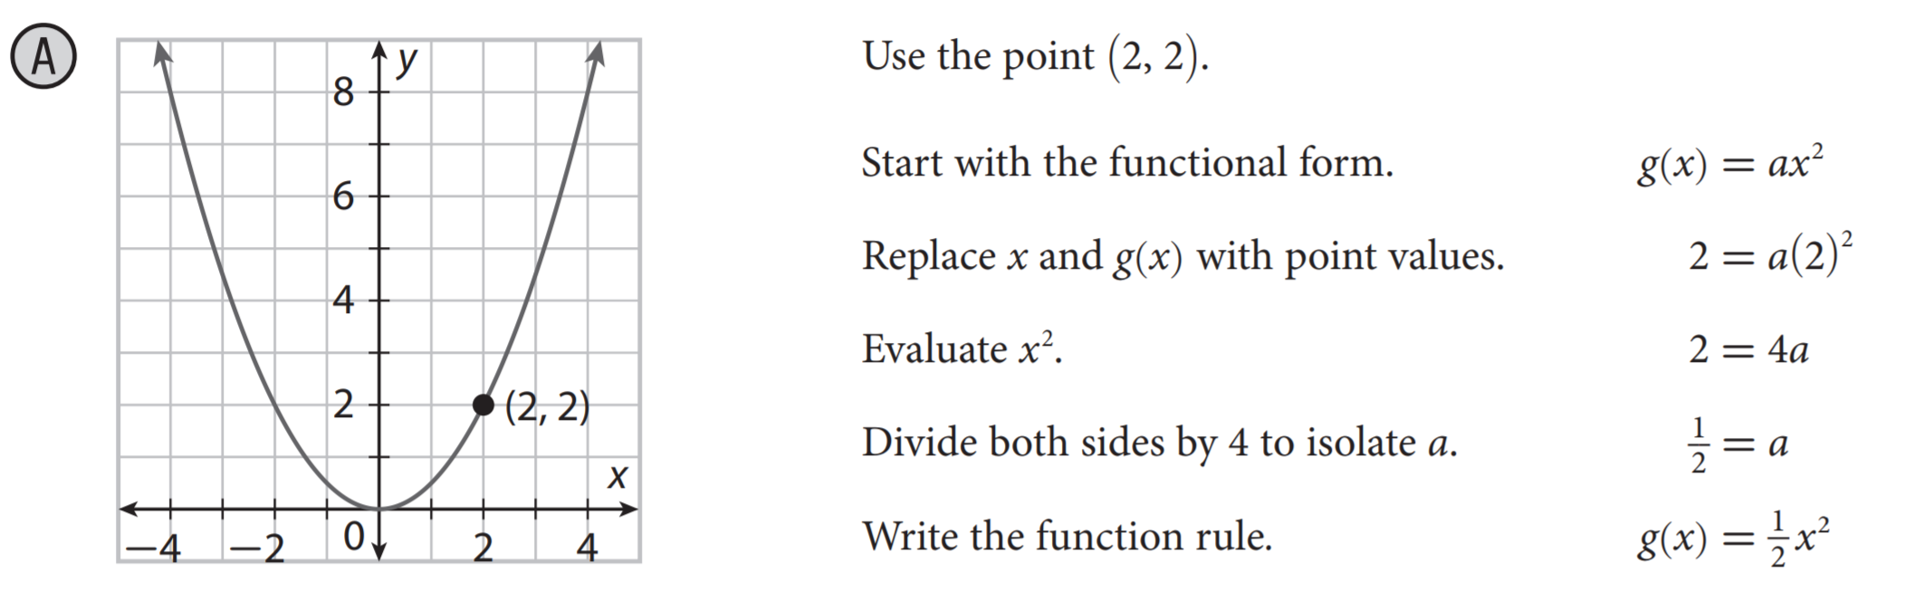

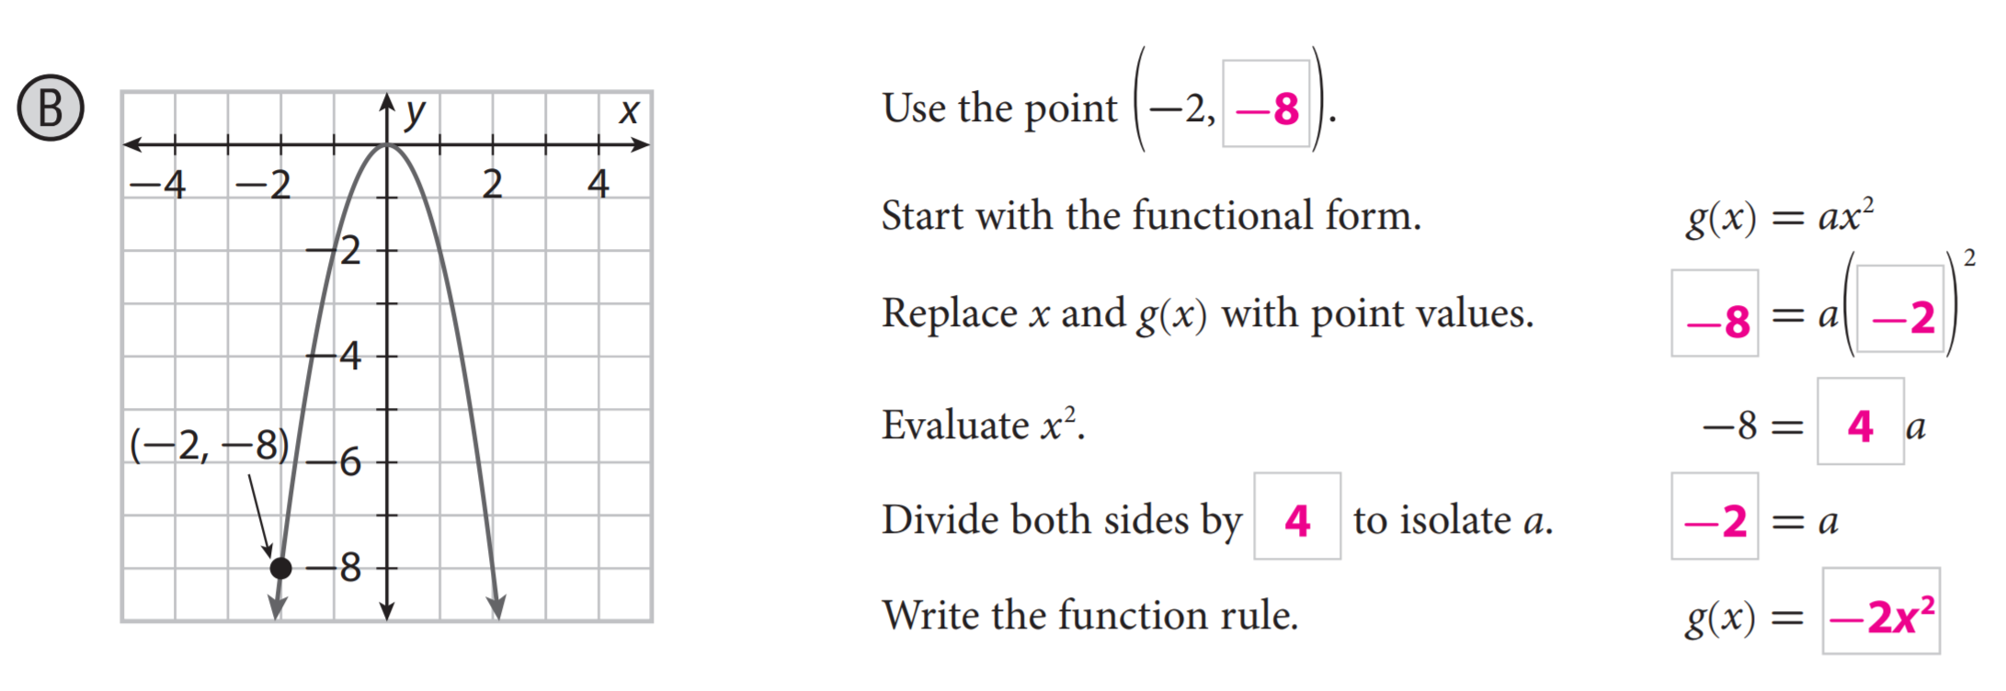
Skill Development/Guided Practice (continued)
You can determine the value of “a” for a parabola by substituting a point $\left(x, y\right)$ values for any other point on the parabola into $y={ax}^{2}+c$and solving for “a”.
+ c
+ 0

Slide 11
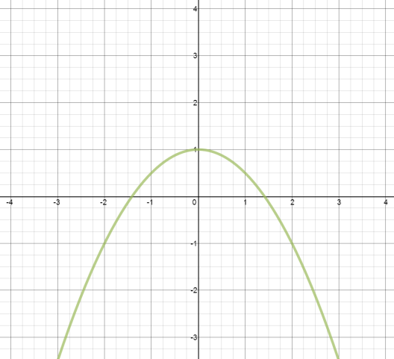
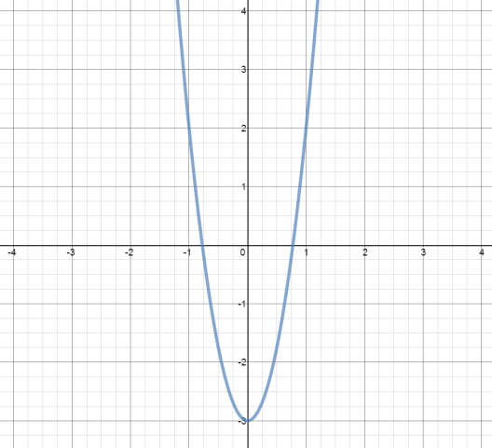


Skill Development/Guided Practice (continued)
You can determine the value of “a” for a parabola by substituting a point $\left(x, y\right)$ values for any other point on the parabola into $y={ax}^{2}+c$and solving for “a”.
Describe the graph of the parabola, then find the quadratic function which represents the parabola. The parabolas are of the form ax² + c. (Hint: Substitute the values of a point on the parabola to find ax²)
4
4
3
3
. (1, 2)
2
2
1
1
-4
-3
-2
-1
1
2
3
4
-4
-3
-2
-1
1
2
3
4
. (2, 1)
-1
-1
-2
-2
-3
-3
The parabola opens downward and wide. The y-intercept is at (0, 1).
The parabola opens upward and narrow. The y-intercept is at (0, -3).
The function is
The function is

Slide 12



Relevance
A quadratic function graphs as a parabola.
The coefficient of x² declares the direction and width of the parabola.
The constant declares the y-intercept of the parabola.
1
Identifying graphs of quadratic functions will help you understand graphs in the real world.
34,000
32,000
  The “Weightless Wonder” is a plane used by NASA to train astronauts in zero-gravity situations. It accelerates upward and then descends fast enough for the effects of gravity to be negated, producing a feeling of weightlessness.
30,000
Altitude (feet)
28,000
26,000
24,000
0
20
45
65
Maneuver Time (seconds)
2
Identifying graphs of quadratic functions will help you do well on tests.
Sample Test Question:
Does anyone else have another reason why it is relevant to identify quadratic function graphs? (Pair-Share) Why is it relevant to identify quadratic function graphs? You may give me one of my reasons or one of your own. Which reason is more relevant to you? Why?
CFU

Slide 13
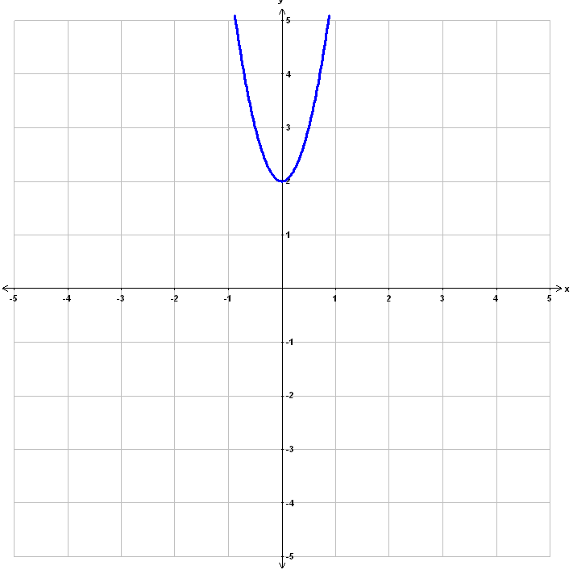
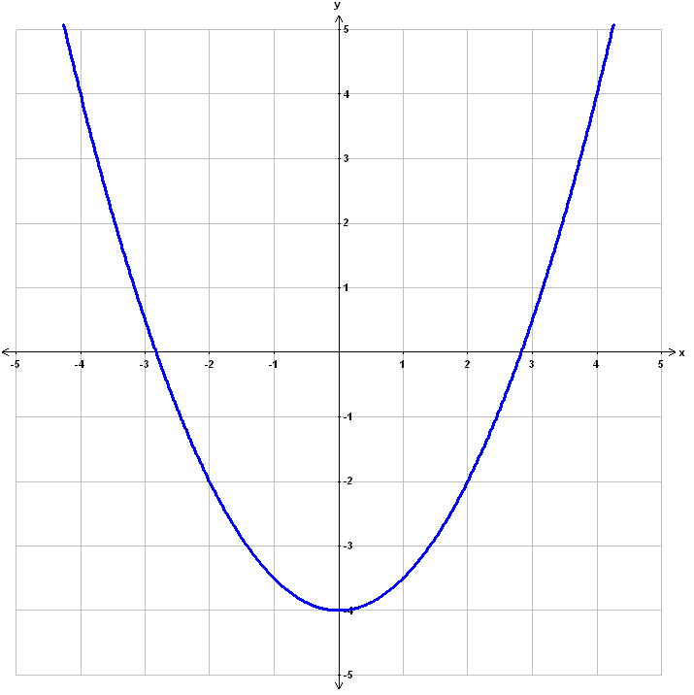
A quadratic function graphs as a parabola.
The coefficient of x² declares the direction and width of the parabola.
The constant declares the y-intercept of the parabola.
direction
y-intercept
width
Skill Closure
Identify quadratic function graphs.
1
Identify the coefficient (a) and constant (c) of the quadratic function. (label)
Determine the direction and width of the parabola.
Determine the y-intercept of the parabola.
Identify the graph of the quadratic function.
2
3
4
a
c
a
c
upward
narrow
Direction: _________ Width: _________
y-intercept: ______
The graph of the quadratic function is ___________.
downward
narrow
(0, 2)
Direction: _________ Width: _________
y-intercept: ______
The graph of the quadratic function is ___________.
(0, -1)
Parabola A
Parabola D
A
B
C
D
Access Common Core
Describe the graph of the quadratic function above.
Hint: Use the words parabola, direction, width, and y-intercept.
Summary Closure
What did you learn today identifying quadratic function graphs? (Pair-Share)

