Slide 1
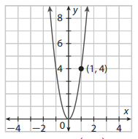
Name: ______________________________
Period:____
Lesson 1: 6.3 Writing a Quadratic Function Given a Graph
Determine if the quadratic function is stretched or compressed. How do you know?
$$1. f\left(x\right)=2x^{2}$$
$$2. f\left(x\right)={\frac{1}{2}x}^{2}$$
Remember the Concept
The graph y= ax² is a stretch if a>1 and compressed if 0<a<1.
ACTIVATE PRIOR KNOWLEDGE
The function is _________
because ______________.
The function is _________
because ______________.
Make the Connection
Students, you already know what will stretch or compress a quadratic function. Now we are going to construct the equation.
Parent Quadratic Function
The most basic quadratic function is ƒ(x) = x².
A quadratic function can be written in the form
y = ax² + bx + c a ≠ 0.
Check for Understanding
Describe the behavior of the following quadratic equation. y= -2x² The quadratic function opens ______ because “a” is ______. The function has a ______and _______________ because…….
if a is positive then the parabola opens up.
If a is negative then the parabola opens down
If |a| > 1 then the parabola is stretched
If |a| < 1 then the parabola is compressed
Concept Development
Example 1: Writing a Quadratic Function Given a Graph
Write a rule for the quadratic function shown on the graph.
Steps
1. Write the functional form.
The functional form is ___________.
2. Identify x and g(x) using the point.
I identified x and g(x) by _______________.
3. Substitute x and g(x)
To substitute x and g(x), I/we _______.
4. Solve for a.
In order to solve for a _________.
5. Write the function rule.
The function rule is ___________.
1. g(x) = ax²
Skill Development
I write the function rule by ______________________.

Slide 2
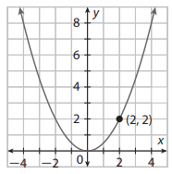
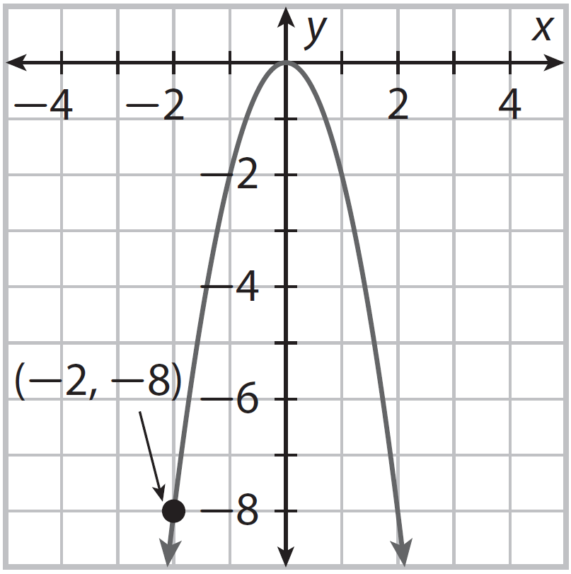
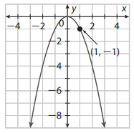
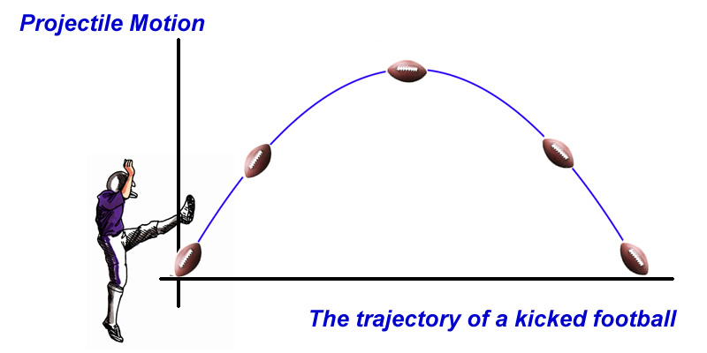
You Turn 1: Writing a Quadratic Function Given a Graph
Write a rule for the quadratic function shown on the graph.
Steps
1. Write the functional form.
The functional form is ___________.
2. Identify x and g(x) using the point.
I identified x and g(x) by _______________.
3. Substitute x and g(x)
To substitute x and g(x), I/we _______.
4. Solve for a.
In order to solve for a _________.
5. Write the function rule.
The function rule is ___________.
1. g(x) = ax²
Skill Development
I write the function rule by ______________________.
Example 2: Writing a Quadratic Function Given a Graph
Write a rule for the quadratic function shown on the graph.
1. g(x) = ax²
Your turn 2: Writing a Quadratic Function Given a Graph
Write a rule for the quadratic function shown on the graph.
1. g(x) = ax²
When a football player kicks the ball, it roughly follows the path of a parabola.
Relevance

Slide 3
What did you learn today about constructing quadratic functions given a graph?
Word Bank
Parent Function
Parabola
Vertex
Axis of Symmetry
Domain / Range
Coefficient
Minimum / Maximum
y-Intercept
Upward / downward
Direction (wide / narrow
Closure
Today, I learned how to______________ _________________________________________________________________.

Slide 4
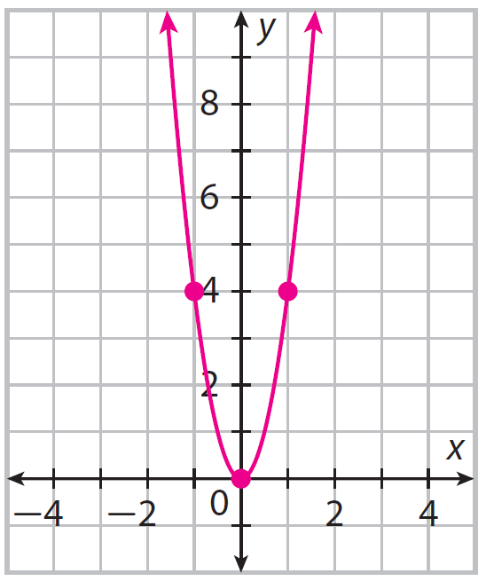
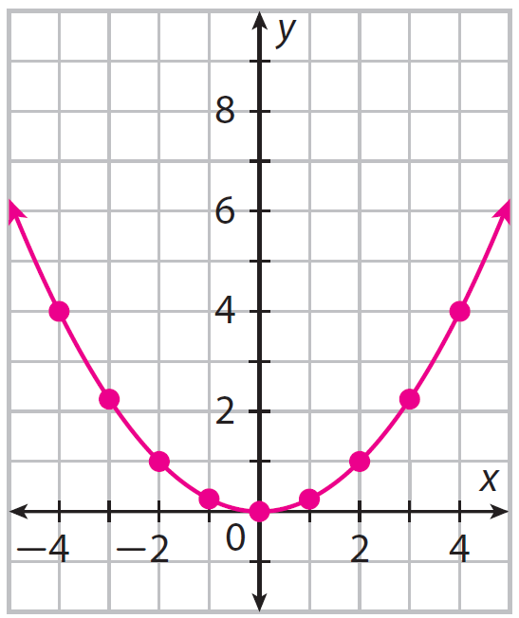
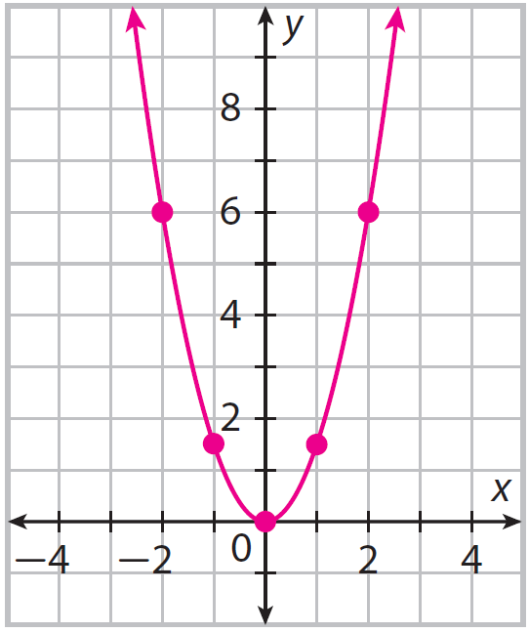
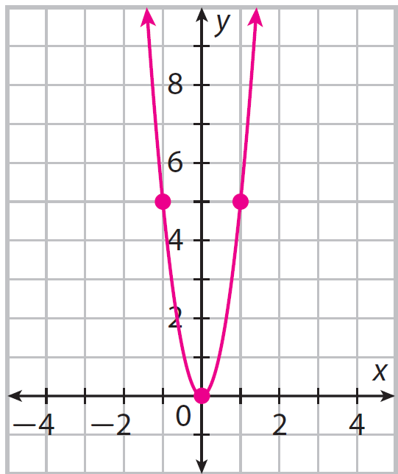
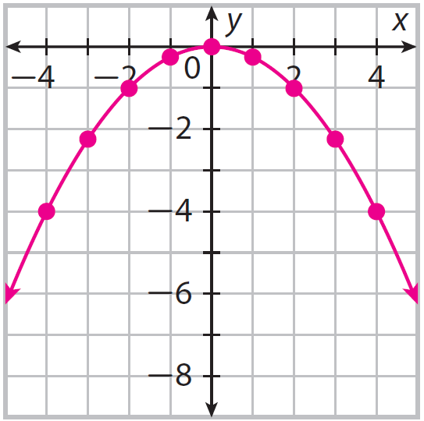
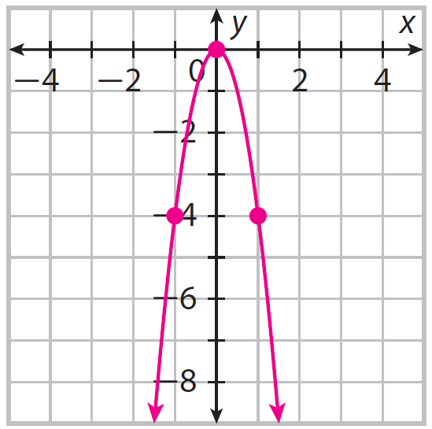
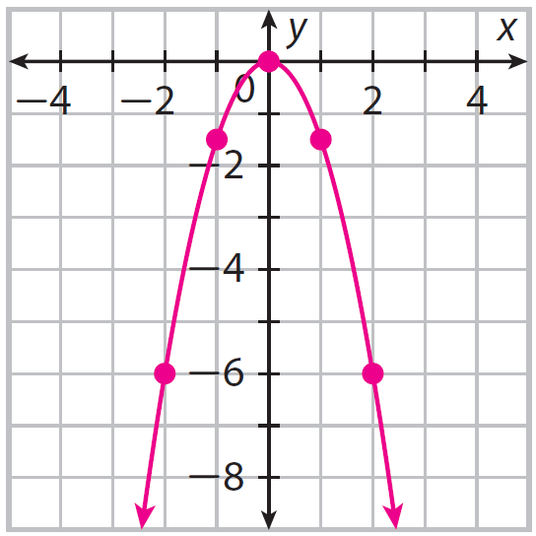
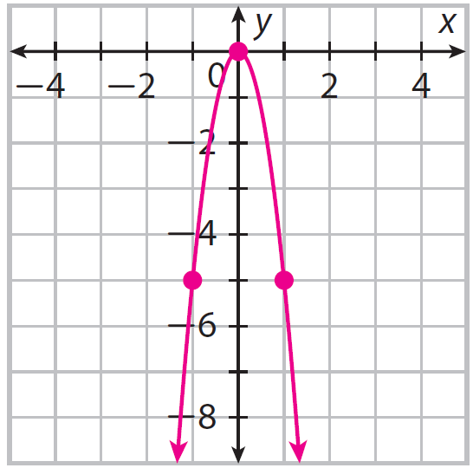
Determine the equation of the parabola graphed.
2.
3.
4.
Guided Practice
_f(x)_= _________
_f(x)_= _________
_f(x)_= _________
_f(x)_= _________
Determine the equation of the parabola graphed.
5.
6.
7.
8.
Guided Practice
_f(x)_= _________
_f(x)_= _________
_f(x)_= _________
_f(x)_= _________

