Slide 1
By the end of class, students will be able to construct₁ a quadratic function given a graph.
LEARNING OBJECTIVE
Definition
Construct-- to build (write)

Slide 2
Determine if the quadratic function is stretched or compressed. How do you know?
Remember the Concept
The graph y= ax² is a stretch if a>1 and compressed if 0<a<1.
f(x)= 2x²
2. f(x)= ½ x²
ACTIVATE PRIOR KNOWLEDGE
Make the Connection
Students, you already know what will stretch or compress a quadratic function. Now we are going to construct the equation.
The function is _____________________because _________________.

Slide 3
Parent Quadratic Function
Check for Understanding
Describe the behavior of the following quadratic equation. y= -2x² The quadratic function opens ______ because “a” is ______. The function has a ______and _______________ because…….
The most basic quadratic function is ƒ(x) = x².
A quadratic function can be written in the form
y = ax² + bx + c, where a ≠ 0.
if a is positive then the parabola opens up.
If a is negative then the parabola opens down
If |a| > 1 then the parabola is stretched
If |a| < 1 then the parabola is compressed
Concept Development
Describe the behavior of the following quadratic equation y = 3 x².
up/ down
stretched/ compressed
The quadratic function opens ___________________because…and ______________________ because...

Slide 4
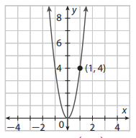
Example 1: Writing a Quadratic Function Given a Graph
Write a rule for the quadratic function shown on the graph.
Steps
1 Write the functional form.
CFU How did you/I write the functional form?
2 Identify x and g(x) using the point.
CFU How did I/you identify x and g(x)?
3 Substitute x and g(x)
CFU How did I/you substitute x and g(x)?
4 Solve for a.
CFU How did I/you solve for a?
5 Write the function rule.
CFU How did I/you write the function rule?
g(x) = ax²
2. (1, 4)
x = 1
y = g(1) = 4
3. 4 = a (1)²
4. 4 = a (1)
4 = a
5. g(x) = 4x²
Skill Development
I write the function rule by ______________________.

Slide 5
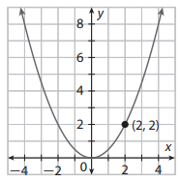
You Turn 1: Writing a Quadratic Function Given a Graph
Write a rule for the quadratic function shown on the graph.
Steps
1 Write the functional form.
CFU How did you/I write the functional form?
2 Identify x and g(x) using the point.
CFU How did I/you identify x and g(x)?
3 Substitute x and g(x)
CFU How did I/you substitute x and g(x)?
4 Solve for a.
CFU How did I/you solve for a?
5 Write the function rule.
CFU How did I/you write the function rule?
g(x) = ax²
2. (2, 2)
x = 2
y = g(2) = 2
3. 2 = a (2)²
4. 2 = a (4)
½ = a
5. g(x) = ½ x²
Skill Development
I write the function rule by ______________________.

Slide 6
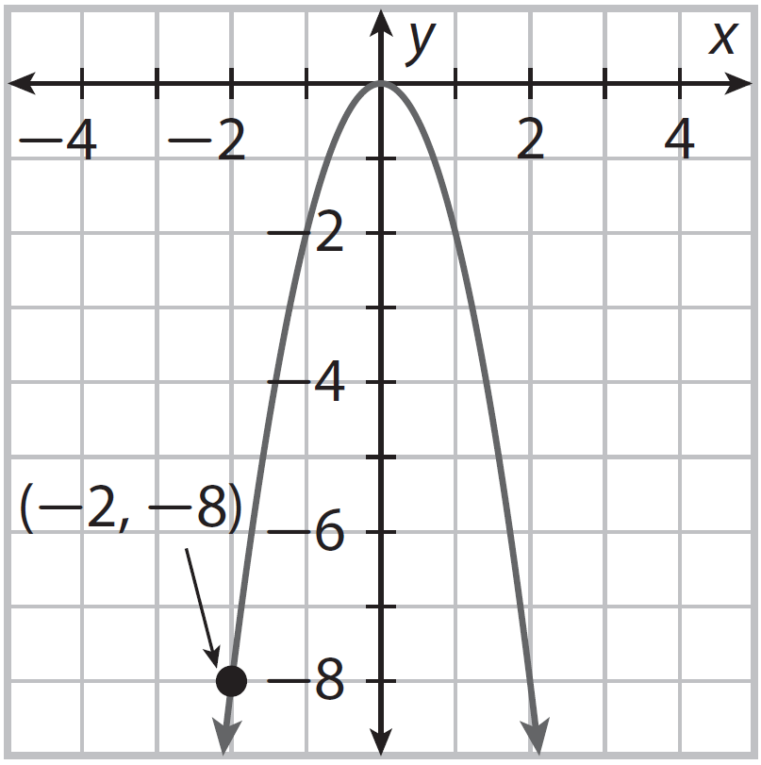
Example 2: Writing a Quadratic Function Given a Graph
Write a rule for the quadratic function shown on the graph.
Steps
1 Write the functional form.
CFU How did you/I write the functional form?
2 Identify x and g(x) using the point.
CFU How did I/you identify x and g(x)?
3 Substitute x and g(x)
CFU How did I/you substitute x and g(x)?
4 Solve for a.
CFU How did I/you solve for a?
5 Write the function rule.
CFU How did I/you write the function rule?
g(x) = ax²
2. (-2, -8)
x = -2
y = g(-2) = -8
3. -8 = a(-2)²
4. -8 = a(4)
-2 = a
5. g(x) = -2 x²
Skill Development
Notes:
Do not forget to determine the VERTEX and if there is minimum or maximum value.

Slide 7
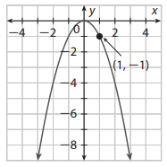
Your turn 2: Writing a Quadratic Function Given a Graph
Write a rule for the quadratic function shown on the graph.
Steps
1 Write the functional form.
CFU How did you/I write the functional form?
2 Identify x and g(x) using the point.
CFU How did I/you identify x and g(x)?
3 Substitute x and g(x)
CFU How did I/you substitute x and g(x)?
4 Solve for a.
CFU How did I/you solve for a?
5 Write the function rule.
CFU How did I/you write the function rule?
g(x) = ax²
2. (1, -1)
x = 1
y = g(1) = -1
3. -1 = a (1)²
4. -1 = a (1)
-1 = a
5. g(x) = - x²
Skill Development
Notes:
Do not forget to determine the VERTEX and if there is minimum or maximum value.

Slide 8
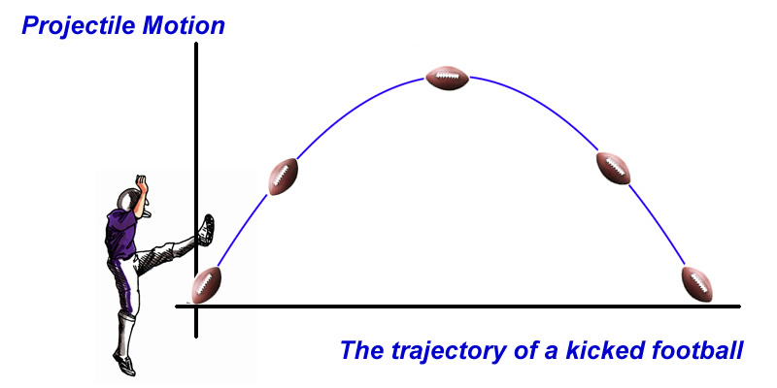
Relevance
When a football player kicks the ball, it roughly follows the path of a parabola.
Skill Development
Notes:
Do not forget to determine the VERTEX and if there is minimum or maximum value.

Slide 9
What did you learn today about constructing quadratic functions given a graph?
Word Bank
Parent Function
Parabola
Vertex
Axis of Symmetry
Domain / Range
Coefficient
Minimum / Maximum
y-Intercept
Upward / downward
Direction (wide / narrow
Closure

Slide 10
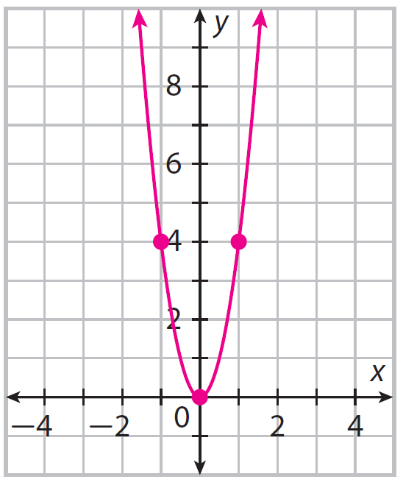
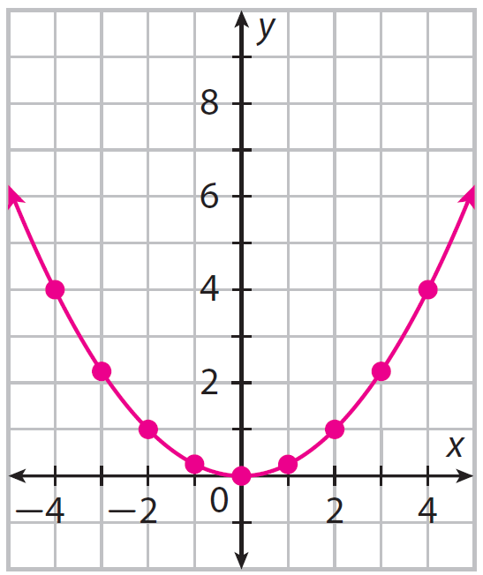
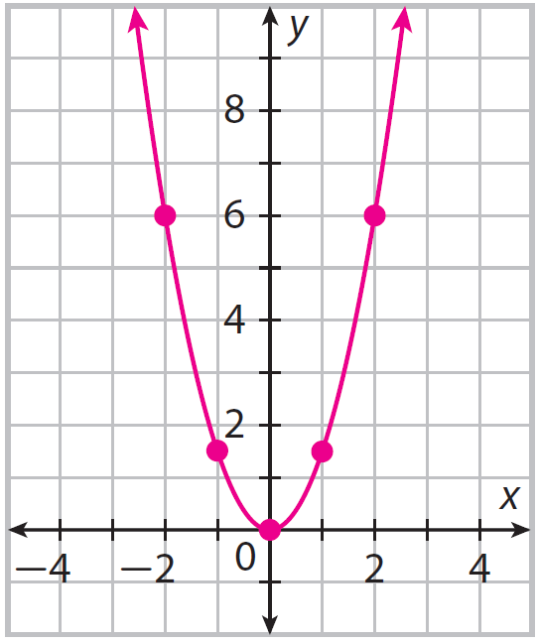
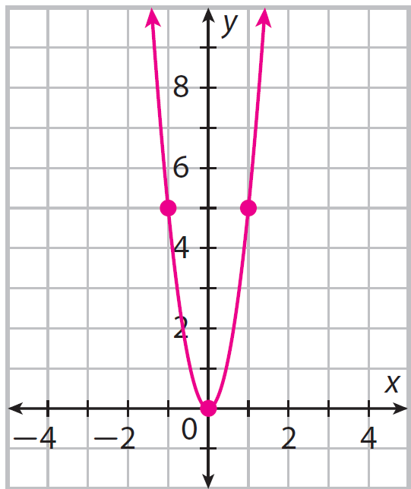
Determine the equation of the parabola graphed.
2.
3.
4.
Guided Practice
_f(x)_= _________
_f(x)_= _________
_f(x)_= _________
_f(x)_= _________

Slide 11
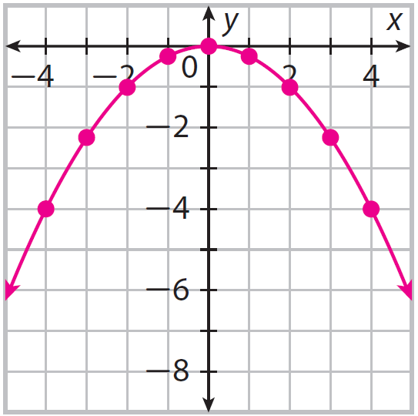
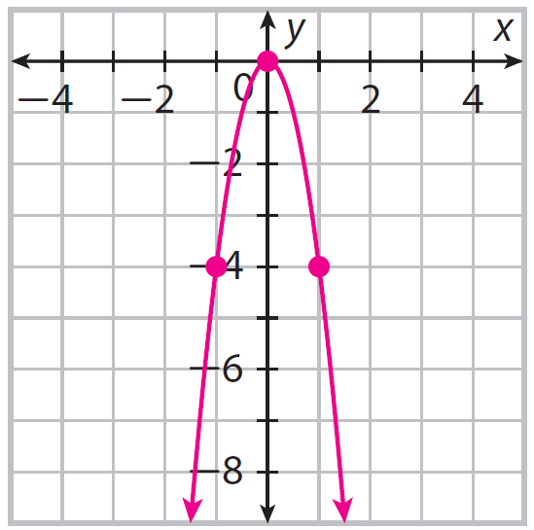
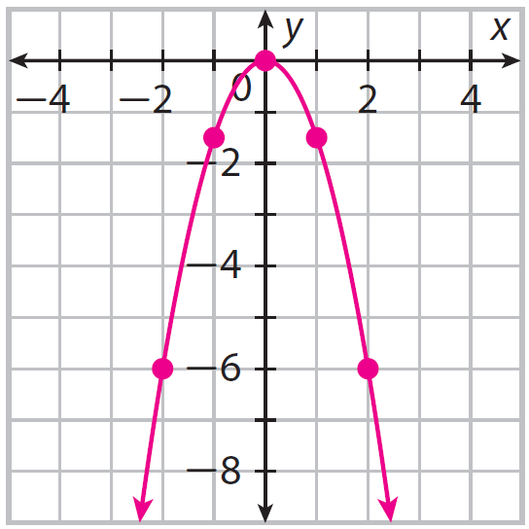
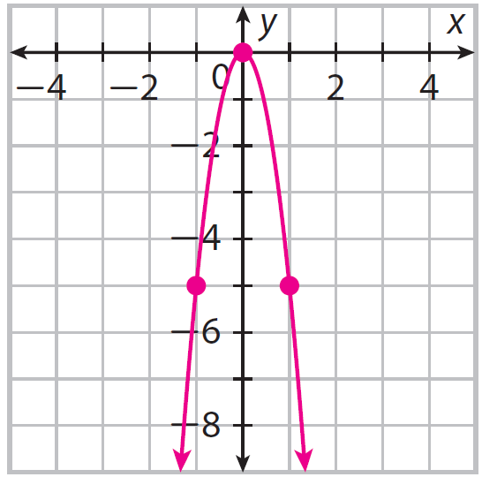
Determine the equation of the parabola graphed.
5.
6.
7.
8.
Guided Practice
_f(x)_= _________
_f(x)_= _________
_f(x)_= _________
_f(x)_= _________

