Slide 1
Learning Objective
CFU
A: What are we going to learn?
B: What is a vertex?
Vertex means_____________.
We will Graph Quadratic Functions in Standard Form by identifying the ${\text{vertex}}_{1}.$
Activate Prior Knowledge
Find the vertex of y = 2x² + 8x +6
2. Find the vertex of
y = x² + 4x + 5
y = 2x² + 8x +6
Remember
Step 1: Identify a and b:
Step 1: Identify a and b:
a = 2 and b = 8
a = 1 and b = 4
Step 2: Find the X.
Step 2: Find the X.
$$x=\frac{−b}{2a}$$
$$=\frac{−8}{2(2)}$$
$$=\frac{−8}{ 4}$$
$$x=\frac{−b}{2a}$$
$$=\frac{−4}{2(1)}$$
$$=\frac{−4}{ 2}$$
$$=−2$$
$=−$2
Students, you already know how to find the vertex of a parabola. Now, we will learn how to Graph Quadratic Functions in Standard Form.
Step 3: Find the Y:
Step 3: Find the Y:
Make Connection
y = 2($−2$)² + 8($−2$) +6
y = ($−2$)² + 4($−2$) +5
= 2($4$) -16 + 6
= ($4$) -8 + 5
= 8-16 + 6
= -4 + 5
= -8 + 6
= -2
= 1
Step 4: Write the Order Pair:
Step 4: Write the Order Pair:
2x² + 8x +6
( -2, -2)
The vertex of $y=_____________is at$(__, _ _)
x² + 4x +5
( -2, 1)
The vertex of $y=_____________is at$(__, _ _)
1: The endpoint of a Parabola.
Vocabulary

Slide 2
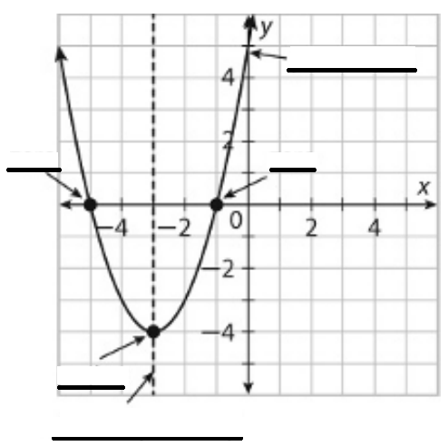
Concept Development
A quadratic function has a standard form of y = ax² + bx + c, where a ≠ 0.
Vertex - the lowest (or highest) point of a parabola at (h, k).
Zeroes – where the parabola crosses the x-axis.
A parabola can have two zeroes, one zero, or no zeroes.
Zeroes are called the solutions of the quadratic equation.
y-intercept(c)– where the parabola crosses the y-axis. (There will only be one y-intercept.)
Axis of symmetry – splits a parabola into two “mirror images” of each other ($x=\frac{−b}{2a}$).
CFU: Identify the key terms below on the graph.
Word Bank
Vertex
Zero
Zero
y-intercept
Axis of symmetry

Slide 3
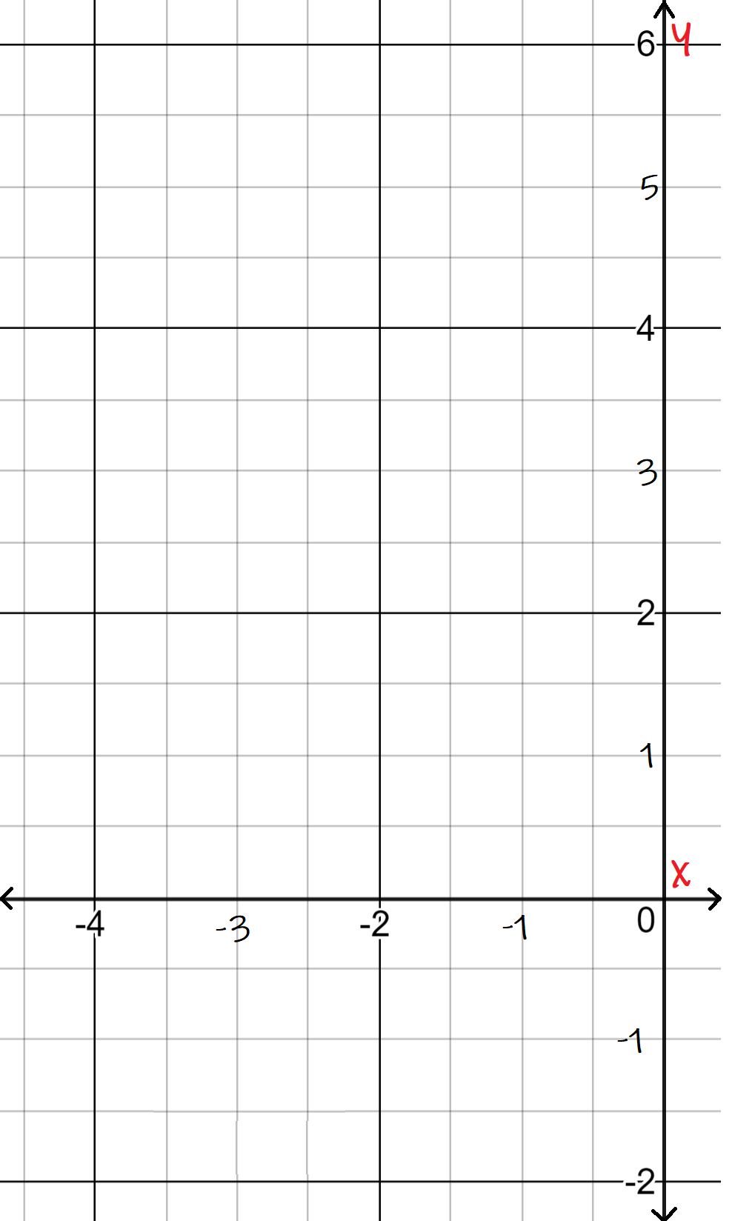
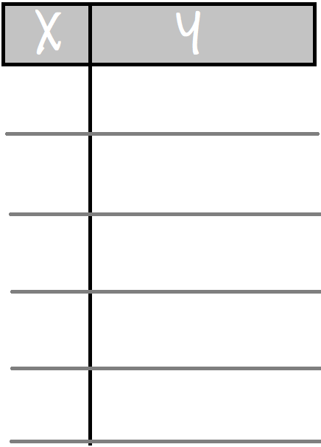
Skill Development
Vertex Form
If a function is not written in the vertex form, you can use a formula $x=\frac{−b}{2a}$ to find the x-coordinate of the vertex.
Standard Form
Steps to Graph Quadratic Functions in Standard Form.
Goto Page 2!
1
Find the Vertex (h, k). Hint: use the formal x$=−\frac{b}{2a},\text{the}\text{n} \text{substitute} \text{back} \text{to} \text{find} \text{y}$.
How did I/you find the Vertex point?
How did I/you find two more points?
How did I/you reflect the graph?
2
Graph the vertex point and draw axis of symmetry line.
CFU: Pair Share!
3
Find two more points left/right of vertex and Graph it.
1
4
Reflect the graphed points over the axis of symmetry to create two more points and sketch the graph.
3
4
.
.
Graph the quadratic function: $y=\text{2}\text{x}\text{2}\text{ + 8}\text{x}\text{ + 6}\text{.}$
a = 2
b = 8
$$x=\frac{−b}{2a}$$
$$=\frac{−8}{2(2)}$$
$$=\frac{−8}{ 4}$$
Step 1:
$$=−2$$
y = 2($−2$)² + 8($−2$) + 6
= -2
Step 2: Graph vertex point (-2, -2).
Zeroes
Step 3:
“Solutions”
Vertex:
(-2,
-2)
-1
2($−1$)² + 8($−1$) +6 = 0
.
0
2($0$)² + 8($0$) + 6 = 6 (y-intercept)
.
-3
0
-4
6
.
Step 4: Reflect the graph
Vertex

Slide 4
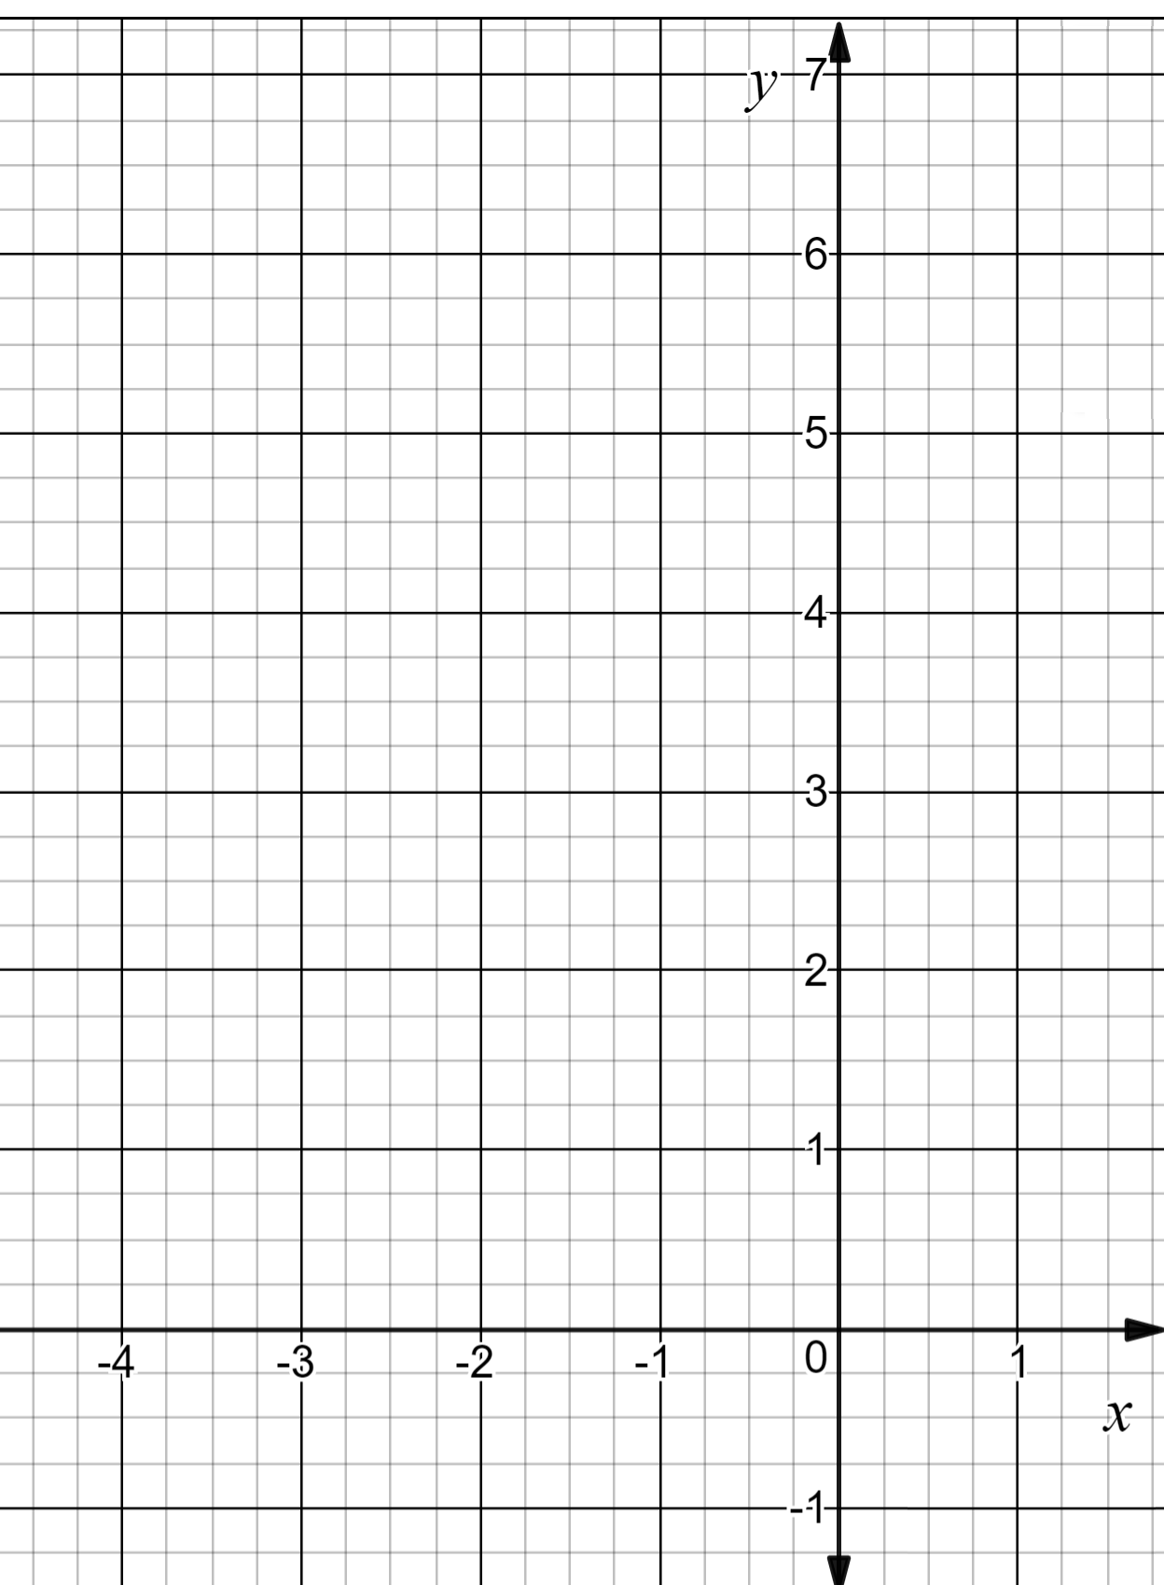
Skill Development
Vertex Form
If a function is not written in the vertex form, you can use a formula $x=\frac{−b}{2a}$ to find the x-coordinate of the vertex.
Standard Form
Steps to Graph Quadratic Functions in Standard Form.
1
Find the Vertex (h, k). Hint: use the formal x$=−\frac{b}{2a},\text{the}\text{n} \text{substitute} \text{back} \text{to} \text{find} \text{y}$.
2
Graph the vertex point and draw axis of symmetry line.
How did I/you find the Vertex point?
How did I/you find two more points?
How did I/you reflect the graph?
CFU: Pair Share!
Find two more points left/right of vertex and Graph it.
Why is it important to find additional points before graphing a quadratic function?
3
Discussion
1
4
Reflect the graphed points over the axis of symmetry to create two more points and sketch the graph.
3
4
Graph the quadratic function: $y=\text{x}\text{2}\text{ + 4}\text{x}\text{ + }\text{5}\text{.}$
1
$$x=\frac{−b}{2a}$$
a = __
b = __
4
$$=\frac{−(__)}{2(__)}$$
4
$$−2$$
Step 1:
$$=\frac{ }{ }$$
$$=______$$
.
4
1
2
.
$$−2$$
$$−2$$
1
y = ($___$)² + 4($____$) + 5
= ___
$$−2$$
$$1$$
Step 2: Graph vertex point (__, __).
.
Step 3:
.
$$−2$$
1
Vertex:
( ,
)
-1
2
No Zeroes
.
( )² + 4( ) + 5 = __
-1
-1
“No Solutions”
Vertex
0
0
0
( )² + 4( ) + 5 = ___
5 (y-int)
-3
2
-4
5
Step 4: Reflect the graph

Slide 5
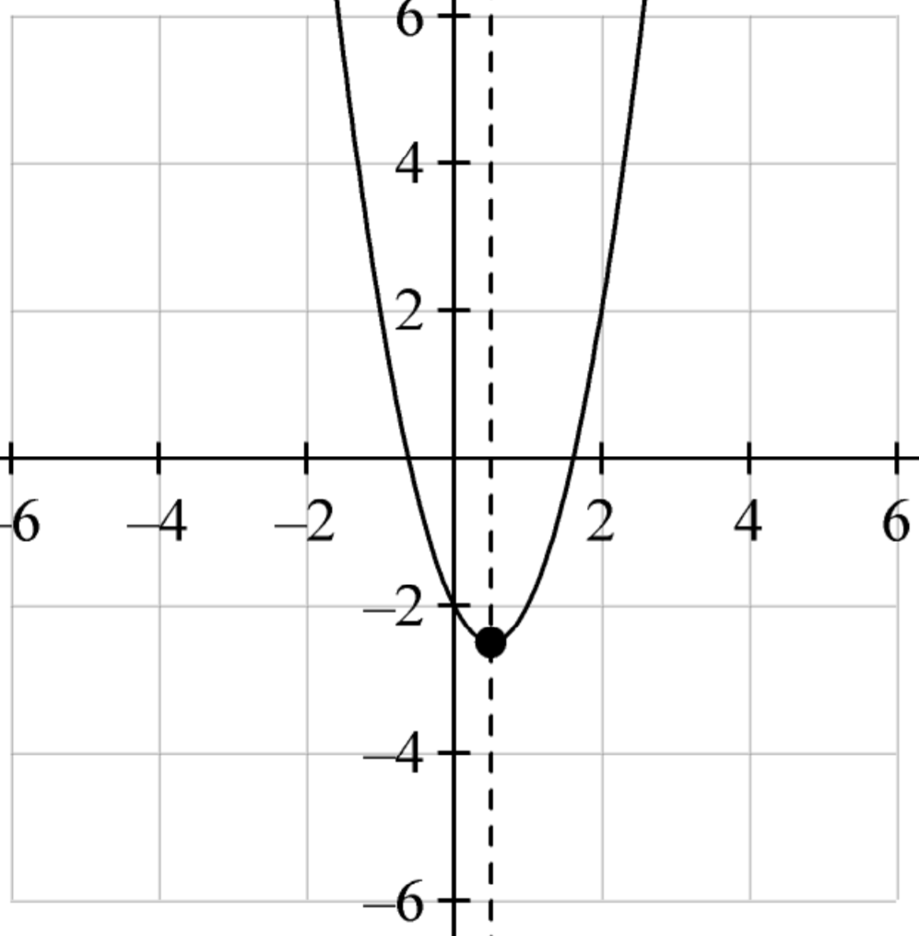
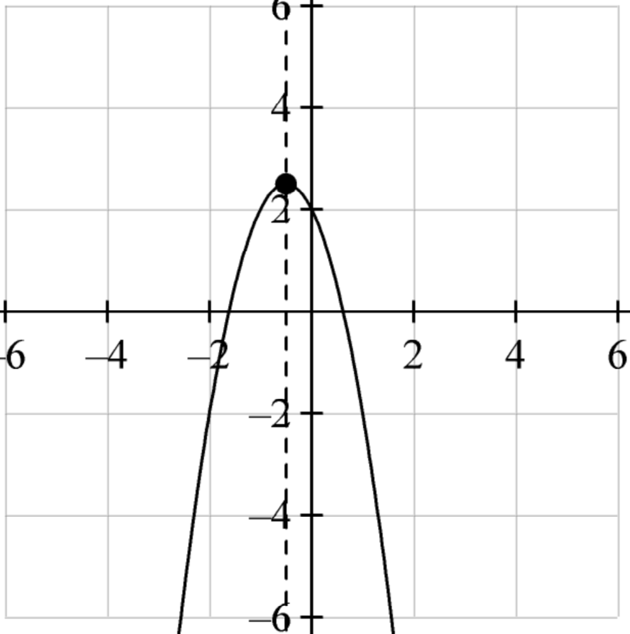
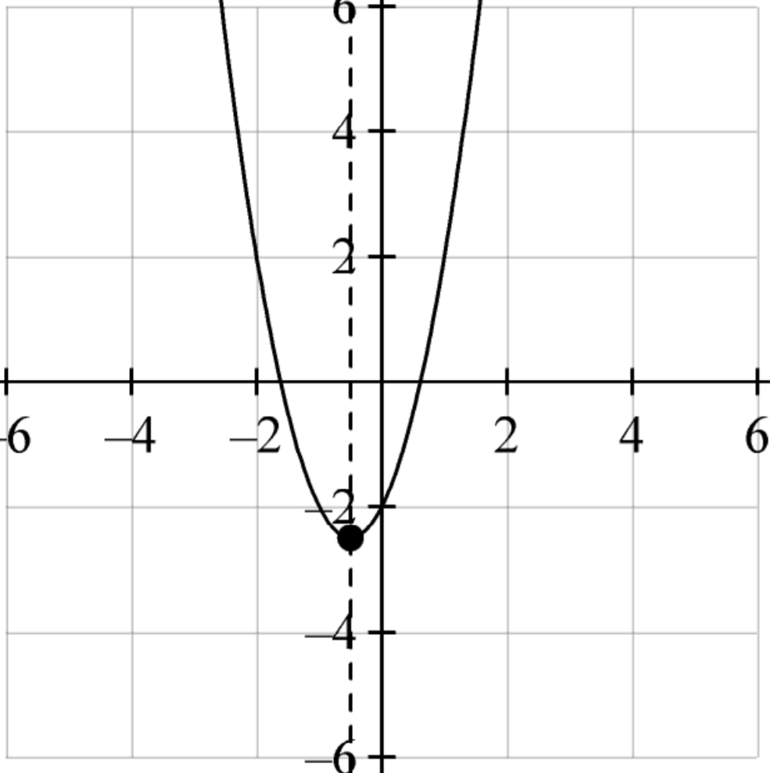
Relevance
If a function is written in the Standard form, you can use ($\frac{−b}{2a}$ , f ($\frac{−b}{2a})$to find the vertex (h, k) and pick additional two more points to graph the function.
1
Using Vertex will help you graph a quadratic function.
Vertex can be useful in graphing a quadratic functions since the vertex is the point where the parabola crosses its axis of symmetry. We look to the left or to the right of the vertex point to get extra points to help us graph the parabola. We already know that, if the coefficient of $x^{2}$ term is negative then the graph opens down (∩) and thus gives us a maximum point. If the coefficient of the $x^{2}$ term is positive, then the graph opens up(∪) and thus gives us a minimum point.
2
Knowing how to find the Vertex will help you do well on tests.
Sample Test Question:
Graph f(x) = 2x² + 2x – 2. Label the axis of symmetry, y-intercept, and vertex.
Does anyone else have another reason why it is relevant to use algebraic terminology? (Pair-Share) Why is it relevant to use algebraic terminology? You may give me one of my reasons or one of your own. Which reason is more relevant to you? Why?
CFU
A.
B.
C.
D.
Axis of symmetry: $x=−0.5$
y-intercept: -2
Vertex: ($0.5$, 2.5)
Axis of symmetry: $x=−0.5$
y-intercept: -2
Vertex: ($−0.5$, 2.5)
Axis of symmetry: $x=−0.5$
y-intercept: -2
Vertex: ($−0.5$, -2.5)
Axis of symmetry: $x=−0.5$
y-intercept: -2
Vertex: ($0.5$, -2.5)

Slide 6
Summary Closure
What did you learn today about how to Graph Quadratic Functions in Standard Form by identifying the Vertex?
(Pair-Share)
Today, I learned how to ___________________________
______________________________________________.
Standard form
Vertex
Zeroes
y-intercept
Axis of Symmetry
Steps to Graph Quadratic Functions in Standard Form.
1
Find the Vertex (h, k). Hint: use the formal x$=−\frac{b}{2a},\text{the}\text{n} \text{substitute} \text{back} \text{to} \text{find} \text{y}$.
2
Graph the vertex point and draw axis of symmetry line.
3
Find two more points left/right of vertex and Graph it.
4
Reflect the graphed points over the axis of symmetry to create two more points and sketch the graph.
Remember

Slide 7
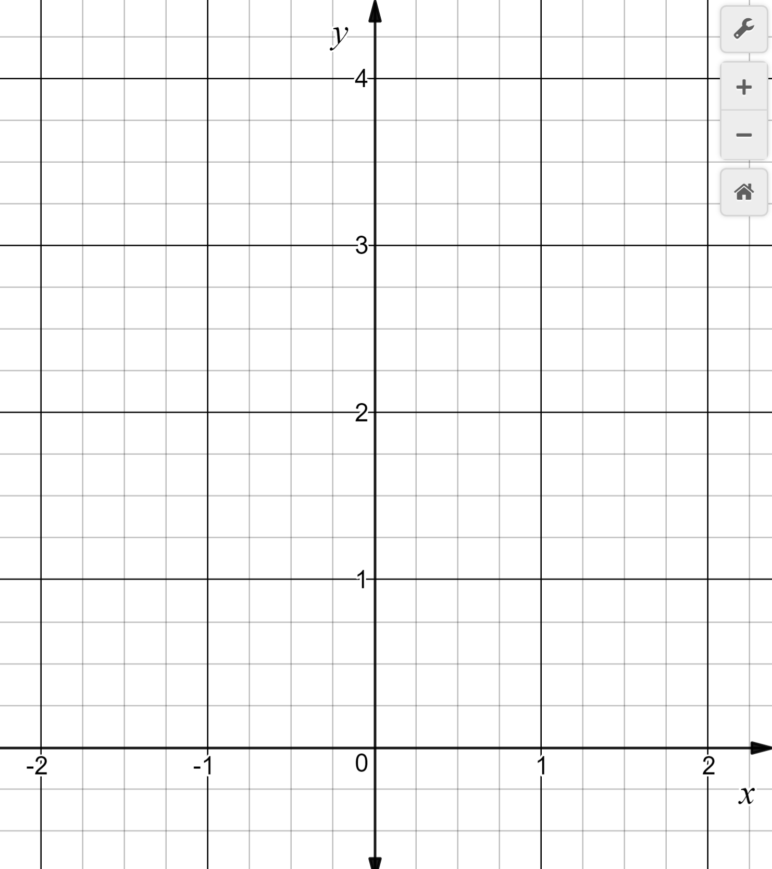
Guided/Independent Practice
Steps to Graph Quadratic Functions in Standard Form.
1
Find the Vertex (h, k). Hint: use the formal x$=−\frac{b}{2a},\text{the}\text{n} \text{substitute} \text{back} \text{to} \text{find} \text{y}$.
2
Graph the vertex point and draw axis of symmetry line.
3
Find two more points left/right of vertex and Graph it.
4
Reflect the graphed points over the axis of symmetry to create two more points and sketch the graph.
Graph the quadratic function: $y=\text{3}\text{x}\text{2}\text{ + }\text{2}\text{x}\text{ + }\text{1}\text{.}$
a = __
b = __
$$x=\frac{−b}{2a}$$
$$=\frac{−(__)}{2(__)}$$
Step 1:
$$=\frac{ }{ }$$
$$=______$$
y =
Step 2: Graph vertex point (__, __).
Step 3:
Vertex:
( ,
)
Step 4: Reflect the graph

Slide 8
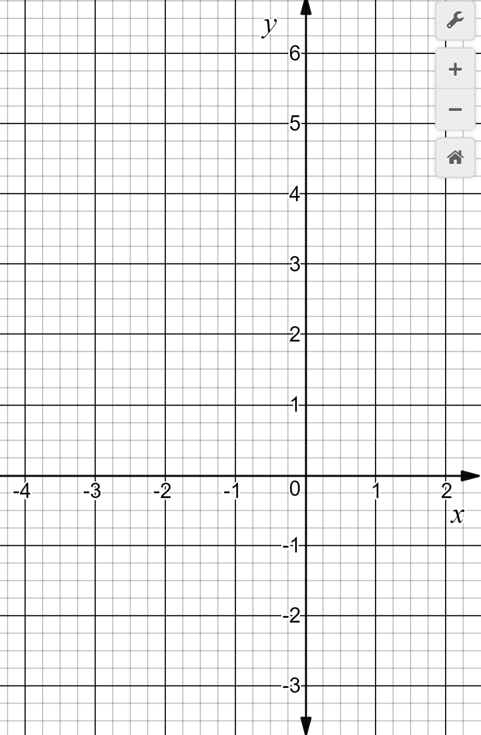
Independent Practice
Steps to Graph Quadratic Functions in Standard Form.
1
Find the Vertex (h, k). Hint: use the formal x$=−\frac{b}{2a},\text{the}\text{n} \text{substitute} \text{back} \text{to} \text{find} \text{y}$.
2
Graph the vertex point and draw axis of symmetry line.
3
Find two more points left/right of vertex and Graph it.
4
Reflect the graphed points over the axis of symmetry to create two more points and sketch the graph.
Graph the quadratic function: $y=\text{2}\text{x}\text{2}\text{ + }\text{8}\text{x} \text{− 1}\text{.}$
a = __
b = __
$$x=\frac{−b}{2a}$$
$$=\frac{−(__)}{2(__)}$$
Step 1:
$$=\frac{ }{ }$$
$$=______$$
y =
Step 2: Graph vertex point (__, __).
Step 3:
Vertex:
( ,
)
Step 4: Reflect the graph

Slide 9
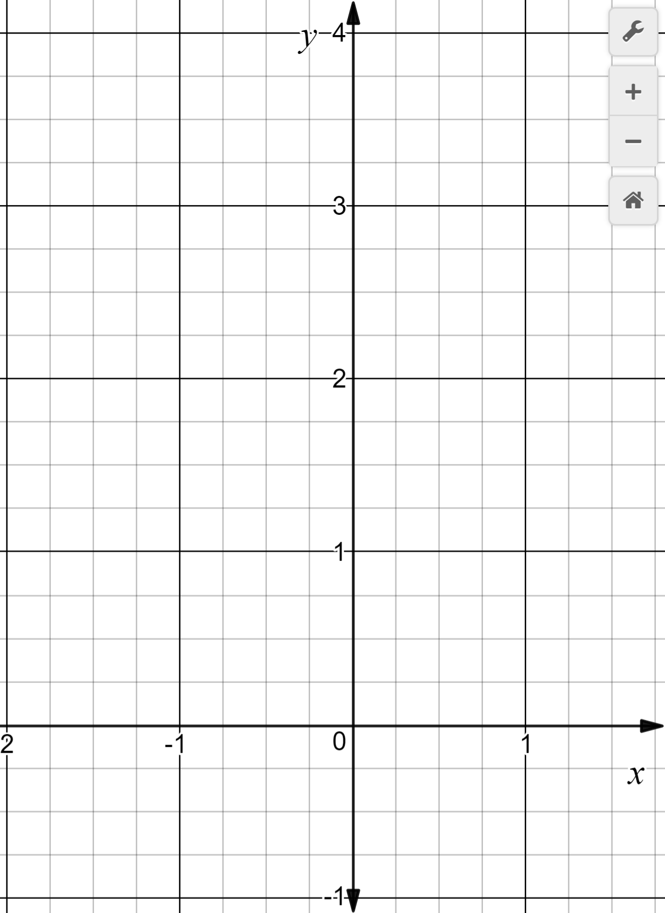
Independent Practice
Steps to Graph Quadratic Functions in Standard Form.
1
Find the Vertex (h, k). Hint: use the formal x$=−\frac{b}{2a},\text{the}\text{n} \text{substitute} \text{back} \text{to} \text{find} \text{y}$.
2
Graph the vertex point and draw axis of symmetry line.
3
Find two more points left/right of vertex and Graph it.
4
Reflect the graphed points over the axis of symmetry to create two more points and sketch the graph.
Graph the quadratic function: $y=\text{3}\text{x}\text{2}\text{ + 2}\text{x}\text{.}$
a = __
b = __
$$x=\frac{−b}{2a}$$
$$=\frac{−(__)}{2(__)}$$
Step 1:
$$=\frac{ }{ }$$
$$=______$$
y =
Step 2: Graph vertex point (__, __).
Step 3:
Vertex:
( ,
)
Step 4: Reflect the graph

Slide 10
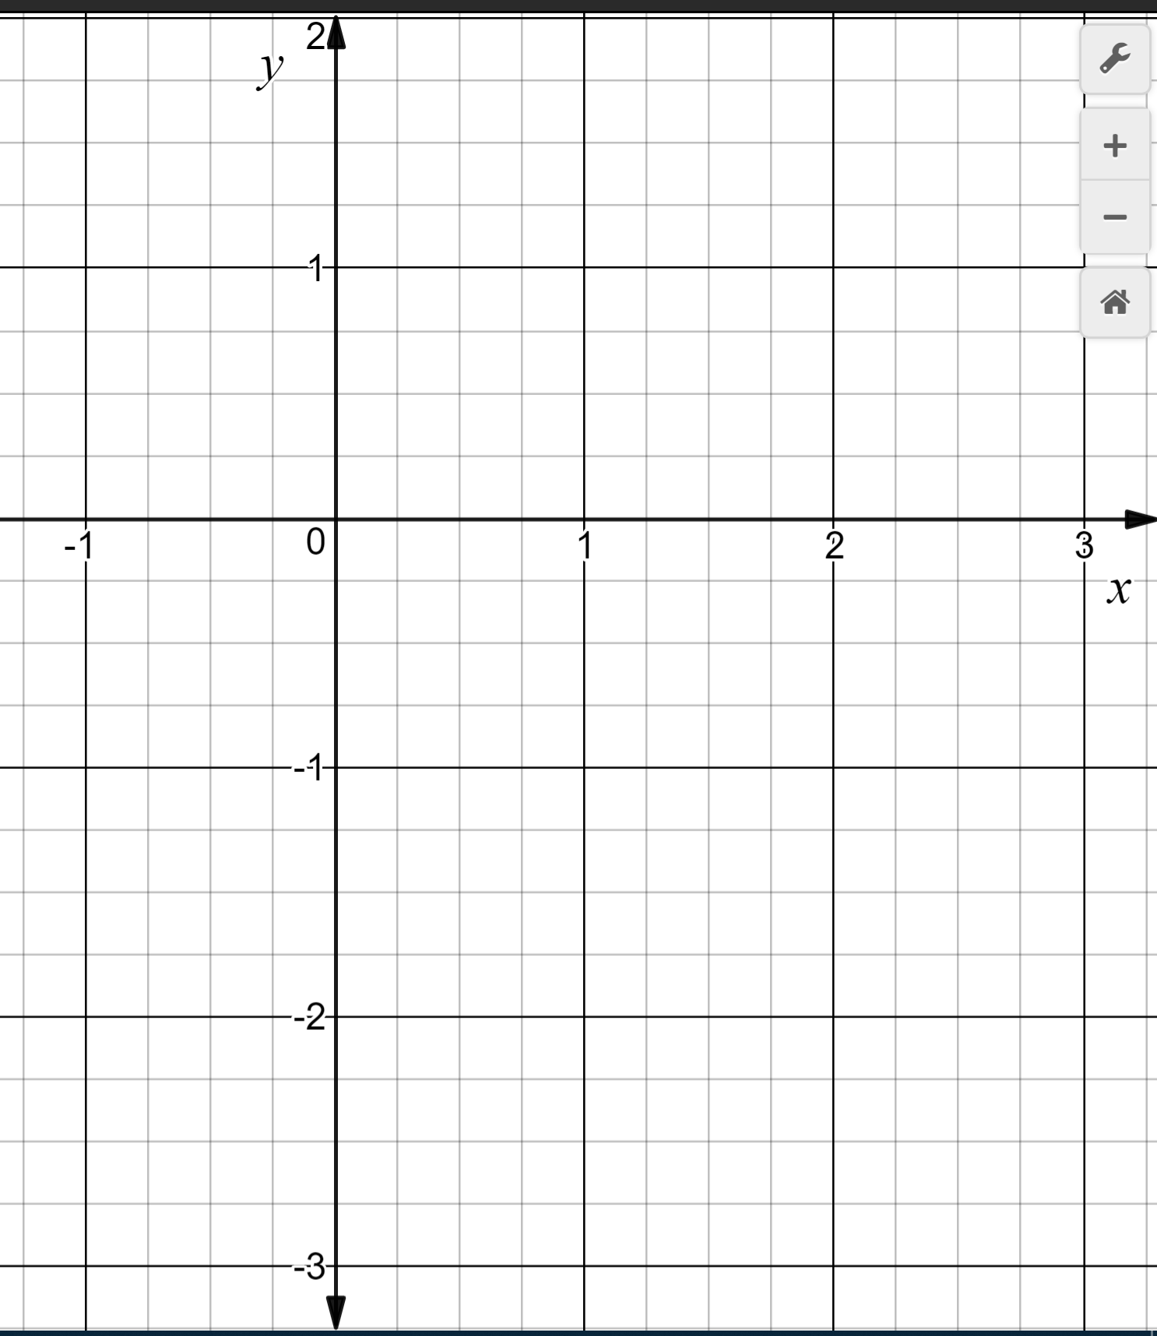
Independent Practice
Steps to Graph Quadratic Functions in Standard Form.
1
Find the Vertex (h, k). Hint: use the formal x$=−\frac{b}{2a},\text{the}\text{n} \text{substitute} \text{back} \text{to} \text{find} \text{y}$.
2
Graph the vertex point and draw axis of symmetry line.
3
Find two more points left/right of vertex and Graph it.
4
Reflect the graphed points over the axis of symmetry to create two more points and sketch the graph.
Graph the quadratic function: $y=\text{2}\text{x}\text{2} \text{−} \text{5}\text{x}$
a = __
b = __
$$x=\frac{−b}{2a}$$
$$=\frac{−(__)}{2(__)}$$
Step 1:
$$=\frac{ }{ }$$
$$=______$$
y =
Step 2: Graph vertex point (__, __).
Step 3:
Vertex:
( ,
)
Step 4: Reflect the graph

Slide 11
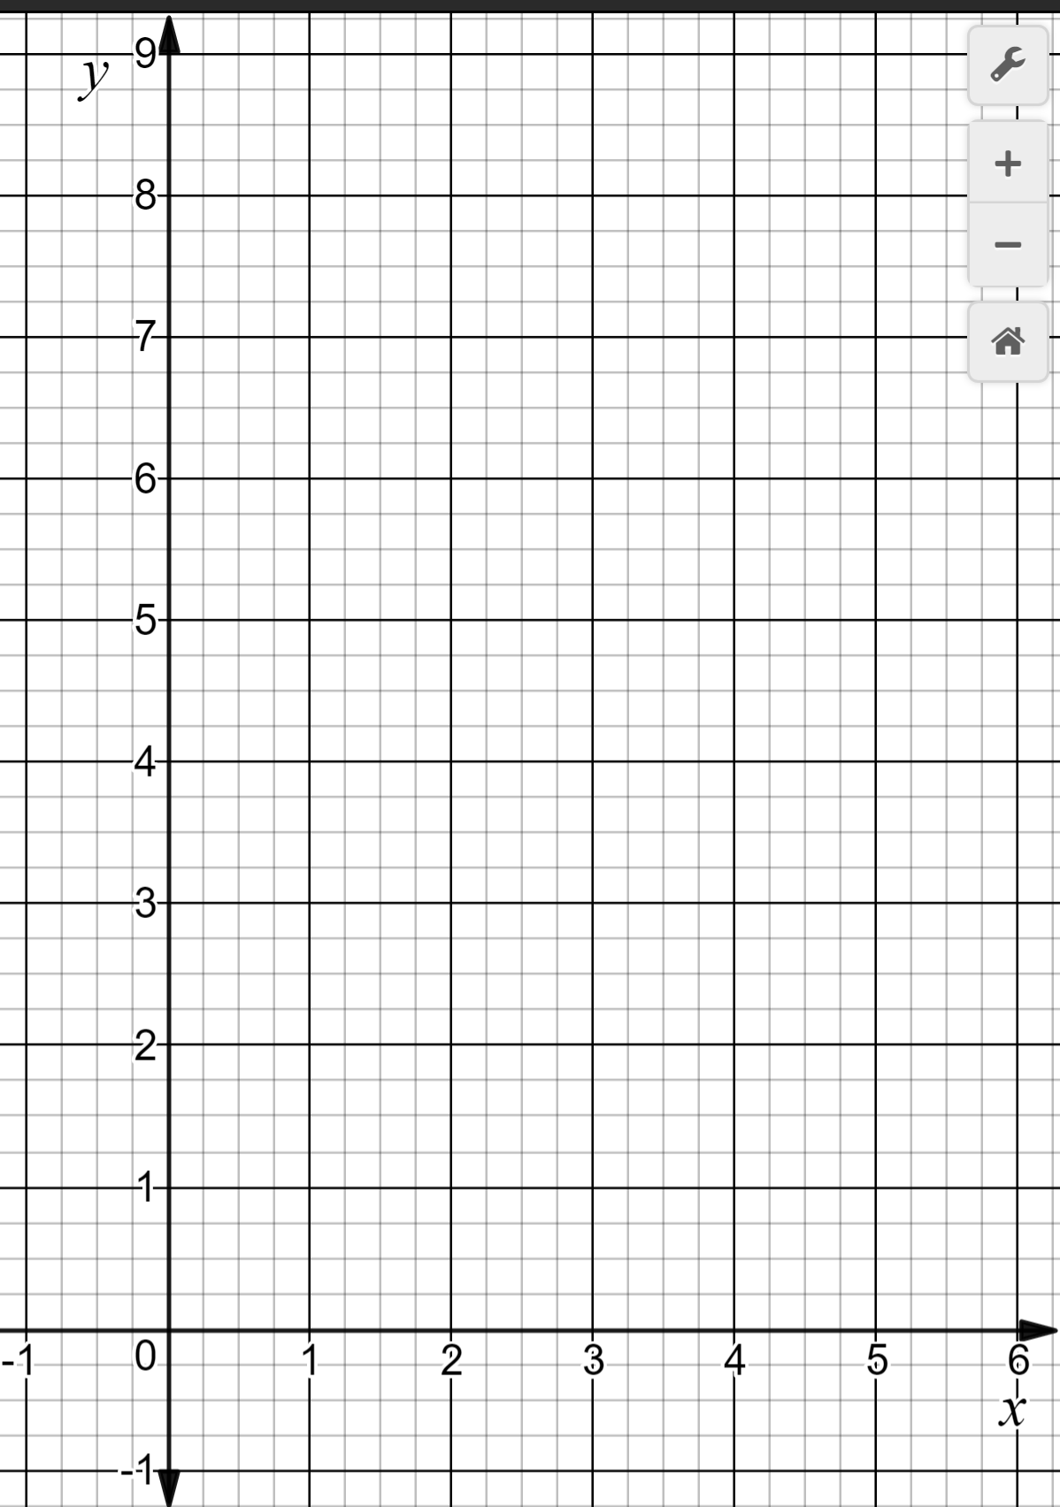
Independent Practice
Steps to Graph Quadratic Functions in Standard Form.
1
Find the Vertex (h, k). Hint: use the formal x$=−\frac{b}{2a},\text{the}\text{n} \text{substitute} \text{back} \text{to} \text{find} \text{y}$.
2
Graph the vertex point and draw axis of symmetry line.
3
Find two more points left/right of vertex and Graph it.
4
Reflect the graphed points over the axis of symmetry to create two more points and sketch the graph.
Graph the quadratic function: $y=\text{x}\text{2} \text{−4}\text{x} \text{+ 5}\text{.}$
a = __
b = __
$$x=\frac{−b}{2a}$$
$$=\frac{−(__)}{2(__)}$$
Step 1:
$$=\frac{ }{ }$$
$$=______$$
y =
Step 2: Graph vertex point (__, __).
Step 3:
Vertex:
( ,
)
Step 4: Reflect the graph

Slide 12
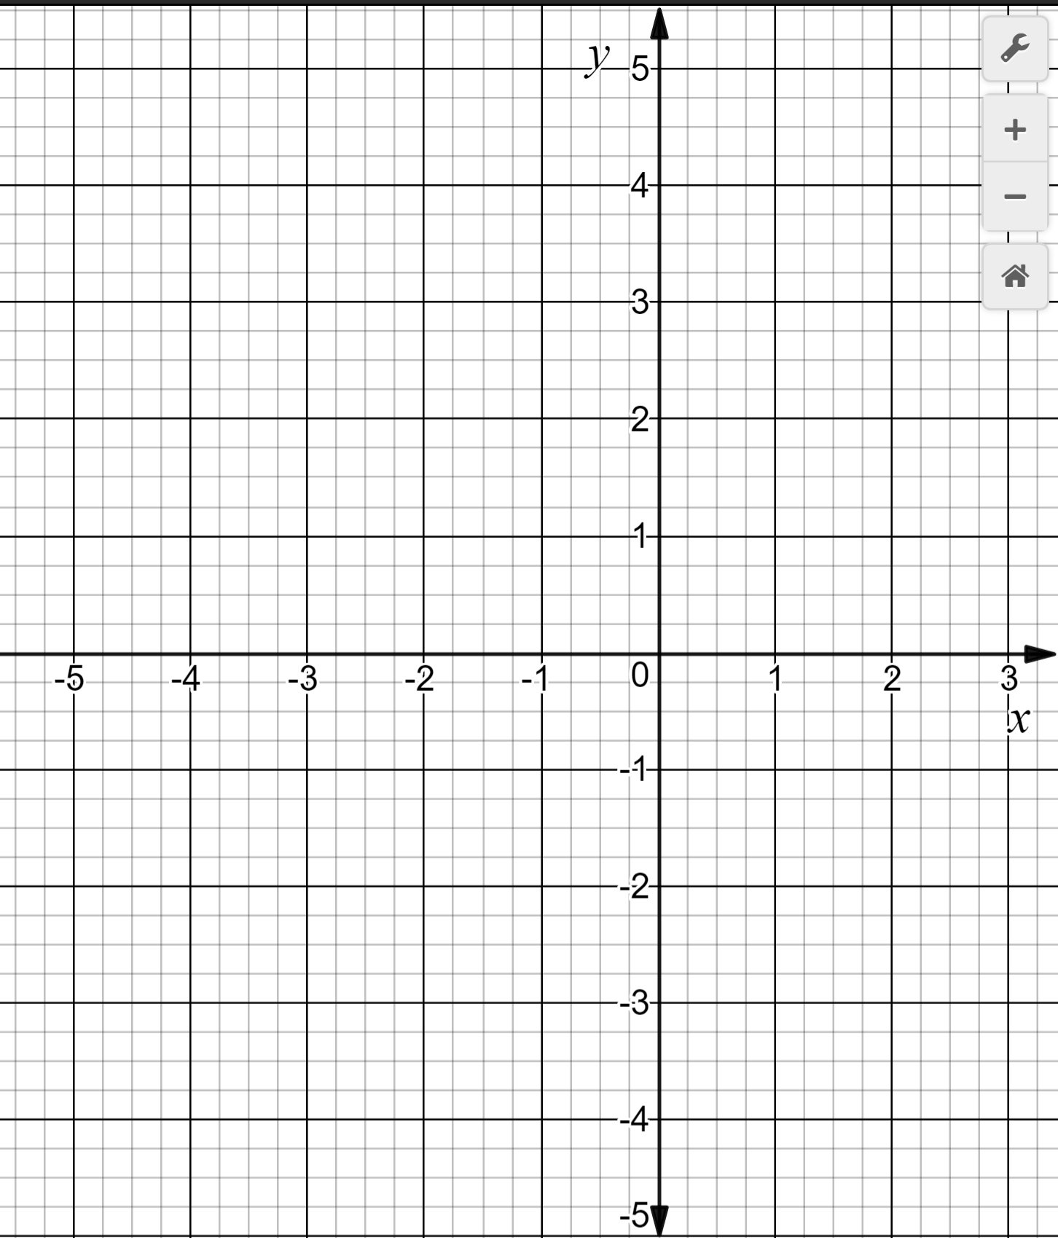
Independent Practice
Steps to Graph Quadratic Functions in Standard Form.
1
Find the Vertex (h, k). Hint: use the formal x$=−\frac{b}{2a},\text{the}\text{n} \text{substitute} \text{back} \text{to} \text{find} \text{y}$.
2
Graph the vertex point and draw axis of symmetry line.
3
Find two more points left/right of vertex and Graph it.
4
Reflect the graphed points over the axis of symmetry to create two more points and sketch the graph.
Graph the quadratic function: $y=\text{x}\text{2}\text{ + }\text{2}\text{x} \text{− 3}\text{.}$
a = __
b = __
$$x=\frac{−b}{2a}$$
$$=\frac{−(__)}{2(__)}$$
Step 1:
$$=\frac{ }{ }$$
$$=______$$
y =
Step 2: Graph vertex point (__, __).
Step 3:
Vertex:
( ,
)
Step 4: Reflect the graph

