Slide 1
Learning Objective
What is Axis of Symmetry?
Axis of symmetry is ___________.
What is a vertex?
Vertex means ______________.
CFU
Find the ${\text{axis} \text{of} \text{symmetry}}_{1}$and the ${\text{vertex}}_{2}$of a parabola.
Activate Prior Knowledge
Identify the vertex (h, k) of each function.
3. Find the y, given the x = -1
1. f(x) = (x – 2)² + 3
y = x² – 2x – 3
(2, 3)
y = x² – 2x – 3
(-1, 0)
Vertex: __________
y = (–1)² – 2(–1) – 3
= 1 + 2 – 3 = 0
2. f(x) = 2(x + 1)² – 4
4. Find the y, given the x = 3
y = x² – 2x – 3
(–1,–4)
Vertex : __________
(-1, 0)
y = 3² –2(3) – 3
= 9 – 6 – 3 = 0
Students, you already know how to find the vertex of a parabola given the vertex form and how to evaluate a function. Now, we will learn how to find the axis of symmetry and the vertex of a parabola.
Make Connection
1: the line that divides the graph into two perfect halves. 2: endpoint
Vocabulary

Slide 2
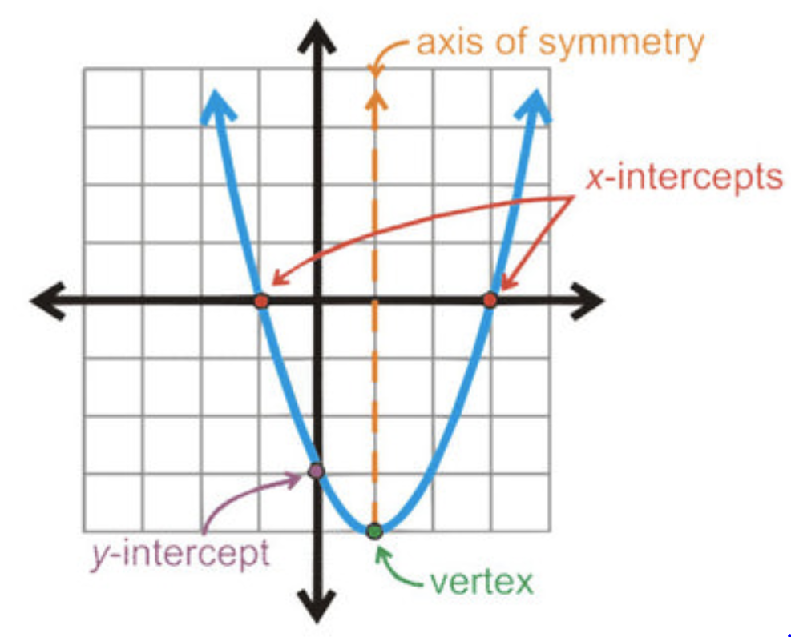
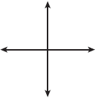
Concept Development
A quadratic function has a standard form y = ax² + bx + c where a ≠ 0.
The constant number(c) is the y-intercept of the parabola.
The lowest or highest point on the graph of a quadratic function is called the vertex.
The axis of symmetry is the vertical line $x= −\frac{b}{2a}$ (the h-value).
The x-intercepts are known as the solutions(zeros) of the parabola.
CFU
The vertical line passing through the vertex of a parabola is call the ________________________
________________________________.
The standard form of the quadratic function is _________________________________________.
The x-intercepts of the parabola are known as _______________________________________.
How many different types of solutions are there for a quadratic function ______, _______, or _________________. Draw one of the solution type and label it.
$$−\frac{b}{2a}$$
The “Axis of Symmetry” ALWAYS passes through the vertex.
If we graph one side of the parabola, we could REFLECT it over the Axis of symmetry to graph the other side.
MAKE A TABLE using x – values close to the Axis of symmetry.
“C”
"(h, k)

Slide 3
Skill Development/Guided Practice
Vertex Form
If a function is not written in the vertex form, you can use a formula $x=\frac{−b}{2a}$ to find the axis of symmetry. The formula works for all quadratic functions.
Standard Form
To find the “Axis of symmetry”.
How did I/you write the standard form?
How did I/you identify the a & b values?
How did I/you find the x-value?
How did I/you find the y-value?
1
Write the quadratic function in “Standard Form” $y={ax}^{2}+bx+c$.
Hint: move all of the numbers and variables to the one side of the equal sign “=“.
Identify the a and b values. Hint: coefficient of $x^{2}=a and \text{coefficient} of x=b$.
Substitute into the formal $x=\frac{−b}{2a}$ to find the value of x.
Substitute the x-value back into the quadratic function to find the y.
CFU
1
2
2
3
3
4
4
Find the vertex of the quadratic equations $y={2x}^{2}+8x+6$.
Step 1: Write the quadratic function in “Standard Form”.
$y={2x}^{2}+8x+6$.
Step 2: Identify the a and b values.
$a=2 and b=8$.
Step 3: Substitute into the formal $x=\frac{−b}{2a}$ to find the value of x.
$x=\frac{−(8)}{2(2)}=$ - $\frac{8}{4}=−2$
Step 4: Substitute the x-value back into the quadratic function to find the y.
$y={2x}^{2}+8x+6$.
$={2(−2)}^{2}+8(−2)+6$.
The vertex of $y={2x}^{2}+8x+6 is at$(2, -2)
$=8−16+6$ = -2

Slide 4
Skill Development/Guided Practice
Vertex Form
If a function is not written in the vertex form, you can use a formula $x=\frac{−b}{2a}$ to find the axis of symmetry. The formula works for all quadratic functions.
Standard Form
To find the “Axis of symmetry”.
How did I/you write the standard form?
How did I/you identify the a & b values?
How did I/you find the x-value?
How did I/you find the y-value?
1
Write the quadratic function in “Standard Form” $y={ax}^{2}+bx+c$.
Hint: move all of the numbers and variables to the one side of the equal sign “=“.
Identify the a and b values. Hint: coefficient of $x^{2}=a and \text{coefficient} of x=b$.
Substitute into the formal $x=\frac{−b}{2a}$ to find the value of x.
Substitute the x-value back into the quadratic function to find the y.
CFU
1
2
2
3
3
4
4
Find the vertex of the quadratic equations y = 2x² + 4x + 3.
Step 1: Write the quadratic function in “Standard Form”.
Step 2: Identify the a and b values.
Step 3: Substitute into the formal $x=\frac{−b}{2a}$ to find the value of x.
Step 4: Substitute the x-value back into the quadratic function to find the y.
The vertex of $y={2x}^{2}+4x+3 is at$(__, _ _)

Slide 5
Guided Practice (continued)
Vertex Form
If a function is not written in the vertex form, you can use a formula $x=\frac{−b}{2a}$ to find the axis of symmetry. The formula works for all quadratic functions.
Standard Form
To find the “Axis of symmetry”.
How did I/you write the standard form?
How did I/you identify the a & b values?
How did I/you find the x-value?
How did I/you find the y-value?
Write the quadratic function in “Standard Form” $y={ax}^{2}+bx+c$.
Hint: move all of the numbers and variables to the one side of the equal sign “=“.
Identify the a and b values. Hint: coefficient of $x^{2}=a and \text{coefficient} of x=b$.
Substitute into the formal $x=\frac{−b}{2a}$ to find the value of x.
Substitute the x-value back into the quadratic function to find the y.
CFU
1
1
2
2
3
3
4
4
1.
2.
3.
Find the vertex of y = x² + 2x + 3.
Find the vertex of y = x² + 2x – 1.
Find the vertex of y = 2x² + 8x +6
The vertex of $y=_____________is at$(__, _ _)
The vertex of $y=_____________is at$(__, _ _)
The vertex of $y=_____________is at$(__, _ _)
4.
5.
6.
Find the vertex of y = 3x² – 6x + 1.
Find the vertex of y = -2x² – 8x – 2
Find the vertex of y = –3x ² - 6x – 7
The vertex of $y=_____________is at$(__, _ _)
The vertex of $y=_____________is at$(__, _ _)
The vertex of $y=_____________is at$(__, _ _)

Slide 6
Relevance
If a function is not written in the vertex form, you can use a formula $x=\frac{−b}{2a}$ to find the axis of symmetry. The formula works for all quadratic functions.
1
Using axis of symmetry will help you graph a quadratic function.
Symmetry can be useful in graphing an equation since it says that if we know one portion of the graph then we will also know the remaining (and symmetric) portion of the graph as well. We used this fact when we were graphing parabolas to get an extra point of some of the graphs.
2
Knowing how to find the axis of symmetry will help you do well on tests.
Sample Test Question:
Choose the best answer for the following.
Find the vertex for y = x² + 2x – 3.
(0, -4)
(1, -2)
(-1, -4)
(-2, -3)
Does anyone else have another reason why it is relevant to use algebraic terminology? (Pair-Share) Why is it relevant to use algebraic terminology? You may give me one of my reasons or one of your own. Which reason is more relevant to you? Why?
CFU

Slide 7
If a function is not written in the vertex form, you can use a formula $x=\frac{−b}{2a}$ to find the axis of symmetry. The formula works for all quadratic functions.
Vertex Form
Standard Form
Skill Closure
To find the “Axis of symmetry”.
How did I/you write the standard form?
How did I/you identify the a & b values?
How did I/you find the x-value?
How did I/you find the y-value?
Write the quadratic function in “Standard Form” $y={ax}^{2}+bx+c$.
Hint: move all of the numbers and variables to the one side of the equal sign “=“.
Identify the a and b values. Hint: coefficient of $x^{2}=a and \text{coefficient} of x=b$.
Substitute into the formal $x=\frac{−b}{2a}$ to find the value of x.
Substitute the x-value back into the quadratic function to find the y.
CFU
1
1
2
2
3
3
4
4
Caution!
y = –3x² - 6x – 7
The minimum (or maximum) value is the y-value at the vertex. It is not the ordered pair that represents the vertex.
Determine whether the graph opens upward or downward.
______________
2. Find the axis of symmetry $x=−\frac{b}{2a}$.
3. Find the vertex (h, k).
4. Identify the maximum or minimum value of the function.
__________, y =
5. Find the y-intercept. ______
Discuss why is it important to know the Vertex of a quadratic function?
_________________________________________________________________________________________________________.

Slide 8
Summary Closure
What did you learn today about how to find the axis of symmetry and the vertex of a parabola? (Pair-Share)
Today, I learned how to ___________________________
______________________________________________.
axis of symmetry
standard form
minimum value
maximum value
List the steps to find the “Axis of symmetry”.
1
2
3
4

