Slide 1
Lesson_1 Exploring Data
Name:_______________________
Period:____
Activate Prior Knowledge
Find the median of the given data set.
Dance-a-Thon: You receive the pledge amounts listed below for your participation in a dance-a-thon. Find the median?
$1 $8 $12 $10 $45 $9 $1 $7 $6
Make the Connection
Students, you already know how to find the mean, median, and range of data set. Today, we will learn how to describe and compare data sets.
Caleb and Kim have bowled three games. Their scores are shown in the chart below.
Calculation

Slide 2
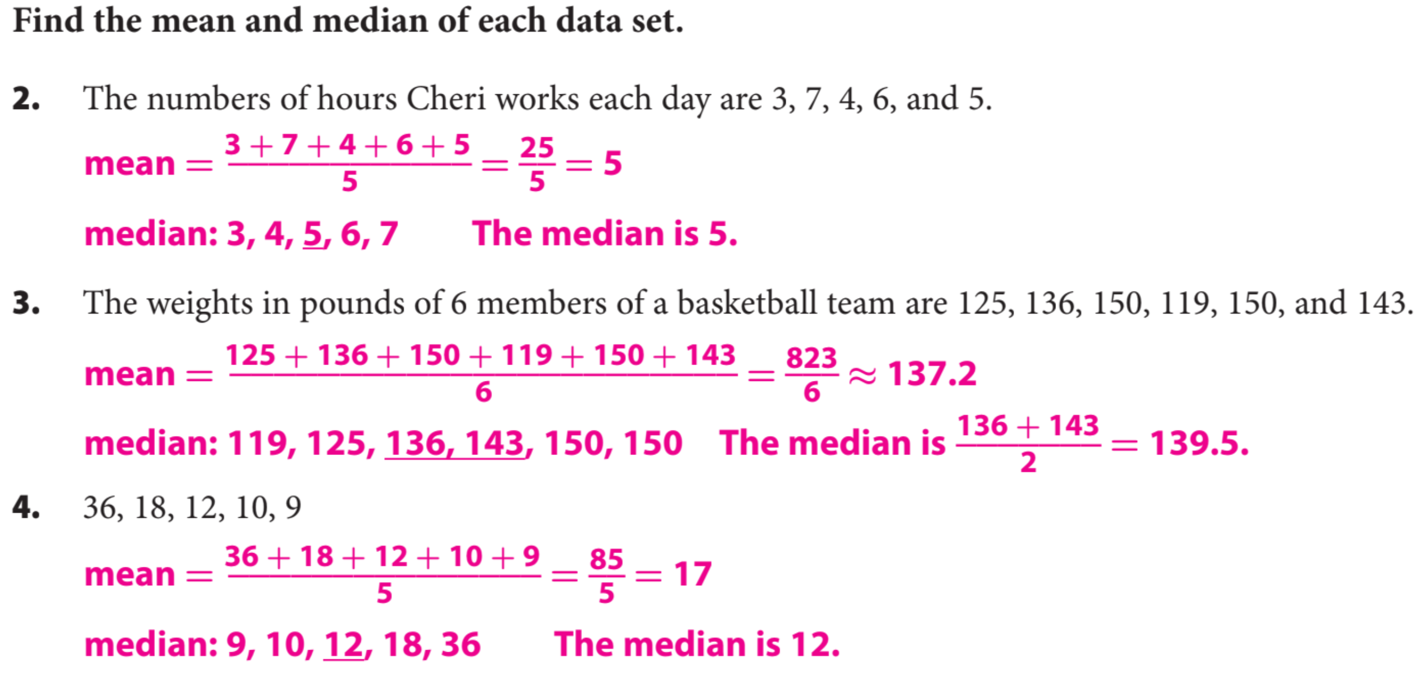
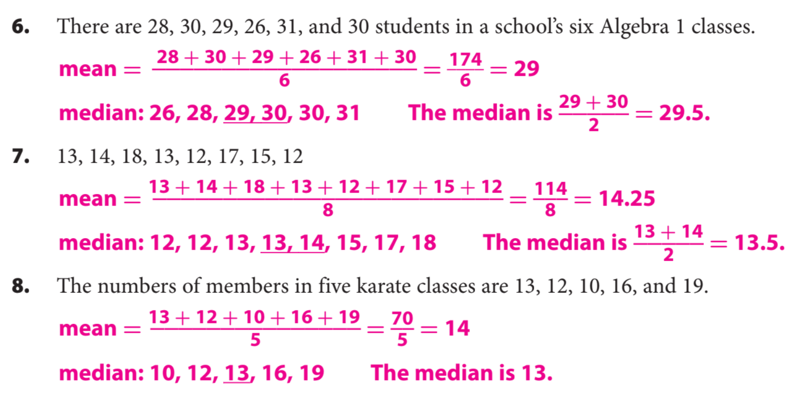
Guided Practice

Slide 3
Common Core
What did you learn about median, mean of two different data sets.
Word Bank
Mean
Median
Mode
Range
Data Set
Today, I learned how to _________________________________________________________________________________.
SUMMARY CLOSURE

