Slide 1
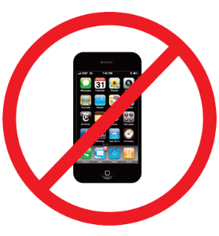
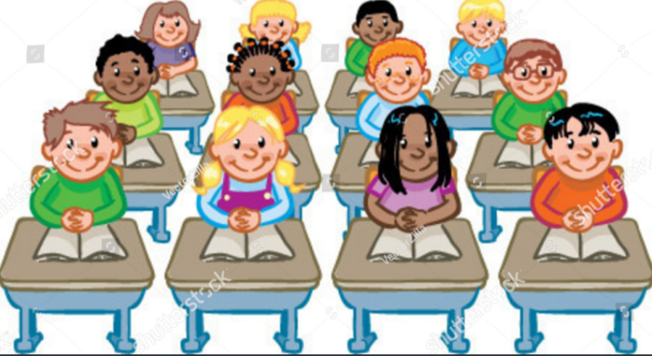
ACT RESPONSIBLY & SUPPORT the COMMUNITY.
Be on Time
Wear ID
Chromebook Ready
SEE SOMETHING, SAY SOMETHING

Slide 2
Ander
Jocelyn
Primo
Julio
Vivian
Jocelyn
Yamila
Noheme
Melanie
Delilah
Valeria
Angel
Saray
Osiel
Monrose
Jose
Will be in gradebook Today by 3pm!!
Due Tomorrow!
https://forms.gle/nRYm3oCtkvxbZjbi7

Slide 3
We will determine₁ how to use the data distribution to compare center (median, mean) of two or more different data sets.
Learning Objective
LEARNING OBJECTIVE
CFU
What are we going to learn today?
What is Determine means?_______.
Definition
¹ figure out

Slide 4
Activate Prior Knowledge
Find the median of the given data set.
Dance-a-Thon: You receive the pledge amounts listed below for your participation in a dance-a-thon. Find the median?
$1 $8 $12 $10 $45 $9 $1 $7 $6
1 1 6 7 8 9 10 12 45
The median is $8. It is the middle value of the nine values.
Make the Connection
Students, you already know how to find the mean, median, and range of data set. Today, we will learn how to describe and compare data sets.

Slide 5
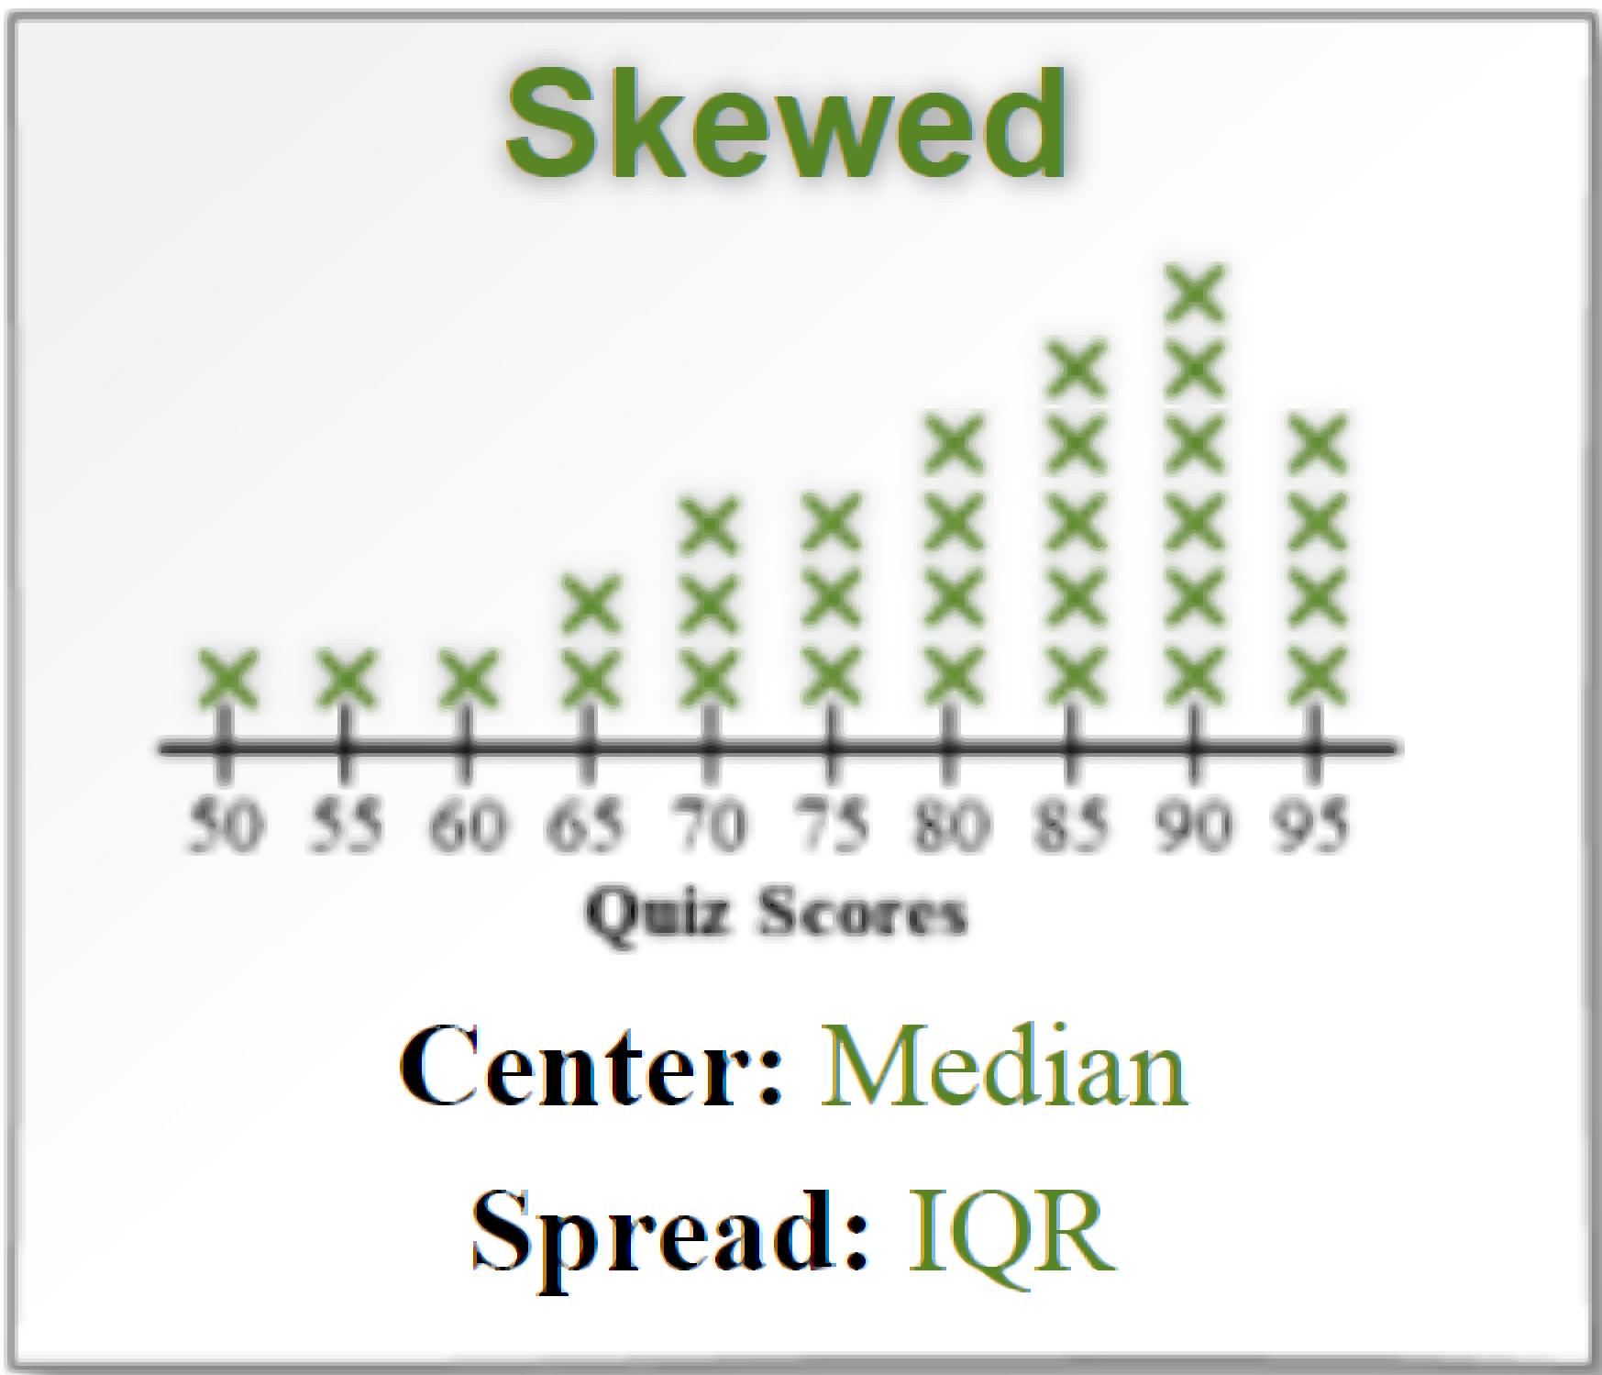
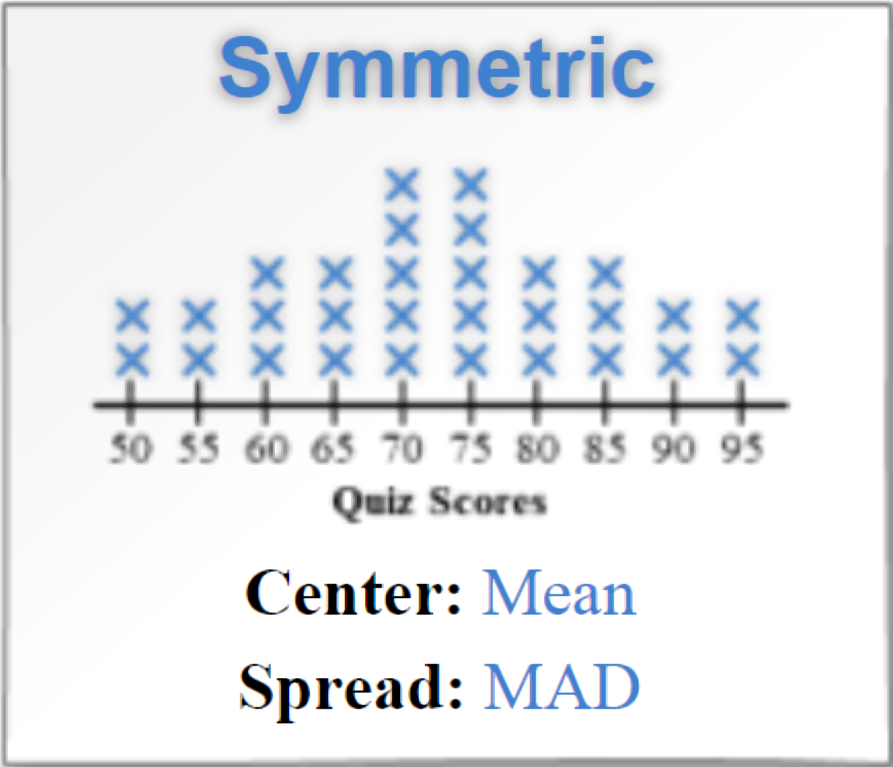
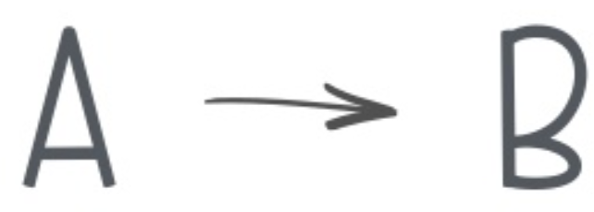
L.O: Find median, mean, and interquartile range of two or more different data sets, with 100% accuracy.
Caleb and Kim have bowled three games. Their scores are shown in the chart below.
Calculation
Pair-Share:
Partner-A: How is a histogram different from a dot plot?
Partner-B: How many test scores were collected? How do you know?
CFU: Pair-Share

Slide 6
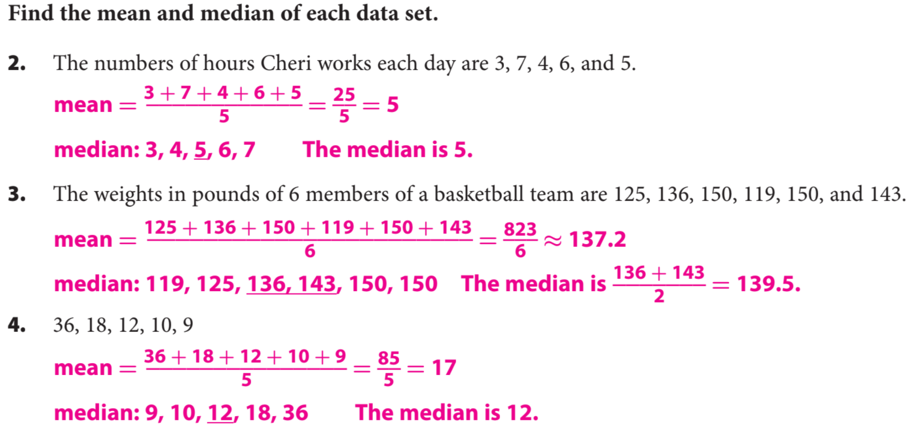
Guided Practice

Slide 7
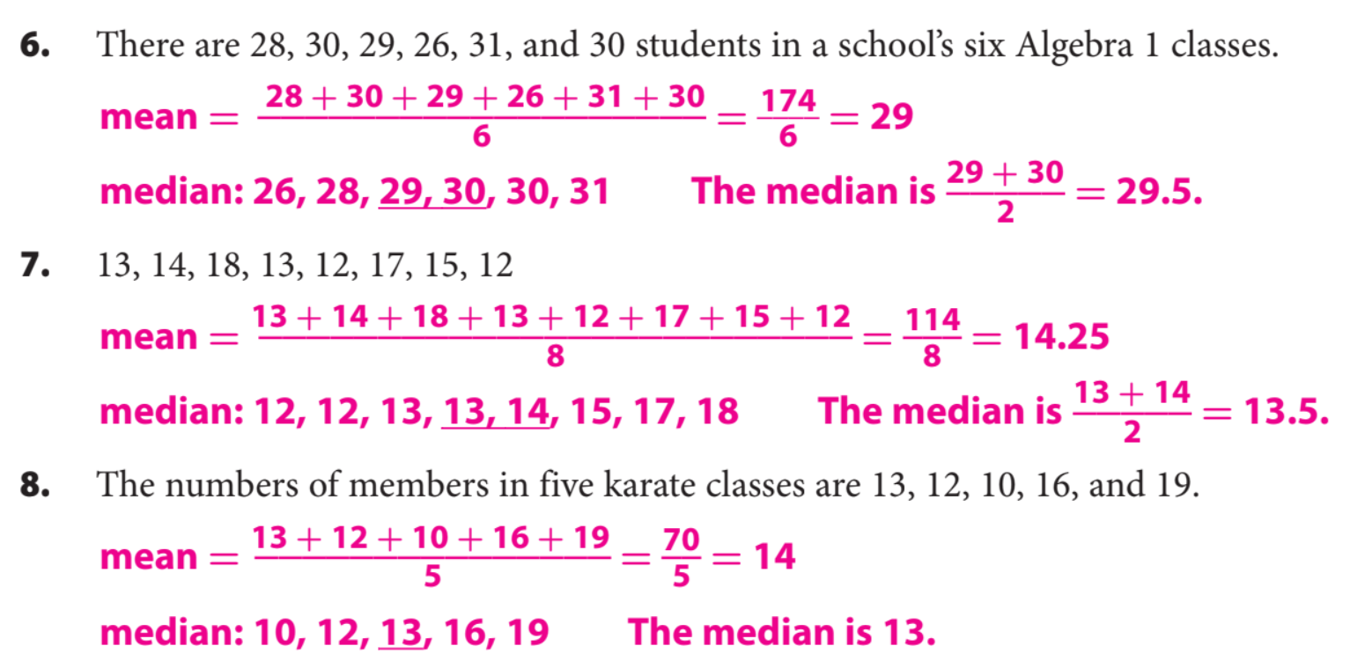

Slide 8
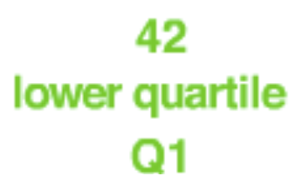
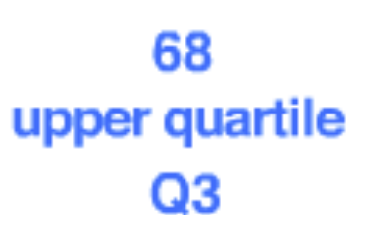
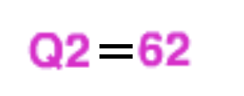
Interquartile Range (IQR):- Measures how far the data values are spread-out from the middle.
Steps to find IQR
1. Put the numbers in order. (Least to Greatest)
CFU How did I/you put numbers in order?
2. Find the Median (Q2) and place parentheses around the numbers Left and Right side of the median. (If two value, add up & divide by 2).
CFU How did I/you find the middle value of the data set?
3. Find the Median (Q1) of the Lower half of data set. Q1
CFU How did I/you find the Q1..
4. Find the Median (Q3) of the Upper half of data set. Q3
CFU How did I/you find Q3.
5. Subtract Q1 from Q3 to find the interquartile range: IQR = Q3 - Q1
CFU How did I/you find interquartile range?
Example:
( )( )

Slide 9
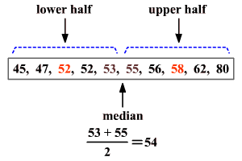
Steps to find IQR
1. Put the numbers in order. (Least to Greatest)
CFU How did I/you put numbers in order?
2. Find the Median (Q2) and place parentheses around the numbers Left and Right side of the median. (If two value, add up & divide by 2).
CFU How did I/you find the middle value of the data set?
3. Find the Median (Q1) of the Lower half of data set. Q1
CFU How did I/you find the Q1..
4. Find the Median (Q3) of the Upper half of data set. Q3
CFU How did I/you find Q3.
5. Subtract Q1 from Q3 to find the interquartile range: IQR = Q3 - Q1
CFU How did I/you find interquartile range?
IQR = Q3- Q1
= 58 – 52
= 6

Slide 10
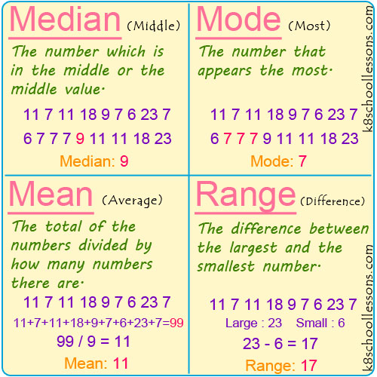

Slide 11
Due: Monday by 9pm.
Start now on my.hrw.com

Slide 12
What did you learn about median, mean of two different data sets.
Common Core
To find the mean cost of the trees, divide the sum of the costs by the total number of trees purchased.
300 + 120
420
Mean
=
=
=
21
20
20
Word Bank
Mean
Median
Mode
Range
Data Set
Today, I learned how to _________________________________________________________________________________.
SUMMARY CLOSURE

