Slide 1
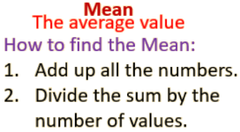
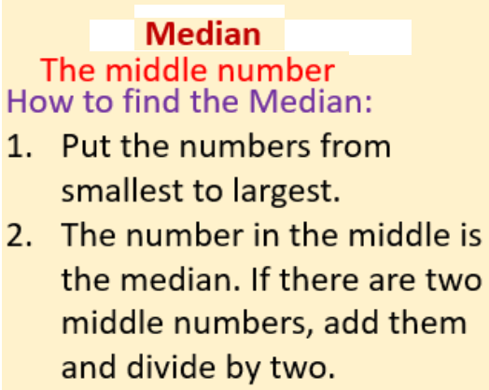
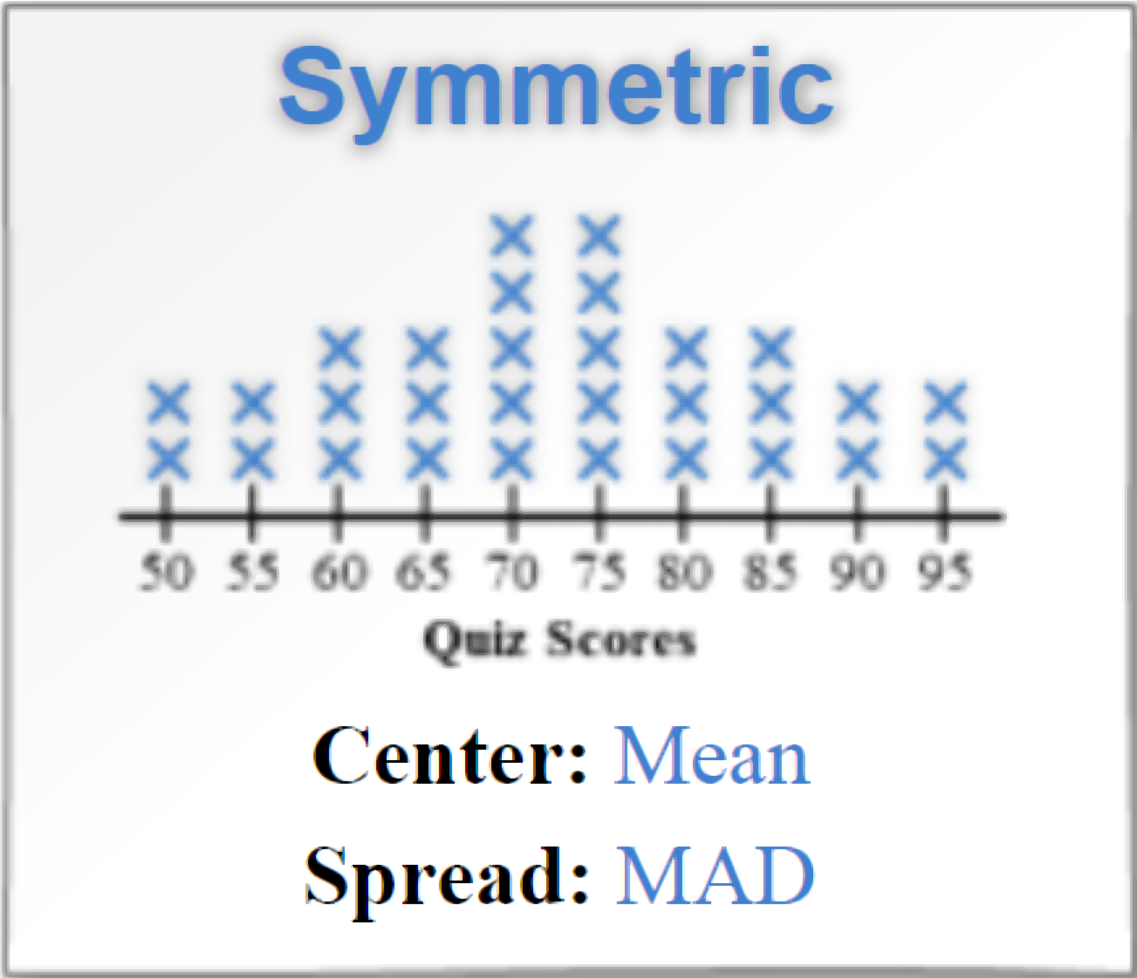
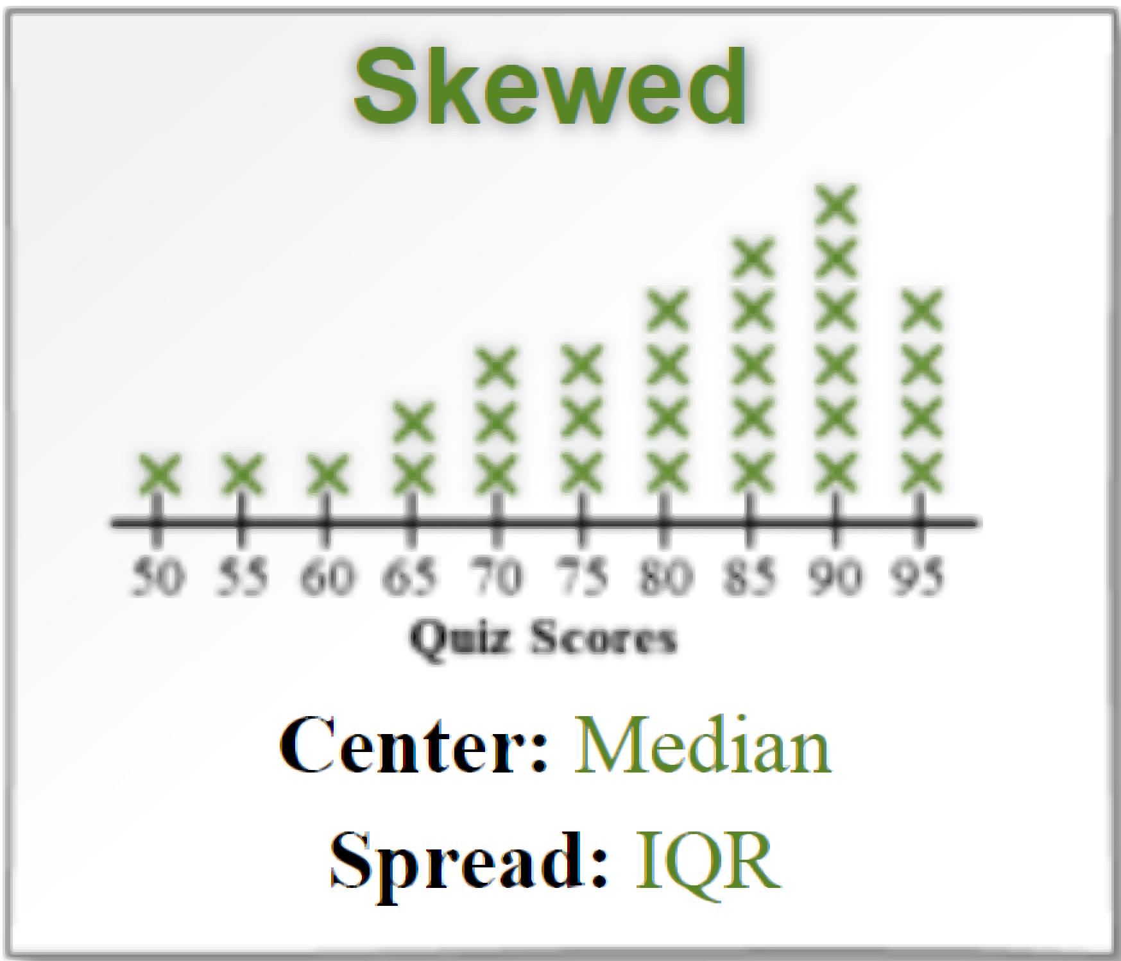
Lesson 1: Measures of Center Mean and Median
Name:_______________________
Period:____
Activate Prior Knowledge
Find the mean of the given data set.
The numbers of members in five
karate classes are 13, 12, 10, 16, and 19.
Find the mean value:
2. There are 28, 30, 29, 26, 31, and 30
students in a school’s four Algebra 1
Classes. Find the mean value:
Remember the Concept
Remember the Concept
Make the Connection
Students, you already know how to find the mean and median. Today, we will learn how to use Mean and Median to Measures the Center.
Two commonly used measures of _______ or a set of numerical data are the _____ and _______.Measures of center represent a central or typical value of a data set.
Pair-Share:
Partner-A: How do you find the mean and median?
Partner-B: When do you use: Mean as center and Median as center?
CFU: Pair-Share
CONCEPT DEVELOPMENT

Slide 2
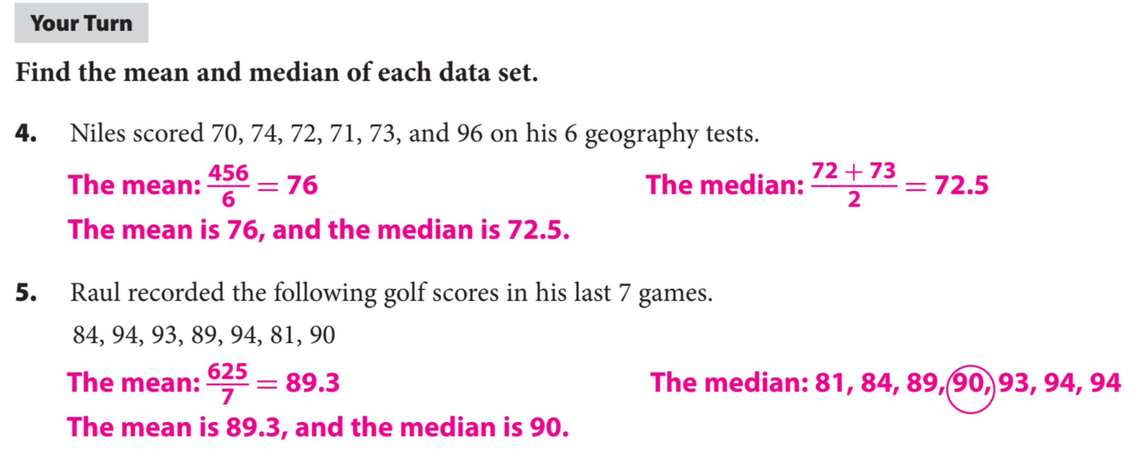
The number of text messages that Isaac
received each day for a week is shown.
47, 49, 54, 50, 48, 47, 55
2. The amount of money Elise earned in tips per
day for 6 days is listed below.
$80, $74, $77, $71, $75, and $91.:
Find the mean.
Find the mean.
Find the median.
Find the median.
Guided Practice
Remember the Concept
Remember the Concept

Slide 3
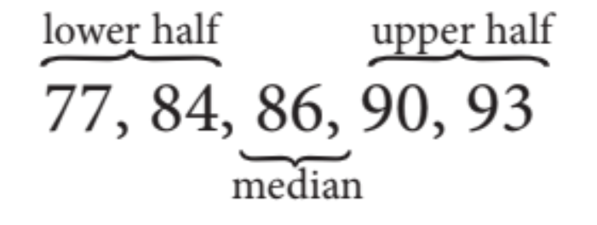
Measures of spread are used to describe the consistency of data values. They show the distance between data values and their distance from the center of the data.
Two commonly used measures of spread for a set of numerical data are the ______ and ______________.
The _________ is the difference between the greatest and the least data values.
_________ are values that divide a data set into four equal parts.
The _________ ($Q_{1}$) is the median of the lower half of the set,
the _________ ($Q_{2}\text{) }$is the median of the whole set, and
the _________ ($Q_{3}$) is the median of the upper half of the set.
The _________ ___ (IQR) of a data set is the difference between the third and first quartiles. It represents the range of the middle half of the data.
Steps to Find IQR
Step 1: Put the numbers in order.
Step 2: Find the median($Q_{2}$).
Step 3: Cut the data set into Lower Half and Upper Half.
Step 4: Find Median of Lower Half ($Q_{1}$).
Step 5: Find Median of Upper Half ($Q_{3}$).
Step 6: IQR = $Q_{3}$ - $Q_{1}$.
CONCEPT DEVELOPMENT
The April high temperatures for 5 years in Delhi are
77 °F, 86 °F, 84 °F, 93 °F, and 90 °F. Find IQR

Slide 4
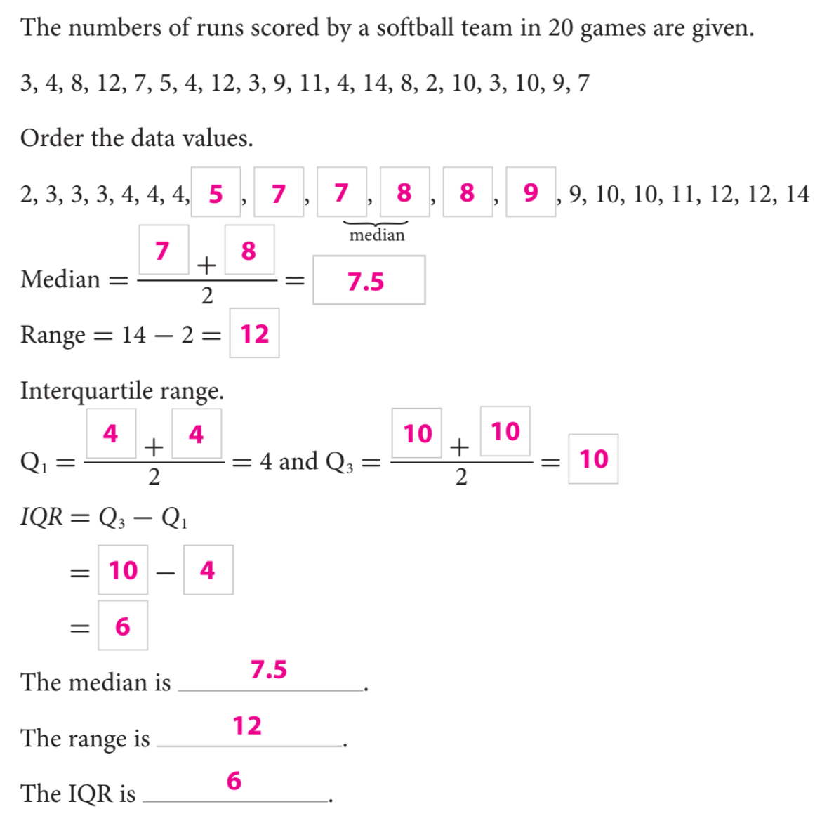
Steps to Find IQR
Step 1: Put the numbers in order.
Step 2: Find the median($Q_{2}$).
Step 3: Cut the data set into Lower Half and Upper Half.
Step 4: Find Median of Lower Half ($Q_{1}$).
Step 5: Find Median of Upper Half ($Q_{3}$).
Step 6: IQR = $Q_{3}$ - $Q_{1}$.

Slide 5
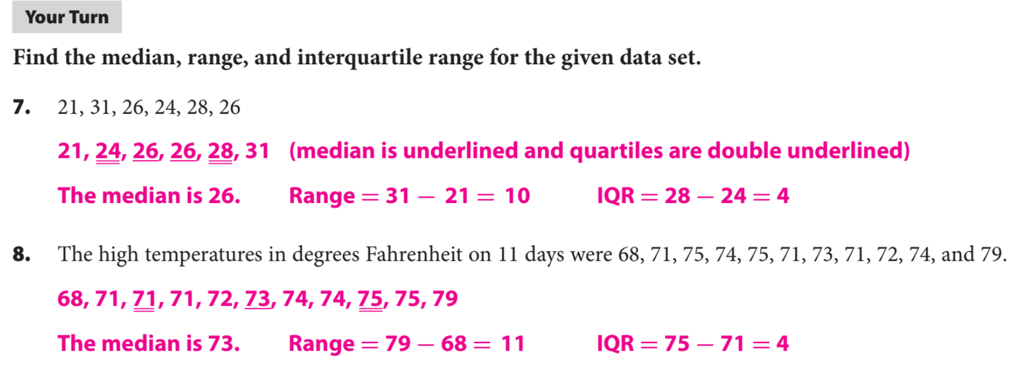
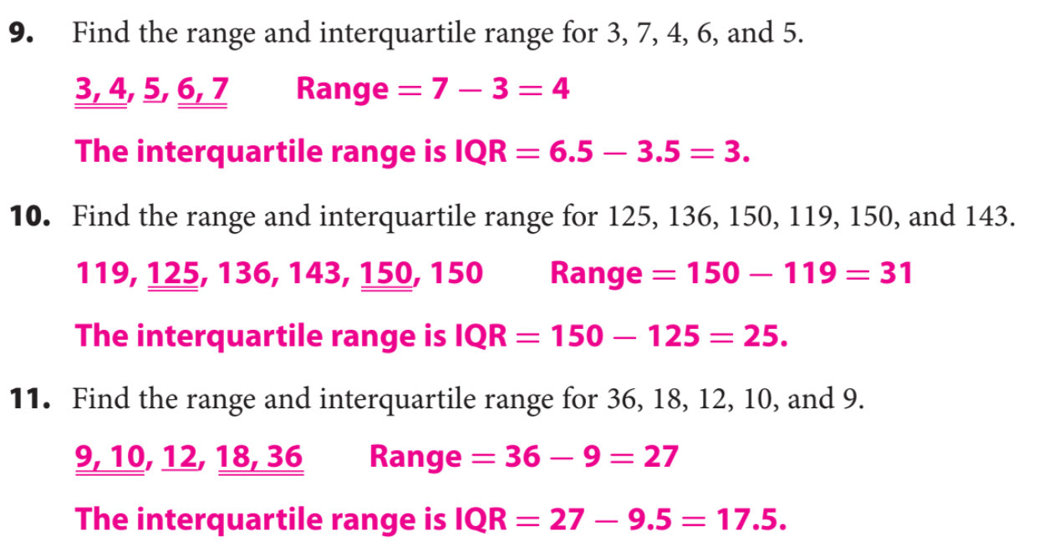
What did you learn about using the mean, Median, & IQR.
Word Bank
Mean
Median
Quartile
IQR
Range
Data Set
Today, I learned how to _________________________________________________________________________________.
SUMMARY CLOSURE

