Slide 1
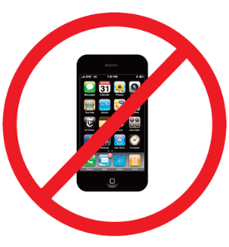
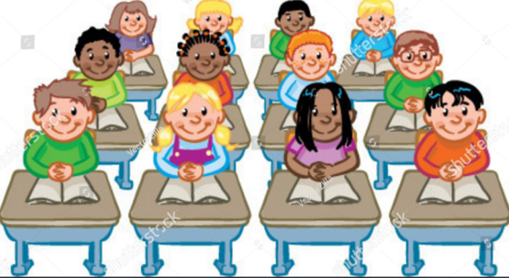
ACT RESPONSIBLY & SUPPORT the COMMUNITY.
Be on Time
Wear ID
Chromebook Ready
SEE SOMETHING, SAY SOMETHING

Slide 2
We will determine₁ how to use Mean and Median to Measures the Center.
Learning Objective
LEARNING OBJECTIVE
CFU
What are we going to learn today?
What is Determine means?_______.
Definition
¹ figure out

Slide 3
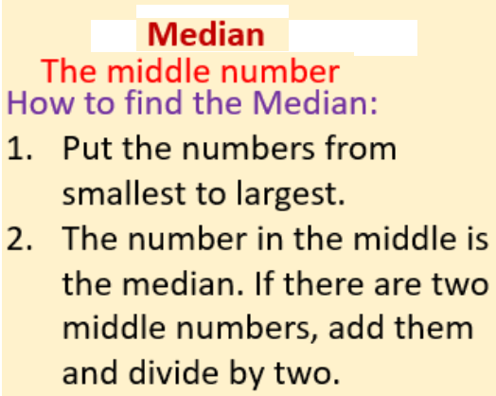
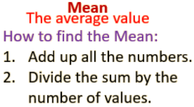
Activate Prior Knowledge
Find the mean of the given data set.
The numbers of members in five
karate classes are 13, 12, 10, 16, and 19.
Find the mean value:
2. There are 28, 30, 29, 26, 31, and 30
students in a school’s four Algebra 1
Classes. Find the mean value:
Remember the Concept
Remember the Concept
Make the Connection
Students, you already know how to find the mean and median. Today, we will learn how to use Mean and Median to Measures the Center.

Slide 4
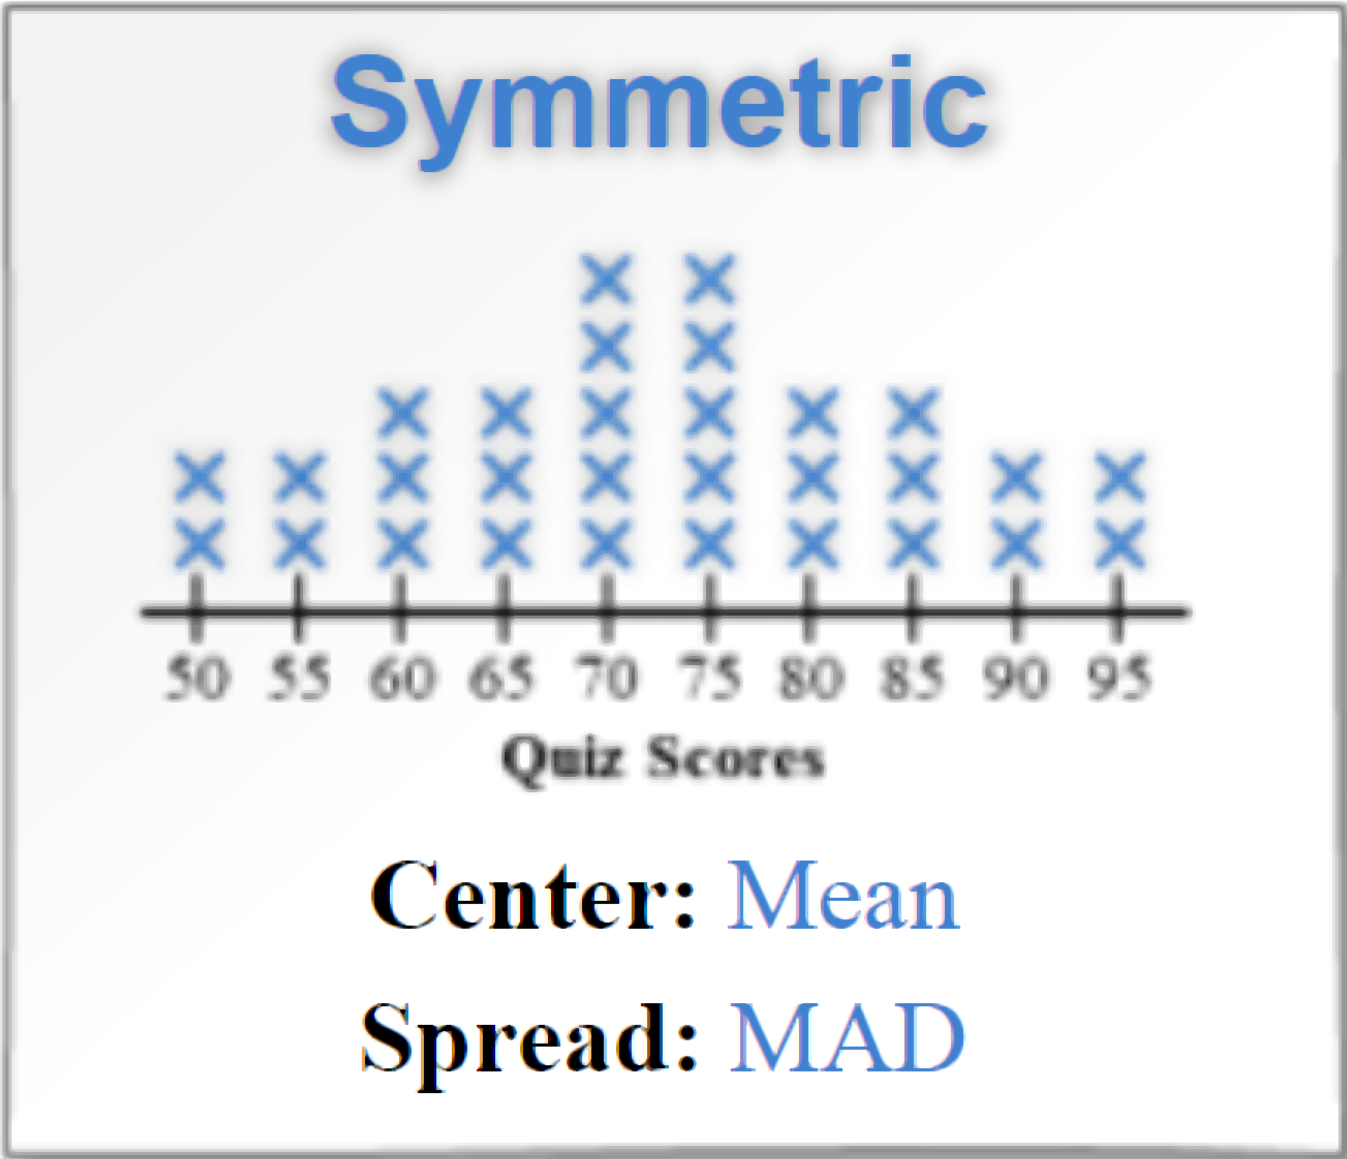
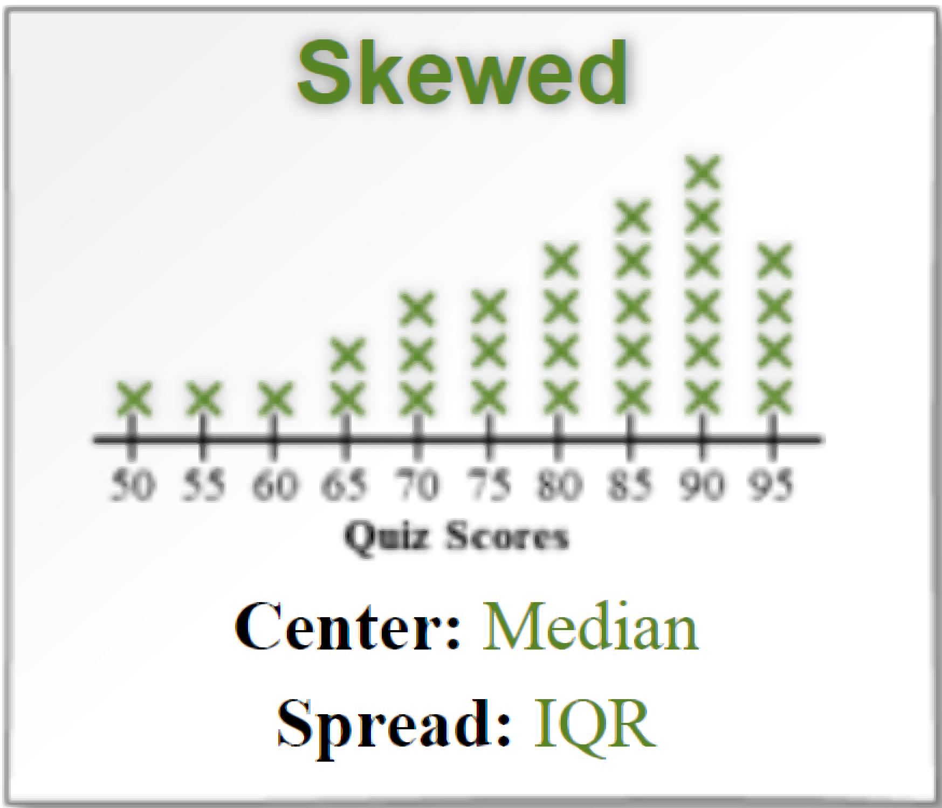
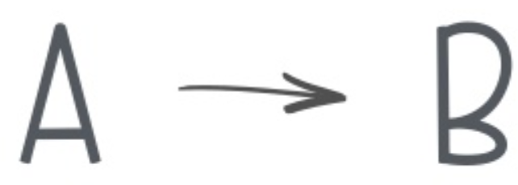
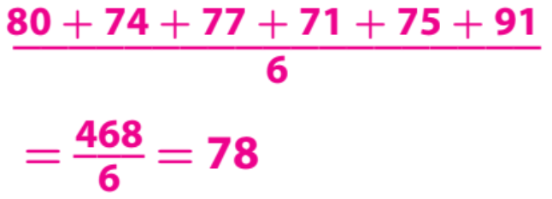
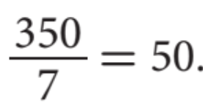
L.O: Find median, mean, and interquartile range of two or more different data sets, with 100% accuracy.
Two commonly used measures of center for a set of numerical data are the mean and median. Measures of center represent a central or typical value of a data set.
Pair-Share:
Partner-A: How do you find the mean and median?
Partner-B: When do you use: Mean as center and Median as center?
CFU: Pair-Share
Calculation
CONCEPT DEVELOPMENT
The number of text messages that Isaac
received each day for a week is shown.
47, 49, 54, 50, 48, 47, 55
2. The amount of money Elise earned in tips per
day for 6 days is listed below.
$80, $74, $77, $71, $75, and $91.:
Find the mean.
Divide the sum by the numbers of data values in the list.
Find the mean.
The mean is 50 text messages a day.
Rewrite the values in increasing order and find the middle.
Find the median.
Find the median.
76
The median is 49 text messages a day.

Slide 5
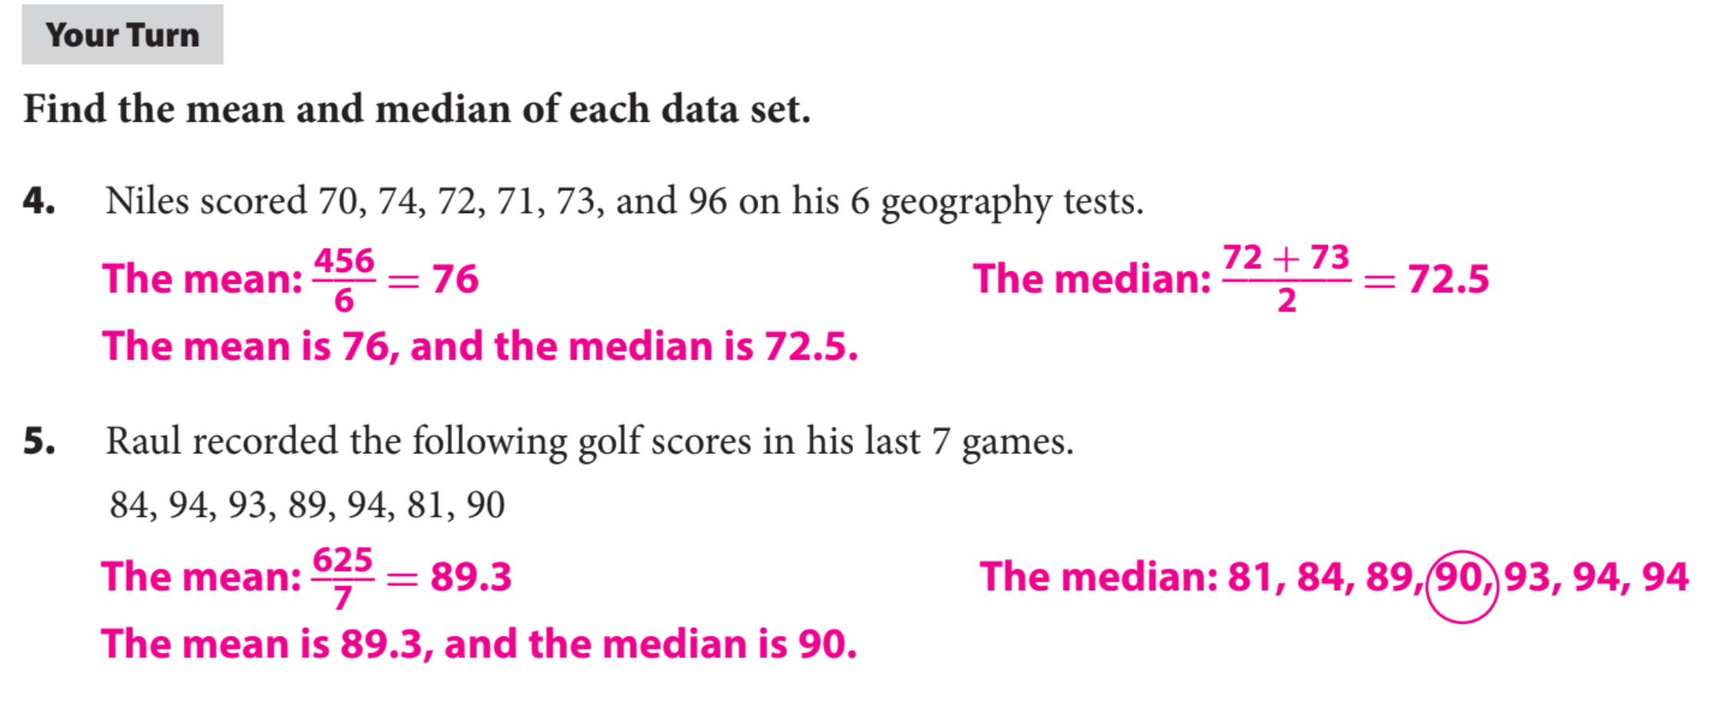
Guided Practice
Remember the Concept
Remember the Concept

Slide 6
Measures of spread are used to describe the consistency of data values. They show the distance between data values and their distance from the center of the data.
Two commonly used measures of spread for a set of numerical data are the range and interquartile range (IQR).
The range is the difference between the greatest and the least data values.
Quartiles are values that divide a data set into four equal parts.
The first quartile ($Q_{1}$) is the median of the lower half of the set,
the second quartile ($Q_{2}\text{) }$is the median of the whole set, and
the third quartile ($Q_{3}$) is the median of the upper half of the set.
The interquartile range (IQR) of a data set is the difference between the third and first quartiles. It represents the range of the middle half of the data.
Pair-Share:
Partner-A: What is $Q_{1},Q_{2}\text{,}{ Q}_{3}\text{?}$
Partner-B: What is Interquartile Range (IQR)?
CFU: Pair-Share
CONCEPT DEVELOPMENT

Slide 7
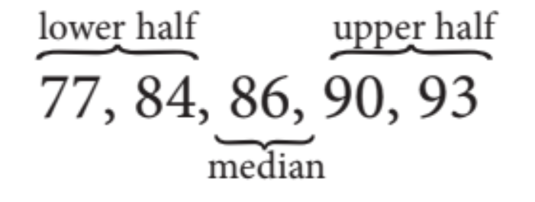
Pair-Share:
Partner-A: What is $Ex\text{plain} \text{steps}\text{ 1 }\text{to}\text{ 3}\text{?}$
Partner-B: What is $Ex\text{plain} \text{steps}\text{ 4 }\text{to}\text{ 6 ?}$
CFU: Pair-Share
Steps to Find IQR
Step 1: Put the numbers in order.
Step 2: Find the median($Q_{2}$).
Step 3: Cut the data set into Lower Half and Upper Half.
Step 4: Find Median of Lower Half ($Q_{1}$).
Step 5: Find Median of Upper Half ($Q_{3}$).
Step 6: IQR = $Q_{3}$ - $Q_{1}$.
The April high temperatures for 5 years in Delhi are
77 °F, 86 °F, 84 °F, 93 °F, and 90 °F. Find IQR
CONCEPT DEVELOPMENT

Slide 8
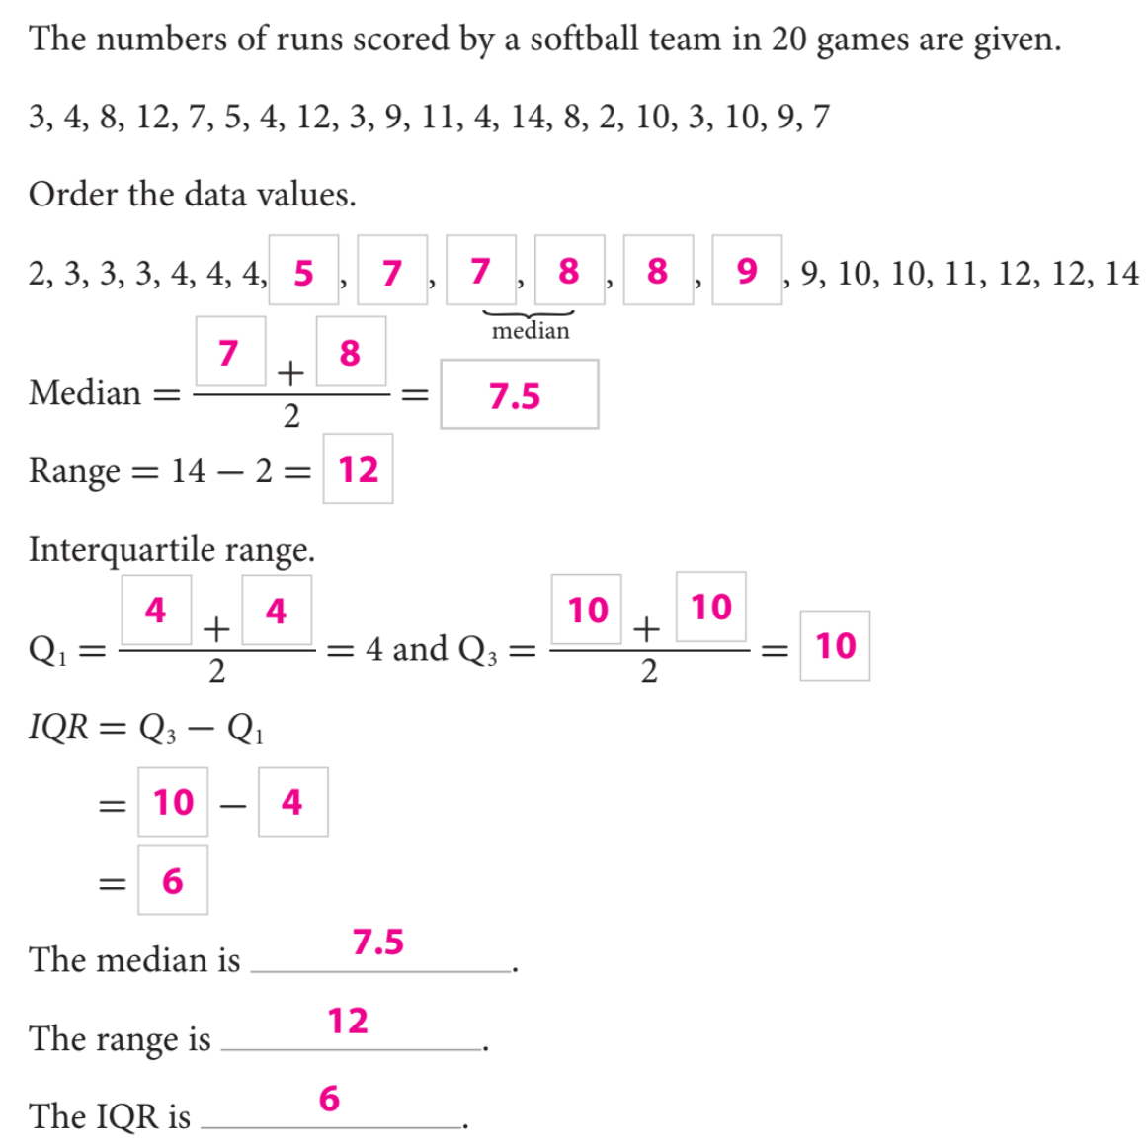
Steps to Find IQR
Step 1: Put the numbers in order.
Step 2: Find the median($Q_{2}$).
Step 3: Cut the data set into Lower Half and Upper Half.
Step 4: Find Median of Lower Half ($Q_{1}$).
Step 5: Find Median of Upper Half ($Q_{3}$).
Step 6: IQR = $Q_{3}$ - $Q_{1}$.

Slide 9
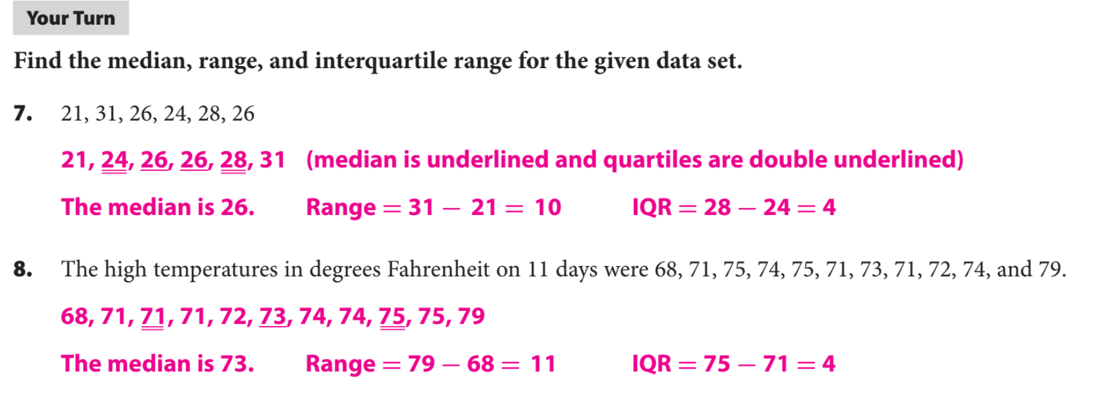
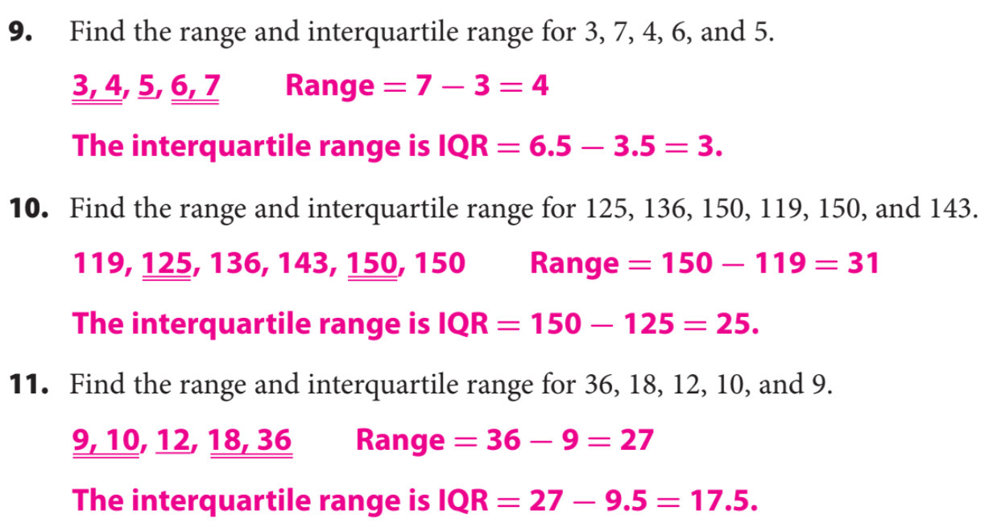

Slide 10
What did you learn about using the mean, Median, & IQR.
Word Bank
Mean
Median
Quartile
IQR
Range
Data Set
Today, I learned how to _________________________________________________________________________________.
SUMMARY CLOSURE

