Slide 1
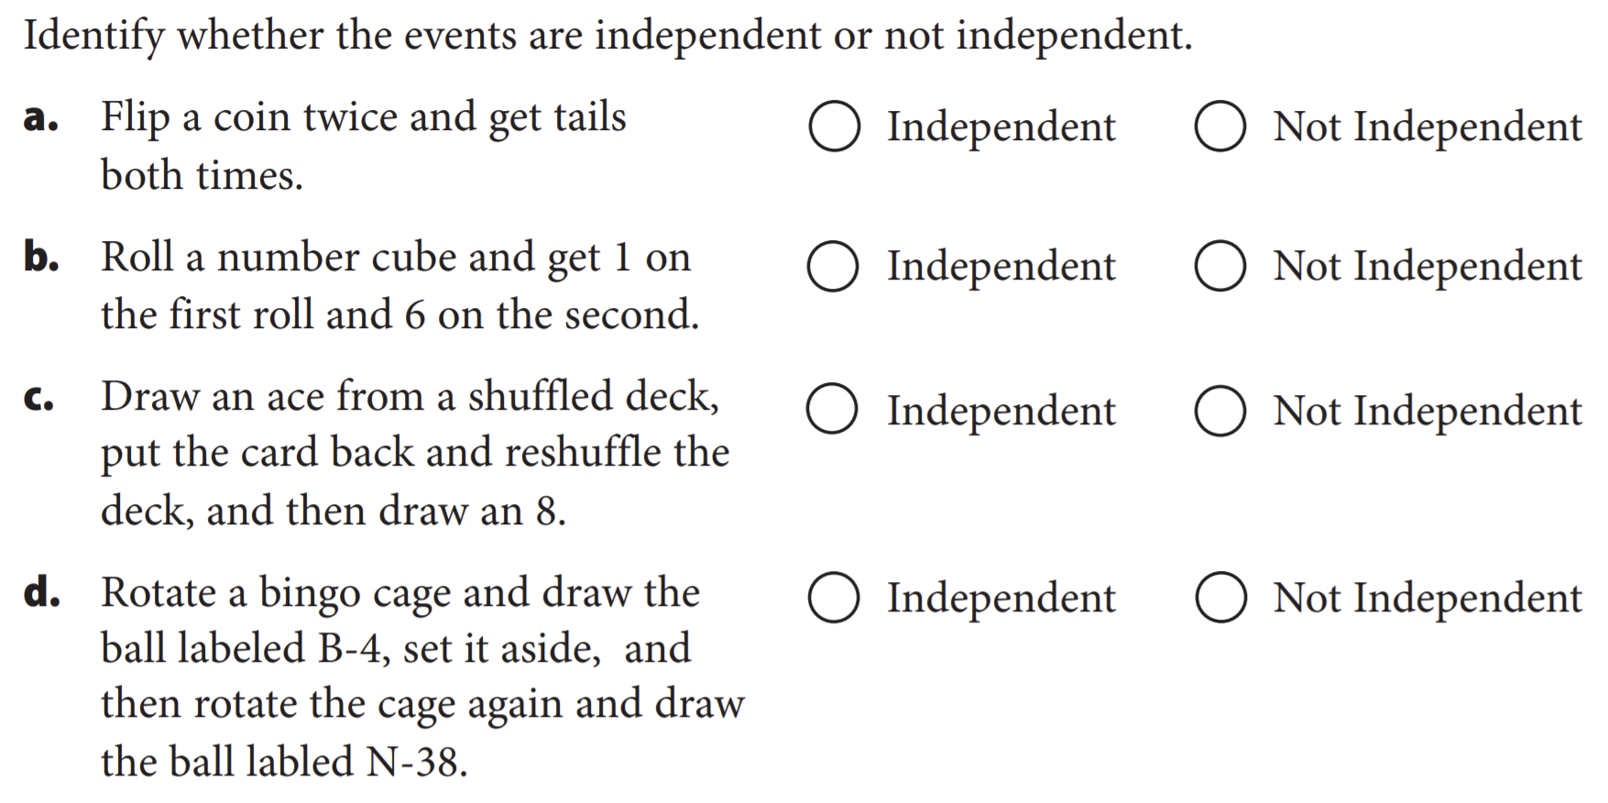
Objective & Prior Knowledge
Lesson-1: 23.3 Dependent Events
Name: _______________________
Learning Objective
Students will learn how to Calculate the Probability ${Dependent}_{1}$of Events.
What are we going to do?
What does Dependent mean?
Dependent means _________.
CFU
Activate Prior Knowledge
Two events are independent provided the occurrence of one event has no effect on the occurrence of the other event. Now, we will use the Multiplication Rule to find the probability of dependent events.
Make Connection
¹ depend or based upon
Vocabulary

Slide 2
Concept Development
Concept Development
Probability =
Number of desired outcomes
Total number of outcomes
Two tests for the independence of events A and B:
If P(A|B) = P(A), then A and B are independent.
If P(A ∩ B) = P(A) ∙ P(B), then A and B are independent.
Two events that fail either of these tests are dependent events because the occurrence of one
event affects the occurrence of the other event.
Find: P(Prefers walking outdoors), P(Male) , and
P(Prefers walking outdoors ∩ Male) as fractions.
Then determine whether events “Prefers walking outdoors” and “Male” are independent or dependent.
Find:
P(Prefers walking outdoors) =
P(Male) =
P(Prefers walking outdoors $∩$Male) =
Find:
P(Prefers walking outdoors) ∙ P(Male) =
$$∙\frac{ }{ }$$
$$=\frac{ }{ }$$
So, therefor Event “Prefers walking outdoors” and “Male” are _____________

Slide 3
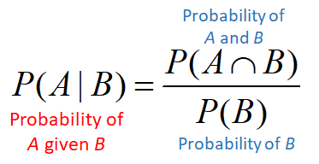
Concept Development
Concept Development
Find and Calculate the conditional probabilities of:
P(Prefers walking outdoors | Male) and P(Male | Prefers walking outdoors).
P(Prefers walking outdoors | Male) =
=
=
P(Male | Prefers walking outdoors) =
=
=

Slide 4
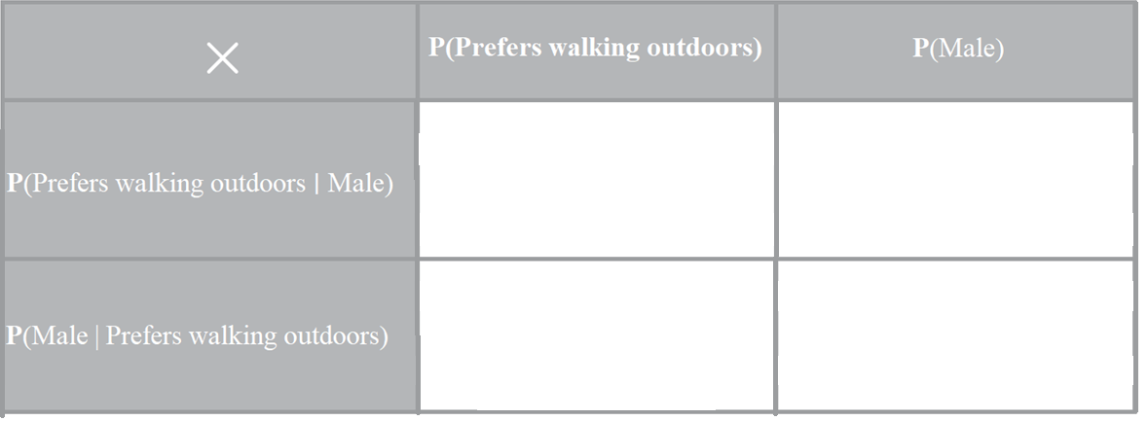
Concept Development
Complete the multiplication table using the fractions for P(Prefers walking outdoors) and P(Male) from Step A and the fractions for P(Prefers walking outdoors ∣ Male) and P(Male | Prefers walking outdoors) from Step B.
Restate
P(Prefers walking outdoors) =
P(Male) =
P(Prefers walking outdoors $|$Male) =
P(Male | Prefers walking outdoors) =
=
=
$∙\frac{ }{ }$
$∙\frac{ }{ }$
=
=
$∙\frac{ }{ }$
$∙\frac{ }{ }$
Do any of the four products in Step C equal P (Prefers walking outdoors $∩$Male) , calculated in Step A? If so, which of the four products?
P(Prefers walking outdoors $∩$Male) =

Slide 5
Concept Development
Concept Development
Summary Closure
Why is probability of dependent events different from the probability of independent events?

