Slide 1

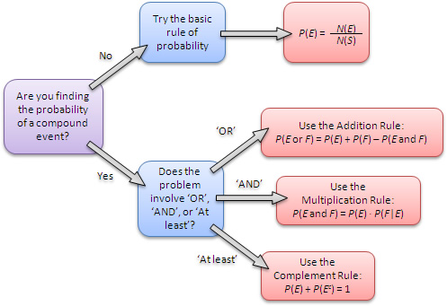
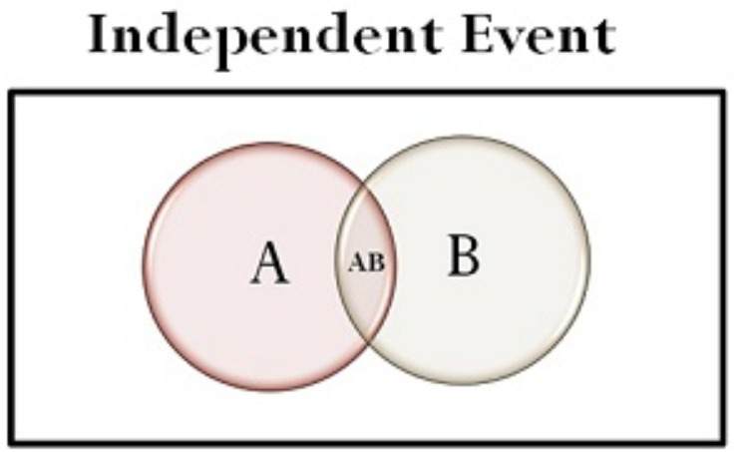

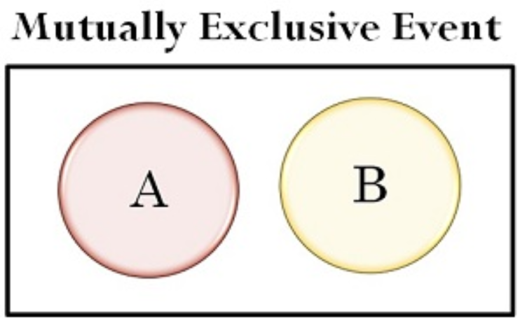
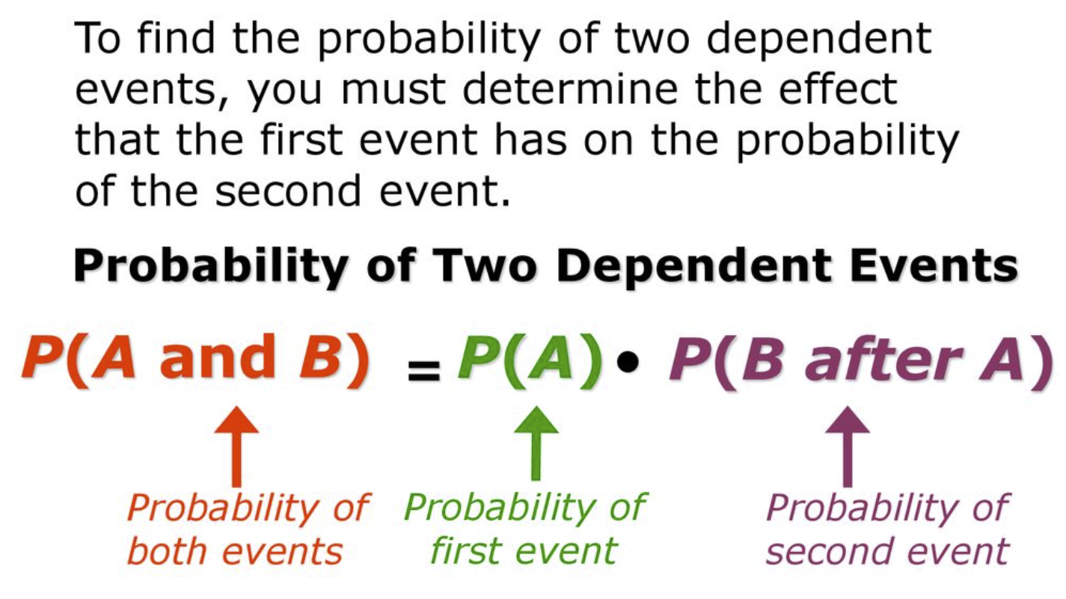
Objective & Prior Knowledge
Lesson-2: 23.3 Dependent Events
Name: _____________________
Learning Objective
Students will learn how to find the Probability of Two ${Dependent}_{1}$ Events.
Activate Prior Knowledge
Probability =
Number of desired outcomes
Total number of outcomes
Overlapping Events
Make Connection
Two events are independent provided the occurrence of one event has no effect on the occurrence of the other event. Now, we will use the Multiplication Rule to find the probability of dependent events.
¹ depend or based upon
Vocabulary

Slide 2
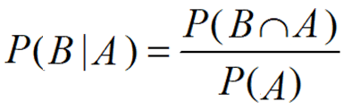
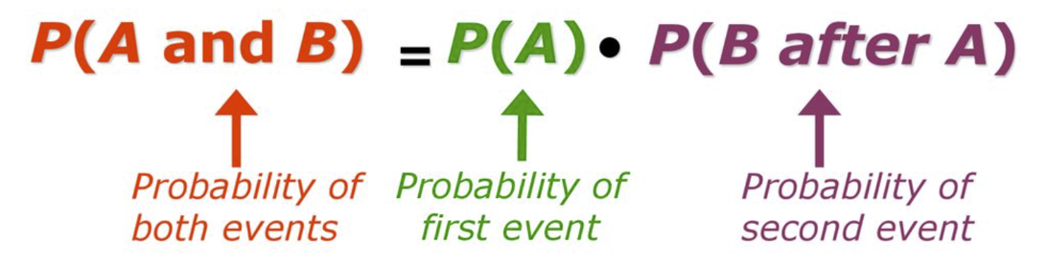
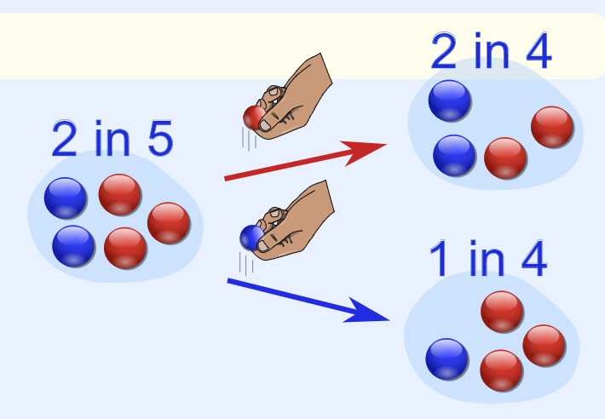
Concept Development
Concept Development
Number of desired outcomes
Two tests for the independence of events A and B:
  If P(A|B) = P(A), then A and B are independent.
  If P(A ∩ B) = P(A) ∙ P(B), then A and B are independent.
Two events that fail either of these tests are dependent events because the occurrence of one
event affects the occurrence of the other event.
Probability =
Total number of outcomes
You can use the Multiplication Rule to find the probability of dependent events.
Probability of second event
*Use this equation when dealing with a Two-way frequency table:
If a red pick
2 blue and 3 red marbles are in a bag.
What are the chances of getting a blue marble first try?
If a blue pick
What are the chances of getting a blue marble second try without replacing?

Slide 3
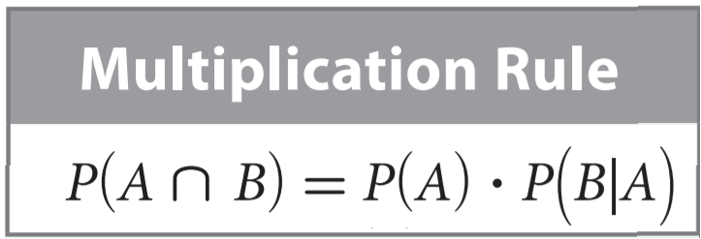



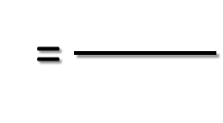
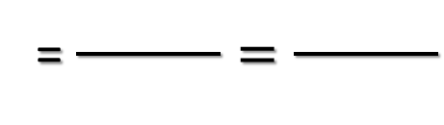
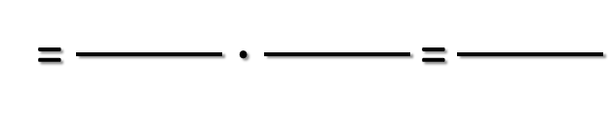
Concept Development
Concept Development
A bag holds 4 green marbles and 2 blue marbles. You choose a marble without looking, put it aside, and choose another marble without looking.
Use the Multiplication Rule to find the specified probability, writing it as a fraction.
1. Find the probability that you choose a green marble followed by a blue marble.
P(green)
= $\frac{ }{ }=\frac{ }{ }$
P(blue|green)
=
Already picked a green marble,
now pick a blue marble
6 marble – 1 green marble picked = 5 marbles in bag now
P(green ⋂ blue) = P(green) ∙ P(blue|green)
= $\frac{ }{ }∙\frac{ }{ }\text{=}\frac{ }{ }$

Slide 4
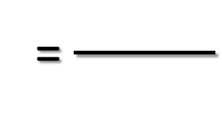
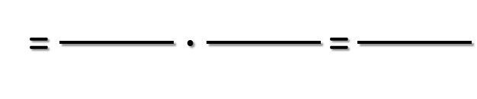
Concept Development
Concept Development
A bag holds 4 green marbles and 2 blue marbles. You choose a marble without looking, put it aside, and choose another marble without looking.
Use the Multiplication Rule to find the specified probability, writing it as a fraction.
2. Find the probability that you choose a green marble followed by another green marble.
P(green)
= $\frac{ }{ }=\frac{ }{ }$
P(green |green)
=
Already picked a green marble,
now pick a green marble
6 marble – 1 green marble picked = 5 marbles in bag now
P(green ⋂ green ) = P(green) ∙ P(green|green)
= $\frac{ }{ }∙\frac{ }{ }\text{=}\frac{ }{ }$

Slide 5
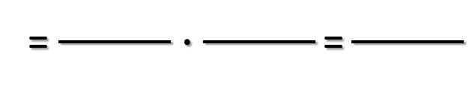
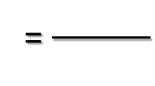
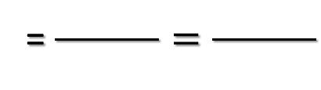
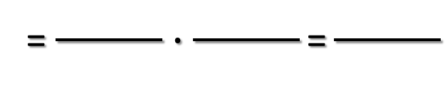
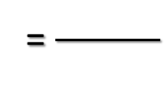
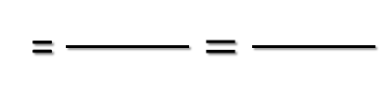
Concept Development
Practice
There are 4 green, 10 red, and 6 yellow marbles in a bag. Each time you randomly choose a marble, you put it aside before choosing another marble at random.
1. Find the probability that you choose a red marble followed by a yellow marble.
Use variable names: red & yellow
P( )
= $\frac{ }{ }=\frac{ }{ }$
P( | )
=
P( ⋂ ) = P( ) ∙ P( | )
= $\frac{ }{ }∙\frac{ }{ }\text{=}\frac{ }{ }$
2. Find the probability that you choose one yellow marble followed by another yellow marble.
Use variable names: yellow1 & yellow2
P( )
= $\frac{ }{ }=\frac{ }{ }$
P( | )
=
P( ⋂ ) = P( ) ∙ P( | )
= $\frac{ }{ }∙\frac{ }{ }\text{=}\frac{ }{ }$

Slide 6
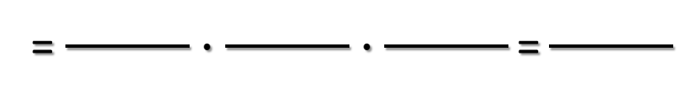
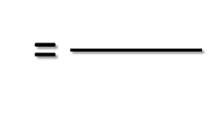
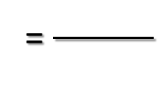
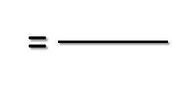
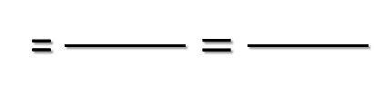
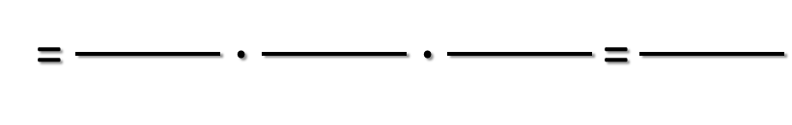
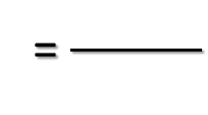
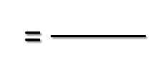
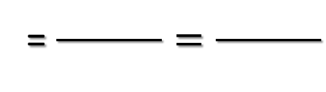
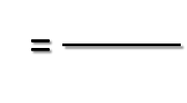
Concept Development
Practice
There are 4 green, 10 red, and 6 yellow marbles in a bag. Each time you randomly choose a marble, you put it aside before choosing another marble at random.
4. Find the probability that you choose a red marble, followed by a yellow marble, followed by a green marble.
Use variable names: red, yellow, & green
P( | )
P( )
= $\frac{ }{ }=\frac{ }{ }$
=
P( | ⋂ )
=
=
P( ⋂ ⋂ ) = P( ) ∙ P( | ) ∙ P( | ⋂ )
= $\frac{ }{ }∙\frac{ }{ }∙\frac{ }{ }\text{=}\frac{ }{ }$
5. Find the probability that you choose three red marbles.
Use variable names: red1, red2, & red3
P( )
= $\frac{ }{ }=\frac{ }{ }$
P( | )
=
P( | ⋂ )
=
=
P( ⋂ ⋂ ) = P( ) ∙ P( | ) ∙ P( | ⋂ )
= $\frac{ }{ }∙\frac{ }{ }∙\frac{ }{ }\text{=}\frac{ }{ }$

Slide 7

Concept Development
Summary Closure
How do you find the probability of Two 𝐷𝑒𝑝𝑒𝑛𝑑𝑒𝑛𝑡 Events using the Multiplication Rule:

