Slide 1
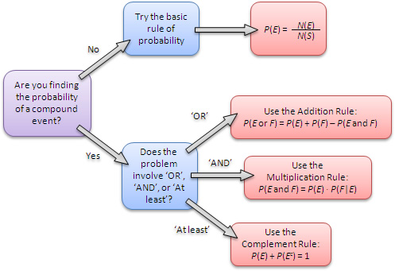
Objective & Prior Knowledge
Learning Objective
Students will learn how to find the Probability of Two ${Dependent}_{1}$ Events.
What are we going to do?
What does Dependent mean?
Dependent means _________.
CFU
Activate Prior Knowledge
Make Connection
Two events are independent provided the occurrence of one event has no effect on the occurrence of the other event. Now, we will use the Multiplication Rule to find the probability of dependent events.
¹ depend or based upon
Vocabulary

Slide 2
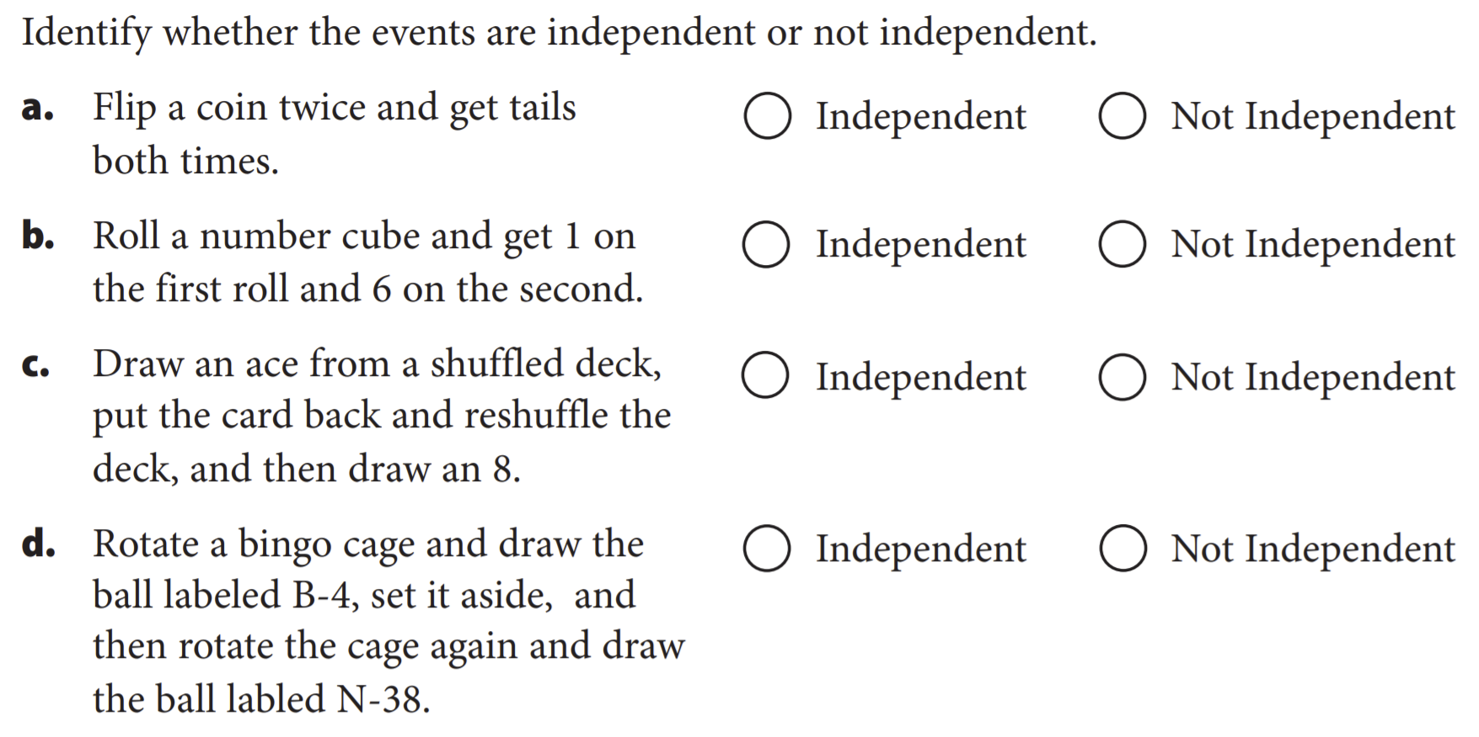
Objective & Prior Knowledge
Learning Objective
Activate Prior Knowledge
Make Connection
Two events are independent provided the occurrence of one event has no effect on the occurrence of the other event. Now, we will use the Multiplication Rule to find the probability of dependent events.
¹ depend or based upon
Vocabulary

Slide 3

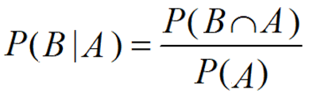
Concept Development
Concept Development
Number of desired outcomes
Two tests for the independence of events A and B:
  If P(A|B) = P(A), then A and B are independent.
  If P(A ∩ B) = P(A) ∙ P(B), then A and B are independent.
Two events that fail either of these tests are dependent events because the occurrence of one
event affects the occurrence of the other event.
Probability =
Total number of outcomes
You can use the Multiplication Rule to find the probability of dependent events.
Two-Way Frequency Tables

Slide 4
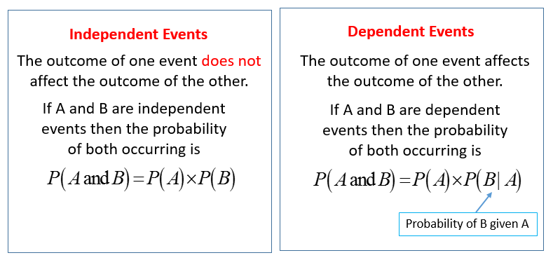
Concept Development
Concept Development
Summary Closure
Why is probability of dependent events different from the probability of independent events?
In dependent event, the occurrence of one event affects the probability of the second event whereas in independent it does not.

Slide 5
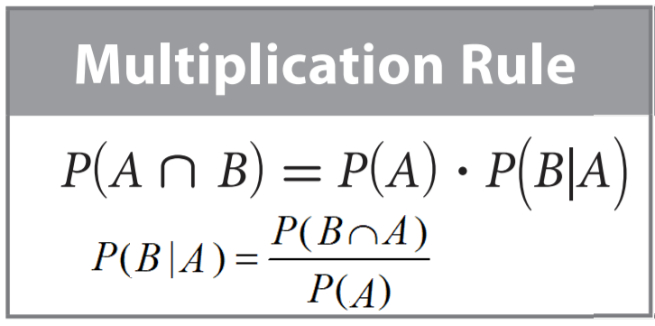



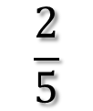
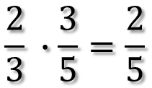




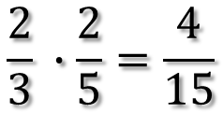
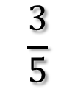
Concept Development
Concept Development
A bag holds 4 green marbles and 2 blue marbles. You choose a marble without looking, put it aside, and choose another marble without looking.
Two-way frequency table:
Use the Multiplication Rule to find the specified probability, writing it as a fraction.
1. Find the probability that you choose a green marble followed by a blue marble.
$$\frac{4}{6}$$
$$=\frac{2}{3}$$
P(green) =
$$\frac{2}{5}$$
P(blue|green)= Already picked a green marble, now pick a blue marble =
6 marble – 1 green marble picked = 5 marbles in bag now
$$\frac{2}{3} ∙\frac{2}{5}=\frac{4}{15}$$
P(green ⋂ blue) = P(green) ∙ P(blue|green) =
2. Find the probability that you choose a green marble followed by another green marble.
$$\frac{3}{5}$$
$$\frac{4}{6}$$
$$=\frac{2}{3}$$
P(green|green)= Already picked a green marble, now pick a
green marble
=
P(green) =
6 marble – 1 green marble picked = 5 marbles in bag now
$$\frac{2}{3} ∙\frac{3}{5}=\frac{2}{5}$$
P(green ⋂ green) = P(green) ∙ P(green|green) =

Slide 6
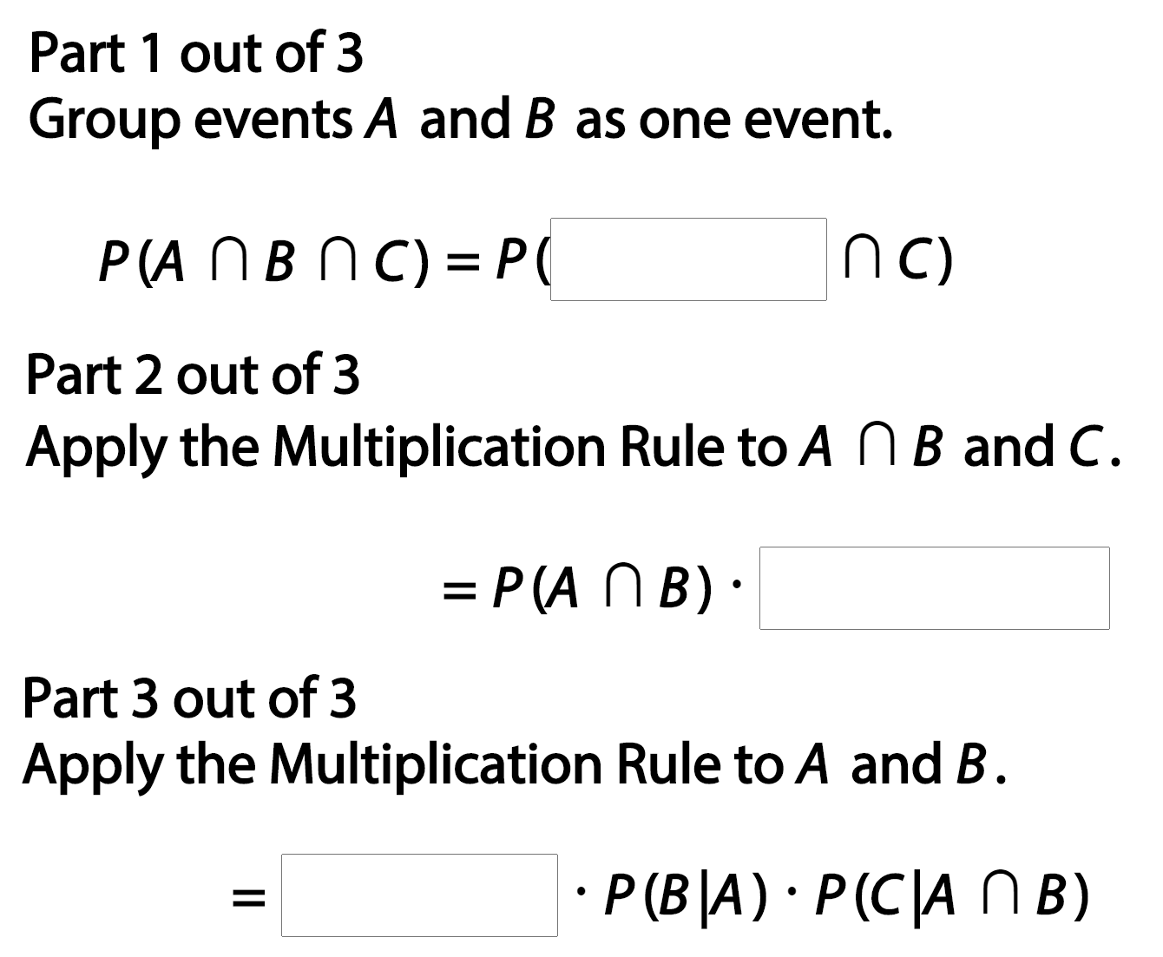

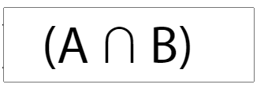
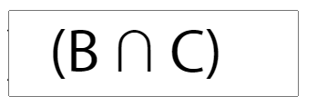
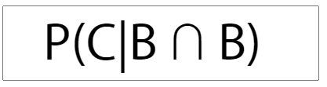
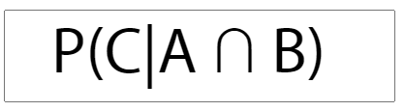
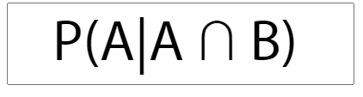

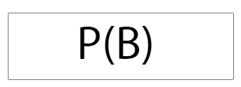


1.
Show how to extend the Multiplication Rule to three events A, B, and C.

Slide 7
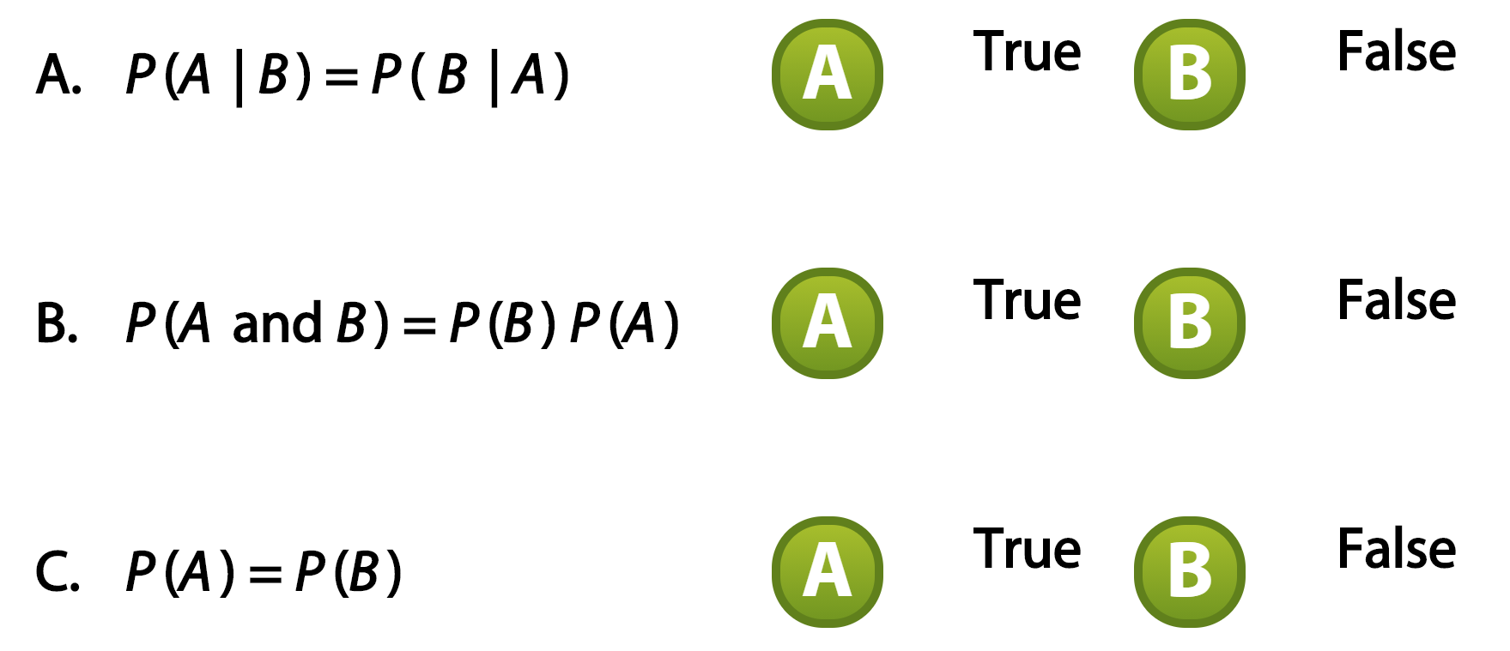


2.
The events A and B are independent. Select True or False for each statement.
.
Two tests for the independence of events A and B:
  If P(A|B) = P(A), then A and B are independent.
  If P(A ∩ B) = P(A) ∙ P(B), then A and B are independent.
Two events that fail either of these tests are dependent events because the occurrence of one event affects the occurrence of the other event.

Slide 8
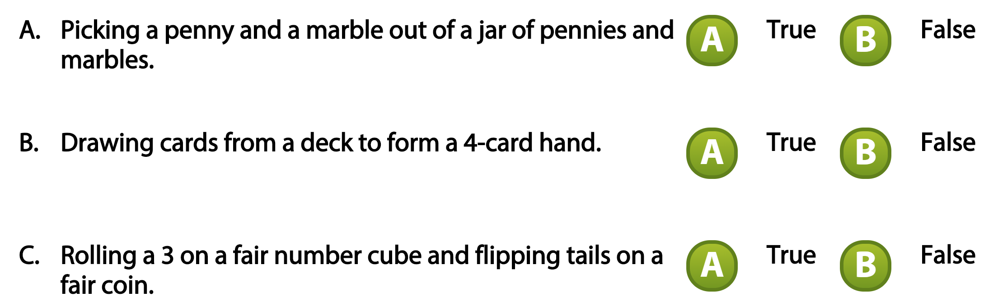




3.
Are the events independent? Choose True or False for each statement.

Slide 9
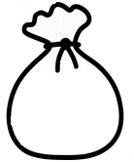


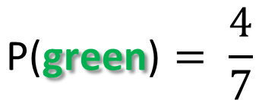

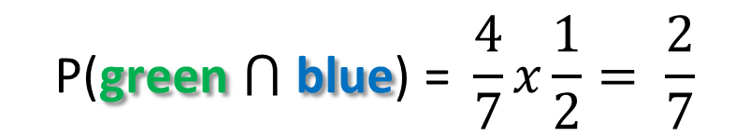
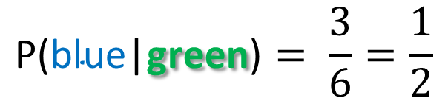
4.
A bag holds 4 green marbles and 3 blue marbles. You choose a marble without looking, put it aside, and choose another marble without looking. Use the Multiplication Rule to find the specified probability, entering it as a fraction.
Find the probability that you remove a green marble followed by a blue marble.
P(green ⋂ blue) = P(green) ∙ P(blue|green)
$$\text{P}\text{(}\text{green}\text{)}= \frac{4}{7}$$
$$\text{P}\text{(}\text{blue}\text{|}\text{green}\text{)}= \frac{3}{6}=\frac{1}{2}$$
$$\text{P}\text{(}\text{green}\text{ ⋂ }\text{blue}\text{) =} \frac{4}{7}x\frac{1}{2}= \frac{2}{7}$$
$$\frac{2}{7}$$
The probability that you choose a green marble followed by a blue marble is

Slide 10
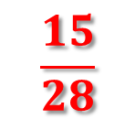
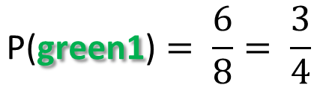

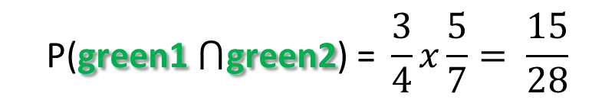
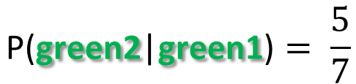
5.
A bag holds 6 green marbles and 2 blue marbles. You choose a marble without looking, put it aside, and choose another marble without looking. Use the Multiplication Rule to find the specified probability, entering it as a fraction.
Find the probability that you remove a green marble followed by a another green marble
P(green1 ⋂ green2) = P(green1) ∙ P(green2|green1)
$$\text{P}\text{(}\text{green}\text{1}\text{)}= \frac{6}{8}= \frac{3}{4}$$
$$\text{P}\text{(}\text{green}\text{2}\text{|}\text{green}\text{1}\text{)}= \frac{5}{7}$$
$$\text{P}\text{(}\text{green}\text{1}\text{ ⋂}\text{green}\text{2}\text{) =} \frac{3}{4}x\frac{5}{7}= \frac{15}{28}$$
$$\frac{15}{28}$$
The probability that you choose a green marble followed by another green marble is

Slide 11
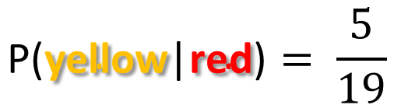
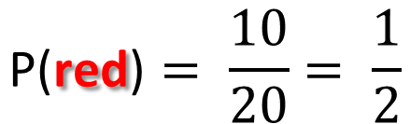

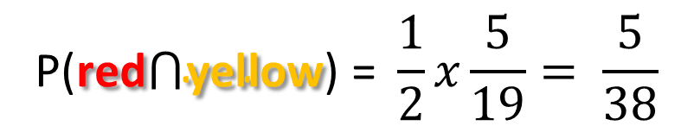
6.
There are 5 green, 10 red, and 5 yellow marbles in a bag. You choose a marble without looking, put it aside, and then choose another marble without looking. Use the Multiplication Rule to find the specified probability, entering it as a fraction.
Find the probability that you choose a red marble followed by a yellow marble.
P(red ⋂ yellow) = P(red) ∙ P(yellow | red)
$$\text{P}\text{(}\text{red}\text{)}= \frac{10}{20}= \frac{1}{2}$$
$$\text{P}\text{(}\text{yellow}\text{|}\text{red}\text{)}= \frac{5}{19}$$
$$\text{P}\text{(}\text{red}\text{⋂}\text{yellow}\text{) =} \frac{1}{2}x\frac{5}{19}= \frac{5}{38}$$
$$\frac{5}{38}$$
The probability that you choose a red marble followed by a yellow marble is

Slide 12
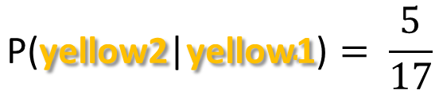
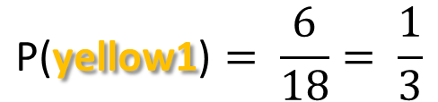

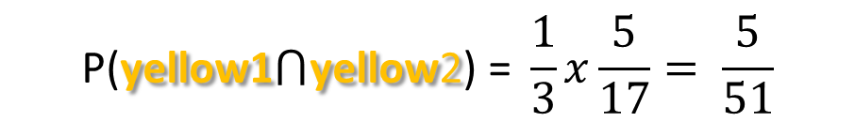
7.
There are 4 green, 8 red, and 6 yellow marbles in a bag. Each time you randomly choose a marble, you put it aside before choosing another marble at random. Use the Multiplication Rule to find the specified probability, entering it as a fraction.
Find the probability that you choose a yellow marble followed by another yellow marble.
P(yellow1 ⋂ yellow2) = P(yellow1) ∙ P(yellow2 | yellow1)
$$\text{P}\text{(}\text{yellow}\text{1}\text{)}= \frac{6}{18}= \frac{1}{3}$$
$$\text{P}\text{(}\text{yellow}\text{2}\text{|}\text{yellow}\text{1}\text{)}= \frac{5}{17}$$
$$\text{P}\text{(}\text{yellow}\text{1}\text{⋂}\text{yellow}\text{2}\text{) =} \frac{1}{3}x\frac{5}{17}= \frac{5}{51}$$
$$\frac{5}{51}$$
The probability that you choose a yellow marble followed by another yellow marble is

Slide 13
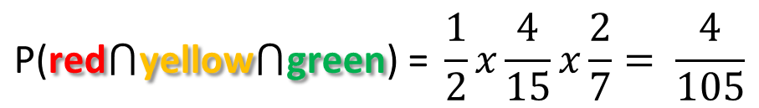
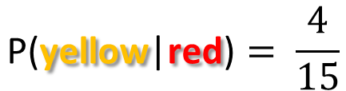
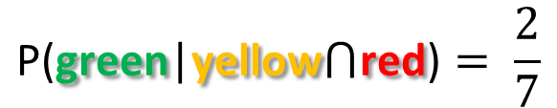
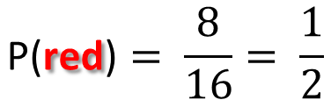

8.
There are 4 green, 8 red, and 4 yellow marbles in a bag. You choose a marble without looking, put it aside, and then choose another marble without looking. Use the Multiplication Rule to find the specified probability, entering it as a fraction.
Find the probability that you choose a red marble, followed by a yellow marble, followed by a green marble.
P(red⋂yellow⋂green) = P(red) ∙ P(yellow|red) ∙ P(green|yellow⋂red)
$$\text{P}\text{(}\text{red}\text{)}= \frac{8}{16}= \frac{1}{2}$$
$$\text{P}\text{(}\text{yellow}\text{|}\text{red}\text{)}= \frac{4}{15}$$
$$\text{P}\text{(}\text{green}\text{|}\text{yellow}\text{⋂}\text{red}\text{)}= \frac{2}{7}$$
$$\text{P}\text{(}\text{red}\text{⋂}\text{yellow}\text{⋂}\text{green}\text{) =} \frac{1}{2}x\frac{4}{15}x\frac{2}{7}= \frac{4}{105}$$
$$\frac{4}{105}$$
The probability that you choose a red, followed by a yellow marble, followed by a green marble is

Slide 14
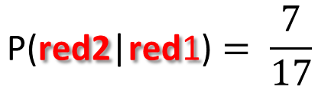
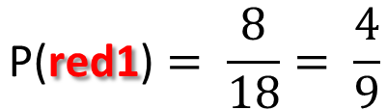
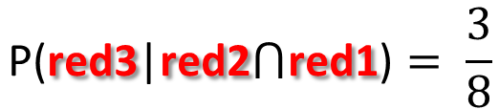

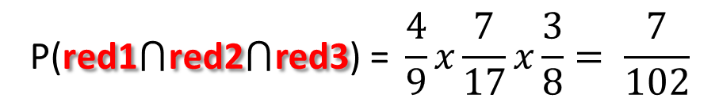
9.
There are 6 green, 8 red, and 4 yellow marbles in a bag. Each time you randomly choose a marble, you put it aside before choosing another marble at random.Use the Multiplication Rule to find the specified probability, entering it as a fraction.
Find the probability that you choose three red marbles.
P(red1⋂red2⋂red3) = P(red1) ∙ P(red2|red1) ∙ P(red3 |red2⋂red1)
$$\text{P}\text{(}\text{red}\text{1}\text{)}= \frac{8}{18}= \frac{4}{9}$$
$$\text{P}\text{(}\text{red}\text{2}\text{|}\text{red}\text{1}\text{)}= \frac{7}{17}$$
$$\text{P}\text{(}\text{red}\text{3}\text{|}\text{red}\text{2}\text{⋂}\text{red}\text{1}\text{)}= \frac{3}{8}$$
$$\text{P}\text{(}\text{red}\text{1}\text{⋂}\text{red}\text{2}\text{⋂}\text{red}\text{3}\text{) =} \frac{4}{9}x\frac{7}{17}x\frac{3}{8}= \frac{7}{102}$$
$$\frac{7}{102}$$
The probability that you choose three red marbles is

Slide 15

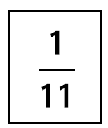
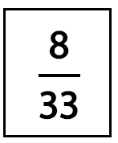
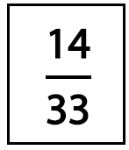
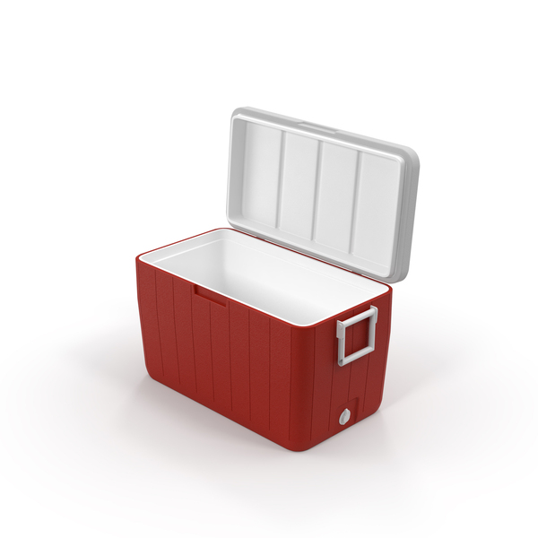






10.
A cooler contains 4 bottles of apple juice and 8 bottles of grape juice. You choose a bottle without looking, put it aside, and then choose another bottle without looking. Drag and drop each probability into the boxes to show the probability for the corresponding situation. More than one situation can have the same probability.
P(apple ⋂ graph) = P(apple) ∙ P(graph|apple)
$$\text{P}\text{(}\text{apple}\text{)}= \frac{4}{12}= \frac{1}{3}$$
$$\text{P}\text{(}\text{graph}\text{|}\text{apple}\text{)}= \frac{8}{11}$$
$$\text{P}\text{(}\text{apple}\text{ ⋂ }\text{graph}\text{) =} \frac{1}{3}x\frac{8}{11}= \frac{8}{33}$$

Slide 16



10.
A cooler contains 4 bottles of apple juice and 8 bottles of grape juice. You choose a bottle without looking, put it aside, and then choose another bottle without looking. Drag and drop each probability into the boxes to show the probability for the corresponding situation. More than one situation can have the same probability.
P(apple ⋂ apple) = P(apple) ∙ P(apple |apple)
$$\text{P}\text{(}\text{apple}\text{)}= \frac{4}{12}= \frac{1}{3}$$
$$\text{P}\text{(}\text{apple}\text{|}\text{apple}\text{)}= \frac{3}{11}$$
$$\text{P}\text{(}\text{apple}\text{ ⋂}\text{apple}\text{) =} \frac{1}{3}x\frac{3}{11}= \frac{1}{11}$$

Slide 17




10.
A cooler contains 4 bottles of apple juice and 8 bottles of grape juice. You choose a bottle without looking, put it aside, and then choose another bottle without looking. Drag and drop each probability into the boxes to show the probability for the corresponding situation. More than one situation can have the same probability.
P(graph ⋂ apple) = P(graph) ∙ P(apple | graph)
$$\text{P}\text{(}\text{graph}\text{)}= \frac{8}{12}= \frac{2}{3}$$
$$\text{P}\text{(}\text{apple}\text{|}\text{graph}\text{)}= \frac{4}{11}$$
$$\text{P}\text{(}\text{graph}\text{⋂}\text{apple}\text{) =} \frac{2}{3}x\frac{4}{11}= \frac{8}{33}$$

Slide 18



10.
A cooler contains 4 bottles of apple juice and 8 bottles of grape juice. You choose a bottle without looking, put it aside, and then choose another bottle without looking. Drag and drop each probability into the boxes to show the probability for the corresponding situation. More than one situation can have the same probability.
P(graph ⋂ graph) = P(graph) ∙ P(graph | graph)
$$\text{P}\text{(}\text{graph}\text{)}= \frac{8}{12}= \frac{2}{3}$$
$$\text{P}\text{(}\text{graph}\text{|}\text{graph}\text{)}= \frac{7}{11}$$
$$\text{P}\text{(}\text{graph}\text{⋂}\text{graph}\text{) =} \frac{2}{3}x\frac{7}{11}= \frac{14}{33}$$

