Slide 1
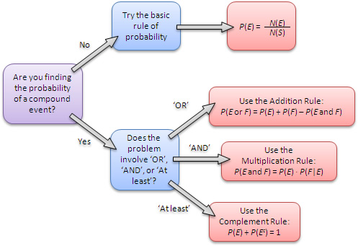
Objective & Prior Knowledge
Learning Objective
Students will learn how to find the Probability of Two ${Dependent}_{1}$ Events.
What are we going to do?
What does Dependent mean?
Dependent means _________.
CFU
Activate Prior Knowledge
Make Connection
Two events are independent provided the occurrence of one event has no effect on the occurrence of the other event. Now, we will use the Multiplication Rule to find the probability of dependent events.
¹ depend or based upon
Vocabulary

Slide 2

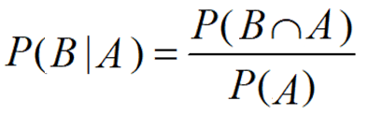
Concept Development
Concept Development
Number of desired outcomes
Two tests for the independence of events A and B:
  If P(A|B) = P(A), then A and B are independent.
  If P(A ∩ B) = P(A) ∙ P(B), then A and B are independent.
Two events that fail either of these tests are dependent events because the occurrence of one
event affects the occurrence of the other event.
Probability =
Total number of outcomes
You can use the Multiplication Rule to find the probability of dependent events.

Slide 3
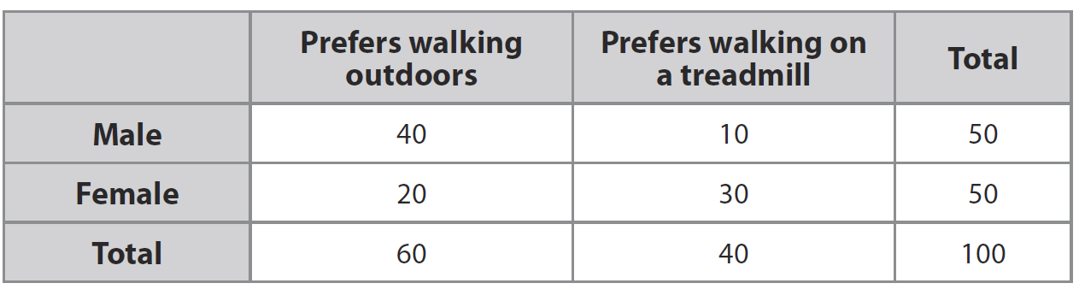


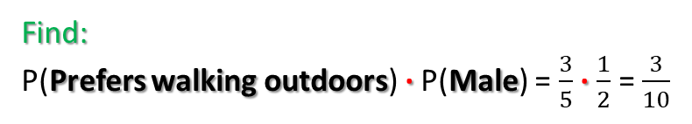




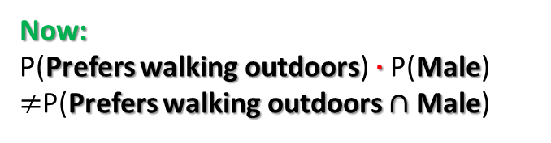
Concept Development
Concept Development
Number of desired outcomes
Two tests for the independence of events A and B:
  If P(A|B) = P(A), then A and B are independent.
  If P(A ∩ B) = P(A) ∙ P(B), then A and B are independent.
Two events that fail either of these tests are dependent events because the occurrence of one
event affects the occurrence of the other event.
Probability =
Total number of outcomes
Find P(Prefers walking outdoors), P(Male) , and P(Prefers walking outdoors ∩ Male) as fractions.
Then determine whether events “Prefers walking outdoors” and “Male” are independent or dependent.
P(Prefers walking outdoors) = $\frac{60}{100}=\frac{3}{5}$
Find:
P(Prefers walking outdoors) ∙ P(Male) = $\frac{3}{5}$ ∙ $\frac{1}{2}$ = $\frac{3}{10}$
P(Male) = $\frac{50}{100}=\frac{1}{2}$
Now:
P(Prefers walking outdoors) ∙ P(Male) $≠$P(Prefers walking outdoors $∩$Male)
$\frac{3}{10}$ $≠$ $\frac{2}{5}$
P(Prefers walking outdoors $∩$Male) = $\frac{40}{100}=\frac{2}{5}$
So, therefor Event “Prefers walking outdoors” and “Male” are dependent

Slide 4
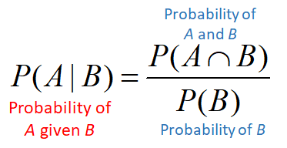

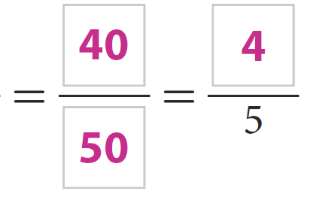
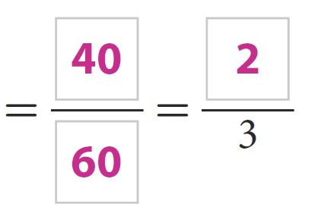

Concept Development
Concept Development
Find and Calculate the conditional probabilities of:
P(Prefers walking outdoors | Male) and P(Male | Prefers walking outdoors).
P(Prefers walking outdoors | Male) = $\frac{n(\text{Prefers} \text{walking} \text{outdoors} ∩ \text{Male})}{n(\text{Male})}$
P(Male | Prefers walking outdoors) = $\frac{n(\text{Male} ∩ \text{Prefers} \text{walking} \text{outdoors})}{n(\text{Prefers} \text{walking} \text{outdoors})}$

Slide 5

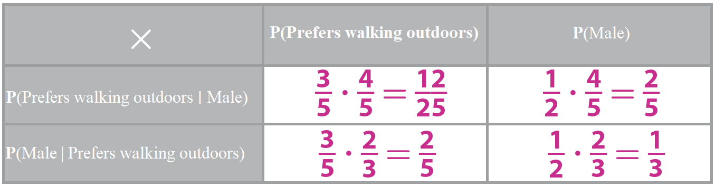


Concept Development
Concept Development
Complete the multiplication table using the fractions for P(Prefers walking outdoors) and P(Male) from Step A and the fractions for P(Prefers walking outdoors ∣ Male) and P(Male | Prefers walking outdoors) from Step B.
Do any of the four products in Step C equal P (Prefers walking outdoors $∩$Male) , calculated in Step A? If so, which of the four products?
P(Prefers walking outdoors $∩$Male) = $\frac{40}{100}=\frac{2}{5}$
Yes, the products P (Prefers walking outdoors ) ∙ P (Male ∣ Prefers walking outdoors ) and
P (Male) ∙ P (Prefers walking outdoors | Male) both equal $\frac{2}{5}$ ,

Slide 6
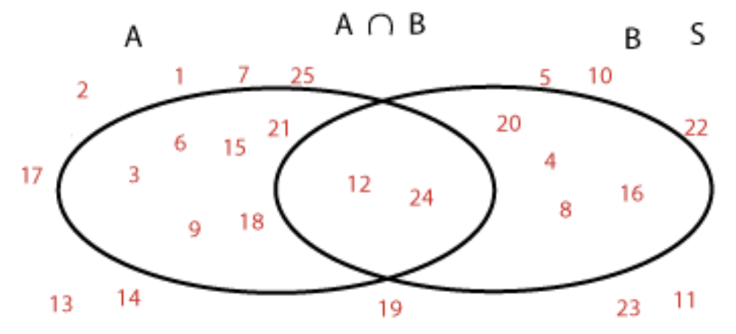

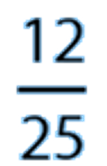

1.
Use a Venn diagram to find the probability of randomly choosing a multiple of 3 or a multiple of 4 from the set of numbers from 1 to 25.
Let A be the set of multiples of 3 from 1 to 25 = {3, 6, 9, 12, 15, 18, 21, 24} Let B be the set of multiples of 4 from 1 to 25 = {4, 8, 12, 16, 20, 24}
Add the numbers of elements in A and B, and then subtract the number of elements in the overlap to get the numerator of the probability. The denominator is 25.
Create a Venn diagram representing the sets A and B.
= 8
+ 6
- 2
= 12

Slide 7

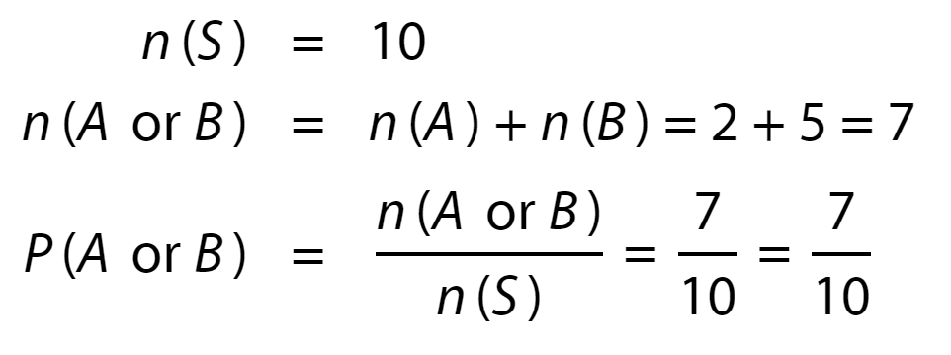




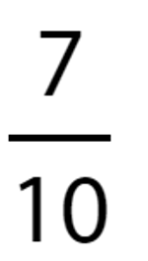
2.
A bag contains 3 blue marbles, 2 red marbles, and 5 green marbles. You choose one without looking. What is the probability that it is red or green?
Enter your answer as a fraction.
Let S be the sample space, A be the event that you choose a red marble, and B be the event that you choose a green marble.

Slide 8
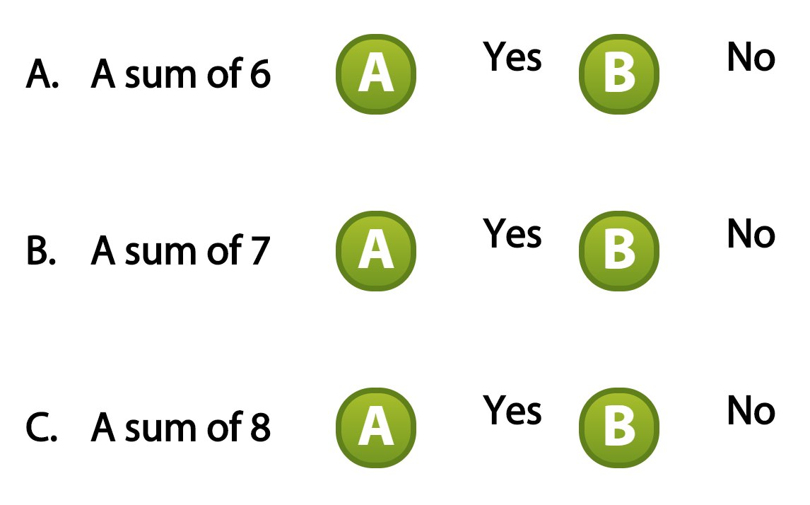
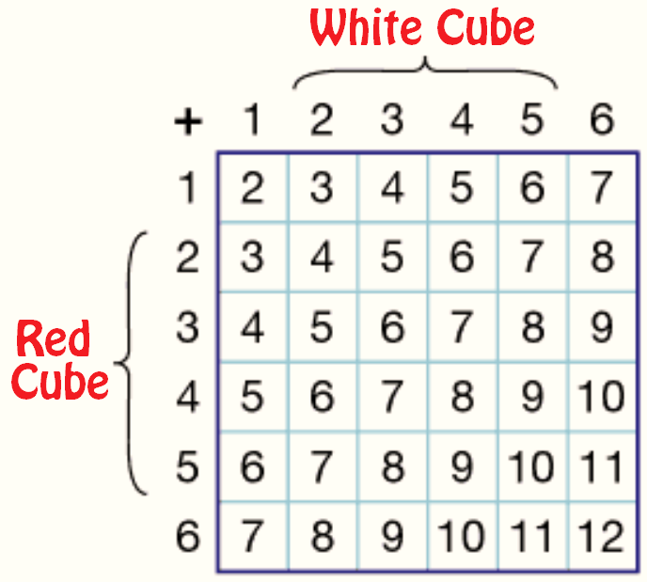


3.

Slide 9

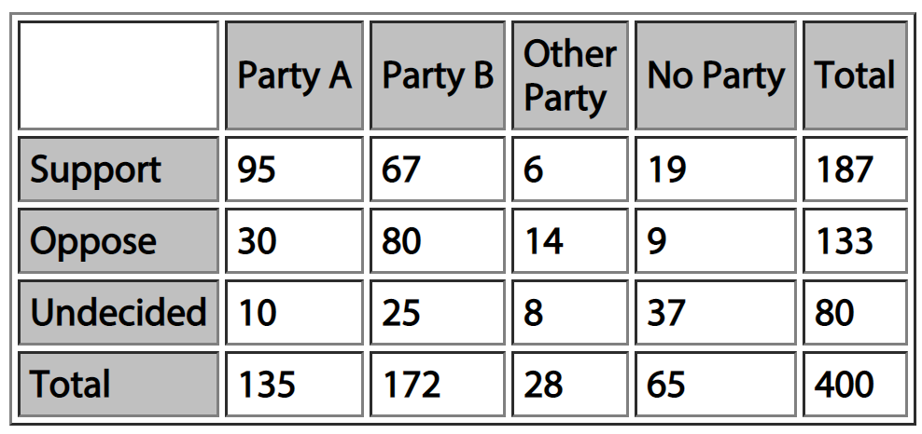

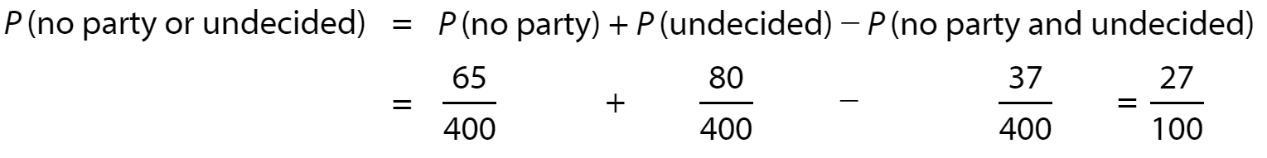
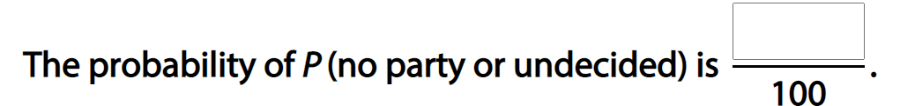

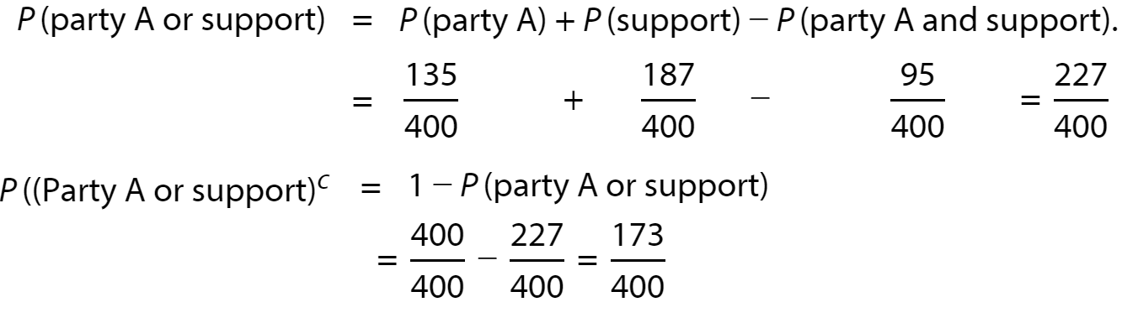
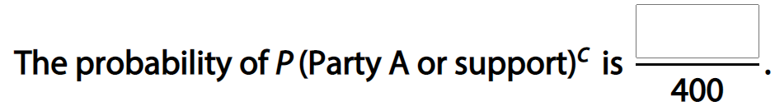
4.
The two-way table shows the results of a poll in a certain country that asked voters, sorted by political party, whether they supported or opposed a proposed government initiative. Find the given probabilities.
27
173

Slide 10
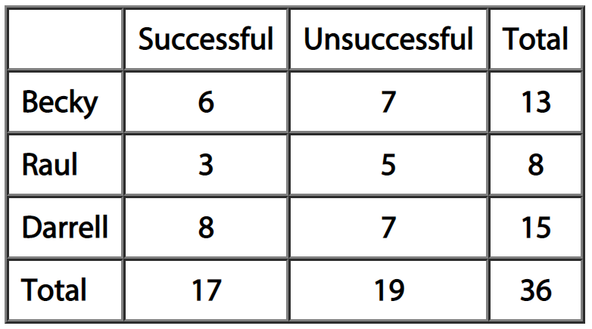


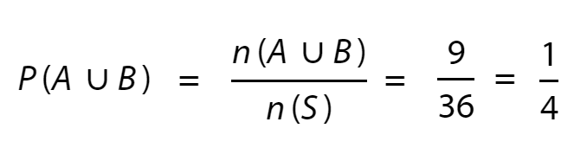

5.
Roberto is the owner of a car dealership. He is assessing the success rate of his top three salespeople in order to offer one of them a promotion. Over two months, for each attempted sale, he records whether the salesperson made a successful sale or not. The results are shown in the chart.
Roberto randomly chooses one of the attempted sales.
Find the probability, as a fraction in simplest form, that the sale was one of Becky's or Raul's successful sales.
Let A be the set of Becky's successful sales attempts.
Let B be the set of Raul's successful sales attempts.
Let S be the set of all sales attempts.

Slide 11
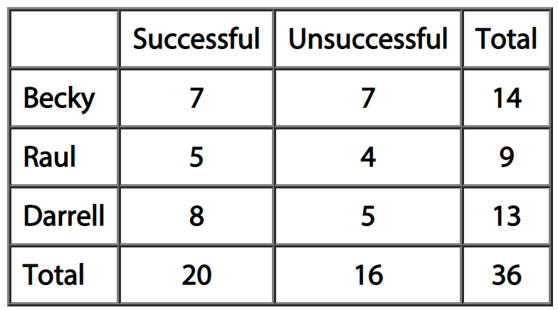


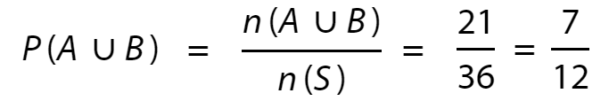

6.
Roberto is the owner of a car dealership. He is assessing the success rate of his top three salespeople in order to offer one of them a promotion. Over two months, for each attempted sale, he records whether the salesperson made a successful sale or not. The results are shown in the chart.
Roberto randomly chooses one of the attempted sales.
Find the probability that the sale was one of the unsuccessful sales or one of Raul's successful sales.
These events are mutually exclusive since they have no outcomes in common. No sale could be both unsuccessful and one of Raul's successful sales.

Slide 12
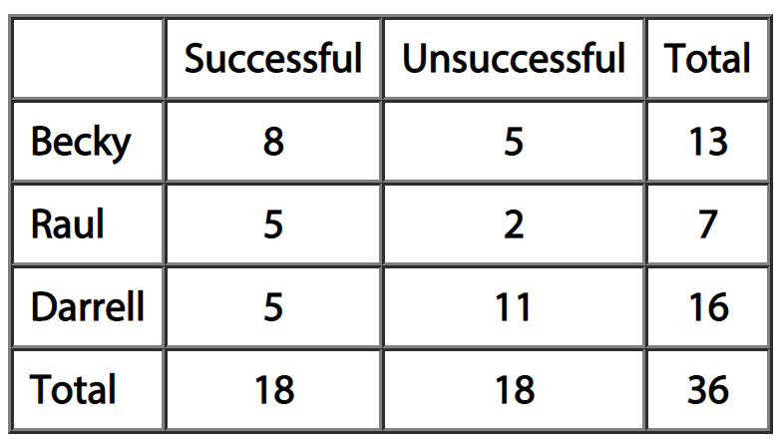

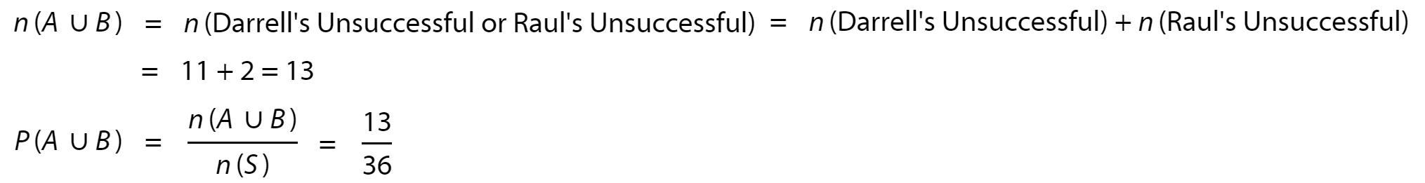

7.
Roberto is the owner of a car dealership. He is assessing the success rate of his top three salespeople in order to offer one of them a promotion. Over two months, for each attempted sale, he records whether the salesperson made a successful sale or not. The results are shown in the chart.
Roberto randomly chooses one of the attempted sales.
Find the probability that the sale was one of Darrell's unsuccessful sales or one of Raul's unsuccessful sales.
These events are mutually exclusive since they have no outcomes in common. No sale could be one of Darrell's unsuccessful sales and one of Raul's unsuccessful sales.

Slide 13
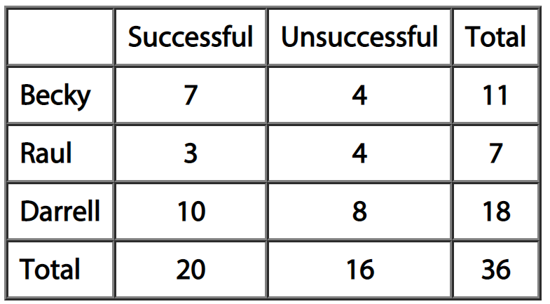
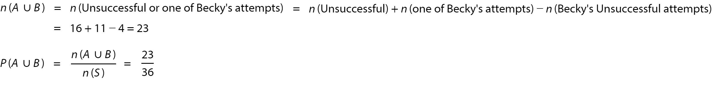

8.
Roberto is the owner of a car dealership. He is assessing the success rate of his top three salespeople in order to offer one of them a promotion. Over two months, for each attempted sale, he records whether the salesperson made a successful sale or not. The results are shown in the chart.
Roberto randomly chooses one of the attempted sales.
Find the probability that the sale was an unsuccessful sale or one of Becky's attempted sales.
These events are overlapping since they have one or more outcomes in common. There are 4 outcomes that are unsuccessful and one of Becky's attempted sales.

Slide 14
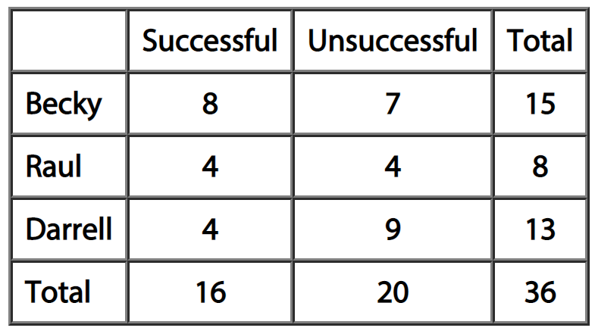
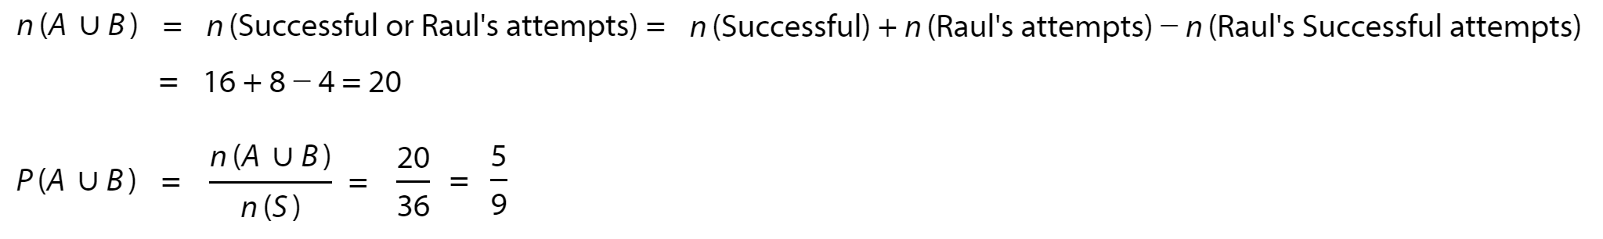

9.
Roberto is the owner of a car dealership. He is assessing the success rate of his top three salespeople in order to offer one of them a promotion. Over two months, for each attempted sale, he records whether the salesperson made a successful sale or not. The results are shown in the chart.
Roberto randomly chooses one of the attempted sales.
Find the probability that the sale was a successful sale or one of Raul's attempted sales.
These events are overlapping since they have one or more outcomes in common. There are 4 outcomes that are successful and one of Raul's successful sales.

Slide 15

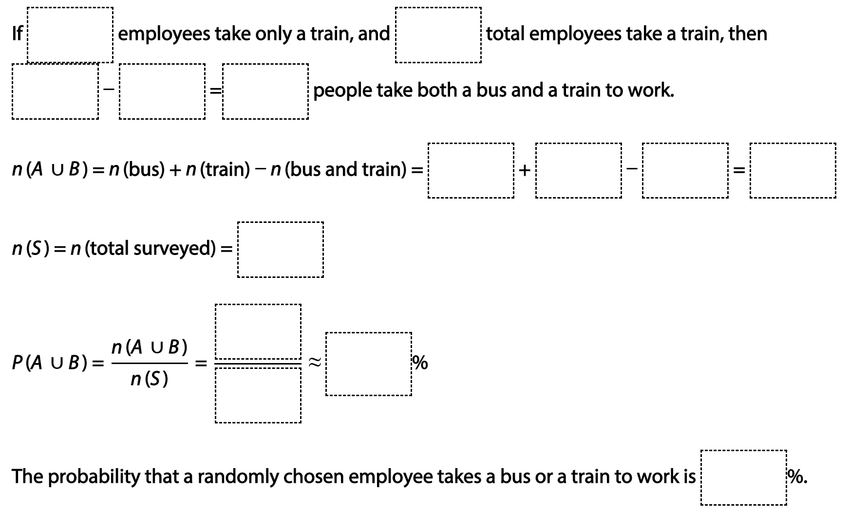






10.
A survey of 1,193 employees at a software company finds that 614 employees take a bus to work and 447 employees take a train to work. Some employees take both a bus and a train, and 324 employees take only a train. To the nearest percent, find the probability that a randomly chosen employee takes a bus or a train to work. Drag and drop numbers into the correct boxes to complete the explanation.

