Slide 1
Name: _____________________
Lesson 2: 11.2.3 Solve Real World System
Period: _____
Solve Linear System of equations by Substitution.
Steps
1 Substitute the expression of the isolated variable into the other equation.
CFU How did I/you substitute the equation with the isolated variable into the other equation?
2 Solve for the variable. (Write ordered pair)
CFU How did I/you solve for the variable?
3 Solve for the remaining ordered pair solution value. (Write ordered pair)
CFU How did I/you solve for the remaining ordered pair solution value?
1
$$\left\{\begin{aligned}2y + x = 1 \\ y−2=x \end{aligned}\right.$$
solution $$\left(___,___\right)$$
2
$$\left\{\begin{aligned}y =2x−1 \\ 2x+y=7 \end{aligned}\right.$$
solution $$\left(___,___\right)$$
Step 1
Step 1
Step 2
Step 2
Remember the Concept
A solution of a system is an ORDERED PAIR that makes BOTH equations true.
Make the Connection
Students, you already know how solve system of equations by substation. Now, we will learn how to write and solve system of equations using substation method.
Step 3
Step 3
ACTIVATE PRIOR KNOWLEDGE
The _______________________ solves a system by substituting one equation into the other equation.
1

Slide 2
Essential Questions
How can you solve a system of linear equations by using substitution?
How do you choose which equation you solve first and which variable you solve it for? Explain.
When solving a system of linear equations by substitution, how can you tell if the system has no solution or infinitely many solutions? Draw a example graph of each.
CONCEPT DEVELOPMENT
In equation form of no solution:
In graphed form of no solution:
In equation form of many solutions:
In graphed form of many solutions:
No solutions
Infinitely many solutions
One solution
2

Slide 3
You can use a system of linear equations to model real-world situations.
Let t represent the total cost in dollars and m represent the number of months.
Fitness center A has a $60 enrollment fee and costs $35 per month.
Fitness center B has no enrollment fee and costs $45 per month.
___________
___________
In how many months will both fitness centers cost the same? _______________________
What will the cost be? ________________________
Write & Solve the system of equations
CONCEPT DEVELOPMENT
Let t represent the total amount paid in dollars and m represent the number of months.
High-speed Internet provider A has a $100 setup fee and costs $65 per month.
High-speed internet provider B has a setup fee of $30 and costs $70 per month.
___________
___________
In how many months will both providers cost the same? ________________________
What will that cost be? ______________________________
Write & Solve the system of equations
3

Slide 4
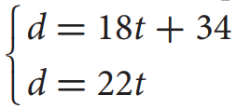
If the variables in a real-world situation represent the number of months and cost, why must the values of the variables be greater than or equal to zero?
Let d represent the distance the boats are from the port in kilometers and t represent the amount of time in hours.
____________
A boat travels at a rate of 18 kilometers per hour from its port.
A second boat is 34 kilometers behind the first boat when it starts traveling in the same direction at a rate of 22 kilometers per hour to the same port.
SKILL DEVELOPMENT
____________
How many hours will it take for the second boat to catch up to the first boat? ___________________________
How far will the boats be from their port? _________________________
What did you learn today about solving system of linear equations to model real-world situations.
Write & Solve the
system of equations
Word Bank
SUMMARY CLOSURE
Substitution Method
System of Equations
Ordered Pair
Solution
4

Slide 5
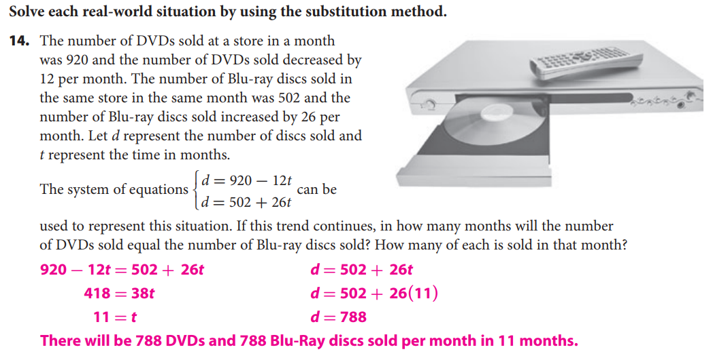
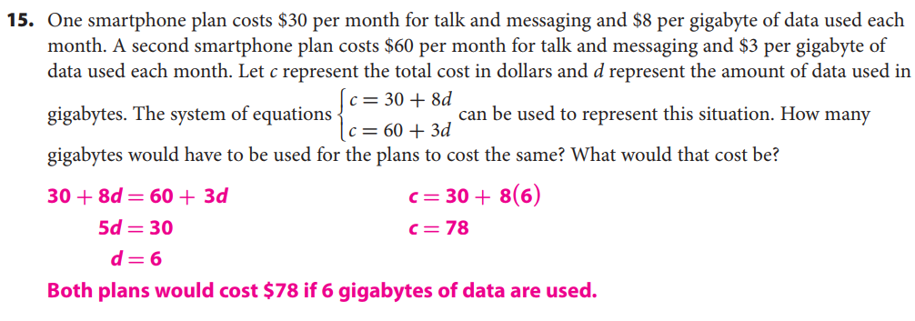
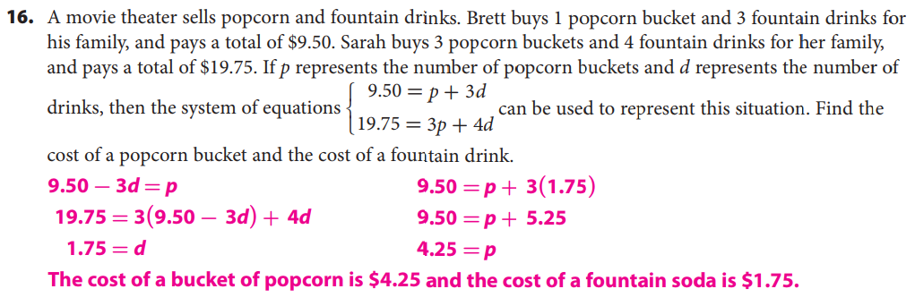
HOMEWORK
5

Slide 6
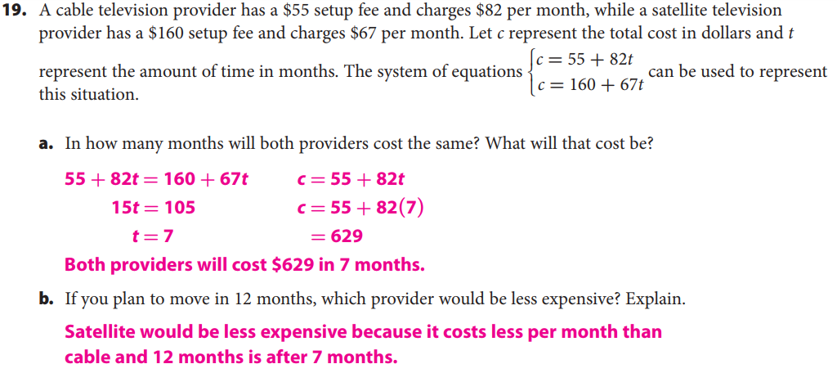
6

Slide 7
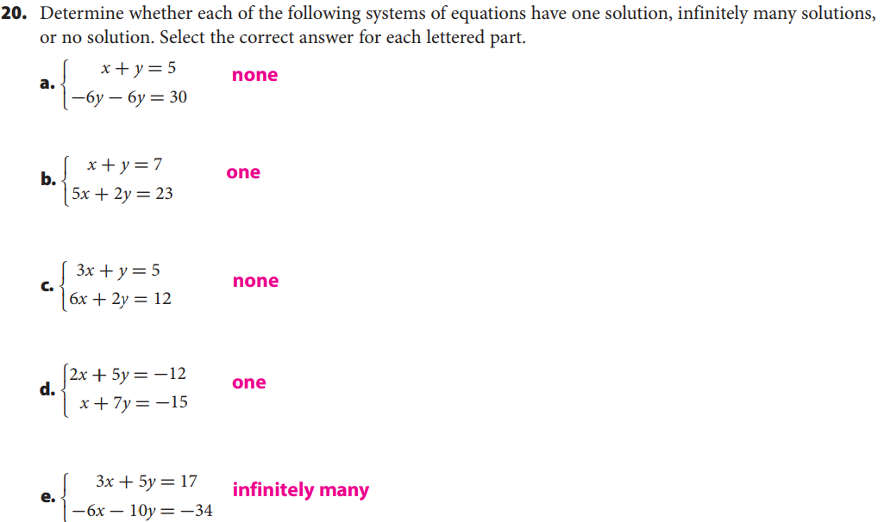
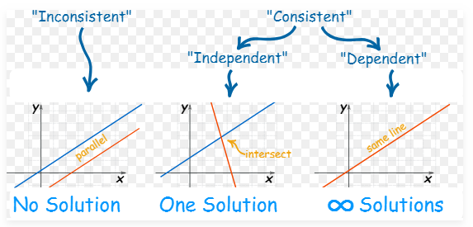
7

