Slide 1
We will solve ${\text{system}}_{1}$of linear equations to model real-world situations.
Lesson 2: 11.2.3 Solve Real World System
LEARNING OBJECTIVE
System of equations
1: a set of two equations with the same set of variables.
Definition
¹ figure out

Slide 2
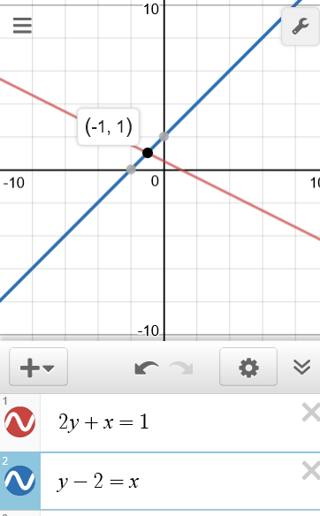
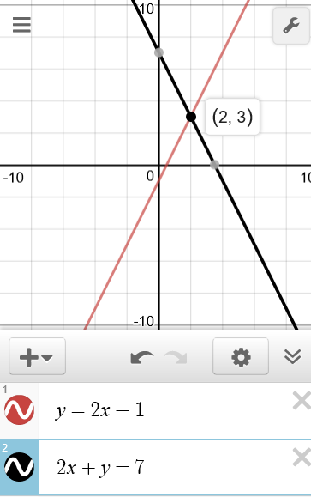
Remember the Concept
A solution of a system is an ORDERED PAIR that makes BOTH equations true.
Solve Linear System of equations by Substitution.
Steps
1 Substitute the expression of the isolated variable into the other equation.
CFU How did I/you substitute the equation with the isolated variable into the other equation?
2 Solve for the variable. (Write ordered pair)
CFU How did I/you solve for the variable?
3 Solve for the remaining ordered pair solution value. (Write ordered pair)
CFU How did I/you solve for the remaining ordered pair solution value?
1
$$\left\{\begin{aligned}2y + x = 1 \\ y−2=x \end{aligned}\right.$$
2
$$\left\{\begin{aligned}y =2x−1 \\ 2x+y=7 \end{aligned}\right.$$
solution $$\left(___,___\right)$$
solution $$\left(___,___\right)$$
-$1$
$$1$$
$$2$$
$$3$$
Step 1
Step 1
$$2y + x = 1$$
$$2x+y=7$$
$$2y +(y−2) = 1$$
$$2x+(2x−1)=7$$
$$2y +y−2 = 1$$
$$2x +2x−1 =7$$
Step 2
$$3y −2 = 1$$
Step 2
$$4x −1 =7$$
$$+2$$
$$+2$$
$$+1$$
$$+1$$
$$3y =3$$
$$4x =8$$
$$\overline{ 3 }$$
$$\overline{ 3 }$$
$$\overline{ 4 }$$
$$\overline{ 4 }$$
$$y =1$$
$$x =2$$
Step 3
Step 3
ACTIVATE PRIOR KNOWLEDGE
$$y−2=x$$
Make the Connection
Students, you already know how solve system of equations by substation. Now, we will learn how to write and solve system of equations using substation method.
$$y =2x−1$$
$$1−2=x$$
$$y =2(2)−1$$
$$−1=x$$
$$y=3$$

Slide 3
The substitution method solves a system by substituting one equation into the other equation.
CONCEPT DEVELOPMENT
Essential Question: How can you solve a system of linear equations by using substitution?
Solve one equation for one variable and substitute the resulting expression into the other equation. Solve for the value of the other variable in that equation, and then substitute that value into either equation to find the value of the first variable.
How do you choose which equation you solve first and which variable you solve it for? Explain.
Look for an equation that can easily be solved for one variable, such as an equation in which one variable has a coefficient of 1 or -1. The solution will be the same no matter which equation you solve first, but this will make the process easier.

Slide 4
When solving a system of linear equations by substitution, how can you tell if the system has no solution or infinitely many solutions? Draw a example graph of each.
In equation form: If it has no solutions, the solution process will result in an equation that is false.
On graph: When the equations represent two parallel lines, the lines do not intersect, so there is no solution.
In equation form: If it has infinitely many solutions, the solution process will result in an equation that is always true.
On the graph: When both equations represent the same line, the system has infinitely many solutions.
CONCEPT DEVELOPMENT
no solutions
infinitely many solutions
One Solution
Same Slope
Different y-intercept.
Same Slope
Same y-intercept.
Different Slope
Different y-intercept.

Slide 5
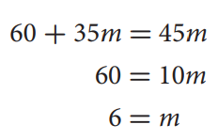
You can use a system of linear equations to model real-world situations.
Let t represent the total cost in dollars and m represent the number of months.
Fitness center A has a $60 enrollment fee and costs $35 per month.
Fitness center B has no enrollment fee and costs $45 per month.
In how many months will both fitness centers cost the same? _______________________
What will the cost be? ________________________
CONCEPT DEVELOPMENT
Write & Solve the system of equations

Slide 6
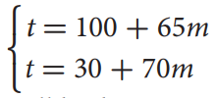
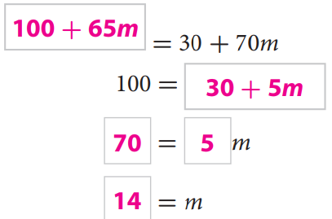
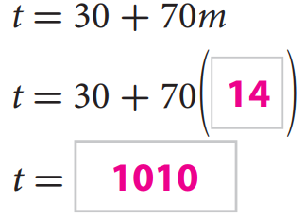
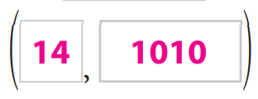
You can use a system of linear equations to model real-world situations.
Let t represent the total amount paid in dollars and m represent the number of months.
High-speed Internet provider A has a $100 setup fee and costs $65 per month.
High-speed internet provider B has a setup fee of $30 and costs $70 per month.
In how many months will both providers cost the same? ________________________
What will that cost be? ______________________________
SKILL DEVELOPMENT
Write & Solve the system of equations

Slide 7
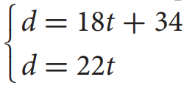
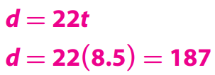
If the variables in a real-world situation represent the number of months and cost, why must the values of the variables be greater than or equal to zero?
The values of the variables must be greater than or equal to zero because the total cost and the number of months cannot be negative.
Let d represent the distance the boats are from the port in kilometers and t represent the amount of time in hours.
A boat travels at a rate of 18 kilometers per hour from its port.
A second boat is 34 kilometers behind the first boat when it starts traveling in the same direction at a rate of 22 kilometers per hour to the same port.
SKILL DEVELOPMENT
How many hours will it take for the second boat to catch up to the first boat? ________
How far will the boats be from their port? _________________________
Write & Solve the
system of equations

Slide 8
What did you learn today about solving system of linear equations to model real-world situations.
Word Bank
Substitution Method
System of Equations
Ordered Pair
Solution
SUMMARY CLOSURE

Slide 9
HOMEWORK

Slide 10
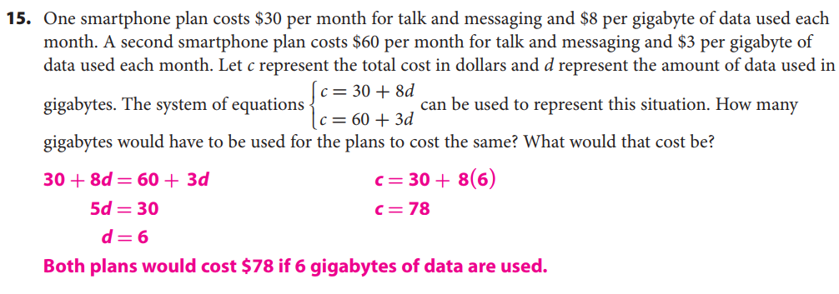
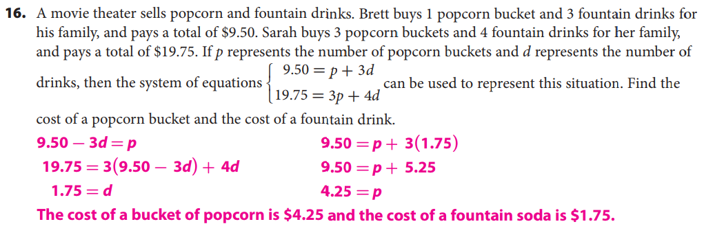

Slide 12
