Slide 1
We will solve a system of linear equations by substitution.
Lesson 2: 11.2 Substitution Method
LEARNING OBJECTIVE
Declare the Objective
Read the objective to your partner.
Definition
¹ figure out

Slide 2
Algebraic Equations
Check for Understanding
Select one or more algebraic equations. Explain. “… are algebraic equations because…”
An algebraic equation sets two expressions equal to each other.
An algebraic equation consists₁ of at least one variable, possibly one or more numbers, possibly one or more operations (+, $−, ×, ÷$), and an equal sign.
200y + 7 = 505
Check for Understanding
On your whiteboards, write an algebraic equation. Explain. “It is an algebraic equation because…”
A
Algebraic equation(s)
5002
B
59 + y = 62 102 = 21x $−$ $\frac{3}{11}$ (9)(7) $=$ 7z x $=$ y 26 $÷$ 4b = 2b ma $=$ 707
C
.9z + (9)(2) $÷$ 3
☑
19m + 2 $÷$ $\frac{1}{2}$ = 7
D
Not algebraic equations
31 + 7 = 38 x (s)(t)$÷$ 8 25
☒
Definition
¹ contains or has
Check for Understanding
Using your own words, what is an algebraic equation? “An algebraic equation is…”

Slide 3
Simplify Expressions
To simplify an expression means to combine₁ all like terms until there are no more like terms left.
To simplify an expression, use the Distributive Property and combine like terms.
 | $15y+2(5−y)$ + 2
Distributive Property | $15y$+ 10 $−$ 2y + 2
Combine Like Terms | $$13y+12$$
Check for Understanding
In your own words, how do you simplify an expression? “To simplify an expression…”
 | $9x+5(3+x)$
Distributive Property | $9x+15+5x$
Combine Like Terms | $14x+15$
 | $2($a + 5) + 4 (a – 2)
Distributive Property | $$2a+10+4a −8$$
Combine Like Terms | $6a+2$
 | 10t²$− 7($t² + 2) – 5
Distributive Property | 10t²$− 7$t² $−$ 14 – 5
Combine Like Terms | 3t²$−$ 19
Not simplified expressions
Definition
¹ put together
$50b+18 −10b$
7 $−$ $z+18$
m² $−$ $11+9$

Slide 4
Simplify Expressions
To simplify an expression means to combine₁ all like terms until there are no more like terms left.
To simplify an expression, use the Distributive Property and combine like terms.
Check for Understanding
Which are the simplified expressions? Explain. “The simplified expressions are… because…”
A
$$100y+22$$
B
22z $−$ $z+1$
C
z² $−$ $11+x$
D
4n + 17 – 5n
E
$$−77b$$
F
10 $−$ $88q+1$
Definition
¹ put together

Slide 5
Simplify Expressions
To simplify an expression means to combine₁ all like terms until there are no more like terms left.
To simplify an expression, use the Distributive Property and combine like terms.
Check for Understanding
Which are the simplified expressions? Explain. “The simplified expressions are… because…”
A
$$\text{ 7 }− 88\text{r}+1$$
B
y² $−11+$ x
C
44b $−$b $+1$
D
$−$b
E
$$\text{4}\text{n}\text{ + 17 – 5}\text{n}$$
F
9$y+1$
Definition
¹ put together

Slide 6
Simplify Expressions
To simplify an expression means to combine₁ all like terms until there are no more like terms left.
To simplify an expression, use the Distributive Property and combine like terms.
Check for Understanding
Simplify the expressions. Explain. “To simplify the expression…”
A
3 $+$ $17w−1$
B
27b $−$ $\text{b}+1$
C
9y² $−$ 2($\text{y}\text{2}+2)$
$17w+2$
26b $+ 1$
9y² $−$ 2$\text{y}\text{2}−4$
7y² $− 4$
Definition
¹ put together

Slide 7
$$x=−1$$
Show that $(−1, 1)$ is the solution to the system of equations:
$(−1, 1)$
Remember the Concept
A solution of a system is an ORDERED PAIR that makes BOTH equations true.
$$y=1$$
$$2y + x = 1$$
$$2(1) +(−1) = 1$$
$$2−1= 1$$
ACTIVATE PRIOR KNOWLEDGE
$$1= 1$$
$$y−2=x$$
$$(1)−2=(−1)$$
Make the Connection
Students, you already know that the solutions makes both equations true. Now, we will find the solution ordered pair using substitution.
$$1−2=−1$$
$$−1=−1$$

Slide 8
The substitution method solves a system by substituting one equation into the other equation.
The substitution method is ideal when a system has one equation with an isolated variable term.
CONCEPT DEVELOPMENT
$$\left\{\begin{aligned}2y + x = 1 \\ y−2=x \end{aligned}\right.$$
NOT Ideal for the substitution method
$$\left\{\begin{aligned}3x +2y =5 \\ 2x−3y=1 \end{aligned}\right.$$

Slide 9
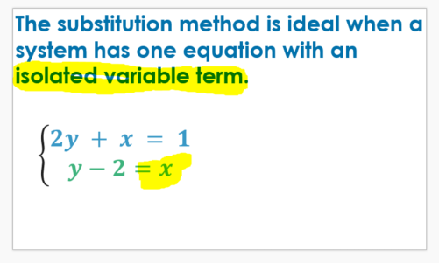
The substitution method solves a system by substituting one equation into the other equation.
Check for Understanding
Which of the following systems of linear equations is ideal for the substitution method? How do you know? The system of linear equations ___ is ideal for the substitution method because ____________.
A $\left\{\begin{aligned}4x +y =−8 \\ y=3x+1 \end{aligned}\right.$
CONCEPT DEVELOPMENT
B $\left\{\begin{aligned}2x +3y = 1 \\ 4x−5y=−3 \end{aligned}\right.$
NOT Ideal for the substitution method
$$\left\{\begin{aligned}3x +2y =5 \\ 2x−3y=1 \end{aligned}\right.$$

Slide 10
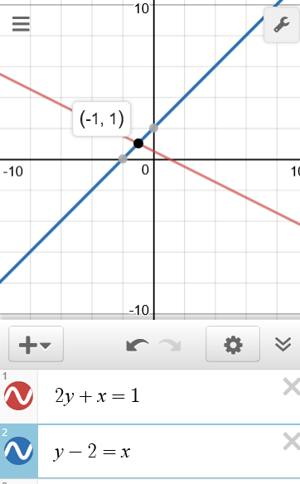
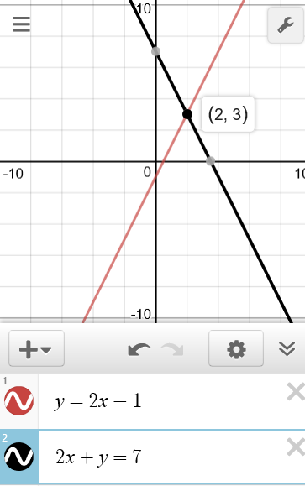
Steps
1 Substitute the expression of the isolated variable into the other equation.
CFU How did I/you substitute the equation with the isolated variable into the other equation?
2 Solve for the variable. (Write ordered pair)
CFU How did I/you solve for the variable?
3 Solve for the remaining ordered pair solution value. (Write ordered pair)
CFU How did I/you solve for the remaining ordered pair solution value?
1
$$\left\{\begin{aligned}2y + x = 1 \\ y−2=x \end{aligned}\right.$$
2
$$\left\{\begin{aligned}y =2x−1 \\ 2x+y=7 \end{aligned}\right.$$
solution $$\left(___,___\right)$$
solution $$\left(___,___\right)$$
-$1$
$$1$$
$$2$$
$$3$$
Step 1
Step 1
$$2y + x = 1$$
$$2x+y=7$$
$$2y +(y−2) = 1$$
$$2x+(2x−1)=7$$
$$2y +y−2 = 1$$
$$2x +2x−1 =7$$
Step 2
$$3y −2 = 1$$
Step 2
$$4x −1 =7$$
$$+2$$
$$+2$$
$$+1$$
$$+1$$
$$3y =3$$
$$4x =8$$
$$\overline{ 3 }$$
$$\overline{ 3 }$$
$$\overline{ 4 }$$
$$\overline{ 4 }$$
$$y =1$$
$$x =2$$
Step 3
$$y−2=x$$
Step 3
$$y =2x−1$$
$$1−2=x$$
$$y =2(2)−1$$
$$−1=x$$
$$y=3$$
Graph
Graph

Slide 11
Conceptual Refocusing
1
$$\left\{\begin{aligned}2y + x = 1 \\ y−2=x \end{aligned}\right.$$
2
$$\left\{\begin{aligned}y =2x−1 \\ 2x+y=7 \end{aligned}\right.$$
solution $$\left(___,___\right)$$
solution $$\left(___,___\right)$$
-$1$
$$1$$
$$2$$
$$3$$
“The solution to the system of linear equation is the ordered pair (__, __).
The ordered pair (__, __) represents
the intersection of the two graphs
AND
the values that make BOTH equations TRUE.”

Slide 12
The substitution method solves a system by substituting one equation into the other equation.
The substitution method is ideal when a system has one equation with an isolated variable term.
The substitution method is ideal when a system has any variable with a coefficient of 1.
CONCEPT DEVELOPMENT
$$\left\{\begin{aligned}−7x −2y=−13 \\ x−2y=11 \end{aligned}\right.$$
NOT Ideal for the substitution method
$$\left\{\begin{aligned}3x +2y =5 \\ 2x−3y=1 \end{aligned}\right.$$

Slide 13
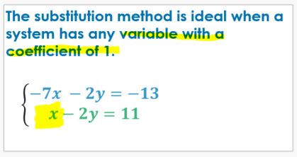
The substitution method solves a system by substituting one equation into the other equation.
Check for Understanding
Which of the following systems of linear equations is ideal for the substitution method? How do you know? The system of linear equations ___ is ideal for the substitution method because ____________.
A $\left\{\begin{aligned}4x +y =−8 \\ 3x+2y=4 \end{aligned}\right.$
CONCEPT DEVELOPMENT
B $\left\{\begin{aligned}2x +3y = 1 \\ 4x−5y=−3 \end{aligned}\right.$
NOT Ideal for the substitution method
$$\left\{\begin{aligned}3x +2y =5 \\ 2x−3y=1 \end{aligned}\right.$$

Slide 14
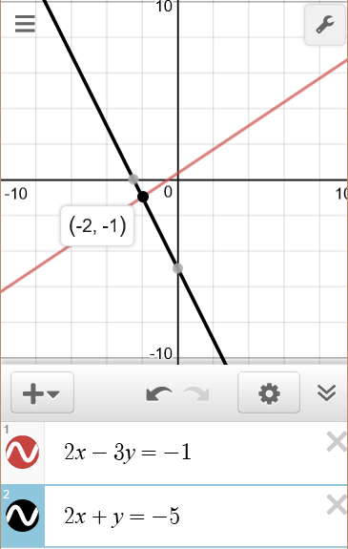
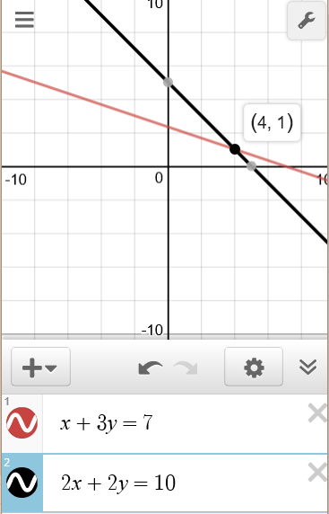
Steps
0 Isolate the 1-coefficient variable to be ready for substitution.
CFU How did I/you set up the equation for the substitution method?
1 Substitute the expression of the isolated variable into the other equation.
CFU How did I/you substitute the equation with the isolated variable into the other equation?
2 Solve for the variable. (Write ordered pair)
CFU How did I/you solve for the remaining variable?
3 Solve for the remaining ordered pair solution value. (Write ordered pair)
CFU How did I/you solve for the remaining ordered pair solution value?
3
$$\left\{\begin{aligned}2x −3y =−1 \\ 2x+y=−\text{5} \end{aligned}\right.$$
4
$$\left\{\begin{aligned}x+3y=7 \\ 2x+2y=10\end{aligned}\right.$$
solution $$\left(___,___\right)$$
solution $$\left(___,___\right)$$
-$2$
$$\text{−}1$$
$$4$$
$$1$$
$$2x+y=\text{−5}$$
$$x+3y=7$$
$$−2x$$
$$−2x$$
$$−3y$$
$$−3y$$
$$y=−2x−5$$
$$x=7−3y$$
$$2x −3y =−1$$
$$2x+2y=10$$
$$2x −3(−2x−5) =−1$$
$$2(7−3y)+2y=10$$
$$2x+6x+15 =− 1$$
$$14−6y+2y=10$$
$$8x+15 =−1$$
$$14−4y=10$$
$$−15$$
$$−15$$
$$−14$$
$$−14$$
$$8x =−16$$
$$−4y =−4$$
$$\overline{ 8 }$$
$$\overline{ 8 }$$
$$\overline{ −4 }$$
$$\overline{−4 }$$
$$x =−2$$
$$y =1$$
$$y=−2x−5$$
$$x=7−3y$$
$$y=−2(−2)−5$$
$$x=7−3(1)$$
Graph
$$y=−1$$
Graph
$$x=4$$

Slide 16
Step 2 is wrong, you must substitute the expression from step 1 into the other equation not the same equation.
Step 3 is wrong, x = 6 and it was substituted in for y.

Slide 17
What did you learn today about solving a system of linear equations by substitution?
Word Bank
Substitution Method
System of Equations
Ordered Pair
Solution
SUMMARY CLOSURE

Slide 18
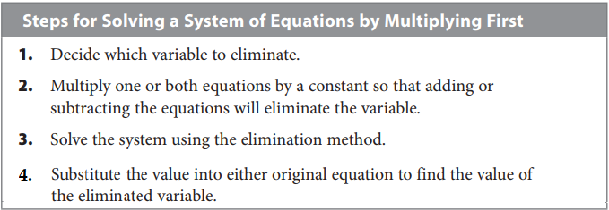
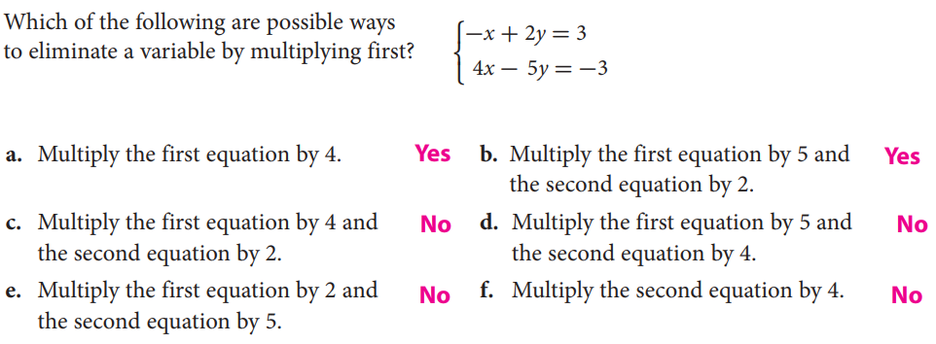
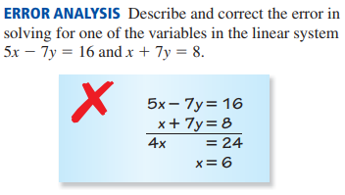
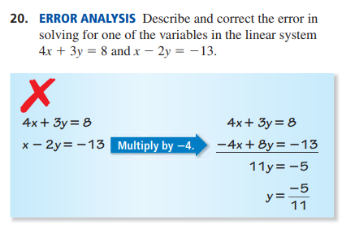

Slide 20
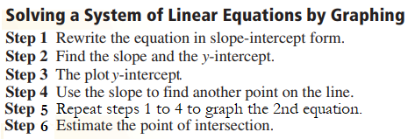
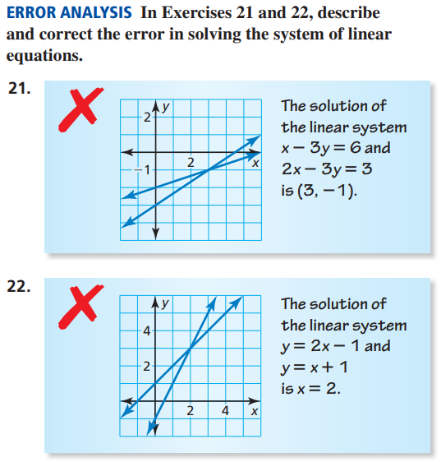

Slide 21
