Slide 1
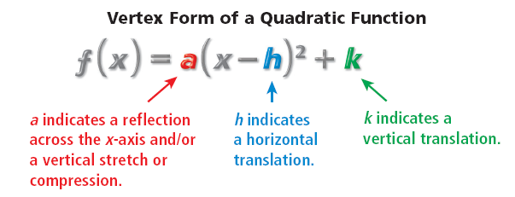
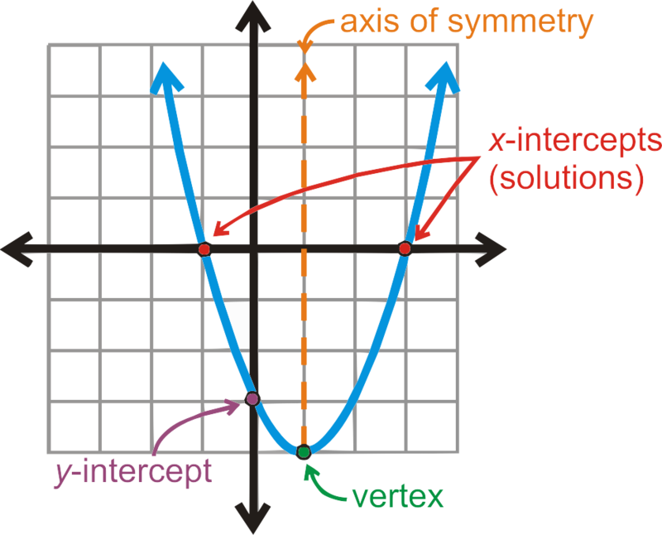
Graph the Quadratic Functions.
Name: ______________________________
Period:____
Activate Prior Knowledge:
Lesson 2_6.2_Transforming Quadratic Functions
Fill in the blanks with the following terms.
y-intercept width direction
Students, you already know how to identify the direction, y-intercept, and width of the quadratic functions in the form of $y={ax}^{2}+c$. Now, we will learn how to use the Vertex Form to graph Functions.
Make Connection
Concept Development
Quadratic Functions
Quadratic function:- A polynomial of the second degree, when graphed it forms a u-shape and
function form f(x) = ax² + bx + c where a, b, and c are numbers.
y = x² + 5x + 7
Parabola:- a ${\text{symmetrical}}_{1}$ u-shape curve formed by graphing of quadratic functions.
y = 3x² − 7
Vertex Form:- f(x) = a(x – h)² + k, where (h, k) is the vertex.
y = 4x²
Vertex of a Parabola:- the high point (maximum) or the low point (minimum) of the graph.
(x=h)
Helpful Hint
(0, C)
(h, k)
If a = Whole Number, than Compression.
If a = Fraction, than Stretch.
CFU
Identify the following from giving Vertex form:
1.)
a =___, h =___, k =___, Opening:
b.)
a =___, h =___, k =___, Opening:
c.)
a =___, h =___, k =___, Opening:
Helpful Hint
When the quadratic parent function f(x) = $x^{2}$
is written in vertex form, y = a(x – h) + k,
a = 1, h = 0, and k = 0.
2
¹ Same shape on both sides.
Vocabulary
Page: 1

Slide 2
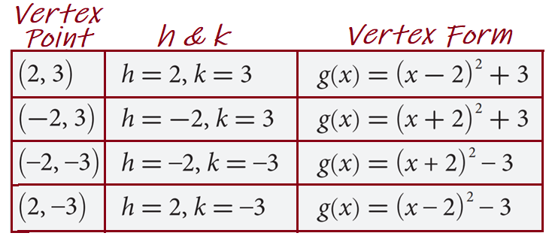
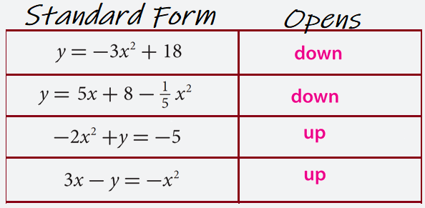
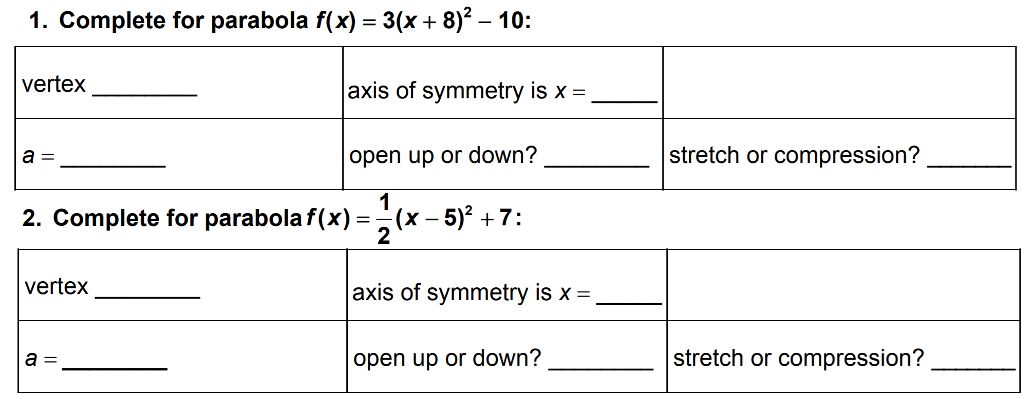
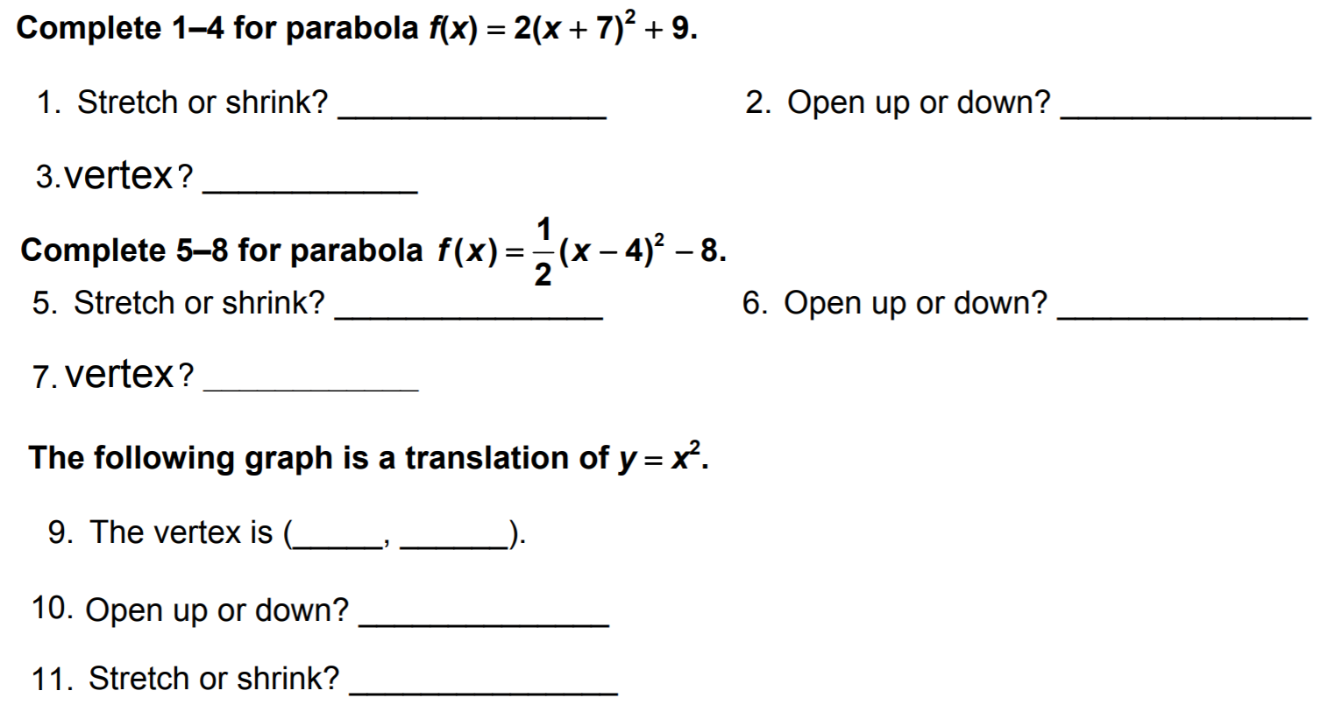
Concept Development
Quadratic Functions
Quadratic function:- A polynomial of the second degree, when graphed it forms a u-shape and
function form f(x) = ax² + bx + c where a, b, and c are numbers.
y = x² + 5x + 7
Parabola:- a ${\text{symmetrical}}_{1}$ u-shape curve formed by graphing of quadratic functions.
y = 3x² − 7
Vertex Form:- f(x) = a(x – h)² + k, where (h, k) is the vertex.
y = 4x²
Vertex of a Parabola:- the high point (maximum) or the low point (minimum) of the graph.
Homework
¹ Same shape on both sides.
Vocabulary
Page: 2

Slide 3
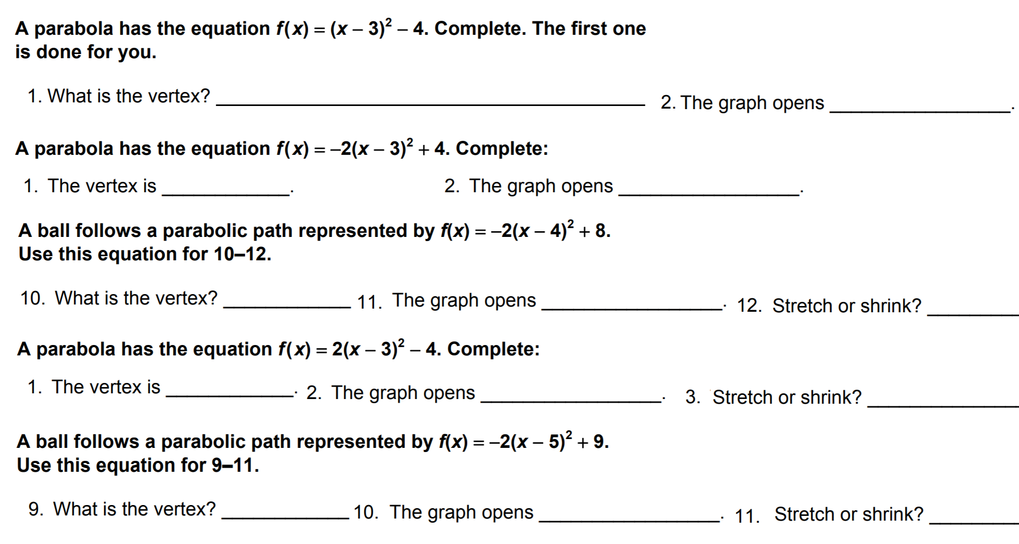
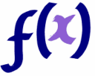
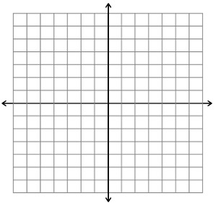
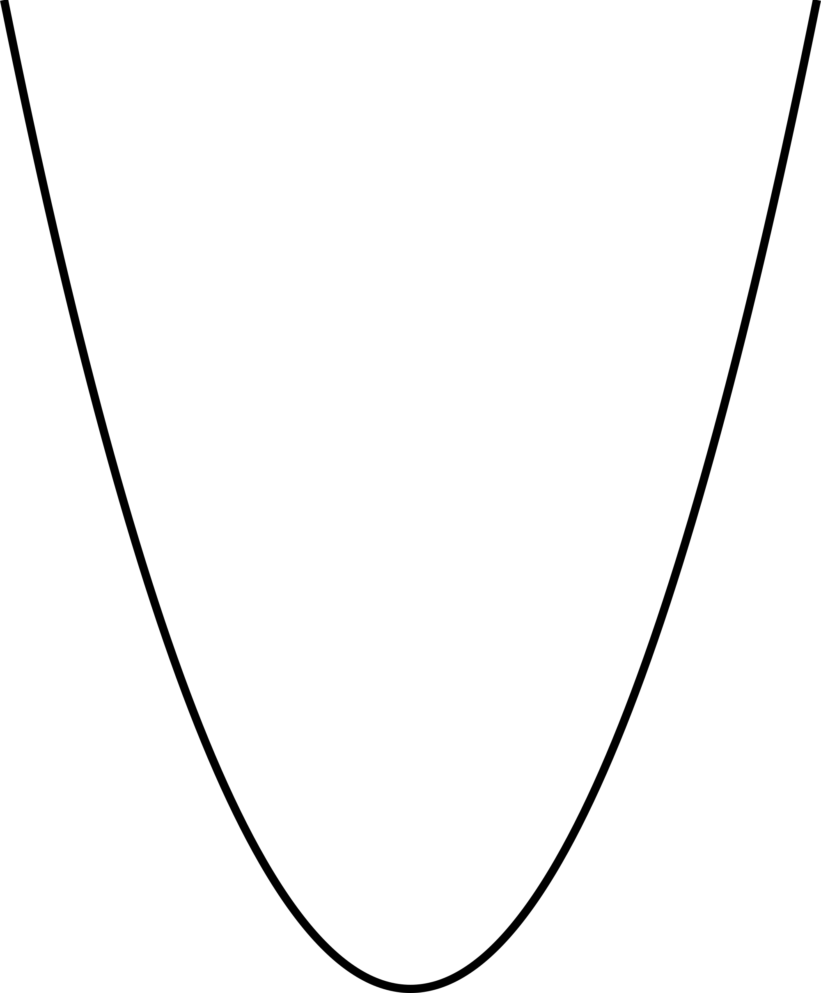
Homework
Concept Development
Now, we will learn how to transform quadratic functions.
You can also graph quadratic functions by applying transformations to the parent function f(x) = x². Recall that functions can also be reflected, stretched, or compressed.
h (Opposite Direction) units Left/Right
K units Up -K units Down
$$f\left(x\right)={(x+3)}^{2}$$
Opposite Direction to the sign of h !!
$$f\left(x\right)={(x−3)}^{2}$$
Opposite Direction to the sign of h !!
$$f\left(x\right)=x^{2}−3$$
$$f\left(x\right)=x^{2}+3$$
Page: 3

Slide 4
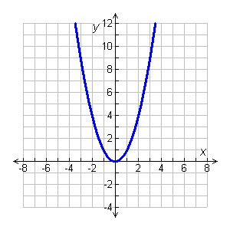
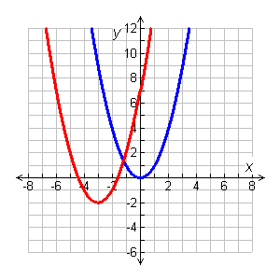
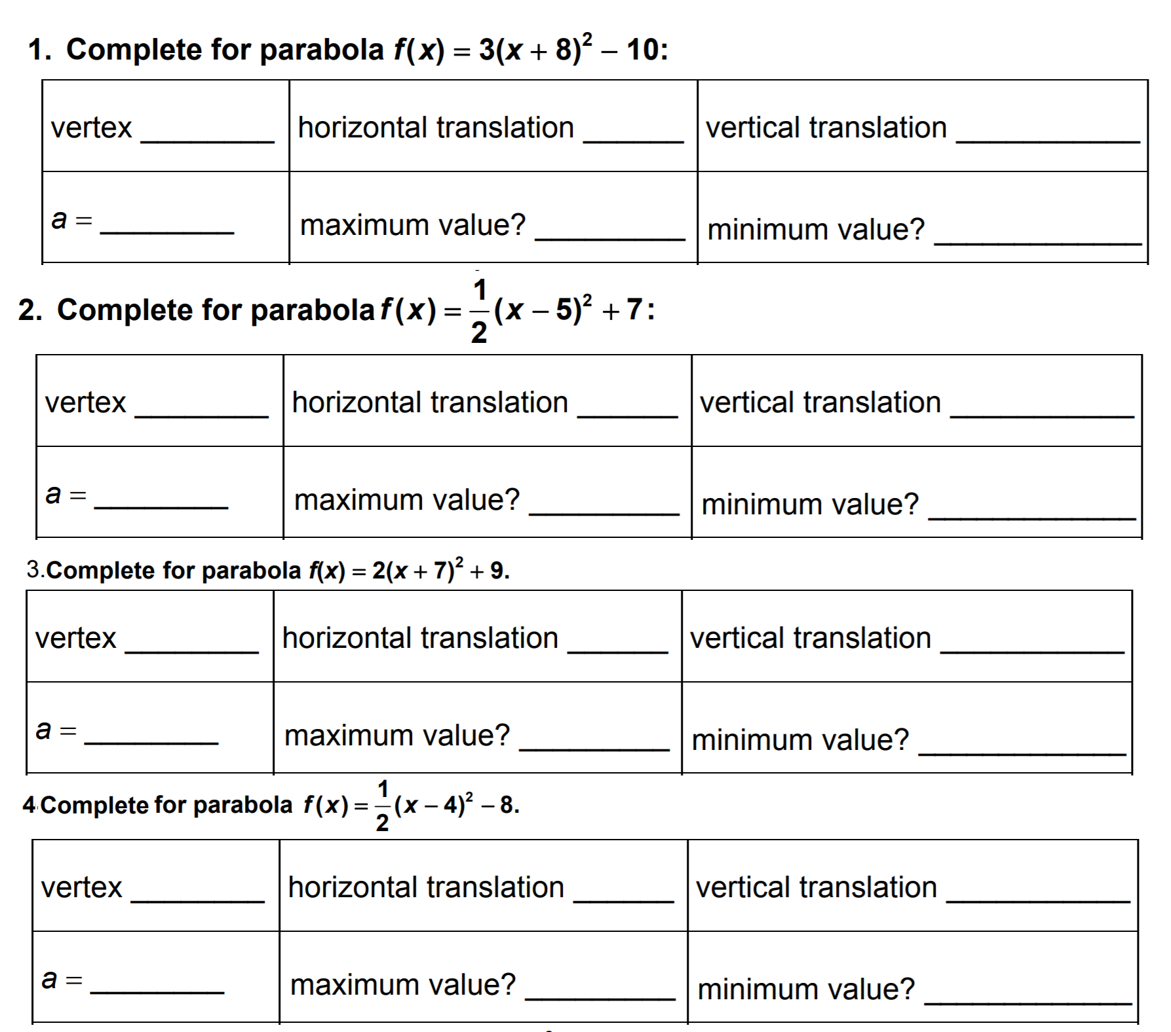
Concept Development
Now, we will learn how to transform quadratic functions.
Use the graph of $f\left(x\right)=x^{2}$ as a guide, describe the transformations and then graph each function.
2
g(x) = (x + 3) – 2
Identify h and k.
2
g(x) = (x – (–3)) + (–2)
h
k
Because h = –3, the graph is translated 3 units left. Because k = –2, the graph is translated 2 units down. Therefore, g is f translated 3 units left and 2 units down.
Homework
Page: 4

Slide 5
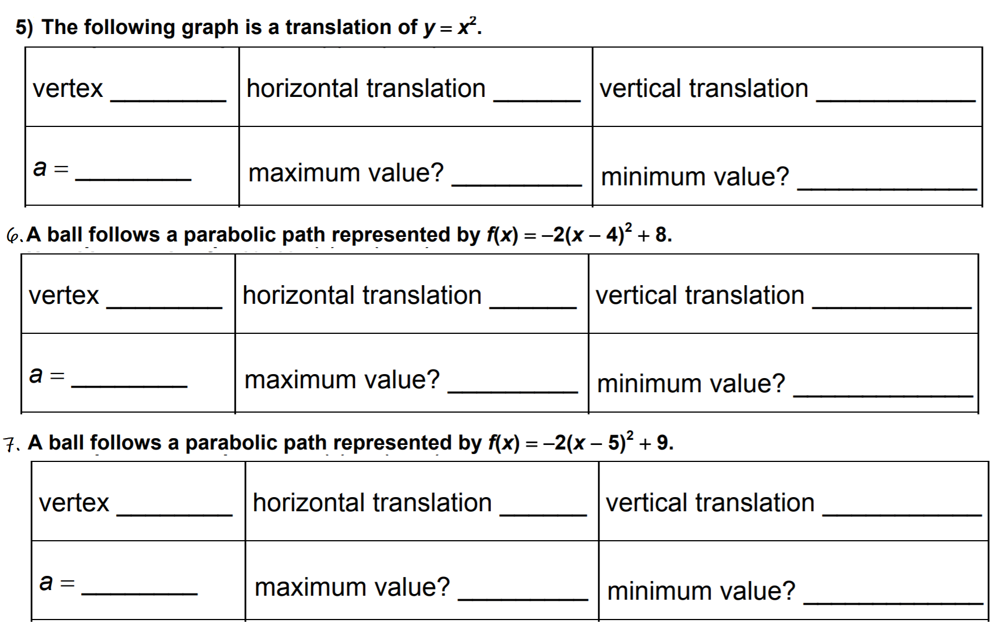
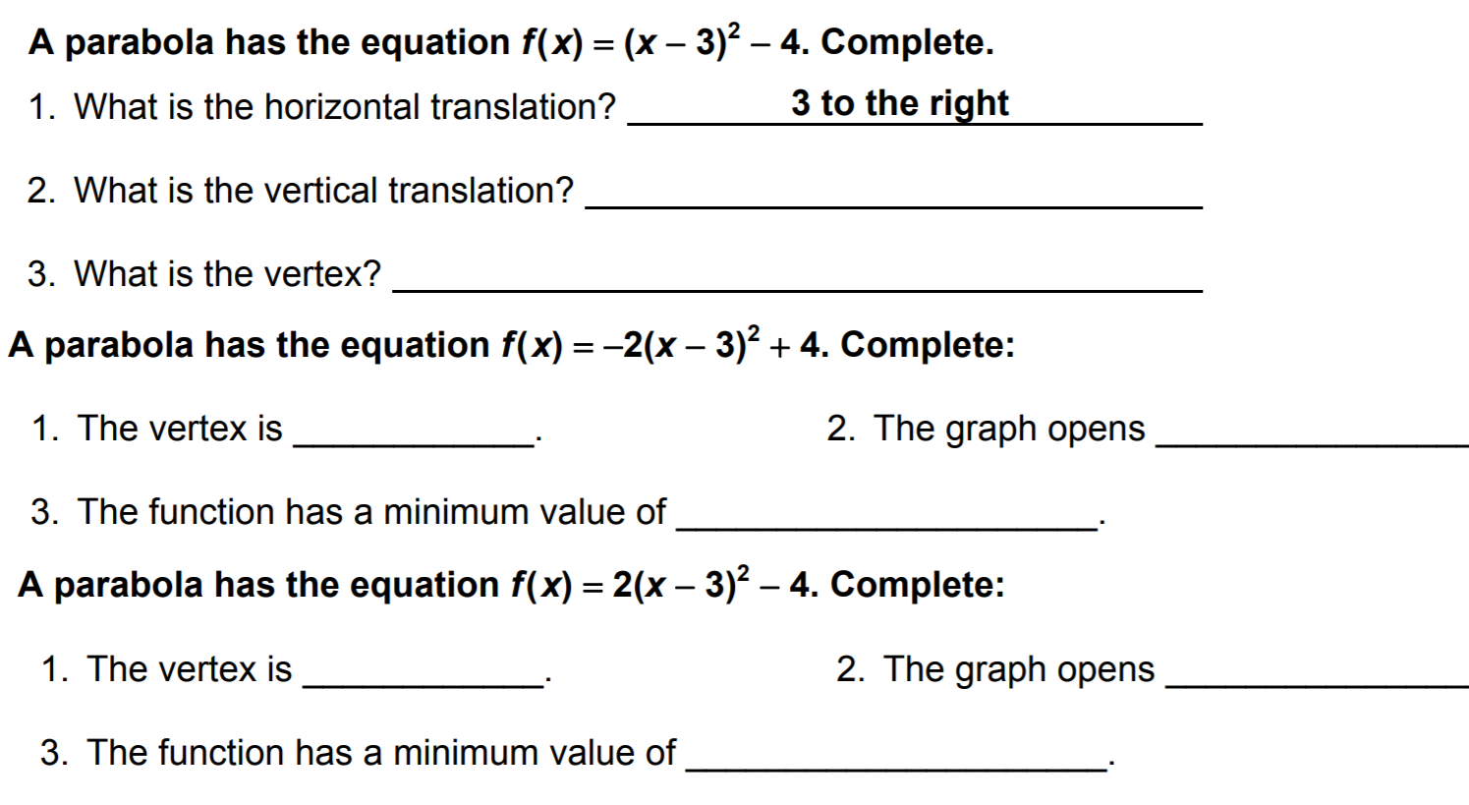
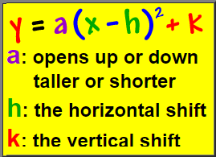
Homework
Concept Development
Now, we will learn how to graph quadratic functions.
How did I/you determine the direction of the parabola?
How did I/you determine the vertex of the parabola?
How did I/you identify the graph the parabola?
CFU
1
2
3
Graph: $f\left(x\right)={(x+4)}^{2}−5$
* “The parabola opens upward/downward. Its axis of symmetry is _____; the vertex is at the point _____.”
Page: 5

Slide 6
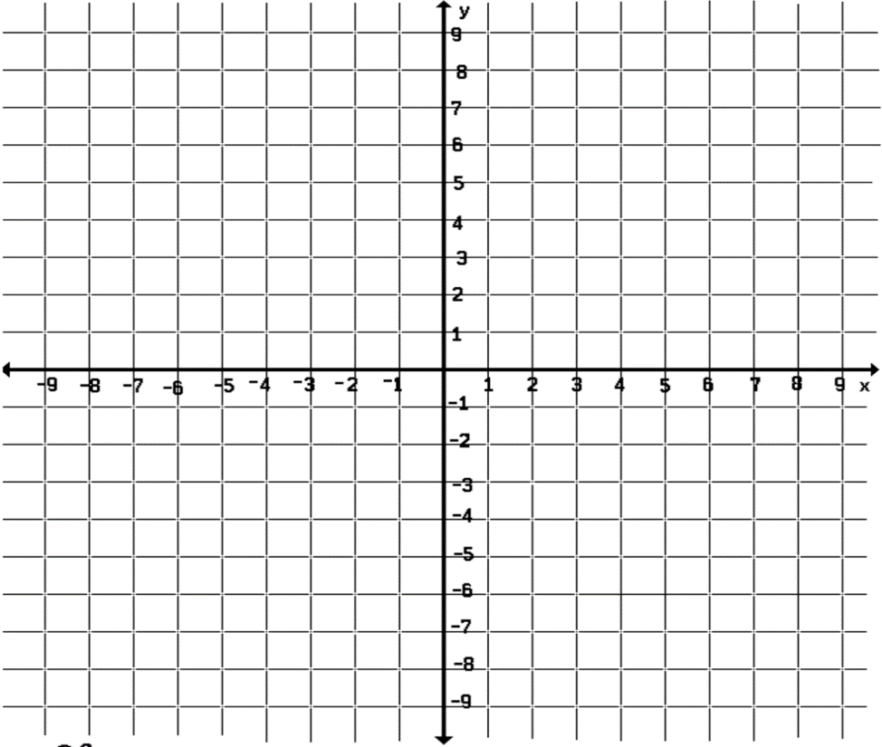
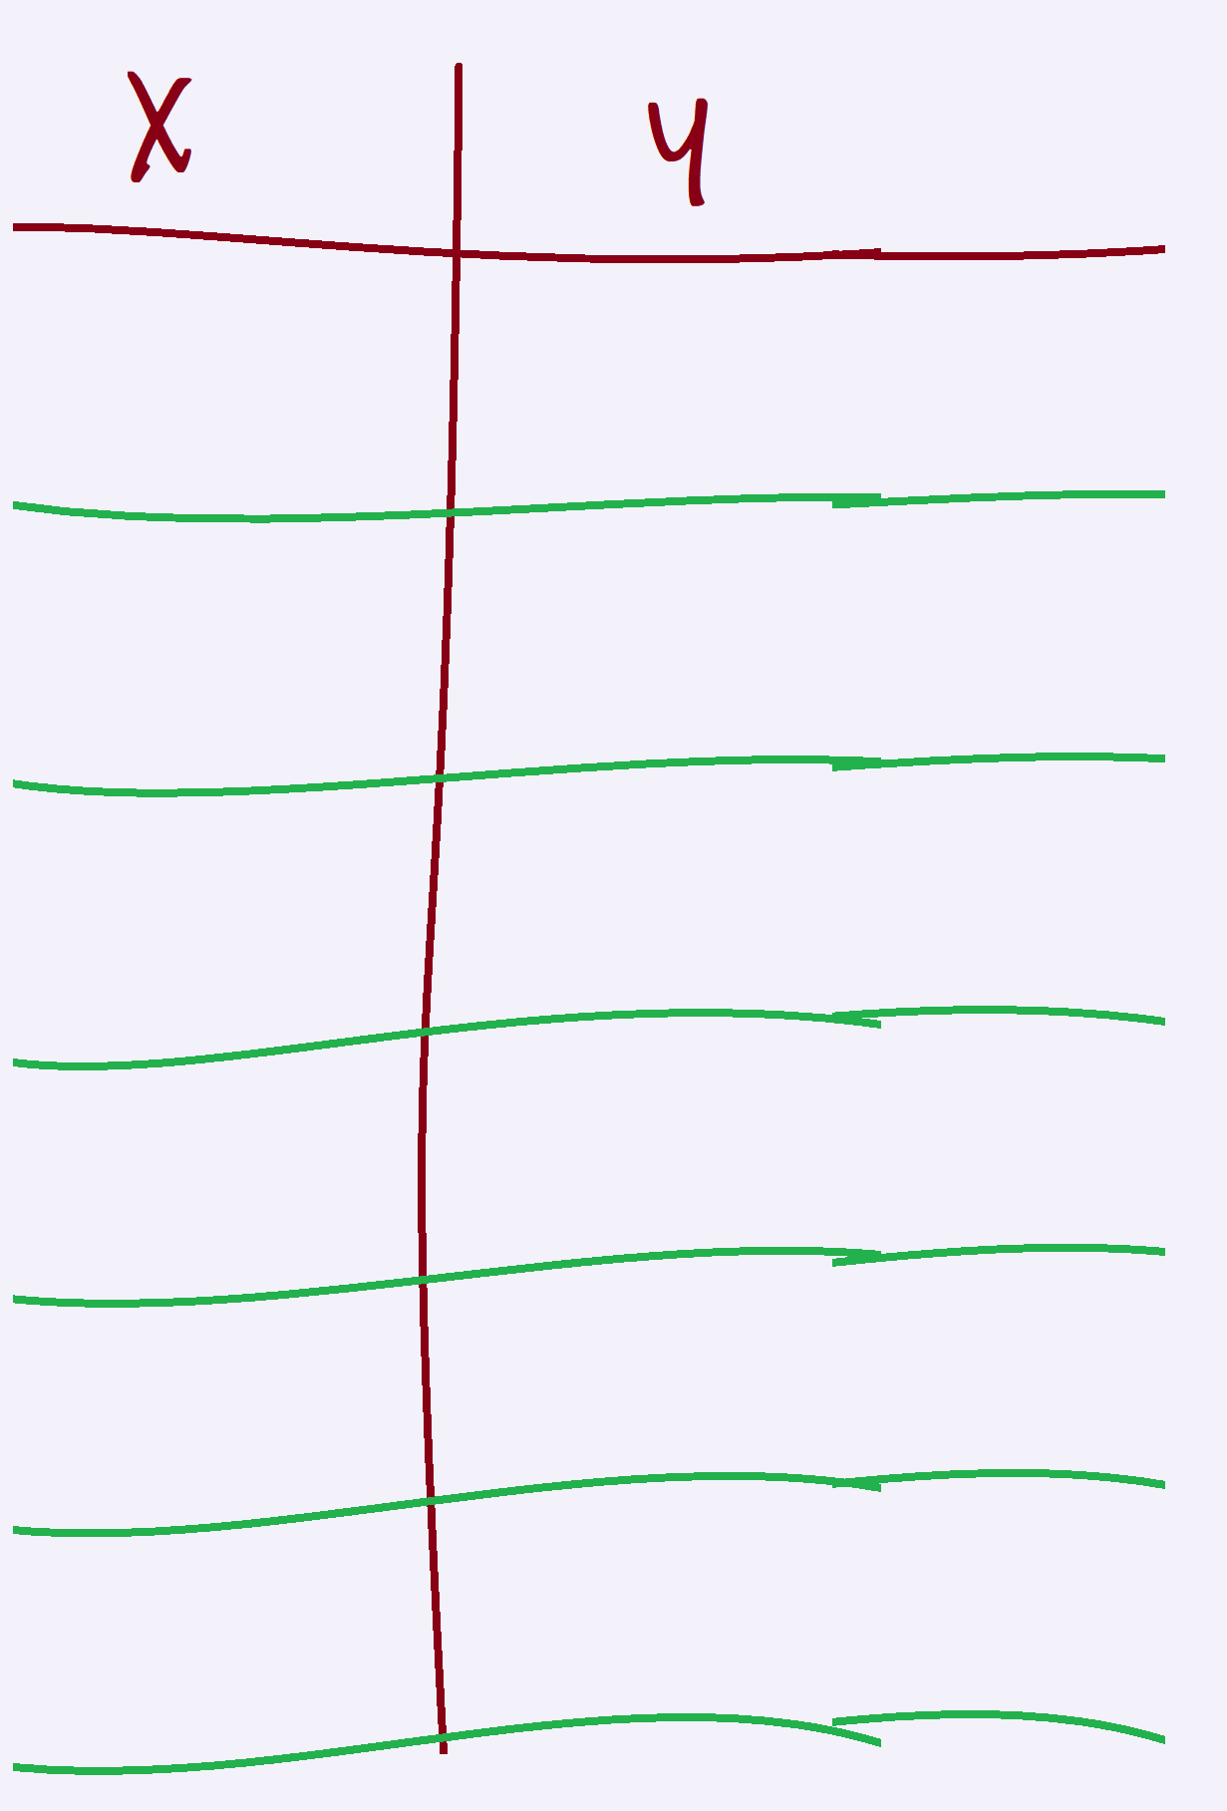
Concept Development
CFU
How did I/you determine the direction of the parabola?
How did I/you determine the vertex of the parabola?
How did I/you identify the graph the parabola?
1
2
3
Graph: $f\left(x\right)={(x+4)}^{2}−5$
(a) Openness
(b) Vertex
(c) Axis of symmetry
(d) T-Table
(a) Openness
Graph: $f\left(x\right)={(x−4)}^{2}+ 5$
(b) Vertex
(c) Axis of symmetry
(d) T-Table
Page: 6

Slide 7
Homework
CFU
How did I/you determine the direction of the parabola?
How did I/you determine the vertex of the parabola?
How did I/you identify the graph the parabola?
1
2
3
(a) Openness
(b) Vertex
(c) Axis of symmetry
(d) T-Table
(a) Openness
(b) Vertex
(c) Axis of symmetry
(d) T-Table
Page: 7

Slide 8
Homework
CFU
How did I/you determine the direction of the parabola?
How did I/you determine the vertex of the parabola?
How did I/you identify the graph the parabola?
1
2
3
(a) Openness
(b) Vertex
(c) Axis of symmetry
(d) T-Table
(a) Openness
(b) Vertex
(c) Axis of symmetry
(d) T-Table
Page: 8

Slide 9
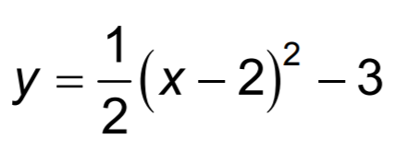
Homework
CFU
How did I/you determine the direction of the parabola?
How did I/you determine the vertex of the parabola?
How did I/you identify the graph the parabola?
1
2
3
(a) Openness
(b) Vertex
(c) Axis of symmetry
(d) T-Table
(a) Openness
(b) Vertex
(c) Axis of symmetry
(d) T-Table
Page: 9

Slide 10
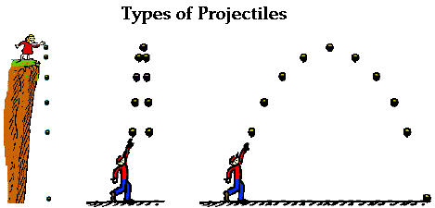
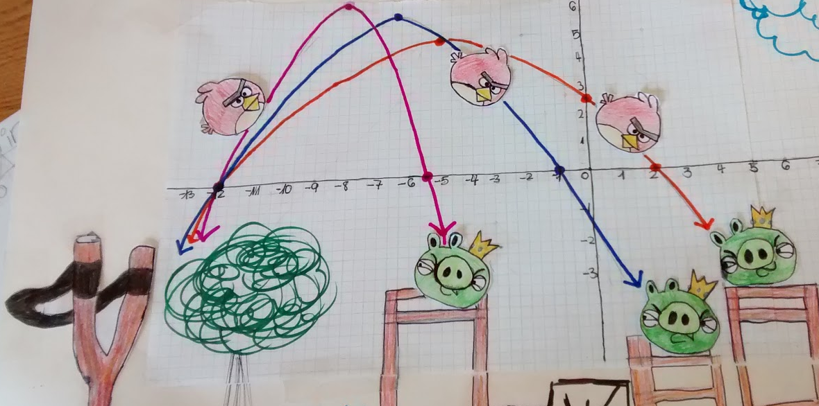
Relevance
Quadratic functions are more than algebraic curiosities—they are widely used in science, business, and engineering. The U-shape of a parabola can describe the trajectories of angry birds in a game, a bouncing ball, or be incorporated into structures like the parabolic reflectors that form the base of satellite dishes and car headlights. Quadratic functions help forecast business profit and loss, plot the course of moving objects, and assist in determining minimum and maximum values. Most of the objects we use every day, from cars to clocks, would not exist if someone, somewhere hadn't applied quadratic functions to their design.
How do you graph a Quadratic Function of the $f\left(x\right)=a{(x−h)}^{2}+k$?
Essential Question:
SUMMARY CLOSURE
To obtain the graph using vertex form, you ______________ _________________________________________________________________.
Page: 10

