Slide 1
LO: We will determine how to graph the Quadratic Functions.
ACT RESPONSIBLY & SUPPORT the COMMUNITY.
Be on Time
Wear ID
Chromebook Ready
SEE SOMETHING, SAY SOMETHING

Slide 2
We will learn how to use the Vertex Form to graph the ${\text{Quadratic}}_{1}$ Functions.
LEARNING OBJECTIVE
What is our Learning Objective?
What does “Quadratic” mean? Quadratic means _________.
CFU
Definition
¹ involving a variable that is squared, or raised to a power of two.

Slide 3
Graph the Quadratic Functions.
Activate Prior Knowledge:
Fill in the blanks with the following terms.
Whiteboard
y-intercept width direction
How is the graph of ${g\left(x\right)=x}^{2}+2$related to the graph of ${f\left(x\right)=−x}^{2}−5$?
Is the y-intercept/opening the same?
How do you know, explain.
direction
y-intercept
width
direction
y-intercept
width
Students, you already know how to identify the direction, y-intercept, and width of the quadratic functions in the form of $y={ax}^{2}+c$. Now, we will learn how to use the Vertex Form to graph Functions.
Make Connection

Slide 4
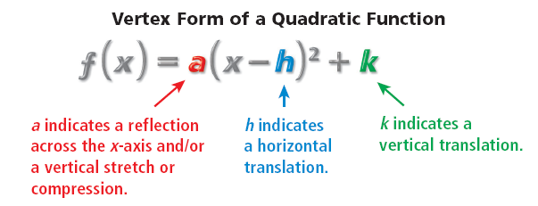
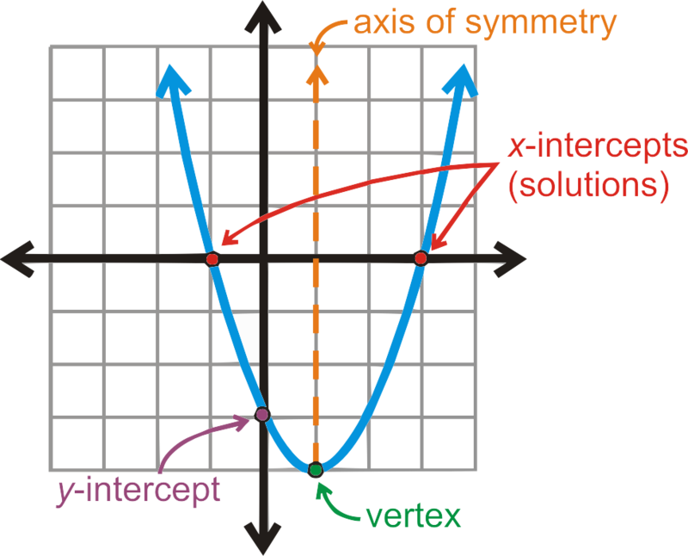
Concept Development
Quadratic function:- A polynomial of the second degree, when graphed it forms a u-shape and
function form f(x) = ax² + bx + c where a, b, and c are numbers.
Quadratic Functions
y = x² + 5x + 7
Parabola:- a ${\text{symmetrical}}_{1}$ u-shape curve formed by graphing of quadratic functions.
y = 3x² − 7
Vertex Form:- f(x) = a(x – h)² + k, where (h, k) is the vertex.
y = 4x²
Vertex of a Parabola:- the high point (maximum) or the low point (minimum) of the graph.
(x=h)
Helpful Hint
(0, C)
(h, k)
If a = Whole Number, than Compression.
If a = Fraction, than Stretch.
CFU
Identify the following from giving Vertex form:
1.)
a =___, h =___, k =___, Opening:
b.)
a =___, h =___, k =___, Opening:
c.)
a =___, h =___, k =___, Opening:
Helpful Hint
When the quadratic parent function f(x) = $x^{2}$
is written in vertex form, y = a(x – h) + k,
a = 1, h = 0, and k = 0.
2
¹ Same shape on both sides.
Vocabulary

Slide 5
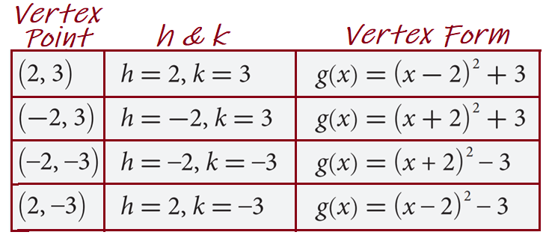
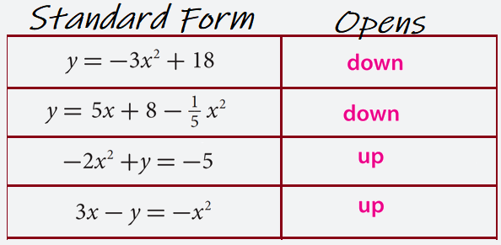
Concept Development
Quadratic function:- A polynomial of the second degree, when graphed it forms a u-shape and
function form f(x) = ax² + bx + c where a, b, and c are numbers.
Quadratic Functions
y = x² + 5x + 7
Parabola:- a ${\text{symmetrical}}_{1}$ u-shape curve formed by graphing of quadratic functions.
y = 3x² − 7
Vertex Form:- f(x) = a(x – h)² + k, where (h, k) is the vertex.
y = 4x²
Vertex of a Parabola:- the high point (maximum) or the low point (minimum) of the graph.
¹ Same shape on both sides.
Vocabulary

Slide 6
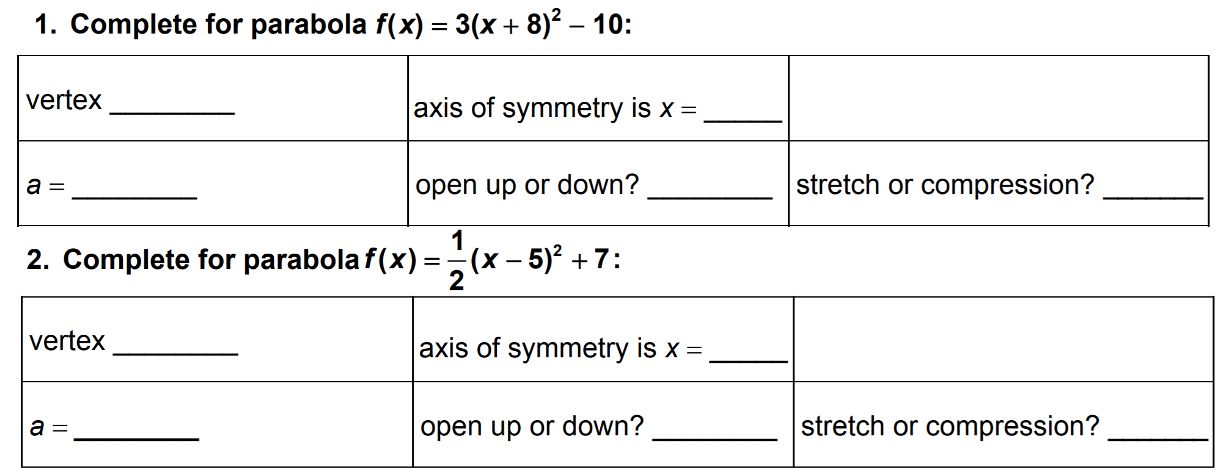
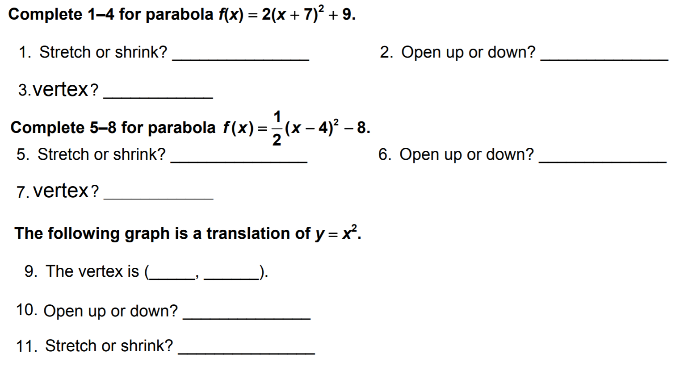
Homework

Slide 7
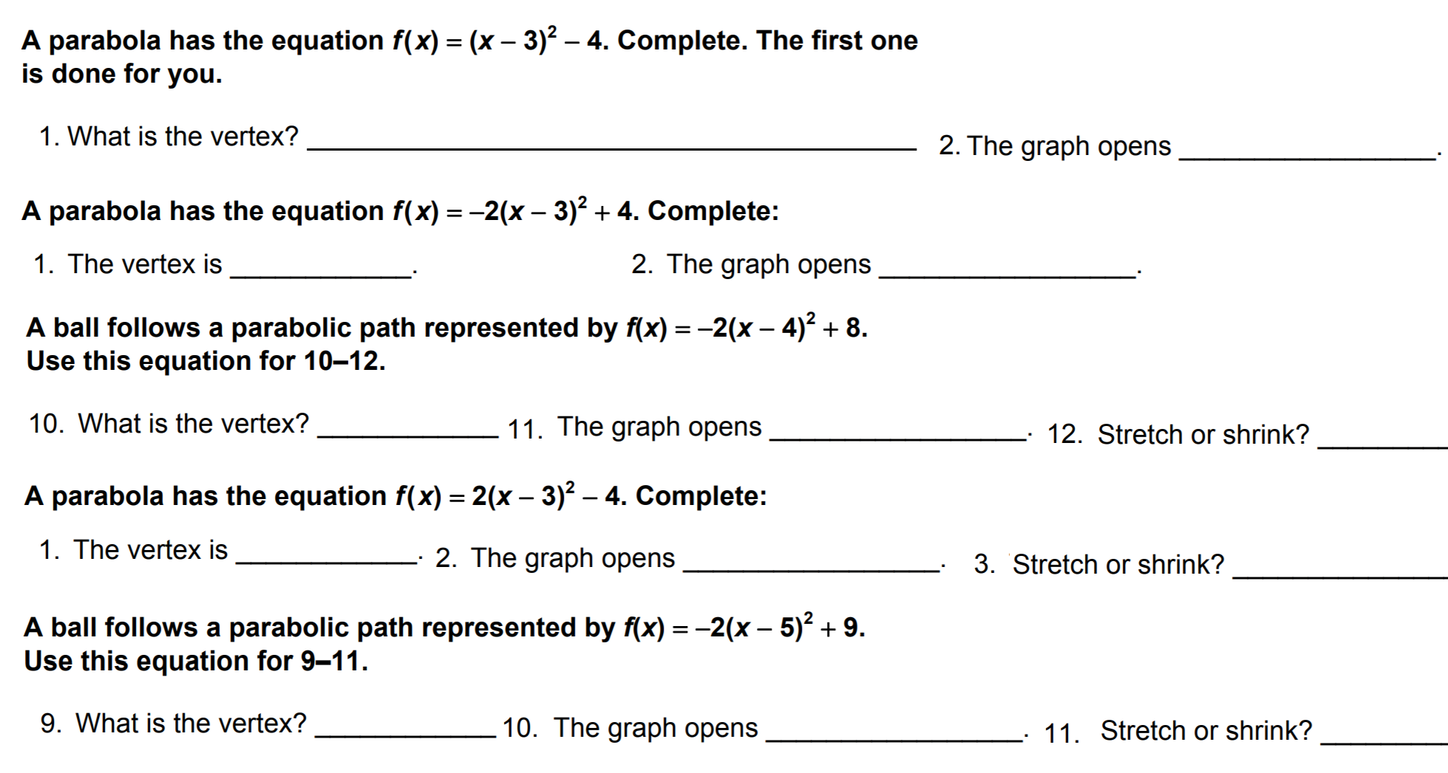
Homework

Slide 8
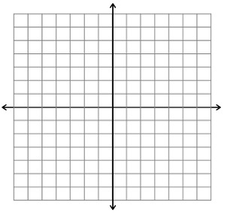
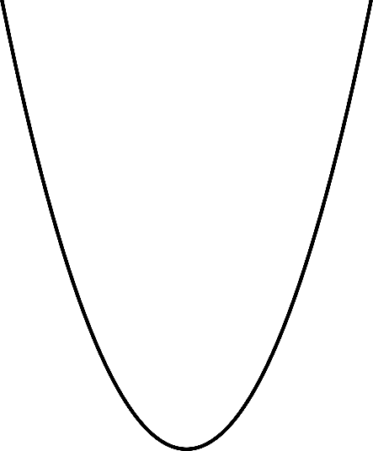
Concept Development
Now, we will learn how to transform quadratic functions.
You can also graph quadratic functions by applying transformations to the parent function f(x) = x². Recall that functions can also be reflected, stretched, or compressed.
h (Opposite Direction) units Left/Right
K units Up -K units Down
$$f\left(x\right)={(x+3)}^{2}$$
Opposite Direction to the sign of h !!
$$f\left(x\right)={(x−3)}^{2}$$
Opposite Direction to the sign of h !!
$$f\left(x\right)=x^{2}−3$$
$$f\left(x\right)=x^{2}+3$$
Pair-Share
A: Explain how to do the Horizontal Translation?
B: Explain Vertical Translation concept?

Slide 9
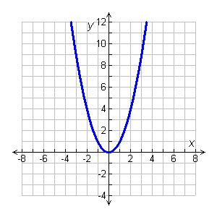
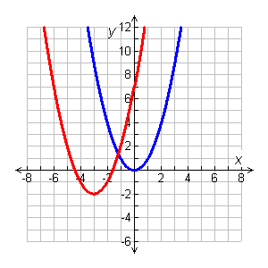
Concept Development
Now, we will learn how to transform quadratic functions.
Use the graph of $f\left(x\right)=x^{2}$ as a guide, describe the transformations and then graph each function.
CFU
If the graph of ${f\left(x\right)=x}^{2}$ is translated 11 units to the left and
5 units down, which function is represented by the translated graph?
2
g(x) = (x + 3) – 2
Identify h and k.
2
g(x) = (x – (–3)) + (–2)
h
k
Because h = –3, the graph is translated 3 units left. Because k = –2, the graph is translated 2 units down. Therefore, g is f translated 3 units left and 2 units down.

Slide 10
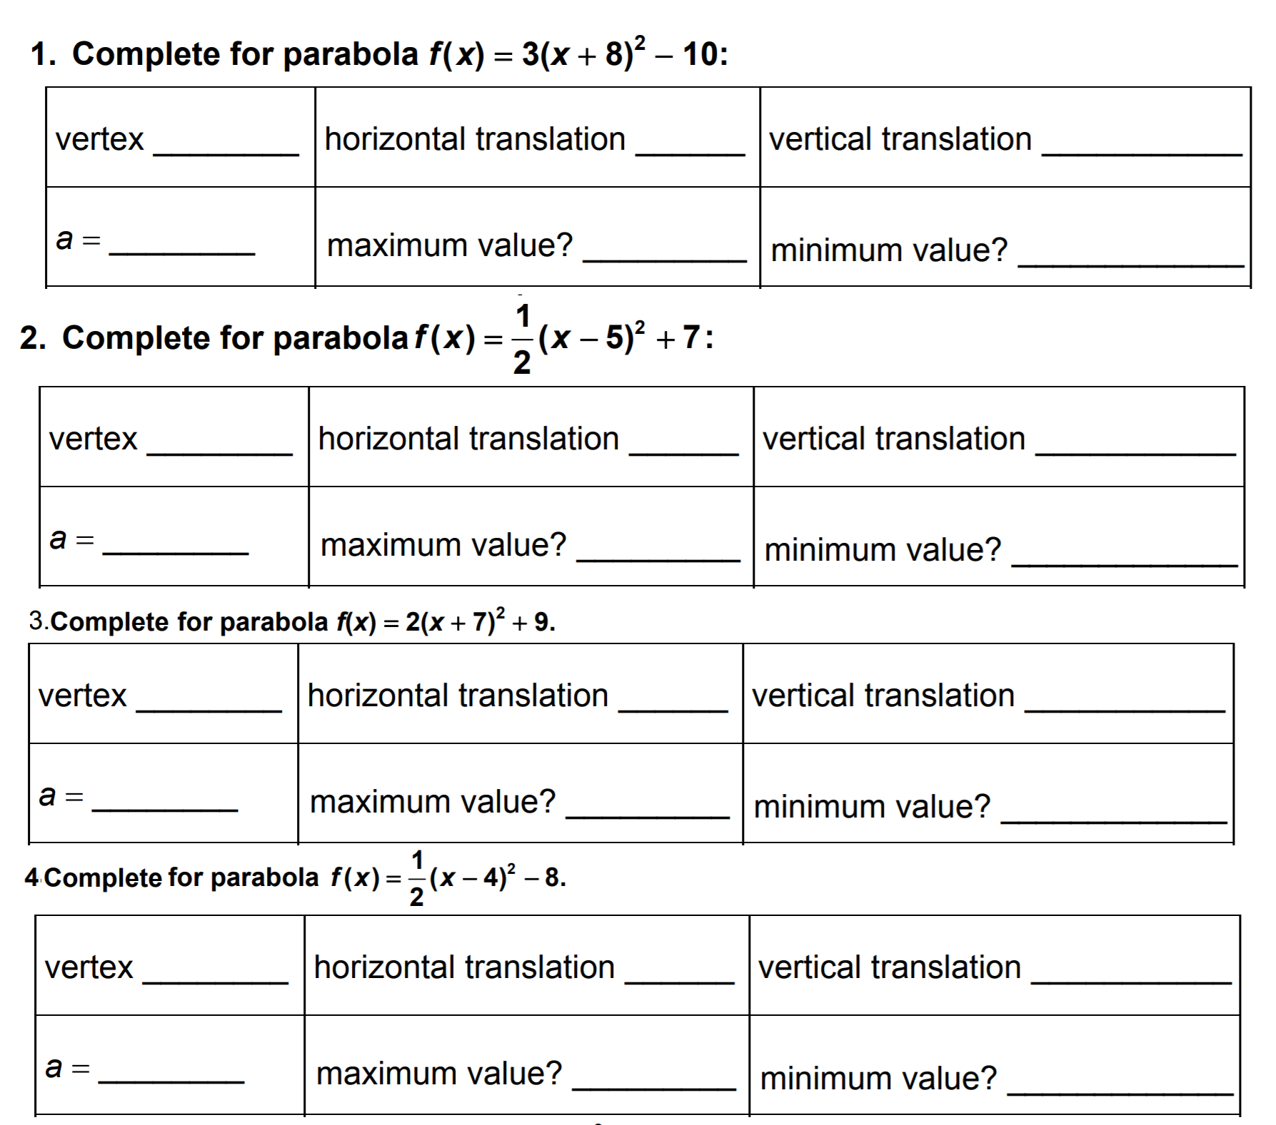
Homework

Slide 11
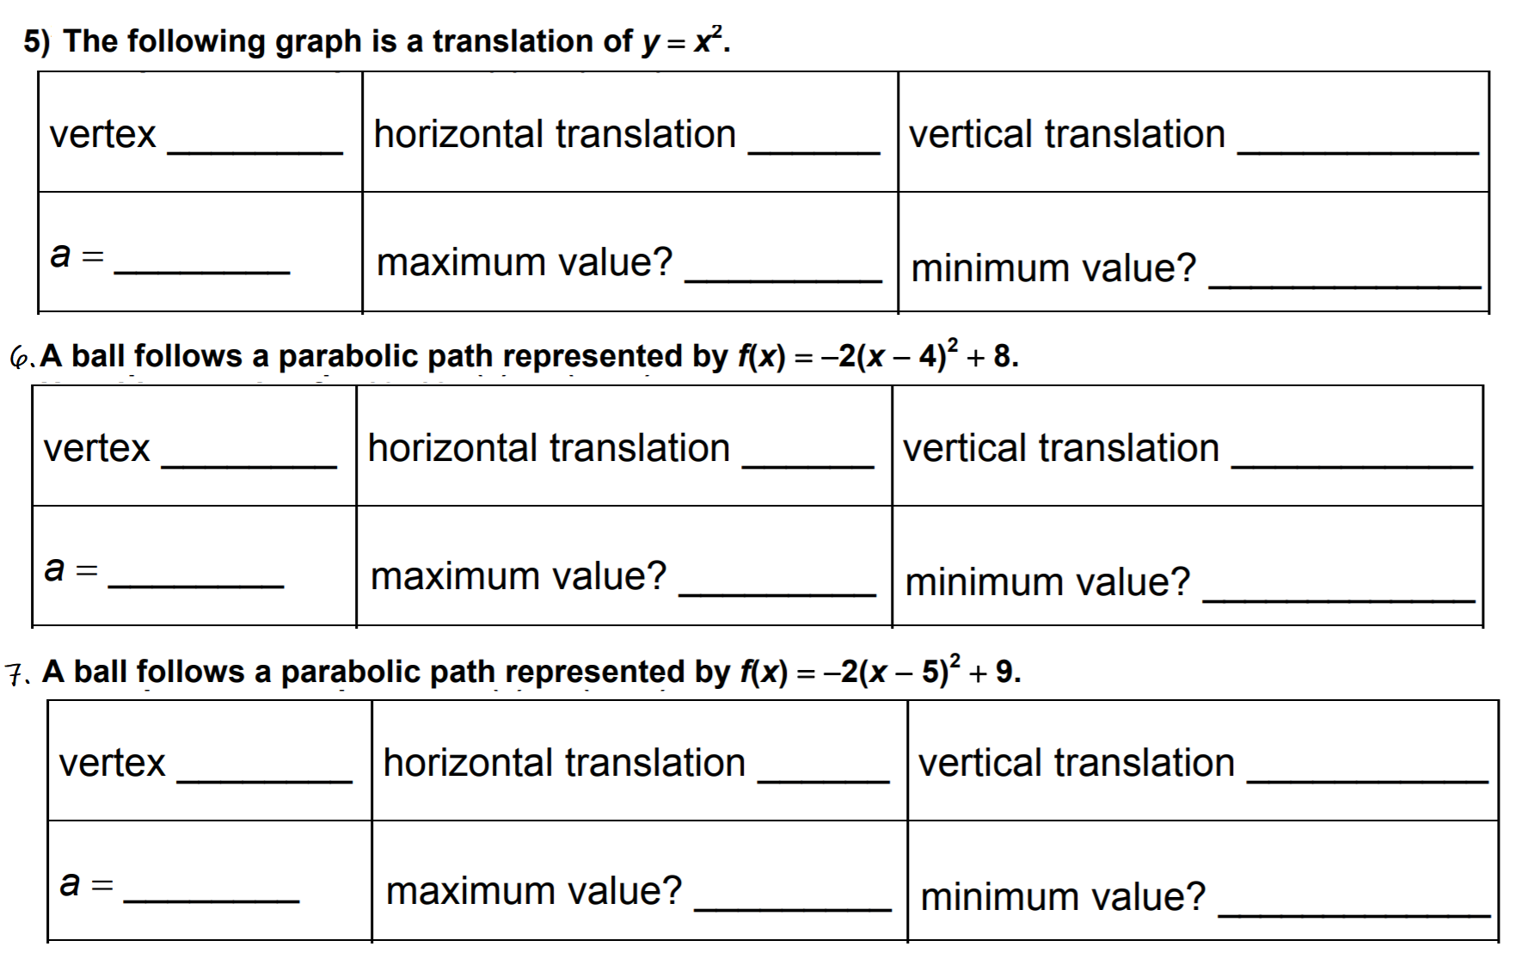
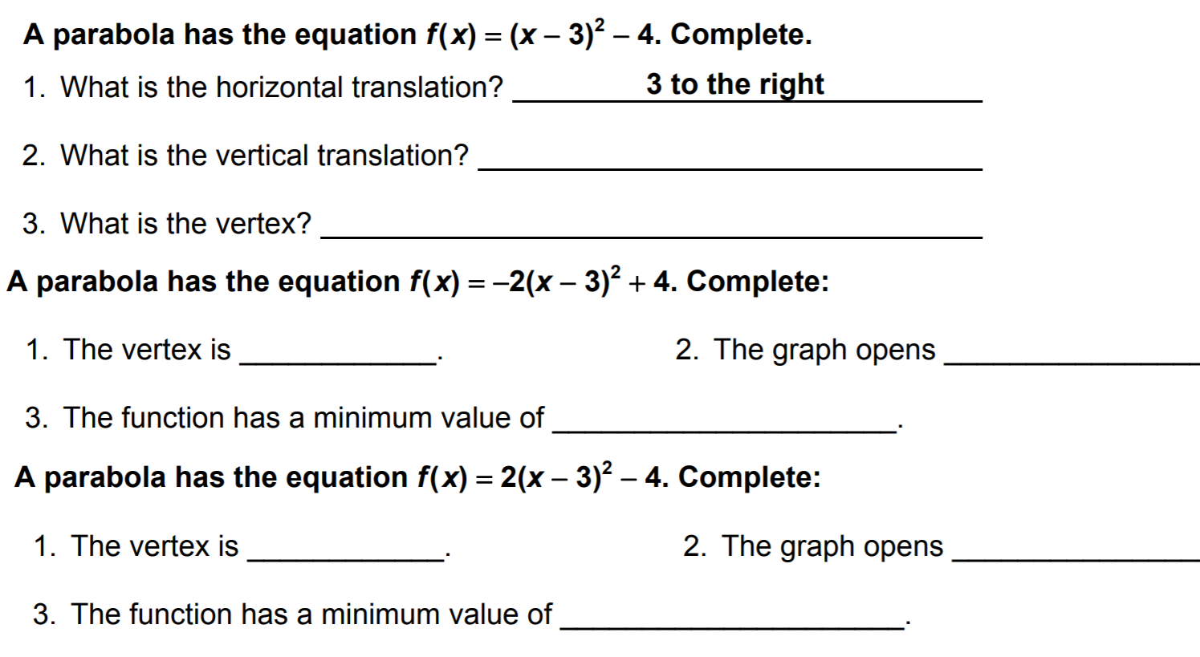
Homework

Slide 12
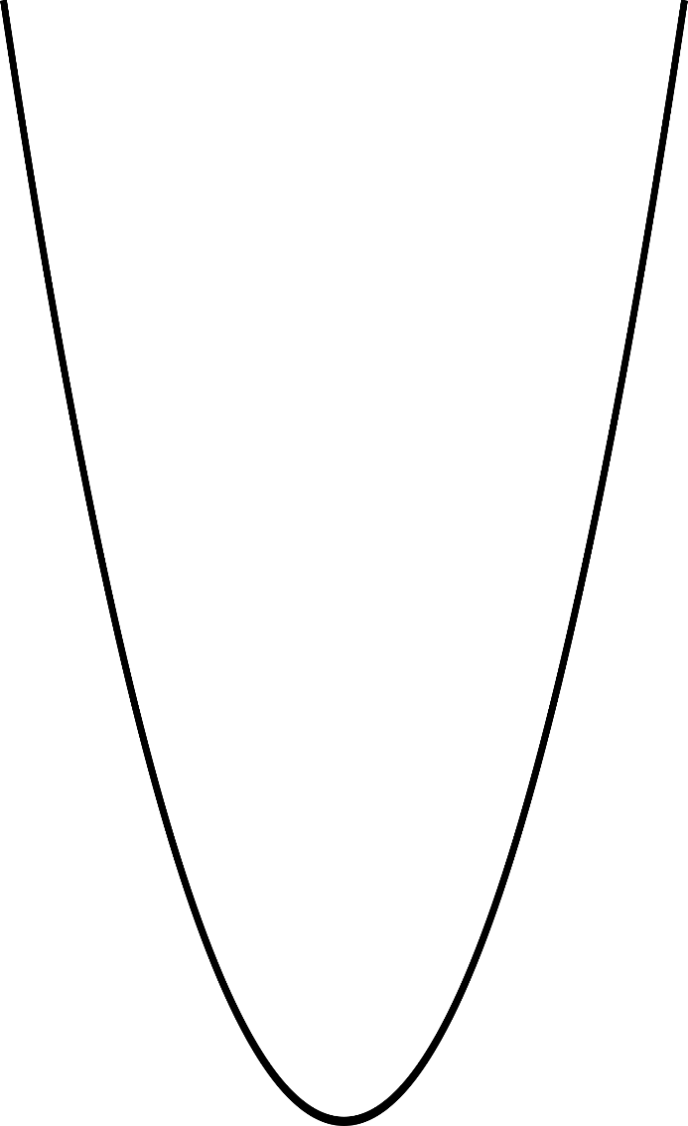
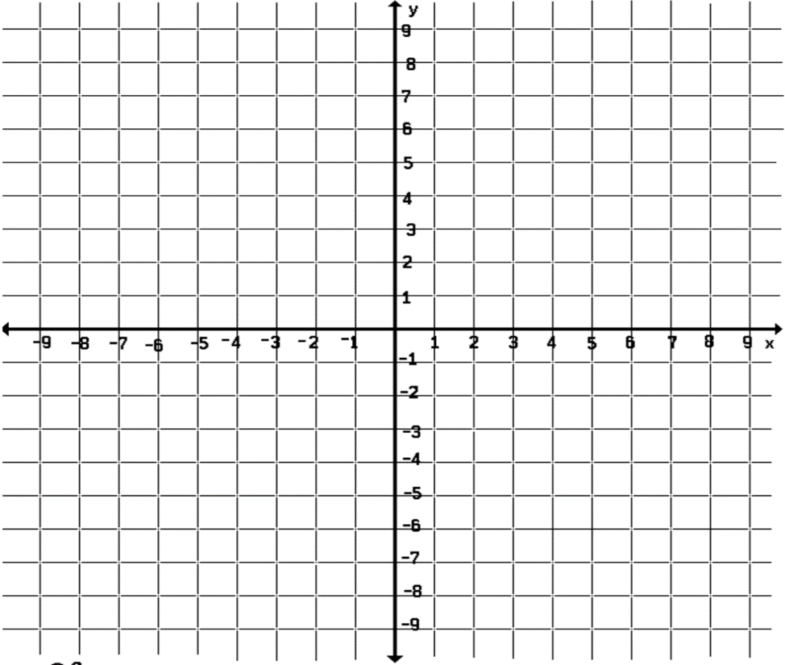
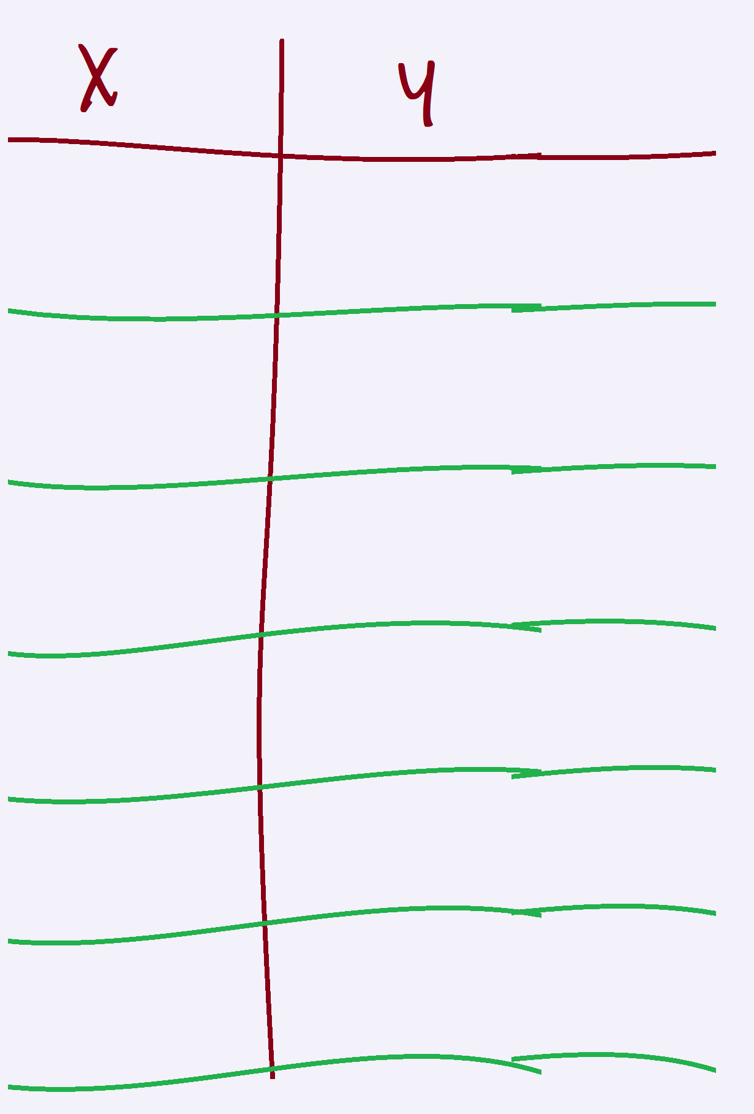
Concept Development
CFU
How did I/you determine the direction of the parabola?
How did I/you determine the vertex of the parabola?
How did I/you identify the graph the parabola?
1
2
3
Graph: $f\left(x\right)={(x+4)}^{2}−5$
(a) Openness
: Up
(b) Vertex
: (-4, -5)
(c) Axis of symmetry
: x = -4
(d) T-Table
-5
-4
(-6, -1) .
. (-2, -1)
-6
-1
-3
-4
(-5, -4) .
. (-3, -4)
. (-4, -5)
-2
-1

Slide 13
Guided Practice
CFU
How did I/you determine the direction of the parabola?
How did I/you determine the vertex of the parabola?
How did I/you identify the graph the parabola?
1
2
3
Graph: $f\left(x\right)={(x−4)}^{2}+ 5$
(a) Openness
(b) Vertex
(c) Axis of symmetry
(d) T-Table

Slide 14
Homework
CFU
How did I/you determine the direction of the parabola?
How did I/you determine the vertex of the parabola?
How did I/you identify the graph the parabola?
1
2
3
(a) Openness
(b) Vertex
(c) Axis of symmetry
(d) T-Table

Slide 15
Homework
CFU
How did I/you determine the direction of the parabola?
How did I/you determine the vertex of the parabola?
How did I/you identify the graph the parabola?
1
2
3
(a) Openness
(b) Vertex
(c) Axis of symmetry
(d) T-Table

Slide 16
Homework
CFU
How did I/you determine the direction of the parabola?
How did I/you determine the vertex of the parabola?
How did I/you identify the graph the parabola?
1
2
3
(a) Openness
(b) Vertex
(c) Axis of symmetry
(d) T-Table

Slide 17
Homework
CFU
How did I/you determine the direction of the parabola?
How did I/you determine the vertex of the parabola?
How did I/you identify the graph the parabola?
1
2
3
(a) Openness
(b) Vertex
(c) Axis of symmetry
(d) T-Table

Slide 18
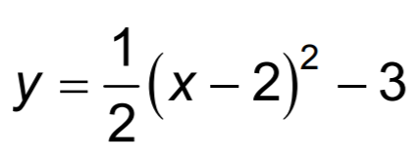
Homework
CFU
How did I/you determine the direction of the parabola?
How did I/you determine the vertex of the parabola?
How did I/you identify the graph the parabola?
1
2
3
(a) Openness
(b) Vertex
(c) Axis of symmetry
(d) T-Table

Slide 19
We will learn how to use the Vertex Form to graph the ${\text{Quadratic}}_{1}$ Functions.
LEARNING OBJECTIVE
What is our Learning Objective?
What does “Quadratic” mean? Quadratic means _________.
CFU
Definition
¹ involving a variable that is squared, or raised to a power of two.

Slide 20
Concept Development
Now, we will learn how to graph quadratic functions.
How did I/you determine the direction of the parabola?
How did I/you determine the vertex of the parabola?
How did I/you identify the graph the parabola?
CFU
1
2
3
* “The parabola opens upward/downward. Its axis of symmetry is _____; the vertex is at the point _____.”

Slide 21
Homework
CFU
How did I/you determine the direction of the parabola?
How did I/you determine the vertex of the parabola?
How did I/you identify the graph the parabola?
1
2
3
(a) Openness
(b) Vertex
(c) Axis of symmetry
(d) T-Table

Slide 22
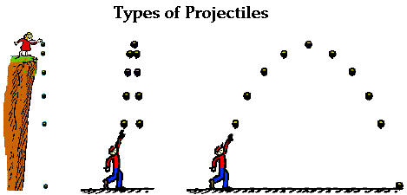
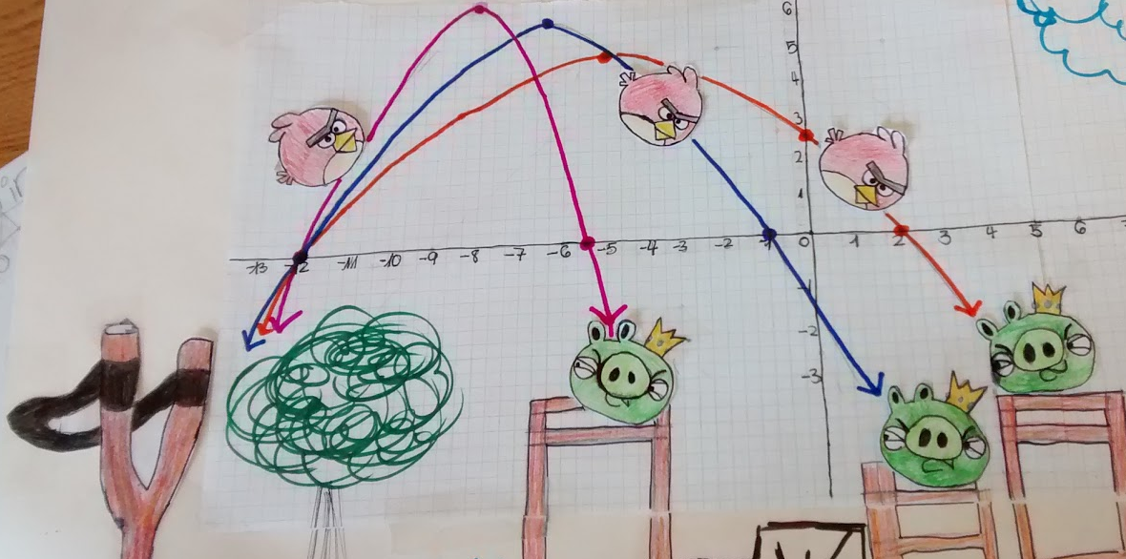
Relevance
Quadratic functions are more than algebraic curiosities—they are widely used in science, business, and engineering. The U-shape of a parabola can describe the trajectories of angry birds in a game, a bouncing ball, or be incorporated into structures like the parabolic reflectors that form the base of satellite dishes and car headlights. Quadratic functions help forecast business profit and loss, plot the course of moving objects, and assist in determining minimum and maximum values. Most of the objects we use every day, from cars to clocks, would not exist if someone, somewhere hadn't applied quadratic functions to their design.

Slide 23
How do you graph a Quadratic Function of the $f\left(x\right)=a{(x−h)}^{2}+k$?
Essential Question:
SUMMARY CLOSURE
To obtain the graph using vertex form, you ______________ _________________________________________________________________.
*Identify the vertex(h, k) and use the sign of a to determine whether the graph opens up or down. Generate a few points on one side of the vertex and sketch the graph using those points and symmetry.

Slide 24
Objective: The students will take Quiz-2 to demonstrate their understanding of Transforming Quadratic Function by achieving an accuracy rate of 70% or higher.
Submit: Lesson_2_6.2_Transforming Quadratic Functions
Paper: Quiz-2.
Chromebook: my.hrw.com
Sub Tomorrow!
*If accuracy of 70% or higher is not achieved, the student(s) will be required to retake it.

