Slide 1
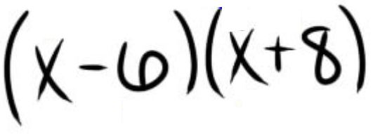
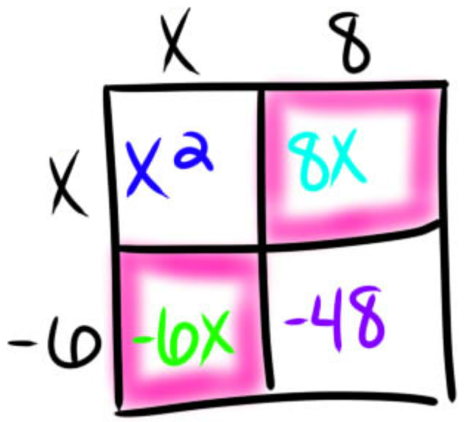
Learning Objective
CFU
A: What are we going to learn?
B: What is a x-intercept?
x-intercept means_____________.
We will learn how to write Quadratic Functions Given ${\text{x}\text{−}\text{Intercepts}}_{1}.$
Students, you already know how to multiply two binomials. Now, we will learn how to write Quadratic Functions Given x-intercepts.
Make Connection
1: The point where the parabola crosses the x-axis.
Vocabulary
Activate Prior Knowledge
FOIL (x - 2)(x - 5)
2. FOIL (x - 3)(x + 4)

Slide 2
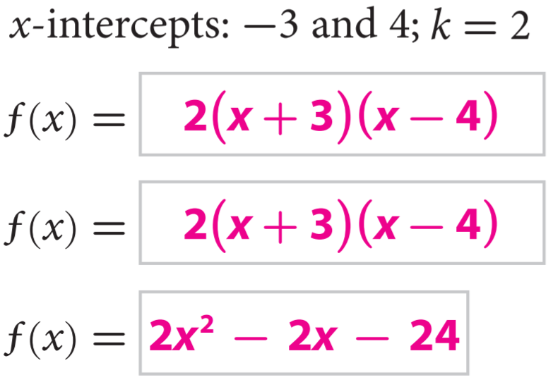
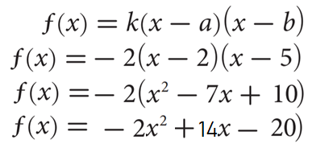
Concept Development
Given two quadratic functions $f\left(x\right)=\left(x−a\right)\left(x−b\right) and g\left(x\right)=k(x−a)(x−b)$, where $k$ is any non-zero real constant, examine the $x−intecepts$for each quadratic function.
Notice that $f\left(x\right)=\left(x−a\right)\left(x−b\right) and g\left(x\right)=k(x−a)(x−b)$ have the same
$x−intecepts$. You can use the factored form to construct a quadratic function given the
$x−intecepts$ and the value of $k$.
Write the function in standard form$.$
1.
2.

Slide 3
Concept Development
Graphic Organizers
Complete the following table.
Caution! a, b, and k do not represent the same values in the different forms.
A: CFU
C: CFU
How are x–intercepts and zeros related? Explain.
The x–intercepts of a quadratic function are the same as the zeros of a quadratic function.
A: CFU
How do you identify the x-intercepts of a quadratic function in factored form? Explain.
For a function in the form, y = k (x - a)(x - b) the x-intercepts will be a and b.
How are x–intercepts and zeros related? Explain.
C: CFU
B: CFU
How do you identify the x-intercepts of a quadratic function in factored form? Explain.
What would the factored form look like if there were only one x–intercept? Explain.
f(x) = ${k(x−a)}^{2}$ where a is the x–intercept.
B: CFU
What would the factored form look like if there were only one x–intercept? Explain.

Slide 5
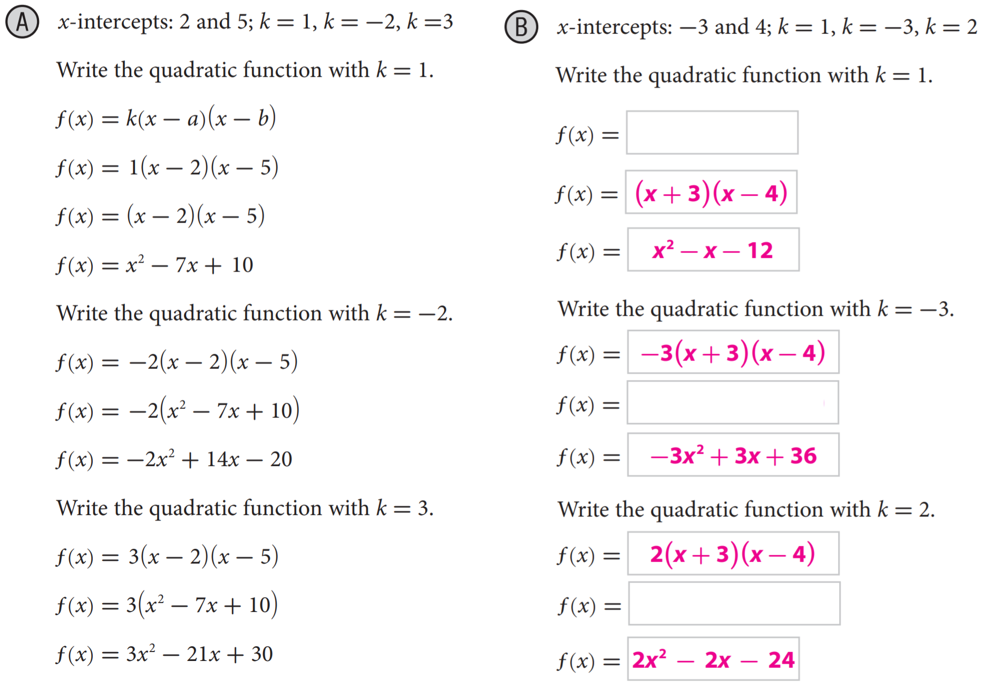
Skill Development
Vertex Form
Steps to write Quadratic Functions Given x-Intercepts.
How did I/you identify the function form rule?
How did I/you write the function in standard form?
1
Identify the main points:
CFU
Standard Form
a
x-intercept, k, vertex, etc..
2
2
Write the function form rule & substitute in the points.
3
3
Rewrite the function in standard form. (box method)
For the two given intercepts, use the factored form to generate a quadratic function for each given constant k. Write the function in standard form.

Slide 6
Relevance
1
Writing Quadratic Functions will help you in ReAl-LiFe.
Everything about the quadratic equation has been reduced to a formula: how to graph it, how to solve it, how to manipulate it into various forms. Extremely useful in physics, engineering, and statistics.
For instance:
it can tell us how far a thing under the effects of gravity has travelled after a certain amount of time.
It can help businesses determine how to price their products (if they assume a very, very simple relationship between price and the number of customers who would be willing to buy).
It can help engineers determine the most effective shape of a satellite dish.
2
Knowing how to write Quadratic Functions will help you do well on tests.
Sample Test Question:
Does anyone else have another reason why it is relevant to use algebraic terminology? (Pair-Share) Why is it relevant to use algebraic terminology? You may give me one of my reasons or one of your own. Which reason is more relevant to you? Why?
A farmer has 1000 feet of fencing and a very big field. She can enclose a rectangular area with dimensions x ft and 500 – x ft.
What is the largest rectangular area she can create?
62,500 ft2
250,000 ft2
1,000 ft2
500 ft2
CFU
Correct is A).
The area y is y = x(500 – x), or y = -x² + 500x (ft²).
The vertex of the parabola will be (250, 62,500).
The maximum area possible is the y-coordinate of the vertex, or 62,500 ft².

Slide 7
Summary Closure
What did you learn today about how to write Quadratic Functions Given x-Intercepts.?
(Pair-Share)
Today, I learned how to ________________________________________________
___________________________________________________________________
__________________________________________________________________.
Standard form
Vertex
Zeroes (Roots)
y-intercept
Axis of Symmetry

Slide 8
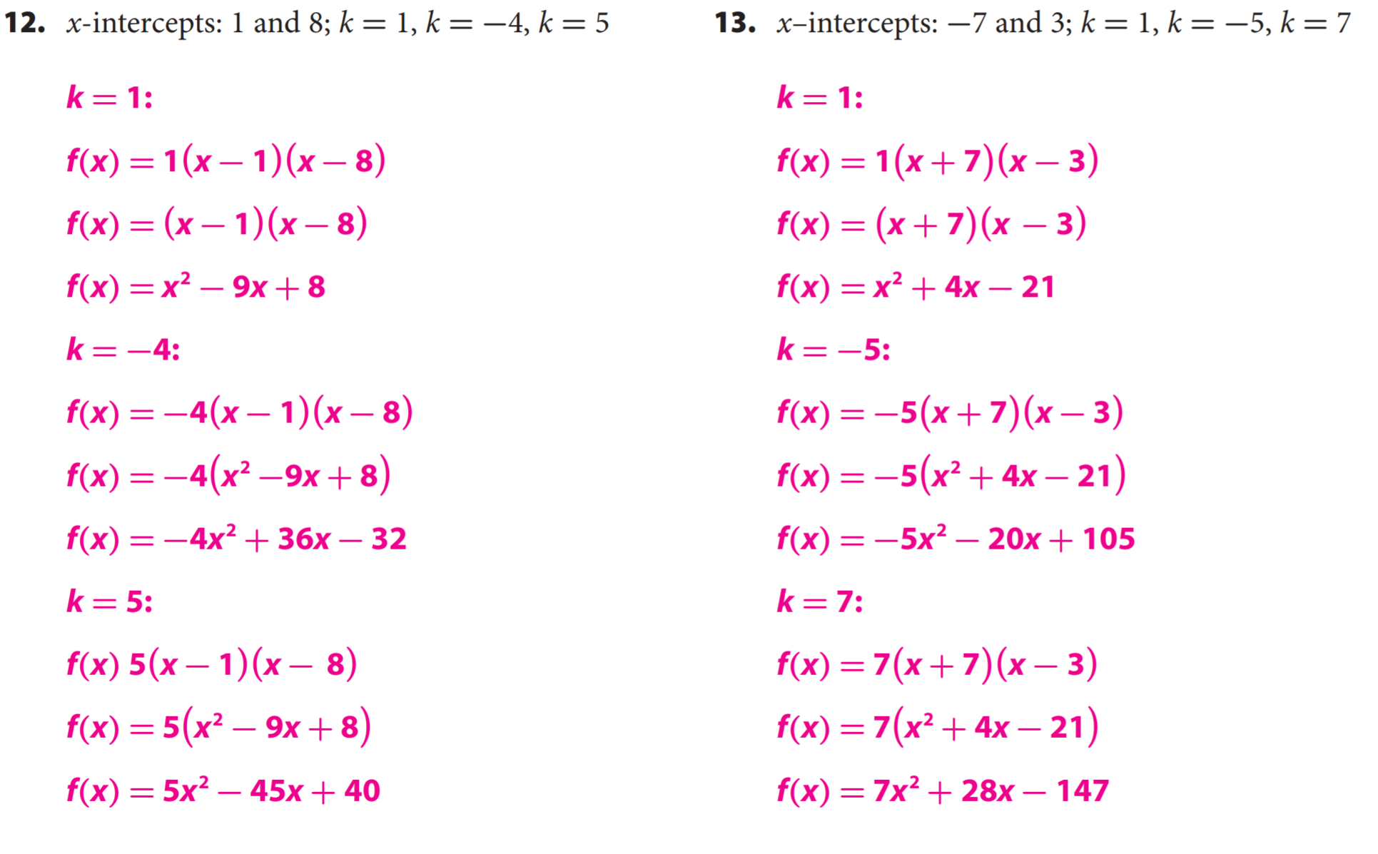
Guided/Independent Practice
Steps to write Quadratic Functions Given x-Intercepts.
1
Identify the main points:
a
x-intercept, k, vertex, etc..
2
Write the function form rule & substitute in the points.
3
Rewrite the function in standard form. (box method)

Slide 9
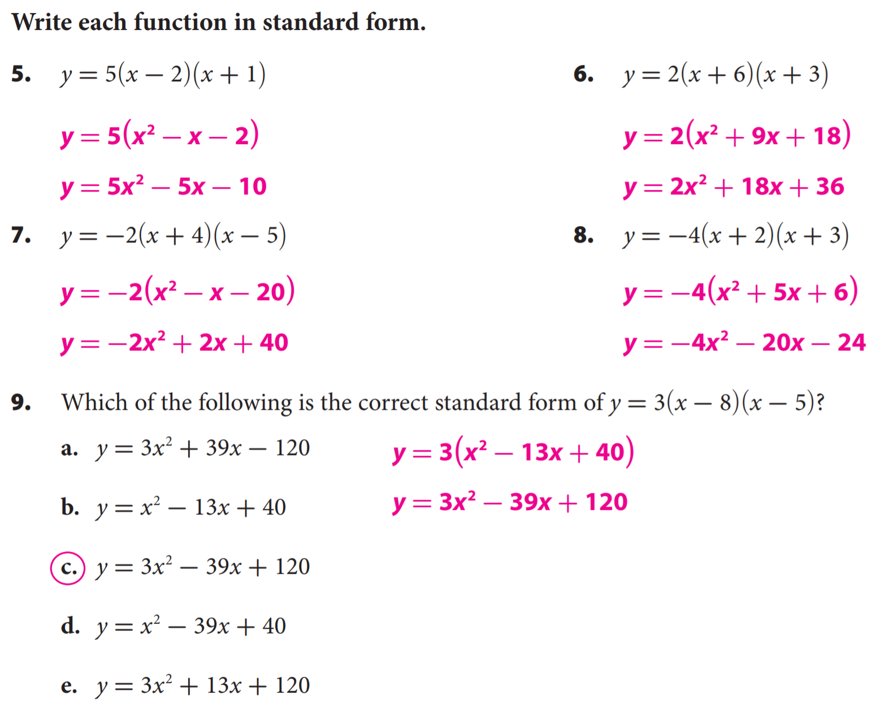
Independent Practice

Slide 10
Independent Practice

Slide 11
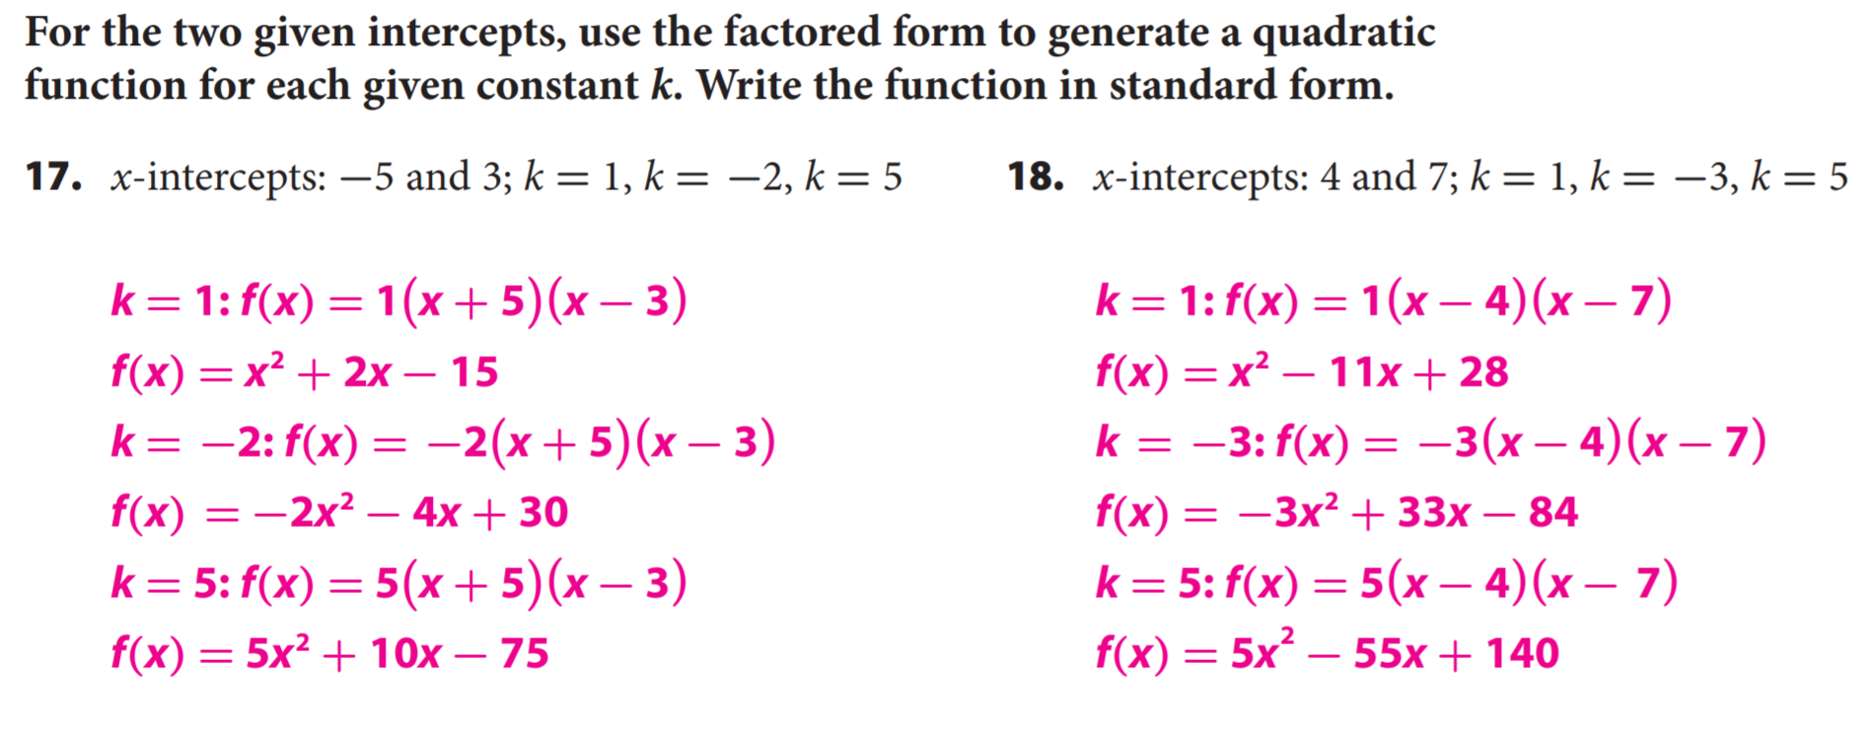
Independent Practice

Slide 12
Independent Practice

