Slide 1
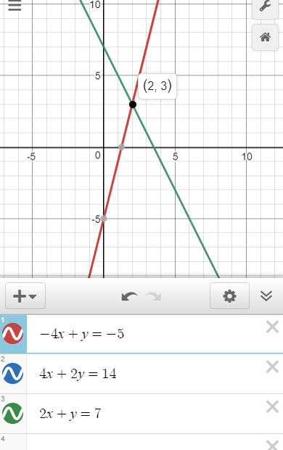
Activate Prior Knowledge
Name:__________________________
Period:______
Lesson 3: 11.3 Solving Systems using Elimination
Write the opposite of the variable term.
$$−4x$$
1
2
“The opposite variable term of _____ is _____.”
$$3y$$
Remember the Concept
Opposites add up to zero.
“The opposite variable term of _____ is _____.”
ACTIVATE PRIOR KNOWLEDGE
Make the Connection
Students, you already know what opposite variable terms are. Today, we will eliminate opposite variable terms to solve a system of equations.
The elimination method ____________ two equations together to ____________ one of the variables.
The elimination method ONLY works if the equations have ____________ variable terms.
$$\left\{\begin{aligned}−4x+y=−5 \\ 4x+2y=14\end{aligned}\right.$$
CONCEPT DEVELOPMENT
Not ideal for the elimination method
$$\left\{\begin{aligned}−4x+y=−5 \\ 2x+y=7\end{aligned}\right.$$
Check for Understanding
Which of the following systems is ready for the elimination method? How do you know? The system of equations, ___, is ready for the elimination method because _____________ _____________________________________.
A $\left\{\begin{aligned}−4x+3y=−5 \\ 2x−3y=−5\end{aligned}\right.$
B $\left\{\begin{aligned}−4x+y=−5 \\ 2x−4y=7\end{aligned}\right.$
1

Slide 2
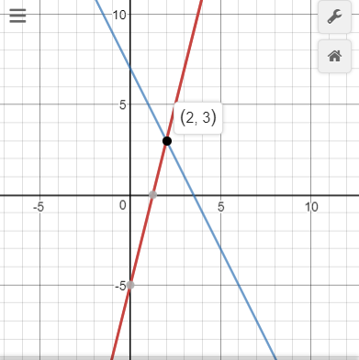
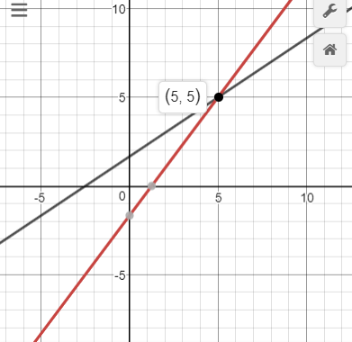
Steps
1. Add the equations to eliminate the opposite variable terms.
CFU How did I/you eliminate the opposite variable terms?
2. Find the first value of the ordered pair solution. (Write ordered pair)
CFU How did I/you find the first value of the ordered pair solution?
3. Find the second value of the ordered pair solution. (Write ordered pair)
CFU How did I/you find the second value of the ordered pair solution?
1
$$\left\{\begin{aligned}−4x+y=−5 \\ 4x+2y=14\end{aligned}\right.$$
2
$$\left\{\begin{aligned}−4x+3y=−5 \\ 2x−3y=−5\end{aligned}\right.$$
$$+$$
$$+$$
Step 1
Step 1
Step 2
Step 2
Step 3
Step 3
CONCEPT DEVELOPMENT
1
$$\left\{\begin{aligned}−4x+y=−5 \\ 4x+2y=14\end{aligned}\right.$$
solution $$\left(___,___\right)$$
2
$$\left\{\begin{aligned}−4x+3y=−5 \\ 2x−3y=−5\end{aligned}\right.$$
solution $$\left(___,___\right)$$
“The solution to the system of linear equation is the ordered pair (__, __).
The ordered pair (__, __) represents the __________ of the two graphs AND
the values that make BOTH equations __________.”
$$2$$

Slide 3
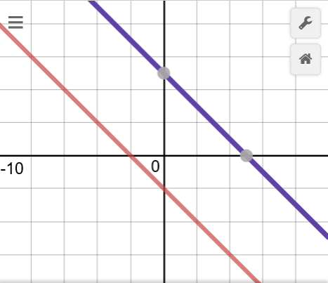
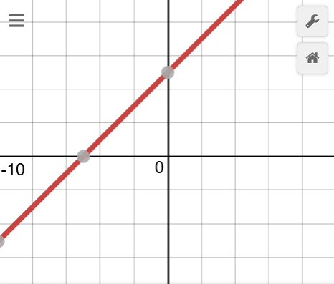
Steps
1 Add the equations to eliminate the opposite variable terms.
CFU How did I/you eliminate the opposite variable terms?
2 Find the first value of the ordered pair solution. (Write ordered pair)
CFU How did I/you find the first value of the ordered pair solution?
3 Find the second value of the ordered pair solution. (Write ordered pair)
CFU How did I/you find the second value of the ordered pair solution?
IF the equations are __________
THEN there are ______ ordered pair __________
IF the equations are __________
THEN there are __________
ordered pair __________
3
$$\left\{\begin{aligned}−x−y=2 \\ x+y=5\end{aligned}\right.$$
4
$$\left\{\begin{aligned}−x+y=5 \\ x−y=−5\end{aligned}\right.$$
$$+$$
$$+$$
The elimination method __________ two equations together to __________ one of the variables.
The elimination method ___________ works if the equations have opposite variable terms.
Equivalent equations can be created to be able to use elimination method.
___________________
look different, but represent the same line.
$$\left\{\begin{aligned}−4x+y=−5 \\ 3x−2y=14\end{aligned}\right.$$
$$×2=$$
$$\left\{\begin{aligned}−8x+2y=−10 \\ 3x−2y=14\end{aligned}\right.$$
CONCEPT DEVELOPMENT
$$+$$
Check for Understanding
How can we make the equations eliminate one of variable? To eliminate y, you multiple the top equation by _____. To eliminate x, you multiple the top equation by ______.
$$−4x+y=−5$$
$$−8x+2y=−10$$
Check for Understanding
Which equivalent equation should replace the second equation be use the elimination method? How do you know? The equivalent expression ___ should replace the second equation because _____________________________________________________________________.
$$\left\{\begin{aligned}−3x+9y=−5 \\ 2x−3y=−5\end{aligned}\right.$$
A$4x−6y=−10$
B$6x−9y=−15$
$$3$$

Slide 4
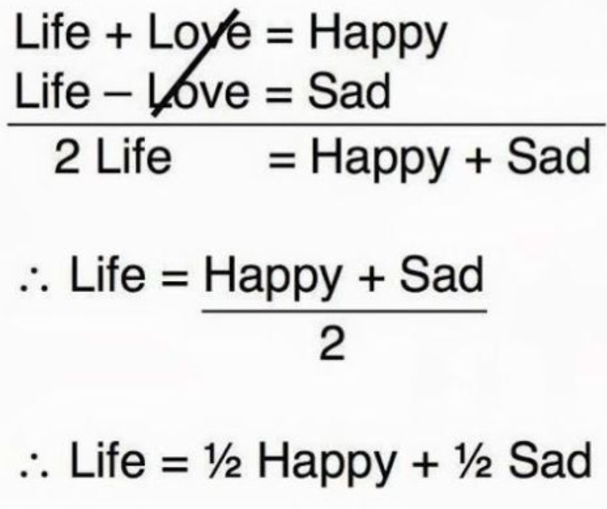
Steps
0 Create an equivalent equation to be ready for the elimination method.
CFU How did I/you create an equivalent expression?
1 Add the equations to eliminate the opposite variable terms.
CFU How did I/you eliminate the opposite variable terms?
2 Find the first value of the ordered pair solution. (Write ordered pair)
CFU How did I/you find the first value of the ordered pair solution?
3 Find the second value of the ordered pair solution. (Write ordered pair)
CFU How did I/you find the second value of the ordered pair solution?
1
$$\left\{\begin{aligned}−4x+y=−5 \\ 4x+2y=14\end{aligned}\right.$$
solution $$\left(___,___\right)$$
2
$$\left\{\begin{aligned}−4x+3y=−5 \\ 2x−3y=−5\end{aligned}\right.$$
solution $$\left(___,___\right)$$
$$+$$
$$+$$
Step 1
Step 1
Step 2
Step 2
What did you learn today about solving a system of equations using the elimination method?
Step 3
Step 3
Word Bank
To solve system of equations using the elimination method, you
Step 1:______________________________________________________.
Step 2:______________________________________________________.
Step 3:______________________________________________________.
Elimination
Opposite Variable Terms
Ordered Pair
System of Equations
Solution
SUMMARY CLOSURE
$$4$$

Slide 5
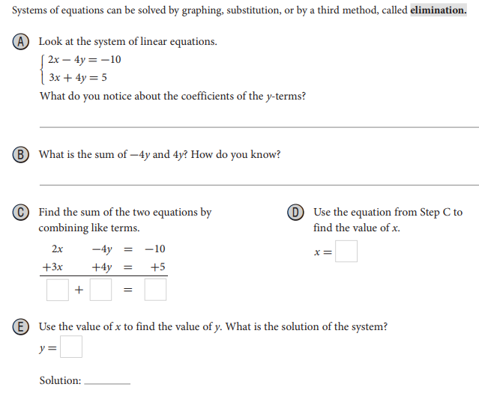
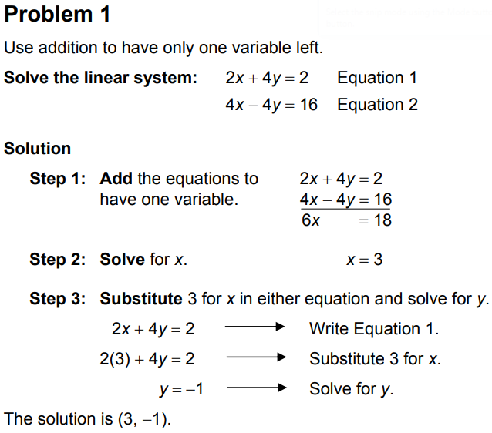
Homework
$$5$$

Slide 6
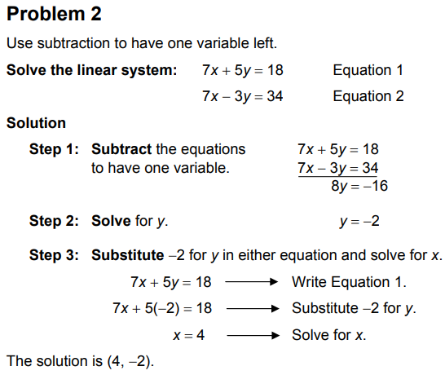
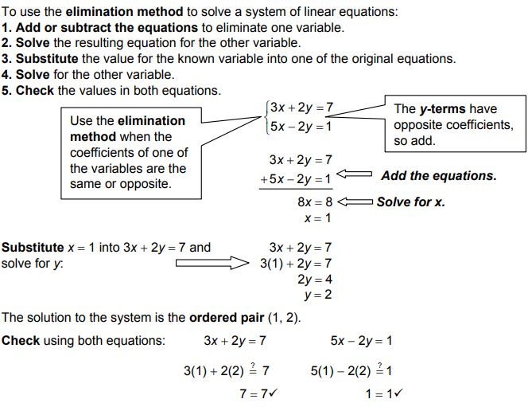
Homework
6

Slide 7
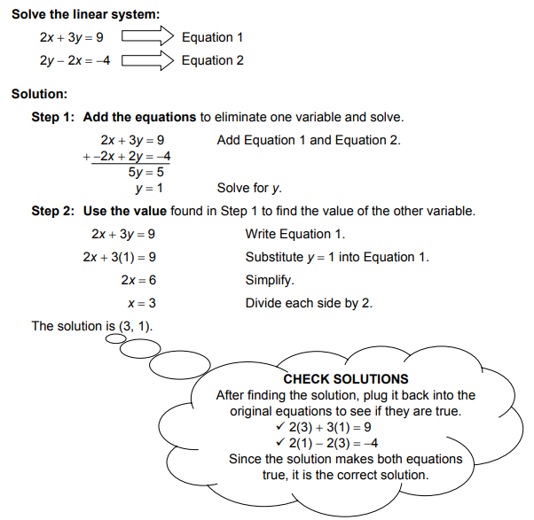
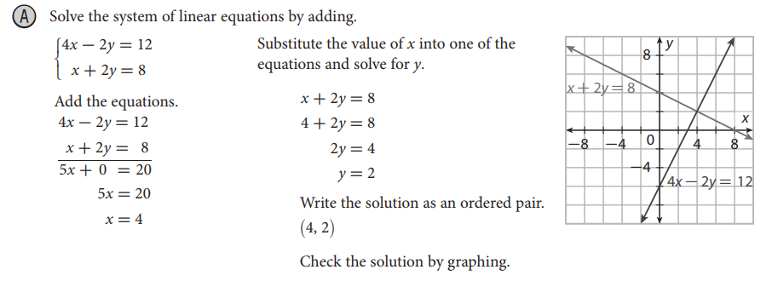
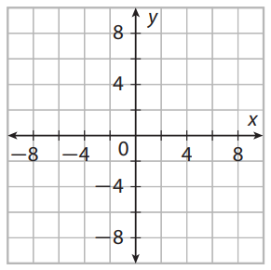
Homework
$$7$$

Slide 8
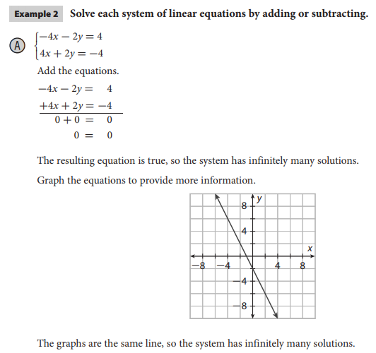
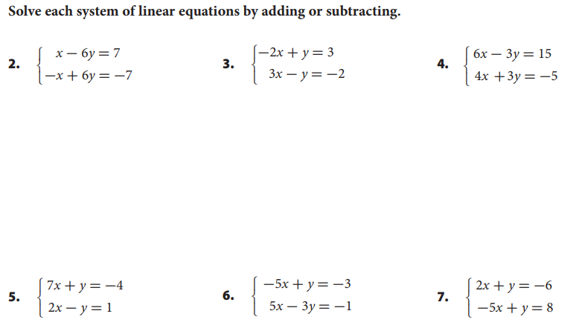
Homework
$$8$$

