Slide 1
Learning Objective
We will solve a system of equations₁ using the elimination method.
LEARNING OBJECTIVE
Definition
¹ (solve a system) find the ordered pair solution.
Declare the Objective
Read the objective to your partner.

Slide 2
Activate Prior Knowledge
Remember the Concept
Opposites add up to zero.
Write the opposite of the variable term.
“The opposite variable term of ___ is ___.”
1
2
$$−4x$$
$$3y$$
Make the Connection
Students, you already know what opposite variable terms are. Today, we will eliminate opposite variable terms to solve a system of equations.
ACTIVATE PRIOR KNOWLEDGE
$$4x$$
-$3y$

Slide 3
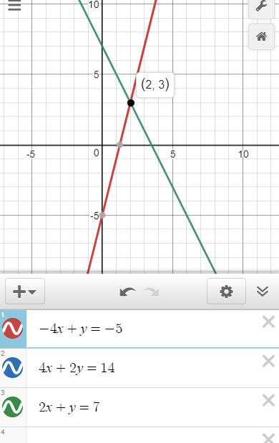
The elimination method adds two equations together to eliminate one of the variables.
The elimination method ONLY works if the equations have opposite variable terms.
$$\left\{\begin{aligned}−4x+y=−5 \\ 4x+2y=14\end{aligned}\right.$$
CONCEPT DEVELOPMENT
$$\left\{\begin{aligned}−4x+y=−5 \\ 2x+y=7\end{aligned}\right.$$
Not ideal for the elimination method

Slide 4
The elimination method adds two equations together to eliminate one of the variables.
Check for Understanding
Which of the following systems is ready for the elimination method? How do you know? The system of equations, ___, is ready for the elimination method because __________________.
A $\left\{\begin{aligned}−4x+3y=−5 \\ 2x−3y=−5\end{aligned}\right.$
CONCEPT DEVELOPMENT
Not ideal for the elimination method
B $\left\{\begin{aligned}−4x+y=−5 \\ 2x−4y=7\end{aligned}\right.$
$$\left\{\begin{aligned}−4x+y=−5 \\ 2x+y=7\end{aligned}\right.$$

Slide 5
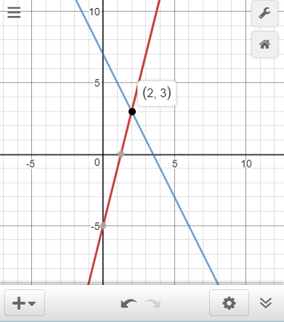
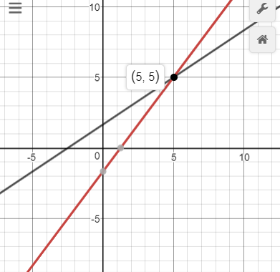
Steps
1. Add the equations to eliminate the opposite variable terms.
CFU How did I/you eliminate the opposite variable terms?
2. Find the first value of the ordered pair solution. (Write ordered pair)
CFU How did I/you find the first value of the ordered pair solution?
3. Find the second value of the ordered pair solution. (Write ordered pair)
CFU How did I/you find the second value of the ordered pair solution?
1
$$\left\{\begin{aligned}−4x+y=−5 \\ 4x+2y=14\end{aligned}\right.$$
2
$$\left\{\begin{aligned}−4x+3y=−5 \\ 2x−3y=−5\end{aligned}\right.$$
solution $$\left(___,___\right)$$
solution $$\left(___,___\right)$$
$$+$$
$$2$$
$$3$$
$$+$$
$$5$$
$$5$$
Step 1
$$3y=9$$
Step 1
$$−2x =−10$$
Step 2
$$3y =9$$
Step 2
$$−2x =−10$$
$$\overline{ 3 }$$
$$\overline{ 3 }$$
$$\overline{ −2 }$$
$$\overline{ −2 }$$
$$y =3$$
$$x =5$$
Step 3
Step 3
$$4x+2y=14$$
$$−4x+3y=−5$$
$$4x+2(3)=14$$
$$−4\left(5\right)+3y=−5$$
$$4x+6=14$$
$$−20+3y=−5$$
$$−6$$
$$−6$$
$$+20$$
$$+20$$
$$4x=8$$
$$3y=15$$
$$\overline{ 4 }$$
$$\overline{ 4 }$$
$$\overline{ 3 }$$
$$\overline{ 3 }$$
$$x=2$$
$$y=5$$

Slide 6
Conceptual Refocusing
1
$$\left\{\begin{aligned}−4x+y=−5 \\ 4x+2y=14\end{aligned}\right.$$
2
$$\left\{\begin{aligned}−4x+3y=−5 \\ 2x−3y=−5\end{aligned}\right.$$
solution $$\left(___,___\right)$$
solution $$\left(___,___\right)$$
“The solution to the system of linear equation is the ordered pair (__, __).
The ordered pair (__, __) represents
the intersection of the two graphs
AND
the values that make BOTH equations TRUE.”
$$2$$
$$3$$
$$5$$
$$5$$

Slide 7
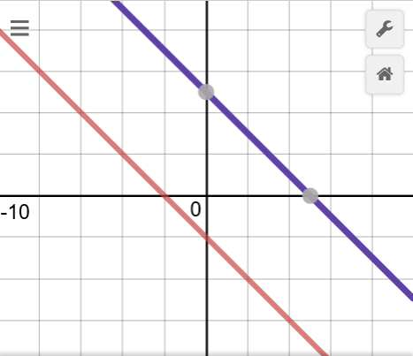
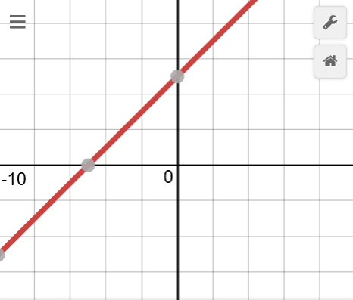
Steps
1 Add the equations to eliminate the opposite variable terms.
CFU How did I/you eliminate the opposite variable terms?
2 Find the first value of the ordered pair solution. (Write ordered pair)
CFU How did I/you find the first value of the ordered pair solution?
3 Find the second value of the ordered pair solution. (Write ordered pair)
CFU How did I/you find the second value of the ordered pair solution?
IF the equations are NOT EQUAL
THEN there are NO ordered pair SOLUTIONS
IF the equations are EQUAL
THEN there are INFINITE ordered pair SOLUTIONS
3
$$\left\{\begin{aligned}−x−y=2 \\ x+y=5\end{aligned}\right.$$
4
$$\left\{\begin{aligned}−x+y=5 \\ x−y=−5\end{aligned}\right.$$
$$+$$
$$+$$
$$0=7$$
$$0=0$$

Slide 8
The elimination method adds two equations together to eliminate one of the variables.
The elimination method ONLY works if the equations have opposite variable terms.
Equivalent equations can be created to be able to use elimination method.
$$\left\{\begin{aligned}−4x+y=−5 \\ 3x−2y=14\end{aligned}\right.$$
$$×2=$$
$$\left\{\begin{aligned}−8x+2y=−10 \\ 3x−2y=14\end{aligned}\right.$$
Equivalent equations look different, but represent the same line.
CONCEPT DEVELOPMENT
$$+$$
$$−4x+y=−5$$
$$−8x+2y=−10$$

Slide 9
The elimination method adds two equations together to eliminate one of the variables.
The elimination method ONLY works if the equations have opposite variable terms.
Check for Understanding
Which equivalent equation should replace the second equation be use the elimination method? How do you know? The equivalent expression ___ should replace the second equation because ________.
$$\left\{\begin{aligned}−3x+9y=−5 \\ 2x−3y=−5\end{aligned}\right.$$
CONCEPT DEVELOPMENT
A$4x−6y=−10$
$$×2$$
B$6x−9y=−15$
$$×3$$

Slide 10
Steps
0 Create an equivalent equation to be ready for the elimination method.
CFU How did I/you create an equivalent expression?
1 Add the equations to eliminate the opposite variable terms.
CFU How did I/you eliminate the opposite variable terms?
2 Find the first value of the ordered pair solution. (Write ordered pair)
CFU How did I/you find the first value of the ordered pair solution?
3 Find the second value of the ordered pair solution. (Write ordered pair)
CFU How did I/you find the second value of the ordered pair solution?
1
$$\left\{\begin{aligned}−4x+y=−5 \\ 4x+2y=14\end{aligned}\right.$$
2
$$\left\{\begin{aligned}−4x+3y=−5 \\ 2x−3y=−5\end{aligned}\right.$$
solution $$\left(___,___\right)$$
solution $$\left(___,___\right)$$
$$+$$
$$2$$
$$3$$
$$+$$
$$5$$
$$5$$
Step 1
$$3y=9$$
Step 1
$$−2x =−10$$
Step 2
$$3y =9$$
Step 2
$$−2x =−10$$
$$\overline{ 3 }$$
$$\overline{ 3 }$$
$$\overline{ −2 }$$
$$\overline{ −2 }$$
$$y =3$$
$$x =5$$
Step 3
Step 3
$$4x+2y=14$$
$$−4x+3y=−5$$
$$4x+2(3)=14$$
$$−4\left(5\right)+3y=−5$$
$$4x+6=14$$
$$−20+3y=−5$$
$$−6$$
$$−6$$
$$+20$$
$$+20$$
$$4x=8$$
$$3y=15$$
$$\overline{ 4 }$$
$$\overline{ 4 }$$
$$\overline{ 3 }$$
$$\overline{ 3 }$$
$$x=2$$
$$y=5$$

Slide 11
Summary Closure
What did you learn today about solving a system of equations using the elimination method?
Word Bank
Elimination
Opposite Variable Terms
Ordered Pair
System of Equations
Solution
SUMMARY CLOSURE

Slide 12
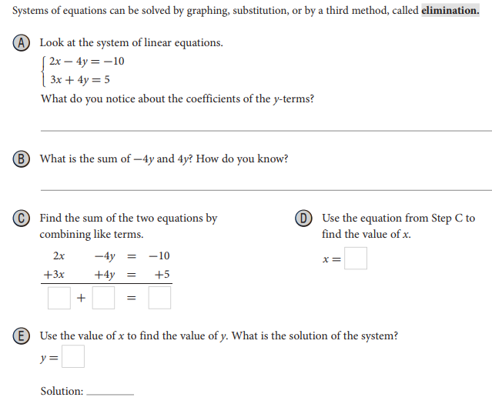
SKILL/CONCEPT CLOSURE
INDEPENDENT PRACTICE

Slide 14
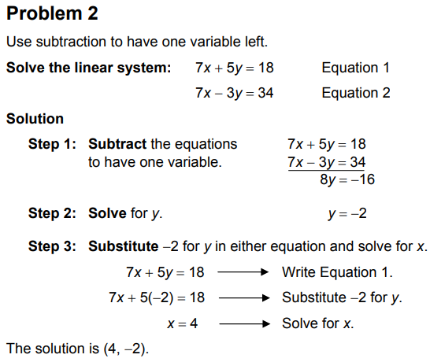
INDEPENDENT PRACTICE

Slide 15
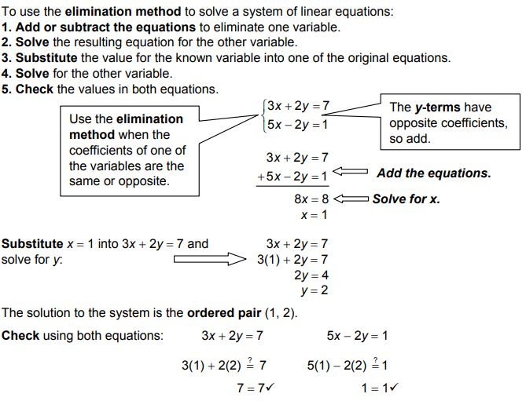
INDEPENDENT PRACTICE

Slide 16
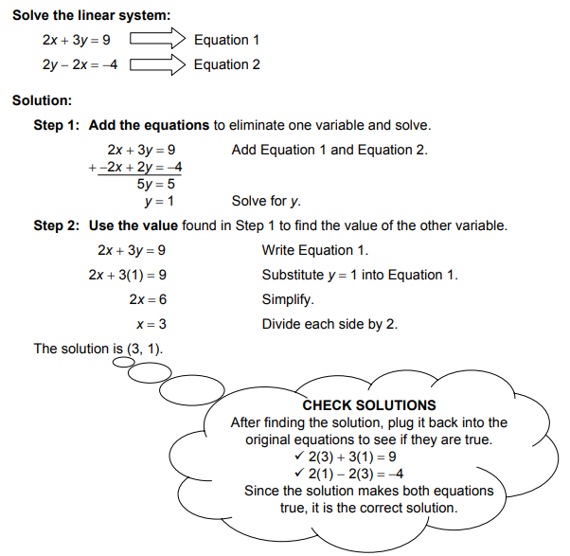
INDEPENDENT PRACTICE

Slide 17
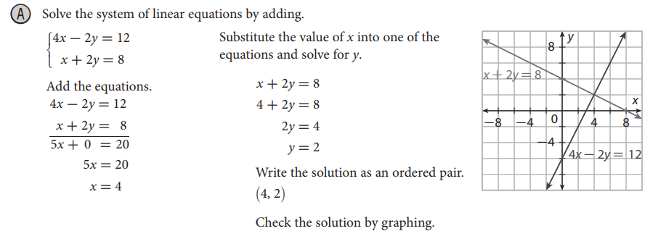
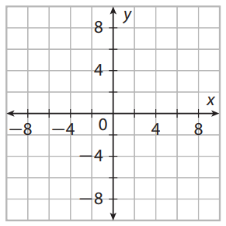
SKILL/CONCEPT CLOSURE
INDEPENDENT PRACTICE

Slide 18
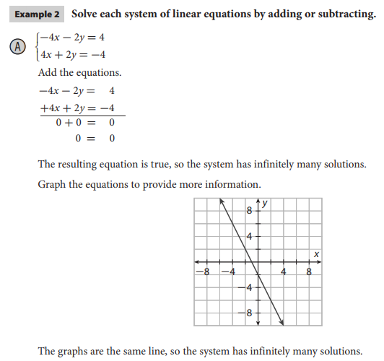
SKILL/CONCEPT CLOSURE
INDEPENDENT PRACTICE

Slide 19
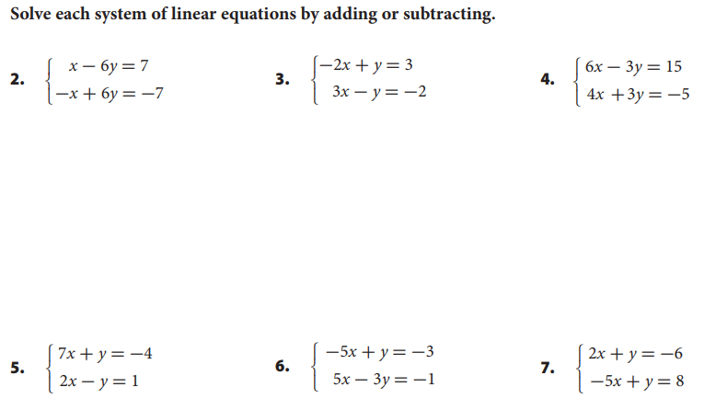
SKILL/CONCEPT CLOSURE
INDEPENDENT PRACTICE

