Slide 1











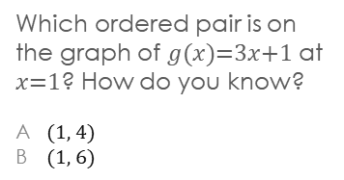
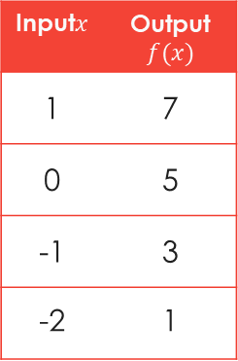
Name: ______________________________
Period:____
Lesson 3: Identifying Quadratic Functions
Learning Objective
We will evaluate₁ and graph different types of functions.
Activate Prior Knowledge
Evaluate the functions.
Remember the Concept
1. $f\left(x\right)=2x+5$ at $x$ = -4
2. $g\left(x\right)=3x+6$ at $x$ = 7
A function is a rule that assigns an input to exactly one output.
An input replaces the 𝑥’s and the expression gives the corresponding output.
Evaluating a function means substituting a number for the input to figure out the output.
(input, output)
x
f(x)
Make the Connection
Students, you already know how to evaluate functions using substitution. Now, we will evaluate functions to create graphs.
Definitions
Concept Development
¹ find the value of
Functions can be represented as graphs by plotting the input-output pairs.
Evaluate the function using an input to figure out the output.
Checking for Understanding
Which ordered pair is on the graph of $g(x$)=3$x$+1 at $x$=1? How do you know?
A (1, 4)
B (1, 6)
Use functions to make graphs.
f(x)
Input$x$ | Output$f(x)$
1 | 7
0 | 5
-1 | 3
-2 | 1
8
7
6
5
$f$( )=
4
3
2
$f$( )=
1
x
-8
-7
-6
-5
-4
-3
-2
-1
1
2
3
4
5
6
7
8
-1
-2
$f$( )=
-3
-4
-5
$f$( )=
-6
-7
-8
Since (-2, 1) is a point on the graph of the function, $f$(-2)=1.
1

Slide 2
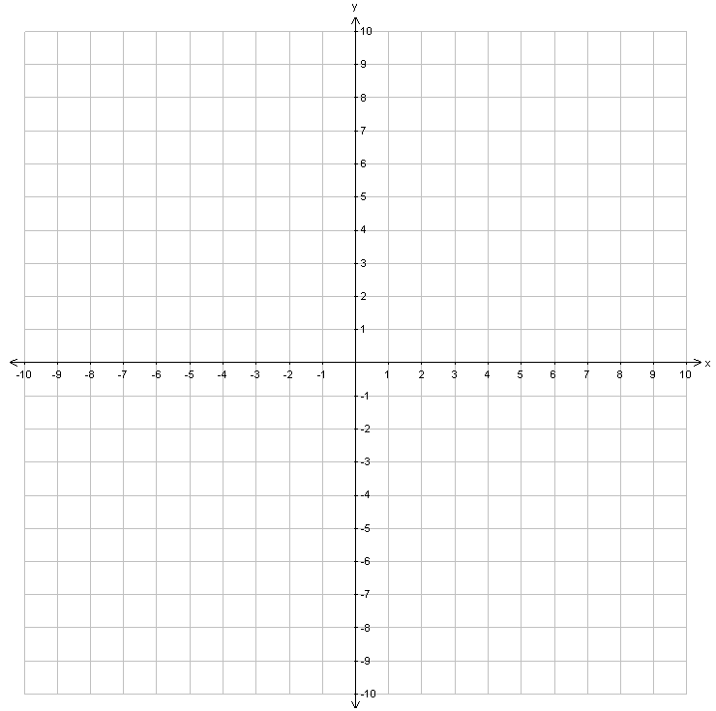
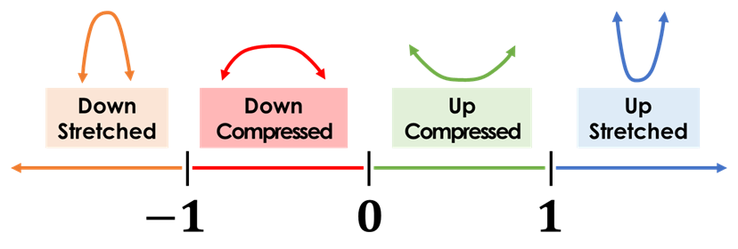
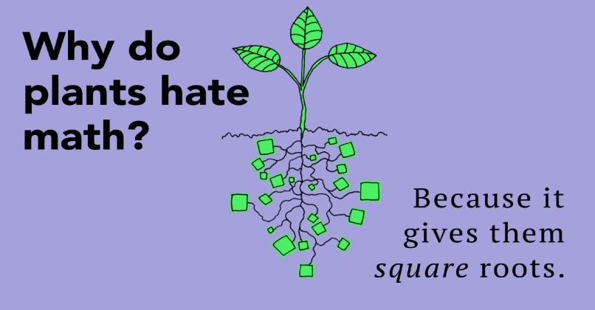
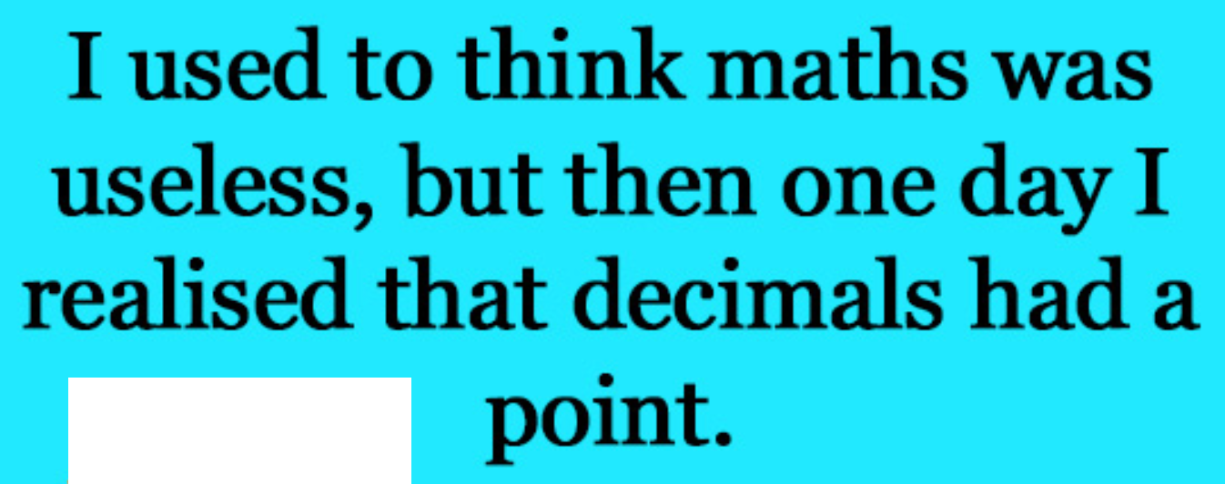

Concept Development
A quadratic function graphs as a parabola₁.
A quadratic function contains a variable to the second power.
To graph a parabola, at least 5 points must be evaluated.
Examples:
$$y=ax^{2}$$
The coefficient of x² determines the direction of the parabola.
Examples:
If ___________, then the parabola opens upward.
If ___________, then the parabola opens downward.
CFU
14
13
12
11
10
9
8
7
6
5
4
3
2
1
-1
-2
y-axis
7
6
5
4
3
2
1
-1
-2
-3
-4
-5
-6
-7
-8
-9
y-axis
On your whiteboard, draw a parabola.
Which phrase best describes the direction of the parabola for the quadratic function
y = -4x²? How do you know?
A opens upward
B opens downward
In your own words, what is a quadratic function?
“A quadratic function is ____________.”
x | y
-2 | 8
-1 | 1
0 | 0
1 | 1
2 | 8
x | y
-2 | -8
-1 | -1
0 | 0
1 | -1
2 | -8
-8 -7 -6 -5 -4 -3 -2 -1 1 2 3 4 5 6 7 8
x-axis
-8 -7 -6 -5 -4 -3 -2 -1 1 2 3 4 5 6 7 8
x-axis
¹ basic “U” shape graph
Vocabulary
Value of “a” Number Line
2

Slide 3
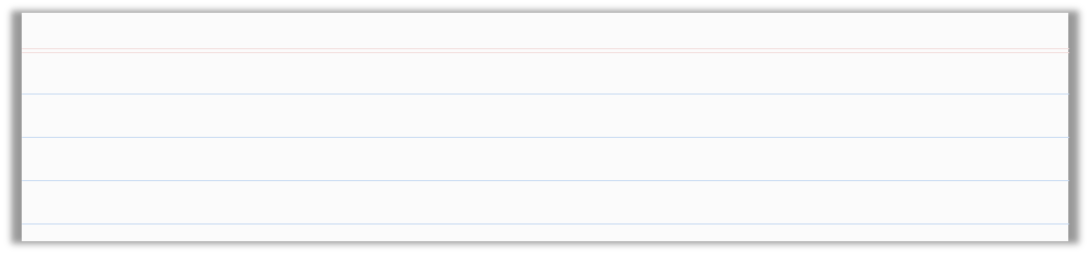

Skill Development/Guided Practice
What n tells about the graph:
A quadratic function graphs as a parabola.
A quadratic function contains a variable to the second power.
If n is positive, then the parabola opens upward.
Graph functions of the form y = nx².
If n is negative, then the parabola opens downward.
How did I/you use the coefficient to describe how the parabola opens?
How did I/you evaluate the function using x-values?
How did I/you create ordered pairs and plot them on the coordinate grid?
$$y=ax^{2}$$
CFU
1
Identify and label the coefficient, a, of the quadratic function.
Using a, describe whether the parabola opens upward or downward.
Complete the table with x- and y-values by evaluating each function for the x-values in the table.
Use the table to create ordered pairs and plot them on the coordinate grid. Sketch the parabola.
2
2
3
3
4
4
x | y
-2
-1
0
1
2
14
13
12
11
10
9
8
7
6
5
4
3
2
1
-1
-2
y-axis
x | y
-2
-1
0
1
2
Opens: __________
Opens: __________
-8 -7 -6 -5 -4 -3 -2 -1 1 2 3 4 5 6 7 8
x-axis
10
9
8
7
6
5
4
3
2
1
-1
-2
-3
-4
-5
-6
y-axis
-8 -7 -6 -5 -4 -3 -2 -1 1 2 3 4 5 6 7 8
x-axis
x | y
-2
-1
0
1
2
7
6
5
4
3
2
1
-1
-2
-3
-4
-5
-6
-7
-8
-9
y-axis
x | y
-2
-1
0
1
2
Opens: __________
Opens: __________
-8 -7 -6 -5 -4 -3 -2 -1 1 2 3 4 5 6 7 8
x-axis
2
1
-1
-2
-3
-4
-5
-6
-7
-8
-9
-10
-11
-12
-13
-14
y-axis
-8 -7 -6 -5 -4 -3 -2 -1 1 2 3 4 5 6 7 8
x-axis
3

Slide 4
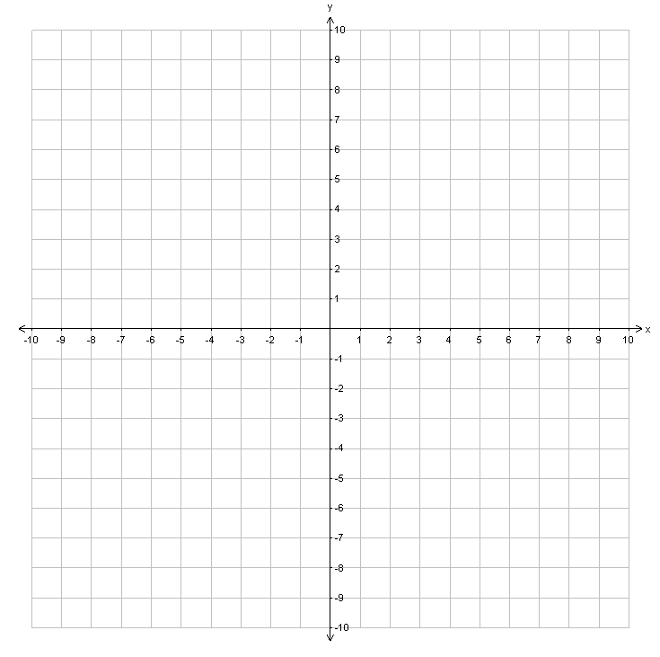


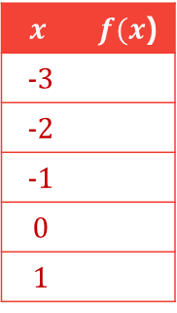
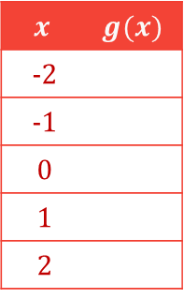

Skill Development & Guided Practice
Evaluate and graph functions.
Checking for Understanding
1 Read the function.
2 Substitute input values into the function.
3 Use order of operations to evaluate and obtain the outputs. (write in table)
4 Use the table to create ordered pairs (input, output) and graph these points.
5 Connect the points.
2 How did I/you substitute the input value into the function?
$f$($x$)=($x$+1)² – 3
$$x$$ | $f(x$)
-3
-2
-1
0
1
f(x)
x =-3
x =-2
8
7
6
5
4
3
2
1
x
x =-1
x =0
f =1
-8
-7
-6
-5
-4
-3
-2
-1
1
2
3
4
5
6
7
8
-1
-2
-3
-4
-5
-6
-7
-8
Extended Thinking Describe the shape of the graph._______________________
$g$($x$)=$x$³+2
$g$(x)
$$x$$ | $$g(x)$$
-2
-1
0
1
2
x =-2
x =-1
x =0
x =1
x =2
Extended Thinking Describe the shape of the graph._______________________
4

Slide 5
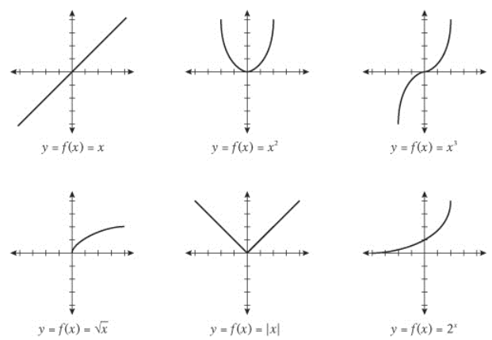







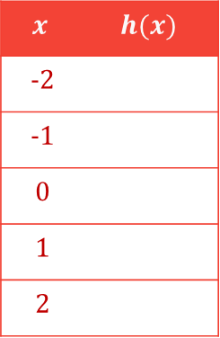




Skill Development & Guided Practice (continued)
Evaluate and graph functions.
1 Read the function.
2 Substitute input values into the function.
3 Use order of operations to evaluate and obtain the outputs. (write in table)
4 Use the table to create ordered pairs (input, output) and graph these points.
5 Connect the points.
Notice that no matter what the input is, the output stays the _______________.
h(x)
$h$($x$)=-5
8
7
$x$=-2
$h$(-2)= ___
$$x$$ | $$h(x)$$
-2
-1
0
1
2
6
5
-5
4
$x$=-1
$h$(-1)= ___
3
2
-5
1
x
-8
-7
-6
-5
-4
-3
-2
-1
1
2
3
4
5
6
7
8
$x$=0
$h$(0)= ___
-1
-5
-2
-3
$x$=1
$h$(1)= ___
-4
-5
-5
-6
-5
-7
$x$=2
$h$(2)= ___
-8
This is called a______________.
5

Slide 6

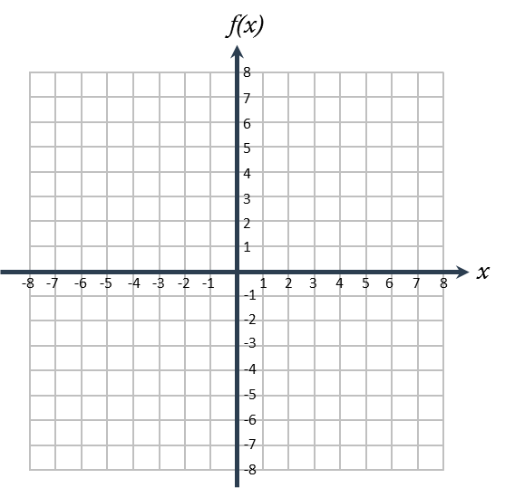



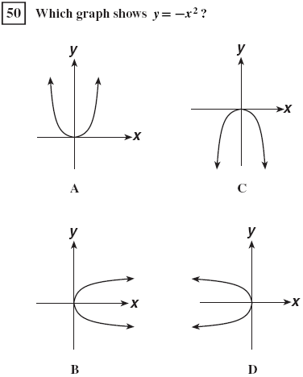
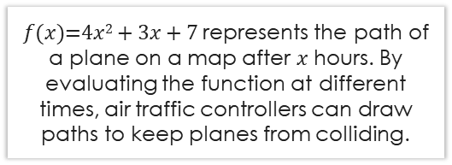
Relevance
1
Evaluating and graphing functions will help air traffic controllers draw flight paths.
$f(x)$=4$x$² + 3$x$ + 7 represents the path of a plane on a map after $x$ hours. By evaluating the function at different times, air traffic controllers can draw paths to keep planes from colliding.
2
Evaluating and graphing functions will help you do well on tests.
Sample Test Question
16. Evaluate f(x)=3x-5 at two values and graph the points using the graphing tool .
A quadratic function graphs as a parabola.
A quadratic function contains a variable to the second power.
1
Graphing functions of the form y = nx² will help you recognize design features in art and architecture.
2
Graphing functions of the form
y = ax² will help you do well on tests.
The Gateway Arch in St. Louis, Missouri
Checking for Understanding
Which reason is most relevant to you?
6

Slide 7







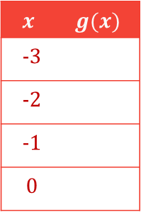








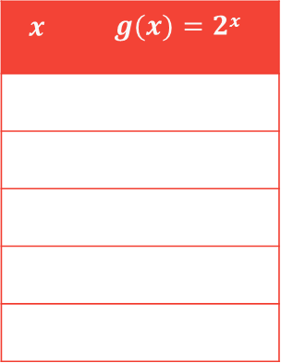



Relevance
3
Evaluating functions will help you do well in this math class.
In later lessons, we will plot different function types.
Evaluate the function and identify the type.
$g$($x$)=2$x$
$x$=-2
$g$(-2)= _____
$g$(-2)= _____
$g$(-2)= _____
$$x$$ | $$g(x)=2x$$
$x$=-1
$g$(-1)= _____
$g$(-1)= _____
$g$(-1)= _____
-2
$x$=0
$g$(0)= _____
$g$(0)= _____
-1
$x$=1
$g$(1)= _____
$g$(1)= _____
0
$g$(2)= _____
1
$x$=2
$g$(2)= _____
2
Closure
Function Type:
Skill Closure Graph $g\left(x\right)=5x+7$ using 4 inputs.
$$x$$ | $$g(x)$$
-3
-2
-1
0
$x$ = -3
$x$ = -2
$x$ = -1
$x$= 0
g(x)
8
Remember the Concept
7
A function is a rule that assigns an input to exactly one output.
An input replaces the 𝑥’s and the expression gives the corresponding output.
Evaluating a function means substituting a number for the input to figure out the output.
6
5
4
3
2
1
x
-8
-7
-6
-5
-4
-3
-2
-1
1
2
3
4
5
6
7
8
-1
-2
-3
-4
(input, output)
-5
-6
x
f(x)
-7
-8
7

Slide 8



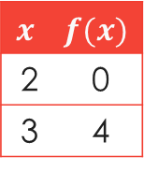
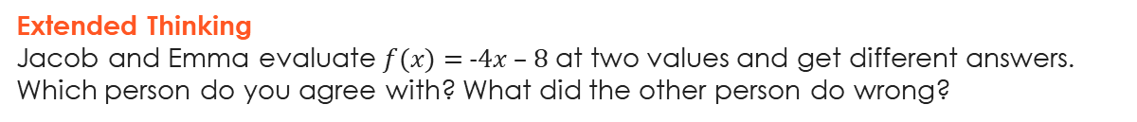
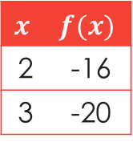
Closure
A quadratic function graphs as a parabola.
A quadratic function contains a variable to the second power.
What n tells about the graph:
If n is positive, then the parabola opens upward.
Skill Closure
If n is negative, then the parabola opens downward.
Graph functions of the form y = nx².
1
Identify and label the coefficient, n, of the quadratic function.
Using n, describe whether the parabola opens upward or downward.
Complete the table with x- and y-values by evaluating each function for the x-values in the table.
Use the table to create ordered pairs and plot them on the coordinate grid. Sketch the parabola.
2
3
4
Opens: __________
Evaluate for x = -2
Evaluate for x = -1
Evaluate for x = 0
Evaluate for x = 1
Evaluate for x = 2
Word Bank
x | y
-2
-1
0
1
2
16
15
14
13
12
11
10
9
8
7
6
5
4
3
2
1
-1
-2
y-axis
-8 -7 -6 -5 -4 -3 -2 -1 1 2 3 4 5 6 7 8
x-axis
Extended Thinking
Jacob and Emma evaluate $f(x)=$-4$x$ – 8 at two values and get different answers. Which person do you agree with? What did the other person do wrong?
Jacob
Emma
$$x$$ | $$f(x)$$
2 | 0
3 | 4
$$x$$ | $$f(x)$$
2 | -16
3 | -20
Remember the Concept
A function is a rule that assigns an input to exactly one output.
An input replaces the 𝑥’s and the expression gives the corresponding output.
Evaluating a function means substituting a number for the input to figure out the output.
Summary Closure What did you learn today about evaluating and graphing different types of functions?
(input, output)
x
f(x)
Word Bank
input output table
graph ordered pair function
8

