Slide 1




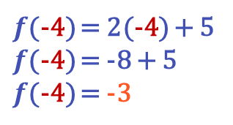


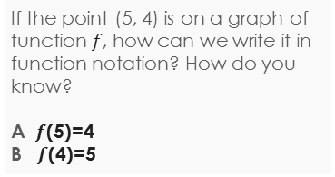
Learning Objective
We will evaluate₁ and graph different types of functions.
Declare the Objective
Read the learning objective to your partner.
Activate Prior Knowledge
Evaluate the functions.
Remember the Concept
A function is a rule that assigns an input to exactly one output.
An input replaces the 𝑥’s and the expression gives the corresponding output.
Evaluating a function means substituting a number for the input to figure out the output.
1. $f\left(x\right)=2x+5$ at $x$ = -4
$f$(-4) = 2(-4) + 5
$f$(-4) = -8 + 5
$f$(-4) = -3
For the input -4, we obtained the output -3.
(input, output)
x
f(x)
2. $g\left(x\right)=3x+6$ at $x$ = 7
$g$(7) = 3(7) + 6
$g$(7) = 21 + 6
$g$(7) = 27
Make the Connection
Students, you already know how to evaluate functions using substitution. Now, we will evaluate functions to create graphs.
For the input 7, we obtained the output 27.
Definitions
¹ find the value of

Slide 2
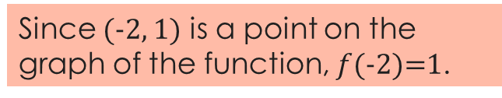
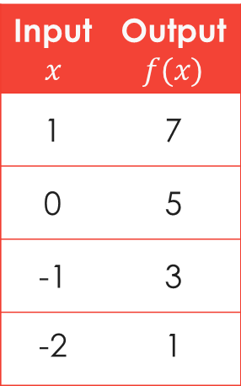


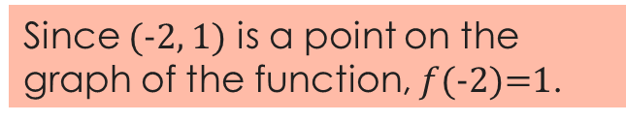
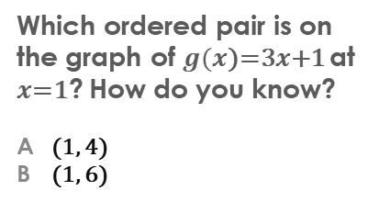

Concept Development
Functions can be represented as graphs by plotting the input-output pairs.
Evaluate the function using an input to figure out the output.
Checking for Understanding
Which ordered pair is on the graph of $g(x$)=3$x$+1 at $x$=1? How do you know?
A (1, 4)
B (1, 6)
Use functions to make graphs.
f(x)
Input$x$ | Output$f(x)$
1 | 7
0 | 5
-1 | 3
-2 | 1
8
(1, 7)
7
(0, 5)
6
(input, output)
$f$(1)=7
5
(-1, 3)
4
x
f(x)
3
A
2
$f$(0)=5
1
x
-8
-7
-6
-5
-4
-3
-2
-1
1
2
3
4
5
6
7
8
Remember the Concept
-1
A function is a rule that assigns an input to exactly one output.
An input replaces the 𝑥’s and the expression gives the corresponding output.
Evaluating a function means substituting a number for the input to figure out the output.
$f$(-1)=3
-2
-3
-4
-5
$f$(-2 )= 1
f
-6
-7
-8
Since (-2, 1) is a point on the graph of the function, $f$(-2)=1.

Slide 3
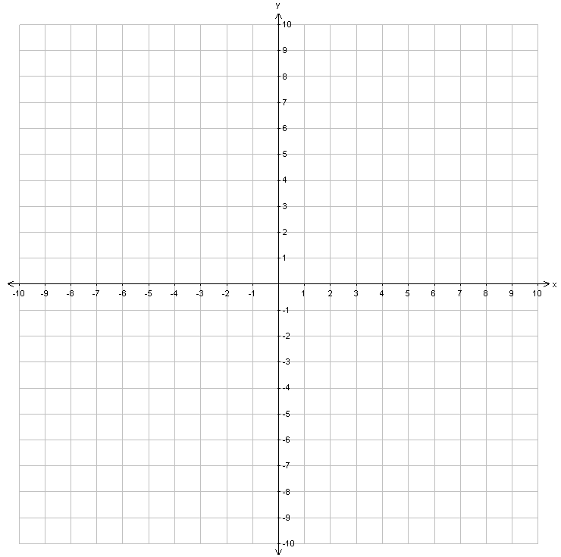
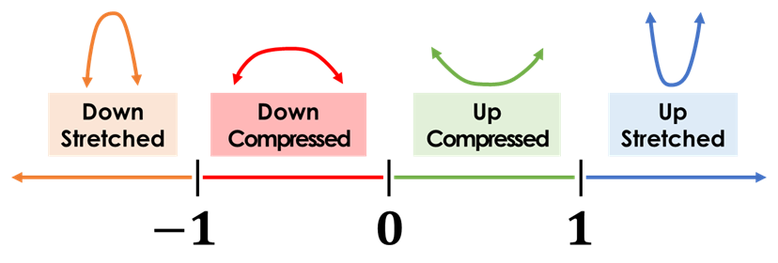

Concept Development
A quadratic function graphs as a parabola₁.
A quadratic function contains a variable to the second power.
To graph a parabola, at least 5 points must be evaluated.
Examples:
$$y=ax^{2}$$
The coefficient of x² determines the direction of the parabola.
CFU
Examples:
On your whiteboard, draw a parabola.
Which phrase best describes the direction of the parabola for the quadratic function
y = -4x²? How do you know?
A opens upward
B opens downward
In your own words, what is a quadratic function?
“A quadratic function is ____________.”
If a is positive, then the parabola opens upward.
If a is negative, then the parabola opens downward.
14
13
12
11
10
9
8
7
6
5
4
3
2
1
-1
-2
y-axis
7
6
5
4
3
2
1
-1
-2
-3
-4
-5
-6
-7
-8
-9
y-axis
x | y
-2 | 8
-1 | 1
0 | 0
1 | 1
2 | 8
x | y
-2 | -8
-1 | -1
0 | 0
1 | -1
2 | -8
-8 -7 -6 -5 -4 -3 -2 -1 1 2 3 4 5 6 7 8
x-axis
-8 -7 -6 -5 -4 -3 -2 -1 1 2 3 4 5 6 7 8
x-axis
¹ basic “U” shape graph
Vocabulary
Value of “a” Number Line

Slide 4
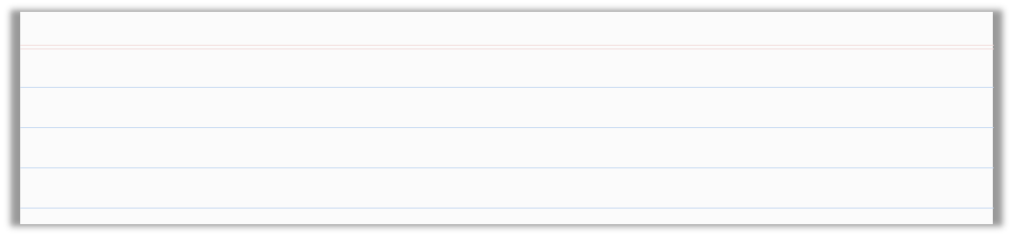


Skill Development/Guided Practice
What n tells about the graph:
A quadratic function graphs as a parabola.
A quadratic function contains a variable to the second power.
If n is positive, then the parabola opens upward.
If n is negative, then the parabola opens downward.
Graph functions of the form y = nx².
How did I/you use the coefficient to describe how the parabola opens?
How did I/you evaluate the function using x-values?
How did I/you create ordered pairs and plot them on the coordinate grid?
$$y=ax^{2}$$
CFU
1
Identify and label the coefficient, a, of the quadratic function.
Using a, describe whether the parabola opens upward or downward.
Complete the table with x- and y-values by evaluating each function for the x-values in the table.
Use the table to create ordered pairs and plot them on the coordinate grid. Sketch the parabola.
2
2
3
3
4
4
$$a$$
x | y
-2
-1
0
1
2
14
13
12
11
10
9
8
7
6
5
4
3
2
1
-1
-2
y-axis
$$a$$
x | y
-2
-1
0
1
2
Opens: __________
Opens: __________
upward
upward
Evaluate for x = -2
Evaluate for x = -1
Evaluate for x = -2
Evaluate for x = -1
-8 -7 -6 -5 -4 -3 -2 -1 1 2 3 4 5 6 7 8
x-axis
10
9
8
7
6
5
4
3
2
1
-1
-2
-3
-4
-5
-6
y-axis
Evaluate for x = 0
Evaluate for x = 1
Evaluate for x = 2
Evaluate for x = 0
Evaluate for x = 1
Evaluate for x = 2
-8 -7 -6 -5 -4 -3 -2 -1 1 2 3 4 5 6 7 8
x-axis

Slide 5
Skill Development/Guided Practice (continued)
What n tells about the graph:
A quadratic function graphs as a parabola.
A quadratic function contains a variable to the second power.
If n is positive, then the parabola opens upward.
If n is negative, then the parabola opens downward.
Graph functions of the form y = nx².
How did I/you use the coefficient to describe how the parabola opens?
How did I/you evaluate the function using x-values?
How did I/you create ordered pairs and plot them on the coordinate grid?
CFU
1
Identify and label the coefficient, n, of the quadratic function.
Using n, describe whether the parabola opens upward or downward.
Complete the table with x- and y-values by evaluating each function for the x-values in the table.
Use the table to create ordered pairs and plot them on the coordinate grid. Sketch the parabola.
2
2
3
3
4
4
x | y
-2
-1
0
1
2
7
6
5
4
3
2
1
-1
-2
-3
-4
-5
-6
-7
-8
-9
y-axis
x | y
-2
-1
0
1
2
Opens: __________
downward
Opens: __________
downward
Evaluate for x = -2
Evaluate for x = -1
-8 -7 -6 -5 -4 -3 -2 -1 1 2 3 4 5 6 7 8
x-axis
Evaluate for x = -2
Evaluate for x = -1
2
1
-1
-2
-3
-4
-5
-6
-7
-8
-9
-10
-11
-12
-13
-14
y-axis
-8 -7 -6 -5 -4 -3 -2 -1 1 2 3 4 5 6 7 8
x-axis
Evaluate for x = 0
Evaluate for x = 1
Evaluate for x = 2
Evaluate for x = 0
Evaluate for x = 1
Evaluate for x = 2

Slide 6

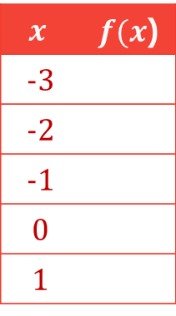
Skill Development & Guided Practice
Evaluate and graph functions.
Checking for Understanding
1 Read the function.
2 Substitute input values into the function.
3 Use order of operations to evaluate and obtain the outputs. (write in table)
4 Use the table to create ordered pairs (input, output) and graph these points.
5 Connect the points.
2 How did I/you substitute the input value into the function?
$f$($x$)=($x$+1)² – 3
$$x$$ | $f(x$)
-3
-2
-1
0
1
1
x =-3
f (-3)=(-3+1)² – 3
f (-3)=(-2)² – 3
f (-3)= 4 – 3
f (-3)= 1
x =-2
f (-2)=(-2+1)² – 3
f (-2)=(-1)² – 3
f (-2)=1 – 3
f (-2)= -2
f(x)
-2
8
-3
7
6
f
-2
5
4
1
3
(-3, 1)
2
(1, 1)
1
x
-8
-7
-6
-5
-4
-3
-2
-1
1
2
3
4
5
6
7
8
x =-1
f (-1)=(-1+1)² – 3
f (-1)=(0)² – 3
f (-1)=0 – 3
f (-1)= -3
x =0
f (0)=(0+1)² – 3
f (0)=(1)² – 3
f (0)=1 – 3
f (0)= -2
f =1
f (1)=(1+1)² – 3
f (1)=(2)² – 3
f (1)=4 – 3
f (1)= 1
(-2, -2)
-1
(0, -2)
-2
-3
(-1, -3)
-4
-5
-6
-7
-8
Extended Thinking Describe the shape of the graph.

Slide 7
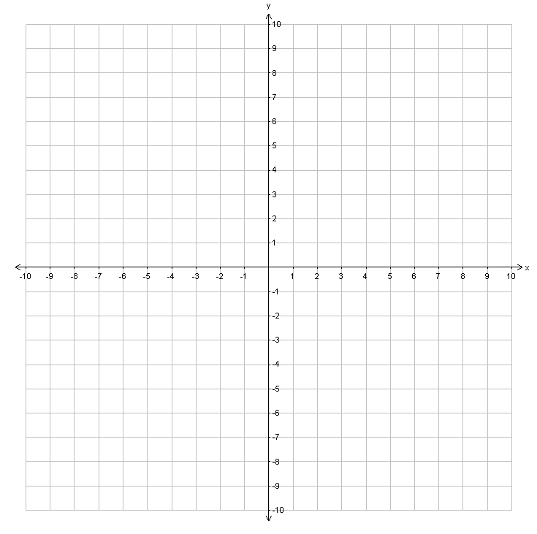



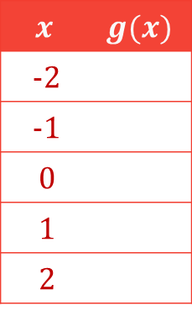
Skill Development & Guided Practice (continued)
Evaluate and graph functions.
Checking for Understanding
1 Read the function.
2 Substitute input values into the function.
3 Use order of operations to evaluate and obtain the outputs. (write in table)
4 Use the table to create ordered pairs (input, output) and graph these points.
5 Connect the points.
2 How did I/you substitute the input value into the function?
$g$(x)
$g$($x$)=$x$³+2
(2, 10)
$$x$$ | $$g(x)$$
-2
-1
0
1
2
x =-2
g (-2)=(-2)³+2
g (-2)=-8+2
g (-2)= -6
x =-1
g (-1)=(-1)³+2
g (-1)=-1+2
g (-1)= 1
-6
1
2
(1, 3)
(0, 2)
3
x =0
g (0)=(0)³+2
g (0)=0+2
g (0)= 2
x =1
g (1)=(1)³+2
g (1)=1+2
g (1)= 3
(-1, 1)
10
x =2
g (2)=(2)³+2
g (2)=8+2
g (2)= 10
(-2, -6)
$$g$$

Slide 8







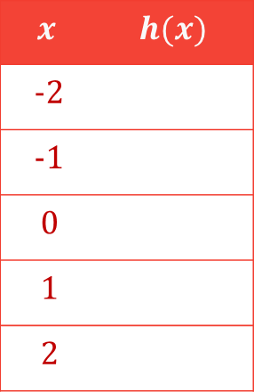




Skill Development & Guided Practice (continued)
Evaluate and graph functions.
1 Read the function.
2 Substitute input values into the function.
3 Use order of operations to evaluate and obtain the outputs. (write in table)
4 Use the table to create ordered pairs (input, output) and graph these points.
5 Connect the points.
h(x)
Notice that no matter what the input is, the output stays the same.
$h$($x$)=-5
8
7
$x$=-2
$h$(-2)=-5
$$x$$ | $$h(x)$$
-2
-1
0
1
2
6
5
4
-5
3
$x$=-1
$h$(-1)=-5
2
-5
1
x
-8
-7
-6
-5
-4
-3
-2
-1
1
2
3
4
5
6
7
8
$x$=0
$h$(0)=-5
-1
-5
-2
-3
(-1, -5)
(1, -5)
h
-4
$x$=1
$h$(1)=-5
-5
-5
(-2, -5)
-6
(2, -5)
(0, -5)
-5
-7
$x$=2
$h$(2)=-5
-8
This is called a constant function.

Slide 9
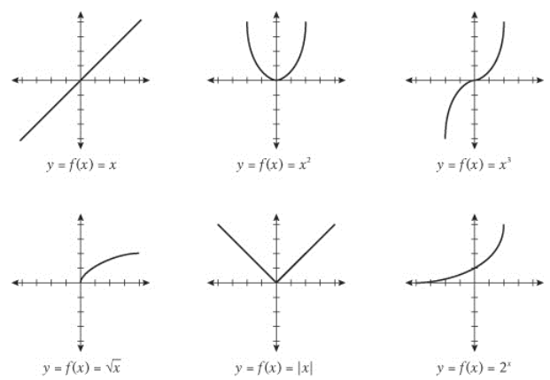

Slide 10
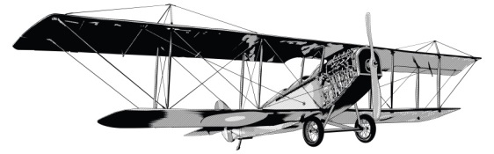
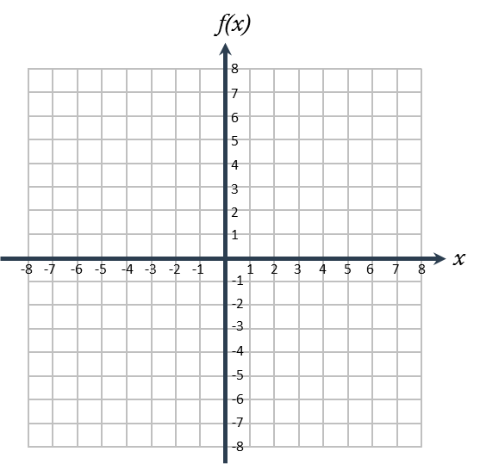


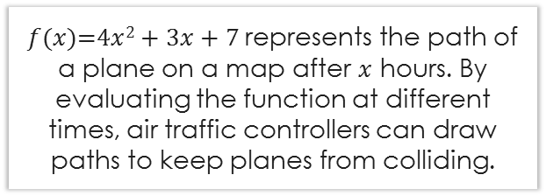
Relevance
1
Evaluating and graphing functions will help air traffic controllers draw flight paths.
$f(x)$=4$x$² + 3$x$ + 7 represents the path of a plane on a map after $x$ hours. By evaluating the function at different times, air traffic controllers can draw paths to keep planes from colliding.
2
Evaluating and graphing functions will help you do well on tests.
Sample Test Question
16. Evaluate f(x)=3x-5 at two values and graph the points using the graphing tool .
Checking for Understanding
Which reason is most relevant to you?

Slide 11

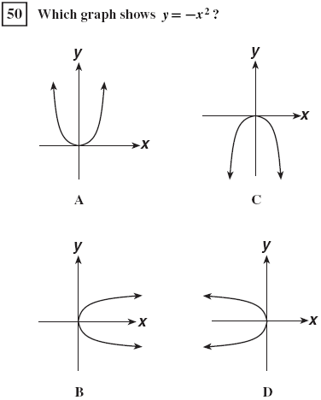
Relevance
Does anyone else have another reason why it is relevant to graph functions of the form y = nx²? (Pair-Share) Why is it relevant to graph functions of the form y = nx²? You may give one of my reasons or one of your own. Which reason is more relevant to you? Why?
CFU
A quadratic function graphs as a parabola.
A quadratic function contains a variable to the second power.
1
Graphing functions of the form y = nx² will help you recognize design features in art and architecture.
2
Graphing functions of the form
y = ax² will help you do well on tests.
The Gateway Arch in St. Louis, Missouri

Slide 12















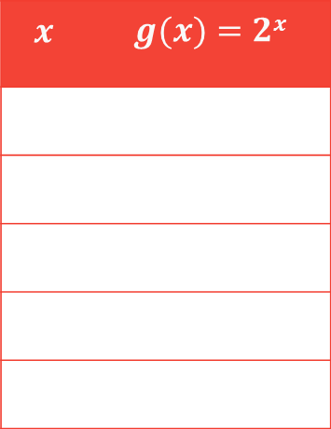



Relevance
3
Evaluating functions will help you do well in this math class.
In later lessons, we will plot different function types.
Evaluate the function and identify the type.
$g$($x$)=2$x$
$x$=-2
$g$(-2)=2⁻²
$g$(-2)=1
$g$(-2)= 1
$$x$$ | $$g(x)=2x$$
2²
4
$g$(-1)= 1
-2
1/4
$x$=-1
$g$(-1)=2⁻¹
$g$(-1)= 1
2¹
2
-1
1/2
$x$=0
$g$(0)=2⁰
$g$(0)= 1
0
1
$x$=1
$g$(1)=2¹
$g$(1)= 2
1
2
$x$=2
$g$(2)=2²
$g$(2)= 4
2
4
Function Type:
exponential

Slide 13
















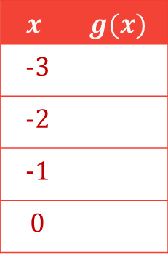
Closure
Skill Closure Graph $g\left(x\right)=5x+7$ using 4 inputs.
$$x$$ | $$g(x)$$
-3
-2
-1
0
$x$ = -3
$x$ = -2
$x$ = -1
$x$= 0
-8
$g$(-3)=5(-3)+7
$g$(-2)=5(-2)+7
$g$(-1)=5(-1)+7
$g$(0)=5(0)+7
$g$(-3)=-15+7
$g$(-2)=-10+7
$g$(-1)=-5+7
$g$(0)=0+7
-3
$g$(-3) = -8
$g$(-2) = -3
$g$(-1) = 2
$g$(0) = 7
2
7
g(x)
8
Remember the Concept
(0, 7)
7
6
A function is a rule that assigns an input to exactly one output.
An input replaces the 𝑥’s and the expression gives the corresponding output.
Evaluating a function means substituting a number for the input to figure out the output.
5
4
(-1, 2)
3
2
1
x
-8
-7
-6
-5
-4
-3
-2
-1
1
2
3
4
5
6
7
8
-1
(-2, -3)
-2
-3
-4
(input, output)
g
-5
-6
x
f(x)
(-3, -8)
-7
-8

Slide 14

Closure
A quadratic function graphs as a parabola.
A quadratic function contains a variable to the second power.
What n tells about the graph:
Word Bank
If n is positive, then the parabola opens upward.
If n is negative, then the parabola opens downward.
Skill Closure
Graph functions of the form y = nx².
1
Identify and label the coefficient, n, of the quadratic function.
Using n, describe whether the parabola opens upward or downward.
Complete the table with x- and y-values by evaluating each function for the x-values in the table.
Use the table to create ordered pairs and plot them on the coordinate grid. Sketch the parabola.
2
3
4
Opens: __________
Evaluate for x = -2
Evaluate for x = -1
Evaluate for x = 0
upward
Evaluate for x = 1
Evaluate for x = 2
x | y
-2
-1
0
1
2
16
15
14
13
12
11
10
9
8
7
6
5
4
3
2
1
-1
-2
y-axis
-8 -7 -6 -5 -4 -3 -2 -1 1 2 3 4 5 6 7 8
x-axis

Slide 15


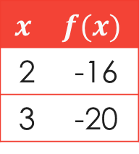
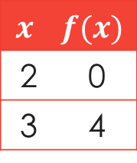
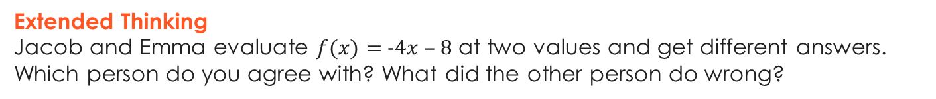
Closure
Extended Thinking
Jacob and Emma evaluate $f(x)=$-4$x$ – 8 at two values and get different answers. Which person do you agree with? What did the other person do wrong?
Jacob
Emma
$$x$$ | $$f(x)$$
2 | 0
3 | 4
$$x$$ | $$f(x)$$
2 | -16
3 | -20
I agree with Emma. Jacob multiplied by positive 4 instead of negative 4.
Remember the Concept
A function is a rule that assigns an input to exactly one output.
An input replaces the 𝑥’s and the expression gives the corresponding output.
Evaluating a function means substituting a number for the input to figure out the output.
Summary Closure What did you learn today about evaluating and graphing different types of functions?
(input,output)
x
f(x)
Word Bank
input output table
graph ordered pair function

