Slide 1
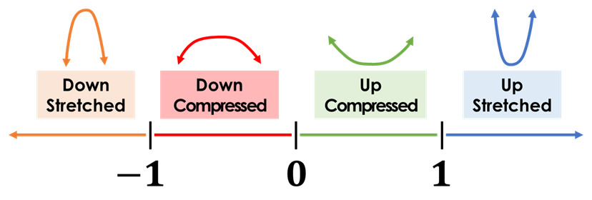
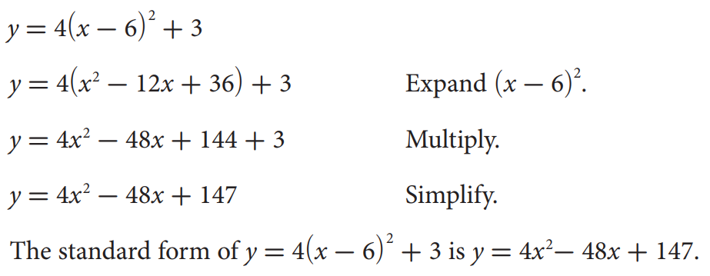
Name: ______________________________
Period:____
Lesson 3: 6.3 Changing from Vertex Form to Standard Form
Activate Prior Knowledge:
direction
y-intercept
if a is positive = up.
If a is negative = down
Vertex
(h, k)
width
Value of “a” Number Line
Warm-Up; You do it now…..
Identify the following from giving Vertex form:
1.)
a =___, h =___, k =___, Opening: ______
b.)
a =___, h =___, k =___, Opening: ______
c.)
a =___, h =___, k =___, Opening:______
Students, you already know how to identify the a, h, & k of the quadratic functions in the Vertex form. Today, we will learn how to change the Vertex form of a quadratic functions into a Standard Form.
Make Connection
Concept Development
If a function is quadratic, it can be represented by an equation of the form y =$_________________$, where _, _, and _ are real numbers and ____. This is called the ______________of a quadratic equation. It is possible to write quadratic equations in various forms.
Example: Rewrite a quadratic function from vertex form to standard form.
1

Slide 2
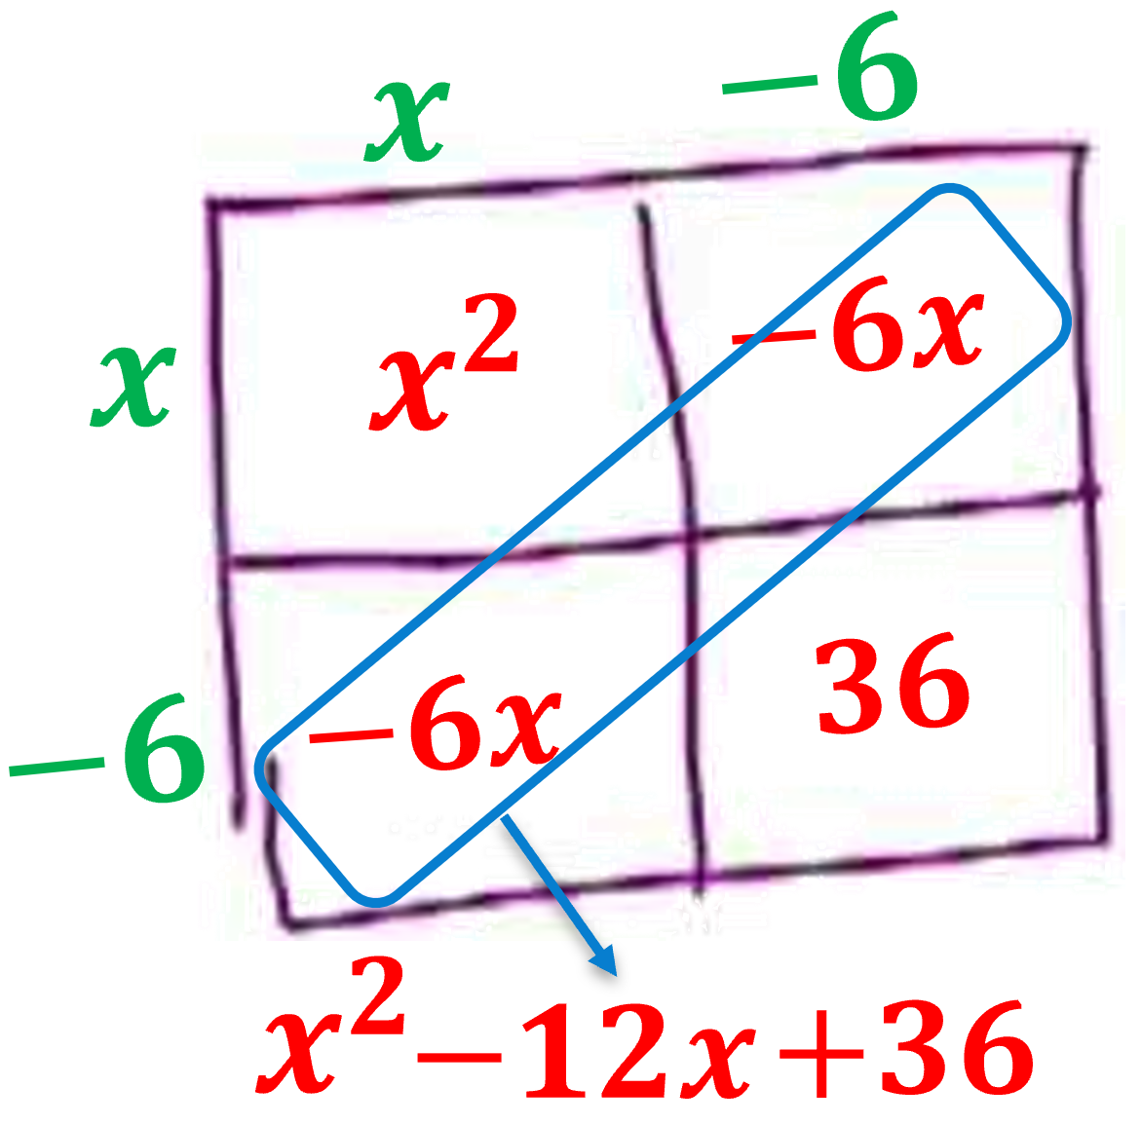
Concept Development
Quadratic function:- A polynomial of the second degree, when graphed forms a u-shape and
function form f(x) = ax² + bx + c where a, b, and c are numbers.
The easy way to multiply squared binomial is to use the “_________“, The box method is also known as the “________”, _______, etc.…
$${y=4(x−6)}^{2}+3$$
*Multiple each edges
*Add the Diagonal
*Rewrite as a Trinomial
Skill Development
Steps to Expand ${(x−h)}^{2}$.
What you write on the Top/Side?
How do you Multiple?
How do you write as a Trinomial?
1
Make a 2x2 Box.
CFU
2
2
Write $\left(x−h\right) on the Top$and $\left(x−h\right) on the Side.$
3
3
Multiple the edges to fill in the box.
4
4
Write as a trinomial by adding the Diagonal terms.
2

Slide 3
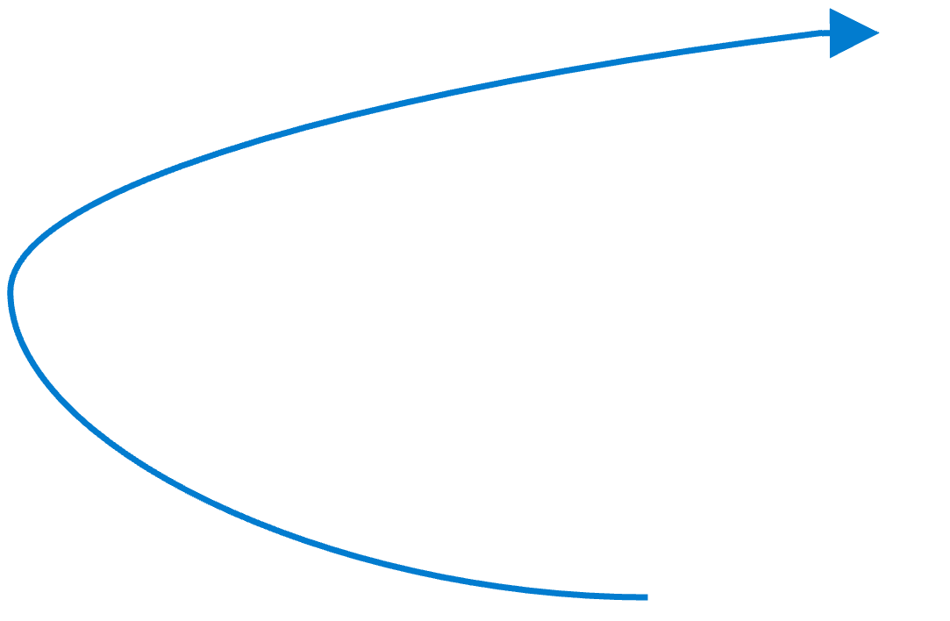
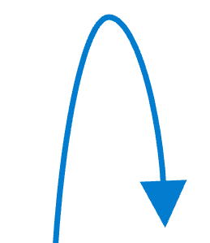
Skill Development/Guided Practice (continued)
Steps to Expand ${(x−h)}^{2}$.
What you write on the Top/Side?
How do you Multiple?
How do you write as a Trinomial?
1
Make a 2x2 Box.
CFU
2
2
Write $\left(x−h\right) on the Top$and $\left(x−h\right) on the Side.$
3
3
Multiple the edges to fill in the box.
4
4
Write as a trinomial by adding the Diagonal terms.
Skill Development
Steps to rewrite as a Standard form.
How I you expand ${(x−h)}^{2}$ ?
How I you distribute the a-term?
How I you write as a Trinomial?
1
Expand ${(x−h)}^{2}$
CFU
1
2
Distribute the $a−term.$
2
3
Add the like terms.
3
3

Slide 4
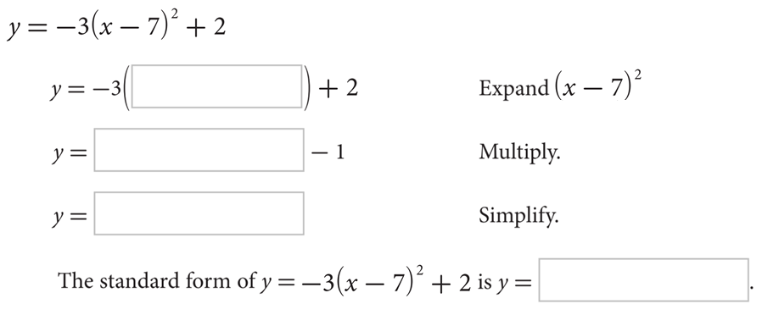
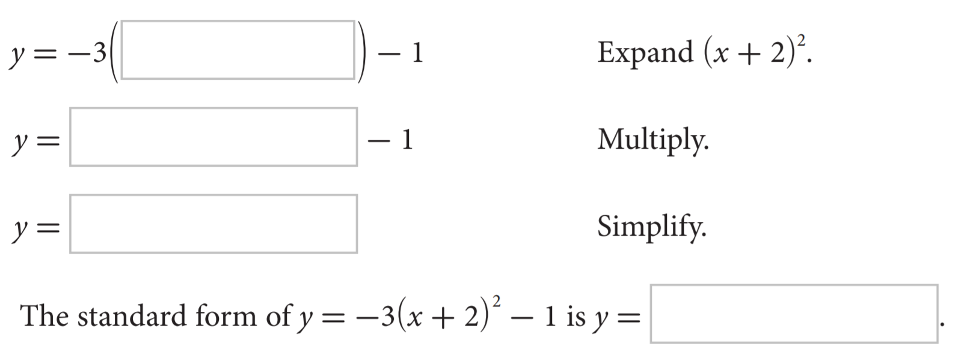
Skill Development/Guided Practice (continued)
Steps to rewrite as a Standard form.
How I you expand ${(x−h)}^{2}$ ?
How I you distribute the a-term?
How I you write as a Trinomial?
1
Expand ${(x−h)}^{2}$
CFU
1
2
Distribute the $a−term.$
2
3
Add the like terms.
3
4

Slide 5
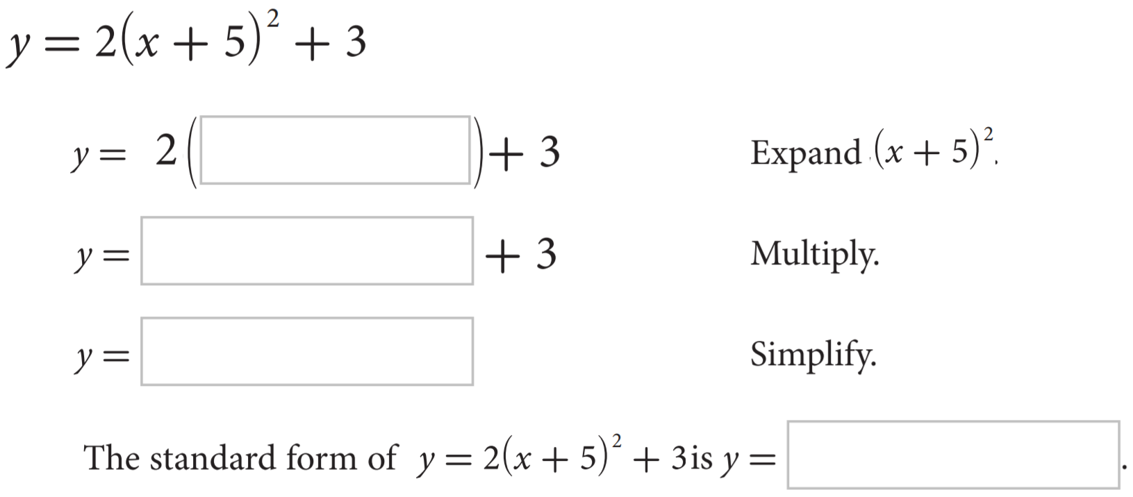
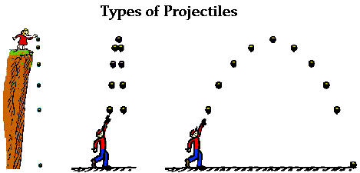
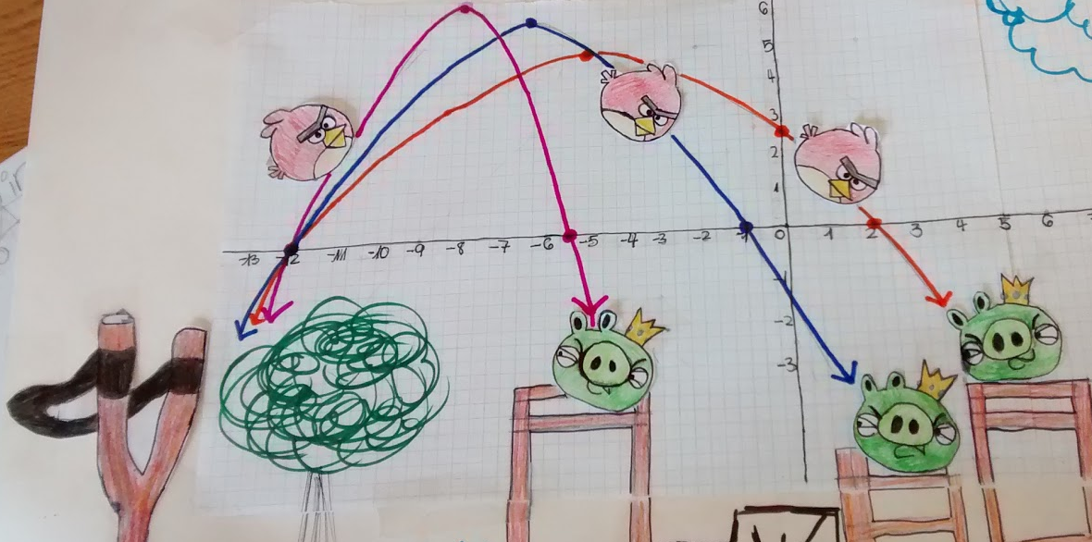
Steps to rewrite as a Standard form.
Skill Development/Guided Practice (continued)
How I you expand ${(x−h)}^{2}$ ?
How I you distribute the a-term?
How I you write as a Trinomial?
1
Expand ${(x−h)}^{2}$
CFU
1
2
Distribute the $a−term.$
2
3
Add the like terms.
3
Relevance
Quadratic functions are more than algebraic curiosities—they are widely used in ______________, ______________, and ______________. The U-shape of a ______________ can describe the trajectories of angry birds in a game, a bouncing ball, or be incorporated into structures like the parabolic reflectors that form the base of satellite dishes and car headlights. Quadratic functions help forecast business ______________ and ______________, plot the course of moving objects, and assist in determining ______________ and ______________ values. Most of the objects we use every day, from cars to clocks, would not exist if someone, somewhere hadn't applied quadratic functions to their design.
5

Slide 6
Essential Question:
How can you change the vertex form of a quadratic function to standard form?
SUMMARY CLOSURE
To change the vertex form to standard form, you ____________________ ______________________________________________
______________________________________________.
Expand:
Homework
6

Slide 7
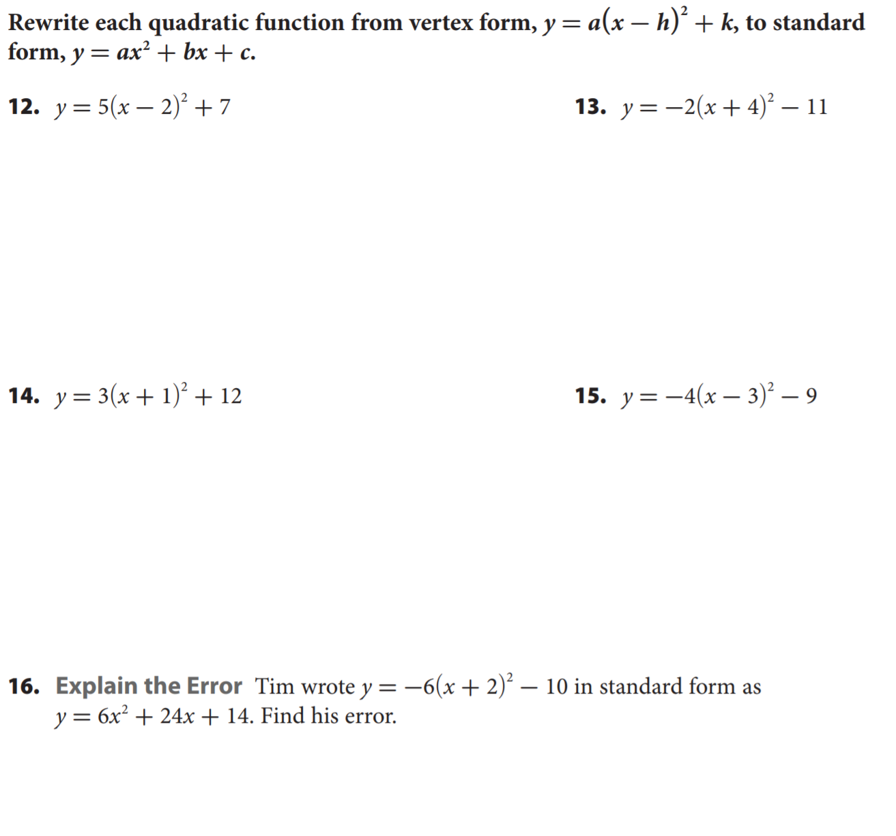
Homework
7

Slide 8
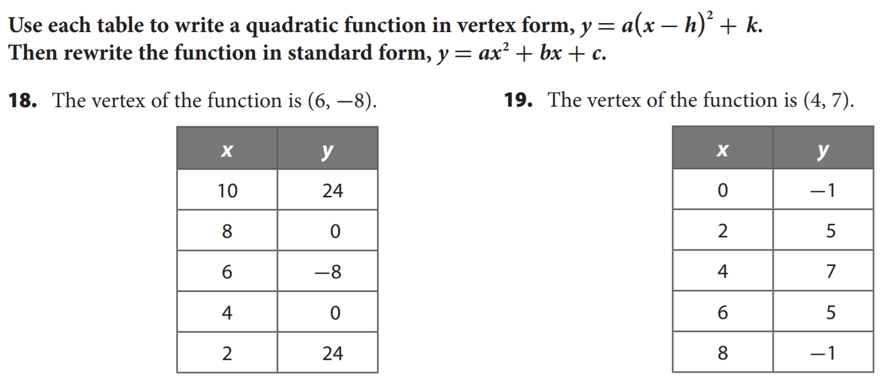
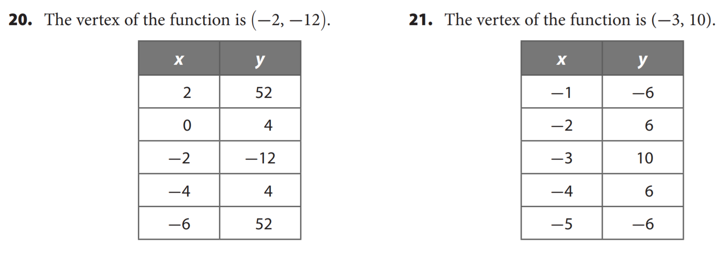
Homework
8

