Slide 1
LO: We will determine how to graph the Quadratic Functions.
ACT RESPONSIBLY & SUPPORT the COMMUNITY.
Be on Time
Wear ID
Chromebook Ready
SEE SOMETHING, SAY SOMETHING

Slide 2
We will learn how to change the vertex form of a ${\text{Quadratic}}_{1}$ Function to standard form.
LEARNING OBJECTIVE
What is our Learning Objective?
What does “Quadratic” mean? Quadratic means _________.
CFU
Definition
¹ involving a variable that is squared($x^{2})$, or raised to a power of two.

Slide 3
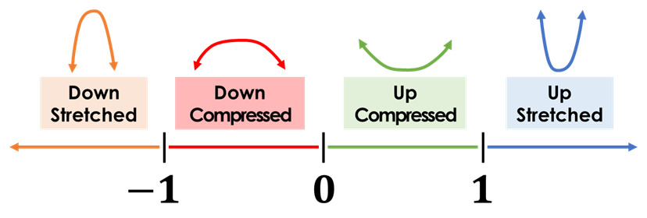
Activate Prior Knowledge:
direction
y-intercept
if a is positive = up.
If a is negative = down
Vertex
(h, k)
width
Value of “a” Number Line
Warm-Up; You do it now…..
Identify the following from giving Vertex form:
1.)
a =___, h =___, k =___, Opening: ______
b.)
a =___, h =___, k =___, Opening: ______
c.)
a =___, h =___, k =___, Opening:______
Students, you already know how to identify the a, h, & k of the quadratic functions in the Vertex form. Today, we will learn how to change the Vertex form of a quadratic functions into a Standard Form.
Make Connection

Slide 4
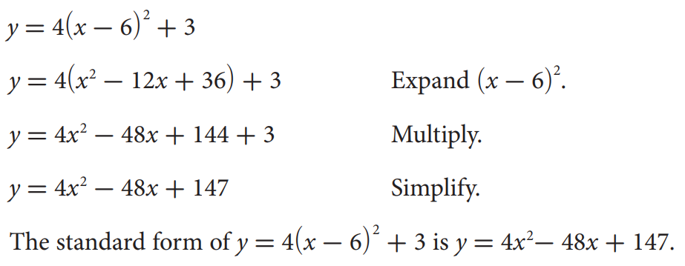
Concept Development
If a function is quadratic, it can be represented by an equation of the form y =${ax}^{2}+bx+c$, where a, b, and c are real numbers and a ≠ 0. This is called the standard form of a quadratic equation. It is possible to write quadratic equations in various forms.
Example: Rewrite a quadratic function from vertex form to standard form.
Subskill: First, we should learn how to “expand” or FOIL!

Slide 5
Quadratic function:- A polynomial of the second degree, when graphed forms a u-shape and
function form f(x) = ax² + bx + c where a, b, and c are numbers.
Concept Development
The easy way to multiply squared binomial is to use the "Box Method“, The box method is also known as the “Area Method”, FOIL, etc.…
$${ (x−6)}^{2}$$
$${y=4(x−6)}^{2}+3$$
$$−6$$
$$(x)$$
$$x$$
($x−6)$
($x−6)$
$${ (x−6)}^{2}$$
$$(x)$$
$$−6x$$
$$x$$
$$x^{2}$$
$$(x−6)(x−6)$$
$$x^{2}$$
($x−6)$
($x−6)$
*Multiple each edges
*Add the Diagonal
$$36$$
$$+36$$
$$−6$$
$$−6x$$
*Rewrite as a Trinomial
$$−12x$$
Pair-Share
How did I “expand” the binomial?

Slide 6
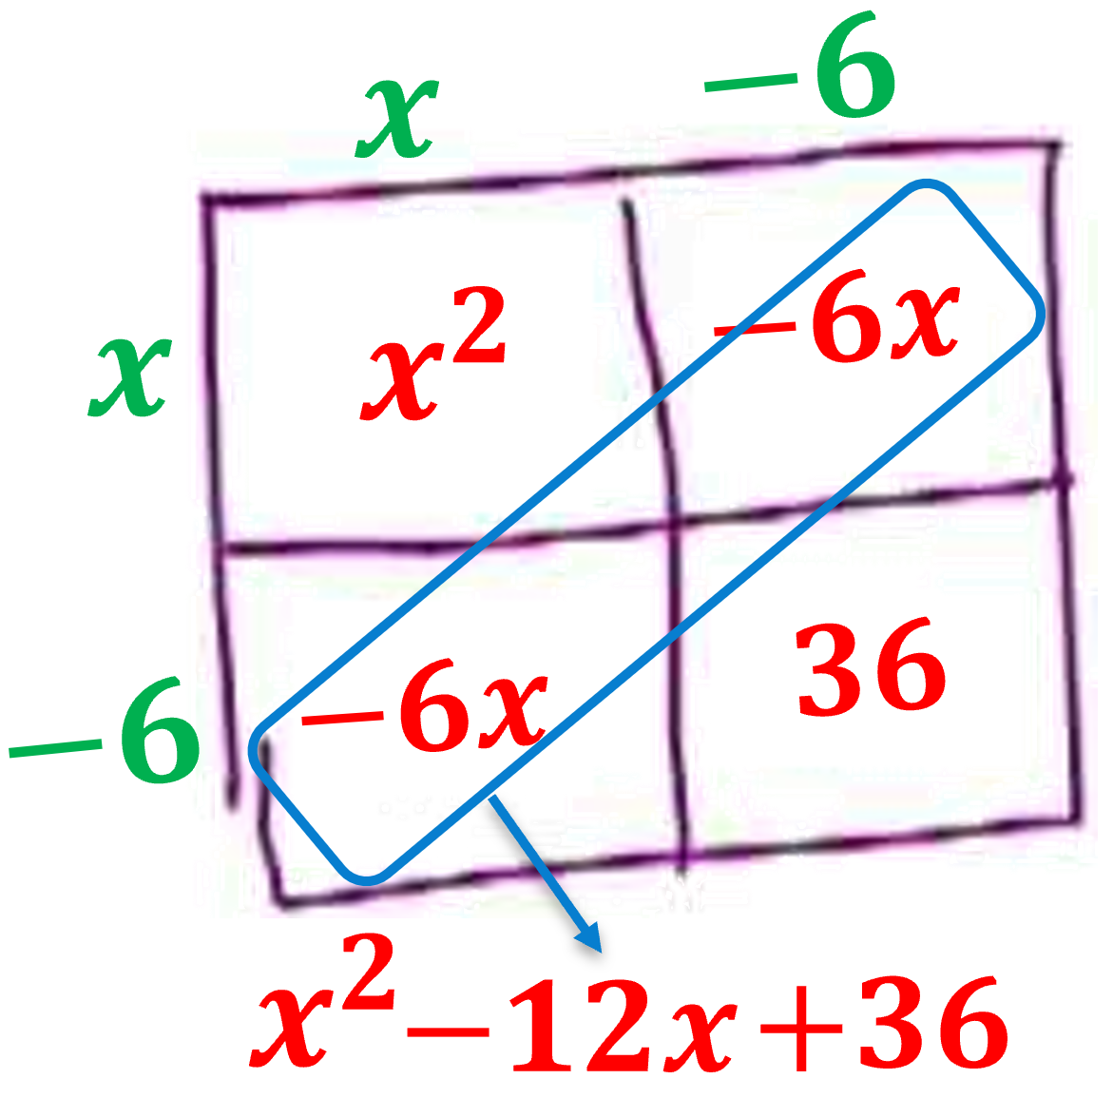
Skill Development
Steps to Expand ${(x−h)}^{2}$.
What you write on the Top/Side?
How do you Multiple?
How do you write as a Trinomial?
1
Make a 2x2 Box.
CFU
2
2
Write $\left(x−h\right) on the Top$and $\left(x−h\right) on the Side.$
3
3
Multiple the edges to fill in the box.
4
4
Write as a trinomial by adding the Diagonal terms.

Slide 7
Skill Development/Guided Practice (continued)
Steps to Expand ${(x−h)}^{2}$.
What you write on the Top/Side?
How do you Multiple?
How do you write as a Trinomial?
1
Make a 2x2 Box.
CFU
2
2
Write $\left(x−h\right) on the Top$and $\left(x−h\right) on the Side.$
3
3
Multiple the edges to fill in the box.
4
4
Write as a trinomial by adding the Diagonal terms.

Slide 8
Skill Development/Guided Practice (continued)
Steps to Expand ${(x−h)}^{2}$.
What you write on the Top/Side?
How do you Multiple?
How do you write as a Trinomial?
1
Make a 2x2 Box.
CFU
2
2
Write $\left(x−h\right) on the Top$and $\left(x−h\right) on the Side.$
3
3
Multiple the edges to fill in the box.
4
4
Write as a trinomial by adding the Diagonal terms.

Slide 9
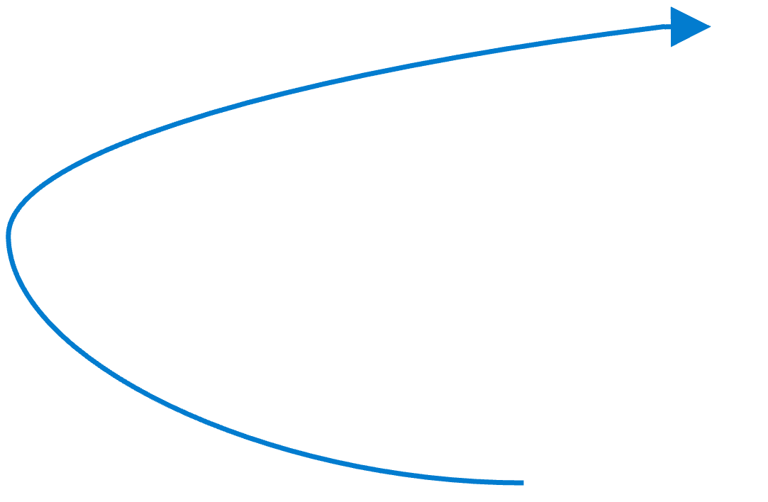
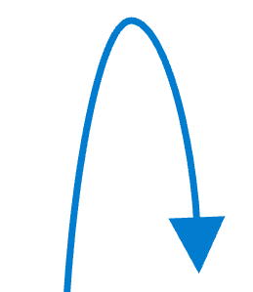
Skill Development
Steps to rewrite as a Standard form.
How I you expand ${(x−h)}^{2}$ ?
How I you distribute the a-term?
How I you write as a Trinomial?
CFU
1
Expand ${(x−h)}^{2}$
1
2
Distribute the $a−term.$
2
3
Add the like terms.
3

Slide 10
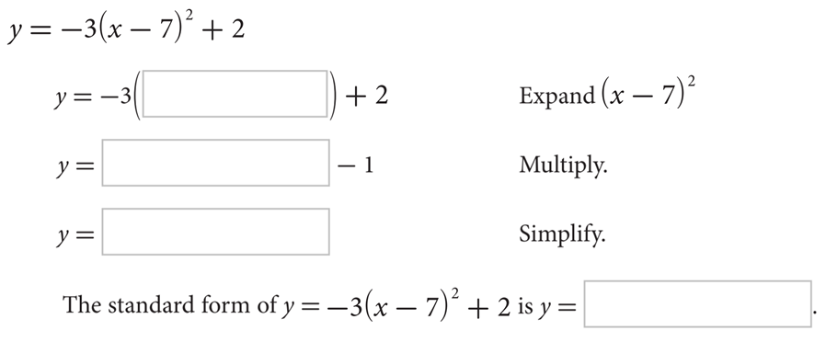
Skill Development/Guided Practice (continued)
Steps to rewrite as a Standard form.
How I you expand ${(x−h)}^{2}$ ?
How I you distribute the a-term?
How I you write as a Trinomial?
CFU
1
Expand ${(x−h)}^{2}$
1
2
Distribute the $a−term.$
2
3
Add the like terms.
3

Slide 11
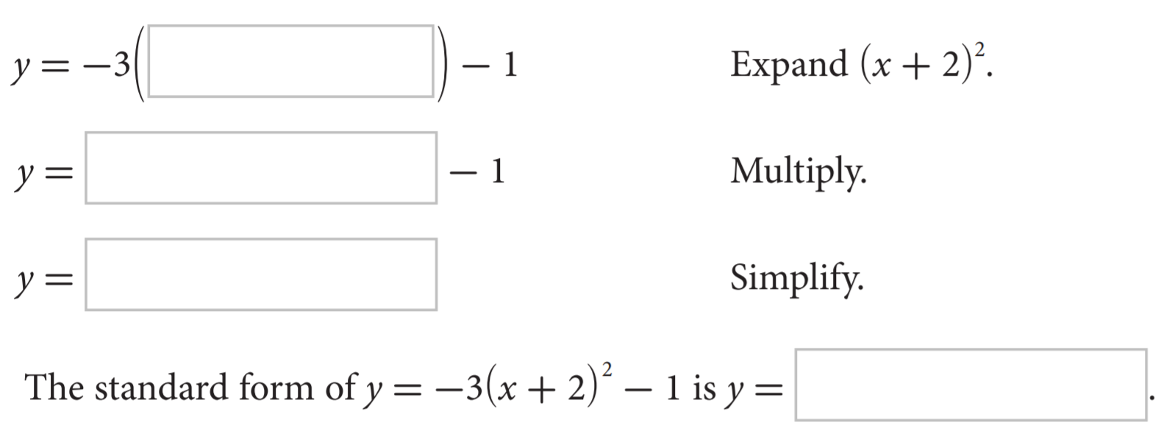
Skill Development/Guided Practice (continued)
Steps to rewrite as a Standard form.
How I you expand ${(x−h)}^{2}$ ?
How I you distribute the a-term?
How I you write as a Trinomial?
CFU
1
Expand ${(x−h)}^{2}$
1
2
Distribute the $a−term.$
2
3
Add the like terms.
3

Slide 12
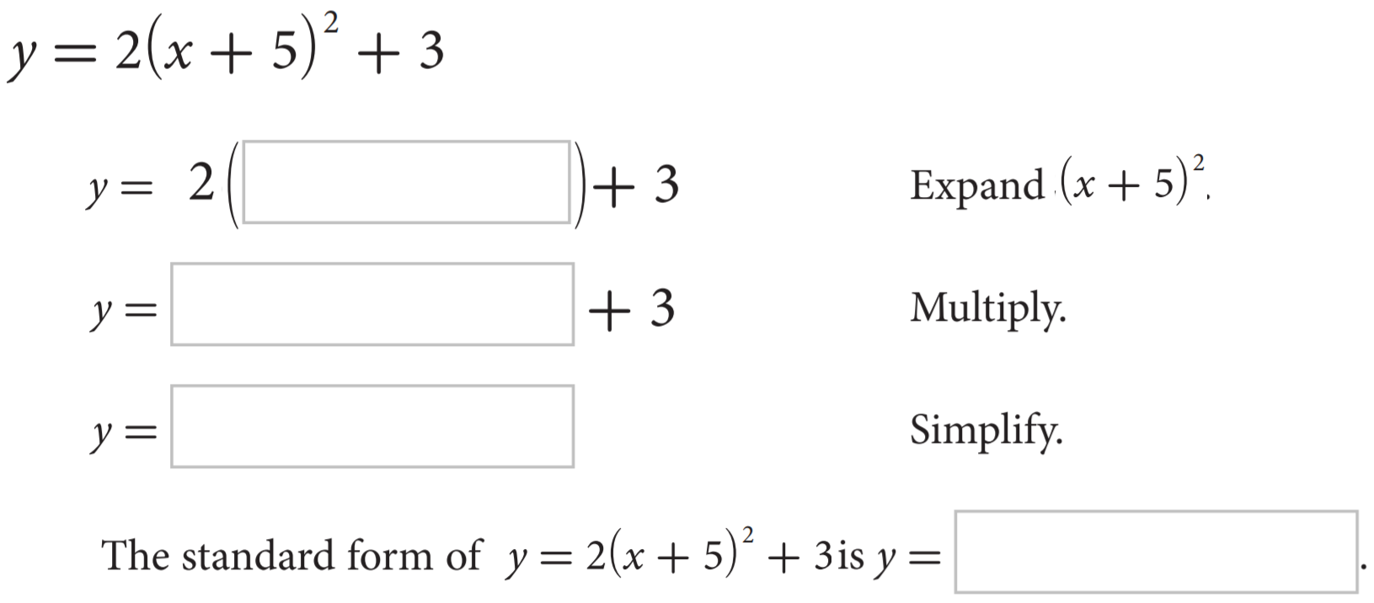
Skill Development/Guided Practice (continued)
Steps to rewrite as a Standard form.
How I you expand ${(x−h)}^{2}$ ?
How I you distribute the a-term?
How I you write as a Trinomial?
CFU
1
Expand ${(x−h)}^{2}$
1
2
Distribute the $a−term.$
2
3
Add the like terms.
3

Slide 13
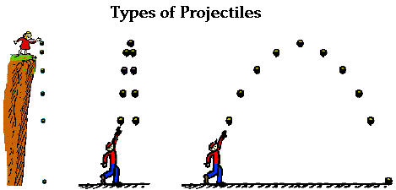
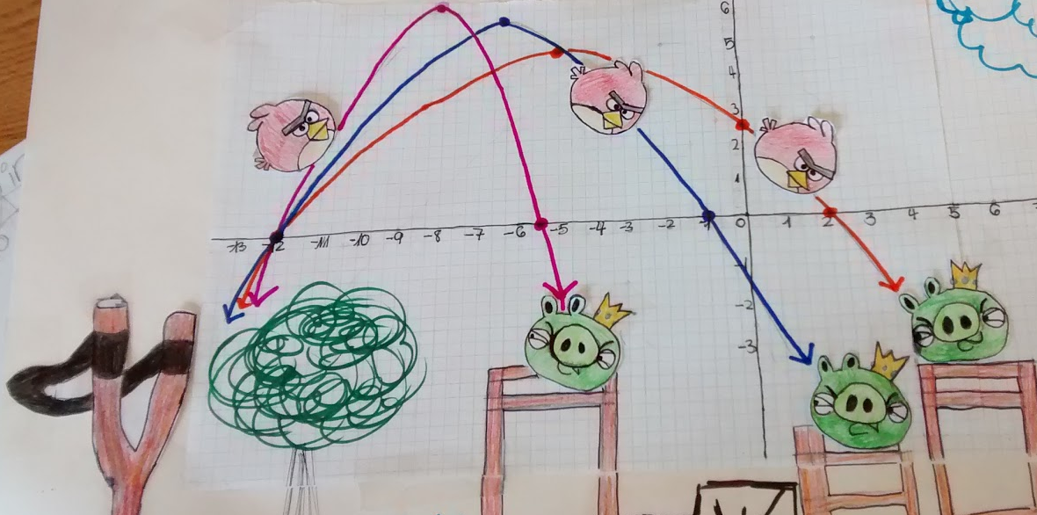
Relevance
Quadratic functions are more than algebraic curiosities—they are widely used in science, business, and engineering. The U-shape of a parabola can describe the trajectories of angry birds in a game, a bouncing ball, or be incorporated into structures like the parabolic reflectors that form the base of satellite dishes and car headlights. Quadratic functions help forecast business profit and loss, plot the course of moving objects, and assist in determining minimum and maximum values. Most of the objects we use every day, from cars to clocks, would not exist if someone, somewhere hadn't applied quadratic functions to their design.

Slide 14
How can you change the vertex form of a quadratic function to standard form?
Essential Question:
SUMMARY CLOSURE
To change the vertex form to standard form, you ____________ ______________________________________________________________.
Expand:

Slide 15
Homework

Slide 16
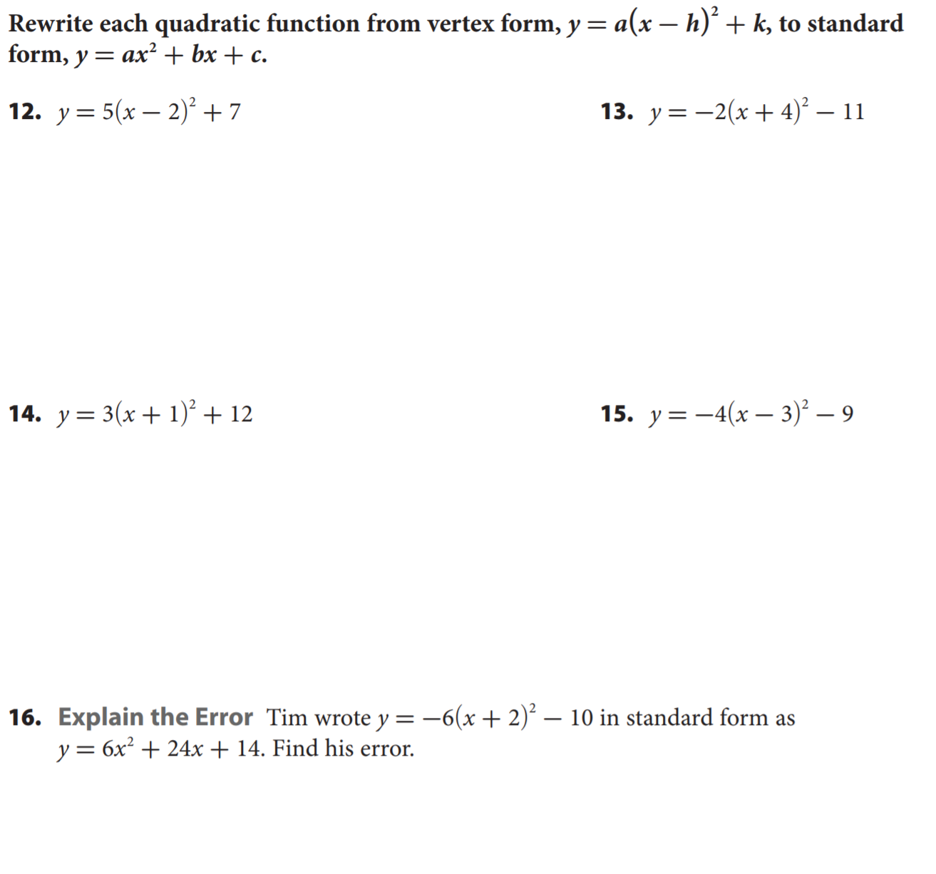
Homework

Slide 17
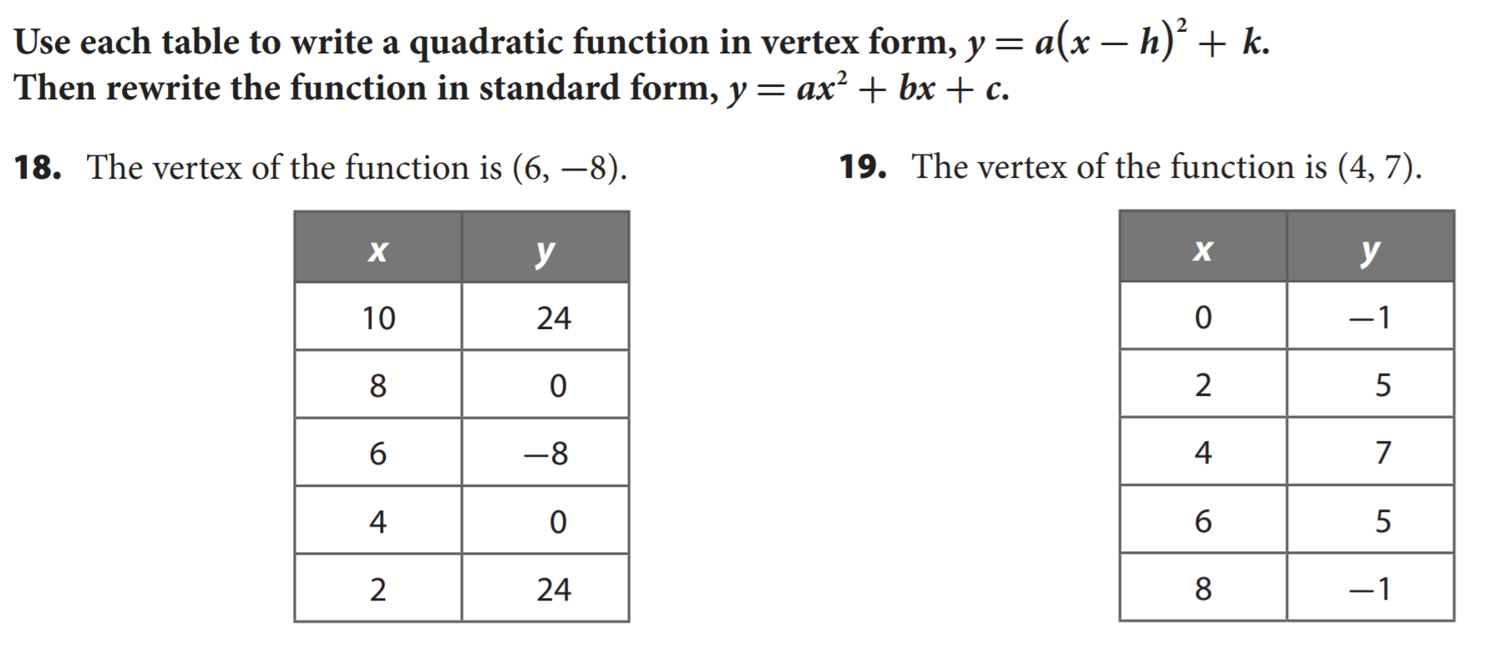
Homework

Slide 18
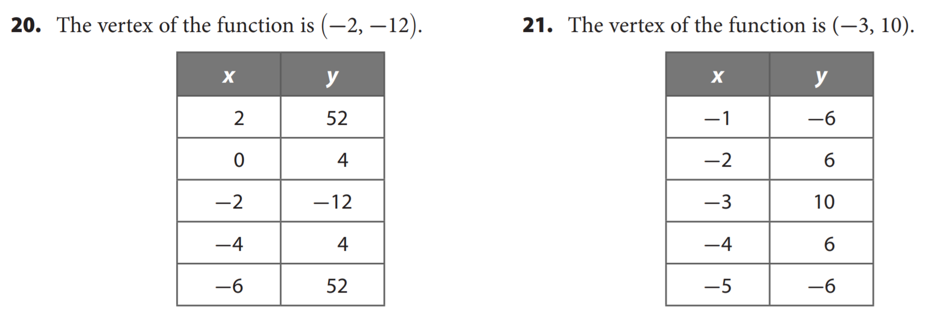
Homework

