Slide 1
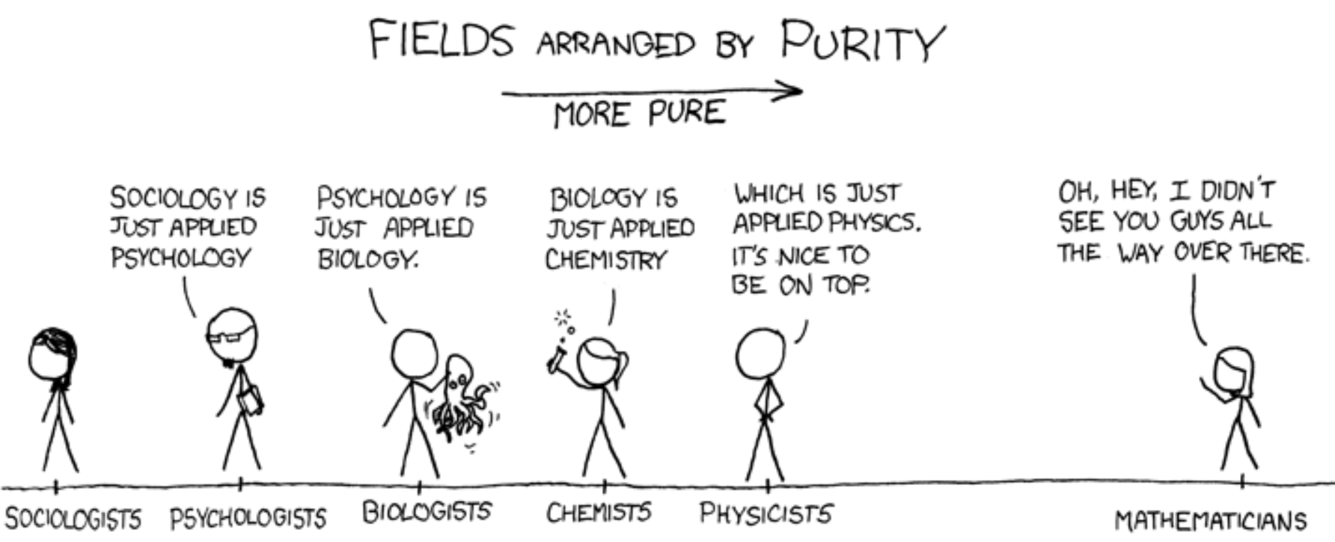
Lesson-3: 9.3 Comparing Box Plots
Name:_______________________
Period:______
Activate Prior Knowledge
The numbers of runs Jane’s baseball team scored in 9 games are: 0, 2, 3, 2, 4, 11, 3, 4, 3. Construct a boxplots to shows the data graphically.
The numbers of field goals James’ football team scored in 12 games are; 3, 2, 5, 3, 5, 2, 1, 0, 5, 4, 4, 2. Construct a boxplots to shows the data graphically.
Remember the Concept
A boxplot can be used to show how the values in a data set are distributed.
Make the Connection
Students, you already know how to Construct Boxplots. Today, we will learn how to compare two boxplots.
Skill Development
You can plot ___________ above a “SAME” single number line to compare two data sets.
Remember, when creating box plots and comparing two sets of data, you must find the
__________, ____________, and ____________.
*Note: the English word quartile has a Spanish cognate “cuartil.”

Slide 2
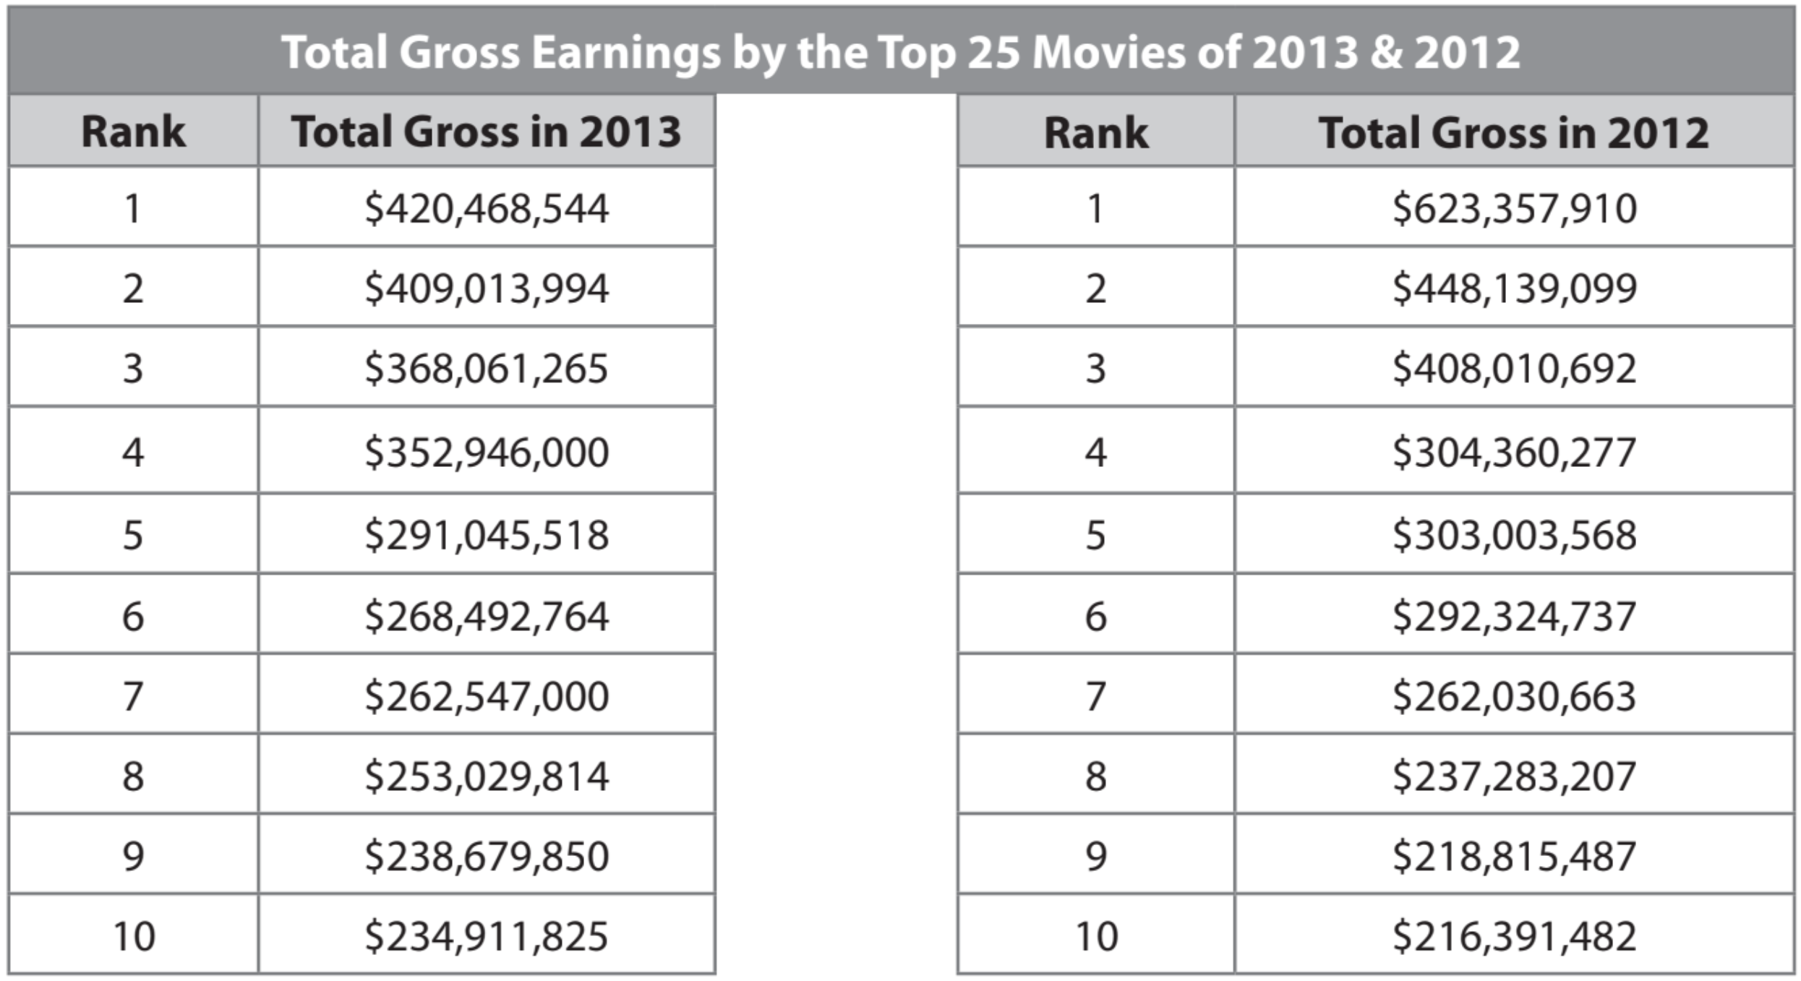
2013:
420, 409, 368, 353, 291, 268, 263, 253, 239, 235
2012:
623, 448, 408, 304, 303, 392, 262, 237, 219, 216
A: Sort the list and find the five values
B: Sort the list and find the five values

Slide 3
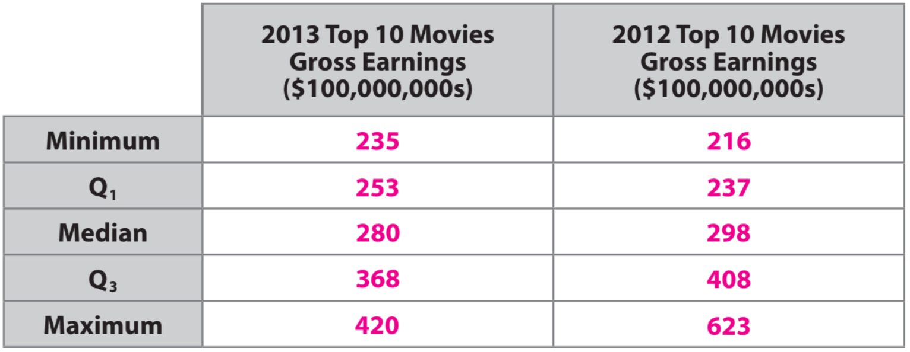
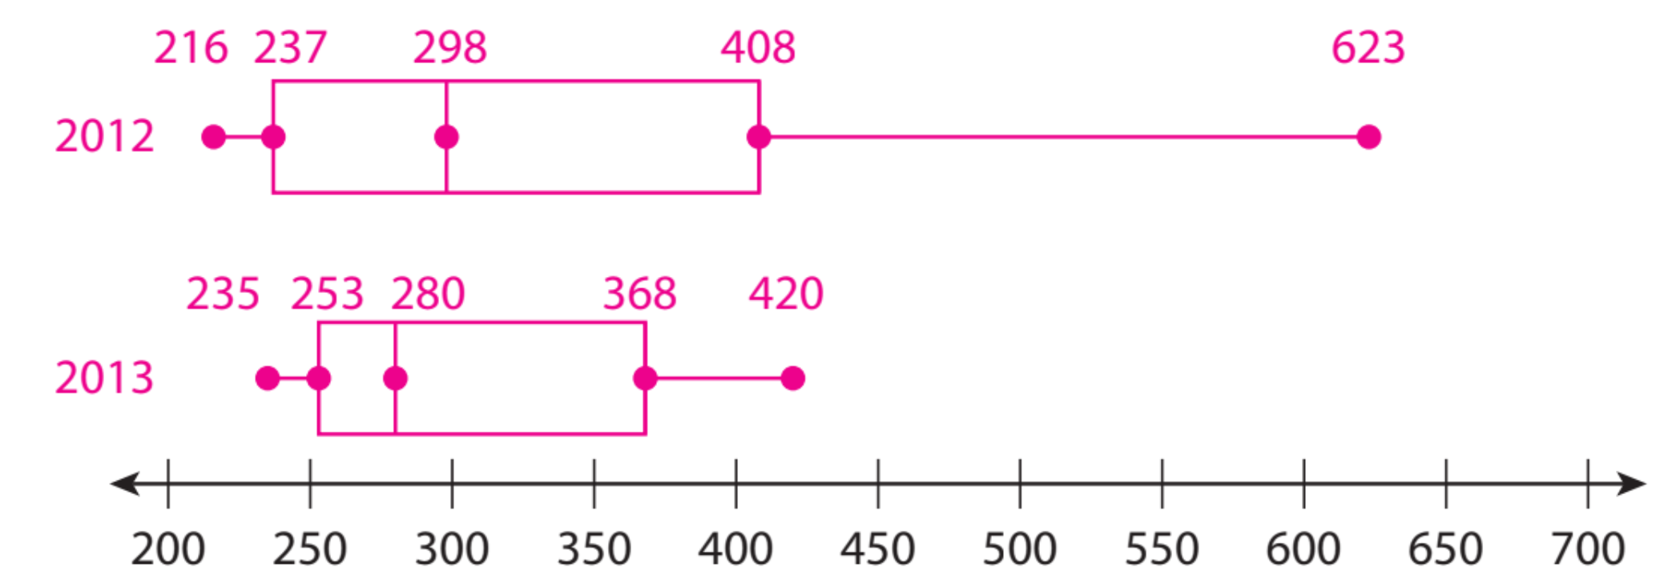
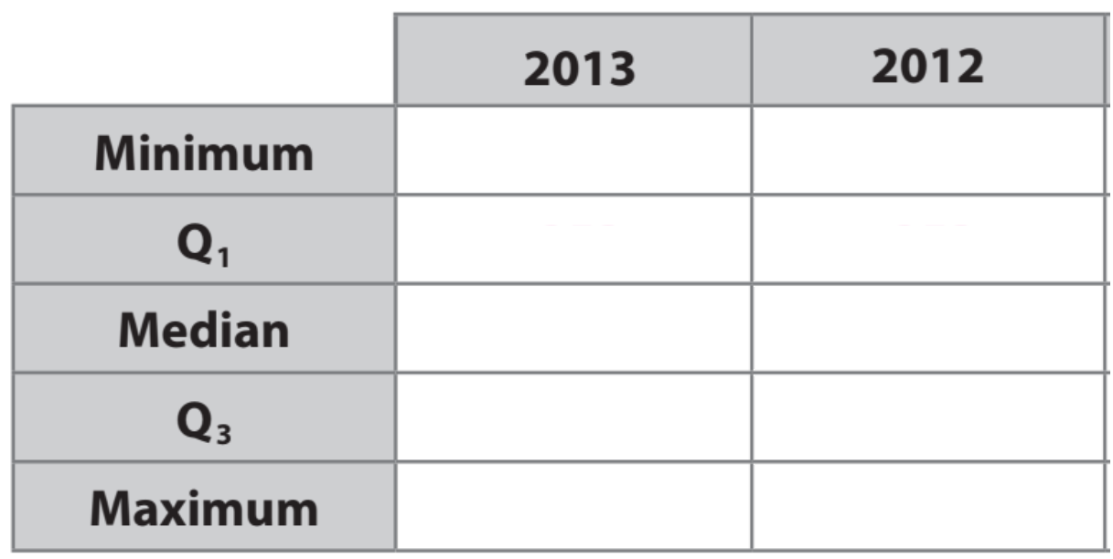
Skill Development
Recall
Remember, when comparing boxplots, both boxplots MUST be drawn using the same number line.
Make the
Boxplots
A: Sort the list and find the five values
B: Sort the list and find the five values
The medians are close, but the median for 2013 is slightly _________that of 2012. The ranges are close, but the interquartile range for 2013 is much ____________ that of 2012.
Make the
Boxplots

Slide 4
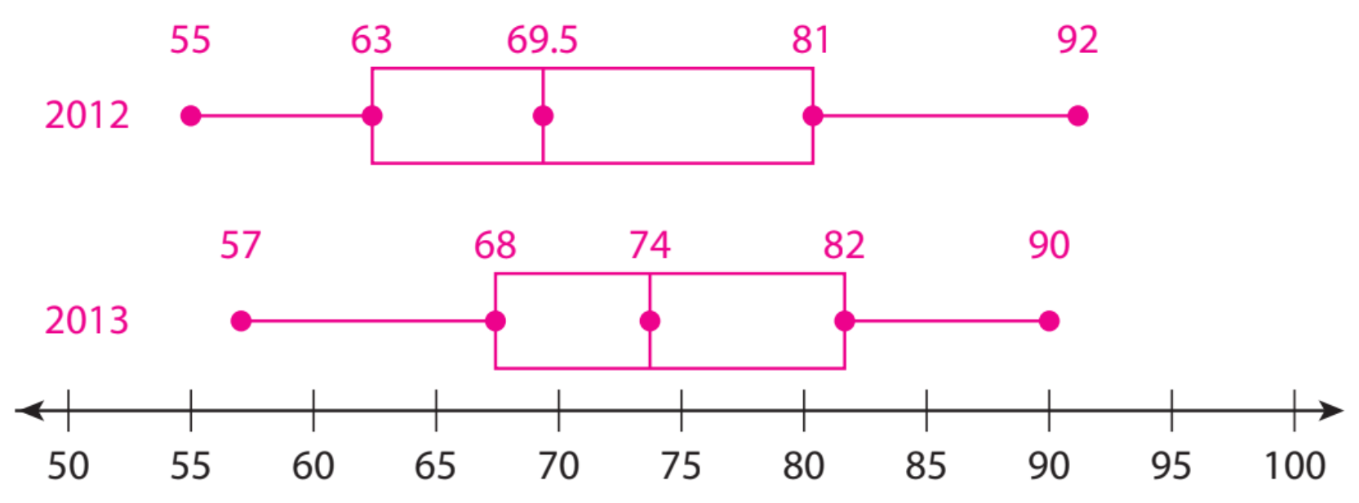
Skill Development/Guided Practice
The ages of the 10 richest people in the world for 2012 and 2013 (in years) are:
2012: 72, 56, 81, 63, 75, 67, 55, 64, 83, 92 2013: 72, 57, 76, 82, 68, 77, 72, 84, 90, 63
A: Sort the list and find the five values
B: Sort the list and find the five values
The median for 2013 is much ___________he median for 2012.
Both the range and interquartile range for 2013 are ______ those of 2012, so the ages were more varied in 2012.

Slide 5
Independent practice
What did you learn today about how to Compare Box Plots.
Common Core
Word Bank
Today, I learned how to _____________________________________________________________________________________________________.
Dot Plot
IQR
Whisker
Quartiles
Median
5-number summary
SUMMARY CLOSURE

