Slide 1
ACT RESPONSIBLY & SUPPORT the COMMUNITY.
Be on Time
Wear ID
Chromebook Ready
SEE SOMETHING, SAY SOMETHING

Slide 2
We will learn how to Comparing Box Plots₁.
Learning Objective
LEARNING OBJECTIVE
Definition
¹ In statistics, a boxplot is a method for graphically displaying groups of numerical data through their quartiles.
CFU
What are we going to learn today?
What is a Boxplot?_______.

Slide 3
Activate Prior Knowledge
The numbers of runs Jane’s baseball team scored in 9 games are: 0, 2, 3, 2, 4, 11, 3, 4, 3. Construct a boxplots to shows the data graphically.
The numbers of field goals James’ football team scored in 12 games are; 3, 2, 5, 3, 5, 2, 1, 0, 5, 4, 4, 2. Construct a boxplots to shows the data graphically.
0, 2, 2, 3, 3, 3, 4, 4, 11
0, 1, 2, 2, 2, 3, 3, 4, 4, 5, 5, 5
Remember the Concept
A boxplot can be used to show how the values in a data set are distributed.
Make the Connection
Students, you already know how to Construct Boxplots. Today, we will learn how to compare two boxplots.

Slide 4
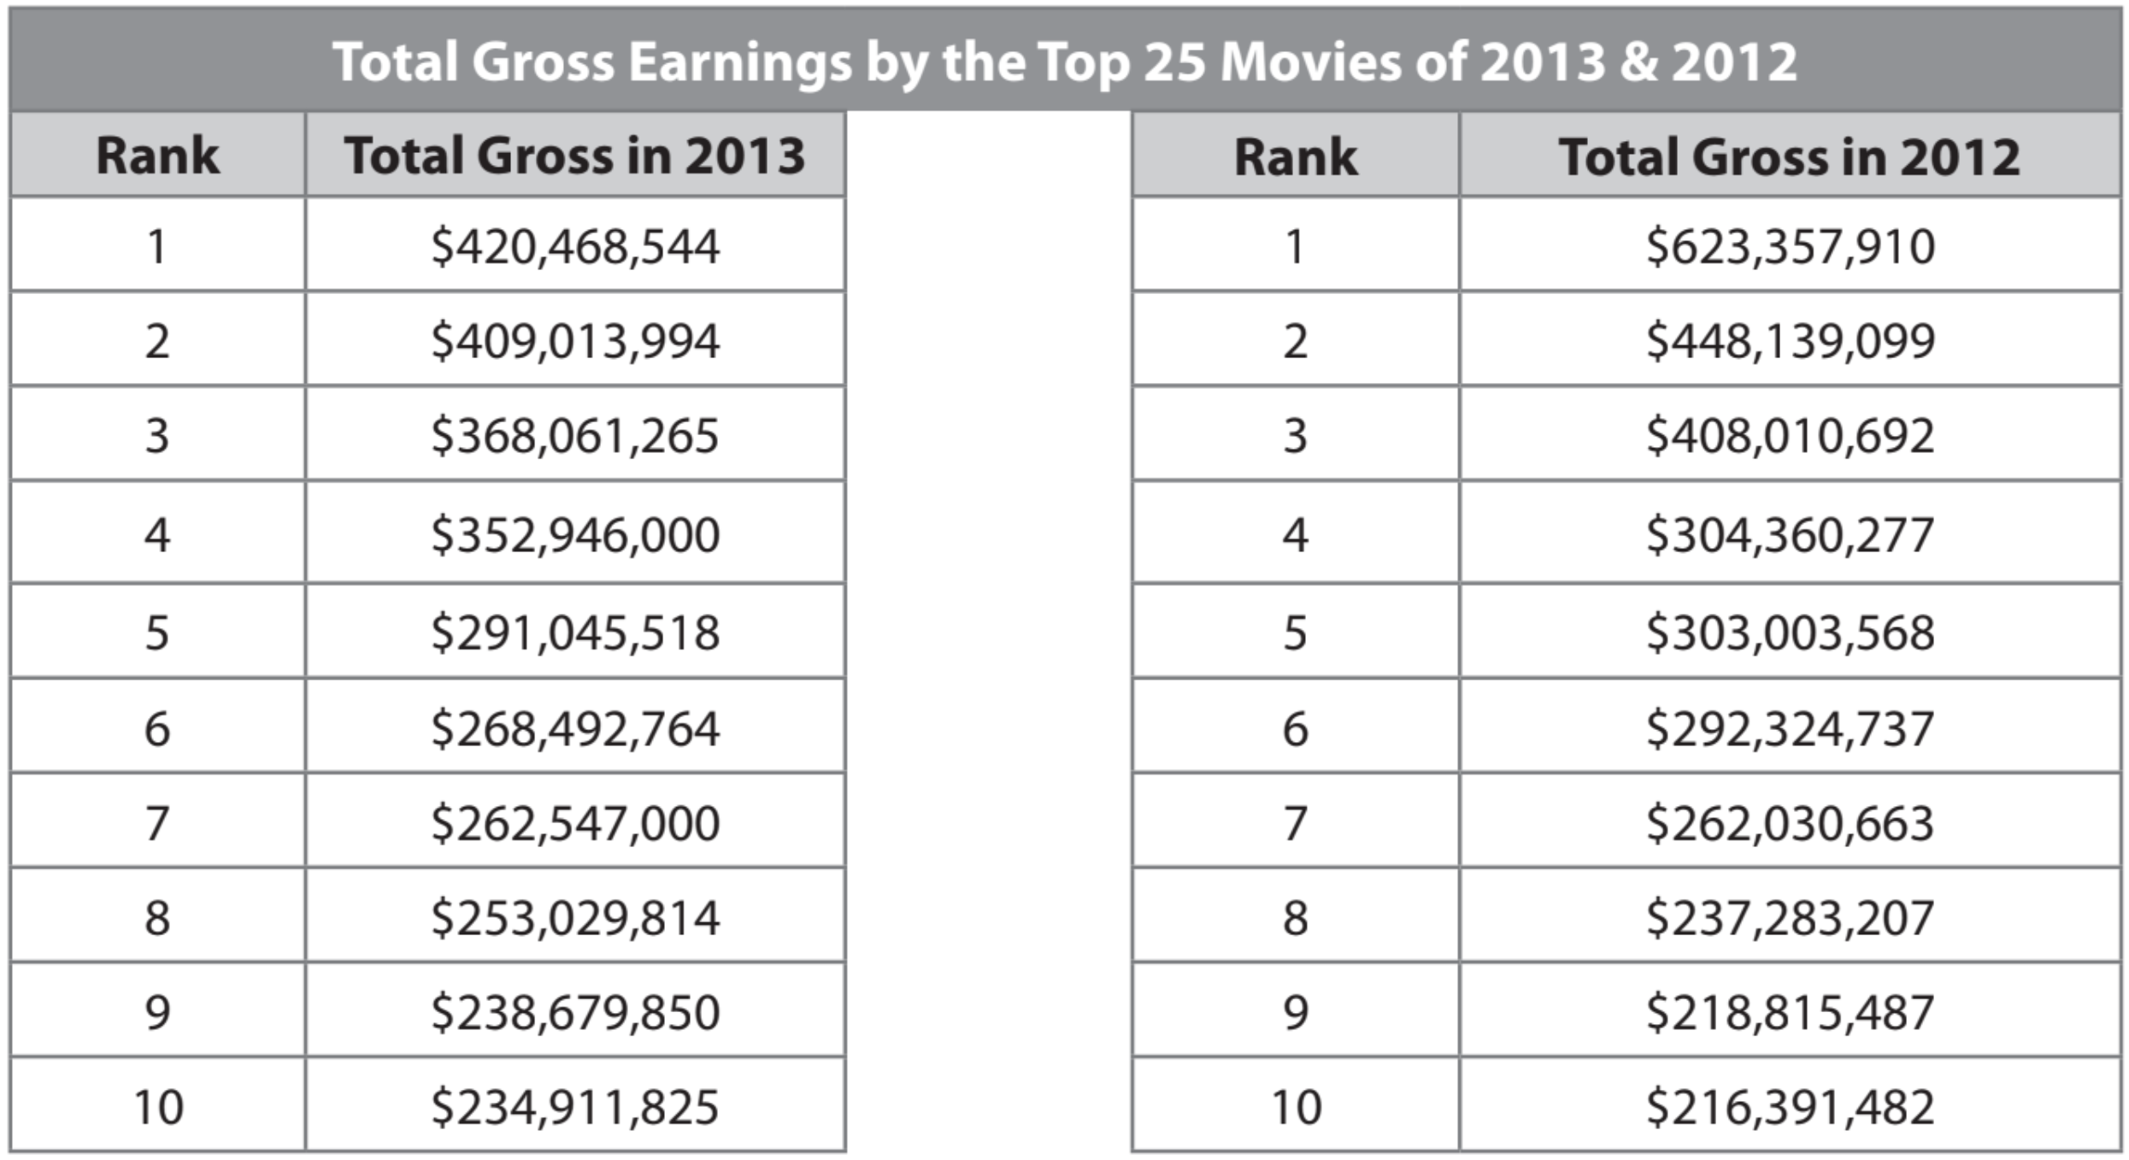
Skill Development
You can plot two boxplots above a “SAME” single number line to compare two data sets.
Remember, when creating box plots and comparing two sets of data, you must find the
first quartile, third quartile, and interquartile range.
*Note: the English word quartile has a Spanish cognate “cuartil.”
CFU: Pair-Share
A: What are the 5 Values that makeup BoxPlot? B: How much data is in each interval & how do you find IQR Value?

Slide 5
Skill Development
2013:
420, 409, 368, 353, 291, 268, 263, 253, 239, 235
2012:
623, 448, 408, 304, 303, 392, 262, 237, 219, 216
A: Sort the list and find the five values
B: Sort the list and find the five values

Slide 6
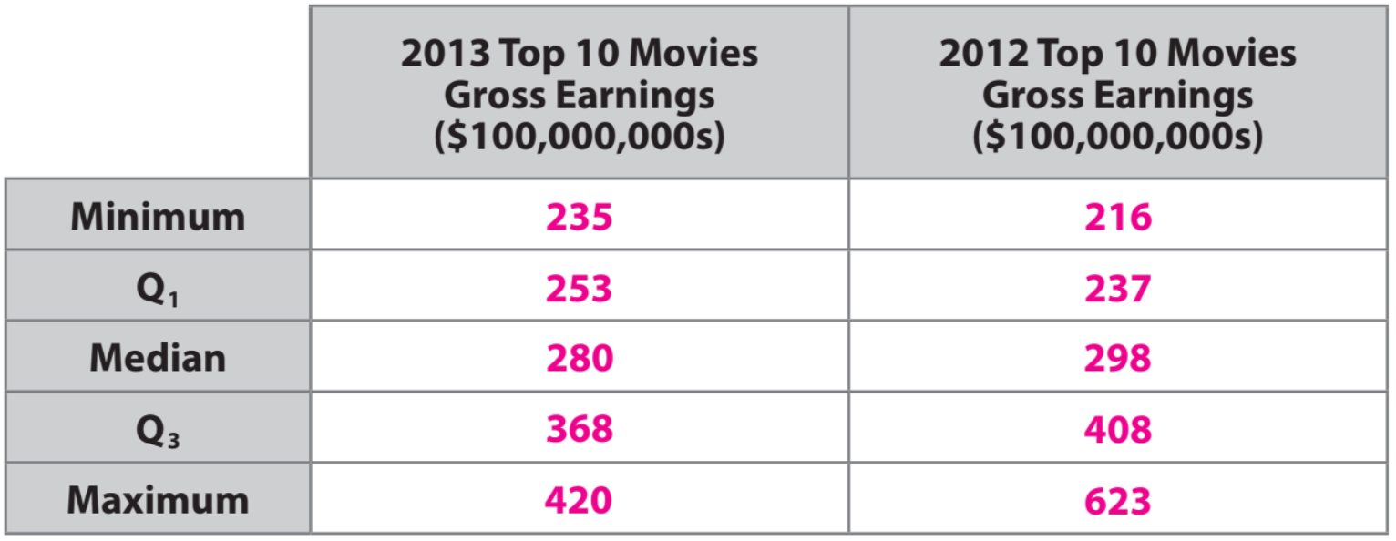
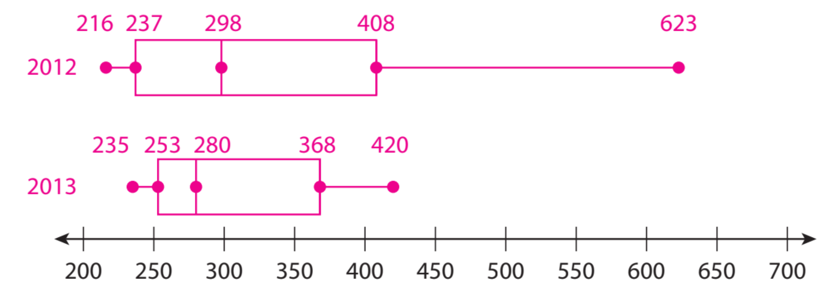
Skill Development
Recall
Remember, when comparing boxplots, both boxplots MUST be drawn using the same number line.
Make the
Boxplots

Slide 7
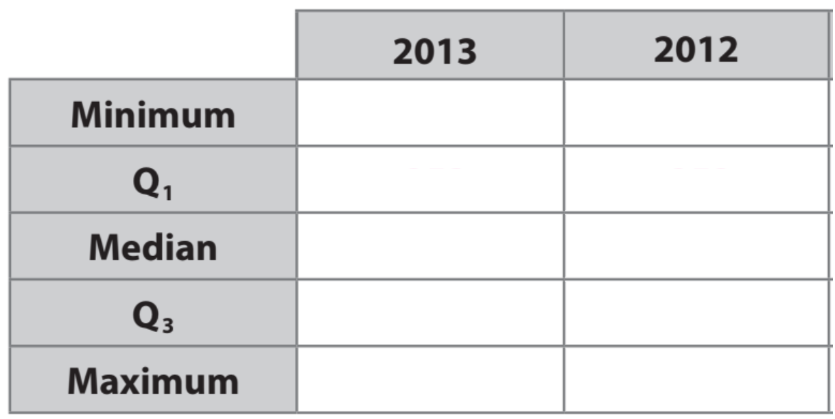
Skill Development/Guided Practice
A: Sort the list and find the five values
B: Sort the list and find the five values
25.4
29
26
31
The medians are close, but the median for 2013 is slightly greater than that of 2012. The ranges are close, but the interquartile range for 2013 is much greater than that of 2012.
36.75
38.5
44
57
69
73
Make the
Boxplots

Slide 8
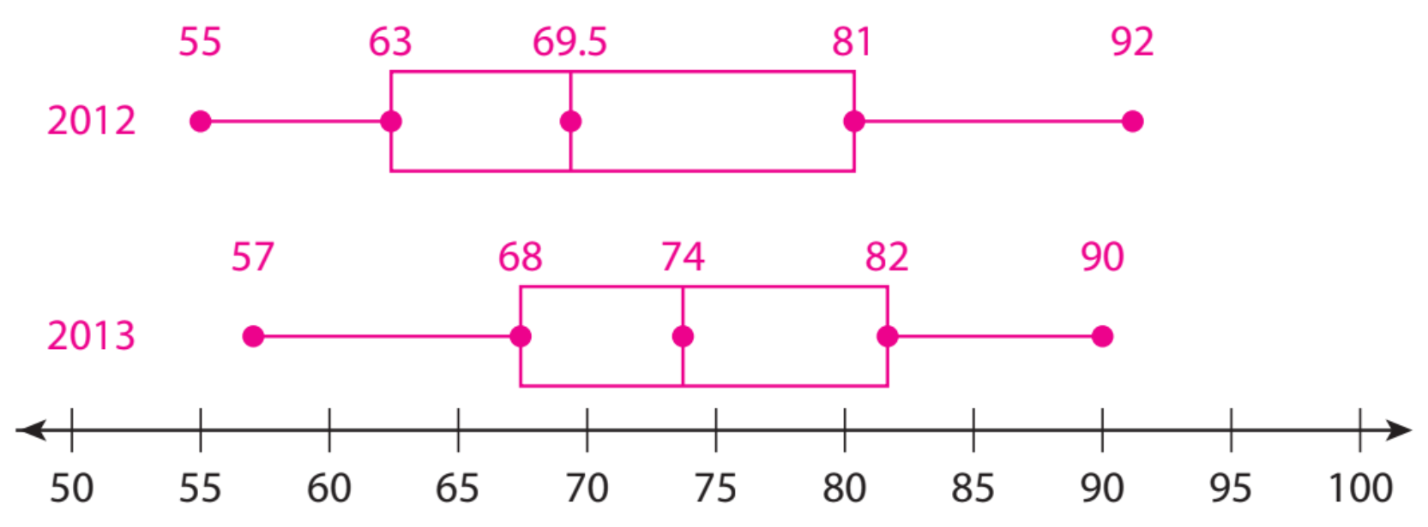
Skill Development/Guided Practice
The ages of the 10 richest people in the world for 2012 and 2013 (in years) are:
2012: 72, 56, 81, 63, 75, 67, 55, 64, 83, 92 2013: 72, 57, 76, 82, 68, 77, 72, 84, 90, 63
A: Sort the list and find the five values
B: Sort the list and find the five values
The median for 2013 is much greater than the median for 2012.
Both the range and interquartile range for 2013 are less than those of 2012, so the ages were more varied in 2012.

Slide 9
Independent practice

Slide 10
Independent practice

Slide 11
What did you learn today about how to Compare Box Plots.
Common Core
Word Bank
SUMMARY CLOSURE
Dot Plot
IQR
Whisker
Quartiles
Median
5-number summary
Today, I learned how to _________________________________________________________________________________.

