Slide 1
ACT RESPONSIBLY & SUPPORT the COMMUNITY.
Be on Time
Wear ID
Chromebook Ready
SEE SOMETHING, SAY SOMETHING

Slide 2
We will determine₁ how to Construct Box Plots₂.
Learning Objective
LEARNING OBJECTIVE
Definition
¹ figure out ² In statistics, a boxplot is a method for graphically displaying groups of numerical data through their quartiles.
CFU
What are we going to learn today?
What is a Boxplot means?_______.

Slide 3
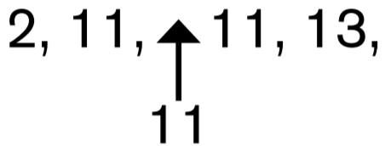
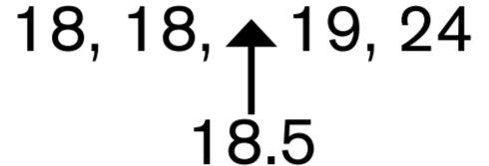
Activate Prior Knowledge
Find the interquartile range (IQR) of the following data set:
14, 18, 11, 2, 19, 24, 13, 11, 18
9, 15, 14, 10, 12, 14, 17, 8, 9, 13, 15
STEP 1: Order the data from least to greatest.
STEP 1: Order the data from least to greatest.
2, 11, 11, 13, 14, 18, 18, 19, 24
8, 9, 9, 10, 12, 13, 14, 14, 15, 15, 17
STEP 2: Find the median (the middle number).
STEP 2: Find the median (the middle number).
8, 9, 9, 10, 12, 13, 14, 14, 15, 15, 17
STEP 3: Find the median of the Lower & Upper half.
STEP 3: Find the median of the Lower & Upper half.
8, 9, 9, 10, 12,
14, 14, 15, 15, 17
STEP 4: Find the difference between the third and first quartiles.
STEP 4: Find the difference between the third and first quartiles.
18.5 – 11 = 7.5
15 – 9 = 6
So the interquartile range is 7.5.
So the interquartile range is 6.
Remember the Concept
The Interquartile range (IQR) describe variability in the data set “the length of the box”.
Make the Connection
Students, you already know how to find IQR of the data set. Today, we will learn how to Construct Boxplots.

Slide 4
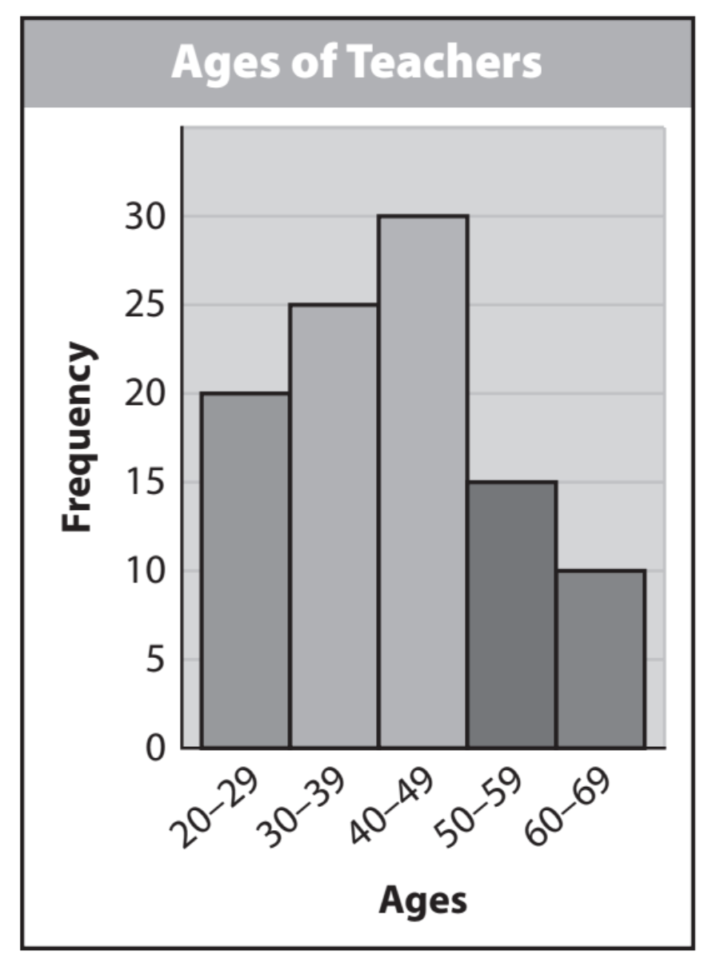
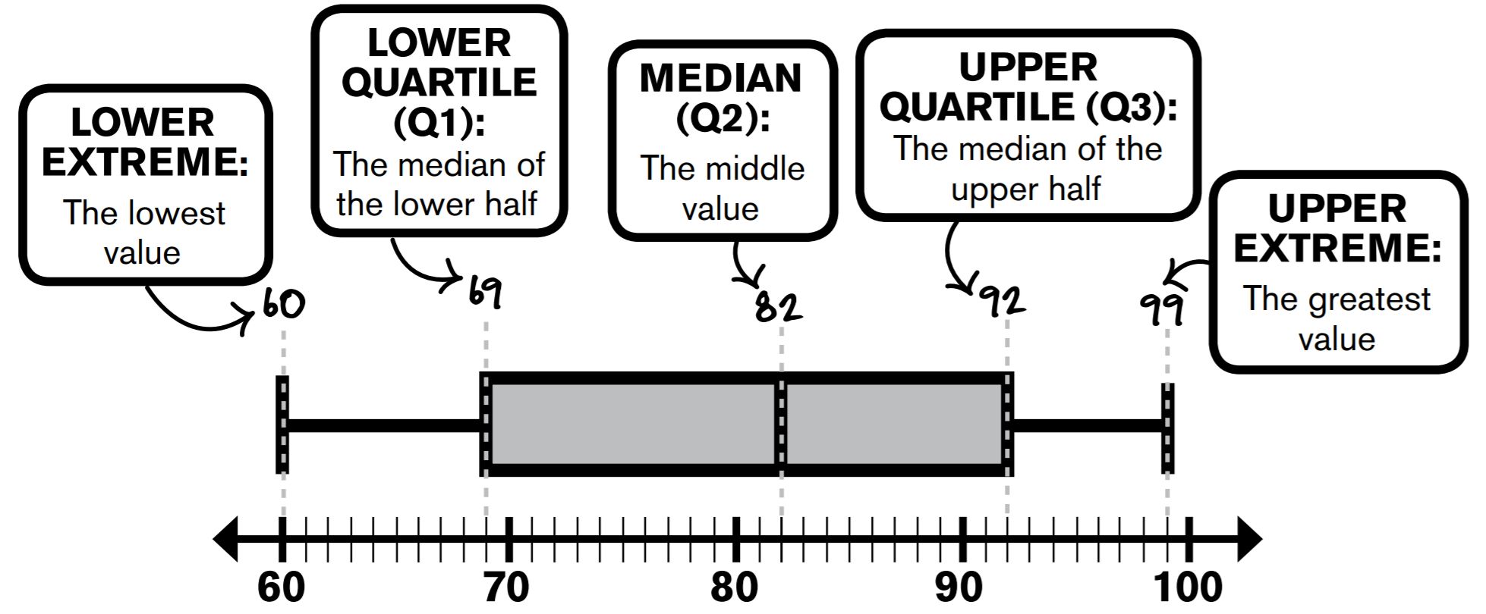
Skill Development
Histograms
A box plot can be used to show how the values in a data set are distributed. You need 5 values to make a box plot: the minimum (or least value), first quartile, median, third quartile, and maximum (or greatest value).
Calculation
The width of the box shows the IQR,
which is 50% of data.
CFU: Pair-Share
A: What are the 5 Values that makeup Box Plot? B: How much data is in each interval & how much data is in the IQR interval?

Slide 5
Skill Development/Guided Practice
The data below shows the number of wins earned by Texas Rangers pitcher Cole Hamels in each year of his 11-year career. Graph the data using a box-and-whisker plot. 9, 15, 14, 10, 12, 14, 17, 8, 9, 13, 15
The data below represents the number of goals scored by U.S. Women’s Soccer player Carli Lloyd for the past 16 seasons. 17, 18, 15, 6, 3, 15, 6.

Slide 6
Skill Development/Guided Practice
The lines that extend from the box in a box plot are sometimes called “whiskers.” About what percent of the data does the each interval represents?
Box (Middle): ______
Left whisker: ______
Right whisker: _____
Which measures of spread can be determined from the box plot, and how are they found?
The range is the length of the entire box plot: Highest Value – Lowest Value.
The IQR is the length of the box: Q3 – Q1.
What are the steps for creating a box plot?
Order the data. Determine the minimum, median, first quartile, third quartile, and maximum. Draw a number line and plot the values. Draw a vertical line at the median, a box from Q1 to Q3, and lines from the box to the minimum and maximum points.

Slide 7
Guided Practice
The numbers below show the average number of points per basketball game the Golden State Warriors’ Kevin Durant has scored each year during his career (2016-2017 season not included). (Hint: To find the median for an even number of values, find the mean for the two middle values.)
28, 25, 32, 28, 28, 28, 30, 25, 20
The data below shows the number of Grand Slam and Women’s Tennis Association tournament titles Serena Williams won the past 8 years. 2, 3, 2, 3, 4, 0, 4, 7.

Slide 8
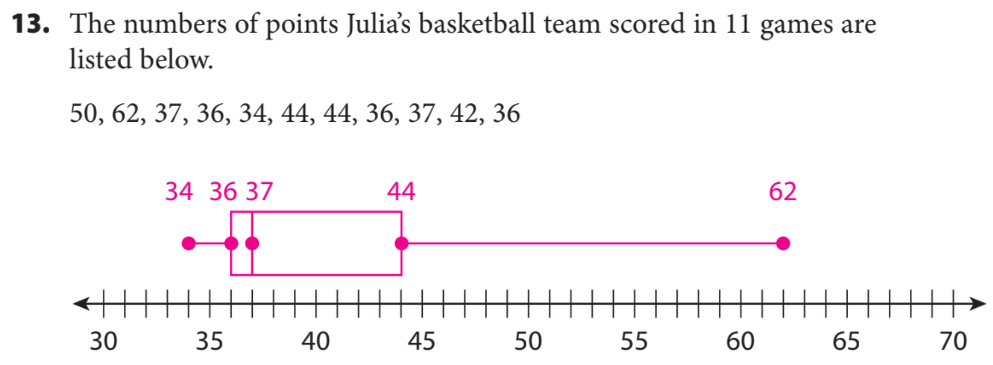
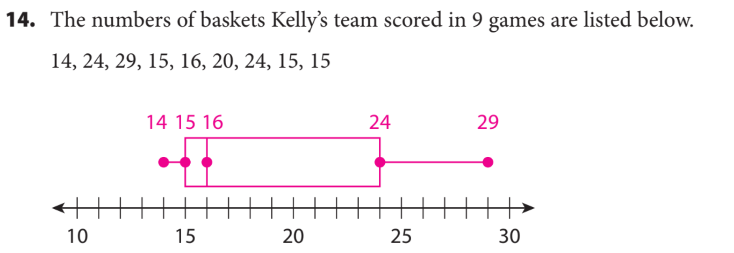
Independent practice

Slide 9
Independent practice

Slide 10
Critical Thinking: Suppose the minimum in a data set is the same as the first quartile. How would this affect a box plot of the data? Explain.
What did you learn today about how to Construct Box Plots..
Because the minimum and the first quartile are the same, the box plot would have no “whisker” on the left side.
Common Core
Word Bank
SUMMARY CLOSURE
Dot Plot
IQR
Whisker
Quartiles
Median
5-number summary
Today, I learned how to _________________________________________________________________________________.

