Slide 1
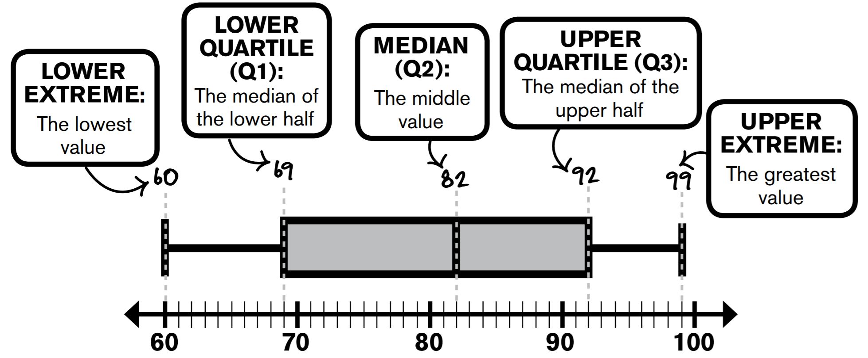
Name: ________________
Period: ____
Lesson 3: 9.3 Constructing Box Plots
Activate Prior Knowledge
Find the interquartile range (IQR) of the following data set:
14, 18, 11, 2, 19, 24, 13, 11, 18
9, 15, 14, 10, 12, 14, 17, 8, 9, 13, 15
STEP 1: Order the data from least to greatest.
STEP 1: Order the data from least to greatest.
STEP 2: Find the median (the middle number).
STEP 2: Find the median (the middle number).
STEP 3: Find the median of the Lower & Upper half.
STEP 3: Find the median of the Lower & Upper half.
STEP 4: Find the difference between the third and first quartiles.
STEP 4: Find the difference between the third and first quartiles.
So the interquartile range is __
So the interquartile range is ___
Remember the Concept
The Interquartile range (IQR) describe variability in the data set “the length of the box”.
Make the Connection
Students, you already know how to find IQR of the data set. Today, we will learn how to Construct Boxplots.
Skill Development
A box plot can be used to show how the values in a data set are distributed. You need _____to make a box plot: the ______ (or least value), ______ , _____ , ______ , and ______ (or greatest value).
The width of the box shows the IQR,
which is 50% of data.

Slide 2
Skill Development/Guided Practice
The data below shows the number of wins earned by Texas Rangers pitcher Cole Hamels in each year of his 11-year career. Graph the data using a box-and-whisker plot. 9, 15, 14, 10, 12, 14, 17, 8, 9, 13, 15
The data below represents the number of goals scored by U.S. Women’s Soccer player Carli Lloyd for the past 16 seasons. 17, 18, 15, 6, 3, 15, 6.
The lines that extend from the box in a box plot are sometimes called “whiskers.” About what percent of the data does the each interval represents?
Box (Middle): ______
Left whisker: ______
Right whisker: _____
Which measures of spread can be determined from the box plot, and how are they found?
____________________________________________________________________________________
What are the steps for creating a box plot?
____________________________________________________________________________________
__________________________________________

Slide 3
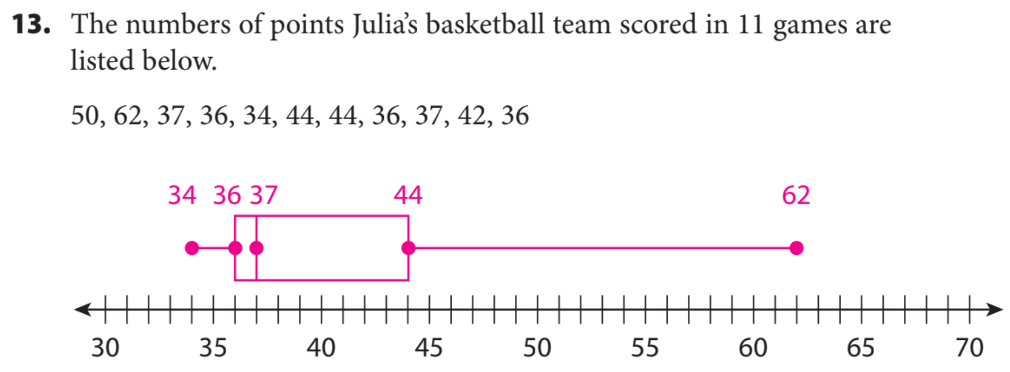
Guided Practice
The numbers below show the average number of points per basketball game the Golden State Warriors’ Kevin Durant has scored each year during his career (2016-2017 season not included). (Hint: To find the median for an even number of values, find the mean for the two middle values.)
28, 25, 32, 28, 28, 28, 30, 25, 20
The data below shows the number of Grand Slam and Women’s Tennis Association tournament titles Serena Williams won the past 8 years. 2, 3, 2, 3, 4, 0, 4, 7.

Slide 4
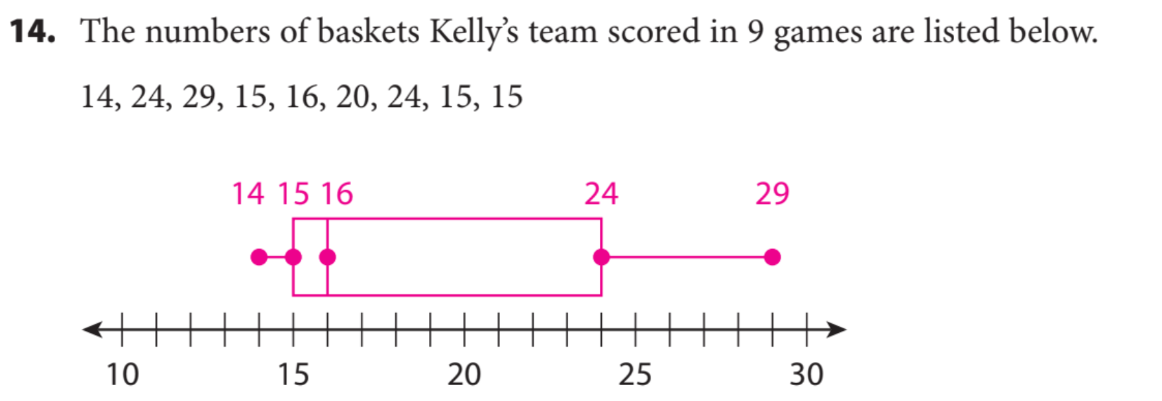
Independent practice

Slide 5
Critical Thinking: Suppose the minimum in a data set is the same as the first quartile. How would this affect a box plot of the data? Explain.
What did you learn today about how to Construct Box Plots..
_______________________________________________________________________________________________________________
Common Core
SUMMARY CLOSURE
Word Bank
Dot Plot
IQR
Whisker
Quartiles
Median
5-number summary
Today, I learned how to _________________________________________________________________________________.

