Slide 1
ACT RESPONSIBLY & SUPPORT the COMMUNITY.
Be on Time
Wear ID
Chromebook Ready
SEE SOMETHING, SAY SOMETHING

Slide 2
We will determine₁ how to create and use Histogram.
Learning Objective
LEARNING OBJECTIVE
CFU
What are we going to learn today?
What is Determine means?_______.
Definition
¹ figure out

Slide 3
Activate Prior Knowledge
Create a dot plot for the data set using an appropriate scale for the number line.
1. The number of feet to the left
outfield wall for 10 randomly chosen
baseball stadiums is 315, 325, 335,
330, 330, 330, 320, 310, 325, and 335.
2. The numbers of students in 10
randomly chosen classes in a high
school are 18, 22, 26, 31, 25, 20, 23, 26,
29, and 30.
Remember the Concept
A dot plot is a data representation that uses a number line and Xs, dots, or other symbols to show frequency.
Make the Connection
Students, you already know how to create a dot plot to show data. Today, we will learn how to create and use histogram.
Steps
Create a number line
Identity appropriate scale.
Range = Highest – Lowest Value
Divide
Give it appropriate name
Put dot(or x’s) on each #.

Slide 4
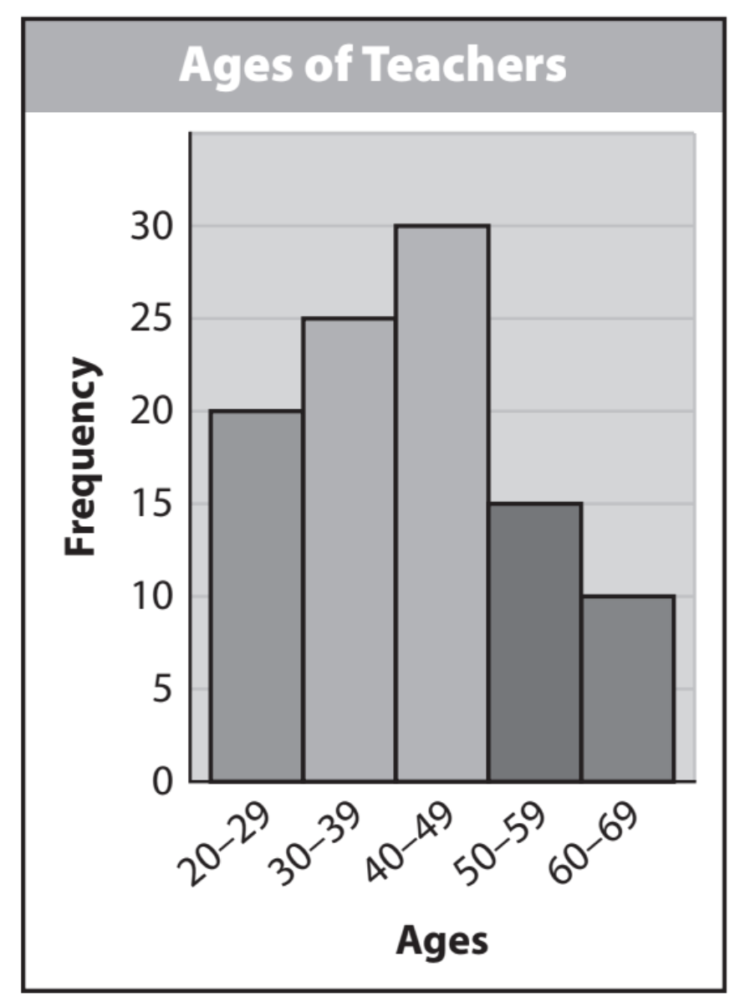
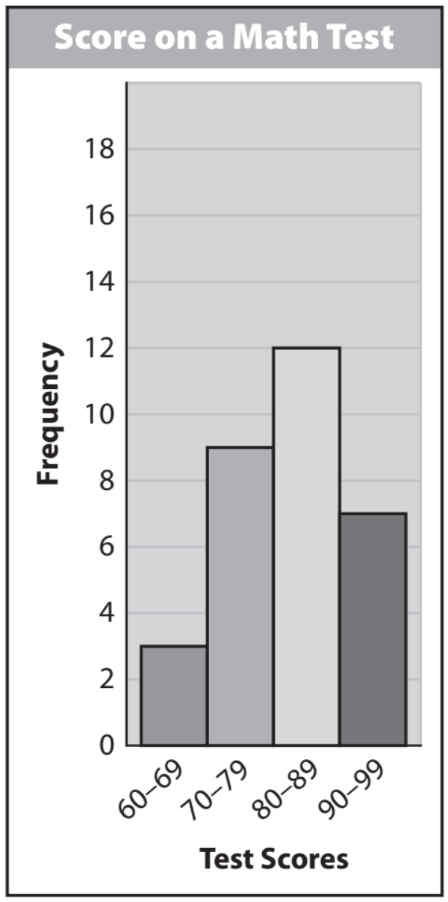
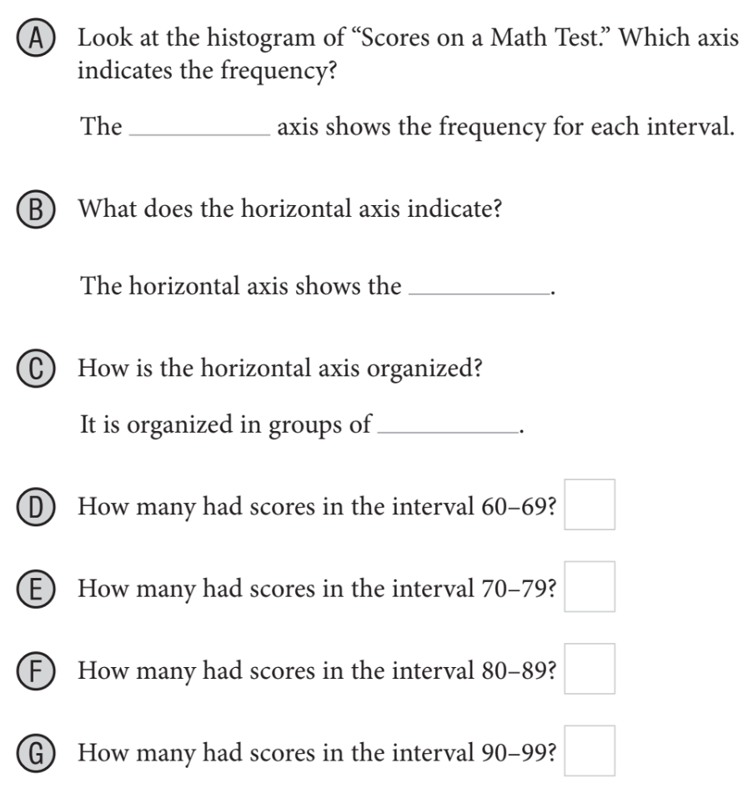
L.O: By the end of class, students will be able to create histograms for given data, with 100% accuracy.
A histogram is a bar graph that is used to display the frequency¹ of data divided into equal intervals. The bars must be of equal width and should touch but not overlap. The heights of the bars indicate the frequency of data values within each interval.
Histograms
Pair-Share:
Partner-A: How is a histogram different from a dot plot?
Partner-B: How many test scores were collected? How do you know?
CFU: Pair-Share
Pair-Share:
Partner-A: Explain what is a “Histogram” is?
Partner-B: Explain what is “Frequency” means?
CFU: Pair-Share
On WB: Label
A-G and Match.
“_____ students had test scores between ______%.”
“_____ students had test scores between ______%.”
“_____ students had test scores between ______%.”
Horizontal
“_____ students had test scores between ______%.”
¹ the rate at which something occurs
Vocabulary

Slide 5
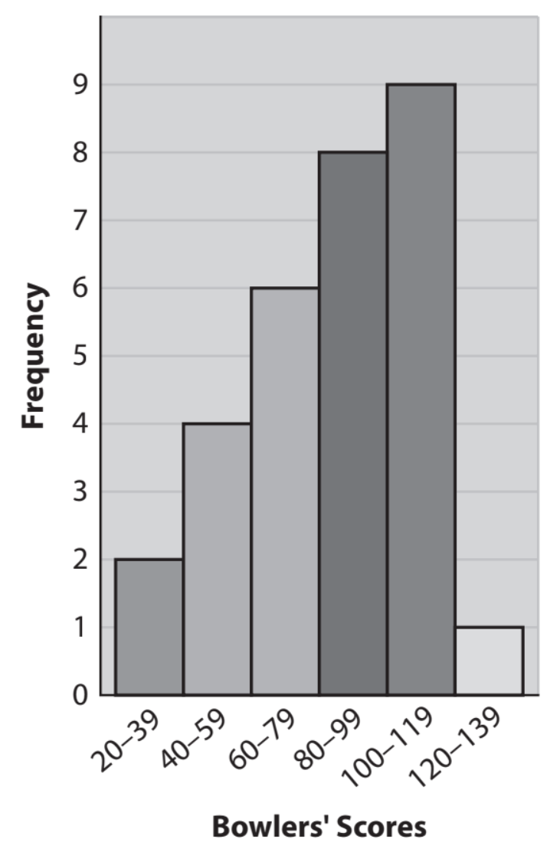
Skill Development/Guided Practice

Slide 6
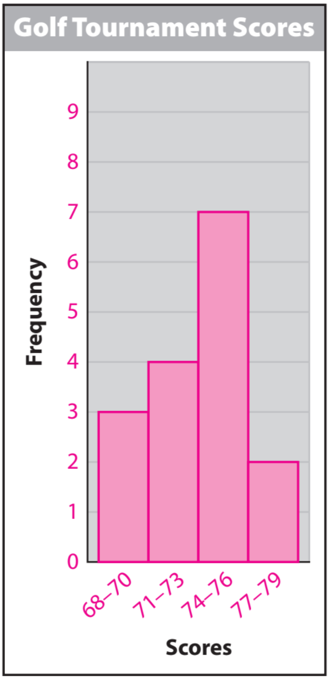
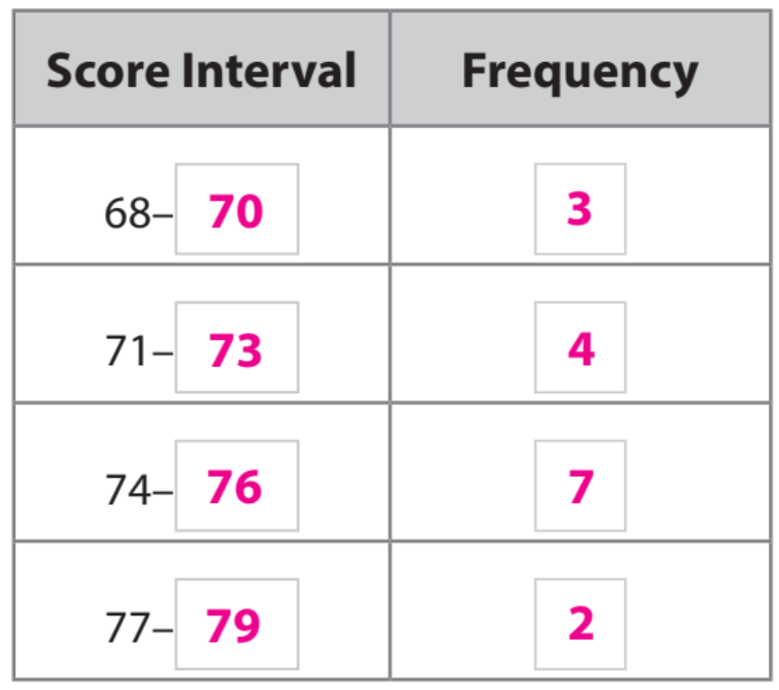
Skill Development/Guided Practice
Histograms
When creating a histogram, make sure that the bars are of equal width and that they touch without overlapping. Create a frequency table to help organize the data before constructing the histogram. Consider the range of the data values when creating intervals.
Pair-Share:
Partner-A: Explain steps 1 to 3?
Partner-B: How do you find the Range, Median, & Mean?
CFU: Pair-Share
Listed are the scores from a golf tournament. Create a histogram:
68, 78, 76, 71, 69, 73, 72, 74, 76, 70, 77, 74, 75, 76, 71, 74
Steps to Create Histogram
1. Determine the Range Value & Intervals
CFU: How did I/you create intervals for the data set?
2. Create a frequency table from the data.
CFU How did I/you create the frequency table?
3. Create a histogram using the frequency table.
CFU How did I/you describe the data distribution? What does that mean?
3.
Calculation
1.
= 10/2
= 5 intervals
use an interval width of 3,
and start the first interval at 68.
2.

Slide 7
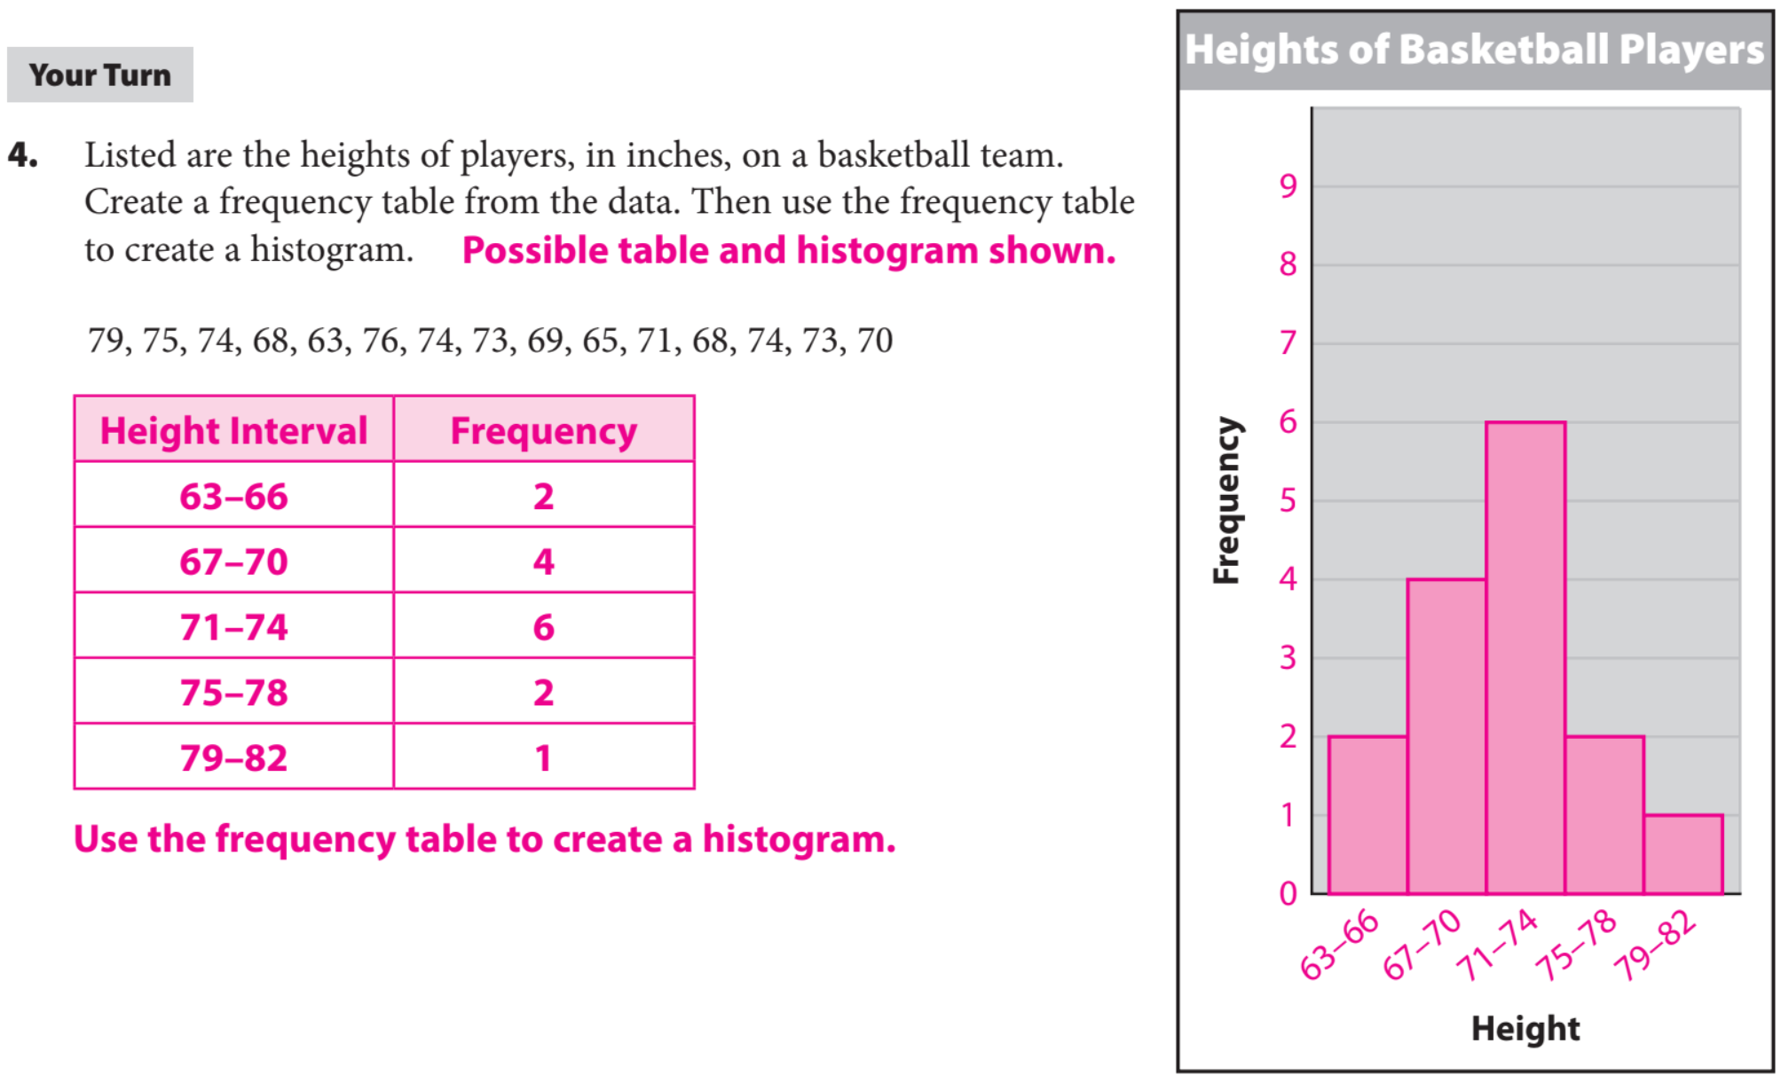
Skill Development/Guided Practice

Slide 8
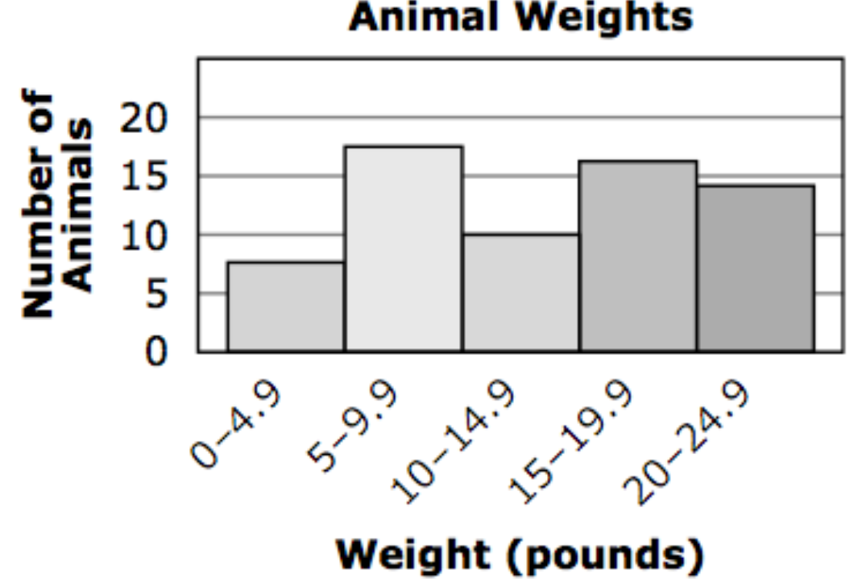
What did you learn today about how to create and use Histogram.
Common Core
Word Bank
SUMMARY CLOSURE
Axis
Histogram
Frequency
Data
Skewed to the left
Skewed to the right.
Today, I learned how to _________________________________________________________________________________.

