Slide 1
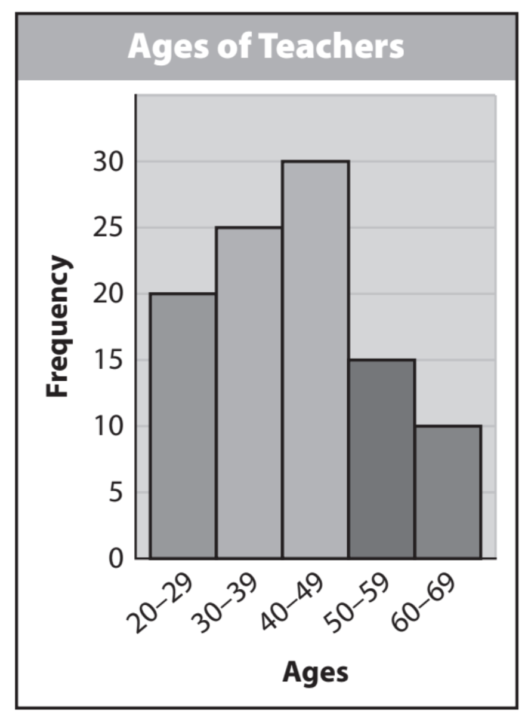
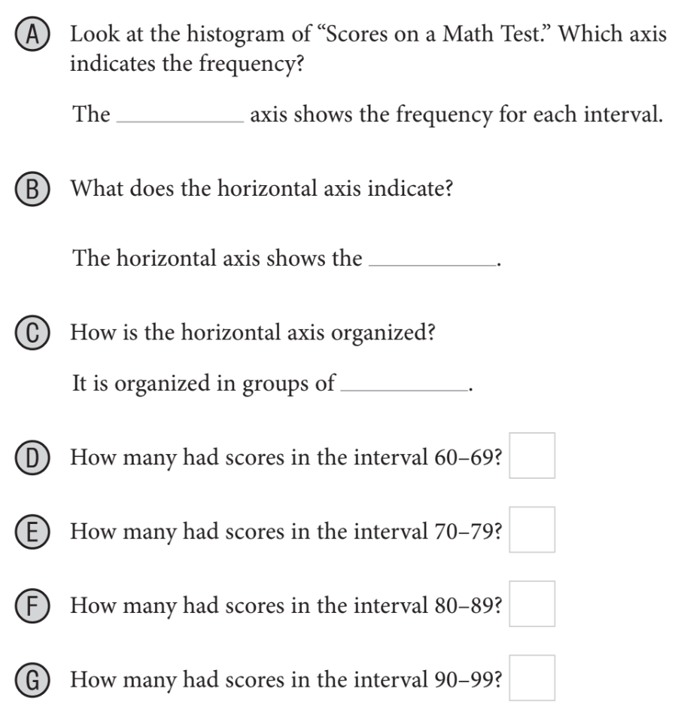
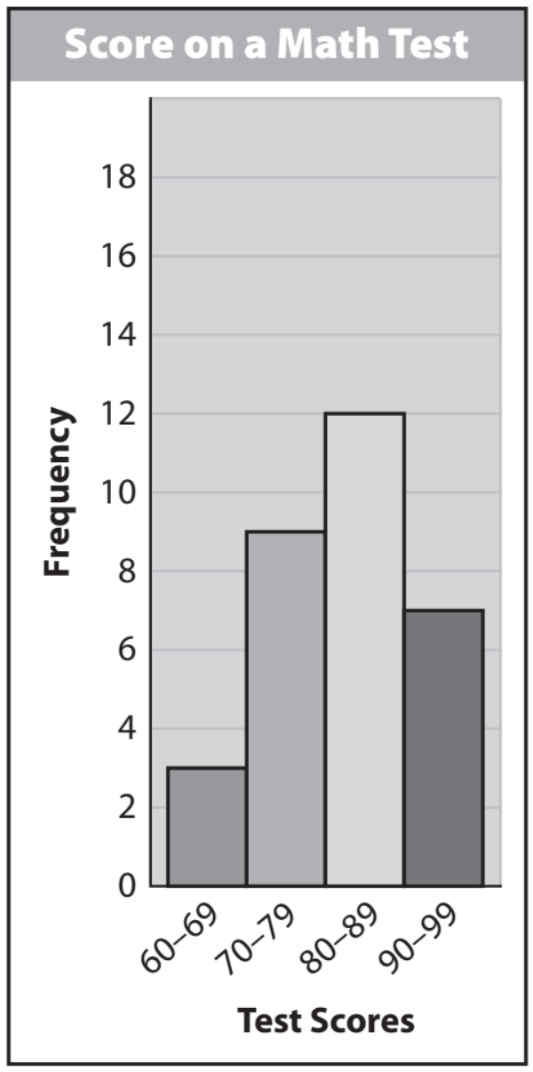
Activate Prior Knowledge
Name:_____________________________
Period: _______
Create a dot plot for the data set using an appropriate scale for the number line.
1. The number of feet to the left
outfield wall for 10 randomly chosen
baseball stadiums is 315, 325, 335,
330, 330, 330, 320, 310, 325, and 335.
2. The numbers of students in 10
randomly chosen classes in a high
school are 18, 22, 26, 31, 25, 20, 23, 26,
29, and 30.
Remember the Concept
A dot plot is a data representation that uses a number line and Xs, dots, or other symbols to show frequency.
Make the Connection
Students, you already know how to create a dot plot to show data. Today, we will how to create and use histogram.
Steps
Create a number
Identity appropriate scale
Give it appropriate name
Put dot(or x’s) on each #.
Histograms
A histogram is a bar graph that is used to display the frequency of data divided into equal intervals. The bars must be of equal width and should touch but not overlap. The heights of the bars indicate the frequency of data values within each interval.
¹ the rate at which something occurs
Vocabulary

Slide 2
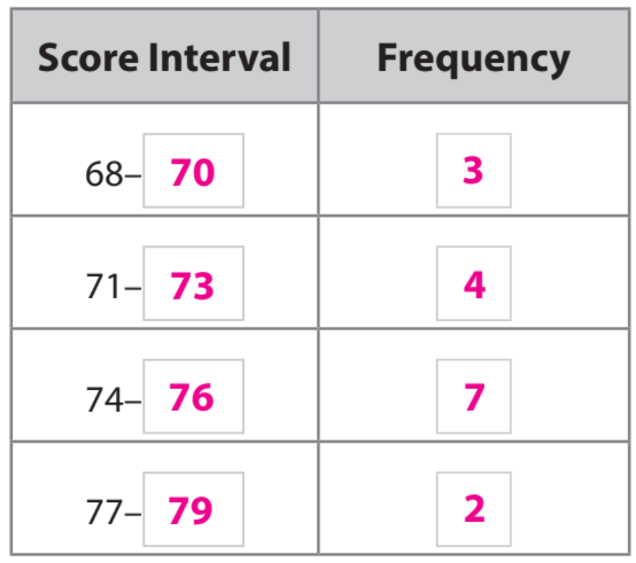
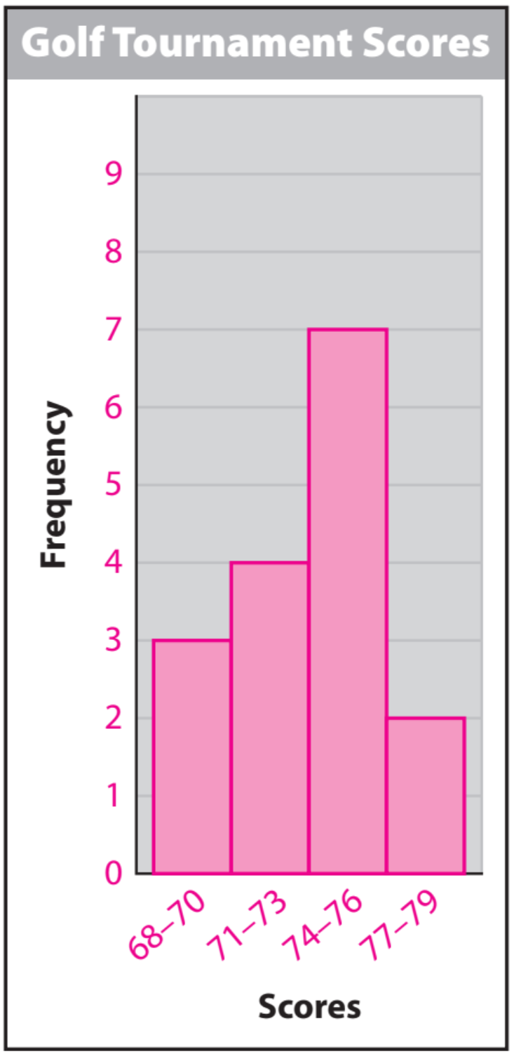
Skill Development/Guided Practice
When creating a histogram, make sure that the bars are of equal width and that they touch without overlapping. Create a frequency table to help organize the data before constructing the histogram. Consider the range of the data values when creating intervals.
Listed are the scores from a golf tournament. Create a histogram:
68, 78, 76, 71, 69, 73, 72, 74, 76, 70, 77, 74, 75, 76, 71, 74
Steps to Create Histogram
1. Determine the Range Value & Intervals
CFU: How did I/you create intervals for the data set?
2. Create a frequency table from the data.
CFU How did I/you create the frequency table?
3. Create a histogram using the frequency table.
CFU How did I/you describe the data distribution? What does that mean?
Histograms
1.
2.
3.
Calculation

Slide 3
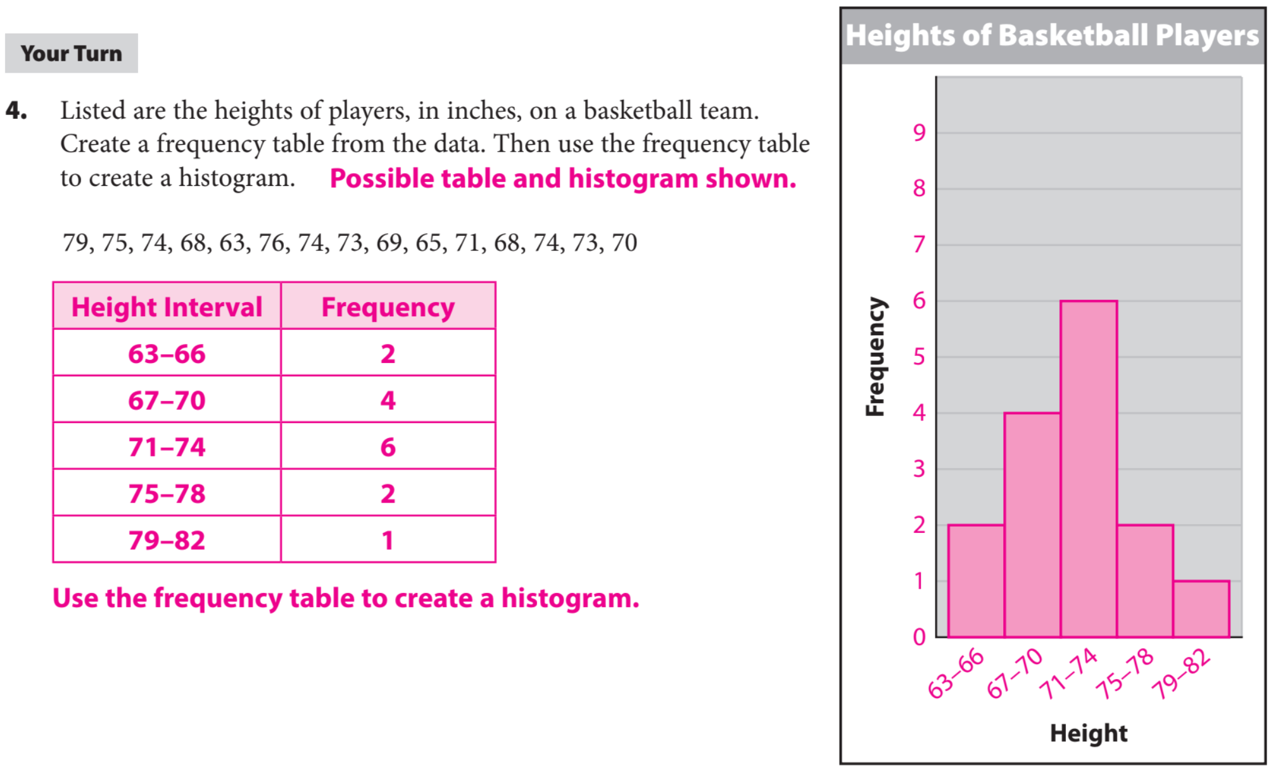
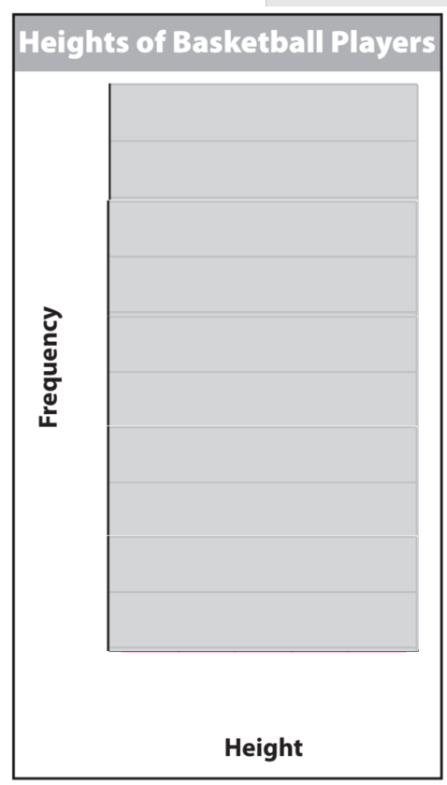
Skill Development/Guided Practice

Slide 4
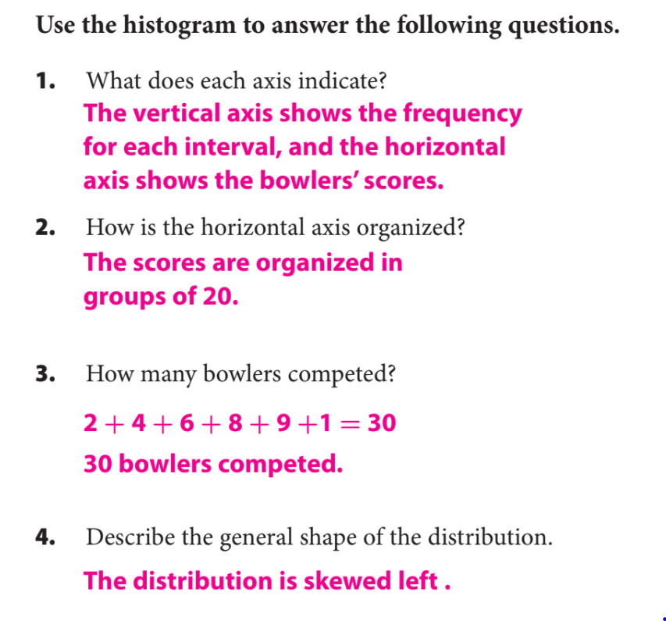
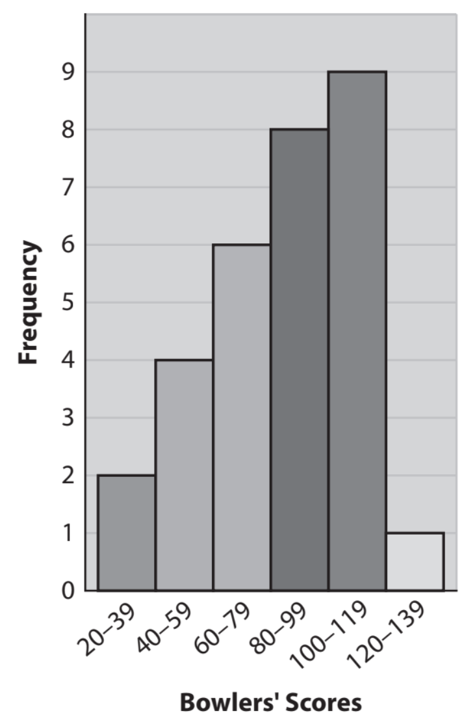
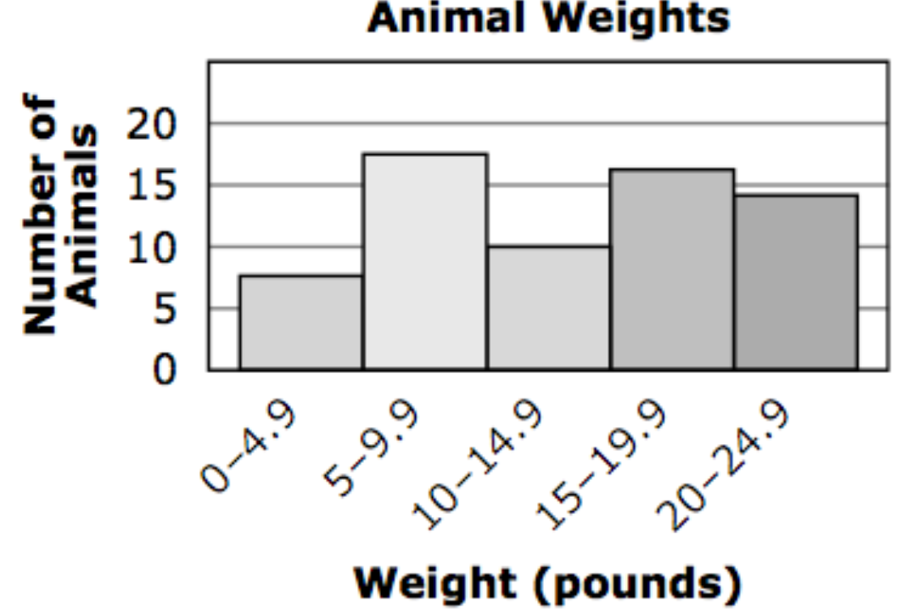
Skill Development/Guided Practice
What did you learn today about how to create and use Histogram.
Common Core
Word Bank
SUMMARY CLOSURE
Today, I learned how to _________________________________________________________________________________.
Axis
Histogram
Frequency
Data
Skewed to the left
Skewed to the right.

