Slide 1
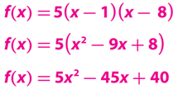
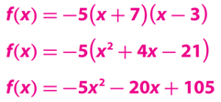
Lesson 3: 7.3 Zero Product Property
Name; _________________________________
Learning Objective
Period: ____
CFU
We will learn how to use the Zero Product Property to solve ${\text{quadratic}}_{1}$equations in factored form.
What is quadratic mean?
Quadratic means ________________.
Students, you already know how to write the quadratic function. Now, we will use the Zero Product Property to find x-intercepts.
Make Connection
1: involving a equation with variable to the second degree.
Vocabulary
Activate Prior Knowledge
Write the function in standard form.
1.
2.
________________
______________
______________
______________
______________
______________
Concept Development
For all real numbers __ and __, if the product of the two quantities _________, then at least one of the quantities equals zero.
1

Slide 2
Concept Development
When given a function of the form ƒ(x) = ____ . you can use the Zero Product Property to find the zeros of the function.
Complete the following table.
Caution! a, b, and k do not represent the same values in the different forms.
Graphic Organizers
2

Slide 3
Concept Development
A: CFU
Jordie was asked to identify the zeros of the function ƒ(x) = (x - 5)(x + 3) . Her answers were x = -5 and x = 3. Do you agree or disagree? Explain
_______________________________________________________________________________________________
______________________________________________________________________________________________.
B: CFU
How would you find the zeros of the function ƒ(x) = -4 (x - 8)
_______________________________________________________________________________________________
______________________________________________________________________________________________.
C: CFU
What are the zeros of the function ƒ(x) = x (x - 12) ? Explain.
_______________________________________________________________________________________________
______________________________________________________________________________________________.
C: CFU
If an equation has two factors, a and b, and ab = 0, can both a and b equal 0? Explain.
_______________________________________________________________________________________________
______________________________________________________________________________________________.
C: CFU
When using the Zero Product Property to find the zeros of a function, why do you set each factor equal to zero?
_______________________________________________________________________________________________
______________________________________________________________________________________________.
3

Slide 4
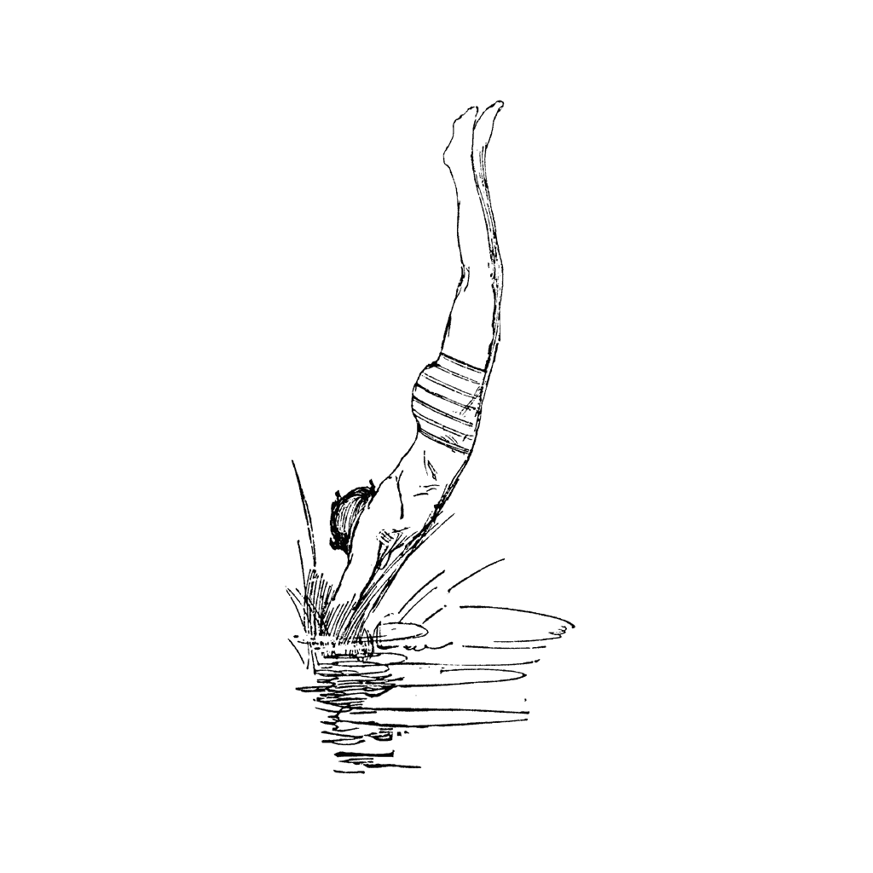
Skill Development
When given a function of the form ƒ(x) = __________________ you can use the Zero Product Property to find the zeros of the function.
Steps to finding the zeros of a function.
How did I/you set up f(x) equal to zero?
How did I/you apply the Zero Product Property rule?
How did I/you solve the equation for x?
1
Set $f(x)$ equal to zero. Ex. (x - 15)(x + 7) = 0
CFU
2
Apply the Zero Product Property.
1
a
a = o or b = o. Ex. x - 15 = 0 or x + 7 = 0
2
3
Solve each equation for x. Ex. x = 15 or x = -7
3
Find the zeros of each function
Relevance
1
Writing Quadratic Functions will help you in ReAl-LiFe.
To “reason and quantitatively,” students need to rewrite quadratic equations so that they can apply the Property to find the solutions. Students build on their previous understanding of the connection between , , ,
x- , and of quadratic functions, as well as the relationship between different forms of quadratic equations. In working with real-world problems, students interpret the solutions of equations to connect them to the real-world context.
2
Knowing how to write Quadratic Functions will help you do well on tests.
Sample Test Question:
The height of one diver above the water during a dive can be modeled by the equation h = -4 (4t + 5)(t - 3) , where h is height in feet and t is time in seconds. Find the time it takes for the diver to reach the water.
Does anyone else have another reason why it is relevant to use algebraic terminology? (Pair-Share) Why is it relevant to use algebraic terminology? You may give me one of my reasons or one of your own. Which reason is more relevant to you? Why?
CFU
________________________________
4

Slide 5
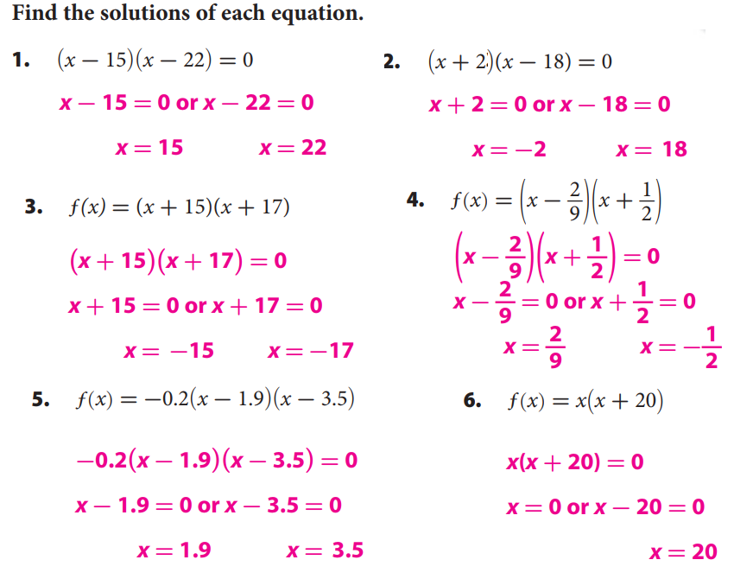
Summary Closure
What did you learn today about how to use the Zero Product Property to solve $\text{quadratic}$equations in factored form. (Pair-Share)
Today, I learned how to ________________________________________________
___________________________________________________________________
__________________________________________________________________.
Standard form
Vertex
Zeroes (Roots)
y-intercept
Axis of Symmetry
Guided/Independent Practice
Steps to finding the zeros of a function.
How did I/you set up f(x) equal to zero?
How did I/you apply the Zero Product Property rule?
How did I/you solve the equation for x?
1
Set $f(x)$ equal to zero. Ex. (x - 15)(x + 7) = 0
CFU
2
Apply the Zero Product Property.
1
a
a = o or b = o. Ex. x - 15 = 0 or x + 7 = 0
2
3
Solve each equation for x. Ex. x = 15 or x = -7
3
5

Slide 6
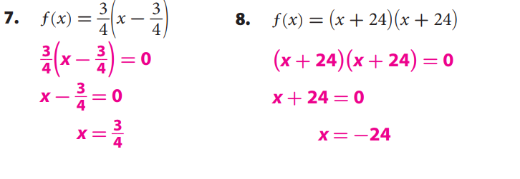
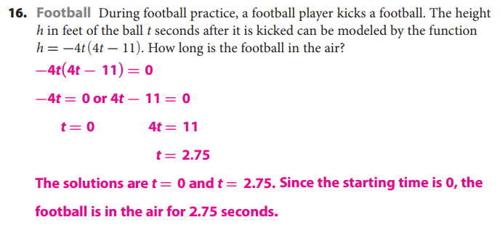
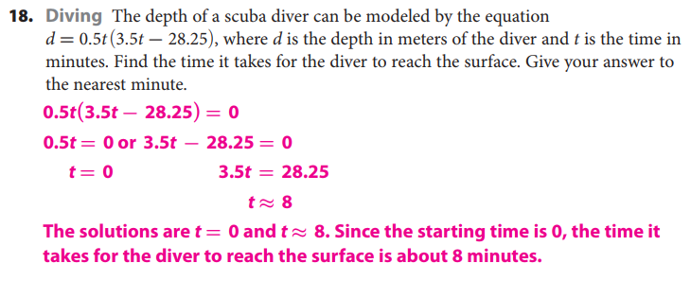
Guided/Independent Practice
6

Slide 7
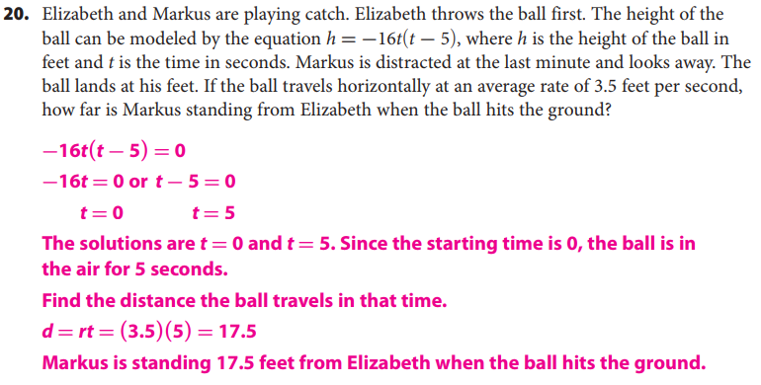
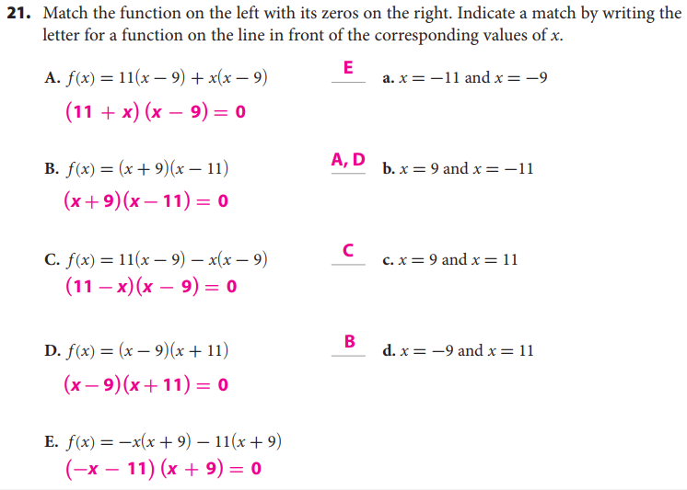
Guided/Independent Practice
7

Slide 8
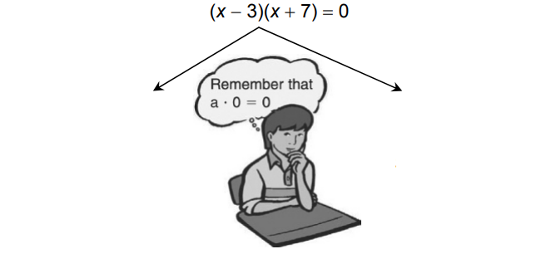
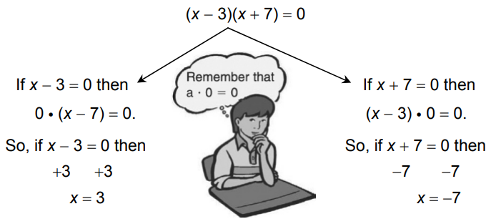
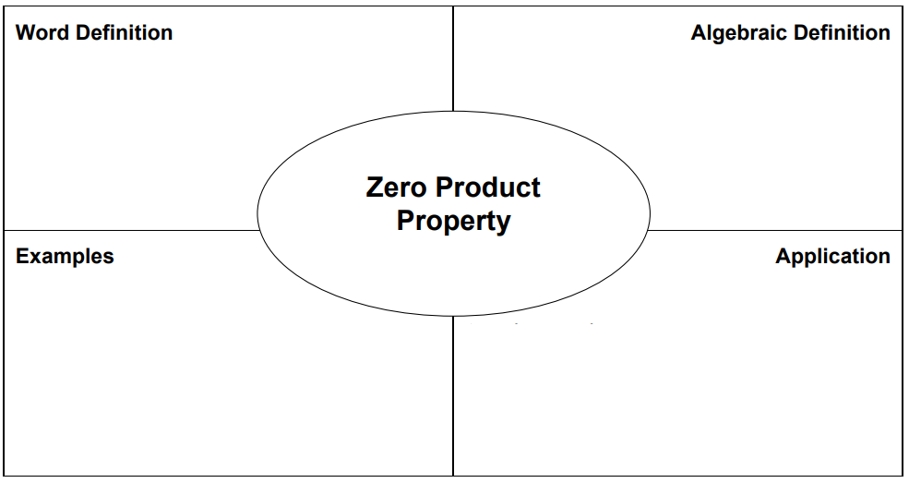
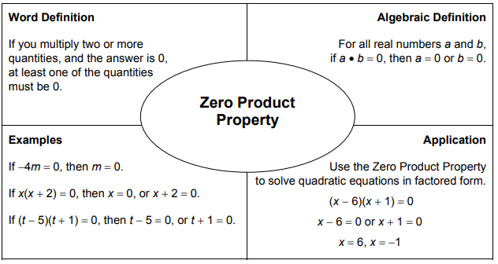
Guided/Independent Practice
8

