Slide 1
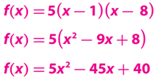
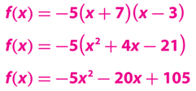
Learning Objective
CFU
We will learn how to use the Zero Product Property to solve ${\text{quadratic}}_{1}$equations in factored form.
What is quadratic mean?
Quadratic means_____________.
Students, you already know how to write the quadratic function. Now, we will use the Zero Product Property to find x-intercepts.
Make Connection
1: involving a equation with variable to the second degree.
Vocabulary
Write the function in standard form.
Activate Prior Knowledge
1.
2.
______________
______________
______________
______________
______________
______________

Slide 2
Concept Development
For all real numbers a and b, if the product of the two quantities equals zero, then at least one of the quantities equals zero.

Slide 3
Concept Development
When given a function of the form ƒ(x) = (x + a)(x + b), you can use the Zero Product Property to find the zeros of the function.

Slide 4
Concept Development
Graphic Organizers
Complete the following table.
Caution! a, b, and k do not represent the same values in the different forms.
A: CFU
B: CFU
Jordie was asked to identify the zeros of the function ƒ(x) = (x - 5)(x + 3) . Her answers were x = -5 and x = 3. Do you agree or disagree? Explain
How would you find the zeros of the function ƒ(x) = -4 (x - 8)
C: CFU
What are the zeros of the function ƒ(x) = x (x - 12) ? Explain.
Disagree; If (x - 5)(x + 3) = 0, then x - 5 = 0 or x + 3 = 0; so x = 5 or x = -3
The x-values that make f(x) = 0 are zeros of the function, so solve -4(x - 8) = 0. The only solution is 8.
0 and 12 because they are the solutions of x(x - 12) = 0.
C: CFU
C: CFU
When using the Zero Product Property to find the zeros of a function, why do you set each factor equal to zero?
If an equation has two factors, a and b, and ab = 0, can both a and b equal 0? Explain.
Yes; the Zero Product Property states that at least one of the factors a and b must equal zero. It is possible that both factors are equal to zero.
You set each factor equal to zero because when at least one of the factors is zero, the product is equal to zero.

Slide 5
Skill Development
When given a function of the form ƒ(x) = (x + a)(x + b), you can use the Zero Product Property to find the zeros of the function.
Steps to finding the zeros of a function.
How did I/you set up f(x) equal to zero?
How did I/you apply the Zero Product Property rule?
How did I/you solve the equation for x?
1
Set $f(x)$ equal to zero. Ex. (x - 15)(x + 7) = 0
CFU
2
Apply the Zero Product Property.
1
a
a = o or b = o. Ex. x - 15 = 0 or x + 7 = 0
2
3
Solve each equation for x. Ex. x = 15 or x = -7
3
Find the zeros of each function

Slide 6
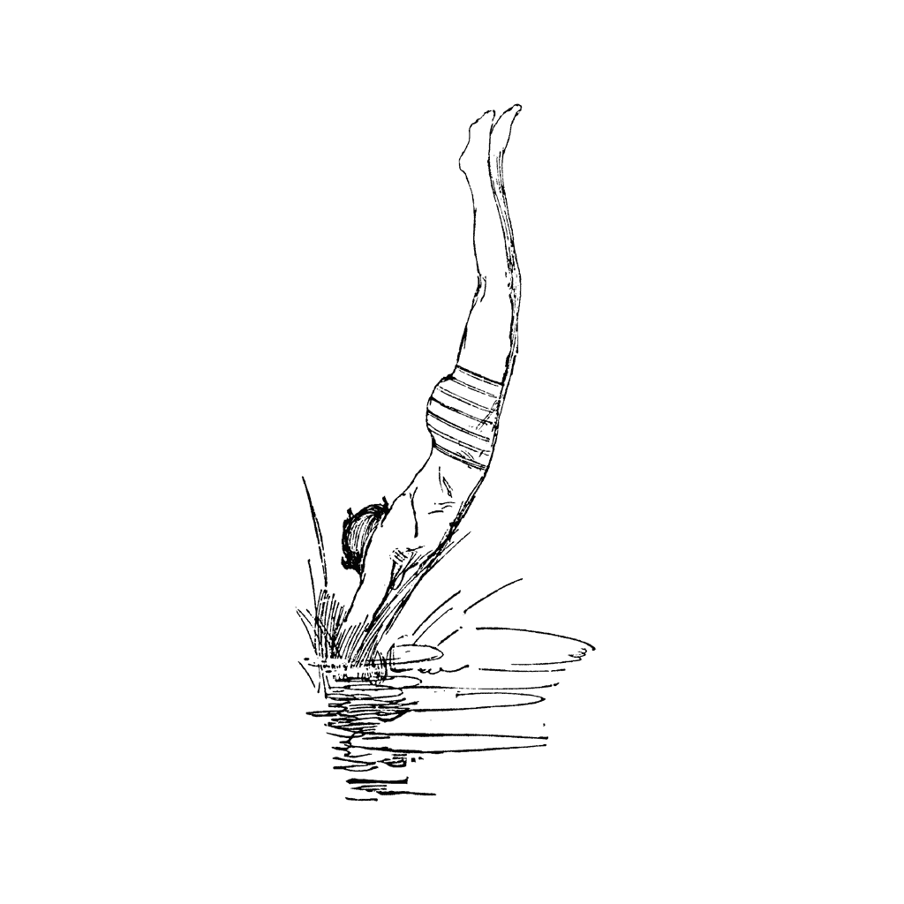
Relevance
1
Writing Quadratic Functions will help you in ReAl-LiFe.
To “reason abstractly and quantitatively,” students need to rewrite quadratic equations so that they can apply the Zero Product Property to find the solutions. Students build on their previous understanding of the connection between zeros, solutions, roots, x-intercepts, and factors of quadratic functions, as well as the relationship between different forms of quadratic equations. In working with real-world problems, students interpret the solutions of equations to connect them to the real-world context.
2
Knowing how to write Quadratic Functions will help you do well on tests.
Sample Test Question:
Does anyone else have another reason why it is relevant to use algebraic terminology? (Pair-Share) Why is it relevant to use algebraic terminology? You may give me one of my reasons or one of your own. Which reason is more relevant to you? Why?
The height of one diver above the water during a dive can be modeled by the equation h = -4 (4t + 5)(t - 3) , where h is height in feet and t is time in seconds. Find the time it takes for the diver to reach the water.
CFU
Since time cannot be negative, the time it takes for the diver to reach the water is 3 seconds.

Slide 7
Summary Closure
What did you learn today about how to use the Zero Product Property to solve $\text{quadratic}$equations in factored form. (Pair-Share)
Today, I learned how to ________________________________________________
___________________________________________________________________
__________________________________________________________________.
Standard form
Vertex
Zeroes (Roots)
y-intercept
Axis of Symmetry

Slide 8
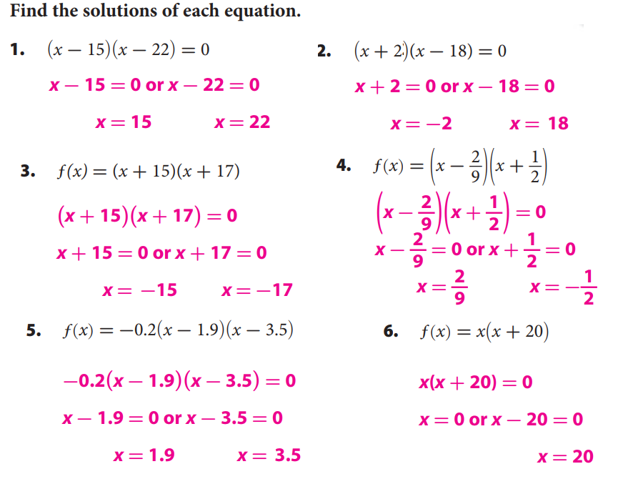
Guided/Independent Practice
Steps to finding the zeros of a function.
How did I/you set up f(x) equal to zero?
How did I/you apply the Zero Product Property rule?
How did I/you solve the equation for x?
1
Set $f(x)$ equal to zero. Ex. (x - 15)(x + 7) = 0
CFU
2
Apply the Zero Product Property.
1
a
a = o or b = o. Ex. x - 15 = 0 or x + 7 = 0
2
3
Solve each equation for x. Ex. x = 15 or x = -7
3

Slide 9
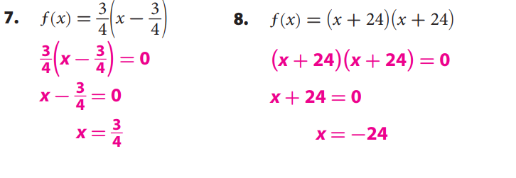
Guided/Independent Practice

Slide 10
We will learn how to use the Zero Product Property to solve ${\text{quadratic}}_{1}$equations in factored form.
LEARNING OBJECTIVE
System of equations
1: involving a equation with variable to the second degree.
Definition
¹ figure out

Slide 11
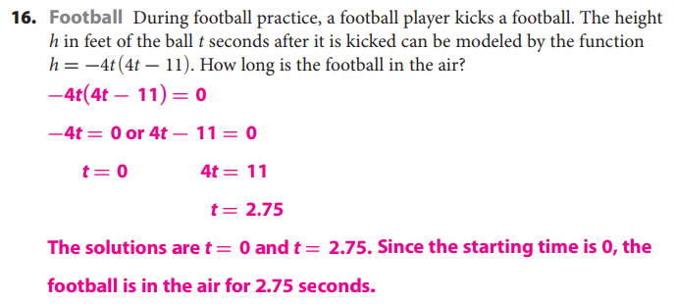
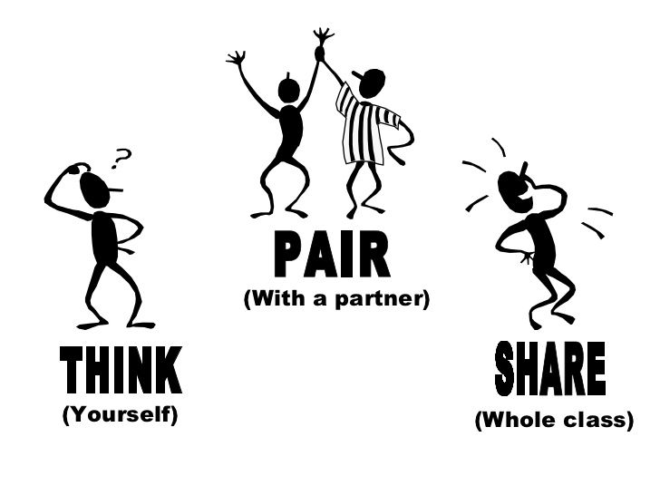
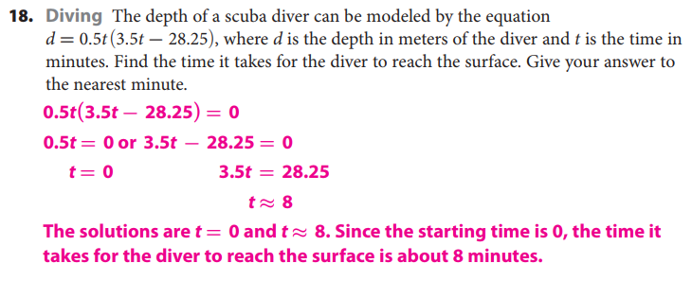
Guided/Independent Practice
Page 6

Slide 12
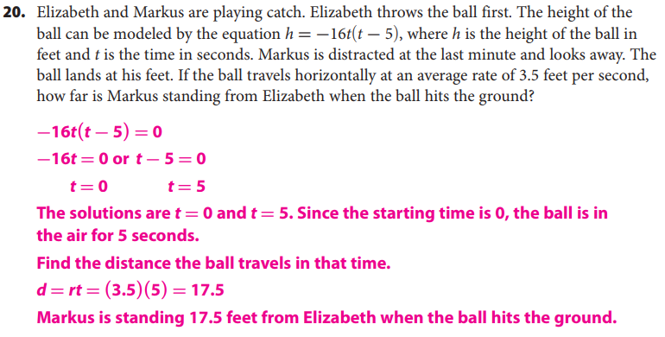
Guided/Independent Practice

Slide 13
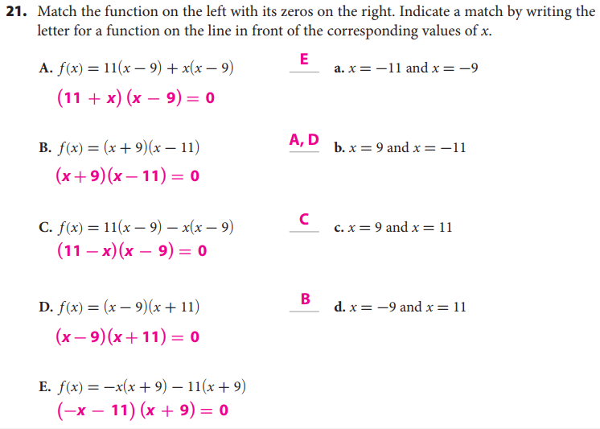
Guided/Independent Practice

Slide 14
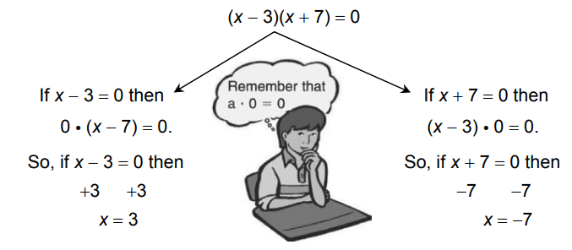
Guided/Independent Practice

Slide 15
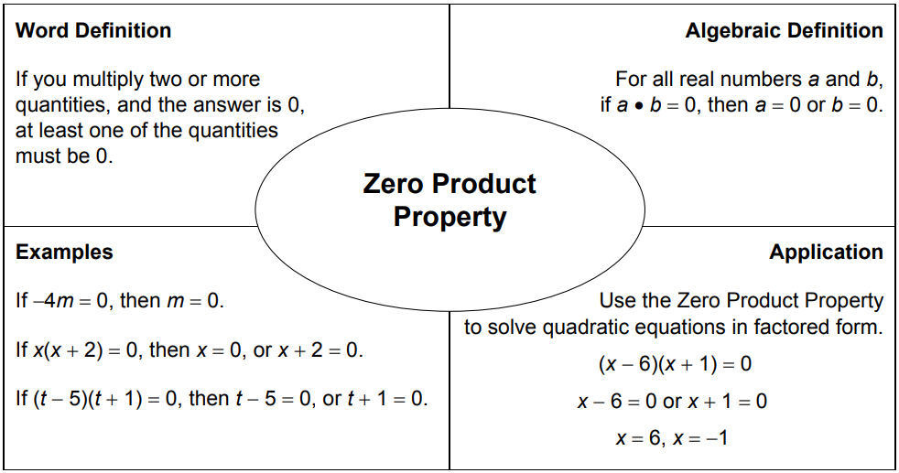
Guided/Independent Practice
*Please go back and utilize the textual evidence in the packet to fill out the academic/content vocabulary in the box below.

