Slide 1
We will construct₁ and interpret two-way frequency tables.
LEARNING OBJECTIVE
Definition
¹ create
Declare the Objective
Read the learning objective to your partner.

Slide 2
Activate Prior Knowledge
Find the probability of each event.
Remember the Concept
Probability is the chance, or likelihood of an outcome occurring.
32 out of 100 high school students surveyed report that science is their favorite subject. What is the probability that a student will favor science?
$$32$$
$$P\left(Science\right)=$$
$$\frac{}{100}$$
$$=0.32$$
2. 39 out of 100 high school students surveyed report that math is their favorite subject. What is the probability that a student will favor math?
$$39$$
$$P\left(Math\right)=$$
$$\frac{}{100}$$
$$=0.39$$
Make the Connection
Students, you already know how to find the probability of an event presented as a written description. Now, we will find the probabilities of events organized in two-way frequency tables.

Slide 3
Concept Development (Clarification and CFU)
A two-way frequency table shows data from one sample group as it relates to two different categories.
CFU
Explain where the data in a two-way table comes from.
Two-Way Frequency Tables
Survey
1. Name:
2. Grade:
3. Favorite Subject:
4. Favorite Sport:
Raw Data
 | Item 1 | Item 2 | Item 3 | Item 4
1. | Holly | 9th | English | Football
2. | Sergio | 11th | Science | Basketball
3. | Laura | 10th | Math | Football
4. | Phyllis | 9th | Math | Soccer
?
100. | Julian | 12th | Science | Football
There are 1,182 students at a high school.
100 students are selected at random to take a survey.
?
 | Math | Science | English | Total
9th | 6 | 9 | 4 | 19
10th | 6 | 4 | 10 | 20
11th | 12 | 13 | 7 | 32
12th | 15 | 6 | 8 | 29
Total | 39 | 32 | 29 | 100
The raw data is converted to a two-way table comparing two different categories.
If a student from the high school is selected at random, what is the probability he or she will favor English?

Slide 4
Concept Development
A two-way frequency table shows data from one sample group as it relates to two different categories.
A two-way frequency table can be used to approximate₂ the probability of events.
Two-Way Frequency Tables
CFU
A survey asks 100 high school students their favorite subject in school and compares the results to their grade. The results are shown in the table below.
Which shows the approximate probability of students who favor math? How do you know?
A
B
 | Math | Science | English | Total
9th | 6 | 9 | 4 | 19
10th | 6 | 4 | 10 | 20
11th | 12 | 13 | 7 | 32
12th | 15 | 6 | 8 | 29
Total | 39 | 32 | 29 | 100
$$P\left(Math\right)=\frac{6}{100}=0.06$$
$$P\left(Math\right)=\frac{39}{100}=0.39$$
Simple Probability Estimate the probability that a randomly selected student will favor science.
$$P\left(Science\right)=\frac{32}{100}=0.32$$
² come close to an exact answer
Vocabulary

Slide 5
Skill Development/Guided Practice 1
A two-way frequency table shows data from one sample group as it relates to two different categories.
Construct and interpret two-way frequency tables.
How did I/you identify the sample space in question?
How did I/you approximate the conditional probability?
1
Read the situation carefully.
Identify the two categories. (underline)
Identify the sample space in question. (circle)
Approximate the probability.
Interpret your answer. (write)
CFU
a
2
2
3
3
4
A survey of 50 male and female students is conducted to determine each student’s choice of their favorite sport from soccer, football, and basketball.
 | Soccer | Football | Basketball | Total
Male | 6 | 9 | 5 | 20
Female | 12 | 8 | 10 | 30
Total | 18 | 17 | 15 | 50
1. Estimate the probability that a student will favor football. | 2. Estimate the probability that a student will favor soccer.
3. Estimate the probability that a student is female and favors football. | 4. Estimate the probability that a student is male and favors soccer.
$$17$$
$$18$$
$$P\left(football\right)=$$
$$\frac{}{50}$$
$$=\frac{34}{100}$$
$$P\left(soccer\right)=$$
$$\frac{}{50}$$
$$=\frac{36}{100}$$
$$=0.34$$
$$=0.36$$
$$8$$
$$6$$
$$\frac{}{50}$$
$$=\frac{16}{100}$$
$$=0.16$$
$$\frac{}{50}$$
$$=\frac{12}{100}$$
$$=0.12$$
$$P\left(female and football\right)=$$
$$P\left(male and soccer\right)=$$

Slide 6
Concept Development
Conditional probability is the chance, or likelihood of an outcome occurring given that another event (or condition) has already occurred.
Conditional Probability
Conditional Probability
Estimate the probability that a randomly selected student will favor science given that the student is in tenth grade.
A|B “A given that B”
$$P\left(Science|10th\right)=\frac{P\left(Science and 10th\right)}{P\left(10th\right)}=\frac{4/{100}}{{20}/{100}}=\frac{4}{20}=\frac{20}{100}=0.20$$
 | Math | Science | English | Total
9th | 6 | 9 | 4 | 19
10th | 6 | 4 | 10 | 20
11th | 12 | 13 | 7 | 32
12th | 15 | 6 | 8 | 29
Total | 39 | 32 | 29 | 100
CFU
Which equation represents the conditional probability of students who favor math given that the student is in ninth grade?
How do you know?
A
B
$$P\left(Math|9th\right)=\frac{P\left(Math and 9th\right)}{P\left(9th\right)}$$
$$P\left(9th|Math\right)=\frac{P\left(9th and Math\right)}{P\left(Math\right)}$$

Slide 7
Skill Development/Guided Practice 2
A two-way frequency table shows data from one sample group as it relates to two different categories.
Construct and interpret two-way frequency tables.
How did I/you identify the sample space in question?
How did I/you approximate the conditional probability?
1
Read the situation carefully.
Identify the two categories. (underline)
Identify the sample space in question. (circle)
Approximate the probability.
Interpret your answer. (write)
CFU
a
2
2
3
3
4
A survey of 50 male and female students is conducted to determine each student’s choice of their favorite sport from soccer, football, and basketball.
Application
Determine whether the given events are independent. Explain.
T: 𝑷(𝒇𝒐𝒐𝒕𝒃𝒂𝒍𝒍│𝒎𝒂𝒍𝒆)
______________________________
______________________________
______________________________
______________________________
S: 𝑷(𝒔𝒐𝒄𝒄𝒆𝒓│𝒇𝒆𝒎𝒂𝒍𝒆)
______________________________
______________________________
______________________________
______________________________
 | Soccer | Football | Basketball | Total
Male | 6 | 9 | 5 | 20
Female | 12 | 8 | 10 | 30
Total | 18 | 17 | 15 | 50
The events of a student favoring football and being male are NOT independent because P(football⏐male) ≈ 0.45 is NOT approximately equal to P(football) = 0.34.
5. Estimate the probability that a student will favor football given that the student is male. | 6. Estimate the probability that a student will favor soccer given that the student is female.
7. Estimate the probability that a student will favor basketball or football given that the student is female. | 8. Estimate the probability that a student will favor soccer or basketball, given that the student is male.
The events of a student favoring soccer and being female are NOT independent because P(soccer⏐female) ≈ 0.4 is NOT approximately equal to P(soccer) = 0.36.

Slide 8
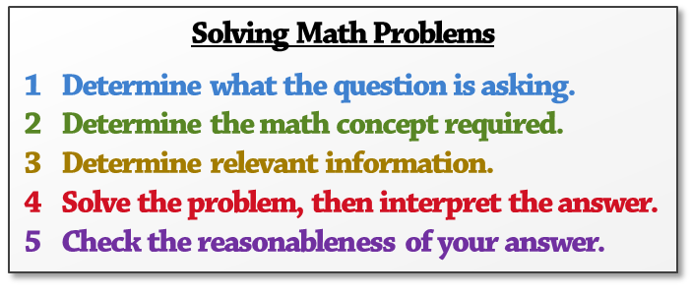
Skill Development/Guided Practice 2 (continued)
How did I/you determine what the question is asking?
How did I/you determine the math concept required?
How did I/you determine the relevant information?
How did I/you solve and interpret the problem?
How did I/you check the reasonableness of the answer?
CFU
Solving Math Problems
1 Determine what the question is asking.
2 Determine the math concept required.
3 Determine relevant information.
4 Solve the problem, then interpret the answer.
5 Check the reasonableness of your answer.
1
2
3
4
5
9.
10.
A teacher takes a sample of 40 high school underclassmen and upperclassman to determine how many students play a sport.
The probability of a randomly selected student from the sample playing a sport, given that student is an upperclassmen is .
Fill in the two-way table to
show how this is possible.
 | Underclassmen | Upperclassmen | Total
Sport
No Sport
Total
12
25
8 (may vary)
12
20
7 (may vary)
13
20
15
25
40
Solving Math Problems
1 What am I trying to find?
2 What do I know about this idea?
3 What amounts do I know?
4 Solve the problem or answer the question.
5 Did I answer all parts of the question?
A teacher takes a sample of 30 high school underclassmen and upperclassman to determine how many students play an instrument.
The probability of a randomly selected student from the sample not playing an instrument, given that student is an underclassmen is .
Fill in the two-way table to
show how this is possible.
 | Underclassmen | Upperclassmen | Total
Instrument
No Instrument
Total
9
3 (may vary)
12
8
17
8
10 (may vary)
18
17
13
30

Slide 9
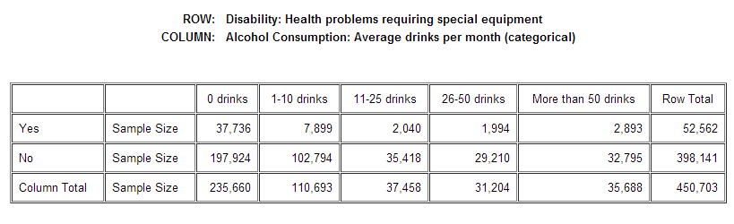
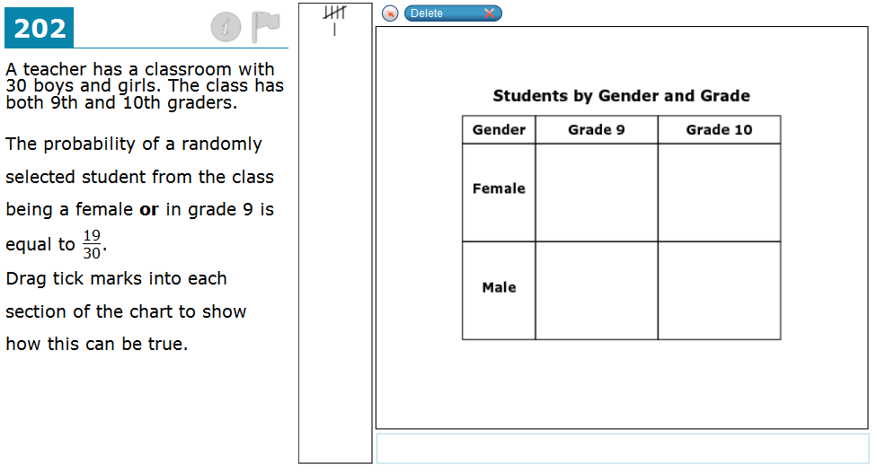
Relevance
A two-way frequency table shows data from one sample group as it relates to two different categories.
1
Constructing and interpreting two-way tables will help you understand data presented to you in different ways.
Every year, the Center for Disease Control (CDC) publishes data comparing diseases and disabilities to relevant risk factors. The given two-way table compares health problems requiring special equipment to average alcoholic drinks per month.
Source: http://apps.nccd.cdc.gov/s_broker/WEATSQL.exe/weat/freq_year.hsql
2
Constructing and interpreting two-way tables will help you do well on tests.
Sample Test Question:
Does anyone else have another reason why it is relevant to construct and interpret two-way tables? (Pair-Share) Why is it relevant to construct and interpret two-way tables? You may give one of my reasons or one of your own. Which reason is more relevant to you? Why?
CFU

Slide 10
A two-way frequency table shows data from one sample group as it relates to two different categories.
Word Bank
Skill Closure
Construct and interpret two-way frequency tables.
1
Read the situation carefully.
Identify the two categories. (underline)
Identify the sample space in question. (circle)
Approximate the probability.
Interpret your answer. (write)
a
2
3
4
Larry is regularly late for work. He decides it may be time to try an alternate route. During the next 6 weeks, he randomly selects between Route A and Route B, recording whether he is on-time or late.
 | Route A | Route B | Total
On-Time | 7 | 3 | 10
Late | 11 | 9 | 20
Total | 18 | 12 | 30
Word Bank
construct
two-way
frequency
tables
approximate
1. Estimate the probability Larry will be on-time. | 2. Estimate the probability that Larry will be late, given that he selected Route A.
Access Common Core
Which route is Larry better off taking? Explain your answer using data from the two-way table.
Larry would be better off taking Route A. It is slightly less probable that he will be late with Route A [P(late⏐Route A) ≈ 0.61] than Route B [P(late⏐Route B) ≈ 0.75].
Summary Closure
What did you learn today about constructing and interpreting two-way tables? (Pair-Share) Use words from the word bank.

